Slide 1

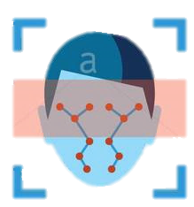






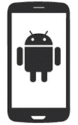
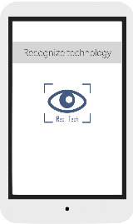
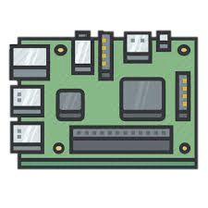
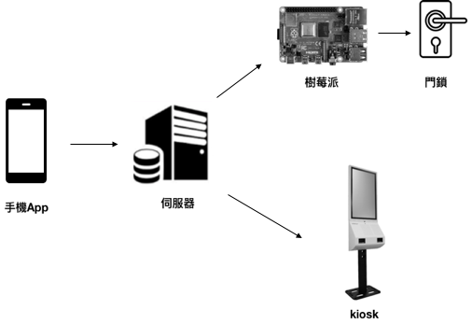
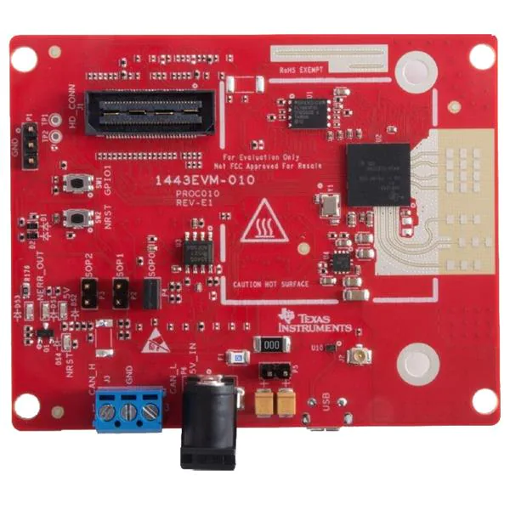
AI service
Face Recognition
Celebrity Detection
Liveness Detection
伺服器端
Operating system
database
Web server
使用者端
APP
KIOSK
Raspberry Pi + door lock
mmWave Radar

Slide 2
