Slide 1
REM_Puzzle
By: Jie Lin

Slide 2
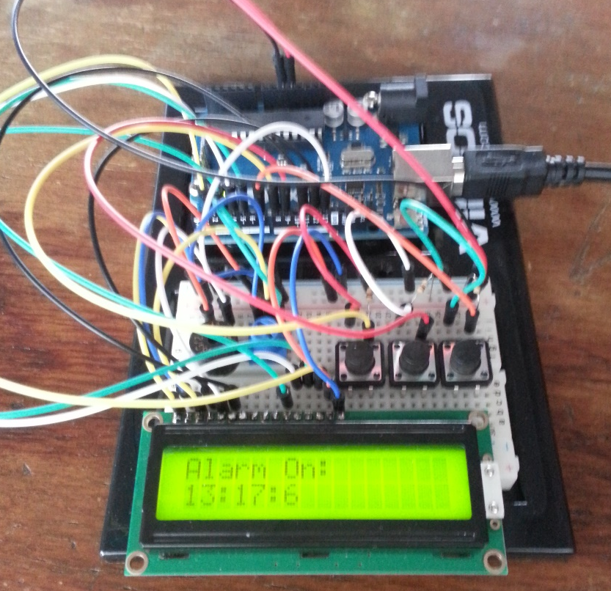
What?
An alarm designed to help people get better sleep, wake up refreshed and get out of bed.

Slide 3
Components
Arduino Uno
16x2 LCD screen
Push buttons x3
Piezo buzzer
Potentiometer
10k resistor x3
Jumper wire x24

Slide 4
Controls
On “Current Time:”
Left button changes hour
Middle button changes minute
Right button goes to next
On “Alarm Time:”
Left button changes hour
Middle button changes minute
Right button goes to next

Slide 5
Controls – continued….
On “Enter Number: “ (puzzle solving)
Left button increases number
Middle button decreases number
Right button submits
On any screen
Unplug and then plug in power supple to restart system.

Slide 6
Why?
I designed this project because many people have a hard time getting out of bed on time.
Even when you manage to get out of bed, you might feel mentally and physically awful.
This design can help people wake up on time and on top of that, feeling refreshed when waking up.

Slide 7
How?
There are 2 features to this design, REM sleep and puzzle solving, hence the name REM_Puzzle.
After setting your alarm, the system will determine the best REM sleep cycle before your desire alarm time or the same as the time you set, depending on the REM cycle and set a new alarm time.
When the alarm goes on, you will be prompt to solve a puzzle. The alarm will remain on until the puzzle is solved.

Slide 8
REM Sleep
REM sleep are consisted of sleep cycles of 90 minutes intervals, which is every hour and a half.
If you wake up in the middle of a REM cycle, you would feel mentally and physically awful
However, if you wake up in between REM cycles (a multiple of 90 minutes), you will wake up feeling refreshed.

Slide 9
Puzzle
To help you completely wake up, you will have to solve 3 puzzles before the alarm goes off.
Solving a puzzle, raises your concentration and focus, which will work your brain to help you wake up.

Slide 10
Testing details
Since this is an alarm, on top of that, a special alarm, we can’t set the alarm 1 minute from current time and expect it to go on after 1 minute. The system will automatically set the alarm of the multiples of 90 minutes. If your alarm time is less than 90 minutes, the system will inform you that the alarm won’t be set.
For testing purposes, if you set the alarm for less than 90 minutes, the alarm will go on immediately and you will have to solve the puzzles for it to go off.

