Slide 1

Introduction to RISC-V
Jielun Tan, James Connolly
February, 2019

Slide 2

Overview
What is RISC-V
Why RISC-V
ISA overview
Software environment
Beta testing

Slide 3
What is RISC-V
RISC-V (pronounced “risk-five”) is an open, free ISA enabling a new era of processor innovation through open standard collaboration. Born in academia and research, RISC-V ISA delivers a new level of free, extensible software and hardware freedom on architecture, paving the way for the next 50 years of computing design and innovation. - RISC-V Foundation
Take the last part of with a huuuuuuge grain of salt
It originated in UC Berkeley, but now it has own foundation with a large number of contributors
Spawned quite a few startups

Slide 4
Why RISC-V
Why not OpenRISC?
OpenRISC had condition codes and branch delay slots, which complicate higher performance implementations
OpenRISC uses a fixed 32-bit encoding and 16-bit immediates, which precludes a denser instruction encoding and limits space for later expansion of the ISA. This pretty much entirely eliminates the ability to explore new research architectures
OpenRISC does not support the 2008 revision to the IEEE 754 floating-point standard
MIPS more or less has the same problems along with patent and trademark issues
Although MIPS is now open sourced, so things could change
License issues for Arm…
Only academia still deals with Alpha
although with MIPS now open sourced that is due for a change
Press F to pay respect to Compaq

Slide 5
Why RISC-V
A completely open ISA that is freely available to academia and industry
A real ISA suitable for direct native hardware implementation, not just simulation or binary translation
An ISA that avoids "over-architecting" for a particular microarchitecture style (e.g., microcoded, in-order, decoupled, out-of-order) or implementation technology (e.g., full-custom, ASIC, FPGA), but which allows efficient implementation in any of these
An ISA separated into a small base integer ISA, usable by itself as a base for customized accelerators or for educational purposes, and optional standard extensions, to support general-purpose software development
Most important part for us in particular, is good software support

Slide 6
Why RISC-V
Lets us explore more layers of the computing stack, mainly compilers and systems
Can arbitrarily generate test cases, since we can just write in C now!
Easier for you to test
Easier for the staff to shuffle around test cases
Easier to generate large test cases that can actually benefit from additional features and properly reward those who worked on extra features

Slide 7
ISA Overview - Base ISA
Base ISA + many extensions including privileges mode
32, 64 and 128-bit address space
We only use 32-bit for now, the other two add a few instructions
32 integer registers
Byte level addressing for memory, little endian
Instructions must align to 32-bit addresses
No condition codes or carry out bits to detect overflow
Intentional, these can be achieved in software
Comparisons are built in for branches
e.g. beq x1, x2, offset

Slide 8
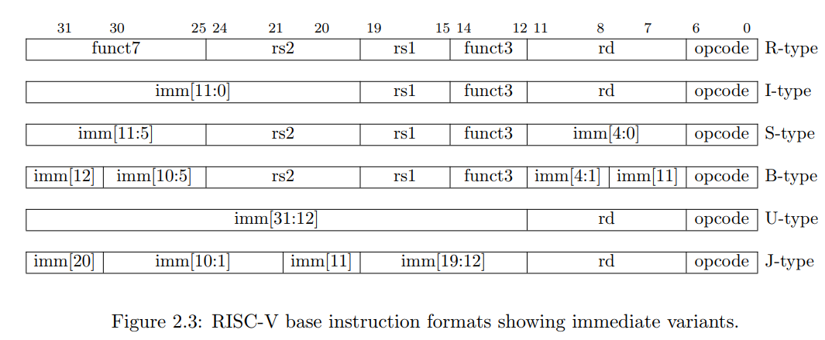
ISA Overview - Instruction Formats
6 different encoding format for instructions
A loooooooot of pseudoinstructions
You can read about all of them in the specification here

Slide 9
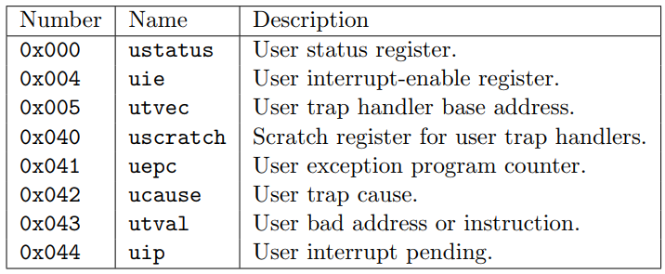
ISA Overview - CSRs
Also a list of Control Status Registers (CSR)
Many are important if interrupt support is needed
You actually don’t need to support any of that, at least for now
Here are some examples, you can read more about them in the privileged spec

Slide 10
ISA Overview - More Extensions
V - Has a vector extension as well, if staff in the future wants to spice things up
A - The atomic extension will be partially used to implement locks in the future
F, D, Q, L- Floating point extensions can be supported for people’s own interest
C - Compressed extension to increase code density
E - for embedded systems; reduced number of registers (only 16), can be combined with C to save ROM
T - RISC-V has plans to support transactional memory in the future
You read it right, transactional memory, ROFL

Slide 11
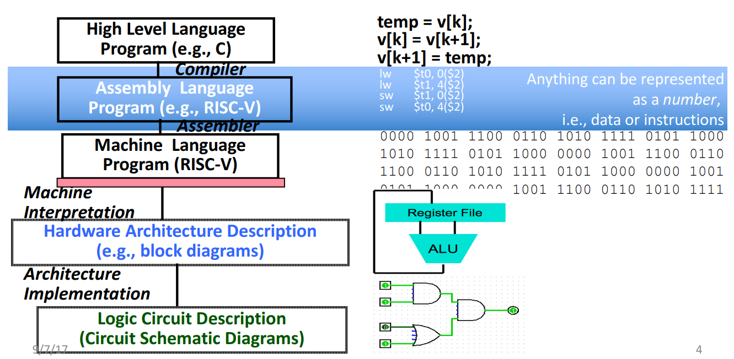
Software Environment

Slide 12
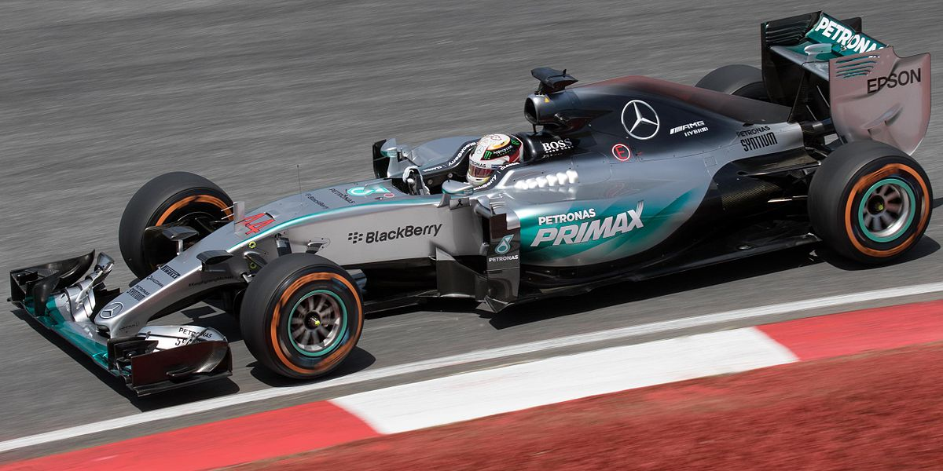
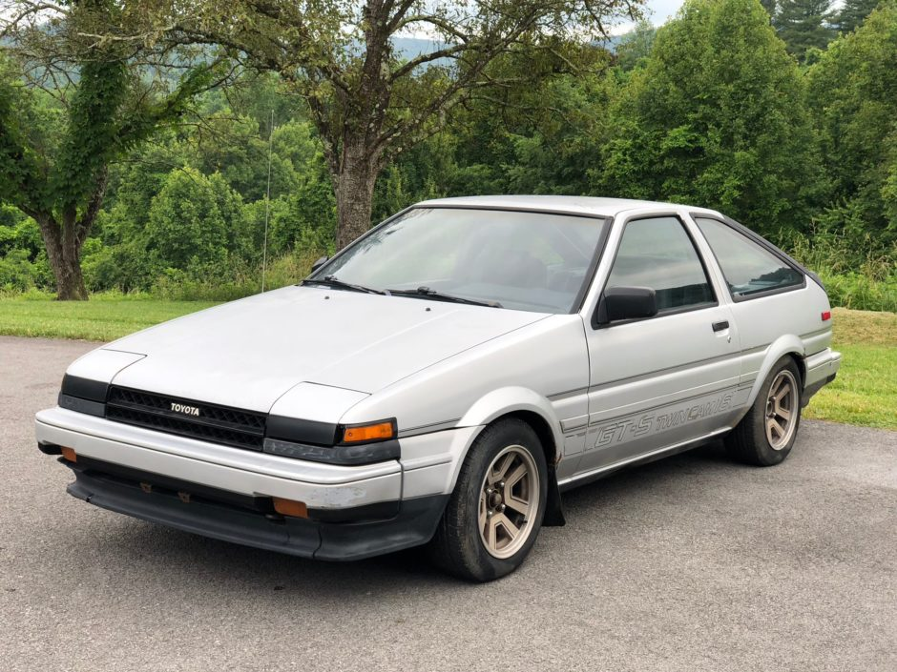
Software Environment
Assembly vs. High-level Language

Slide 13
Software Environment
Why do I remotely even care about software in a hardware class
Believe me, it’s important
Architecture is the bridge between the two (insert preaching)
For RISC-V, we will have both C programs and assembly programs to test
At the same time, you also need to have a grasp of how C works at a very low level
It doesn’t affect your implementation for sure, but knowing this will make your life easier
You will also learn A LOT

Slide 14
Software Environment - GNU Tools
There’s a full suite of GNU tools for RISC-V
gcc - compiler
as - assembler
ld - linker
objdump - disassembler
objcopy - don’t really need but cool
g++ - don’t use this
gdb - no idea if this actually works
a lot more that you can explore yourself...

Slide 15
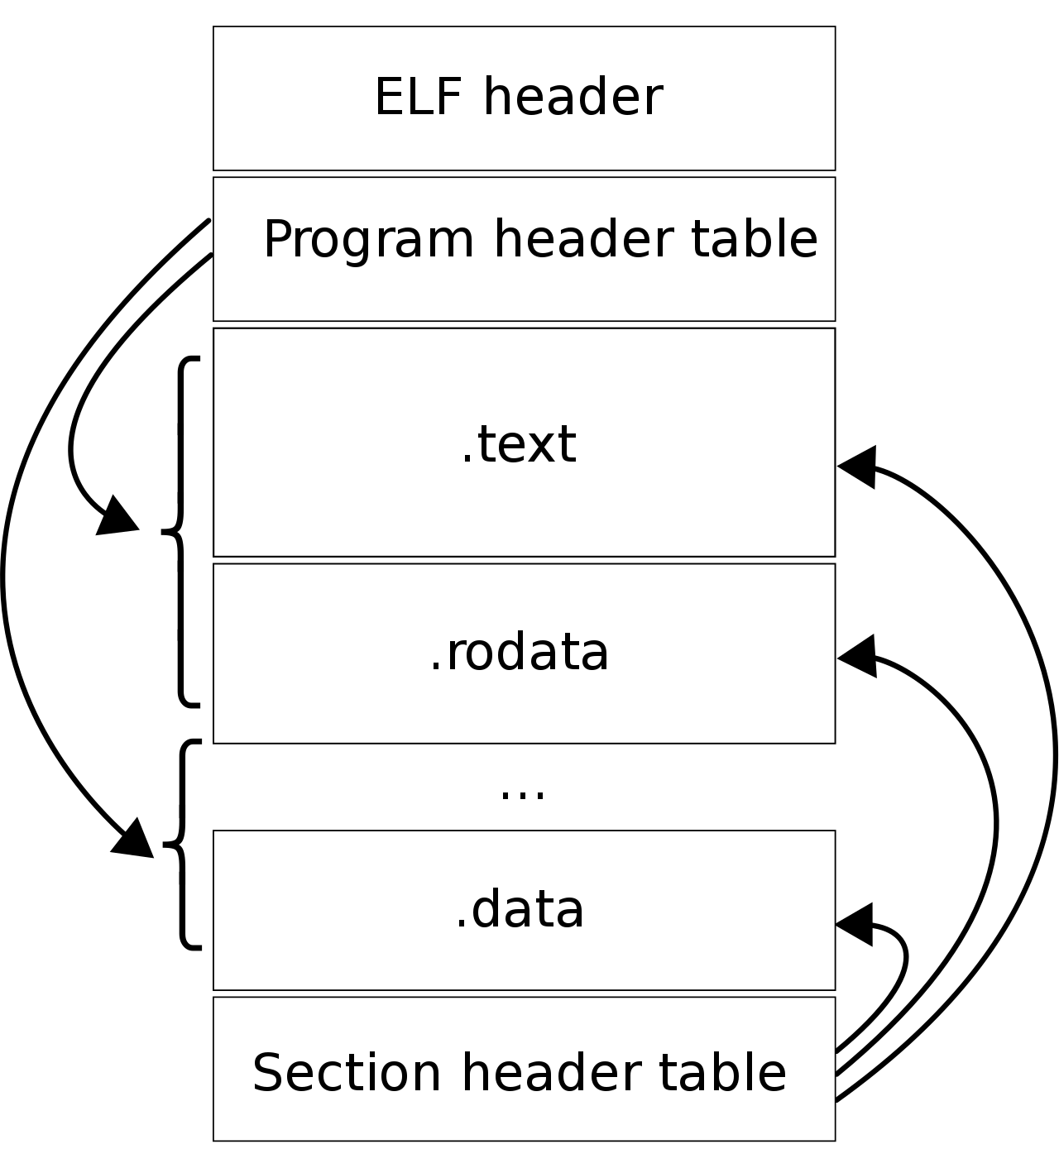
Software Environment - ELF
What happens when you compile a program?
You generate an ELF, not Legolas though
But rather Executable and Linkable Format
What is actually inside an ELF?
ELF/program header
Usually tells what OS it’s for
Where in memory to put the program in
.text: the actual instructions of the program
.rodata: read-only data, but we don’t enforce that
.data: modifiable program data
Section header table: where’s what

Slide 16
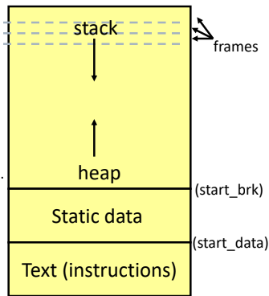
Software Environment - Program Space
Flashback to 370 or whatever computer organization class you had
What does the memory space for a program look like?
Stack for statically allocated variables, pointer decrements
Heap for dynamic memory, pointer increments
We actually never got the heap working for this...

Slide 17
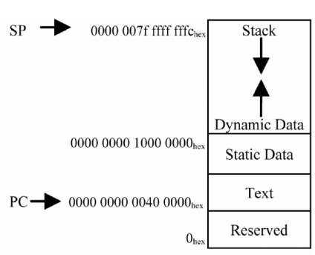
Software Environment - Program Space
Example of program space allocation for arm processors->
The linker allocate the memory space
In general memory addresses around 0x0 are precious
Some peripherals on the serial buses can only talk to
limited addresses
In our case, the text section starts at 0x0 to simplify loading
The stack pointer starts at 0x4000
The end of the testbench memory space
This means any program that you write, text+data+stack < 16KiB

Slide 18
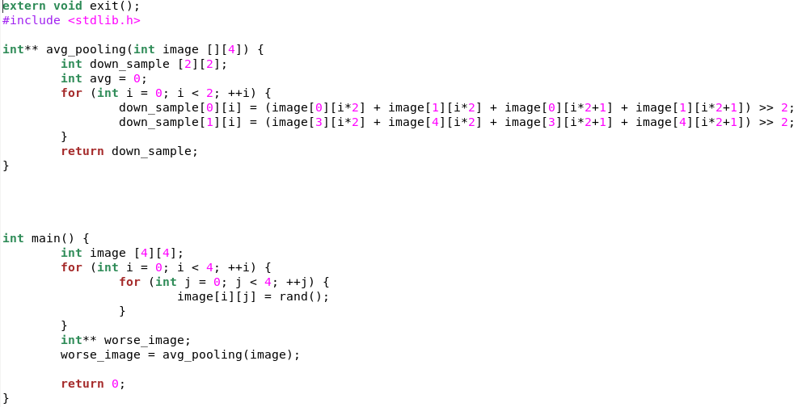
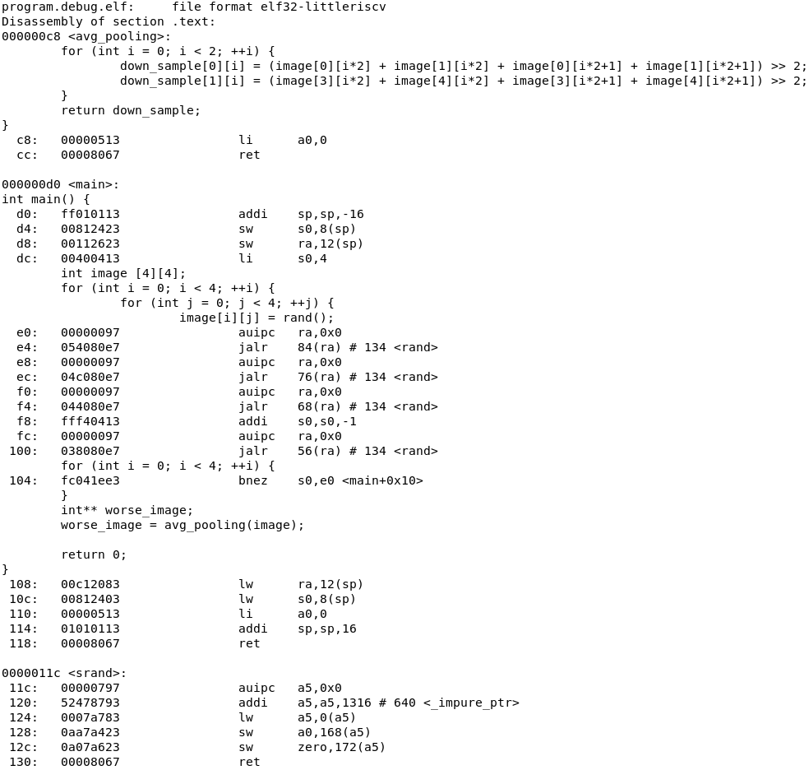
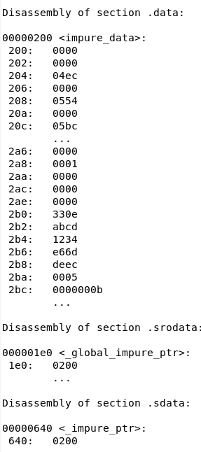
Software Environment - Program Space

Slide 19
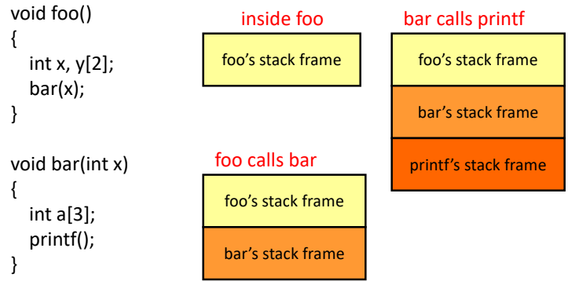
Software Environment - Function Calls
Every time there’s a function call, have a frame pointer that saves the previous stack pointer
Caller/callee save the variables

Slide 20
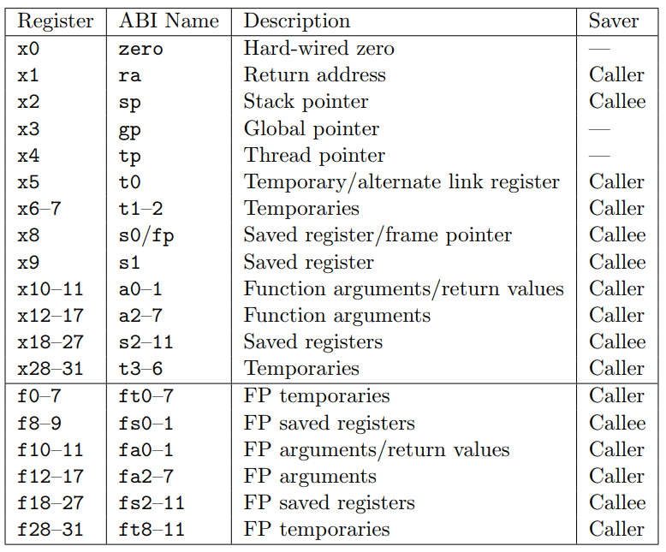
Software Environment - ABI
Registers aren’t just registers, each of them has a meaning
Such concept is called Application Binary Interface (ABI)

Slide 21
Beta Testing
We will provide a pipeline that is analogous to the baseline in P3 and P4
Basically the same microarchitecture, but with more SystemVerilog features
You will still be building an OoO processor, with your choice of additional features
You will have to support byte level memory operation, which will be challenging, but you’ll learn more
You will also have a better testing environment
As Dr. Tse-Yu Yeh has said, implementation can be very independent from the ISA
The overall workload is probably the same, but you’ll see more aspects of computing
At the end of day, we hope this make it easier for people to connect the dots

Slide 22
Beta Testing - New Files
Makefile - an updated Makefile with additional rules to build the program
crt.s - C runtime setup, allocates the stack pointer, initializes all registers
linker.lds/aslinker.lds - linker scripts for C/assembly programs
fix_link.sh - a bash script to some of the problems with the RISC-V GNU toolchain
ISA.svh - Macro defines for the RISC-V ISA

Slide 23
Beta Testing - Expectations
You will be venturing into unknown territories and we understand that
Although not that unknown, just that the baseline given could be buggy
Please report to us if you found any bugs in the baseline source or test files
If it’s on us, we’ll fix it
We would like to see at least one group of brave souls, and ideally 2-3 groups
We will also limit the beta to 5 groups max
More details on the final project next week, but the basic ideas are
The beta testers will start with implementing forwarding logic just like in P3
This is to get you familiar with the new pipeline
First chance to squash any bugs
You will do this as a group, and trust me this time you’ll be a lot better at it
We don’t expect as many features as a traditional project

Slide 24
Beta Testing - Expectations
You will support RV32IM
No system calls needed
ECALL, EBREAK
No CSR operations needed
No need for fence
No need for all DIV and REM instructions
The compilers won’t use any CSR operations unless you use them
Don’t use any functions or libraries that do system calls
Basically all I/O operations (printf, scanf, etc.)
Don’t write code with division or modulus (/, %)
You probably have never used functions that used a fence instruction before
std::atomic in C++
The memory bus will still be 64 bits, so you will need a cache to access the memory
The RISC-V baseline will have a bypass option that works without a cache, but you need one for sure
By default your cache block size is 2 words now

Slide 25
Beta Testing - The comparison
Pros
You have a complete GNU toolchain to work with rather than decaf
Makes writing test cases easier
Makes debugging easier
Features are more likely to influence performance
More relevant materials, broader view of computer architecture
Cons
The baseline given could be buggy
Byte level memory operations are guaranteed to be challenging
Less familiar, both you and us

Slide 26
Questions?

