Slide 1
CS 4476 Project 4
Jie Lyu
jlyu31@gatech.edu
903329676

Slide 2
Part 1

Slide 3
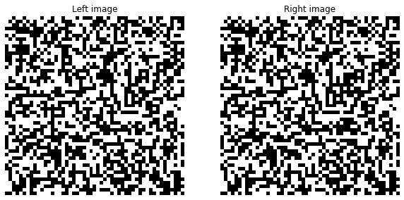
What is the relation between disparity map and depth? [Text/Equations/Drawing whatever you feel is relevant]
In a pair of stereo images, objects closer to the camera (less depth) will shift more than objects further away (more depth), thus having larger disparity. In a visualized disparity map, depth can be shown with color. In this project, objects further away appear to be more blue, and objects closer to camera appear to be more red.
Random dot stereogram image [51x51x3] + Can you judge depth by looking them?
No, I cannot judge depth by looking at the stereograms. (If I overlap them and change quickly from one to another, I can see a square in the center shifting. If I were given a natural pair of images like flowers, I can get the depth, but for stereograms, no I cannot)

Slide 4
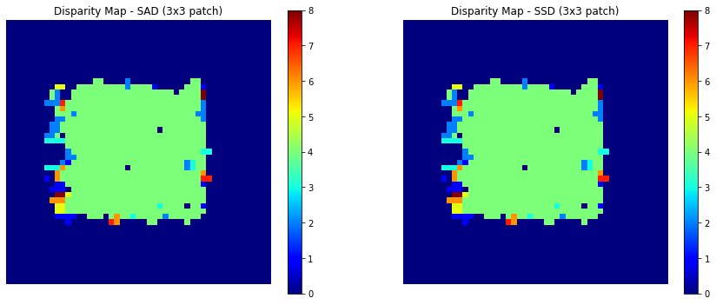
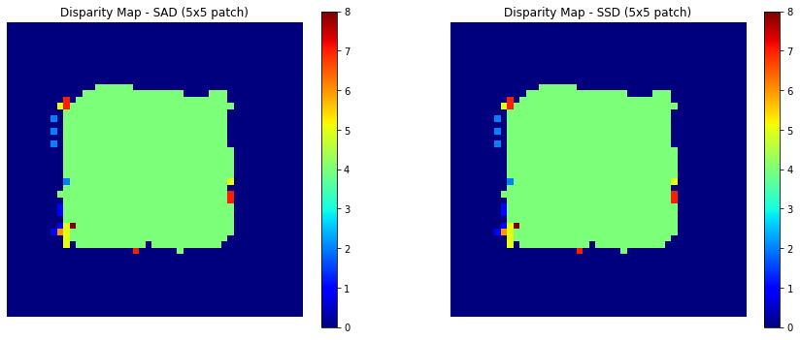
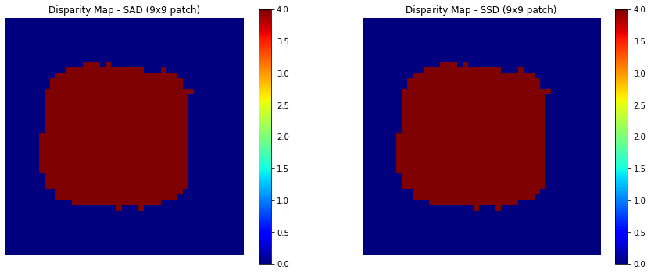
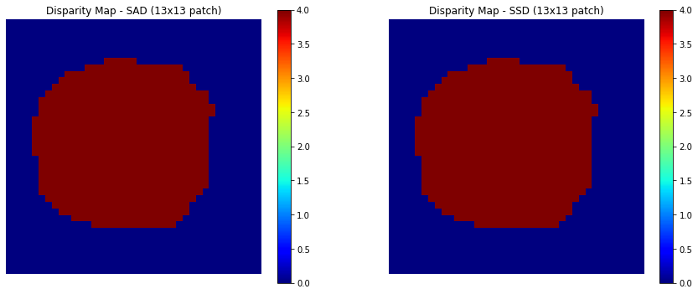
Random dot stereogram disparity maps
What is the effect of increasing the block size? Explain the reasoning behind it?
A bigger block size will include more information for matching and thus giving us more confident. In a real world image, images can be quite different on pixel level since cameras are not perfect. Random noises and lighting can make a 3*3 window completely different from another 3*3 windows taken on the same object. A bigger window size takes in more information, thus making the unwanted variations insignificant.
The effect can be seen from out random dot stereogram disparity maps. In the 3*3 sized one, there are some noise in the green square. It is because when we are shifting the matching window to the left, it sees some blocks with exactly the same contents on the way. So it picked the block with less disparity. As a result, we can see some blue dots in the big green square. However, as we increase the block size, the situation is less likely to happen, as we don’t see any noises in the 9*9 and 13*13 maps.

Slide 5
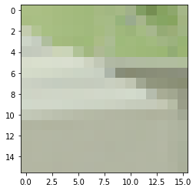
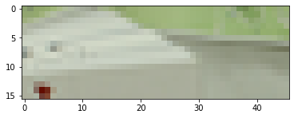
Random dot stereogram: Why is the result poor on the left edge and not on the other edges?
Since the right image is generated by shifting a center block to left, some patterns in the left image is overridden by the shifted block, thus can never be found again. So there are a lot of noise, especially for smaller window size, on the left. On the other hand, no information is overridden on other edges, so similarity measuring will give some decent results, especially with bigger window size.
Convex error profile: Can you generalize the type of regions which will generate convex profiles?
The regions that is unique across the disparity range. For an example below, the pattern in the window only appeared once across the disparity range.

Slide 6
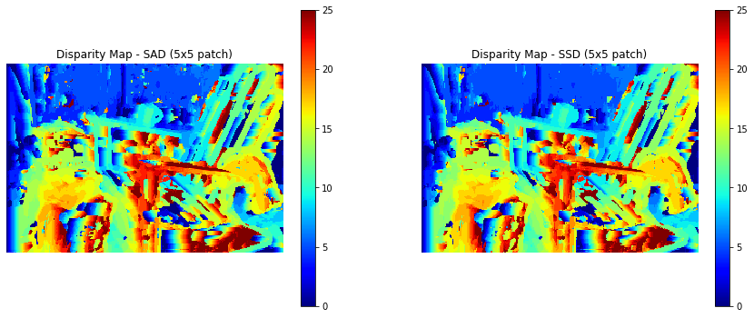
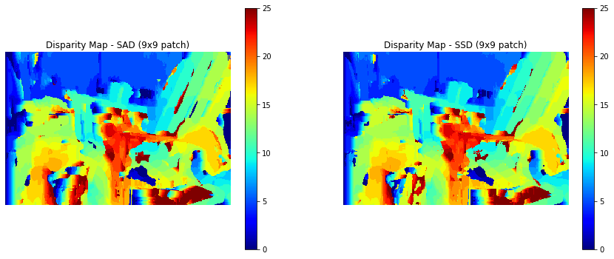
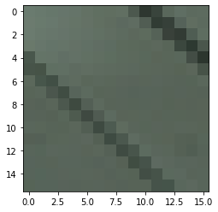
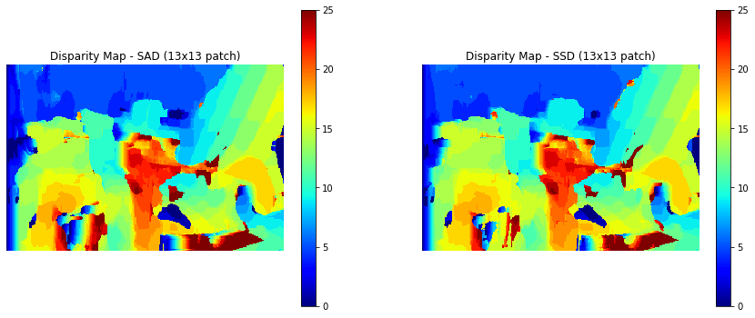
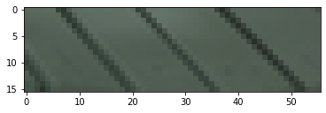
Nonconvex error profile: Can you generalize the type of regions which will generate non-convex profiles?
The regions that is repeated horizontally. For example, in the following window, the strips are repeated horizontally in the disparity range as the red box illustrates, so it will see similar patterns multiple times across the disparity range.
Disparity map for Set 1 (for 3 patch sizes)

Slide 7
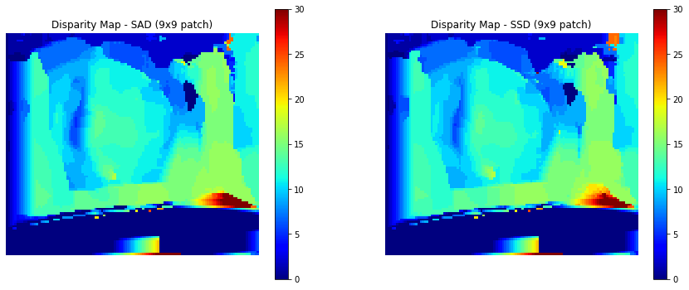
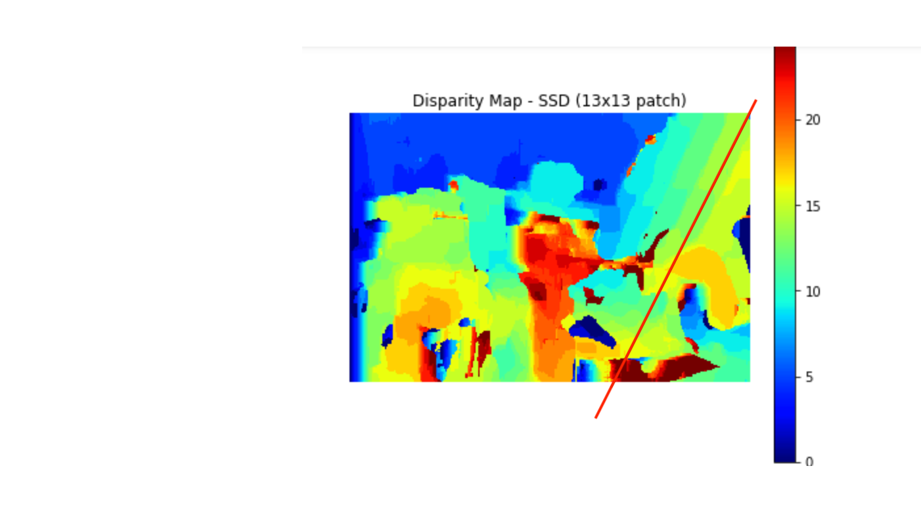
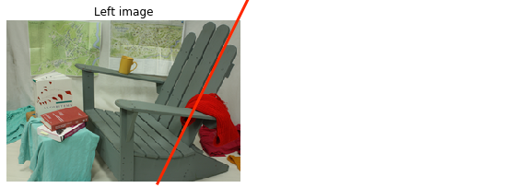
Set 1: Can you think of an explanation as to why the backrest of the chair appears blocky?
The change of color appears blocky instead of continues because the backrest is composed of fours pieces wood, and there are distinctive gaps between them. Basically, the color blocks represents the disparity of each gap. Since these gaps are not continuous in the graph but instead discrete, the disparity for them are discrete. There are in total 5 dark gaps (counting both edges), and therefore 5 corresponding color blocks. See the guide lines below, and you can see that the color blocks corresponds to gaps, and has nothing to do with woods.
Set 4 disparity maps (only one patch size)

Slide 8
Set 3, 4: peculiar behaviour of the disparity maps near right bowling pin: what do you see in input there and can you explain disparity map there?
<Text solution here>
Set 3, 4: What was the change between set 3 and set 4? What effect did it have on the disparity? Can you generalize the reasons where disparity calculations wont
Set 4 is more exposed at the lower portion, almost made the “table” part completely white. In set 3, the disparity map has an orange color for the lower for lower part, indicating more disparity, thus less depth for that part. In set 4, since the lower part is all white, the algorithm believes that there is no shifting, so the disparity map shows dark blue. In general, if a photo is over exposed, for some region the intensity is saturated and no information is captured and so no information can be derived.

Slide 9
Set 6: Effect on block size on the stairs in disparity maps
<Text solution here>
Set 6: Gradual shift in disparity values on the wall
<Text solution here>

Slide 10
Smoothing
Compare these results on the chair image qualitatively to the output of the chair image without smoothing.
2. What regions of the image does smoothing seem to perform better on and why do you think that is?

Slide 11
Smoothing(contd.)
3. What regions of the image does smoothing seem to perform worse on and why do you think that is?
4. Would smoothing still work for images with both a horizontal and vertical shift?

Slide 12
Part 2

Slide 13
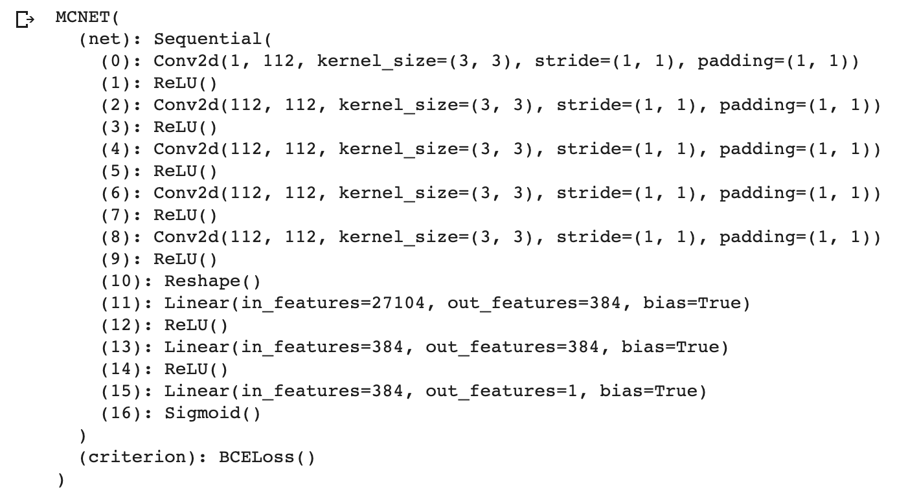
Copy the output of print(net_tr) from the notebook here. You can use screenshot instead of text if that’s easier.
What's the purpose of ReLU and why do we add it after every conv and fc layers?
ReLU stands for Rectified Linear Unit (ReLU). It is an activation function that transforms a summed weighted input into the activation out. Specifically for ReLU, if input > 0, output == input; else, output == 0. It introduces non-linearity to the network.

Slide 14
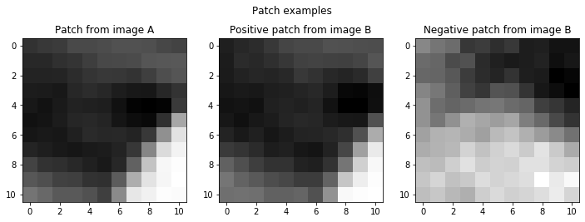
Show the patch example from your gen_patch function.
Giving a true disparity map for each stereo pair, how do we extract positive and negative patches for the training?
Foe positive patches, we query the true disparity map to get the ground truth coordinate e.g. img, dim3, dim4, d = get_disparity(nnz,ind) and pos = gen_patch(x1, dim3, dim4 - d + d_pos). In this case d_pos is 0 because we don’t want to offset it. We need to exactly right coordinate.
For negative patches, we add a random offset for each negative patch to get an incorrect patch as a negative patch e.g. d_neg = torch.Tensor(1).uniform_(5,25) and gen_patch(x1, dim3, dim4 - d + d_neg)

Slide 15
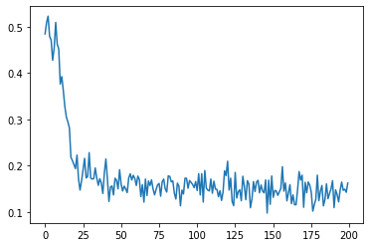
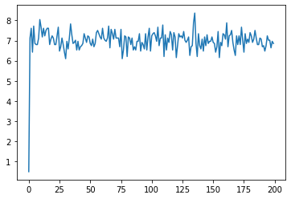
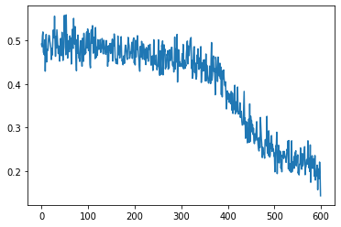
Copy the training loss plot and the final average validation loss of your best network
How does changing learning rate (try using large (> 1) vs small value (< 1e-5)) effect the training? Why?
A very large learning rate will make the loss fail to converge to an optimal. As the left images shows, with a learning rate of 3, the loss shoots up to 7 after a few run. < 1e-5 super slow. If the learning rate is too small, it takes way more time to make the loss converge. As we can see from the right image with a learning rate of 1e-6, the loss is still dropping at epoch 600, meaning the loss has not converged yet. But on the other hand, a smaller learning rate is more likely to give us a more optimal.
Validation loss: 0.202
learning_rate = 3
learning_rate = 1e-6
(max_epoch = 200, learning_rate = 0.00005)

Slide 16
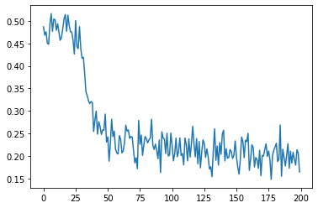
What's the difference between Adam and SGD? What do you notice when switching between them?
SGD (Stochastic Gradient Descent) uses a constant learning rate throughout training. Adam (Adaptive Moment Estimation) implements adaptive learning rate. It also selects different learning rate for different parameters. From the two images, it’s obvious that Adam makes loss converges faster than SGD (around epoch 25 vs around epoch 50). Also, Adam give a better validation result than SGD (0.202 < 0.290)
Is your validation loss lower or higher than your training loss? What is the reason for that? How would we get a better validation loss?
Validation loss is higher than training loss. Generally validation loss will be higher than training loss since in the training process the neuron network is learning and optimizing the weights from the training set. However, at validation stage, a validation set is used. The model has never seen the data in this set, thus more likely it is going to perform worst. A way to to lower validation loss is to prevent overfitting in the model. The most intuitive way is to stop overfitting is “early stopping”. We can plot the time vs loss graph for both training and validation loss, and stop the training when validation starts to increase because after this point overfitting happens. Other ways to prevent overfitting are dropping connections between layers randomly, reduce layers, reduce neurons etc.
Adam
SGD
(max_epoch = 200, learning_rate = 0.00005)

Slide 17
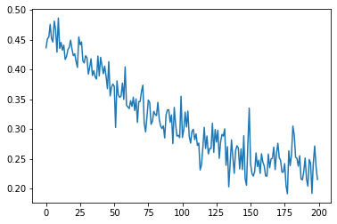
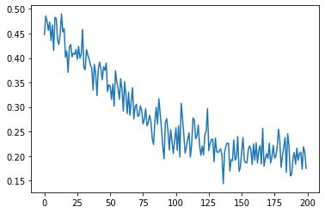
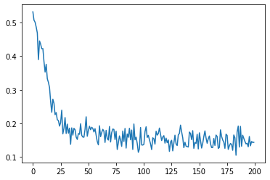
Copy the training loss plot and the final average validation loss of the networks with different window sizes
What's the effect of varying the window size on performance? Do you suppose there is an optimal window size for all images? Explain why or why not.
Out of the four windows sizes, 5x5 performed the worst with a validation loss of 0.337. As the window size increased to 9x9, loss drops to 0.271. 11x11 is the optimal size with a loss 0.202. The loss start to increase as we increase window size further. At 15x15, the loss is 0.219.
I don’t think there is one single optimal windows size for all images. For example, here 11x11 seems to be optimal. However, for images with higher resolution, 11x11 will be too small and not enough information/features can be included, and we may need windows size for example 31x31 to get the optimal result.
5x5, validation loss: 0.337
9x9, validation loss: 0.271
11x11, validation loss: 0.202
15x15, validation loss: 0.219
(max_epoch = 200, learning_rate = 0.00005)

Slide 18
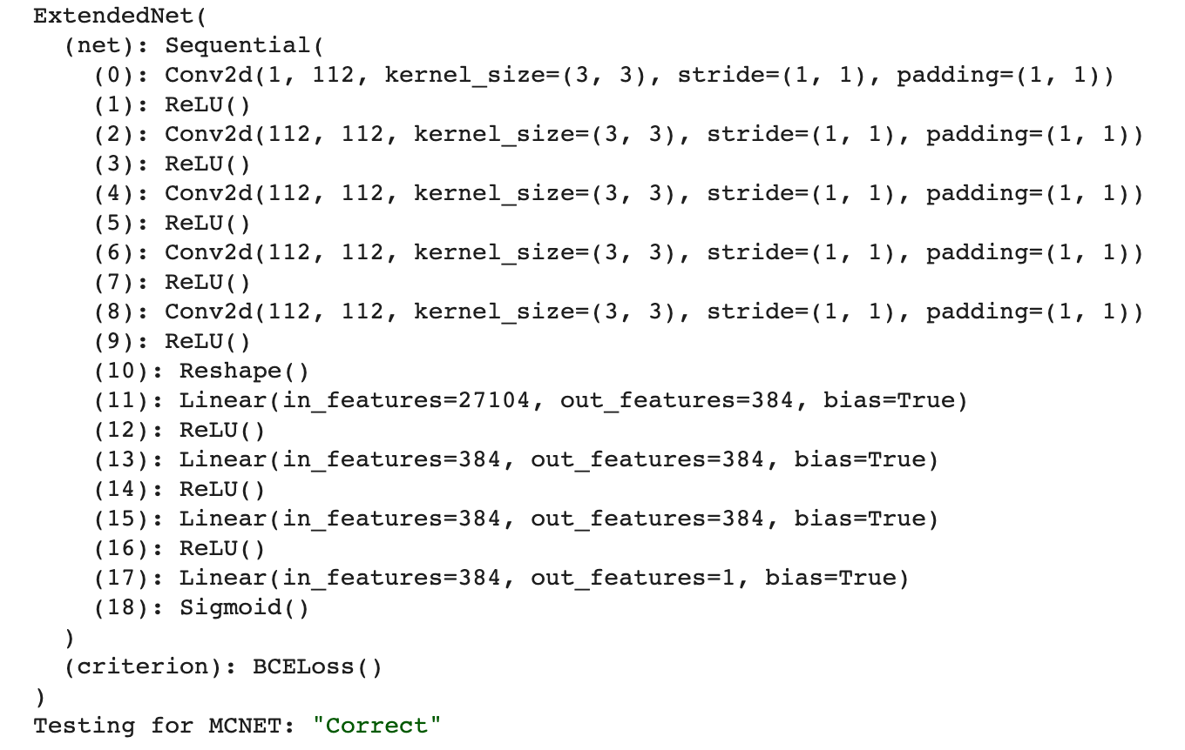
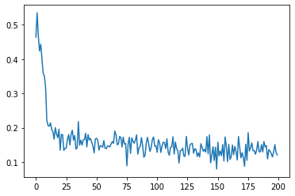
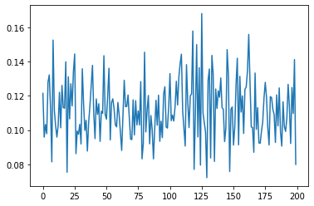
Copy the training loss plot and the final average validation loss of your extended network, as well as the network layer list.
What layers did you add? What's the effect of adding more layers without adding more data? Why?
One fully connected layer is added. Adding more layers without adding more data will likely to cause overfitting. The model will fit the training set better, illustrated by the better training performance from ExtendedNet as the loss is always < 0.2 in the right image, but it will not necessarily fit the testing set better. (validation loss for ExtendedNet >MCNET )
MCNET
validation loss: 0.226
ExtendedNet
validation loss: 0.228
(max_epoch = 200, learning_rate = 0.0001, window_size = 11x11)

Slide 19
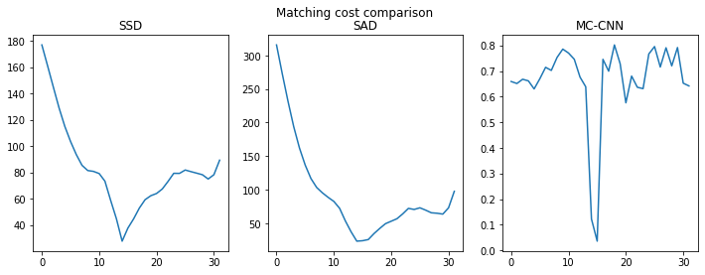
Show the matching cost comparison plot between SSD/SAD/MCCNN
Based on the matching cost comparison plot, how are SSD, SAD, and MC-CNN different? Can you think of a scenario where matching with MC-CNN would be prefered over SSD/SAD?
<Text here>

Slide 20
Show the disparity map comparison between SAD and MCCNN
<Copy figure image here>
Qualitatively, between SAD and MCCNN, which disparity map do you think looks better? Explain your reasoning.
<Text here>

Slide 21
Show the quantitative evaluation between SAD and MCCNN (average error, etc.)
<Text or screenshot here>
Quantitatively, between SAD and MCCNN, which one achieve better score on the metrics? Why do you think that's the case?
<Text here>

Slide 22
Extra Credit
<Discuss What extra credit you did and analyze it. Include Images of results as well >

