Slide 1
CS 4476 Project 5
Jie Lyu
jlyu31
903329676

Slide 2
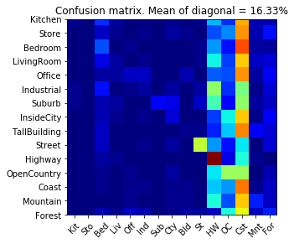
Part 1: Your confusion matrix, together with the accuracy for Part 1 with the standard param set (image_size = 16, k = 3)

Slide 3
Part 1: Experiments: change image size and k individually using the following values, and report the accuracy (when tuning one param, keep the other as the standard (16 x 16, 3)):
ie. when you’re tuning image size, keep k at 3, when changing k, keep image size as 16x16
image size:
8 x 8:
16 x 16: 16.33%
32 x 32:
k:
1: 19.40%
3: 16.33%
5: 17.07%
10: 15.53%
15: 15.60%

Slide 4
Part 1: Reflection: when tuning the parameters, what have you observed about the processing time and accuracy? What do you think might lead to this observation?
<Text solution here>

Slide 5
Part 2: Your best confusion matrix, together with the accuracy for Part 2. Also report your param settings to get this result.
<Plot here>
Param settings:
vocab_size:
stride (build_vocab):
step_size(get_bags_of_sifts):
max_iter (k-means):
k (kNN):

Slide 6
Part 2: Reflection: when experimenting with the value k in kNN, what have you observed? Compare this performance difference with the k value experiment in Part 1, what can you tell from this?
<Text solution here>

Slide 7
Reflection on Tiny Image Representation vs. Bag of Words with SIFT features
Why do you think that the tiny image representation gives a much worse accuracy than bag of words? As such, why is Bag of Words better in this case?
<your response>

Slide 8
Conclusion: briefly discuss what you have learned from this project.
<Text solution here>

Slide 9
Code and Misc. (DO NOT modify this page)
Part 1
Part 2
Late hours
Violations

Slide 10
Extra Credit
<Discuss what extra credit you did and analyze it. Include images of results as well >

