Slide 1
CS 4476 Project 6
Jie Lyu
jie.lyu@gatech.edu
903329676

Slide 2
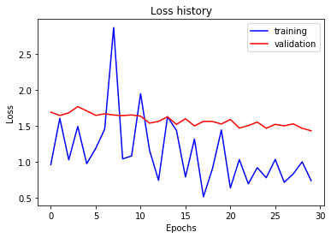
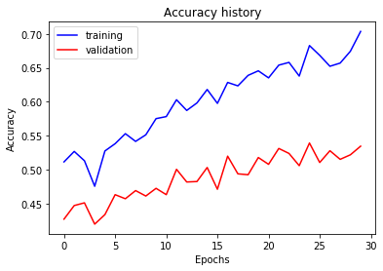
Part 1: Your Training History Plots
Final training accuracy value: 0.7035175879396985
Final validation accuracy value: 0.5346666666666666

Slide 3
Part 1: Experiment: play around with some of the parameters in nn.Conv2d and nn.Linear, and report the effects for: 1. kernel size; 2. stride size; 3. dim of nn.Linear. Provide observations for training time and performance, and why do you see that?
(Base Performance: With default parameters, optimized with Adam wit "lr": 2e-3, "weight_decay": 1e-2, first 5 epochs gives an average loss of 1.2)
Kernel size: When I increased kernel size to (15,15) for both Conv2d layers, performance increased significantly with an average loss of 0.85 for the first 5 epochs, and training time decreased. The reason for the increase of performance may be because with a bigger kernel, the filter is able to learn more of a feature than the tiny details in the picture. With a bigger kernel size, the output size will be smaller, thus less computation needed and the training speed is faster.
Stride size: When I increased stride size to 5 for both Conv2d layers, performance increased with an average loss of 0.70 for the first 5 epochs, and training time again decreased. Again, increasing the stride size decreases the output size, thus speeding up the training. The same observation still holds true when I increase the stride to 30. However, as I increase it to 100, performance is not as good as 5 or 30.
Dim of nn.Linear: When I increased nn.Linear to be 1000 -> 200 -> 15, speed decreased as neuron thus more computation is needed. Training performance is slightly improved, however the loss fluctuates move in the early phase of training.

Slide 4
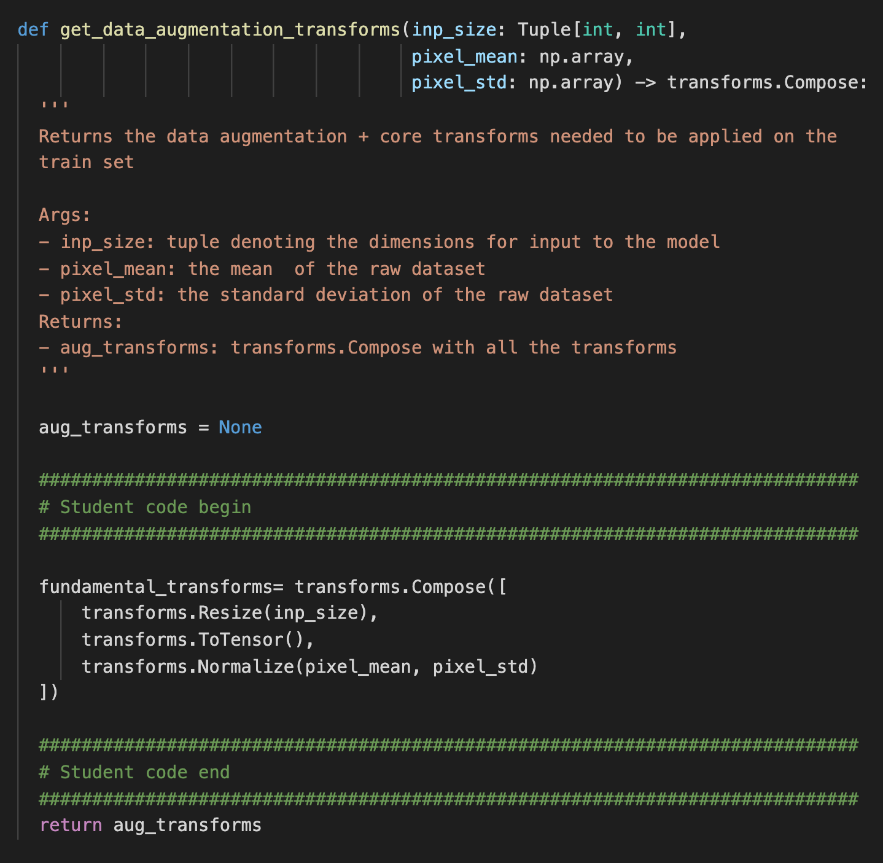
Part 2: Screenshot of your get_data_augmentation_transforms()

Slide 5
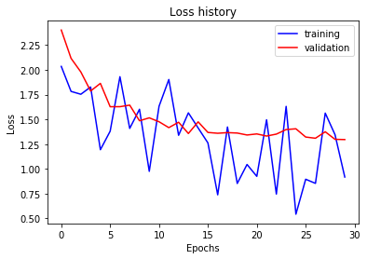
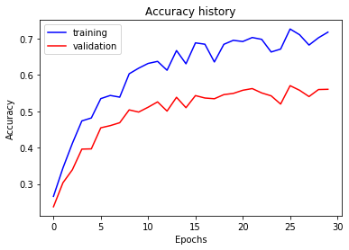
Part 2: Your Training History Plots
Final training accuracy value: 0.7179229480737018
Final validation accuracy value: 0.5606666666666666

Slide 6
Part 2: Reflection: compare the loss and accuracy for training and testing set, how does the result compare with Part 1? How to interpret this result?
<Text solution here>

Slide 7
Part 3: Your Training History Plots
<Loss plot here> <Accuracy plot here>
Final training accuracy value:
Final validation accuracy value:

Slide 8
Part 3: Reflection: what does fine-tuning a network mean?
<Text solution here>

Slide 9
Part 3: Reflection: why do we want to “freeze” the conv layers and some of the linear layers in pretrained AlexNet? Why CAN we do this?
<Text solution here>

Slide 10
Conclusion: briefly discuss what you have learned from this project.
<Text solution here>

Slide 11
Code and Misc. (DO NOT modify this page)
Part 1
Part 2
Part 3
Late hours
Violations

Slide 12
Extra Credit
<Discuss what extra credit you did and analyze it. Include images of results as well >

