Slide 1


PAID: Prioritizing App Issues for Developers by Tracking User Reviews over Versions
Cuiyun Gao, Baoxiang Wang, Pinjia He, Jieming Zhu, Yangfan Zhou, and Michael R. Lyu
The Chinese University of Hong Kong

Slide 2
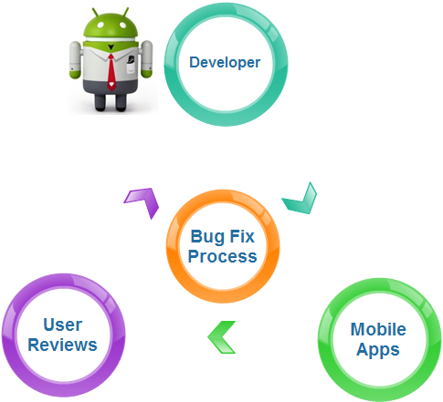
Motivation

Slide 3

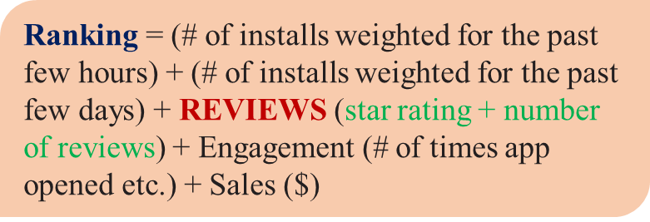



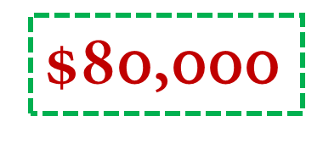
Reviews Impact on Ranking

Slide 4

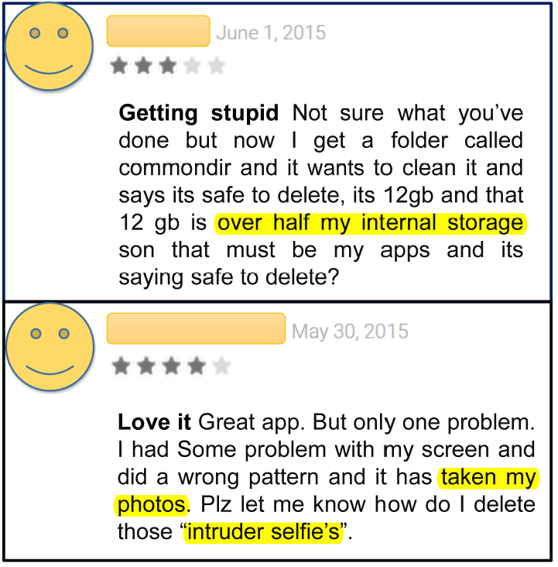
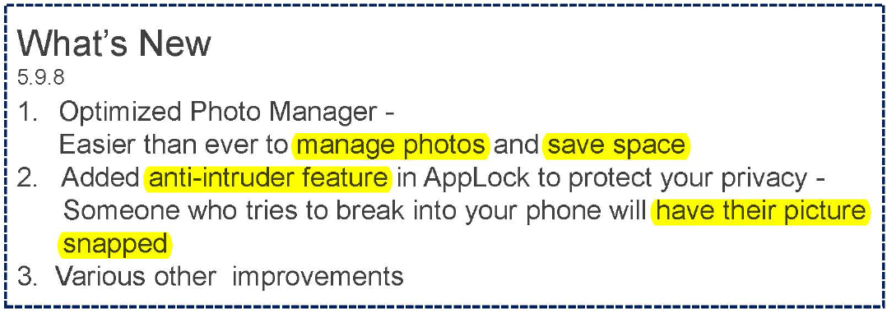


Reviews Influence the Update

Slide 5




Reviews are Massive
Massive and Messy
Automate the Process

Slide 6

Non-informative Reviews
Review
Keep asking to log in, even it's actually had logged in.
Like it cause it doesnt crash on androids
slower ever
Its ok
Love it
Stupid you NEED to use this
……..

Slide 7
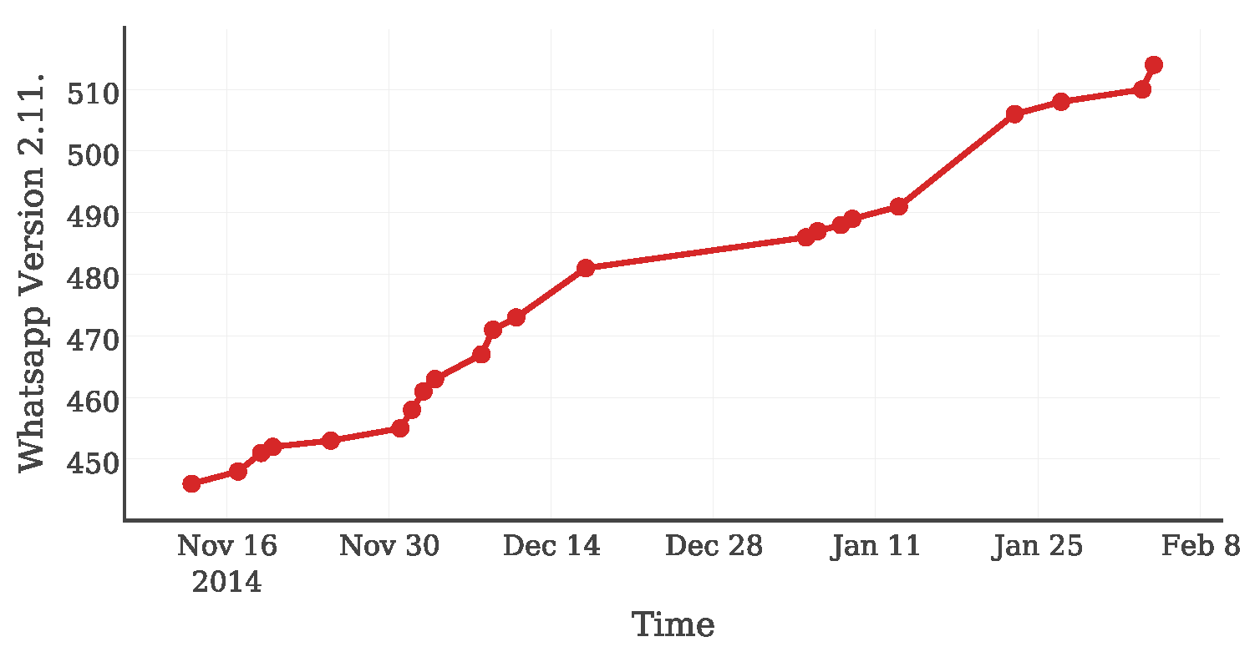
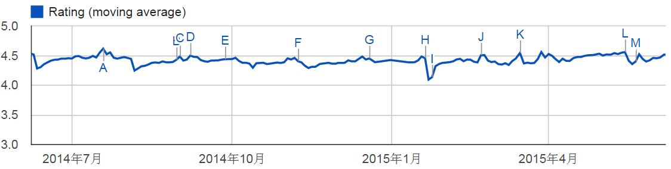
Reviews are Version-sensitive
Jul. 2014
Oct. 2014
Jan. 2015
Apr. 2015
According to the official announcement, WhatsApp commits a new version every 3.77 days on average.

Slide 8
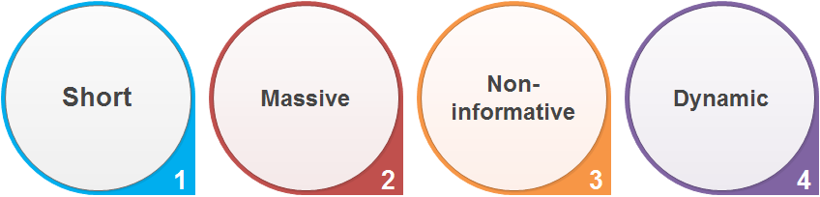
Motivation Summary
Dynamically
Automatically
Accurately
Summary of App Review Characteristics

Slide 9
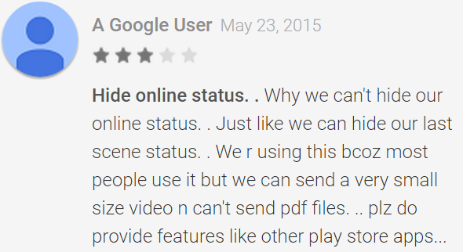
Phrase-level Issues
PAID provides app issues in phrase.

Slide 10








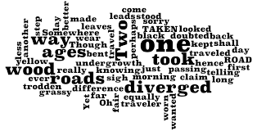




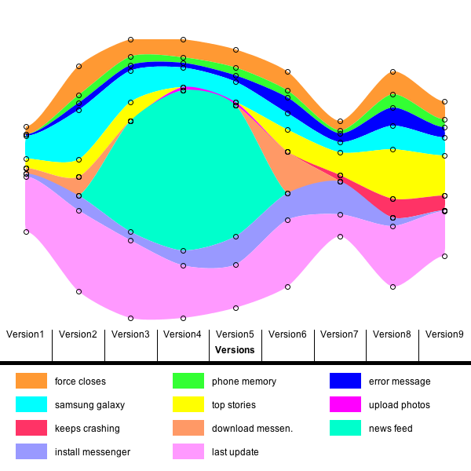

Framework
①Data Crawling
②Preprocessing
③Filtering
A. Data Extraction
1.Call quality
2.Free stickers
3.Galaxy tab
4. …..
④Phrase Generation
⑤Topic Grouping
⑥Issue Prioritizing
B. App Issue Generation
⑦Visualization
⑧Issue Analysis
C. Visualization and Issue Analysis

Slide 11
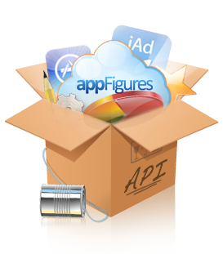

Data Crawling
App # | 37
Review # | 2,089,737
Time Period | 10 months
Google Play
Crawler
ID | Title | Review | Date | Stars | Version
1 | Crash | Like it cause it doesn’t crash on androids | 2014-11-09T08:55:47 | 5 | 15.0.0.15.13

Slide 12
Preprocessing and Filtering
Split the data set into several small ones according to version and app name.
Source Data
Facebook
Facebook messenger
Viber
Instagram
V:1
V:2
V:1
V:2
V:1
V:2
V:1
V:2
V:3
V:4
V:3
V:4
V:3
V:4
V:3
V:4
V:5
V:6
V:7
V:5
V:6
V:7
V:5
V:6
V:7
V:5
V:6
V:7
Lowercase
Lemmatization
Stop words
Casual words (e.g., “supperrrr”)
Meaningless words (e.g., “like”, “good”)
-- filtering word list

Slide 13
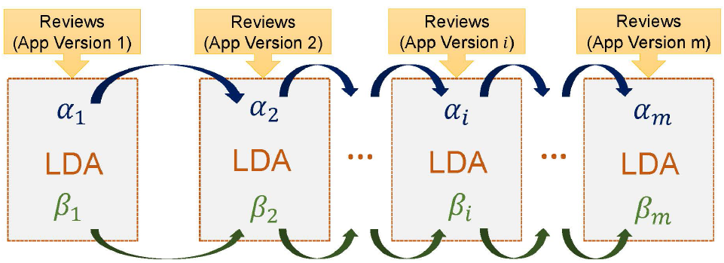
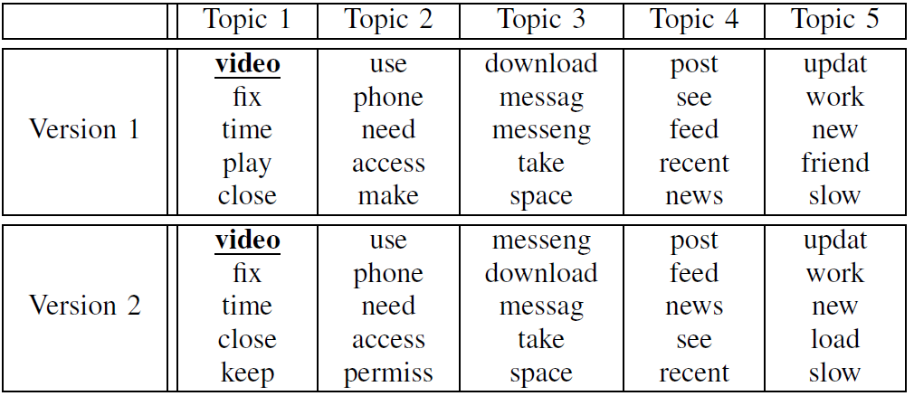

Topic Grouping
A Direct Explanation of dLDA Model

Slide 14

Phrase Generation
Rule-based method:
Length limit (word length >= 3)
Informative assurance (NLTK stopwords list and filtering word list)
Part of speech limit (adverb or determiner)
Quality assurance (occurrence frequency >= 5, TMI score in the top 150).
Raw Review

Slide 15
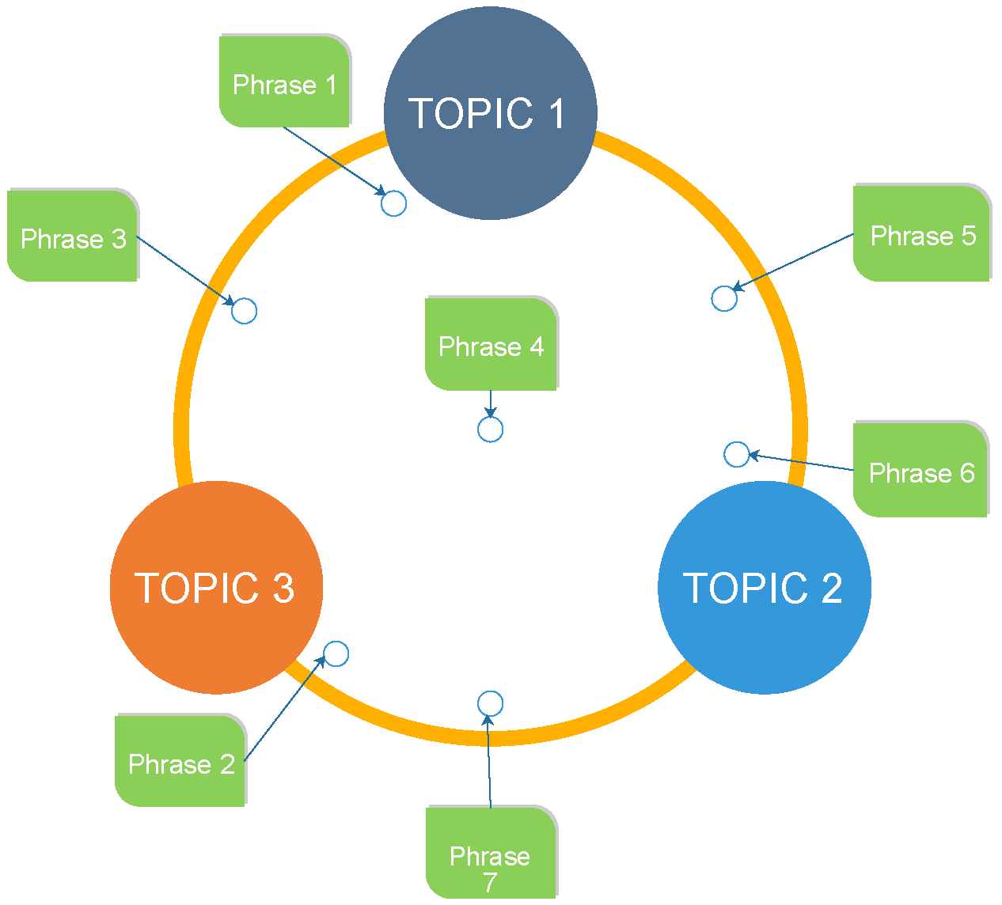
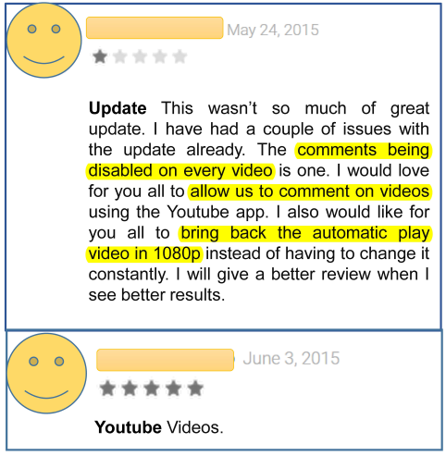



Issue Prioritizing
Rank by:
Semantic aspect:
KL-Divergence [KDD 2007]
Sentiment aspect:
Total score:

Slide 16
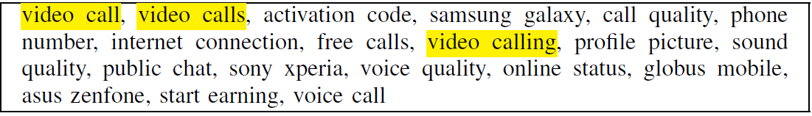
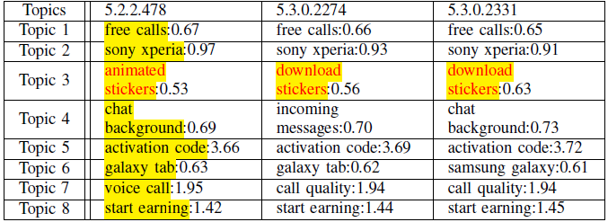


Experiments
Dataset: 37 apps, 10 categories, 56,479 reviews on average.
After combing changelogs: 18 apps, 117 versions.
Phrase Bank (Top 25) of Viber
Which issue is important?

Slide 17
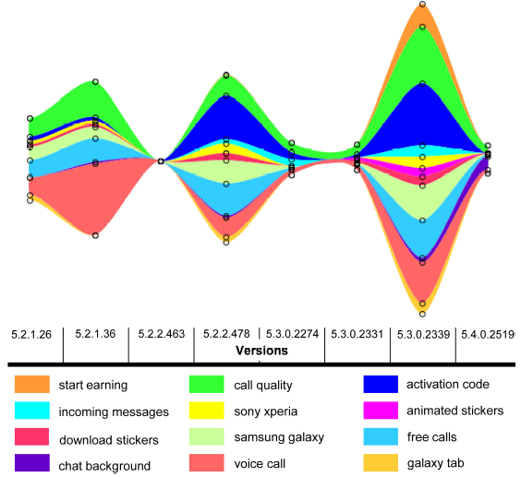
Visualization
The Themeriver of Viber.

Slide 18

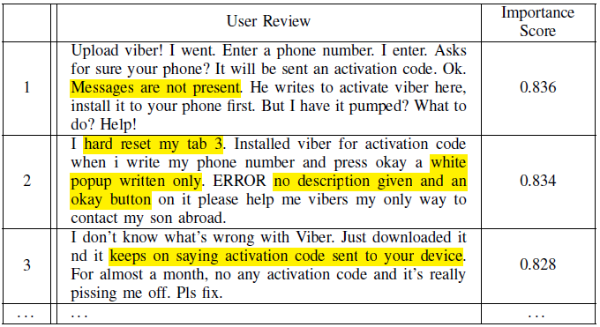
Rank Reviews
Importance score of the review d:
The Top Three Reviews Related to “Activation Code”

Slide 19
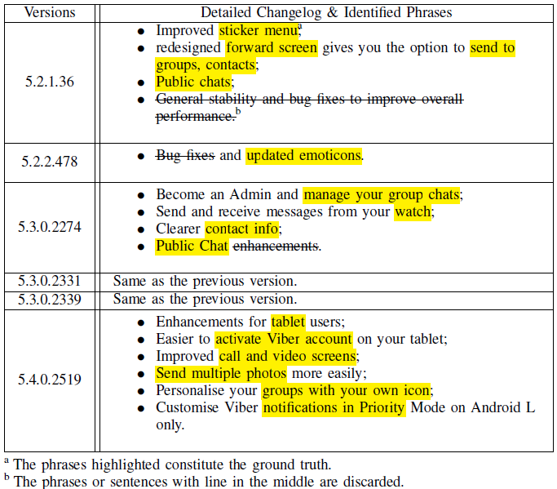

Performance Evaluation
For each phrase u in the ground truth, we compute its similarity degrees to all the phrases in our results, and the highest one is defined as the rate of the phrase Rate(u).

Slide 20
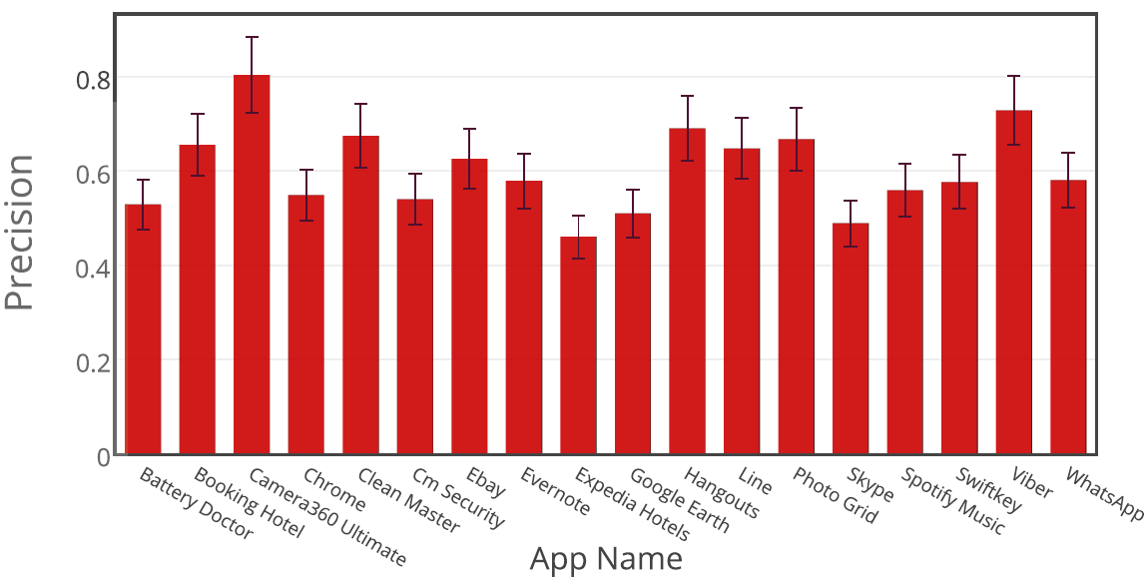
Overall Performance
The Precision of 18 Apps in the Collection. The overall times of comparing is 117. The average precision for these apps is 60.3%, which is quite acceptable for app review analysis [ICSE 2014].

Slide 21
Conclusion
We design a novel framework PAID to prioritize phrase-level issues systematically and automatically.
We propose a new evaluation metric to measure the prioritization of app issues by employing the official app changelogs.
The accuracy and effectiveness of our framework is demonstrated on a large real dataset.

Slide 22
Thanks!
Q & A

Slide 23
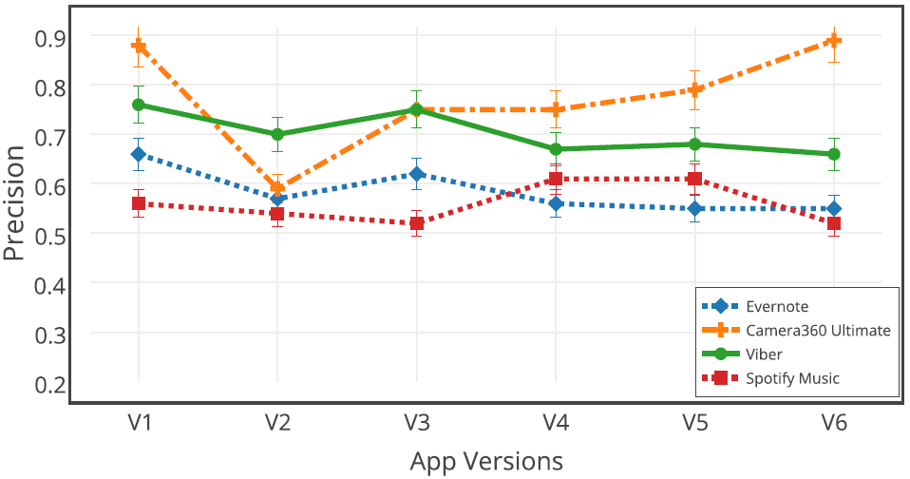
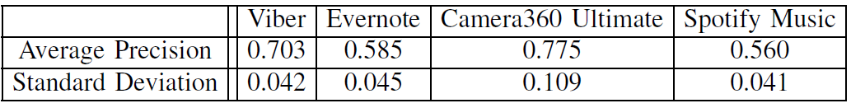
Experiments

Slide 24
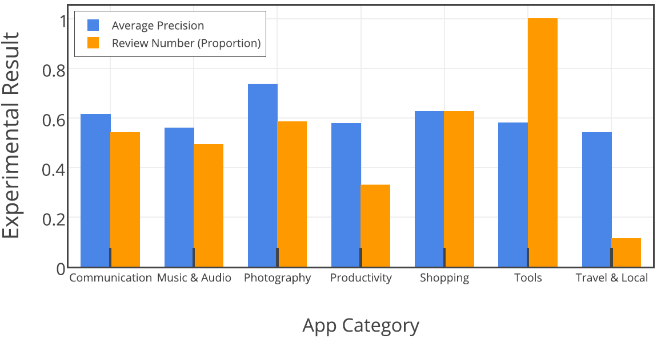
Experiments
The Relation between the Average Precision and the Review Number Regarding to App Category. The review numbers have been normalized by the maximum value in the experimental dataset.

Slide 25
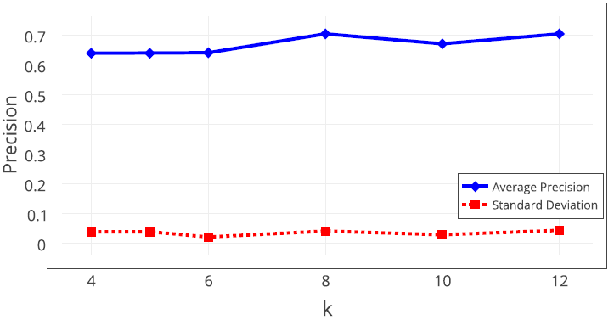
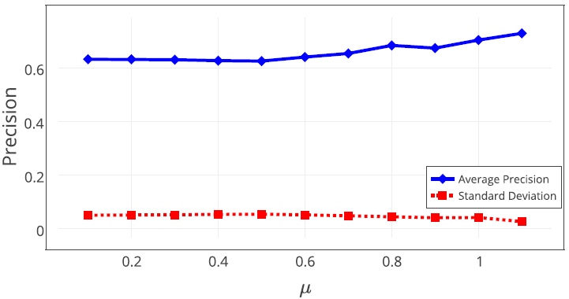
Experiments

