Slide 1



CARP: Context-Aware Reliability Prediction of Black-Box Web Services
Jieming Zhu, Pinjia He, Qi Xie, Zibin Zheng, and Michael R. Lyu

Slide 2
Questions in Mind
What are Web services?
Why is reliability prediction needed?
Why is context information important in reliability prediction?

Slide 3
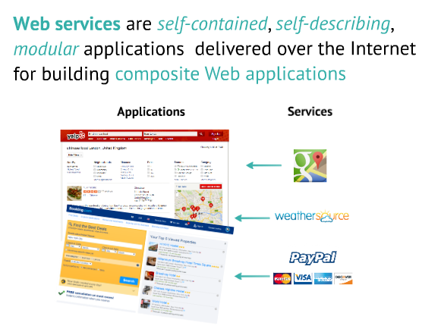
Web services are prevalent

Slide 4
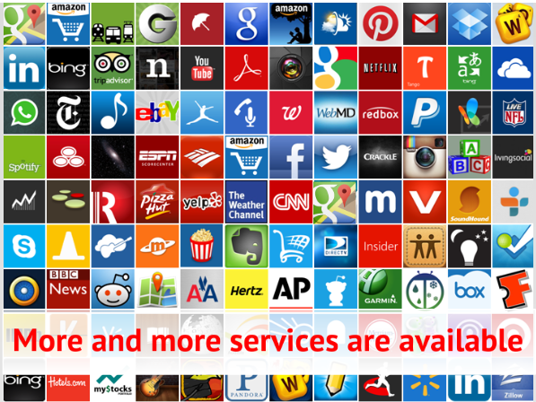

Slide 5
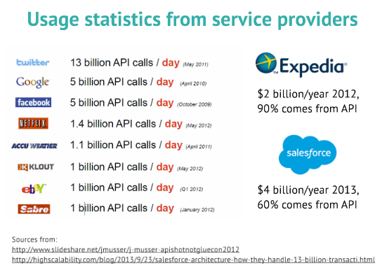

Slide 6
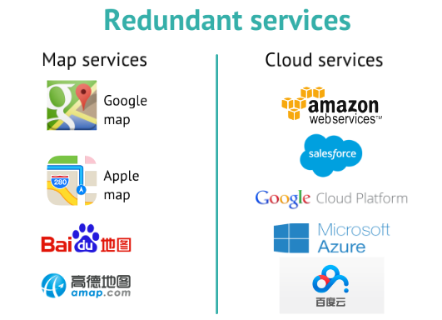

Slide 7
More and more systems employ abundant 3rd-party Web services
Reliability prediction is an important task in software reliability engineering
It becomes a must for users to assess and predict reliability of Web services to build reliable software systems

Slide 8
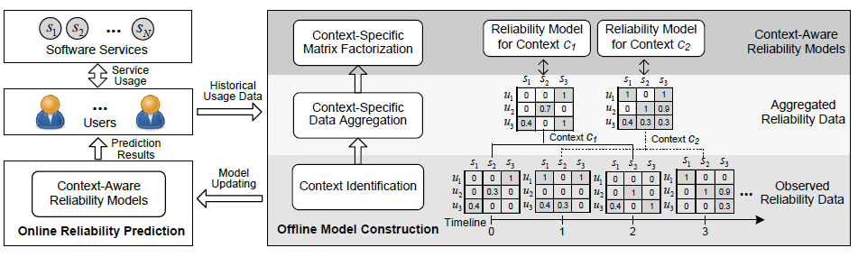
Context-Aware Reliability Prediction
Usage data collection
Offline model construction
Online reliability prediction

Slide 9
Reliability Models (1)
System-side reliability model
s denotes the specific software system or component
depends on the software-specific parameters such as software architecture, system resources (e.g., CPU, memory, and I/O), and other software design and implementation factors.

Slide 10

Reliability Models (2)
User-side reliability model
u and s denote the specific user and service respectively
depends both on user u and service s, such as the influence of user locations and network connections

Slide 11

Reliability Models (3)
Time-aware reliability model
formulates the user-perceived reliability for an invocation inv(u, s, t) between user u and service s at time slice t.
extended to incorporate temporal information due to fluctuating service workloads and dynamic network conditions

Slide 12

Reliability Models (4)
Context-aware reliability model
Indicates that the user-perceived reliability depends on the user u, the service s, and the context c.
We argue that the time-dimensional characteristics can be typically captured by a finite set of context conditions.
Notes:
Log Analysis models cannot directly use raw log messages as input, because they are usually unstructured, printed by human-written natural languages.

Slide 13


Offline Model Construction
1) Context Identification
2) Context-Specific Data Aggregation
3) Context-Specific Matrix Factorization

Slide 14


Online Reliability Prediction
Reliability prediction for invocations performed between user u and service s in context c,

Slide 15
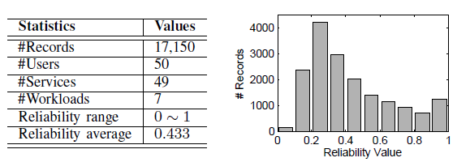
Evaluation
Data collected from Amazon EC2 [Silic et al., FSE’2014]
The services are implemented as matrix multiplication operations with different computational complexities
The users are simulated by a “stress testing” tool, loadUI

Slide 16
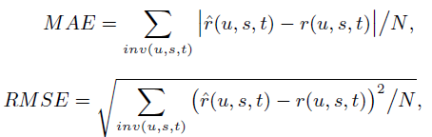
Evaluation Settings
Approaches compared:
Baseline: Using average value as prediction
Hybrid (UIPCC): Hybrid collaborative filtering approach [Zheng et al., ICSE’2010]
CLUS: K-means clustering based reliability prediction [Silic et al., FSE’2013]
PMF: matrix factorization model [Zheng et al., TOSEM’2013]

Slide 17
Evaluation Settings
Approaches compared:
Baseline: Using average value as prediction
Hybrid (UIPCC): Hybrid collaborative filtering approach [Zheng et al., ICSE’2010]
CLUS: K-means clustering based reliability prediction [Silic et al., FSE’2013]
PMF: matrix factorization model [Zheng et al., TOSEM’2013]

Slide 18
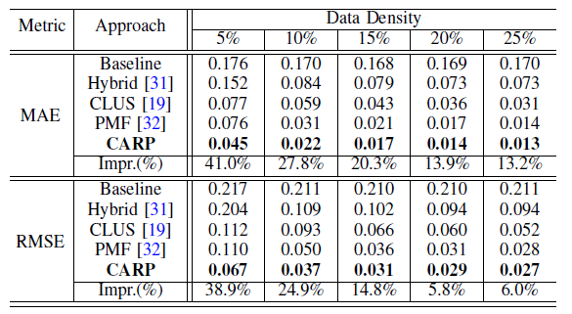
Experimental Results
13%~41% improvement in MAE and 6%~39% improvement in RMSE

Slide 19
Conclusion
Studied the problem of predicting user-perceived reliability of black-box Web services
Presented CARP for context-aware reliability prediction, by leveraging context-specific matrix factorization
Released the source code along with WS-DREAM datasets (http://wsdream.github.io)

Slide 20
Thank you!
Q&A

