Slide 1


Drain: An Online Log Parsing Approach with Fixed Depth Tree
Pinjia He, Jieming Zhu, Zibin Zheng, Michael R. Lyu

Slide 2



More and more developers leverage Web services to build their own systems
[Image from: http://www.linuxnix.com/understanding-awsamazon-web-services-cloud-part/]
[Image from: http://www.fruitionsystems.co.uk/cloud-services/azure/]
[Image from: http://www.lifehack.org/articles/technology/you-may-never-know-these-google-search-tips-and-tricks-you-miss-this.html]
Notes:
Nowadays, more and more developers leverage existing Web services to build their own systems because of their rich functionality and “plug-and-play” property.
Such as amazon Web services; various services provided by google, and Windows Azure

Slide 3

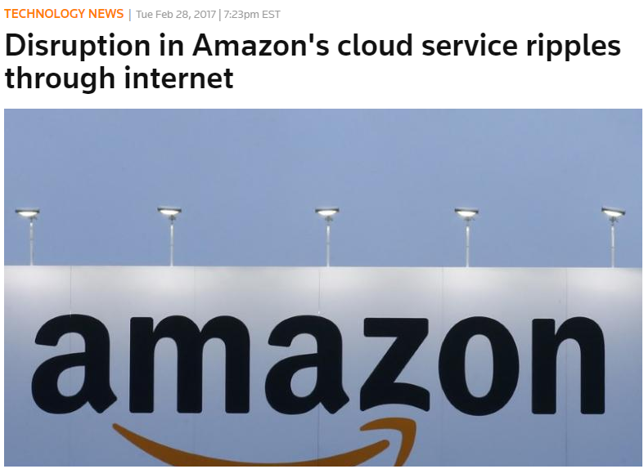




Web services management is
a big challenge, due to increasing scale and complexity
Service Providers
Service Users
Notes:
Amazon today blamed human error for the the big AWS outage that took down a bunch of large internet sites for several hours on Tuesday afternoon. In a blog post, the company said that one of its employees was debugging an issue with the billing system and accidentally took more servers offline than intended. That error started a domino effect that took down two other server subsystems and so on and so on. [https://www.recode.net/2017/3/2/14792636/amazon-aws-internet-outage-cause-human-error-incorrect-command]
Here, Trello, slack, quora, ifttt are also built on Amazon Web services.
Service provider: management, anomaly detection.
Service user: use logs for deployment, debugging, diagnosis.
Both service providers and service users need to manage Web services, and logs are usually the only data available that records service runtime information. So logs are essential for both service providers and services users.

Slide 4
Logs are a pervasive data source produced by Web services;
Log analysis is widely-employed for quality management of Web services

Slide 5

Logs are unstructured
2008-11-11 03:41:48 Received block blk_90 of size 67108864 from /10.250.18.114
Raw Log
What’s this?
I only understand structured data
Log Analysis AI
Notes:
Log Analysis models cannot directly use raw log messages as input, because they are usually unstructured, printed by human-written natural languages.

Slide 6
Log analysis models require structured input
2008-11-11 03:41:48 Received block blk_90 of size 67108864 from /10.250.18.114
Raw Log
Log Parsing
Structured
Log
blk_90 -> Event 1: Received block * of size * from *
Oh! This is Event 1 happened on block blk_90
Log Analysis AI
Notes:
But if we provide structured log messages, the log analysis model can easily understand them. The process to transform from unstructured log messages to structured events are log parsing.

Slide 7
Log Parsing Example
2008-11-11 03:41:48 Received block blk_90 of size 67108864 from /10.250.18.114
Raw Log
Log Parsing
Field of Interest
Structured
Log
blk_90 -> Event 1: Received block * of size * from *
Log Event
Notes:
Detailed explanation of the structured log

Slide 8
Log Parsing Example
2008-11-11 03:41:48 Received block blk_90 of size 67108864 from /10.250.18.114
Raw Log
Log Parsing
Structured
Log
blk_90 -> Event 1: Received block * of size * from *
The goal of log parsing is to distinguish between constant part and variable part from the log contents.

Slide 9
Log parsing is a small step in the whole process of log analysis for anomaly detection, but it is a significant step!
And it is non-trivial to do so!

Slide 10
Existing log parsing methods
Manual maintenance of log events (i.e., regular expressions)
The volume of log
Developer may not understand the logging purpose
Logging statements update frequently
Offline log parsers.
Selection of training logs
Log event changes
Notes:
Why we need automated log parsers? (details also in backup slides)
Why we need online log parsers?
For offline log parsers, we need to train the log parsers on a training log data set to find log events. The log events will be further used to parse to log messages in runtime. However, we often cannot train log data on all historical logs because of the large volume of production level log data. Thus, wee need an online log parser that can automatically update the log events in runtime.
Besides, if we use offline log parsers, we may need to consider the logging statements changes caused by software or hardware changes. This may cause some engineering issues. How often should we retain the system? Thus, an online log parser is needed to automatically retrain the model online.

Slide 11
An online log parser is highly
in demand

Slide 12
Framework of Drain
Root
. . .
Root Node
Length: 4
Length: 5
Length: 10
Internal Node
Leaf Node
Send
Receive
Starting
*
Log Group
A List of Log Groups
Log Group
Log Event: Receive from node *
. . .
Log IDs: [1, 23, 25, 46, 345, …]
Fixed depth tree (depth=3)
Notes:
The depth is a parameter that can be tuned by the developers. In this figure, the depth is 3, which is the distance from the root node to the leave nodes. The distance between the root to all the leave nodes are the same, therefore we call it fixed depth tree.
The depth can control the upper bound of the search depth in log parsing, which improves the efficiency of our log parsing method.
The first layer internal nodes are always encoding the length of the log messages.
The second layer and more are about the first token and more in the log messages.
When get to a leave node, Drain will find the most similar log group among the list log groups by comparing the similarity between the log message and the log events in different group. (also explained in the backup slides)

Slide 13
Update of Drain
The coming log message:
Receive 120 bytes
Root
Length: 3
Length is 3
Send
First token is Receive
block
NOT match!
Need to update the tree.
Log Event: Send block 44
Log IDs: [1]
Fixed depth tree (depth=4)
Notes:
An example about the update of the fixed depth tree. In this example, the depth is set to 4. Thus, we encode the length, the first token, and the second token of the log messages.

Slide 14
Update of Drain
Root
Root
Length: 3
Length: 3
Send
Send
Receive
Receive
Receive 120 bytes
block
block
*
120
Log Event: Send block 44
Log Event: Send block 44
Log Event: Receive 120 bytes
Log IDs: [1]
Log IDs: [1]
Log IDs: [2]
Fixed depth tree (depth=4)
Notes:
The tokens contain digits will not be put into the tree as a search index, because tokens containing digits are more likely to be variables. If we put this kind of tokens into the internal nodes, the tree can easily explode.

Slide 15
Evaluation
Accuracy and Efficiency of Drain
Comparison
LKE [ICDM09]
IPLoM [TKDE12]
SHISO [SCC13]
Spell [ICDM16]
Data sets
BGL
HPC
HDFS
Zookeeper
Proxifier
Offline
Supercomputer
Online
Distributed
System
Standalone
Software

Slide 16
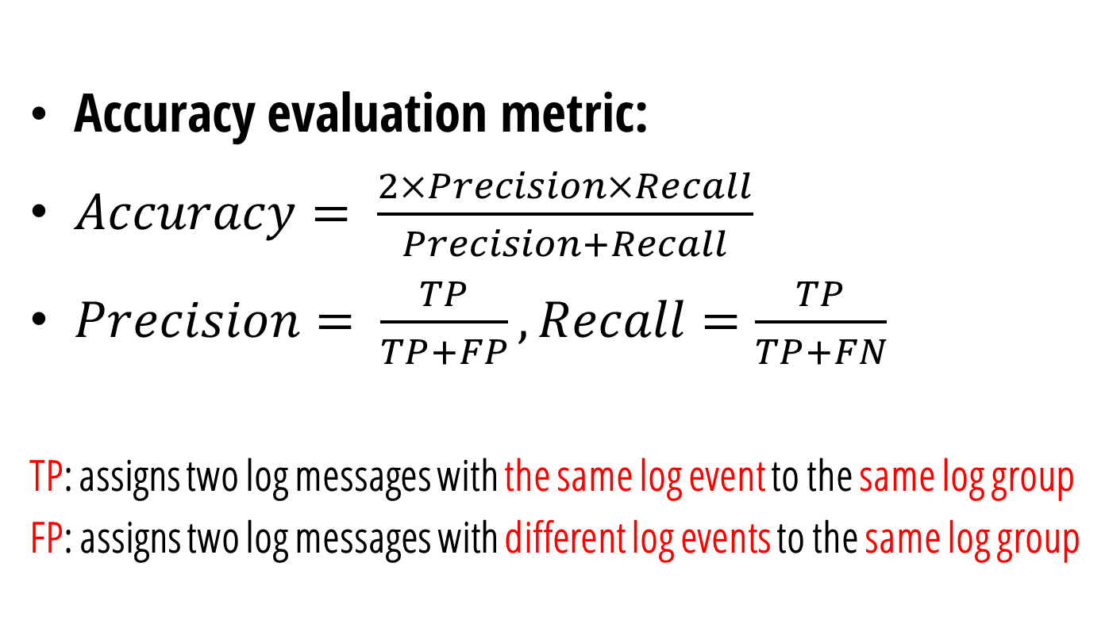
RQ1: Accuracy RQ2: Efficiency
Accuracy evaluation metric:
$Accuracy= \frac{2×Precision×Recall}{Precision+Recall}$
$Precision= \frac{TP}{TP+FP}, Recall=\frac{TP}{TP+FN}$
TP: assigns two log messages with the same log event to the same log group
FP: assigns two log messages with different log events to the same log group

Slide 17
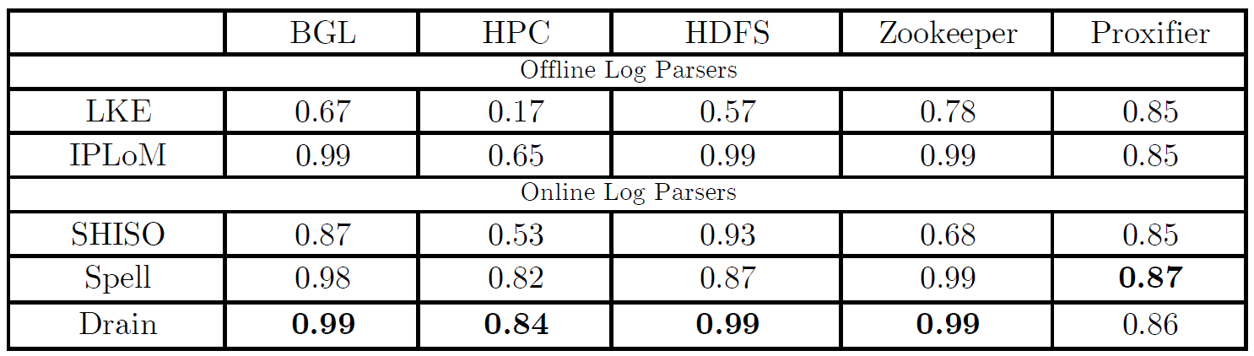
RQ1: Accuracy RQ2: Efficiency
Accuracy results:
Notes:
Accuracy is important because parsing errors can degrade the performance of subsequent log mining task.
An offline log parser could obtain higher accuracy compared with an online one, because an offline method enjoys all raw log messages at the beginning of parsing, while an online method adjusts its parsing model gradually in the parsing process.
Drain, obtains the best accuracy on four data sets, even compared with the offline log parsing methods. For data set Proxifier, Drain also has the second best accuracy (i.e., 0.86), and it is comparable to Spell, which obtains the highest accuracy (0.87) on this data set.
Drain has the overall best accuracy for three reasons. First, it compounds both the log message length and the first few tokens, which are effective and specially-designed rules, to construct the fixed depth tree. Second, Drain only uses tokens that do not contain digits to guide the searching process, which effectively avoids over-partitioning. Third, the tunable tree depth and similar threshold st allows users to conduct fine-grained tuning on different data sets.

Slide 18
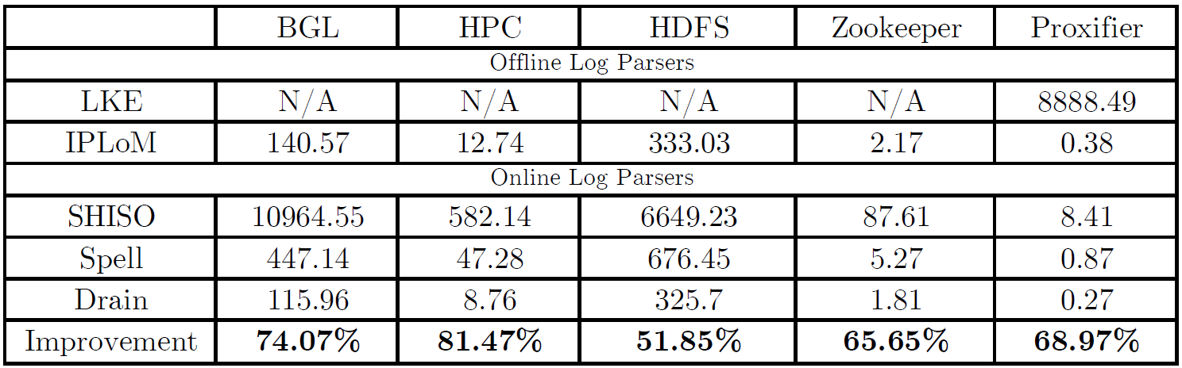
RQ1: Accuracy RQ2: Efficiency
Efficiency experiments:
 | BGL | HPC | HDFS | Zookeeper | Proxifier
#Log Messages | 4,747,963 | 433,490 | 11,175,629 | 74,380 | 10,108
#Log Event Types | 376 | 105 | 29 | 80 | 8
Notes:
Compared with the existing online parsing methods, our proposed Drain requires the least running time on all five data sets. Specifically, Drain only needs 2 min to parse 4m BGL log messages and 6 min to parse 10m HDFS log messages.
Drain greatly improves the running time of existing online parsing methods. The improvements on the five real-world data sets are at least 51.85%, and it reduce 81.47% running time on HPC. Drain also outperforms the existing offline log parsing methods.
It requires less running time than IPLoM on all five data sets. Moreover, as an online log parsing method, Drain is not limited by the memory of a single computer, which is the bottleneck of most offline log parsing methods. For example, IPLoM needs to load all log messages into computer memory, and it will construct extra data structures of comparable size in runtime. Thus, although IPLoM is efficient too, it may fail to handle large-scale log data. Drain is not limited by the memory of single computer, because it processes the log messages one by one.

Slide 19
Conclusion
Presents the design of an online log parser, namely Drain, which encodes specially designed parsing rules in a fixed depth tree
Extensive experiments on five real-world log data sets
Release the source code of Drain (www.cse.cuhk.edu.hk/~pjhe/Drain.py)

Slide 20
Thank you!
Q&A

Slide 21
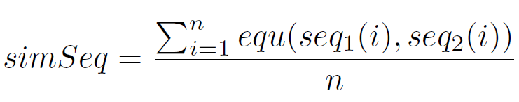
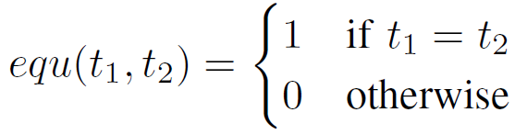
Step 4: Search by token similarity
Calculate the similarity simSeq between the log message and the log event of each log group
If simSeq>st, Drain returns the group as the most suitable log group, where st is a parameter.

Slide 22
Parameter setting
 | BGL | HPC | HDFS | Zookeeper | Proxifier
depth | 3 | 4 | 3 | 3 | 4
st | 0.3 | 0.4 | 0.5 | 0.3 | 0.3

Slide 23
Experimental Environment
We run all experiments on a Linux server
Intel Xeon E5-2670v2 CPU
128GB DDR3 1600 RAM
64- bit Ubuntu 14.04.2
Linux kernel 3.16.0.

Slide 24
Manual maintenance of log event is difficult, even with the help of regular expression
The volume of log is growing rapidly. For example, at a rate of around 50 gigabytes (120~200 million lines) per hour [Mi TPDS’13]
Developer may not understand the logging purpose. Modern systems often integrate open source software components written by hundreds of developers [Xu SOSP’09]
Log printing statements in modern systems update frequently. For example, a system in Google encounters tens or even hundreds of new log printing statements every month independent of the development stage [Xu PhD Thesis’10]
Notes:
ASE里写的三点

