Slide 1

Towards Online, Accurate, and Scalable QoS Prediction for Runtime Service Adaptation
ICDCS 2014
Madrid, Spain 30 June-3 July 2014
Jieming Zhu, Pinjia He, Zibin Zheng,
and Michael R. Lyu
The Chinese University of Hong Kong

Slide 2
Outline
Introduction
QoS Prediction Problem
Collaborative Filtering
Adaptive Matrix Factorization
Experiments
Conclusion & Future Work

Slide 3

Introduction
Service-based applications: built on a set of component services
Service
Service
Service
Service
[ref. http://www.priceline.com]

Slide 4

Introduction
Redundant services: functionally-equivalent services provided in the cloud
Car rental services provided by
different companies

Slide 5
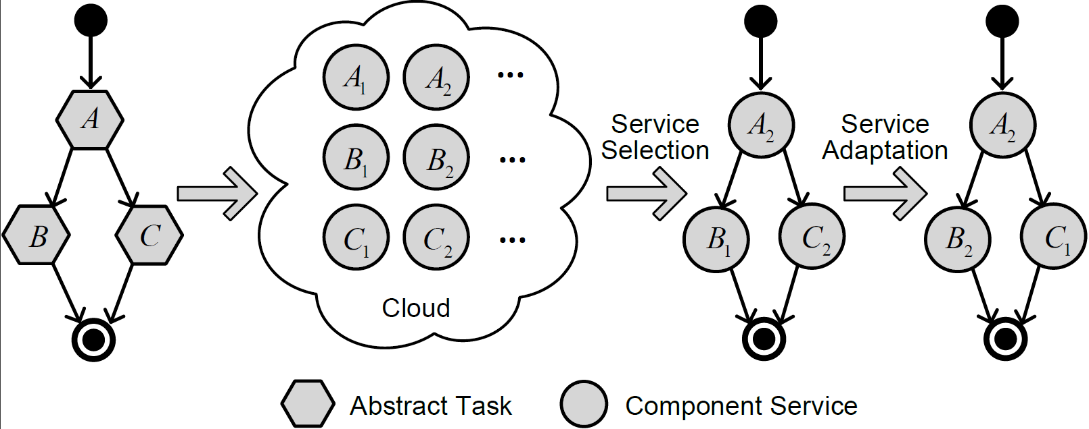
Introduction
Quality-of-Service (QoS): user requirements
Response time, throughput, failure probability
Complex operating environment
Service failures / SLA violations
Failure

Slide 6
Introduction
Service adaptation: switch a working service to a candidate service at runtime (e.g., B₁→ B₂)
Loose coupling and dynamic binding
Make use of redundant services
Become resilient against failures of component services

Slide 7

Introduction
Decisions for service adaptation
When to trigger an adaptation action?
Which working services to be replaced?
Which candidate services to employ?
Need available QoS information of component services
QoS for working services
Existing work: e.g., monitoring
QoS for candidate services
Our work: unsolved problem

Slide 8
Outline
Introduction
QoS Prediction Problem
Collaborative Filtering
Adaptive Matrix Factorization
Experiments
Conclusions & Future Work

Slide 9
Observations
QoS Attributes
Dynamic:
Users are distributed worldwide
The workload of service is varying
Network is dynamic
User-specific:
Different users may perceive different QoS
Monitor all QoS values: straightforward yet impractical
A large number of users as well as services
Prohibitive overhead at runtime

Slide 10
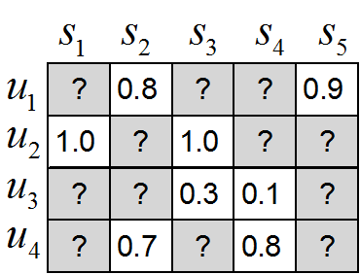
Challenges
QoS prediction: a promising approach
Predict the missing values

Slide 11
Outline
Introduction
QoS Prediction Problem
Collaborative Filtering
Adaptive Matrix Factorization
Experiments
Conclusion & Future Work

Slide 12
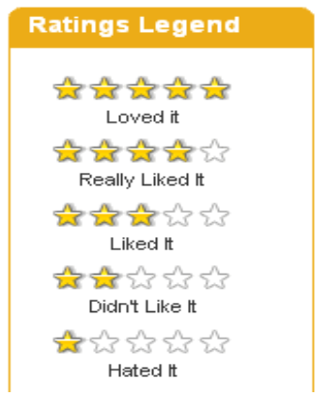
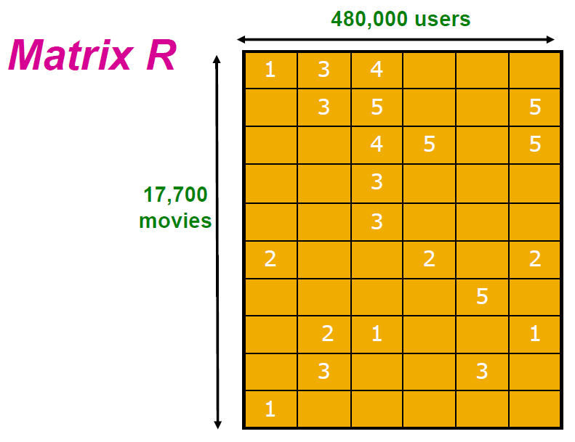
Collaborative Filtering (CF)
Collaborative filtering problem
User-movie rating prediction (Netflix challenge)
Similar users (e.g., similar preferences)
Similar movies (e.g., similar themes)
Rating matrix
movies
users

Slide 13
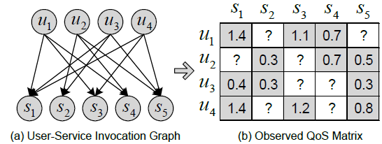
CF vs QoS Prediction
User-perceived QoS prediction
Collaborative filtering for QoS prediction?
Collaborative filtering | QoS Prediction
User- movie rating matrix | User-service QoS matrix
Rows → users | Rows → users
Columns → movies | Columns → services
Latent factors: preferences, topics | Latent factors: network, workload

Slide 14

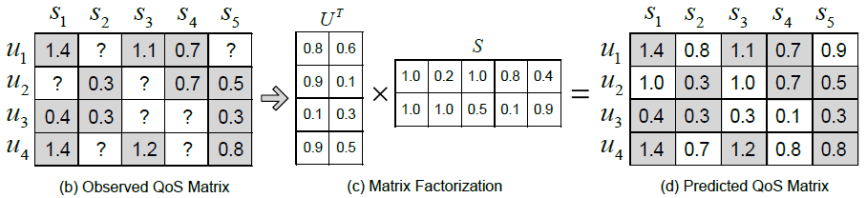
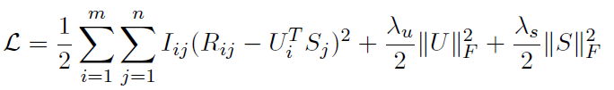
Classic model for CF
Matrix factorization (MF):
Minimization formulation:
Usually solved by gradient descend algorithm (batch mode)
Sum of squared error
Regularization terms

Slide 15
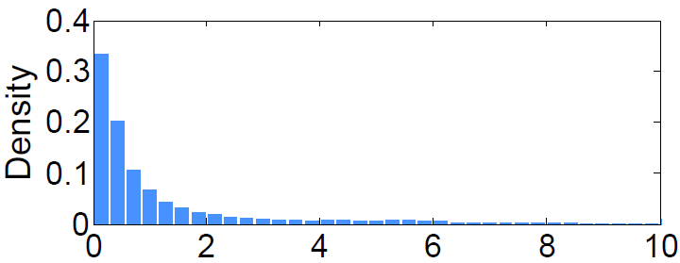
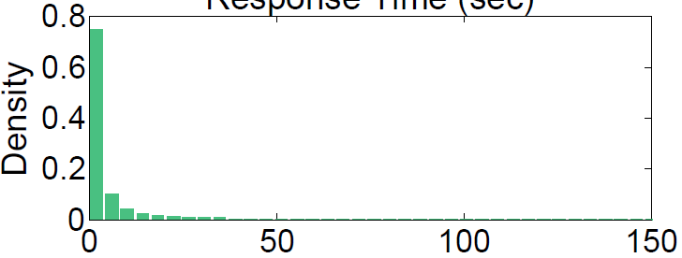
Limitations of MF for QoS prediction
Limitation 1: skewed QoS value distributions
Mismatch with the probabilistic assumption for MF
Degrade its prediction accuracy
Limitation 2: time varying QoS values
Existing QoS values can be continuously updated
However, MF work offline, and cannot adapt to new observed QoS values
Response Time
Throughput

Slide 16
Limitations of MF for QoS prediction
Limitation 3: scalability on new users and services
Users and services may join or leave the environment
MF works on a matrix with a fixed size, not scalable
How to address these limitations?
Our approach: adaptive matrix factorization
Aim to meet the requirements of being online, accurate, and scalable

Slide 17
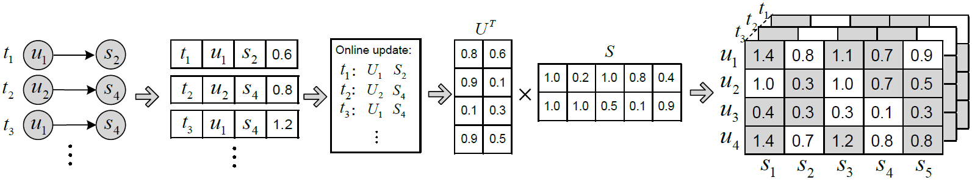
Adaptive Matrix Factorization
Algorithm overview
QoS data stream collection
Data transformation
Online learning and updating
Return predicted QoS values

Slide 18

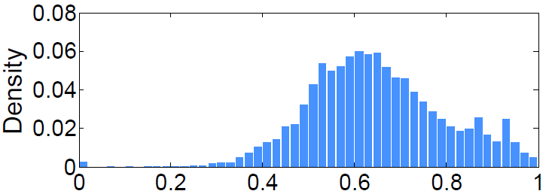
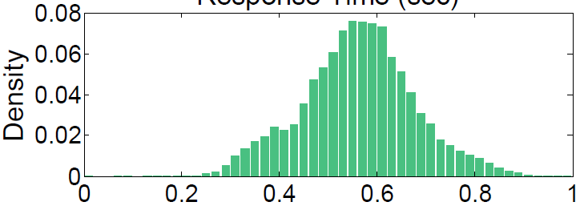
Key Techniques 1: Data Transformation
Box-Cox transformation (to address limitation 1)
Stabilize data variance
Rank-preserving
Response Time
Throughput
Response Time
Throughput

Slide 19
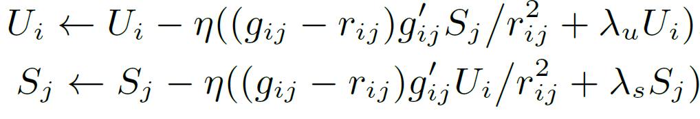
Key Techniques 2: Online Learning
Online learning (to address limitation 2)
Stochastic gradient descent (SGD)
Adapt to each newly observed data sample
Update a user vector and a service vector at each step
Extensible to new users and services
Online mode
SGD update rules

Slide 20

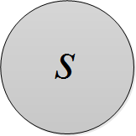

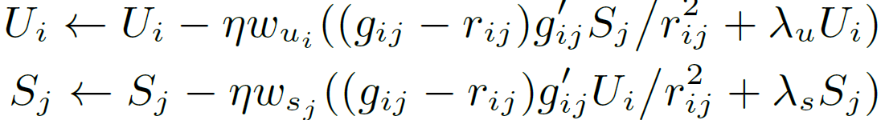
Key Techniques 3: Adaptive Weights
Adaptive weights (to address limitation 3)
Become robust
Existing users and services keep stable
New users and services converge fast
Unique learning rate for each user/service
Large for new vectors, small for converged vectors
1.0
1.5

Slide 21
Outline
Introduction
QoS Prediction Problem
Collaborative Filtering
Adaptive Matrix Factorization
Experiments
Conclusion & Future Work

Slide 22
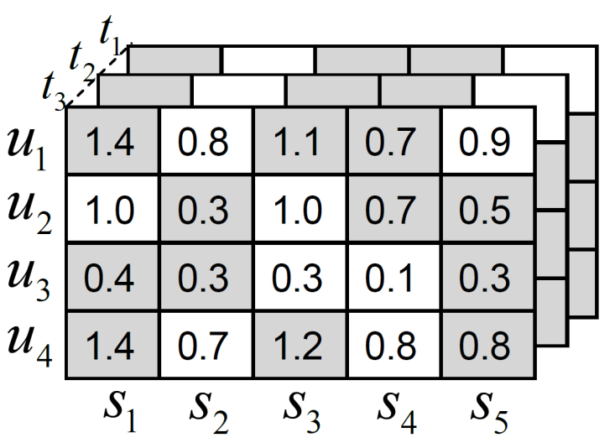
Experiments
Dataset collection
Response time (RT): user-perceived delay of service invocation (sec)
Throughput (TP): data transmission rate (kbps)
142 * 4500 * 64 QoS matrix
142 users (Planetlab nodes)
4,500 real-world Web services
64 time slices, at 15min time interval

Slide 23
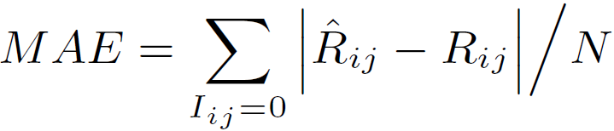
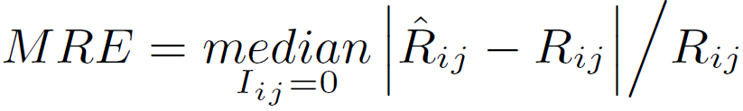
Experiments
Evaluation Metrics
MAE (Mean Absolute Error): to measure the average prediction accuracy
MRE (Median Relative Error): a key metric to identify the error effect of different magnitudes of prediction values
NMRE (Ninety-Percentile Relative Error)： NPRE takes the 90th percentile of all the pairwise relative errors

Slide 24
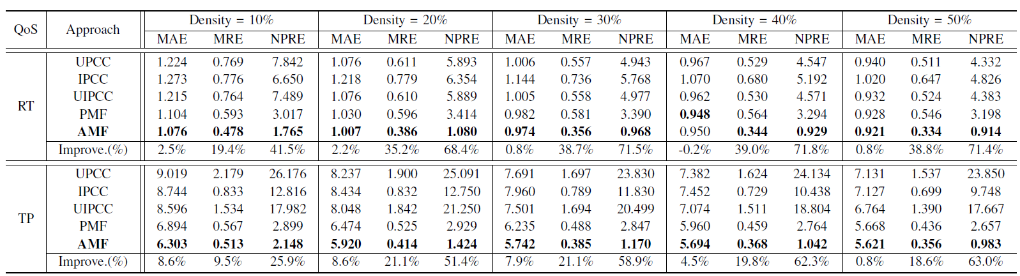
Experiments
Performance Comparison
Compared approaches:
UPCC, IPCC, UIPCC: conventional CF baselines
PMF: convectional matrix factorization approach
These approaches cannot perform online
Matrix density: means how many historical data we use

Slide 25
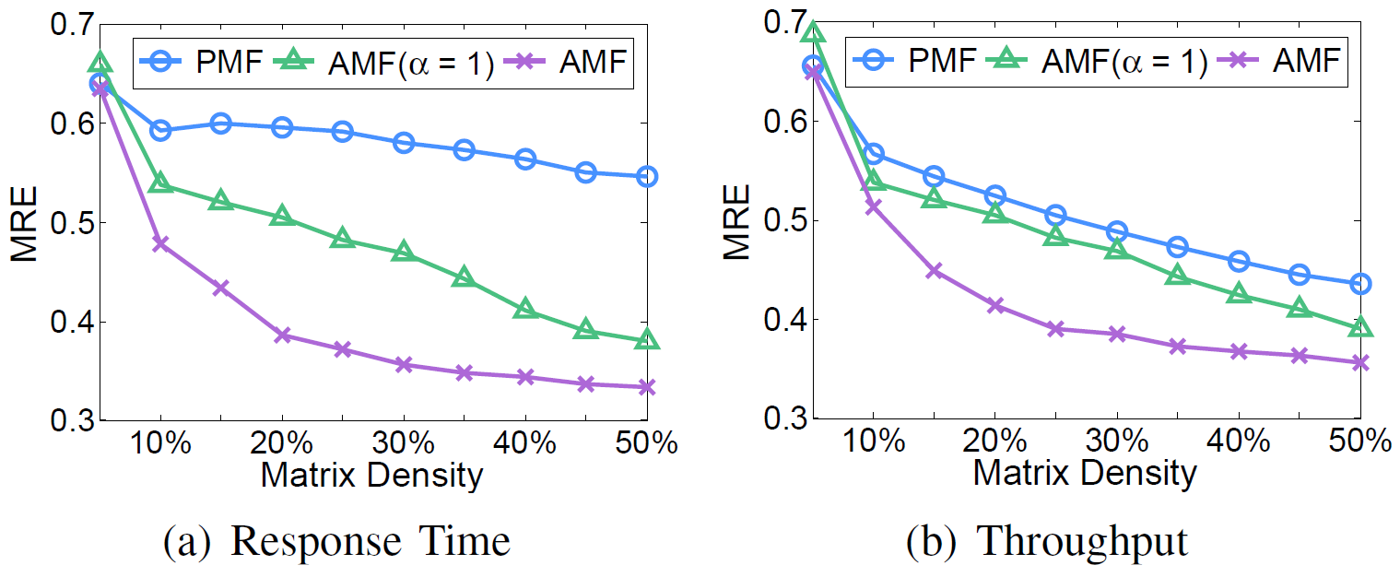

Experiments
Impact of data transformation
Compared approaches
PMF (without data transformation)
AMF($α=1,$ reduce to linear normalization)
AMF (𝛼 can be tuned automatically )

Slide 26
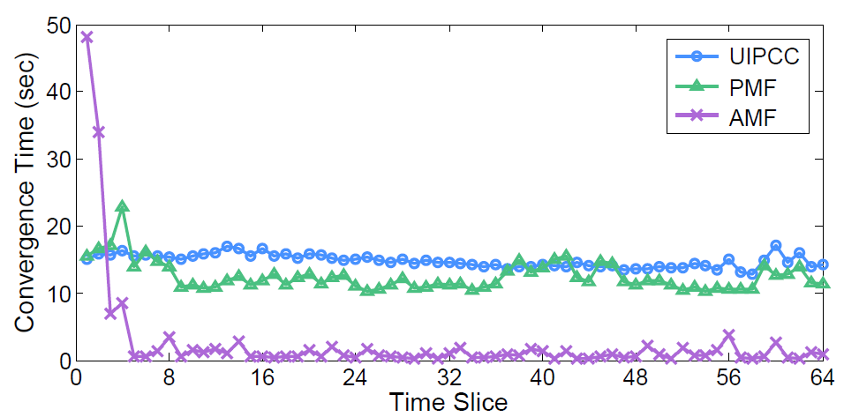
Experiments
Efficiency analysis
Compared approaches:
UIPCC
PMF
Re-train the entire model
at each time slice
AMF: continuously and incremental updating

Slide 27
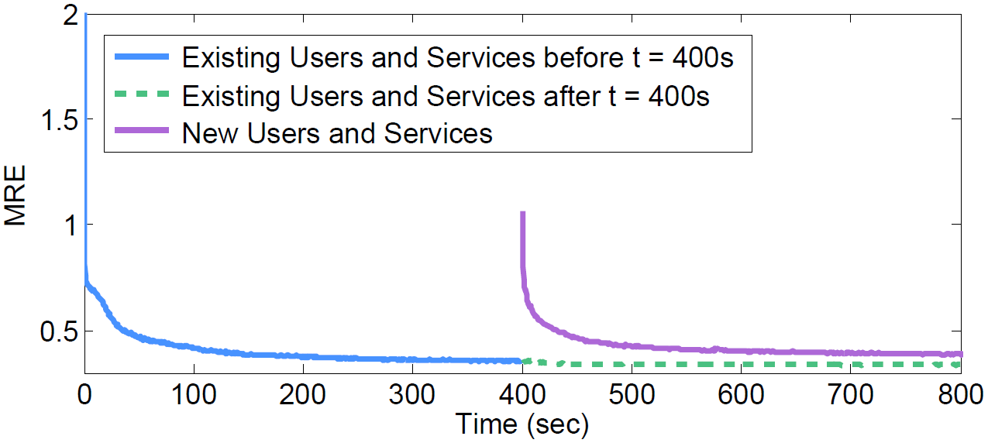
Experiments
Scalability analysis
80% of users and services at time slice 1 as existing users and services
Add the remaining 20% into the model
Robust to new users and services

Slide 28
Outline
Introduction
QoS Prediction Problem
Collaborative Filtering
Adaptive Matrix Factorization
Experiments
Conclusion & Future Work

Slide 29
Conclusions
QoS prediction for candidate services
AMF: Adaptive Matrix Factorization
Data transformation, online learning, and adaptive weights
Online, accurate, and scalable
Future work
Implement our QoS prediction approach together with service adaptation mechanisms
Real-world evaluation on case studies

Slide 30
Our data & code are available at: http://wsdream.github.io/AMF
Thank you!

