Slide 1


WSP: A Network Coordinate based Web Service Positioning Framework for Response Time Prediction
Jieming Zhu, Yu Kang, Zibin Zheng and Michael R. Lyu
The Chinese University of Hong Kong
ICWS 2012, Honolulu

Slide 2
Outline
Motivation
Related Work
WSP Framework
WSP-based Response Time Prediction
Experiments
Conclusions & Future Work

Slide 3


Motivation
Web services: computational components to build service-oriented distributed systems
Web Services Components

Slide 4
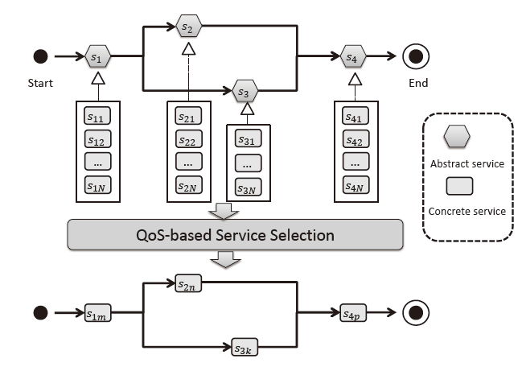

Motivation
Web service composition: build service- oriented systems using existing Web service components
How to select
Web services?

Slide 5
Motivation
Quality-of-Service (QoS)
Response time, throughput, failure probability
QoS evaluation of Web services
Service Level Agreement (SLA): static QoS
Dynamic QoS:
Network conditions
Time-varying server workload
Service users at different locations
How to evaluate the QoS from the users’ perspective?

Slide 6
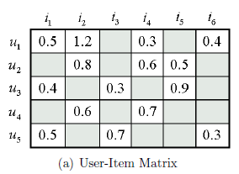
Motivation
Active QoS measurement is infeasible
The large number of Web service candidates and replicas
Time consuming and resource consuming
QoS prediction: an urgent task
Predict the unknown values

Slide 7
Outline
Motivation
Related Work
WSP Framework
Offline Coordinates Updating
Online Web Service Selection
WSP-based Response Time Prediction
Landmark Coordinate Computation
Web Service Coordinate Computation
Service User Coordinate Computation
Response Time Prediction
Experiments
Conclusions & Future Work

Slide 8
Related Work
Collaborative filtering (CF) based QoS prediction approaches
UPCC [Shao et al. 2007]
IPCC, UIPCC [Zheng et al. 2009]
Variants: RegionKNN [Chen et al. 2010], PHCF [Jiang et al. 2011]
Network coordinate (NC) based network distance prediction approaches
Triangulated Heuristic, GNP [T. S. E. Ng et al. 2002]
IDES [Mao et al. 2006]
NC Survey [Donnet et al. 2010]

Slide 9
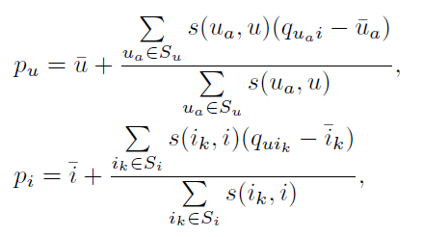
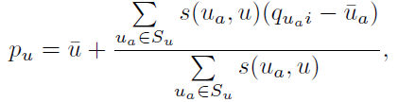
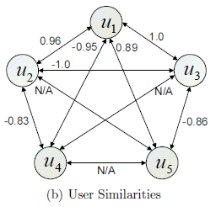
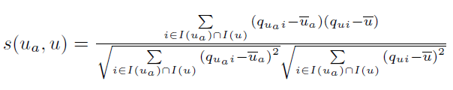


Collaborative Filtering
Collaborative filtering: using historical QoS data to predict the unknown values
PCC similarity
QoS of u_{a}
Mean of u
UPCC:
IPCC:
Mean of i_{k}
Mean of i
Similar neighbors
UIPCC:
Convex combination
Similarity between ua and u

Slide 10
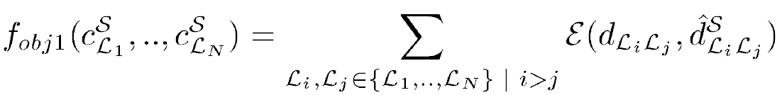
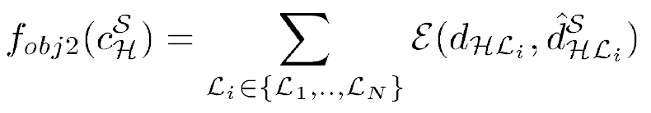
Network Coordinate
Network coordinate: take some measurements to predict the major unknown values (e.g., RTT)
GNP: embed the Internet hosts into a high dimensional Euclidean space
A Prototype of Network Coordinate System
Landmark Operation:
Sum of error
Ordinary Host Operation:

Slide 11
Limitations
CF-based QoS prediction approaches
Suffer from the sparsity of historical QoS data
Cold start problem: Incapable for handling new user without available historical data
Not applicable for mobile users
NC-based approaches
Traditional approaches in P2P scenario
Take no advantage of useful historical information

Slide 12
WSP: Web Service Positioning
Collaborative filtering (CF) employs the available historical QoS data
Network coordinate (NC) employs the reference information of landmarks
WSP: NC-based Web Service Positioning
Combine the advantages of CF and NC to achieve better performance with more available information
CF
NC
WSP
Sparsity problem
Better performance in client-server scenario
P2P scenario,
No historical Info involved

Slide 13
Outline
Motivation
Related Work
WSP Framework
Offline Coordinates Updating
Online Web Service Selection
WSP-based Response Time Prediction
Landmark Coordinate Computation
Web Service Coordinate Computation
Service User Coordinate Computation
Response Time Prediction
Experiments
Conclusions & Future Work

Slide 14
WSP Framework
WSP Framework for response time prediction
Offline Coordinates Updating
Online Response Time Prediction

Slide 15
WSP Framework
WSP Framework for response time prediction
Offline Coordinates Updating
a. The deployed landmarks measure the network distances between each other
b. Embed the landmarks into an high-dimensional Euclidean space
c. Update the landmark coordinates periodically

Slide 16
WSP Framework
WSP Framework for response time prediction
Offline Coordinates Updating
d. The landmarks monitor the available Web services with periodical invocations
e. Obtain the coordinates of Web services by taking the landmarks as references
f. Update the coordinates of Web services periodically

Slide 17
WSP Framework
WSP Framework for response time prediction
Offline Coordinates Updating
Online Response Time Prediction
a. When a service user requests for a Web service invocation, it first measures the network distances to the landmarks
b. The results are sent to a central node to compute the user’s coordinate, combining with the historical data

Slide 18
WSP Framework
WSP Framework for response time prediction
Offline Coordinates Updating
Online Response Time Prediction
c. Predict the response times by computing the corresponding Euclidean distances
d. Optimal Web service is selected for the user
e. The user invokes the selected Web service for application
f. Update the response time to the database

Slide 19
Outline
Motivation
Related Work
WSP Framework
Offline Coordinates Updating
Online Web Service Selection
WSP-based Response Time Prediction
Landmark Coordinate Computation
Web Service Coordinate Computation
Service User Coordinate Computation
Response Time Prediction
Experiments
Conclusions & Future Work

Slide 20
Response Time Prediction
Algorithm Overview
Landmark Coordinate Computation
Web Service Coordinate Computation
Service User Coordinate Computation
Response Time Prediction
Web Service Selection
Offline Coordinates Updating
Online Web Service Selection

Slide 21
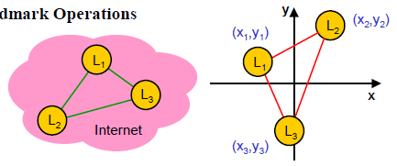
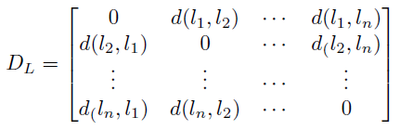
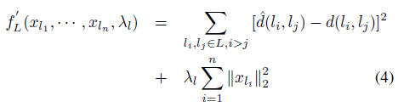

Response Time Prediction
Landmark Coordinate Computation
Landmarks
Distance Matrix between n landmarks
Min
Squared sum of prediction error
Regularization term
where
Euclidean distance
Simplex Downhill Algorithm: to solve the multi-dimensional global minimization problem

Slide 22
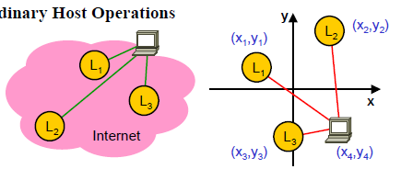
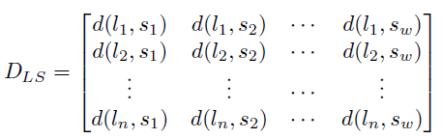

Response Time Prediction
Web Service Coordinate Computation
Web service host
Distance matrix between n landmarks and w Web service hosts
Min
Squared Sum of Error
Regularization term
The coordinates of landmarks and Web services are updated periodically!

Slide 23
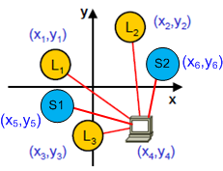
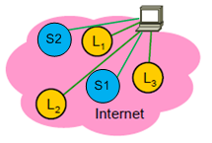

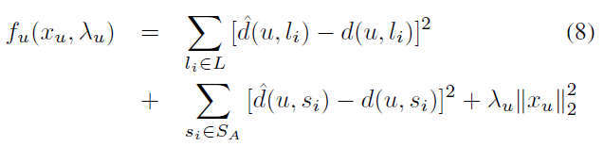
Response Time Prediction
Service User Coordinate Computation
Service user
Web service hosts
Historical data
Min
Reference information of landmarks
Available historical
data constraints
Regularization term
WSP combines the advantages of collaborative filtering based approaches and network coordinate based approaches.

Slide 24

Response Time Prediction
Response Time Prediction & WS Selection
Response time prediction:
Web service selection:
Optimal Web service selection according to the response time prediction
Selection approach: out of the scope of this work
The set of Web
services with unknown response time data
The coordinate of service user u
The coordinate of Web service s_{i}

Slide 25
Outline
Motivation
Related Work
WSP Framework
Offline Coordinates Updating
Online Web Service Selection
WSP-based Response Time Prediction
Landmark Coordinate Computation
Web Service Coordinate Computation
Service User Coordinate Computation
Response Time Prediction
Experiments
Conclusions & Future Work

Slide 26

Experiments
Data Collection
Response times between 200 users (PlanetLab nodes) and 1,597 Web services
The network distances between the 200 distributed nodes
Evaluation Metrics
MAE: to measure the average prediction accuracy
MRE (Median Relative Error): to identify the error effect of different magnitudes of prediction values
50% of the relative errors are below MRE

Slide 27
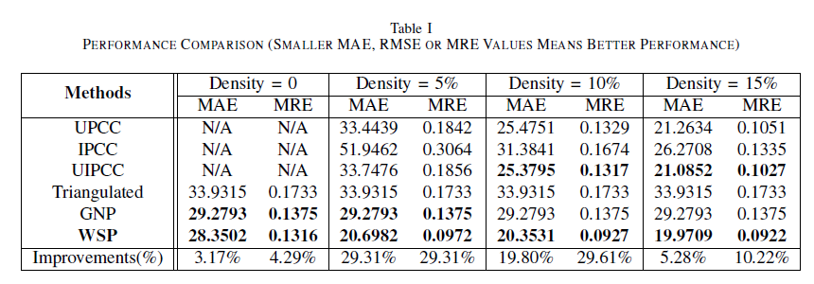
Experiments
Performance Comparison
Parameters setting: 16 Landmarks, 184 users, 1,597 Web services, coordinate dimension m=10, regularization coefficient =0.1.
Matrix density: means how many historical data we use
Take no advantage of historical data
Less sensitive to data sparsity!
WSP outperforms the others!

Slide 28
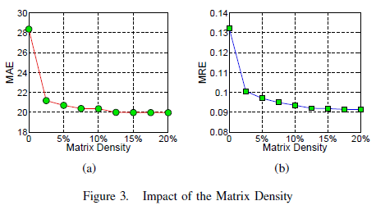
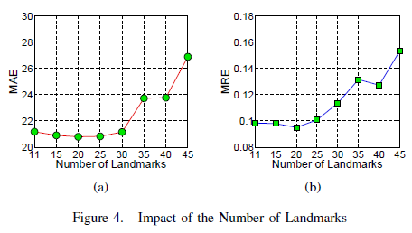
Experiments
The Impact of Parameters
The impact of matrix density:
WSP is less sensitive to the data sparsity.
The impact of number of landmarks:
Optimal landmarks can be selected to achieve best performance.

Slide 29
Conclusions & Future Work
WSP: Web service positioning framework for response time prediction
The first work to apply network coordinate technique to response time prediction for WS
Outperforms the other existing approaches, especially when the historical data is sparse.
Applicable for users without available historical data, such as mobile users.
Future Work
Extend the current work to prediction of more QoS properties
Detect and eliminate the anomalies to improve the accuracy

Slide 30
Thank you!
Q & A
Jieming Zhu
Email: jmzhu@cse.cuhk.edu.hk

