Slide 1

A Clustering-based QoS Prediction Approach for Web Service Recommendation
Jieming Zhu, Yu Kang, Zibin Zheng and Michael R. Lyu
Shenzhen, China
April 12, 2012
iVCE 2012

Slide 2
Outline
Motivation
Related Work
WS Recommendation Framework
QoS Prediction Algorithm
Landmark Clustering
QoS Value Prediction
Experiments
Conclusion & Future Work

Slide 3
Outline
Motivation
Related Work
WS Recommendation Framework
QoS Prediction Algorithm
Landmark Clustering
QoS Value Prediction
Experiments
Conclusion & Future Work

Slide 4
Motivation
Web services: computational components to build service-oriented distributed systems
To communicate between applications
To reuse existing services
Rapid development
The rising popularity of Web service
E.g. Google Map Service, Yahoo! Weather Service
Web Services take Web-applications to the Next Level

Slide 5
Motivation
Web service recommendation: Improve the performance of service-oriented system
Quality-of-Service (QoS): Non-functional performance
Response time, throughput, failure probability
Different users receive different performance
Active QoS measurement is infeasible
The large number of Web service candidates
Time consuming and resource consuming
QoS prediction: an urgent task

Slide 6
Outline
Motivation
Related Work
WS Recommendation Framework
QoS Prediction Algorithm
Landmark Clustering
QoS Value Prediction
Experiments
Conclusion & Future Work

Slide 7
Related Work
Collaborative filtering (CF) based approaches
UPCC (ICWS ’07)
IPCC, UIPCC (ICWS ’09, ICWS’10, ICWS’11)
Suffer from the sparsity of available historical QoS data
Especially run into malfunction for new users
Our approach:
A landmark-based QoS prediction framework
A clustering-based prediction algorithm

Slide 8
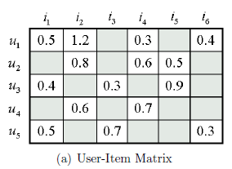
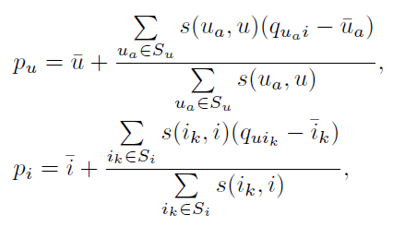
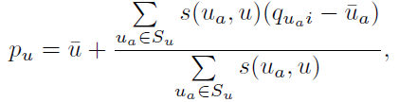
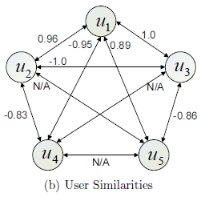

Collaborative Filtering
Collaborative filtering: using historical QoS data to predict
PCC similarity
QoS of u_{a}
Mean of u
UPCC:
IPCC:
Mean of i_{k}
Mean of i
Similar neighbors
UIPCC:
Convex combination

Slide 9
Outline
Motivation
Related Work
WS Recommendation Framework
QoS Prediction Algorithm
Landmark Clustering
QoS Value Prediction
Experiments
Conclusion & Future Work

Slide 10
WS Recommendation Framework
Web service monitoring by landmarks
The landmarks are deployed and monitor the QoS info by periodical invocations
Clustering the landmarks using the obtained data

Slide 11
WS Recommendation Framework
Service user request for WS invocation
c. The user measur-es the latencies to the landmarks
d. Cluster the user
e. Make QoS predict-ion with information of landmarks in the same cluster
f. WS recommendat-ion for users

Slide 12
Outline
Motivation
Related Work
WS Recommendation Framework
QoS Prediction Algorithm
Landmark Clustering
QoS Value Prediction
Experiments
Conclusion & Future Work

Slide 13
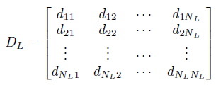
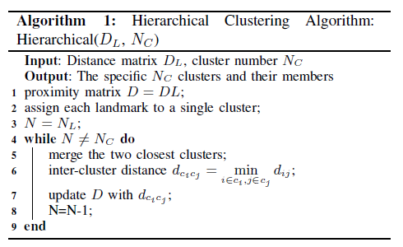
Prediction Algorithm
Landmarks Clustering
UBC： User based Clustering
The network distances between pairwise landmarks
N_{L} the number of landmarks
The clustering algorithm of landmarks

Slide 14
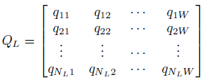
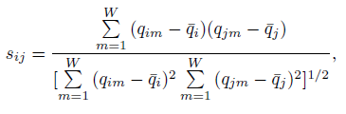


Prediction Algorithm
Landmarks Clustering
WSBC： Web Service based Clustering
The QoS values between N_{L} landmarks and W Web services
W is the number of Web services
Similarity computation between landmarks
Call hierarchical algorithm to cluster the landmarks

Slide 15
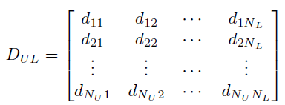
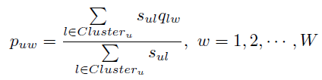
Prediction Algorithm
QoS Prediction
The network distances between N_{U} service users and N_{L} landmarks
N_{U} is the number of service users
The distances between user u and landmarks in the same cluster
Similarity between u and l
Prediction using landmark information in the same cluster

Slide 16
Outline
Motivation
Related Work
WS Recommendation Framework
QoS Prediction Algorithm
Landmark Clustering
QoS Value Prediction
Experiments
Conclusion & Future Work

Slide 17
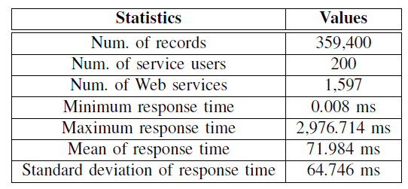
Experiments
Data Collection
The response times between 200 users (PlanetLab nodes) and 1,597 Web services
The latency time between the 200 distributed nodes

Slide 18
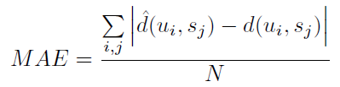
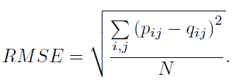

Experiments
Evaluation Metrics
MAE: to measure the average prediction accuracy
RMSE: presents the deviation of the prediction error
MRE (Median Relative Error): a key metric to identify the error effect of different magnitudes of prediction values
50% of the relative errors are below MRE

Slide 19
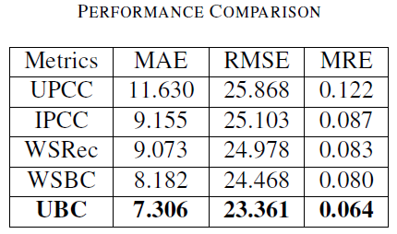
Experiments
Performance Comparison
Parameters setting: 100 Landmarks, 100 users, 1,597 Web services, Nc=50, matrix density = 50%.
WSBC & UBC: Our approaches
UBC outperforms the others!

Slide 20
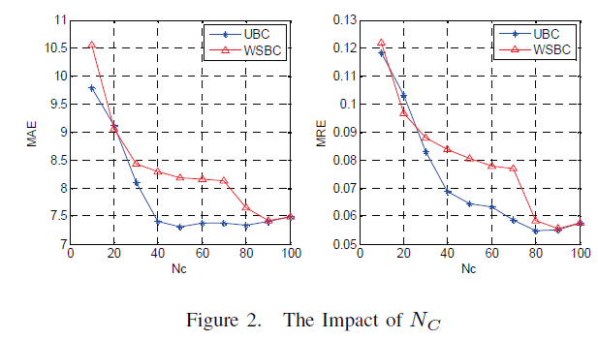
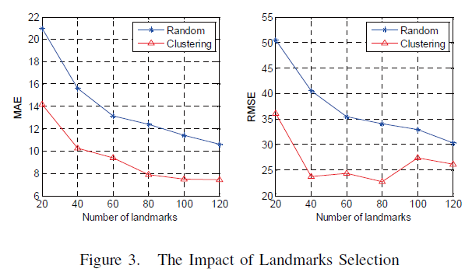
Experiments
The Impact of Parameters
The impact of Nc
The performance is sensitive to Nc. Optimal Nc is important.
The impact of landmarks selection
The landmarks deployment is important to the prediction performance improvement.

Slide 21
Conclusion & Future Work
Propose a landmark-based QoS prediction framework
Our clustering-based approaches outperform the other existing approaches
Release a large-scale Web service QoS dataset with the info between landmarks
http://www.wsdream.net
Future work:
Validate our approach by realizing the system
Apply some other approaches with landmarks to QoS prediction

Slide 22
Q & A
Thank you

