Slide 1
A Hierarchical Matrix Factorization Approach for Location-based Web Service QoS Prediction
Pinjia He, Jieming Zhu, Jianlong Xu, and
Michael R. Lyu

Slide 2
Outline
Motivation
Related Work
Framework
QoS Prediction Approach
Experiment
Conclusion & Future Work

Slide 3
Motivation

Slide 4
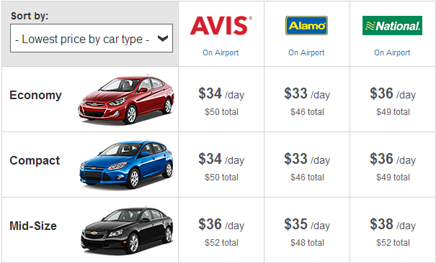
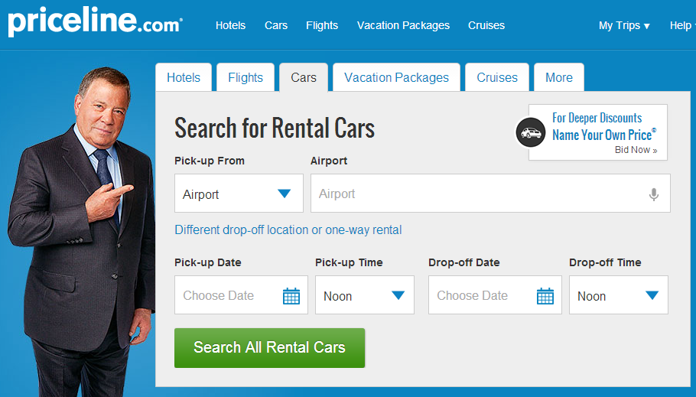


Motivation
Web service: reusable, self-describing and loosely coupled software components designed to construct complex distributed systems
Web services provided by
different companies
WS
WS
WS
WS
[http://www.priceline.com]

Slide 5

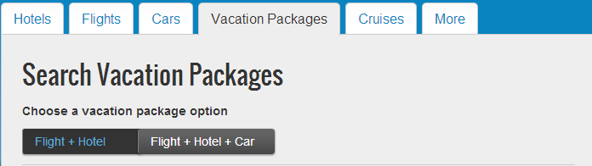
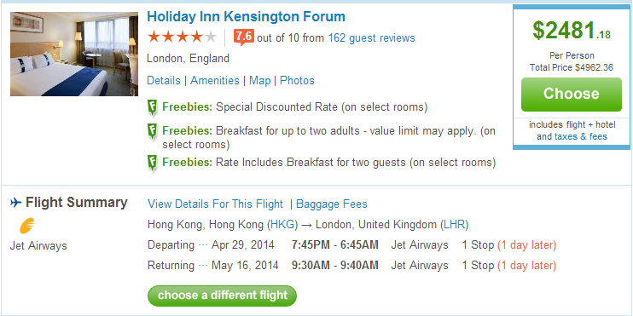
Motivation

Slide 6
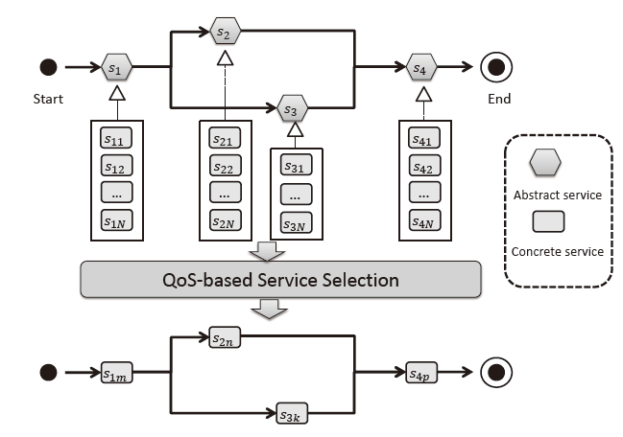

Motivation
Web service composition: build service-oriented systems using existing Web service components
How to select Web services
[Chen et al, TSMC2013]
[http://avitalks.com/archives/243]

Slide 7

Motivation
Quality-of-Service (QoS)
  Response time
  Throughput
  Failure probability
  …
Challenges
  A user has only called a few services before
  Calling all the services one by one is time consuming
  Calling some services may be
  Bring unnecessary workload to service provider
  …

Slide 8
Related Work

Slide 9
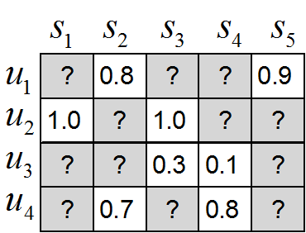
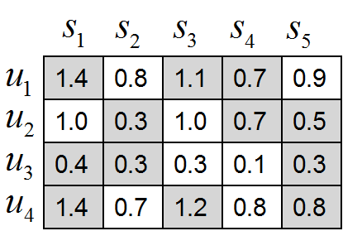
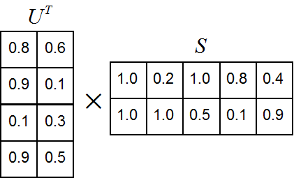

Related Work
Collaborative filtering (CF) based QoS prediction approaches
  UPCC [Shao et al. 2007]
  IPCC, UIPCC [Zheng et al. 2009]
  PMF[Salakhutdinov et al. 2007]
  Variants: LBR [Lo et al. 2012], NQoS [Shen et al. 2013]

Slide 10
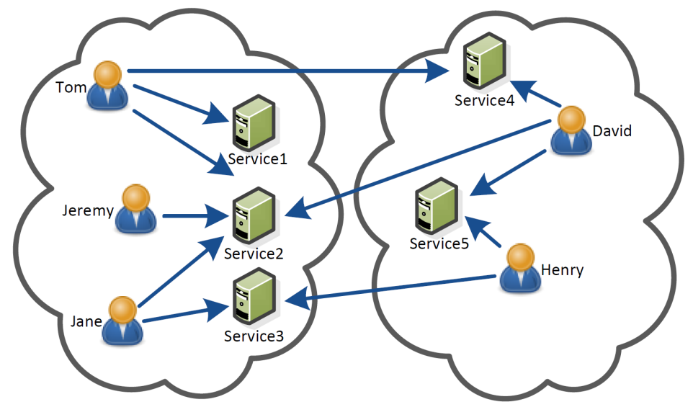

Related Work
Location information is not carefully considered
Why location?
User-service regions
Hierarchical Matrix Factorization
User
Service
Invocation

Slide 11
Framework

Slide 12
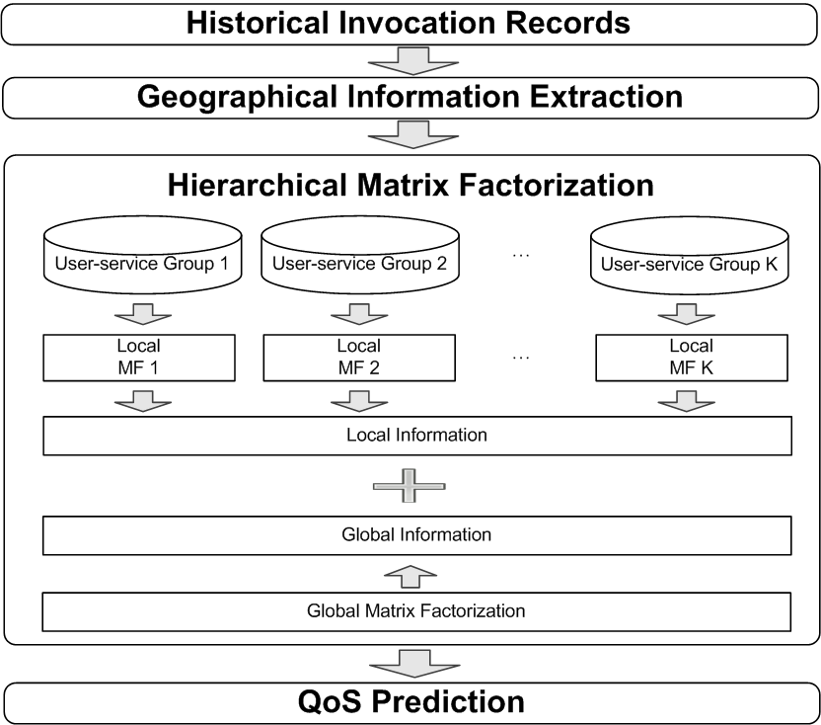
Framework

Slide 13
Approach

Slide 14

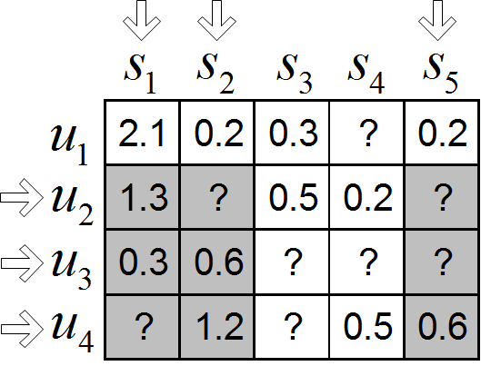
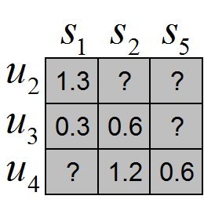
Approach
Cluster users and services into groups according to their longitude and latitude (K-means)
Form local matrices
User
Service
Invocation
Local Matrix

Slide 15

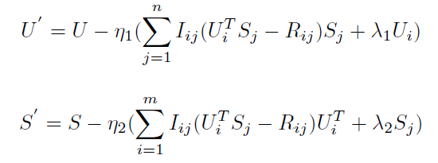

Approach
Diff. between historical records and predicted values
Minimize this value
Regularization terms
Gradient Descent
Used on global matrix and local matrices
Combine global info. & local info.

Slide 16
Experiments

Slide 17
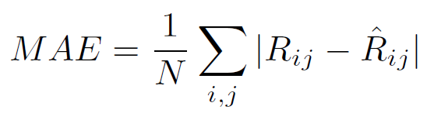
Experiments
Dataset
  Response times between 339 users (PlanetLab nodes) and 5,825 Web services
  The latitude and longitude of users as well as services
Evaluation Metrics
  MAE: to measure the average prediction accuracy
Crawl from IPLocation

Slide 18
Experiments
Performance Comparison
  Parameters setting: beta = 0.6, lambda = 50, and learning rate = 0.0002, matrix density from 10% to 30%.
  Matrix density: means how many historical data we use
Methods | Density = 10% | Density = 15% | Density = 20% | Density = 25% | Density = 30%
 | MAE | MAE | MAE | MAE | MAE
UPCC | 0.560 | 0.520 | 0.491 | 0.471 | 0.457
IPCC | 0.599 | 0.524 | 0.463 | 0.439 | 0.421
UIPCC | 0.552 | 0.500 | 0.453 | 0.431 | 0.415
PMF | 0.515 | 0.471 | 0.446 | 0.428 | 0.416
HMF | 0.508 | 0.467 | 0.442 | 0.425 | 0.413

Slide 19
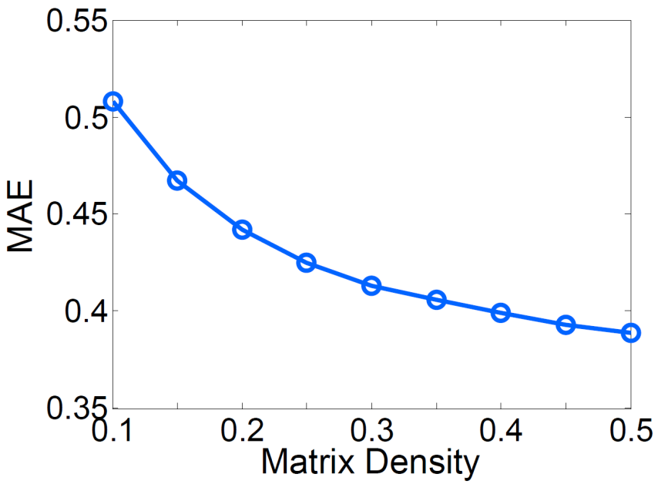
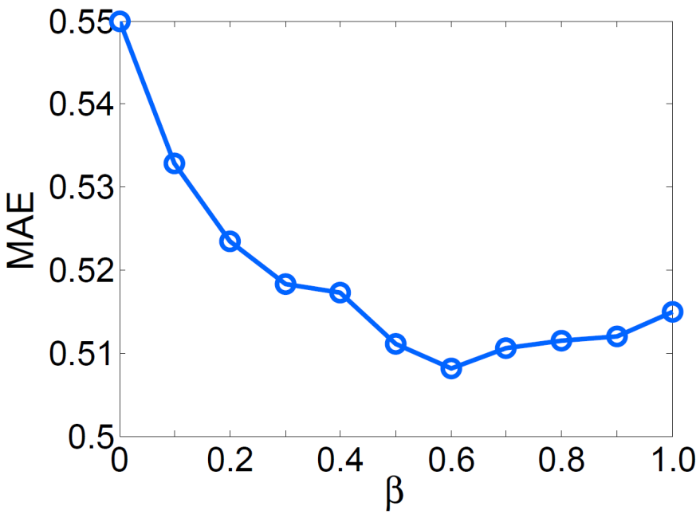
Experiments
Impact of Parameters
The impact of matrix density:
More historical records lead to better performance
The impact of beta:
Optimal value of beta can be found to achieve best performance

Slide 20
Conclusion &
Future Work

Slide 21
Conclusion
Conclusion
  Combine location information with matrix factorization approach
  Propose a hierarchical way to perform matrix factorization
  Location of users and services is collected
Future Work
  Find out some other factors except location to improve the prediction outcome
  Design a way to form groups according to historical records automatically
  Allow users and services to fall into more than one group

Slide 22
Thank You！

