Slide 1
IEEE 2nd International Congress on Big Data
June 27-July 2, 2013,
Santa Clara, USA
Service-generated Big Data and Big Data-as-a-Service: An Overview
Notes:
Abstract
Most of the APIs available to developers today have been coded for robust web server integration with little thought of incorporation into light weight mobile applications. This talk will look at the pitfalls of using these APIs directly and methods of incorporating APIs, such as Amazon, eBay, Google and other API sets into mobile and lightweight applications, while maintaining a quality user experience.
First we will review the challenges of incorporating these APIs including;
* Retrieval of large data sets
* Multiple round trip communications
* Security issues of calls
* Display of information
For each of these challenges we will show specific examples with sample functionality, API flows, and XML blocks. Some examples will include web user authentication techniques, media retrieval lists, and interface usability issues.
Once we understand the challenges of incorporating various web APIs we will then look at techniques for handling APIs properly including caching methods, large data set handling, paging, filtering, just in time techniques, information on demand and speed testing. Throughout we will look at pseudo code, and detailed examples of real life examples.
With the proper techniques mobile applications can take advantage of a wide array of third party and home grown APIs without degradation of performance, memory, and overall usability.

Slide 2
Outline
Introduction
Overview
Service-generated Big Data
  Service Trace Logs
  Service QoS Information
  Service Relationship
Big Data-as-a-Service
  Big Data Infrastructure-as-a-Service
  Big Data Platform-as-a-Service
  Big Data Analytics-as-a-Service
  Business Aspects of Big Data-as-a-Service
Conclusion & Future Work

Slide 3
Introduction

Slide 4
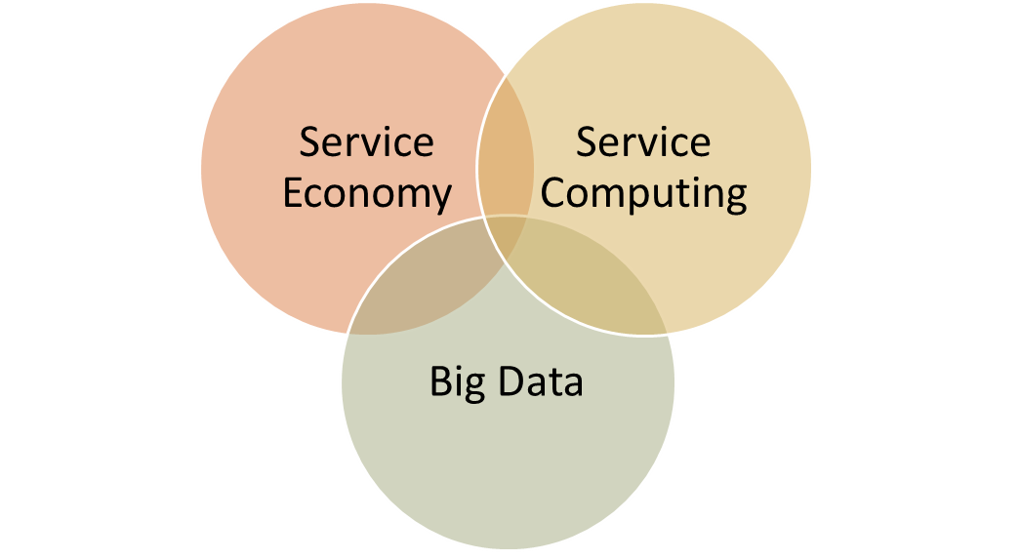
Introduction
Service and Big Data
  Service economy, service computing, big data
  Modern services
  Large number of services and service users.
  Service-generated data: too large and complex
  Takes more than 60% of the world output (World Bank)
  The percentage in developed countries exceeds 70%
  volume
  velocity
  variety
  veracity

Slide 5
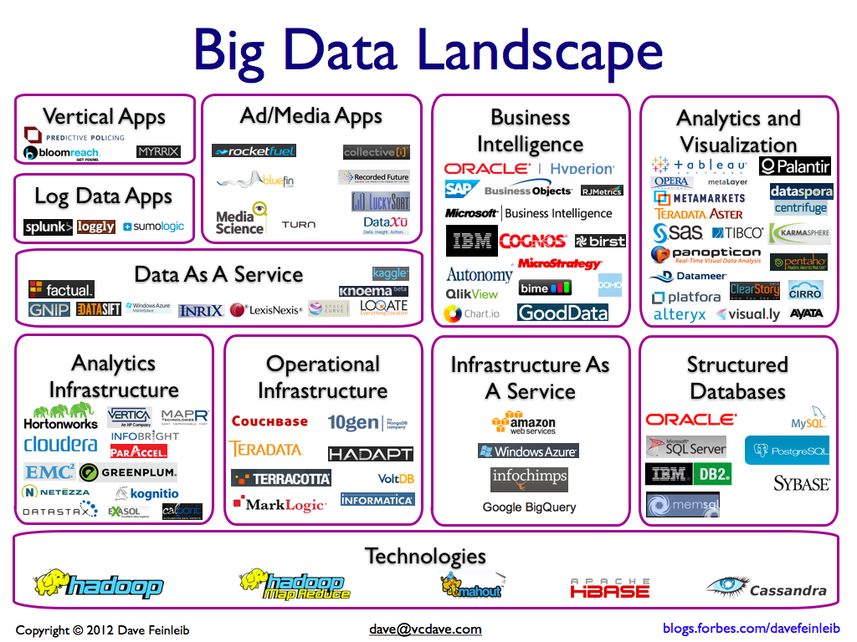
Introduction
  In March 2012, the Obama administration announced the big data research and development initiative.
  The leading IT companies, such as SAG, Oracle, IBM, Microsoft, SAP and HP, have spent more than $15 billion on buying data management and analytics software.
  This industry on its own is worth more than $100 billion.

Slide 6
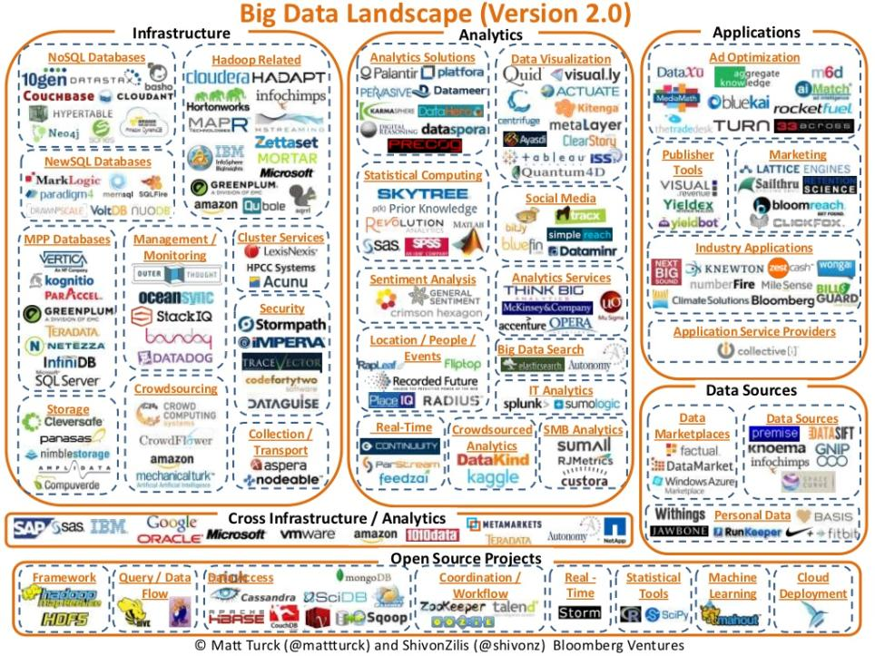
Introduction

Slide 7
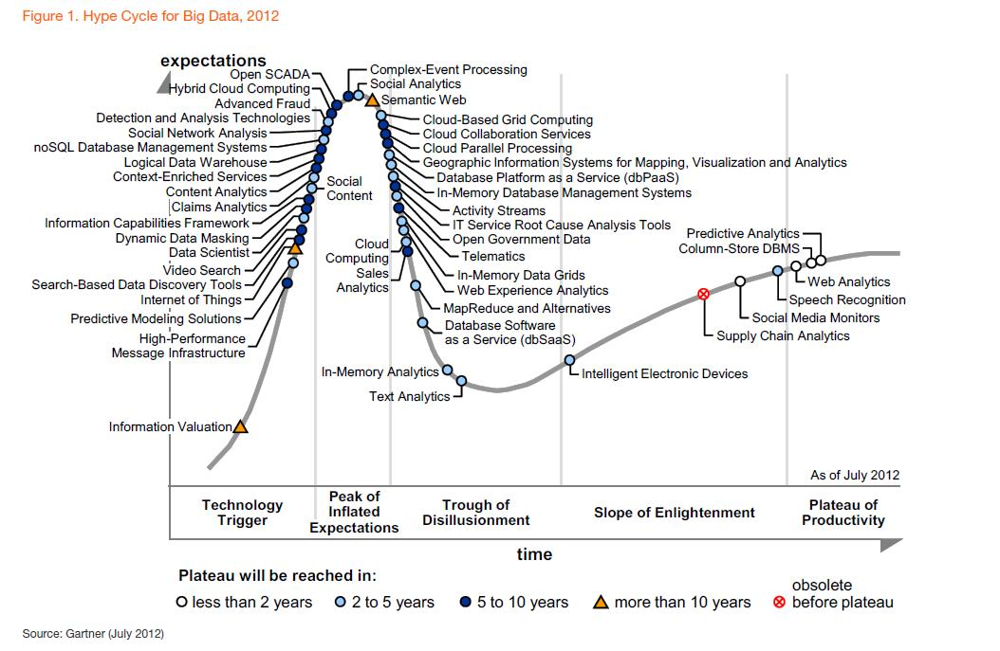
Introduction
  Growing at almost 10% a year, which is roughly twice as fast as the software business as a whole.

Slide 8


Introduction
Big data initiatives span four unique dimensions：
Volume
Velocity
Nowadays’large-scale systems are awash with ever-growing data, easily amassing terabytes or even petabytes of information
Time-sensitive processes, such as bottleneck detection and service QoS prediction, could be achieved as data stream into the system
Variety
Veracity
Structured and unstructured data are generated in various data types, making it possible to explore new insights when analyzing these data together
Detecting and correcting noisy and inconsistent data are important to conduct trustable analysis. Establishing trust in big data presents a huge challenge as the variety and number of sources grows

Slide 9

Challenge：
Service-generated Big Data
  Fast increase of system size and the associated massive volume of service-generated data
  Creating value from Service-generated Big Data
Big Data-as-a-Service
  Effective processing of big data within acceptable processing time
  Easy access of the big data and the big data analysis results

Slide 10
Overview

Slide 11
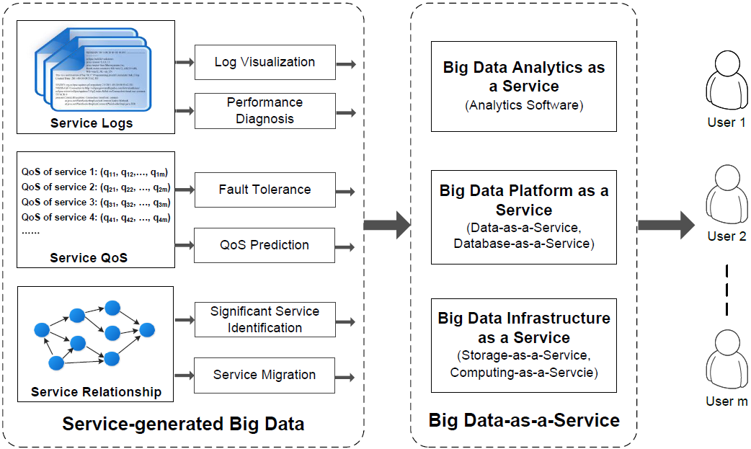
Overview

Slide 12
Service-generated Big Data

Slide 13

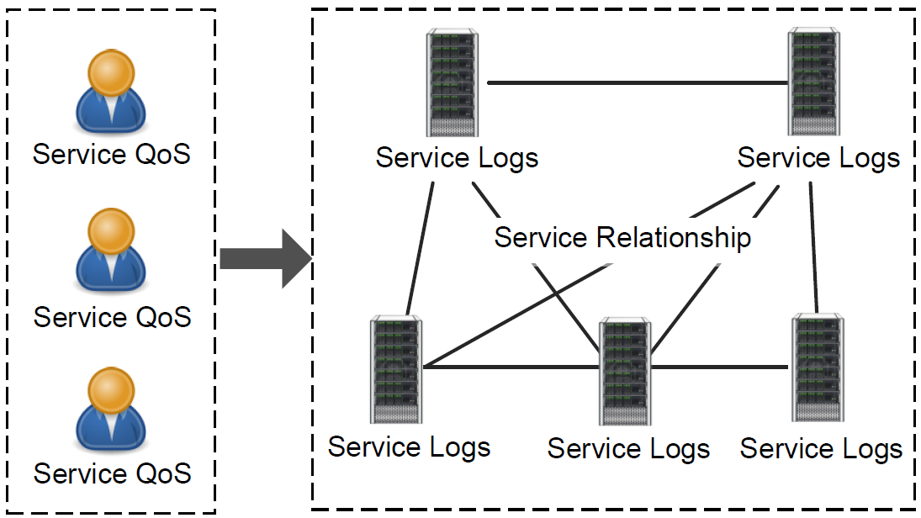

Service-generated Big Data
  send an Email
  post a microblog
  shop on e-commerce Websites
  ……
Big data generated:

Slide 14

Service-generated Big Data
How can the service generated data be processed and analyzed to enhance system performance?
Service QoS information
Service trace logs
  Large volume of QoS data are recorded in both server-side and user-side.
  The volume of user-side QoS data is much larger than that of server-side QoS data.
  QoS values of service components are changing dynamically from time to time, making the user-side service QoS information explosively increase.
  Huge volume of trace logs (Billions of daily logs, 30-50 gigabytes of tracing logs per hour)
  Difficult to manually diagnose the performance problems
Service relationship
  Involve a large number of service components
  Have complex invocation relationships.

Slide 15
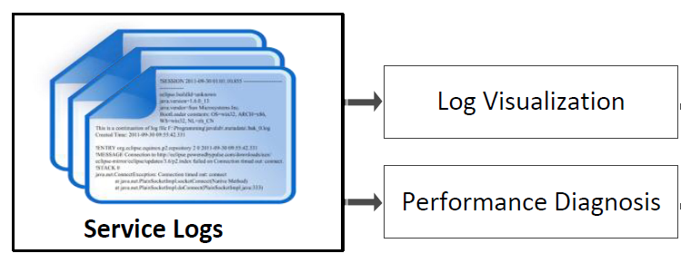


Service-generated Big Data
Service trace logs
How to investigate the trace logs to find the value?
  Log visualization provides tools for abstract visualization of log files
  Lots of previous research investigations
  More research investigations are needed to enable real-time processing and visualization
Trace log visualization
  Identify which module is the root cause
  How to exploit the tremendous trace logs effectively and efficiently
  Most previous solutions suffers from low efficiency in handling large volume of data.
  Require more efficient storage, management, and analysis approaches for service-generated trace logs
Performance problem diagnosis

Slide 16
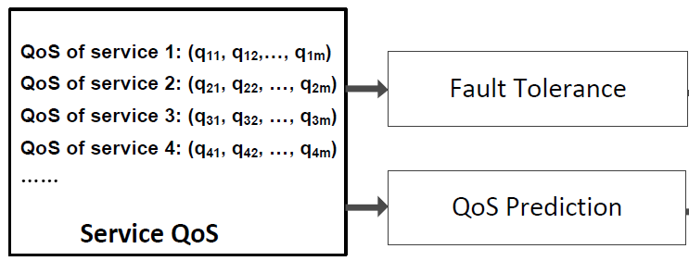


Service-generated Big Data
Service QoS information
Valuable information can be obtained through investigating these user-side service QoS information in order to enhance system performance.
Adaptive fault tolerance
QoS prediction
  Functionally-equivalent Web services can be employed to build fault-tolerant service-oriented systems.
  Server-side fault tolerance is not enough in dynamic Internet environment. Personalized user-side fault tolerance needs to be considered.
  Online learning algorithms are needed to speedup the analysis and computation of the large volume of service QoS information.
  Aims at providing personalized QoS value prediction for service users, by employing the historical QoS values of different users.
  Very challenging research problem: How to efficiently process the large volume of available service QoS data and accurately predict the missing QoS values in the huge user-service-time matrix.

Slide 17


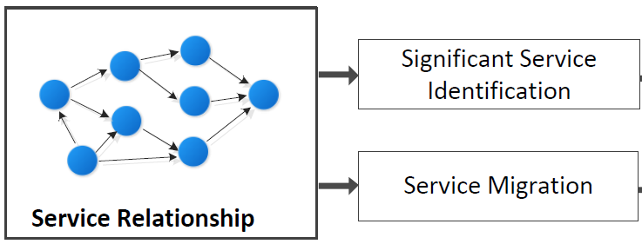
Service-generated Big Data
Service Relationship
By exploiting the service invocation graph, valuable information can be obtained by significant service component identification and service migration.
Significant service identification
Service migration
  Helps us understand how to improve the structure of a system and how to improve the reliability of the system.
  The nature of dynamic composition of service components make the service invocation graph continuously updated at runtime.
  Stochastic ranking techniques can be employed to identify the significant service component in the graph for a distributed system.
  Dynamic service migration is in need by moving the service from one physical machine to another at runtime.
  By modeling and exploiting the service invocation relationship and past service usage experiences, a proper migration of the services can improve the experience for existing users.
  To cope with the growing size of the service migration problem, more efficient approaches are needed.

Slide 18
Big Data-as-a-Service

Slide 19
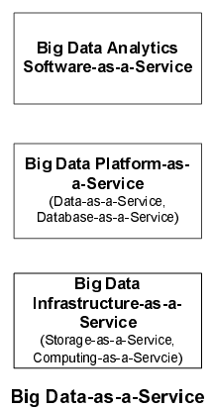
Big Data-as-a-Service
includes three layers:
Provide more advanced services.
Provides the most basic services and the higher layers provide more advanced services.

Slide 20
Big Data-as-a-Service
Big Data Infrastructure-as-a-Service
  Storage-as-a-service
  Computing-as-a-service
  To store and process the massive data
Including
  Requirement to support many different data types computing-as-a-service
  Needs to support reuse and share of the big data
Challenges
  The technologies for processing big data have to combine with data storage technology
Specialty

Slide 21
Big Data-as-a-Service
Big Data Platform-as-a-Service
  Allows users to access, analyze and build analytic applications on top of large data sets (e.g. Google’s BigQuery).
Feature
  Cloud Storage
  DaaS (Data-as-a-Service)
  DBaaS (Database-as-a-Service)
Including

Slide 22
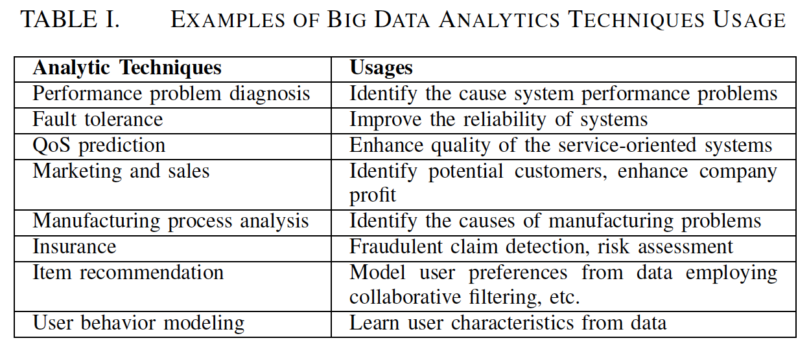
Big Data-as-a-Service
Big Data Analytics-as-a-Service
  The process of examining large amounts of data of various types to uncover hidden patterns, unknown correlations, and other valuable information.
Meaning

Slide 23
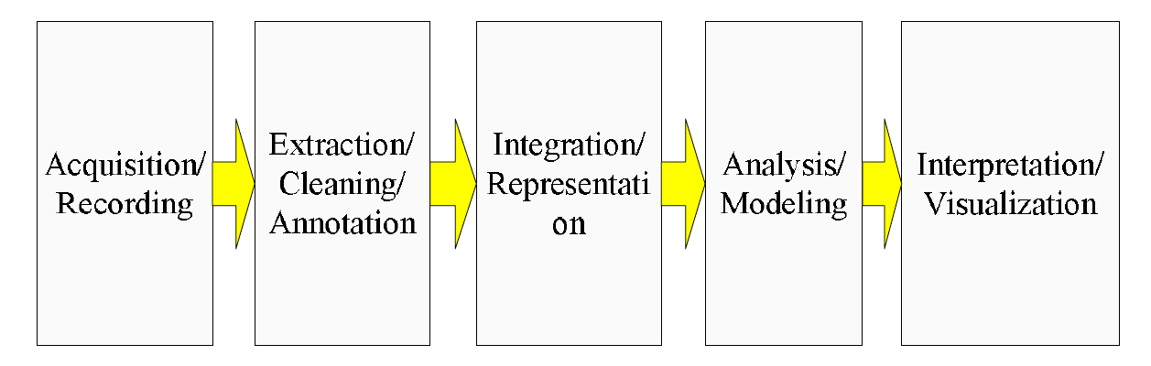

Big Data-as-a-Service
Big Data Analytics-as-a-Service
Involves
  Faster deployment
  Powerful computing and storage capacity
  Less management
  Less cost
Advantages

Slide 24

Big Data-as-a-Service
Business aspects of Big Data-as-a-Service
Divided into two types :
  The owner of big data conducts data storage, management, and analysis and provide Web APIs for users to access the service-generated big data or the analyzed results.
  The owner of big data outsources the big data processing (or part of it) to a third party. It consumes the Big Data-as-a-Service provided by third party and allows the service provider to work on it to extract values.

Slide 25
Conclusion &
Future Work

Slide 26


Conclusion
In this paper
  Three types of service-generated big data are exploited.
  Big Data-as-a-Service is investigated to provide APIs for accessing the service-generated big data and big data analytics results.
Future work
  More types of service-generated big data will be investigated.
  More comprehensive studies of various service-generated big data analytics approaches will also be conducted.

Slide 27
Thank You！

