Slide 1


Learning to Log: Helping Developers Make Informed Logging Decisions
Jieming Zhu¹, Pinjia He¹, Qiang Fu², Hongyu Zhang³,
Michael R. Lyu¹, Dongmei Zhang³
¹The Chinese University of Hong Kong, Hong Kong
²Microsoft, USA
³Microsoft Research, Beijing, China
2015/05/21

Slide 2
Outline
Motivation
Learning to Log
Evaluation
Discussion
Conclusion

Slide 3
Outline
Motivation
Learning to Log
Evaluation
Discussion
Conclusion

Slide 4
What Is Logging
What is logging?
A common programming practice to record runtime system information
Logging functions: e.g., printf, cout, writeline, etc.

Slide 5
Logging Is Important
Logs are crucial for system management
Various tasks of log analysis
Anomaly detection, failure diagnosis, etc.
The only data available for diagnosing production failures
Commercial acceptance
Vendors actively collect logs: Microsoft, VMware, etc.
Logging is important!

Slide 6

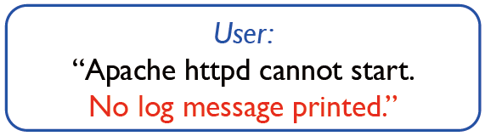
Logging Is Challenging
Challenges of logging
Logging too little
Miss valuable runtime information
Increase the difficulty for problem diagnosis
Logging too much
Additional cost of code dev. & maintenance
Runtime overhead
Producing a lot of trivial logs
Storage overhead
[Yuan et al., OSDI’12]

Slide 7
Focused Snippets
Focused snippets: potential error sites
Exception snippets: try-catch blocks
Return-value-check snippets: function-return errors
Example 1
Example 2
try {
method(…);
}
catch (IOException) {
log(…);
…
}
var res = method(…);
if (res == null) {
log(…);
…
}

Slide 8
Logging Statistics
Our previous study shows that
Only 25.3% exception snippets and 9.3% return-value-check snippets are logged [Fu et al., ICSE’14]
Developers need to make informed logging decisions on where to log!

Slide 9
Current Practice of Logging
How do developers make logging decisions in practice? [Fu et al., ICSE’14]
Lack of rigorous specifications on logging
Based on domain knowledge of developers
Q. Fu, J. Zhu, W. Hu, J-G Lou, R. Ding, Q. Lin, D. Zhang, and T. Xie, “Where Do Developers Log? An Empirical Study of Logging Practice in Industry”, in Proc. of ICSE, SEIP track, 2014.
Notes:
Such domain knowledge is seldom documented

Slide 10
Outline
Motivation
Learning to Log
Evaluation
Discussion
Conclusion

Slide 11
Learning to Log
Our proposal: learning to log
Automatically learn logging practice from existing logging instances via machine learning
Provide logging suggestions during development
Implemented as a tool “LogAdvisor”

Slide 12
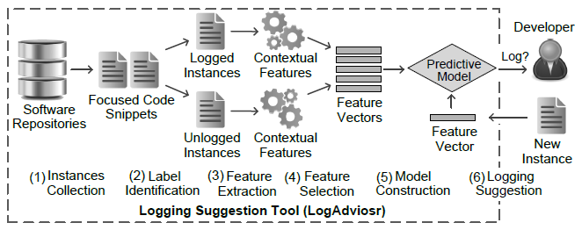
Framework
Framework of learning to log
Similar to other machine learning applications (e.g., defect prediction)

Slide 13
Feature Extraction
Contextual feature extraction
Structural features
Textual features
Syntactic features

Slide 14
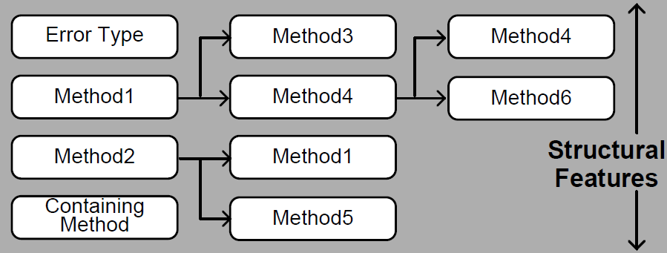
Feature Extraction 1
Structural features: structural info of code
private int LoadRulesFromAssembly (string assembly, ...){
//Code in Setting
try {
AssemblyName aname = AssemblyName.
GetAssemblyName(Path.GetFullPath (assembly));
Assembly a = Assembly.Load (aname);
}
catch (FileNotFoundException) {
Console.Error.WriteLine ("Could not load rules
From assembly '{0}'.", assembly); return 0; }
... }
}
Exception Type:
0.39 (System.IO.FileNotFoundException)
Containing method:
Gendarme.Settings.LoadRulesFromAssembly
Invoked methods:
System.IO.Path.GetFullPath,
System.Reflection.AssemblyName.GetAssemblyName,
System.Reflection.Assembly.Load
/* A code example taken from MonoDevelop (v.4.3.3), at file: * main\external\mono-tools\gendarme\console\Settings.cs,
* line: 116. Some lines are omitted for ease of presentation. */

Slide 15
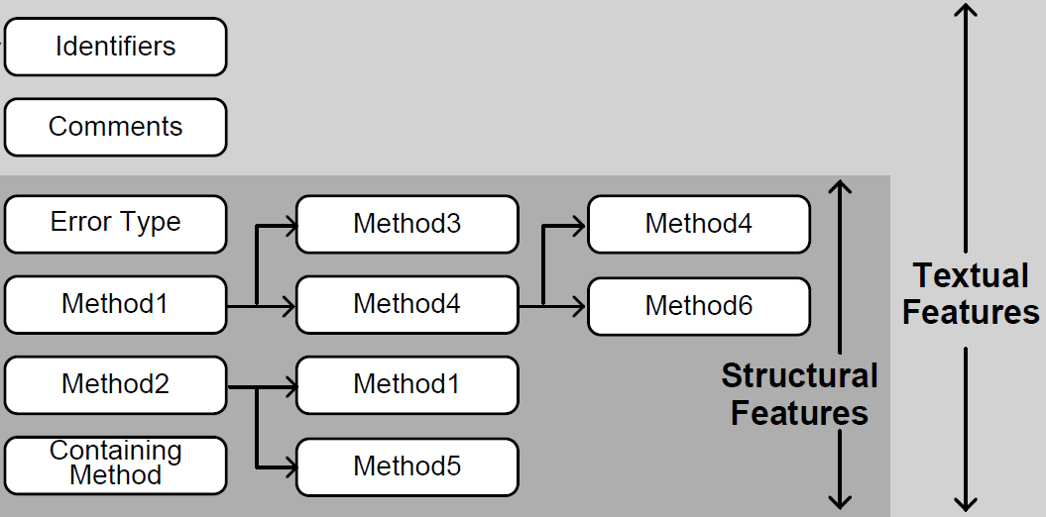
Feature Extraction 2
Textual features: code as text
private int LoadRulesFromAssembly (string assembly, ...){
//Code in Setting
try {
AssemblyName aname = AssemblyName.
GetAssemblyName(Path.GetFullPath (assembly));
Assembly a = Assembly.Load (aname);
}
catch (FileNotFoundException) {
Console.Error.WriteLine ("Could not load rules
From assembly '{0}'.", assembly); return 0; }
... }
}
Textual features:
load(2), rules(1),
assembly(7), setting(1),
name(2), aname(2),
get(2), path(1),
full(1), file(1), not(1),
found(1), exception(1)
Notes:
Only use terms in the try

Slide 16
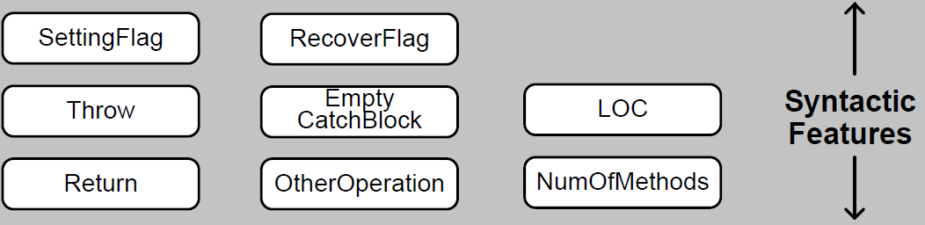
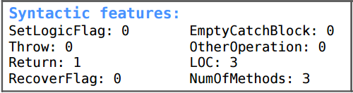
Feature Extraction 3
Syntactic Features: syntactic info of code
private int LoadRulesFromAssembly (string assembly, ...){
//Code in Setting
try {
AssemblyName aname = AssemblyName.
GetAssemblyName(Path.GetFullPath (assembly));
Assembly a = Assembly.Load (aname);
}
catch (FileNotFoundException) {
Console.Error.WriteLine ("Could not load rules
From assembly '{0}'.", assembly); return 0; }
... }
}

Slide 17
Challenges
Challenges in training data
Data noise
Data imbalance
Notes:
0.05 noise

Slide 18

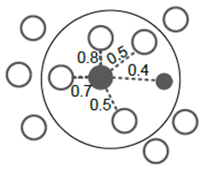
Challenge 1
Noise handling
Lack of “ground truth” on logging
Assumption: Most data instances are enclosed with good logging decisions; some are noise
Use CLNI [Kim et al., ICSE’11] to detect noise
measures the noise degree
S_{i} is the k-nearest neighbors of i, w_{ij} is the similarity between i and j
flip!
Notes:
0.05 noise

Slide 19
Challenge 2
Imbalance handling
Unlogged vs logged instances (ratio up to 50 : 1)
Unlogged instances dominate the neighborhood
Use SMOTE [Chawla et al., 2002] to balance data
Logged instance
Synthetic instance
Notes:
Use dash lines in between
Add synthetic (tuli)

Slide 20
Outline
Motivation
Learning to Log
Evaluation
Discussion
Conclusion

Slide 21
Research Questions
Four research questions
RQ1: What is the accuracy of LogAdvisor?
RQ2: What is the effect of different learning models?
RQ3: What is the effect of noise handling?
RQ4: How does LogAdvisor perform in the cross- project learning scenario?

Slide 22
Systems Under Study
Four large-scale software systems
System-A and System-B (anonymized)
Production online services from Microsoft
SharpDevelop and MonoDevelop
Open-source projects from Github
Popular C# projects
10000+ commits
10+ years of history
C# software systems, 19.1M LOC in total

Slide 23

Evaluation Setup
Ground truth: logging labels made by code owners
Metric: balanced accuracy (BA)
Within-project evaluation: 10-fold cross evaluation
Across-project evaluation: one source project for training, one target project for testing

Slide 24
Evaluation 1
Within-project evaluation
Random: randomly logging (as a new developer)
ErrLog [Yuan et al., OSDI’12]: conservatively logging all focused snippets
LogAdvisor: 0.846 ~ 0.934
Exception snippets
Return-value-check snippets

Slide 25
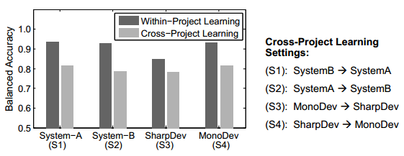
Evaluation 2
Across-project evaluation
Enrich the training data from other projects
Extract common features among these projects
E.g., system APIs, error types
BA results: above 0.8

Slide 26
Discussion
Where to log vs what to log
Potential improvements
Other factors on logging decision: e.g., code owner
Interdependency of logging points
Runtime logging

Slide 27
Outline
Motivation
Learning to Log
Evaluation
Discussion
Conclusion

Slide 28
Conclusion
We propose a “learning to log ” framework
We design and implement an automatic logging suggestion tool: LogAdvisor
We evaluate LogAdvisor on four large-scale software systems
Industrial systems and open-source systems
Within-project and across-project evaluation
Obtained promising results

Slide 29

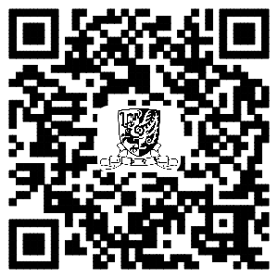
Thanks!
Code and data available:
http://cuhk-cse.github.io/LogAdvisor

Slide 30
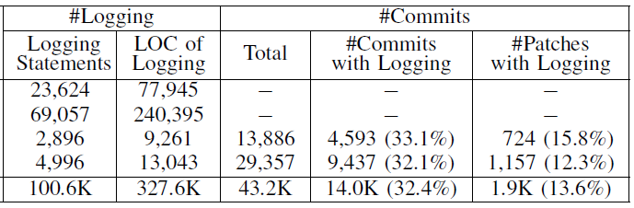
Backup: Logging Statistics
Logging statistics
327K/19.1M logging code (every 58 LOC on average)
17.4% files, 14.4% classes, 7.7% methods, 25.3% catch blocks are logged.
Logging in code maintenance: 32.4% commits, 13.6% patches contain logging modifications

Slide 31
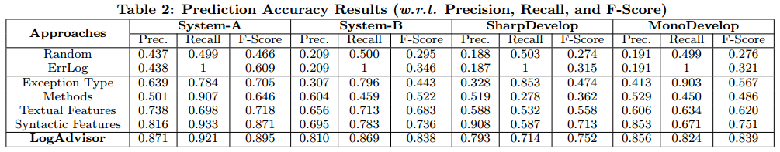
Backup: evaluation results
Other accuracy measures
Precision
Recall
F-score

Slide 32
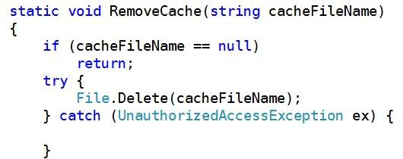


Backup: evaluation results
User study: contrast analysis
Group 1 has 25% accuracy improvements
Group 1 took 33% less time on average
70% participants think LogAdvisor is helpful
Group 1 | Group 2
With logging suggestion | W/O logging suggestion
Choice: logged √ | Choice: unlogged ×

Slide 33
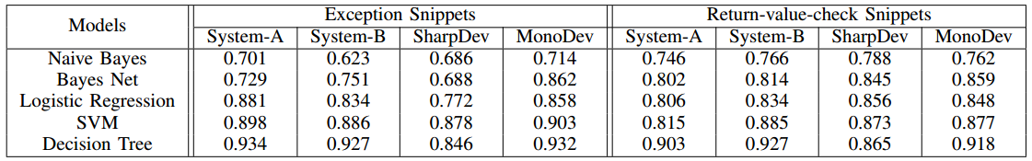
Backup: evaluation (RQ2)
The effect of different learning models
Naive Bayes
Logistic regression
SVM with linear kernel
Decision Tree
Decision tree performs best!

Slide 34

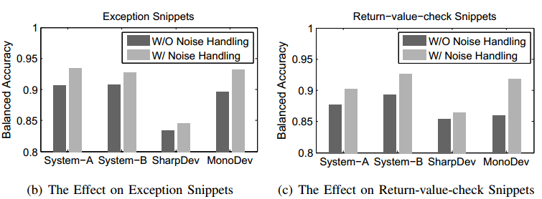
Backup: evaluation (RQ3)
The effect of noise handling
Flagging about 5% training instances as data noise with largest values
Reducing noise improves accuracy

