Slide 1
BB84 and Quantum Key Distribution
By Phan Jie Min

Slide 2
Quantum Key Distribution
Quantum Key Distribution (QKD) makes use of quantum technologies such as quantum states, single photons, or entangled particles to generate and distribute cryptographic keying material.
It is used for its security purposes, and its protocols, combined with classical authentication methods, provide confidentiality and can remain secure even against quantum computers.
The protocols are based on quantum principles, such as the no-cloning theorem.
Notes:
https://www.nsa.gov/Cybersecurity/Quantum-Key-Distribution-QKD-and-Quantum-Cryptography-QC/

Slide 3
Intro to BB84
Developed by Charles Bennett and Gilles Brassard in 1984, based on the Heisenberg’s uncertainty principle, which implies that certain pairs of physical properties cannot be known simultaneously.
It is considered one of the most prominent quantum protocols, and there are many variants of BB84.

Slide 4
Process
Alice prepares a qubits at random bits and bases to be sent to Bob.
Eve possibly intercepts and measures the photons before Bob receives the qubits.
Bob selects random bases, receives the string of qubits, measures them based on the bases.
Bob announces that bits have been received.
Alice reveals her bases.
Notes:
https://medium.com/@qcgiitr/fundamentals-of-quantum-key-distribution-bb84-b92-e91-protocols-e1373b683ead

Slide 5
Process
6. Alice and Bob compares their bases, keeping only those that are matching, while discarding whatever isn’t matching (a process also known as sifting).
7. Alice and Bob both select random bits that are publicly revealed from their matched strings and see if a certain number of them agree.
8. If they agree, they use privacy amplification techniques to the non-revealed bits to create shared keys and if they don’t the process is cancelled and they start over.
Notes:
https://medium.com/@qcgiitr/fundamentals-of-quantum-key-distribution-bb84-b92-e91-protocols-e1373b683ead

Slide 6
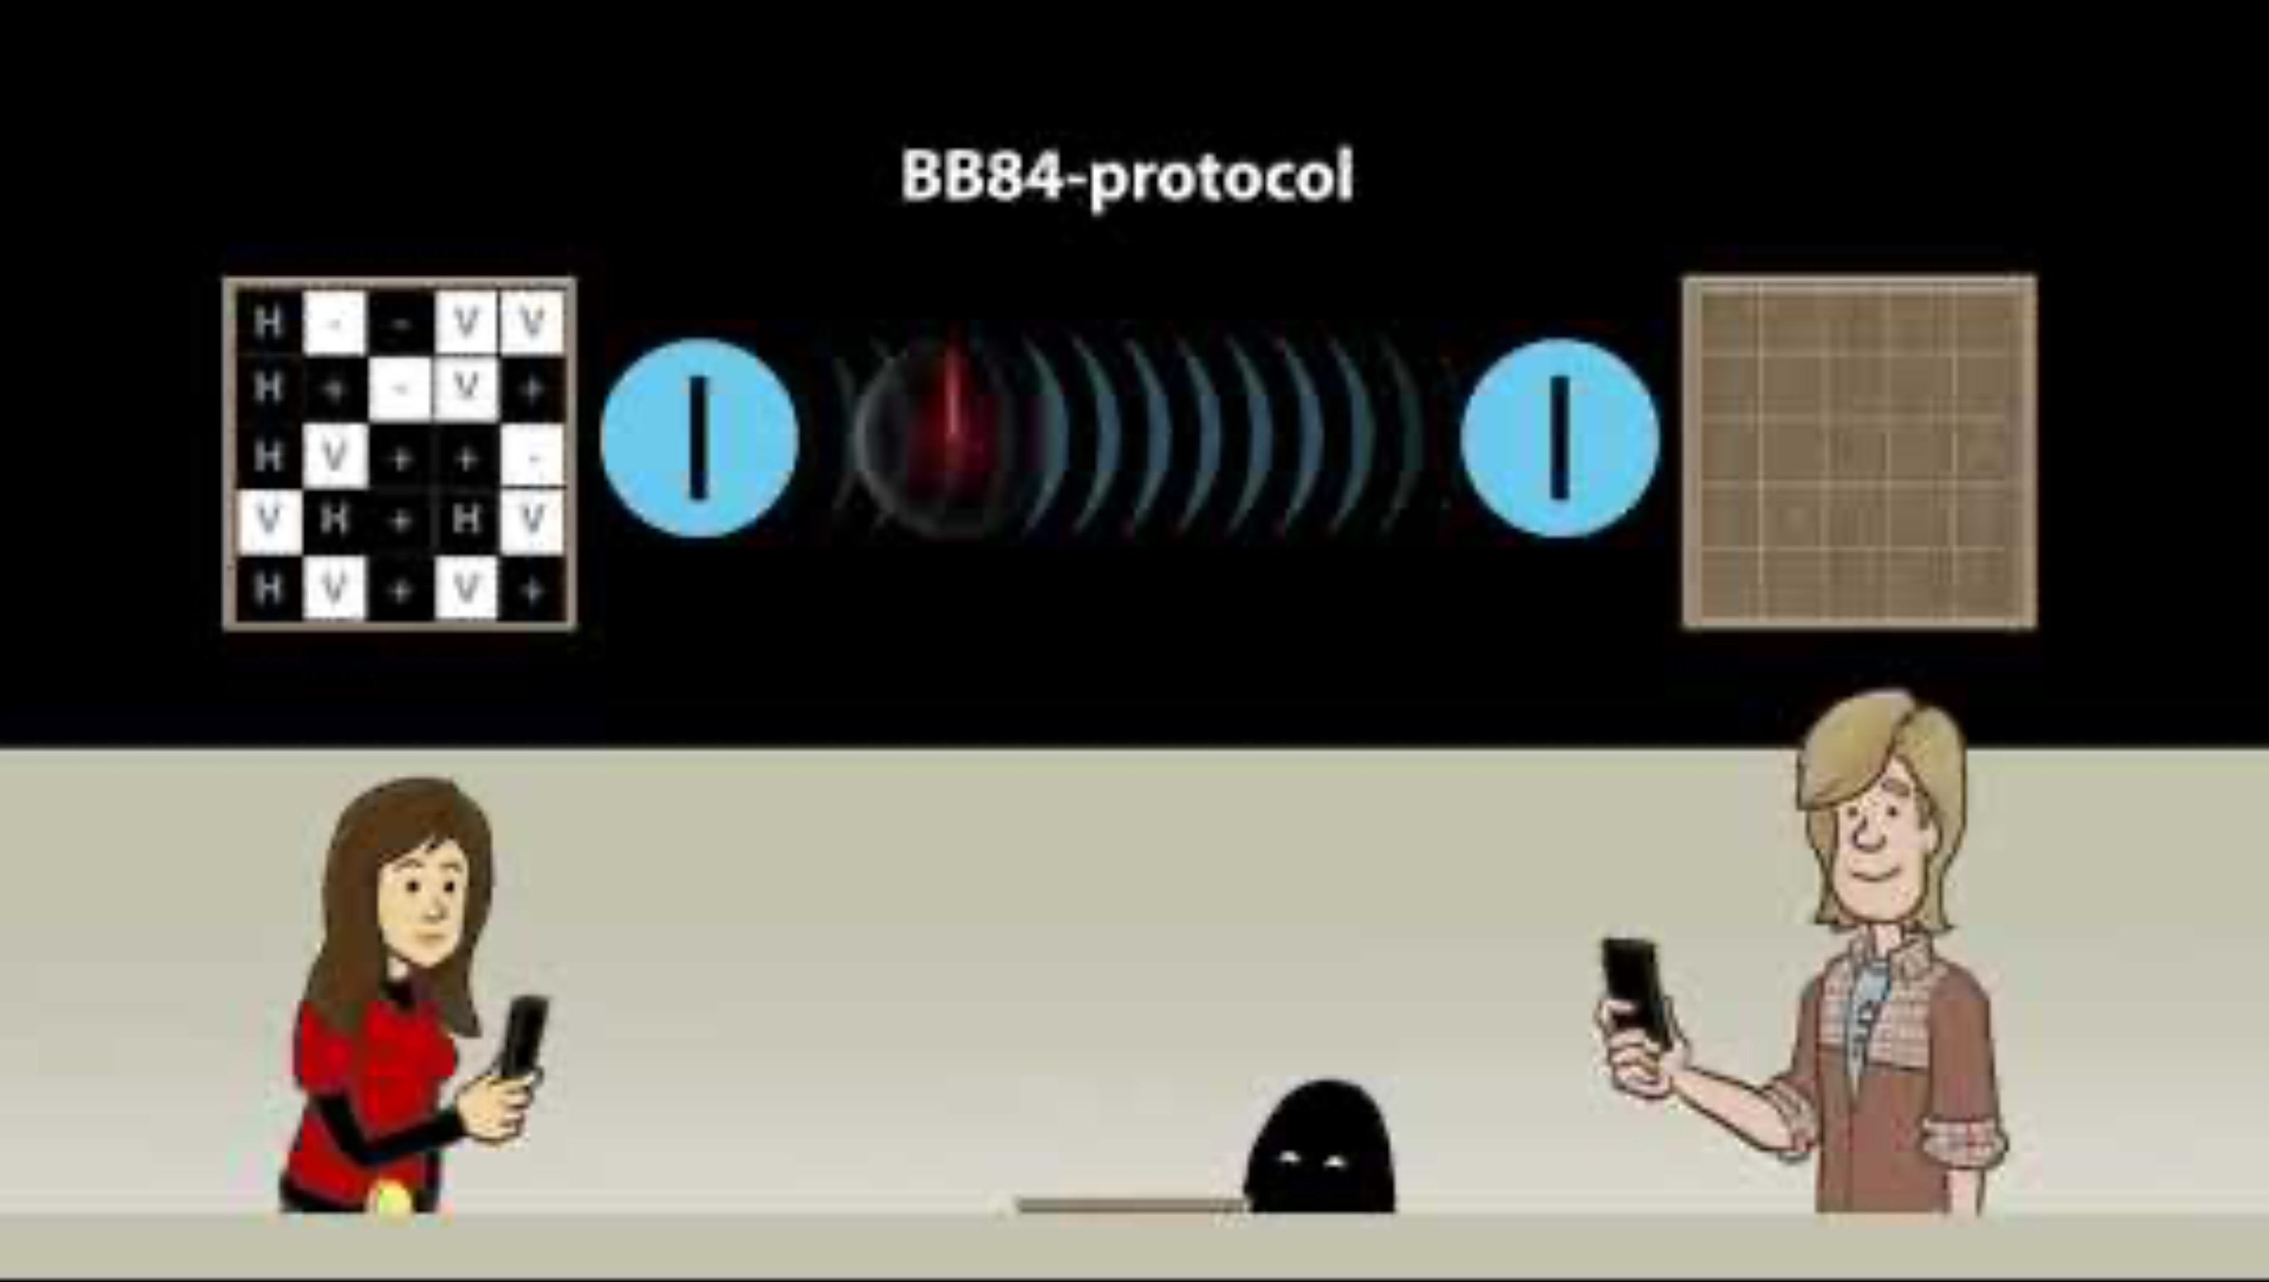
BB84 Process
Notes:
https://www.youtube.com/watch?v=2kdRuqvIaww

Slide 7
BB84 vs E91
E91 is another protocol, developed by Artur Ekert in 1991
Based on quantum entanglement where if 2 particles are entangled and one has its properties measured, they exhibit strong correlation (which is used to detect eavesdropping), regardless of the distance between the particles.
Can be more secure than BB84 as it can be made device-independent – the flaws of the hardware do not affect the performance and security of the protocol.
However, it is less efficient than BB84, as BB84 does not require entanglement - which is more resource-intensive.
Notes:
https://medium.com/sss-quantum/quantum-key-distribution-explained-bb84-b92-e91-protocols-38209d0a7dc0
https://media.neliti.com/media/publications/265683-comparison-and-analysis-of-bb84-and-e91-009f5508.pdf

Slide 8
BB84 vs B92
B92 is a variant of BB84 developed by Charles Bennett in 1992
BB84 uses 4 different polarization states while B92 uses only 2 non-orthogonal states.
B92 is less efficient than BB84 – it receives and transmits fewer bits than BB84.
However, B92 is simpler to implement – making it suitable for educational purposes as simplicity is prioritized over security.
Notes:
https://medium.com/@qcgiitr/fundamentals-of-quantum-key-distribution-bb84-b92-e91-protocols-e1373b683ead
https://www.arpnjournals.org/jeas/research_papers/rp_2020/jeas_1120_8416.pdf

Slide 9
Limitations of QKD
Requires specialized hardware
Costs are high
There are distance limitations, with QKD demonstrations reaching a few hundred kilometers and commercial QKD systems reaching up to 100 kilometers.
Increases the risk of denial service as QKD channels can be disrupted by blocking photons.
Notes:
https://cyber.gouv.fr/sites/default/files/document/Quantum_Key_Distribution_Position_Paper.pdf
https://www.nsa.gov/Cybersecurity/Quantum-Key-Distribution-QKD-and-Quantum-Cryptography-QC/

Slide 10
Conclusion and Future of QKD
As technology advances, QKD could be the norm to security infrastructures across industries
Though it involves overcoming a number of challenges, the QKD market has the potential to grow at a compound annual growth rate (CAGR) of ~20–30% over the next decade.
There will be technologically improvements, like longer distance QKD
Usage might increase especially in high-security sectors and may play a large role in quantum internet
Notes:
https://www.global.toshiba/ww/company/digitalsolution/articles/tsoul/tech/t0204.html
https://www.businessresearchinsights.com/market-reports/quantum-key-distribution-qkd-market-106645
https://www.comsoc.org/publications/ctn/quantum-key-distribution-qkd-safeguarding-future

Slide 11
Thank you

