Slide 1
Hinge (1 DOF)
Universal (2 DOFs)
Ball (3 DOFs)

Slide 2
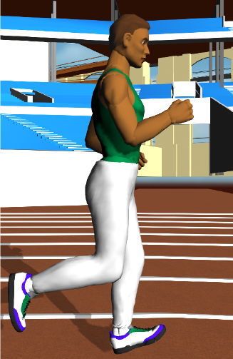

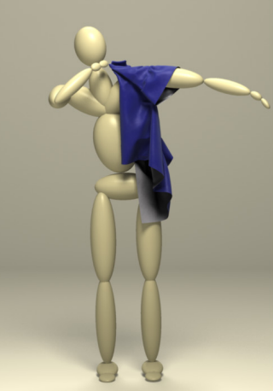
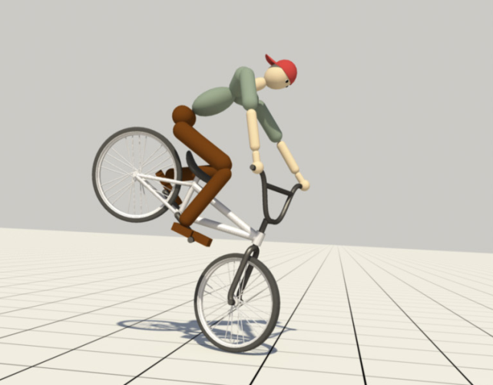
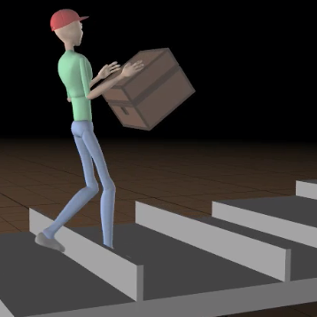
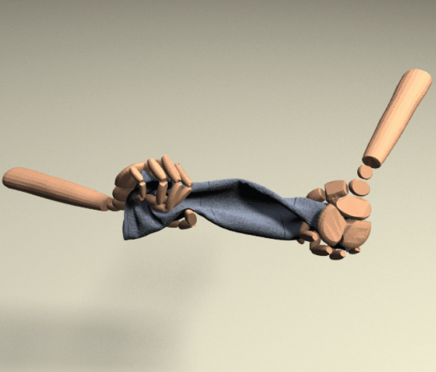

Slide 3
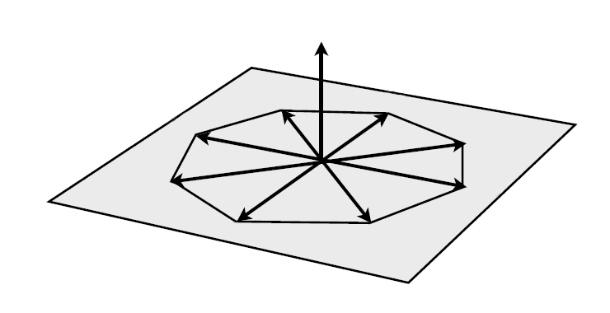
n
b₅
b₆
b₄
b₇
b₃
b₈
n
b₂
b₁
B = [b₁ … b₈]

