Slide 1
Social Network Analysis Class (Spring 2019)
Jieun Shin
Introduction
1) Introduction
2) Overview of Social Network Analysis
3) Network Data Collection & Basic Measures
4) Personal/Ego-centric Methods
Measures & Methods
5) Fundamental Network Concepts 1 (Centrality)
6) Fundamental Network Concepts 2 (Groups)
7) Fundamental Network Concepts 3 (Positions)
8) Network Level Measures
9) Exponential Random Graph Models (ERGM)
Applications
10) Diffusion & Innovations
11) Digital Media & Network
12) Presentation
13) Presentation
14) Final Project

Slide 2
Introduction
Who are you?
Why are you taking this course?
How familiar are you with R?

Slide 3
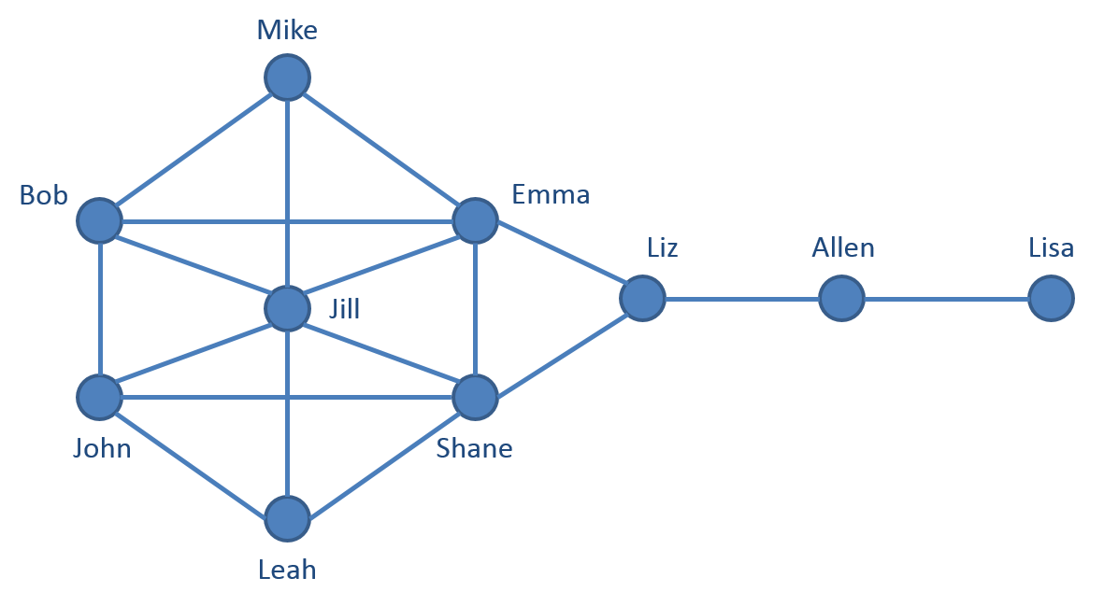
Terminology
Social networks
Networks formed by social ties
Social Networking
An activity aimed towards the creation of new ties or the maintenance of one’s social network

Slide 4
Why We Learn SNA ?
It focuses on the relationships between actors, rather than seeing actors as isolated entities.
SNA is interdisciplinary.
Digital data provides opportunities to collect network data easily.

Slide 5
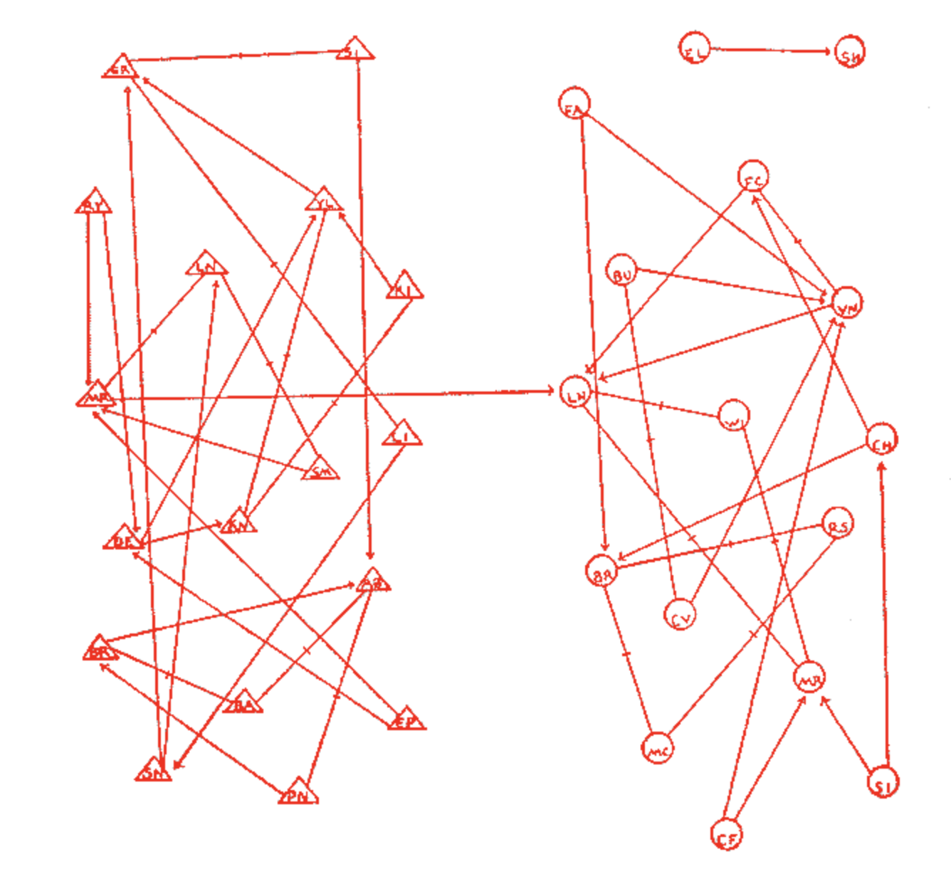
Jacob Moreno (1934): the first to operationalize a social network
Sociogram of the fourth grade
Notes:
Two girls isolated from the other students are displayed in the top right. The story goes that after their analysis Moreno und Jennings predicted that these girls would eventually run away, and so they did.

Slide 6
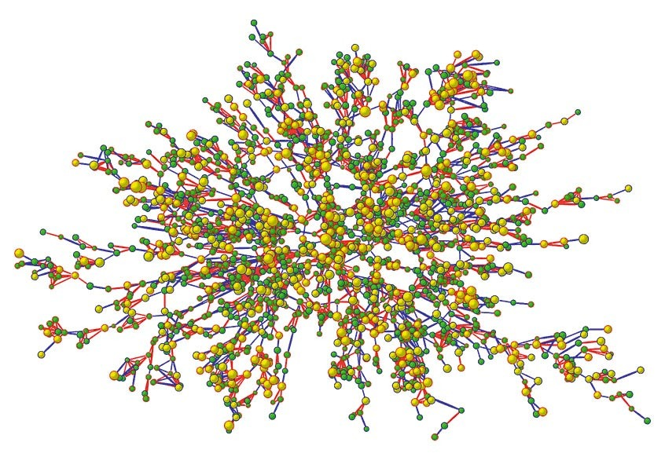
Christakis & Fowler (2007)
The spread of obesity
Notes:
https://www.ted.com/talks/nicholas_christakis_the_hidden_influence_of_social_networks?language=en

Slide 7
Syllabus
Introduction
1) Introduction
2) Overview of Social Network Analysis
3) Network Data Collection & Basic Measures
4) Personal/Ego-centric Methods
Measures & Methods
5) Fundamental Network Concepts 1 (Centrality)
6) Fundamental Network Concepts 2 (Groups)
7) Fundamental Network Concepts 3 (Positions)
8) Network Level Measures
9) Exponential Random Graph Models (ERGM)
Applications
10) Diffusion & Innovations
11) Digital Media & Network
12) Presentation
13) Presentation
14) Final Project

Slide 8
Syllabus
Course materials will be posted on GitHub
https://github.com/jieunshi/MMC6936
Your grades will include three parts
  10 lab assignments (50 points: 5 point each)
  Final presentation (10 points)
  Final Paper (40 points)
Guidelines of the final project
  Requires an extended abstract which is no longer than five-pages excluding all tables, figures, references.

Slide 9
SNA Resources
International Network of Social Network Analysis (INSNA)
www.insna.com
  Socnet list service
  Sunbelt
Journal of Social Networks
Tutorials: http://kateto.net/tutorials

Slide 10
SNA Resources at UF
Network Science Group at CTSI (Clinical & Translational Science Institute) and BEBR (Bureau of Economic & Business Research) https://www.bebr.ufl.edu/networks
Christopher McCarty: Director of BEBR
Jeffrey Johnson: Professor, Department of Anthropology
Raffaele Vacca: Research Assistant Professor, Department of Sociology and Criminology

Slide 11

Why use R ?
It’s free
 | Stata | SPSS | SAS | R
Student | $395 | $30 | $30 | Free
Business | $2090 | $5430 | Quote requested | Free

Slide 12
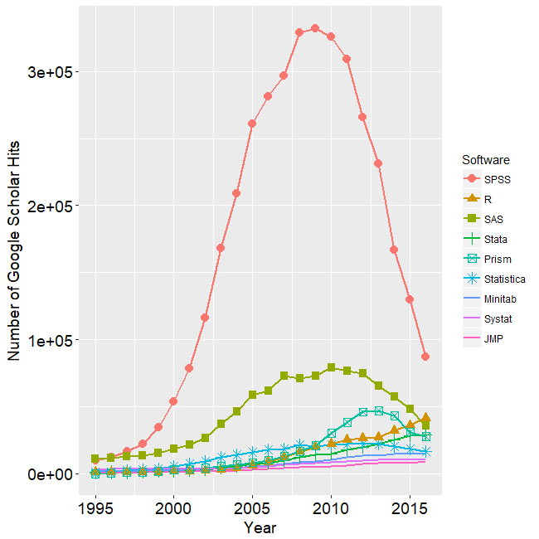
Why use R ?
It’s popular

Slide 13
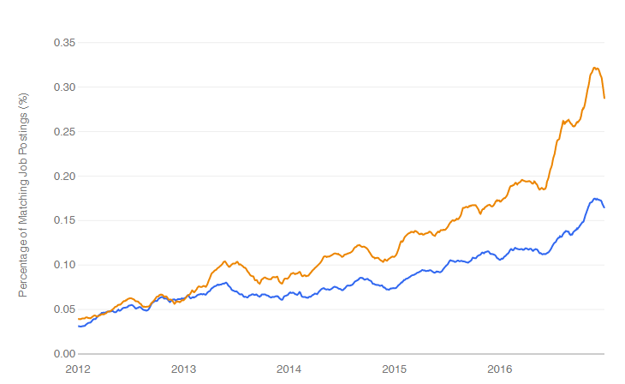
Job trends for R and Python (indeed.com)
Python
R

Slide 14
Why use R
R is flexible and powerful
  R performs a wide variety of basic to advanced statistical and graphical techniques
  R can handle complex and large data
  R can easily program complex simulations
  The most widely used tool for SNA scholars

Slide 15
Why use R
R is well supported
  Stackoverflow
  R-bloggers
  Online courses (Data Science: R Basics –edX)

Slide 16
Why use R
You can’t avoid R if your method is SNA
  Many packages are available such as network, statnet, igraph, etc

Slide 17
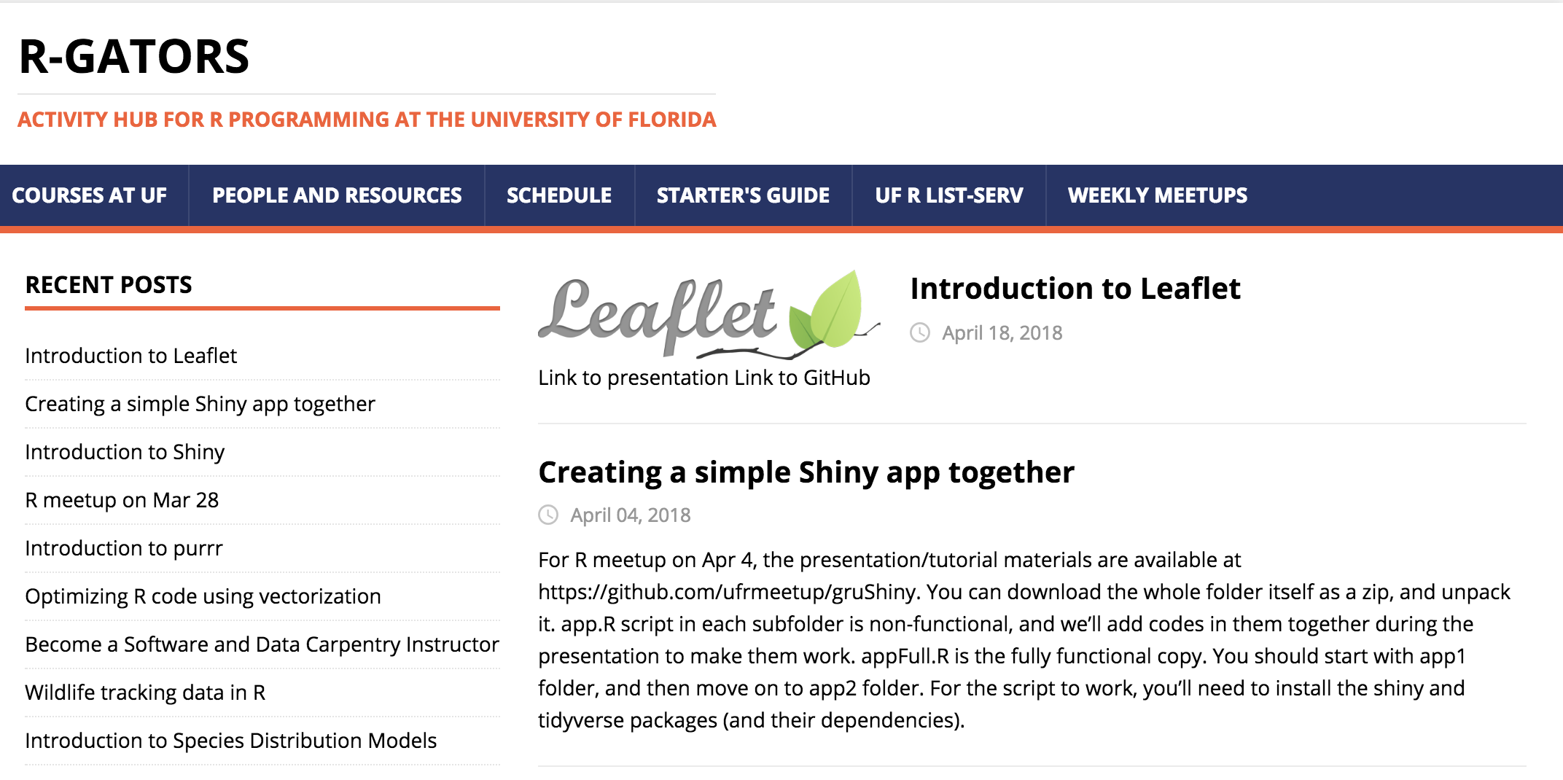
Resources at UF
R-Gators
  (Activity Hub for R Programming at UF) http://www.r-gators.com/

