Slide 1
Social Network Analysis Class (Spring 2019) Jieun Shin
Introduction
1) Introduction
2) Overview of Social Network Analysis
3) Network Data Collection & Basic Measures
4) Personal/Ego-centric Methods
Measures & Methods
5) Fundamental Network Concepts 1 (Centrality)
6) Fundamental Network Concepts 2 (Groups)
7) Fundamental Network Concepts 3 (Positions)
8) Network Level Measures (Reciprocity & Transitivity)
9) Hypothesis Testing (ERGM)
Applications
10) Diffusion & Innovations
11) Digital Media & Network
12) Presentation
13) Presentation
14) Final Project

Slide 2
ERGM : standard parameter settings
 | Parameter | Tie configuration | Description
1 | Reciprocity |  | Models the tendency for ties to be reciprocated.
2 | Popularity (k-instar) |  | Models the in-degree distribution and tendency for popularity.
3 | Expansiveness (k-outstar) |  | Models the out-degree distribution and reflects social activity or expansiveness.
4 | Transitive closure (directed k-triangles: AKT-T) |  | Models the tendency for 2-paths to close, meaning for ‘a friend of a friend to become a friend’ (i.e. shared friendship).
5 | Multiple connectivity (directed k-2paths: A2P-T) |  | Models nodes that are connected by many 2-paths; a pre-cursor to transitivity.
6 | Sender |  | Models the tendency for ties to be sent from nodes with a particular attribute (black node) to any node (white node).
7 | Receiver |  | Models the tendency for ties to be sent from any node (white node) to nodes with a particular attribute (black node).
8 | Absolute difference |  | Models the tendency for ties to be sent to nodes with similar or different scores on a continuous attribute.
Edge
- The underlying propensity to form times
- Analogous to an intercept in regression
Note. See Snijders et al. (2006) and Robins, Pattison, Wang & Handcock (2007) for additional information on model parameters.

Slide 3
MCMC
To model network dynamics, ERGMs use Markov Chain Monte Carlo (MCMC) approaches
The Markov model states that a particular network configuration is a function of that network at the prior time period.
We can generate a series of micro-steps which are small changes in the network and behavior to mimic how the data evolved from time 1 to time 2

Slide 4
Weakness of social network analysis (Winch, 2012)
Tendency to conduct studies in atypical, bounded groups for practical reasons (e.g., specialized occupational groups)
Difficult (but possible) to perform on large sample
Losing one person out of the sample can make a big difference

Slide 5
Weakness of social network analysis (Winch, 2012)
Difficult to determine direction of causality
May be difficult to interpret/give meaning to results without additional ethnographic/qualitative research
Often produces unsurprising findings
“People who have many sexual partners are at higher risk of HIV”
Can be difficult to share findings with larger audience due to terminology, matrix algebra, etc.
Can be a way to maintain control over communities, rather than empower them - “Mystification of the obvious”

Slide 6

Diffusion of Innovations (DoI)
Possibly the oldest social science theory
One of the most frequently used theories in Public Health, Communication, Marketing, Sociology, etc.
The study of how new ideas and practices spread within and between communities (Rogers, 1962, 2003)
Diffusion networks has been historically the branch of networks focused on behavior change

Slide 7
Innovation
Diffusion
The process by which an innovation is communicated through certain channels over time among the members of a social system
An idea, practice, or object that is perceived as new by an individual or other unit of adoption

Slide 8
Research questions
Why some innovations diffuse and others do not
Factors that affect how quickly innovations are adopted
- individual, group, social level
Who is likely to adopt quickly or slowly

Slide 9
Diffusion of Innovations
External sources + Internal sources
New ideas and practices originate or enter communities from some external source (e.g., mass media, cosmopolitan contact, technical shifts).
Adoption of the new idea or practice then flows through interpersonal contact networks.

Slide 10
Elements of the diffusion of innovation
The rate of diffusion is influenced by the perceived characteristics of the innovation such as its relative advantage, compatibility, observability, trialability and complexity
Diffusion occurs over time such that the rate of adoption often yields a cumulative adoption S-shaped pattern.
3) Individuals can be classified as early or late adopters.
4) Individuals pass through stages during the adoption process typically classified as (1) knowledge, (2) persuasion, (3) decision, (4) implementation or trial, and (5) confirmation.
10
Notes:
10

Slide 11
Characteristics of an Innovation
Relative advantage: Is it better than what is used currently ? (e.g., Android vs. iOS)
Compatibility : Does it fit with values and needs of potential adopters ? (e.g., use of condom)
Complexity: How difficult is it to understand and use? (e.g., programming language)
Trialability: Can people try it out before deciding to adopt it? (e.g., perfume)
Observability: Can the benefits be readily observed? (e.g., bike helmets)
11
Notes:
11

Slide 12
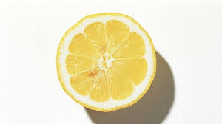
A nutritional intervention that diffused slowly
1601 : Captain Lancaster tests lemon juice (Vitamin C) as treatment for scurvy in sailors
- 1 intervention and 3 comparison ships sailing from England to India
- 100 deaths of 278 sailors vs 0 deaths on intervention ships
1865 : British board of Trade adopts lemon juice for the merchant marine

Slide 13
Hypothetical Cumulative and Incidence Adoption Curves for Diffusion Homogenous Mixing
The S-shaped of the cumulative curve
The bell-shaped of the curve
13
Notes:
13

Slide 14
The Diffusion of Knowledge, Attitudes and Practices (KAP)
14
Notes:
14

Slide 15
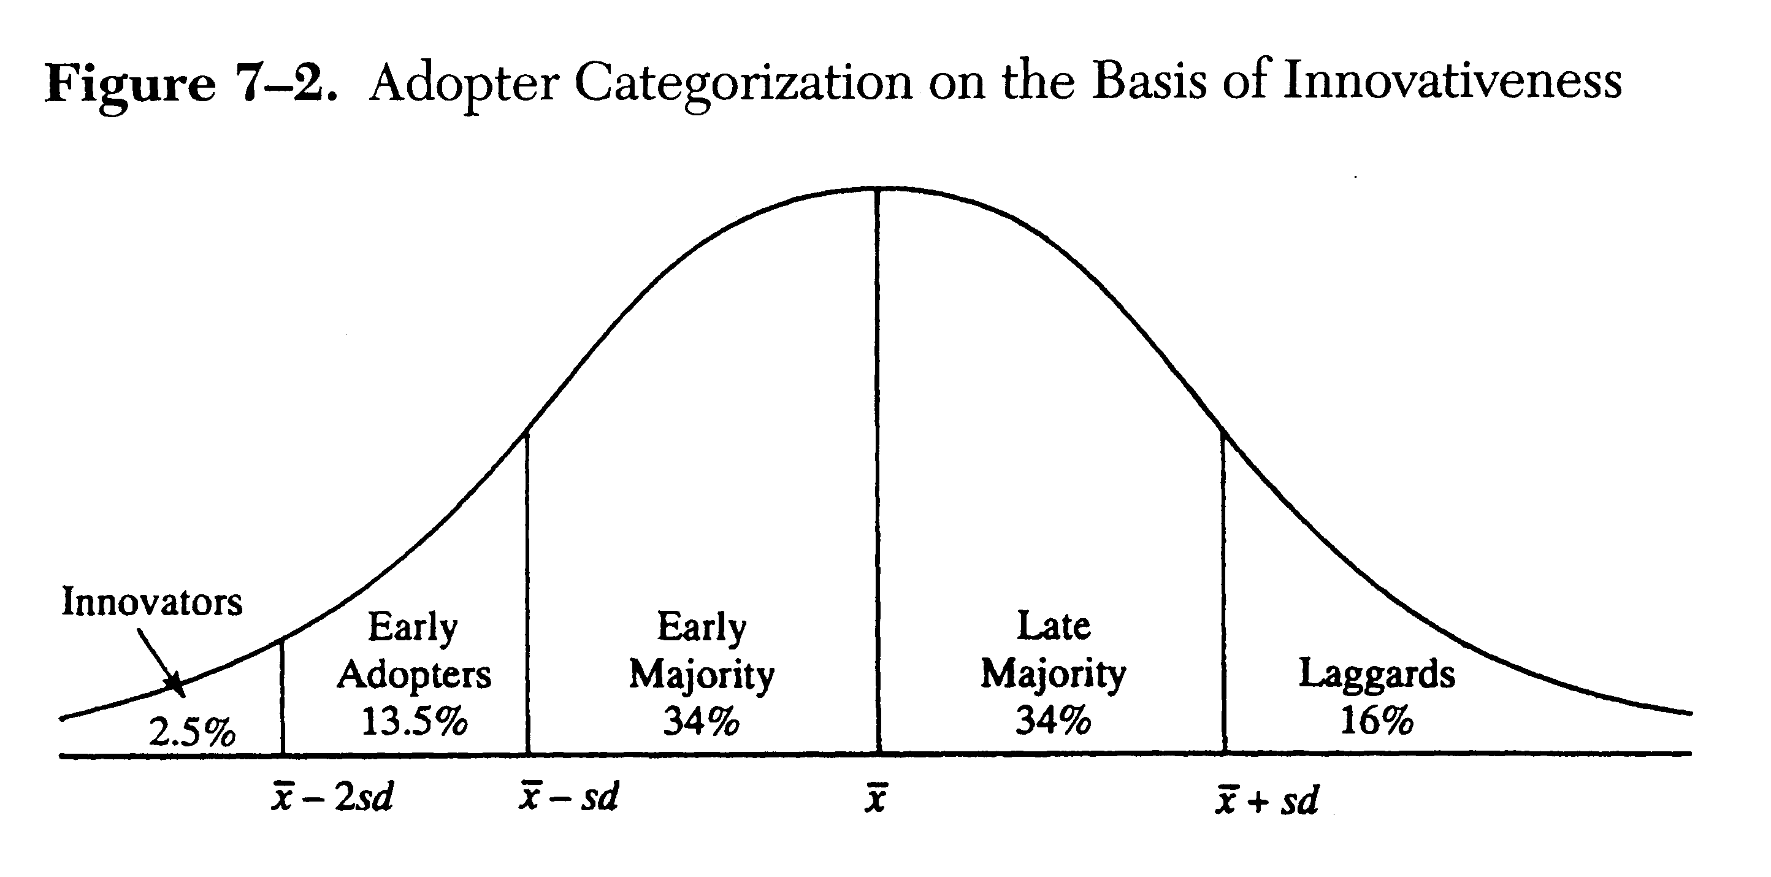
Adoption Profile
Tipping point
; critical mass
; chasm
venturesome
respect
deliberate
skeptical
traditional
15
Notes:
Once critical mass is activated, the remainder of the population subsequently activates as well
15

Slide 16
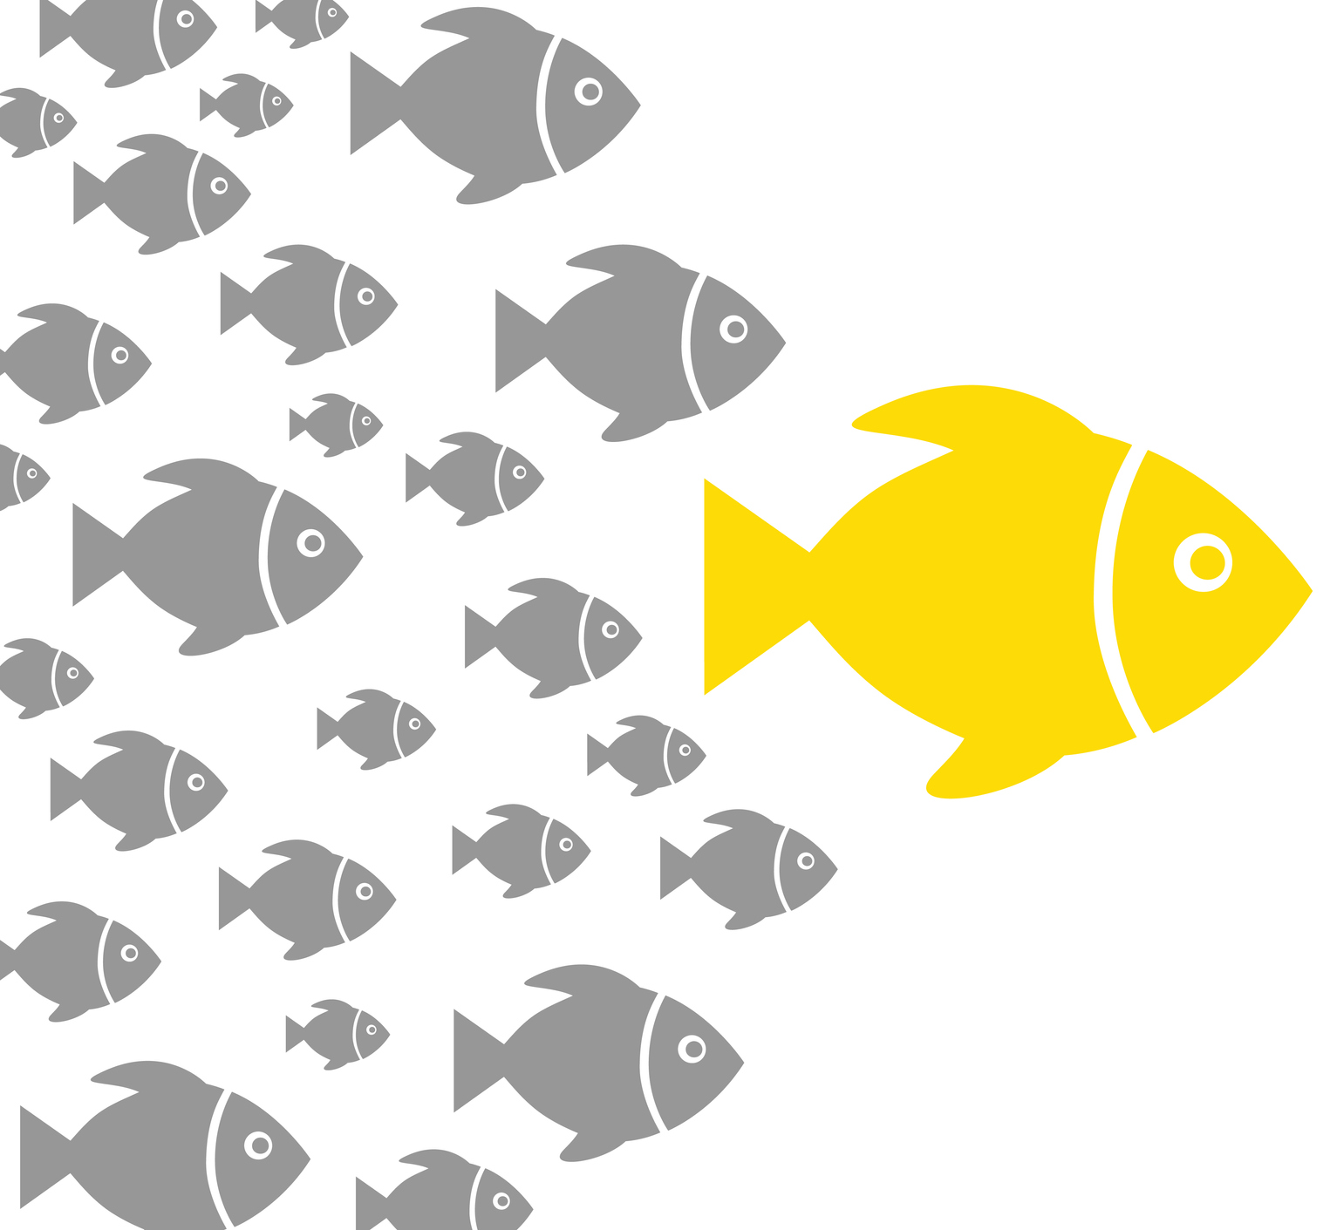
Characteristics of Opinion Leaders (OL)
External communication
- greater exposure to mass media
- two step flow hypothesis
Accessibility
- extensive interpersonal network links
- socially accessible
Socio-economic status
- A follower typically seeks an opinion leader of somewhat higher status
Innovativeness
- tend to be more innovative than their followers .. ?

Slide 17
10 Methods Used to Identify Peer Opinion Leaders
Method | Technique
1. Celebrities | Program recruits well-known people to promote behavior.
2. Self-selection | Staff requests volunteers in-person or via mass media and those who volunteer are selected.
3. Self-identification | Surveys are administered to the sample, and questions measuring leadership are included. Those scoring highest on leadership scales are selected.
4. Staff selected | Program implementers select leaders from those whom they know.
5. Positional Approach | Persons who occupy leadership positions such as clergy, elected officials, media and business elites, and so on are selected.
6. Judge’s Ratings | Persons who are knowledgeable identify leaders to be selected.
7. Expert Identification | Trained ethnographers study communities to select leaders.
8. Snowball method | Index cases provide nominations of leaders or are in turn interviewed until no new leaders are identified.
9. Sample Sociometric | Randomly selected respondents nominate leaders and those receiving frequent nominations are selected.
10. Sociometric | All (or most) respondents are interviewed and those receiving frequent nominations are selected.

Slide 18
Sociometric v. Self Reported OL
Correlated at approximately 0.43 (p<0.01)
Self reported OLs less susceptible to peer influence
Sociometric OLs no more or less susceptible

Slide 19
Example of Diffusion
19
Notes:
19

Slide 20
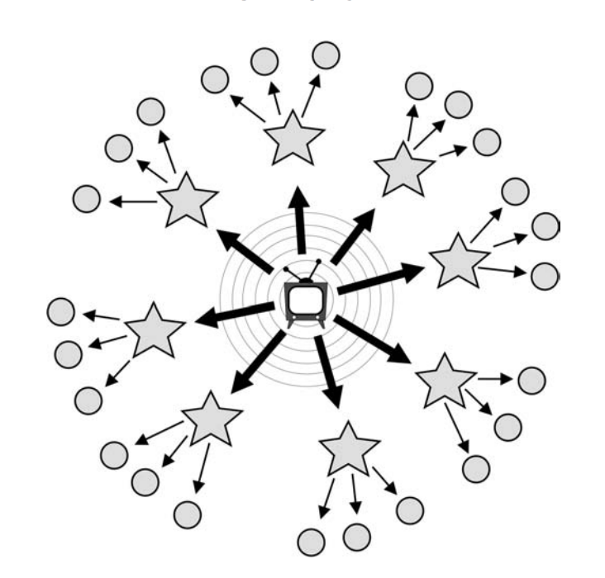
The two-step flow of communication (Katz & Lazarsfeld, 1955)
Opinion leaders
(influentials)

Slide 21
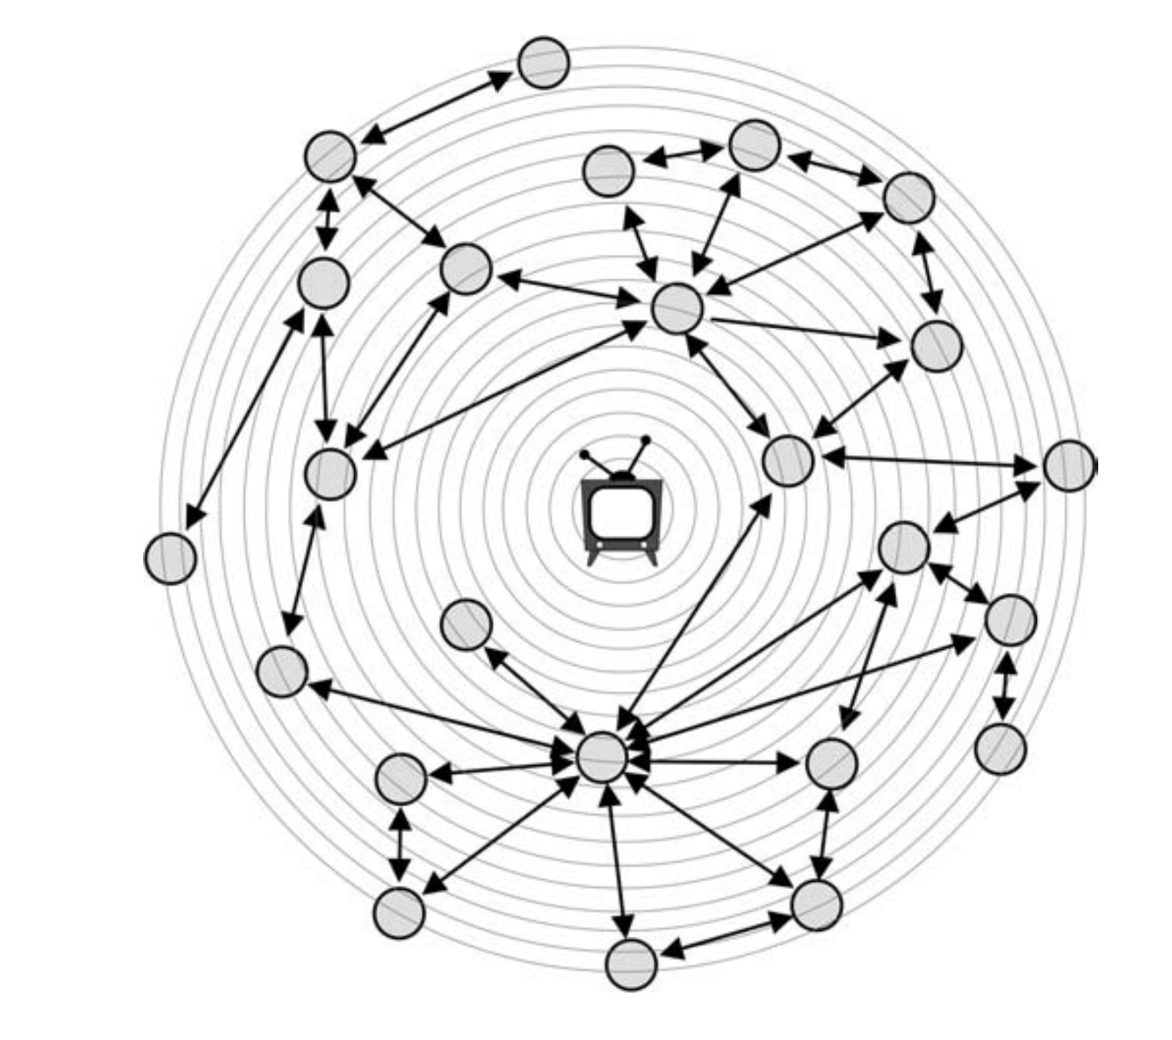
Threshold models of social influence (Watts & Dodds, 2009)
Opinion leaders vs. susceptible
Large-scale changes in public opinion are not driven by highly influential people but rather by easily influenced people influencing other easily influenced people

Slide 22
History of diffusion research
In 1943, Ryan & Gross published a study on farmers’ adoption of hybrid seed corn retrospectively 1928-1941
2 communities in Iowa, 255 of 257 farmers adopted
Compared Social & Economic Variables
Measured Time of Adoption
Social factors rather than economic ones were important influences on adoption
22
Notes:
22

Slide 23
Diffusion History
Coleman, Katz & Menzel’s (1966) study of Medical Innovation solidified the theory on diffusion networks
Argued for contagion model
First published sociometric diffusion study
Data collected 1955-1956
Interviewed all MDs in 4 Illinois cities: Peoria, Bloomington, Galesburg, & Quincy
Sampled prescription records first 3 days of each month to measure Time of Tetracycline Adoption
Showed that well-connected individuals adopted early

Slide 24
Diffusion of Tetracycline for Marginal versus Integrated Doctors
24
Notes:
24

Slide 25
Opinion leadership and contagion in new product diffusion. (Iyengar et al., 2011)
Iyengar, R., Van den Bulte, C. & Valente, T. W. (2011). Marketing Science
Data on discussion and referral ties in 3 cities: SF, LA & NY
Prescribing data from product launch out 3 years

Slide 26
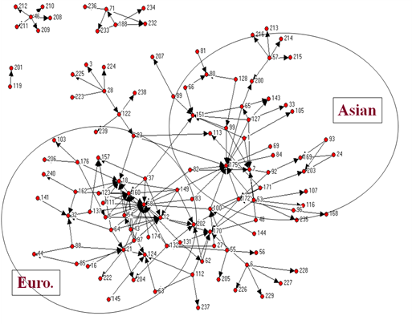
Discussion Network for SF

Slide 27
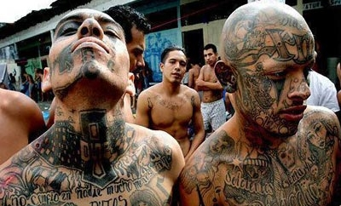

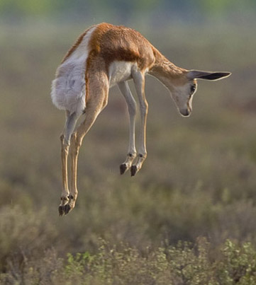
Costly signaling theory & Networks
Zahavi (1975)
Michael Spence (1974)
Notes:
Expensive and often seemingly “wasteful” behavioral signals are designed to convey honest information benefiting both signalers and observers (Zahavi 1975). These signals reveal information about underlying qualities of the signaling individuals (or groups). By “qualities” we mean characteristics of the signaler that are of importance to observers, but that are directly observable with difficulty.

Slide 28

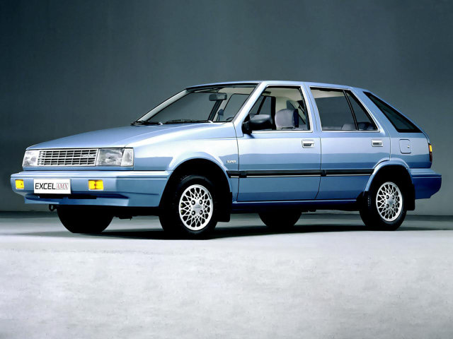
Warranty as a Signal of Quality
The First Hyundai Excel (1986)

Slide 29

Corporate Social Responsibility (CSR) as Signaling

Slide 30
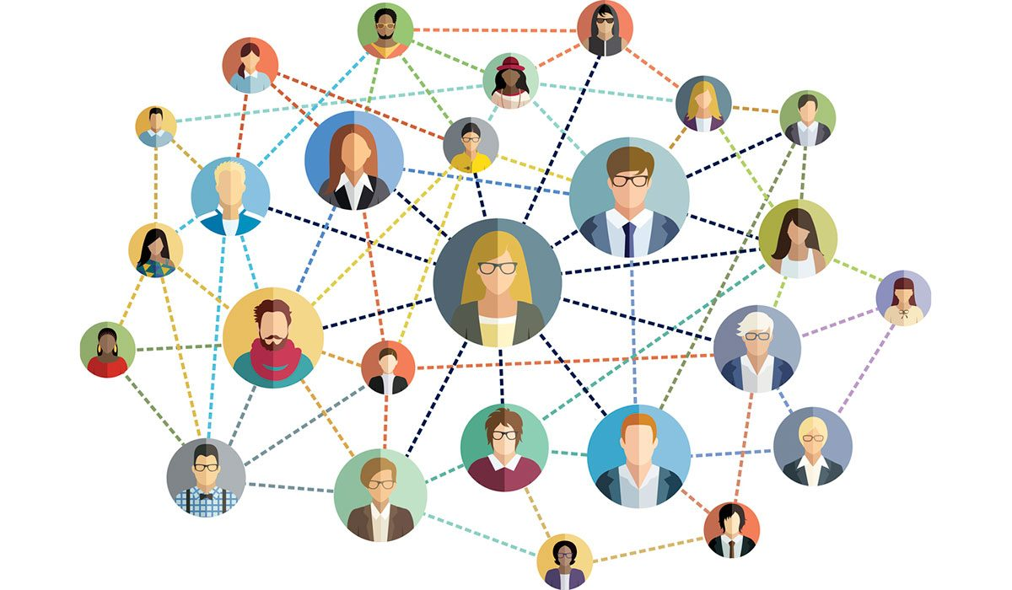
Social connections as signaling of “status”

Slide 31
Signals in social supernets (Judith Donath)
Once having many friends on social media (SNSs) became a signal of status and popularity, users invented fake friends and bots
One of the most valuable contributions of SNSs is their potential to add trust to weak ties (distance acquaintances)

Slide 32
NODEXL
a data scraping, visualization, and analysis tool created by researchers at Microsoft as an add-on to Excel
Maintained by the Social Media Research Foundation
graphing social media communities, it has built-in features for grabbing the data for you
Uses APIs (application programming interface) to interact with social media platform databases
Limited datasets (API – rate limited, 3200 tweets, limited amount per 15 minutes)
Recent data only

Slide 33
Available Social Media
Facebook Fan page network
Facebook personal network
Flicker
Media wiki page network
Twitter Search Network (#hashtag, keyword, other)
Twitter user’s network
YouTube user’s network
YouTube video network

