Slide 1
Social Network Analysis Class (Spring 2019) Jieun Shin
Introduction
1) Introduction
2) Overview of Social Network Analysis
3) Network Data Collection & Basic Measures
4) Personal/Ego-centric Methods
Measures & Methods
5) Fundamental Network Concepts 1 (Centrality)
6) Fundamental Network Concepts 2 (Groups)
7) Fundamental Network Concepts 3 (Positions)
8) Network Level Measures
9) Exponential Random Graph Models (ERGM)
Applications
10) Diffusion & Innovations
11) Digital Media & Network
12) Presentation
13) Presentation
14) Final Project

Slide 2
Network Analysis Data Types
 | A. General | B. Specific
1. Egocentric | Roles pre-determined | Name generator
2. Sequenced | Random selection of alters | Snowball
3. Census | Nominations w/n bounded community | Roster
4. 2-mode | Nominations of events/orgs. | Membership lists

Slide 3
Egocentric Data
Ego-centric network analysis is about relations surrounding individuals or social contexts of an individual
Egocentric network data are collected from independently sampled units (people).
Respondents are asked a “name generator” question and then respondents provide data on these alters
Ego centric data provide some estimate of a person’s immediate close ties
Notes:
3

Slide 4
2 Types of Network Data
Ego-Centric
Sociometric
9
10
1
12
3
4
1
2
11
7
5
2
8
6

Slide 5
Personal v. Sociometric Data
Several studies have tested the correspondence between ego-centric and sociometric data;
Generally find poor agreement on what ego thinks alters do, and what alters self-report

Slide 6
The shape of an ego-centric network
Ascribed characteristics
Achieved characteristics
Sex
Age
Race
Income
Occupation
Religion
Cultural Taste

Slide 7

Burt, 1984 GSS Egocentric Survey
Started collecting data since 1972
Proposed and tested a set of egocentric network survey items
The GSS is expensive ($600,000) - In-person interviews
Recommended name generator “Name up to 5 people you discuss important matters with”

Slide 8
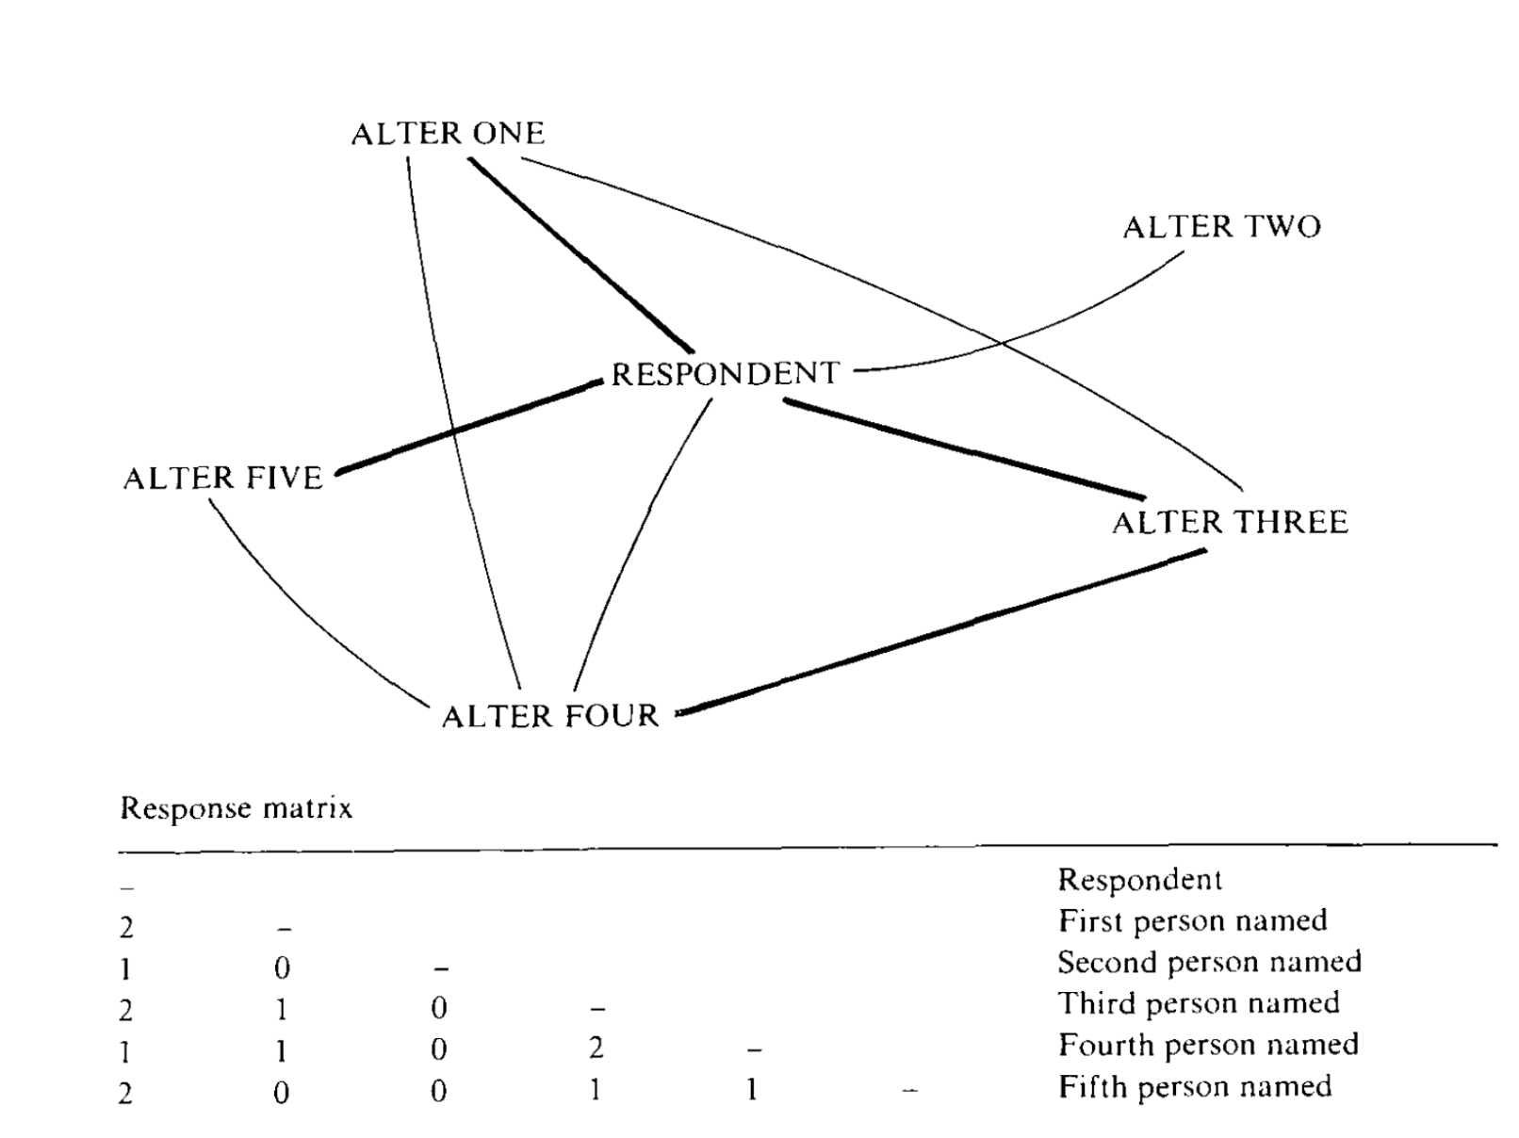
Burt, 1984 GSS Egocentric Survey
Who are the people with whom you discussed matters important to you?
Notes:
who are the people with whom you discussed matters important to you

Slide 9
Ego-centric Networks
Typically the following characteristics are measured:
1. Type of relation (family, friend, coworker)
2. Strength of relation (close, acquaintance, stranger; how long known)
2. Frequency of interaction (how often talk to)
4. Socio-economic characteristics (education, religion, wealth)
5. Demographic characteristics (age, location)
6. Substantive characteristics (approve of abortion)
7. Content of communication (discuss politics, health, child rearing)
9
Notes:
9

Slide 10
Graphs of Ego-centric
1
2
3
4
5
Notes:
10

Slide 11
Graphs of Ego-centric
1
2
3
4
5
Notes:
11

Slide 12
egocentric variables:
Compositional (e.g., mean, percentage)
Heterogeneity (variance)
Size- number of alters
Density – connectedness of alters
Income ?
Gender?
Stress?
Political tolerance?
Social norms?

Slide 13
Burt, 1984 GSS Egocentric Survey
YouTube Video : https://bit.ly/2G3nJg6
Network questions were included in the GSS for the first time (1985), due largely to the efforts of Burt

Slide 14
Marsden (1987) “Core Discussion Networks”
Data show remarkably high tendency of homogeneity- and may be underestimated because of presence of kin
These are “core” networks, they are small, centered on kin, relatively dense, and homogenous by comparison to the R population.
Network range (a diverse set of other actors) is greatest among the young, the highly educated, and metropolitan residents

Slide 15
McPherson, Smith-Lovin, & Brashears (2006)
They replicated the 1985 network questions in the 2004 GSS
Discussion networks were smaller in 2004 than in 1985.
# of people saying there is no one with whom they discuss important matters nearly tripled.
Size decreased by about a 1/3 (one confidant), from 2.94 in 1985 to 2.08 in 2004.

Slide 16

Bowling Alone (Robert D. Putnam, 2000)
The decline of social capital in the US since 1950
The reduction in all the forms of in-person social interaction
This undermines the active civil engagement

Slide 17
The GSS Controversy : Fisher (2006)
Problems with the survey instruments : A block of taxing questions were placed in prior to the network questions. Respondents knew that more names would lead to more questions
A random technical error : some respondents who declined to answer the network question were misclassified in a way that lumped them in with those that said they don’t have any discussion partners
Problem with the question wording : Some people may have not considered online communication

Slide 18
Ego Centric Data Used to Study 5 Behavioral Hypotheses
Degree/Size
Personal Network Exposure
Ties Strength
Concurrency
Density/Constraint
Notes:
18

Slide 19
1. Ego-centric – degree/size
Higher Risk
Or More Privileged Position
Lower Risk
Or Isolated
Notes:
19

Slide 20
Size
Basic and critical variable in analysis
Often restricted to name up to 5 or 7 alters so the variable is censored.
5 names is the cost effective number of alters to record (Merluzzi & Burt, 2013)

Slide 21
2. Personal Network Exposure
= Non-User
= User
Exposure=33%
Exposure=66%
Exposure=100%
21
Notes:
21

Slide 22
Personal Network Thresholds
= Non User
= User
PN Exposure=33%
PN Threshold=33%
PN Threshold=66%
Low Threshold Adopter
High Threshold Adopter
22
Notes:
22

Slide 23
3. Ego-centric –Tie Strength
Weak ties are strong for communicating information, strong ties necessary for behavior change. The more complex the behavior, the more tie strength matters.
Notes:
23

Slide 24
Ways to Incorporate Tie Strength
Take the average of any tie strength measure you have such as closeness or frequency of communication.
Convert the data to dyadic and test whether stronger ties are more strongly associated with behavioral homophily than weak ones.

Slide 25
Dyadic Format
Normal Data (wide) |  |  |  |  | Dyadic (long)
Bob | Mary | Jim | Sue |  | Bob | Mary
Amy | Sam | Ken |  |  | Bob | Jim
 |  |  |  |  | Bob | Sue
 |  |  |  |  | Amy | Sam
 |  |  |  |  | Amy | Ken
Notes:
25

Slide 26
Dyadic Data
Ego-centric data are converted to dyadic in which case is the person-alter relationships.
If 100 respondents name an overage of 3.1 alters, the dyadic data has 310 cases.
Makes testing some hypotheses easier (e.g., association between behavior and gender homophily).

Slide 27
Testing Relational Hypotheses
Is behavioral correspondence more likely among homogeneous pairs than among heterogeneous ones.
E.g., Smoking similarity greater among same sex pairs than among different sex pairs.

Slide 28
Valente & Vlahov (2001) Baltimore NEP
Time Period: August 12, 1994 - February 12, 1997
Repeated interviews with 1,184 respondents at baseline, 2-week, 6-month, 1-year, 18-month
Included ego-centric questions on survey
“Provide the initials or nicknames of up to 5 your closest friends”
Asked whether the respondent shared syringes with each friend named
Notes:
28

Slide 29
Schematic of Needle Network Study
Get Needles
Return Needles
Registration
N=3,500
Return to van periodically
and continue about their
business
Every
Seventh
Participated in
Evaluation
Study N=448
Interviewed at Baseline
2-weeks (364),
6 mos. (308),
1 year (175), and
18 mos. (88).
29
Notes:
29

Slide 30
Graph of reported syringe sharing by friendship rank and survey wave : sharing decreases
Notes:
30

Slide 31
4. Ego-centric -Concurrent
Serial
Concurrent
Notes:
31

Slide 32
Concurrency
Changes the sexual contact network
Simulation studies show that HIV spreads more rapidly when concurrency is common.
Data driven simulation show that concurrency may be responsible for the HIV epidemic in South Africa

Slide 33
Concurrency (cont.)
Difficult to measure concurrency accurately since it requires enrolling indexes and their partners who might not want to be identified
Also challenging because disease spread depends significantly on the type and duration of the behavior.

Slide 34
5. Dense vs. Radial Personal Networks
Ego
Ego
Integrated/Dense/ Constrained
Personal Network
Radial/Open
Personal Network
Notes:
34

Slide 35
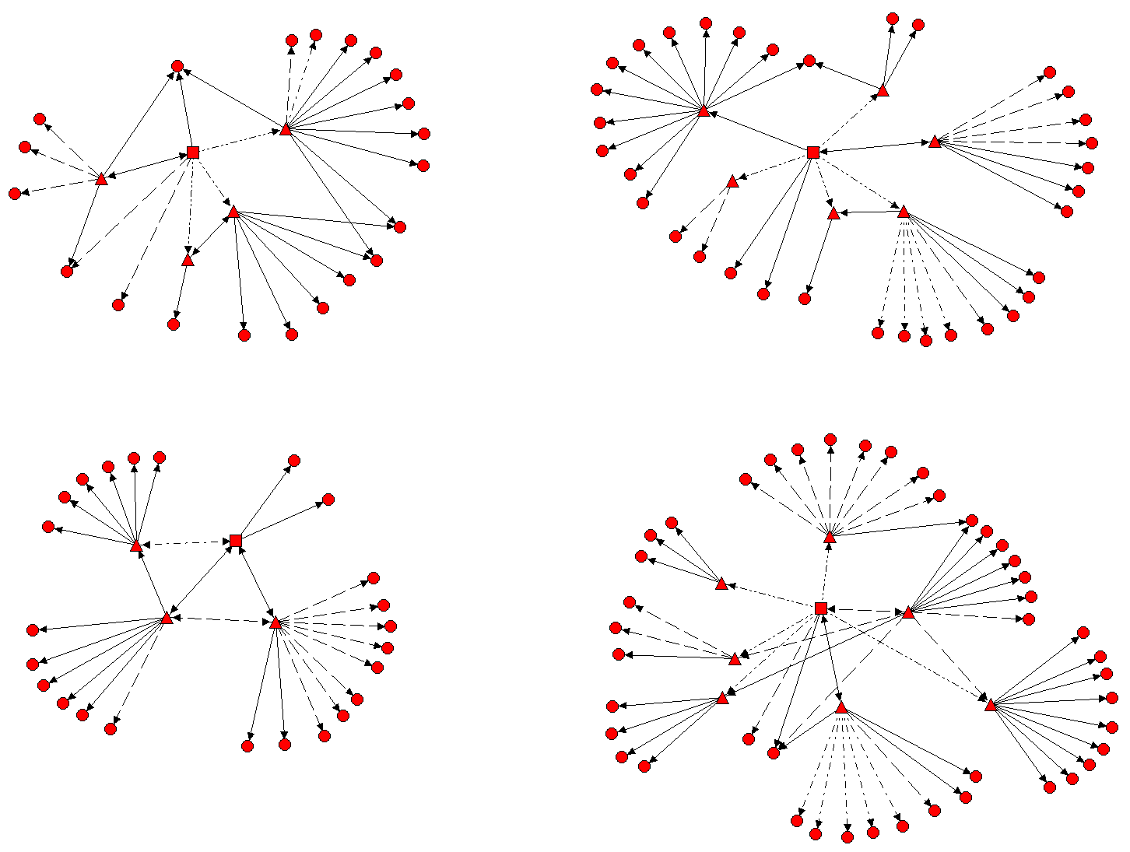
A
B
C
D

