Slide 1
Social Network Analysis Class (Spring 2019)
Jieun Shin
[ Week 4 ]
Introduction
1) Introduction to Social Network Analysis
2) Network Data Collection & Basic Measures
3) Personal/Ego-centric Methods
Measures & Methods
4) Fundamental Network Concepts 1 (Centrality)
5) Fundamental Network Concepts 2 (Groups)
6) Fundamental Network Concepts 3 (Positions)
7) Network Level Measures
8) Exponential Random Graph Models (ERGM)
Applications
8) Graphics & Visualization
9) Diffusion & Innovations
10) Digital Media & Network
11) Presentation
12) Presentation
14) Final Project

Slide 2
Centrality
Centrality measure addresses “Who is the most important or central person in this network?”
Centrality has been a central preoccupation in the study of networks
There are many ways to identify central nodes in a network and different methods may have different applications.

Slide 3
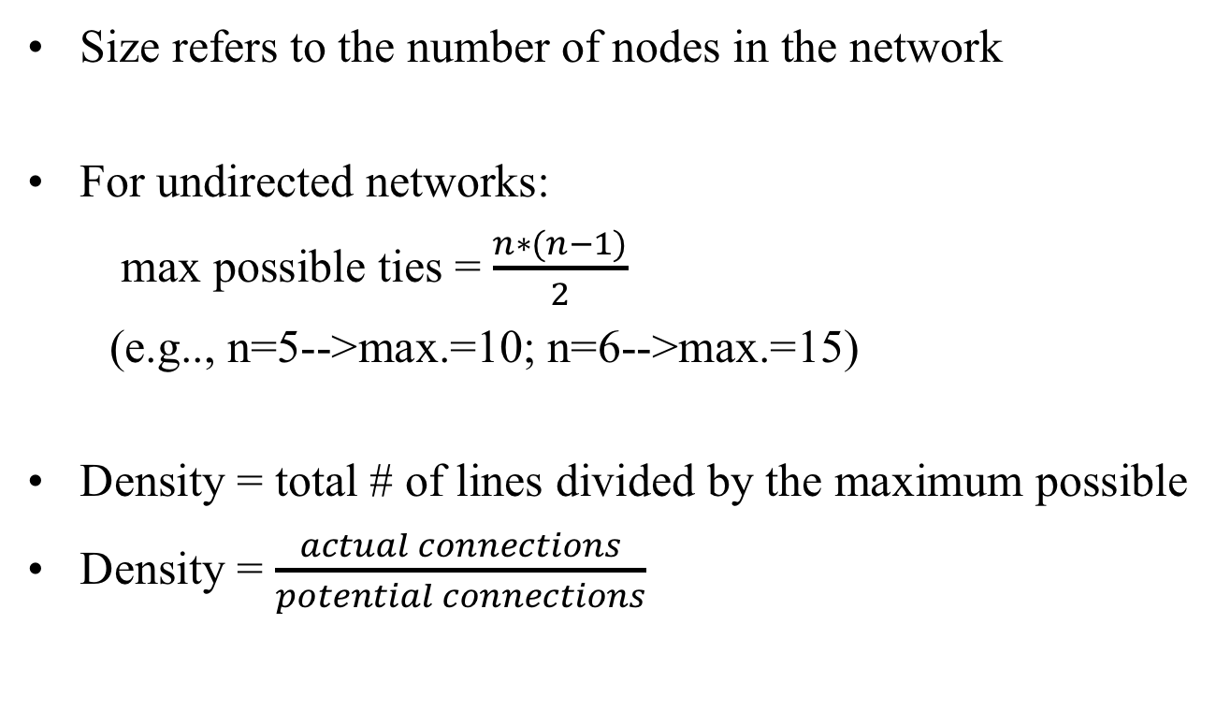
Network Density

Slide 4
Network Density
Density is dependent on the size of a graph and this prohibits comparison of density measures between graphs.
Larger graphs, all things equal, will have lower densities than small graphs.

Slide 5
Implications of network density
The degree to which a respondent’s ties know one another.
The speed at which information diffuses among the nodes
The extent to which actors have high levels of social capital and/or social constraint

Slide 6
Centrality
Individual Centrality
Local centrality vs. global centrality
Local centrality - when a node has a large number of connections to other points in its immediate environment.
Global centrality - has a strategic position within the network.
Centralization - overall centrality of the network
Whether the ties are directed to or clustered around one or a set of nodes.

Slide 7
Centrality Measures (Freeman, 1979)
Degree centrality
Closeness centrality
Betweenness centrality

Slide 8
1. Centrality measure: Degree
In-degree - # of nominations received
Out-degree - # of nominations sent
Degree measures only comparable for graphs of same size
Normalized degree measures : divide by the maximum # of possible ties (N-1)

Slide 9
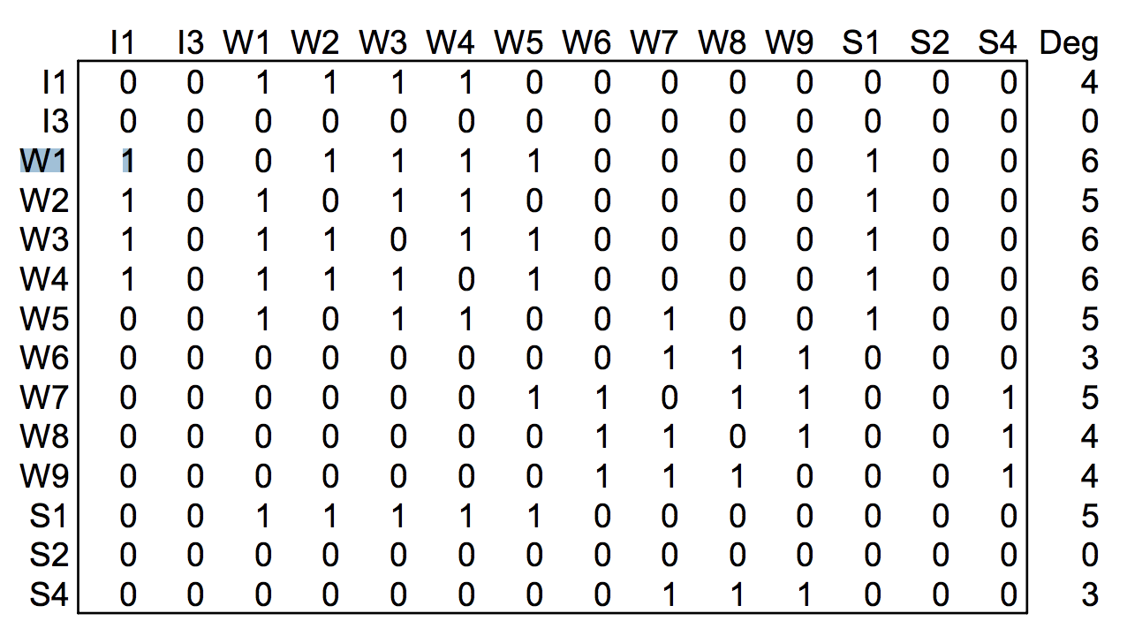
Calculating degree centrality

Slide 10
2. Centrality measure: Closeness
The farness of a node : Defined as the sum of its distances to all other nodes
Centrally close points can reach others in fewer steps
Closeness measures how long it will take to spread information from a node to all other nodes

Slide 11
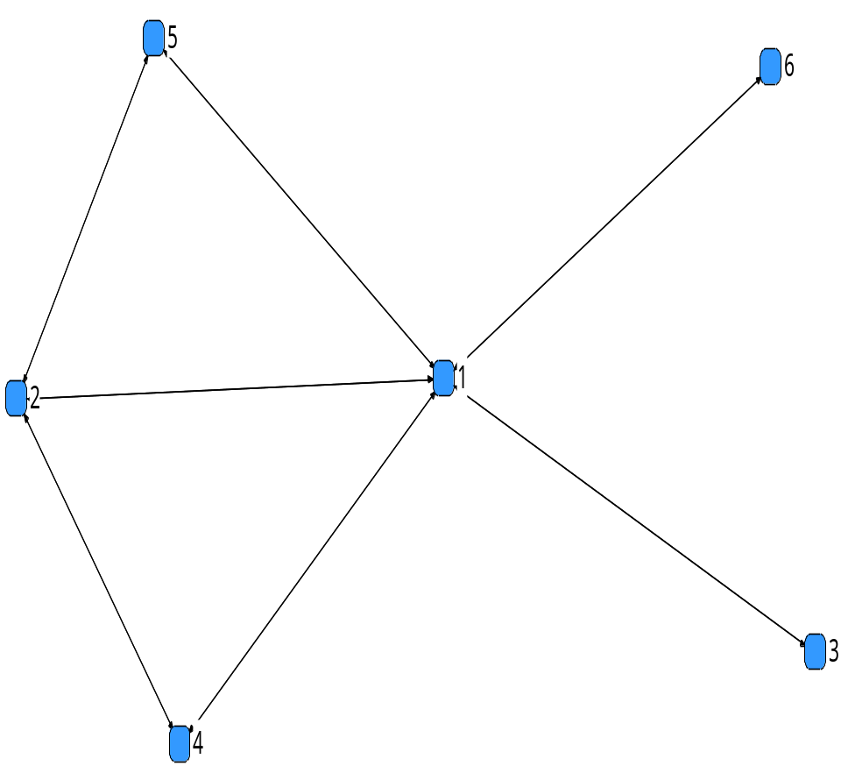
Distances
1 2 3 4 5 6
1 0 1 1 1 1 1
2 1 0 2 1 1 2
3 1 2 0 2 2 2
4 1 1 2 0 2 2
5 1 1 2 2 0 2
6 1 2 2 2 2 0

Slide 12
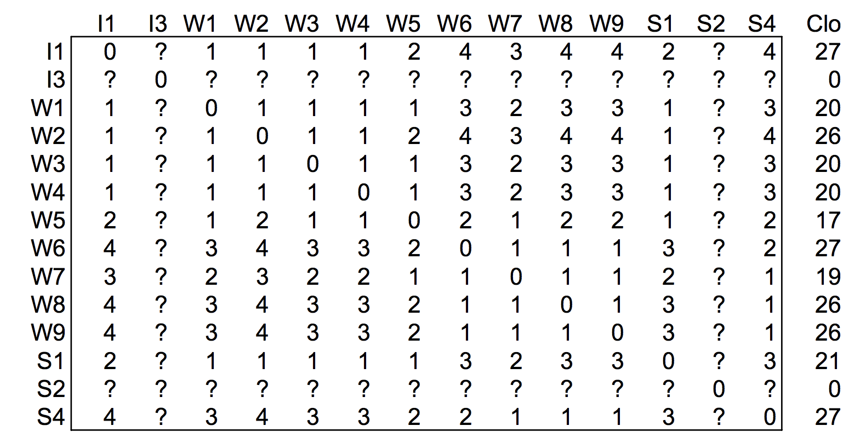
Calculating Closeness

Slide 13
Isolates in Networks
2 nodes that are unreachable technically are infinitely far apart.
Using infinity to represent being unreachable is problematic for several reasons
Dividing or summing with infinity becomes infinity
Unreachable are not necessarily infinitely far apart, rather just very far apart.

Slide 14
Values for Unconnected Pairs:
Using a variant of N the network size:
  N-1 is the maximum distance
  N-1+1 to guarantee that a disconnected pair is further apart than a pair that are maximally distant
D+1 in which D=diameter, the longest distance in the network. Unreachable nodes are one step farther apart than the most distant ones

Slide 15
3. Centrality Measure : Betweenness
The frequency a person lies on the shortest path connecting everyone else in the network
Betweenness individuals play a gatekeeper or broker role
It indicates that the individual is a possible relay between many potential communicants in the network
It can be divided by the maximum betweenness possible to get normalized betweenness.

Slide 16
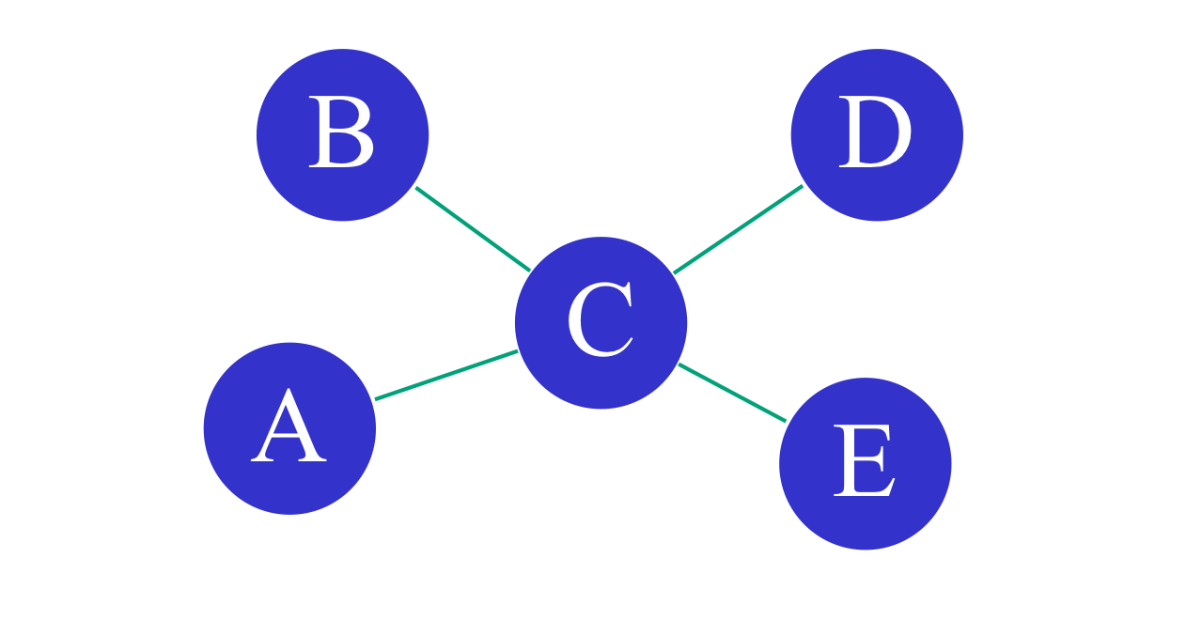
Calculating betweenness
10 path ways possible

Slide 17
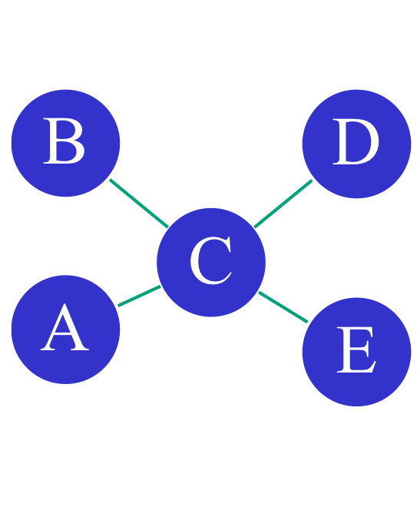
Calculating betweenness
Link | Link
A | B
A | C
A | D
A | E
B | C
B | D
B | E
C | A
C | B
D | E
Geodesic
(A,B)
(A,C)
(A,C,D)
(A,C,E)
(B,C)
(B,C,D)
(B,C,E)
(C,D)
(C,E)
(D,C,E)

Slide 18
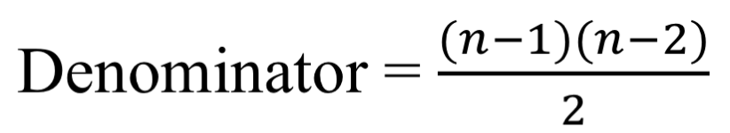
Calculating betweenness
Geodesic
(A,B)
(A,C)
(A,C,D)
(A,C,E)
(B,C)
(B,C,D)
(B,C,E)
(C,D)
(C,E)
(D,C,E)
A | B | C | D | E | F
0 | 0 | 5 | 0 | 0 | Numerator
6 | 6 | 6 | 6 | 6 | Denominator
0 | 0 | 0.83 | 0 | 0 | Betweenness

Slide 19
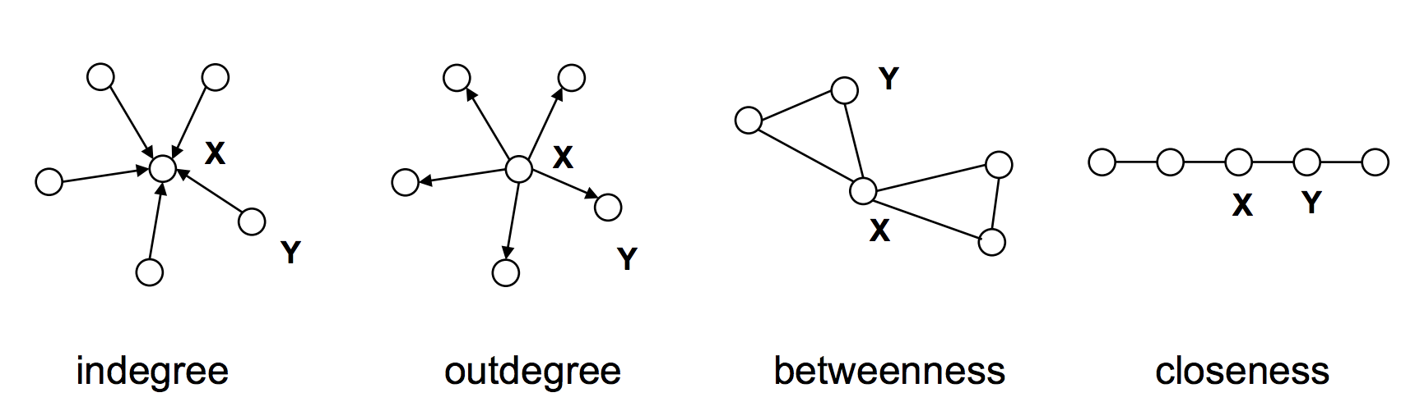
X has higher centrality than Y
Lada Adamic

Slide 20
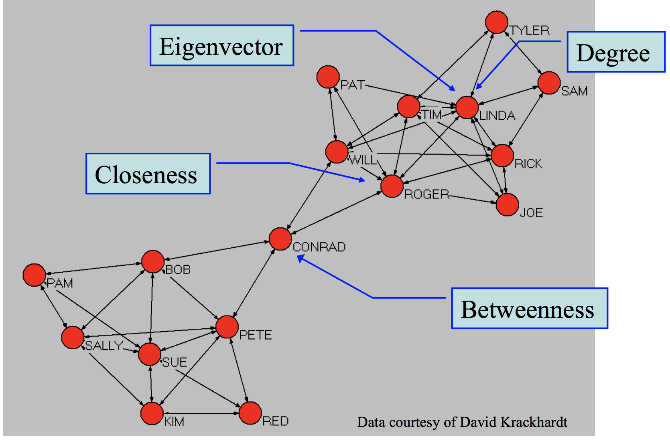

Slide 21
Centralization
The extent to which ties are organized around a set of focal points in the network
The degree of inequality or variance
For example,
1. Degree centralization is calculated by taking the sum of the differences between the node with the highest degree score and all degree scores.
2. The maximum possible sum of differences for degree is n²-3n+2.
3. Dividing the sum in 1. by the value of 2.

Slide 22
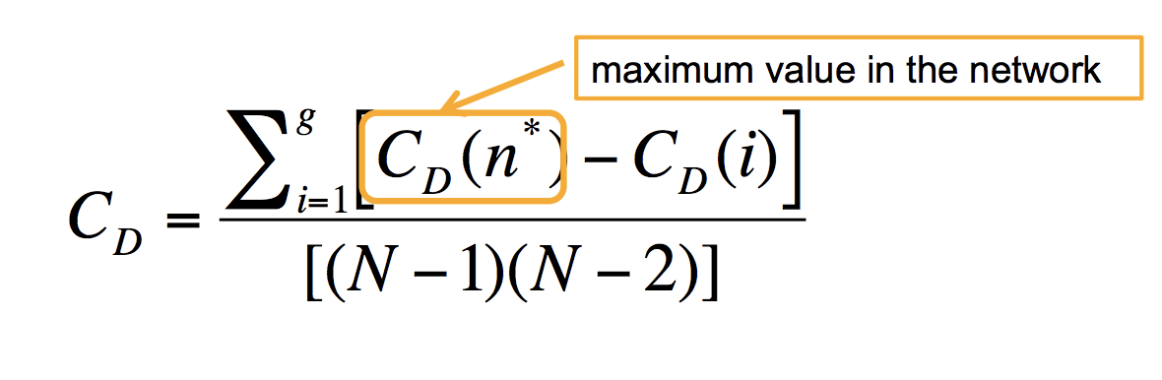
Centralization
(standard deviation)
maximum possible sum of differences for degree
A large SD indicates a centralized network
Notes:
Maximum degree = n-1
Minimum degree = 1
(n-1-1)*(n-1)+0
(n-2)*(n-1)

Slide 23
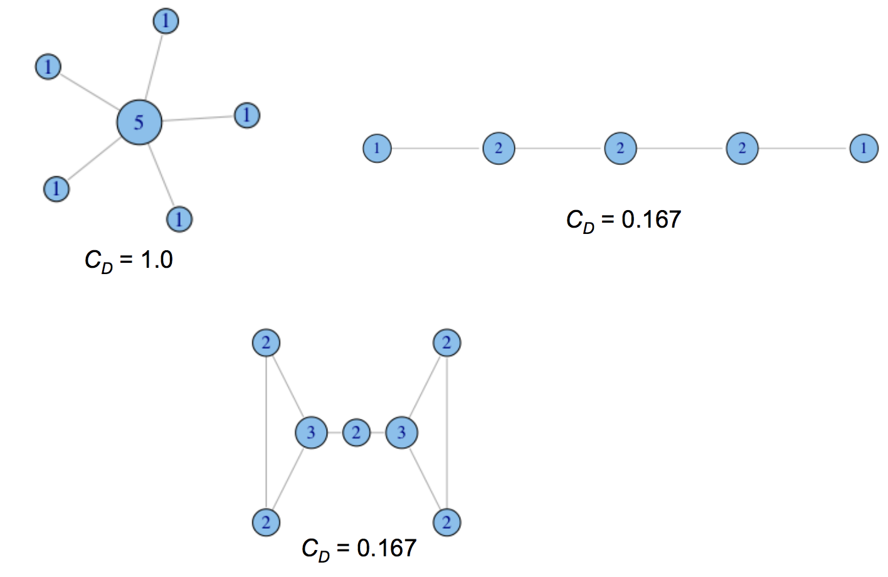
Degree centralization examples

Slide 24
Measure | Meaning
Degree | Activity
In-degree | Influence
Out-degree | Interest
Betweenness | Control
Closeness | Effeciency

Slide 25
When we have time

Slide 26
Costenbader & Valente
Centrality measures are quite stable
For indegree, up to 50% missing and it still correlates at .80 with full sample
Some measures more stable than others

Slide 27
Applications for Centrality Measures
Experimental studies – task efficiency
  Do central people enjoy completing tasks more than peripheral members?
  Are centralized networks more efficient?
  Are people as satisfied working in centralized groups as in decentralized ones?
  Is performance related to centralization or the behavior of central members?

Slide 28
Disease Transmission
Central members of networks are likely to become infected earlier than non-central members
Centralized networks may spread diseases more quickly, particularly once the central nodes become infected

Slide 29
Costenbader & Valente (2003)
People believe that missing data in network studies presents a big problem
If even one non-respondent, you lose N-1pieces of information.
If data are missing at random: How stable are centrality measures?

Slide 30
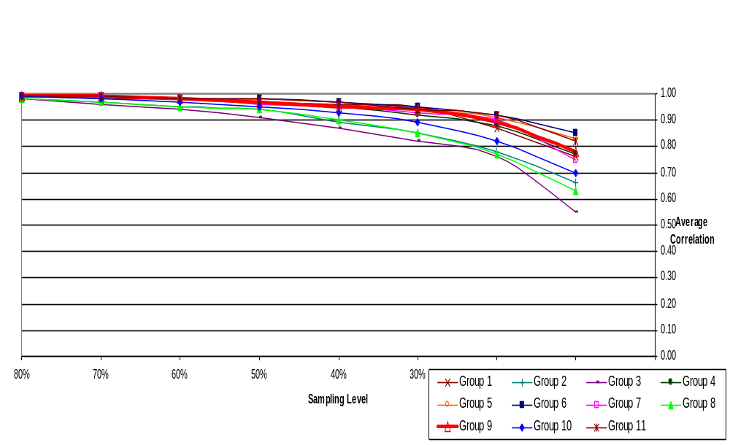
Average Correlation for In-degree Centrality
Brazilian Farmers Data

Slide 31
Network Terminologies
adjacent - two points connected by a line
degree - numerical measure of neighborhood
walk - sequence of lines
path - lines in a unique walk
distance - length of shortest path (geodesic)
in-degree - # of lines directed toward point
out-degree - # of lines directed away from a point

Slide 32
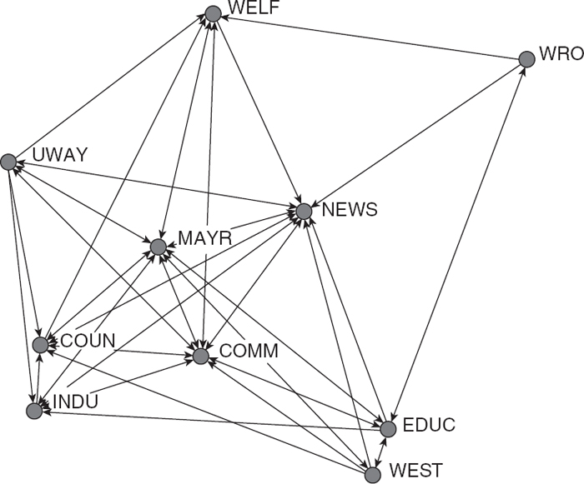
Top down : size, component, density, etc
Bottom-up: centrality, reciprocity, transitivity
Notes:
Information Exchange Network
(Knoke & Wood, 1978)

