Slide 1
Social Network Analysis Class (Spring 2019) Jieun Shin [ Week 7 ]
Introduction
1) Introduction to Social Network Analysis
2) Network Data Collection & Basic Measures
3) Personal/Ego-centric Methods
Measures & Methods
4) Fundamental Network Concepts 1 (Centrality)
5) Fundamental Network Concepts 2 (Groups)
6) Fundamental Network Concepts 3 (Positions)
7) Network Level Measures (Transitivity & Triads)
8) Exponential Random Graph Models (ERGM)
Applications
8) Graphics & Visualization
9) Diffusion & Innovations
10) Digital Media & Network
11) Presentation
12) Presentation
14) Final Project

Slide 3
Reciprocity
Measures the extent to which a tie from A to B is reciprocated by a tie from B to A
Reciprocity is meaningful when a network is directed
B
A
C

Slide 4
Calculating Reciprocity
Proportion of dyads with reciprocated ties among all possible dyads
1/3=0.33
Proportion of dyads with reciprocated ties among all connected dyads **
1/2 = 0.5

Slide 5
Transitivity
Triad refer to any structure that involves three nodes
There are 4 types of triads with undirected
transitive
Notes:
The smallest piece of society. When a third person enters a “dyad”, it transforms into a “group” (Zimmel). ….. Heider’s “balance theory” argues that people tend to seek balance in their relations. If a triad has all positive relationship, or two negatives and one positive, it is “balanced”.

Slide 6
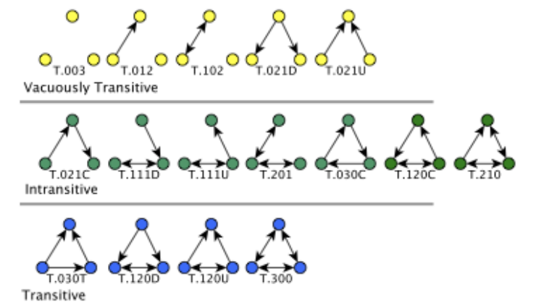
Alhazmi et al., (2015)
Notes:
Actors seek out transitive relations, and avoid intransitive relations (because it involves a middle man, and cause stress for at least one person.
A triple is transitive. If A → B, B → C, and A → C are present

