Slide 1
Social Network Analysis Class (Spring 2019)
Jieun Shin
Introduction
1) Introduction
2) Overview of Social Network Analysis
3) Network Data Collection & Basic Measures
4) Personal/Ego-centric Methods
Measures & Methods
5) Fundamental Network Concepts 1 (Centrality)
6) Fundamental Network Concepts 2 (Groups)
7) Fundamental Network Concepts 3 (Positions)
8) Network Level Measures
9) Exponential Random Graph Models (ERGM)
Applications
10) Diffusion & Innovations
11) Digital Media & Network
12) Presentation
13) Presentation
14) Final Project

Slide 2
Introduction of Network Analysis
Attributes vs. Relations
Attributes
income
education
location
gender
ethnicity
occupation
Relations
Who you know
Who you talk to
What you talk about
What are your networks’ attributes
How does your network constrain or enhance your opportunities

Slide 3
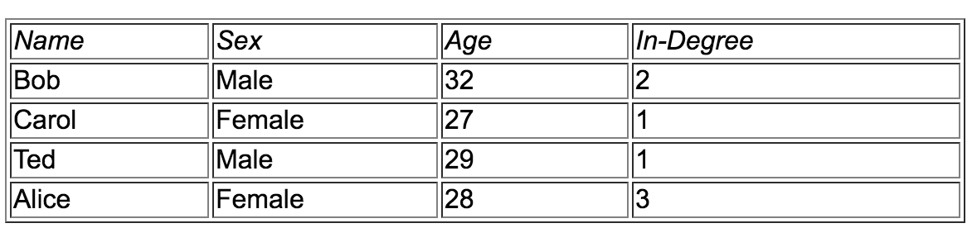
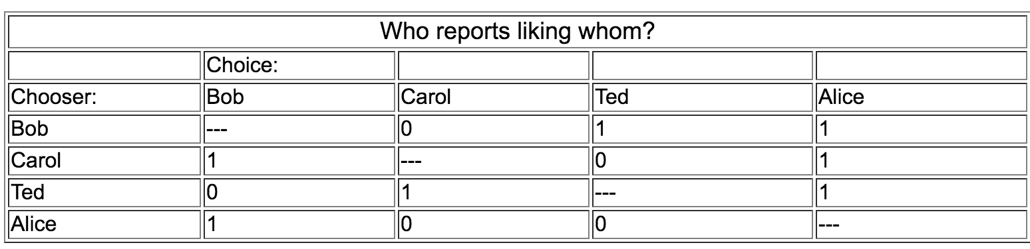
Attributes vs. Relations
Notes:
Typically, study designs that focus on individual characteristics/behaviors and how those characteristics influence health, collect and conduct analysis on attribute data. Attribute data is defined as data that reflects the attitudes, opinions, and behaviors of individuals. Conversely, social network analysis requires not only attribute data, but is built on the collection and analysis of relational data. Relational data refers to contacts, ties and connections, which relate one agent in a network to another. Relational data cannot be reduced to properties of the individual agents themselves but to a system/collection of agents.

Slide 4
4 properties of SNA research
Intuition that links among actors are important
Data collection or analysis of data that record relationships
Heavy reliance on graphic images
Mathematical and computational models
(Freeman, 2011)

Slide 5
SNA is a perspective not a theory
It provides a way of looking at a problem but does not predict what we will see
It does not provide a set of premises from which hypotheses or predictions can be derived.
(Marin & Wellman, 2001)

Slide 6
Primary Applications in Communication
Who are connected with whom ? (emergence of clusters)
How information (and persuasion) flows through social networks
How a community evolves over time
Inter-organizational collaboration, coordination, and cooperation
Semantic networks (a knowledge structure that depicts how concepts are related to one another)
Notes:
Leveraging Social Network Analysis for Research on Journalism in the Information Age
J. Sophia Fu
The Coevolution of Multiplex Communication Networks in Organizational Communities
“Privacy” in Semantic Networks on Chinese Social Media: The Case of Sina Weibo

Slide 7
Major Research Questions
Small world networks
Scale free networks
Social capital
Homophily
Diffusion/contagion/social influence
Centrality (popularity, leadership)
Individual v. network measures
Network dynamics
Efficient network forms
Agent based models (ABM)
Interventions
Algorithms & Measures

Slide 8
1. Small World Networks (SW)
Small world research first conducted by Stanley Milgram (1967)
How many ‘social hops’ would it take for messages to traverse through the US population (200 million) ?

Slide 9
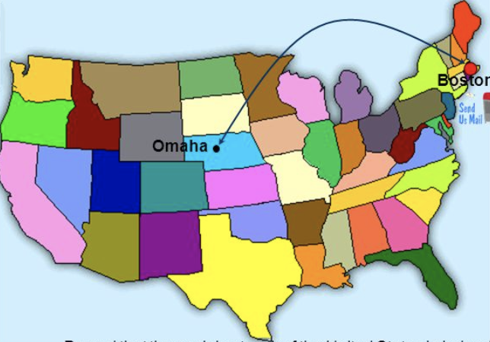
Stanley Milgram (1967)
-Posted 160 letters from randomly chosen people in Omaha, NE
-Asked them to pass these letters to a stockbroker working in Boston, MA
- Use people whom they know on a first name basis
-42 letters made it. On average, 5.5 hops
Notes:
The experiments are often associated with the phrase ”six degrees separation", although Milgram did not use this term himself.

Slide 10
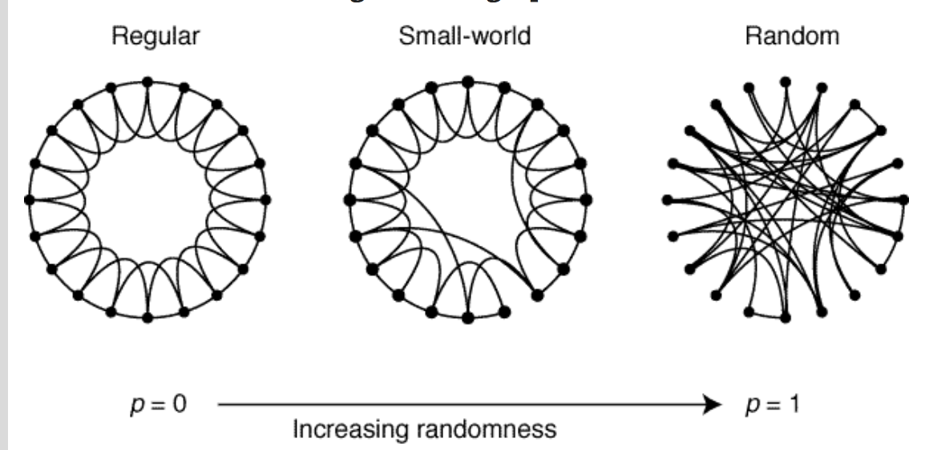
Watts & Strogatz (1998)
Notes:
Dormant for decades then revitalized by Watts & Strogatz. Characterized by: shorter path lengths than would be expected in a random network of the same size and density. local clustering
Bridges. Actors in films

Slide 11
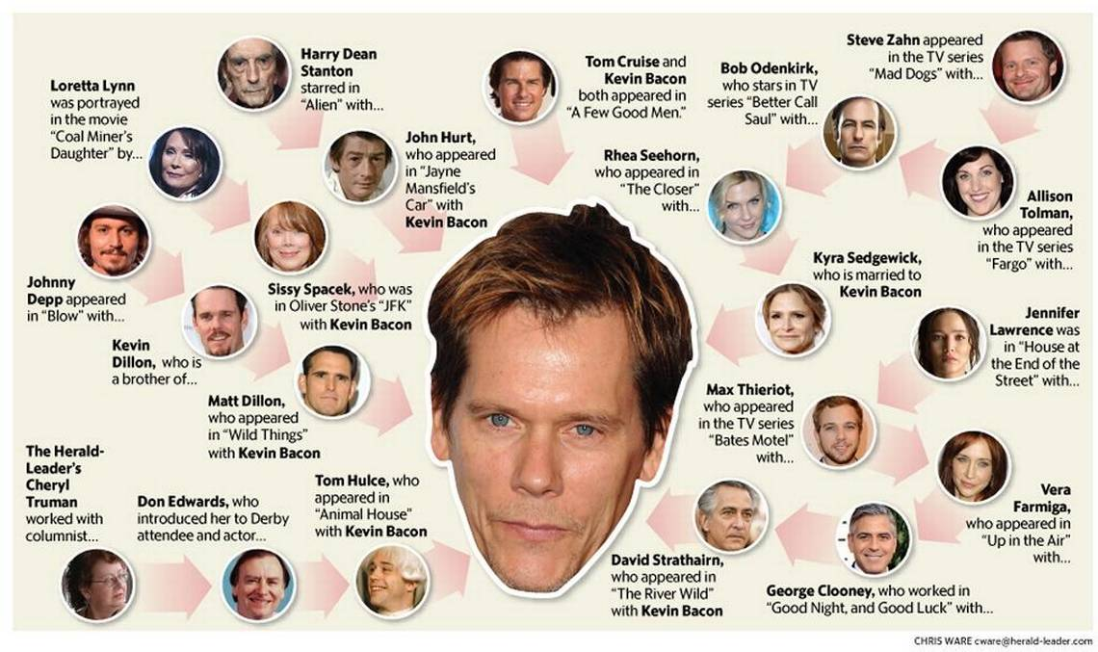
Six Degrees of Kevin Bacon (1994)
https://oracleofbacon.org/movielinks.php

Slide 12
SW
Small world networks: accelerates the spread of ideas, practices, disease
Bridges, which create small world networks, make it possible for diseases to spread between continents and for information to travel quite widely

Slide 13
2. Scale Free Networks
Barabasi (1999) studied how networks grow
Preferential attachment: New nodes have preferences for how they join a network.
  Nodes prefer to attach to central nodes
  Gives rise to very central nodes
  Distribution of degree (# of connections a node has) is highly skewed
  Examples : co-authorship networks, internet webpage networks, semantic networks, airline networks, etc

Slide 14
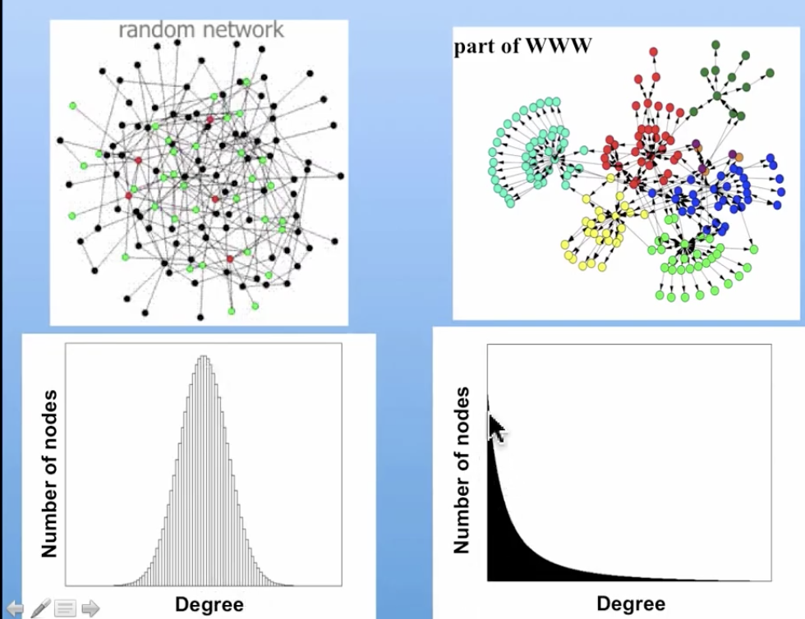
Random vs. Preferential
Notes:
the probability that a given node had degree k was proportional to 1/k raised to a power.

Slide 15
Scale Free
Indicates that network structures are likely to reinforce themselves
Once at the top, you can stay at the top.
It can be difficult to re-arrange networks.
SF means many networks will be very centralized, have ties directed to one or a few people
Centralization is likely to create authoritative structures.

Slide 16


Emergence of Scaling in Random Networks
(Barabasi & Albert, 1999)
Scale-free networks are rare
(Broido & Clauset, 2018)

Slide 17
3. Social Capital
People have human (abilities), material (resources) and social capital (social connections).
SC is the resources available in one’s network- useful for getting a job, access to health care, information, etc.
SC also exists at the community level
SC can be negative
Notes:
resources to which individuals and groups have access through their social networks.

Slide 18
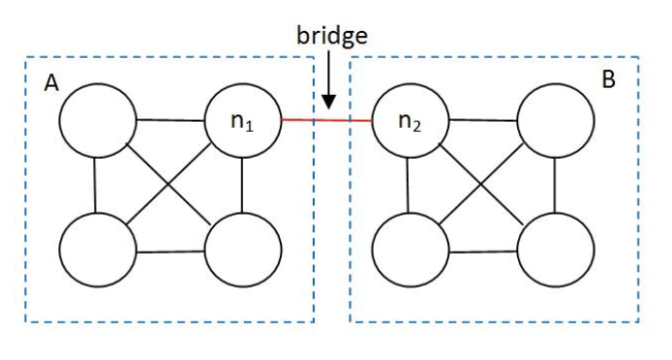
The strength of weak ties
(Mark Granovetter, 1973)
The strength of a tie as a combination of the amount of time, the intimacy, the reciprocal services between people
People are more likely to find information about job opportunities through weak ties
Notes:
Social capital provides resources that people can use to advance their economic or social well being. Ronald Burt is well-known for the concept of "structural holes," which is the absence of ties between two nonredundant clique

Slide 19
Dimensions of SC
(Robert Putnam, 2000)
Bonding
Bridging
generated by strong ties
located within a group
good for “getting by”
generated by weak ties
located between social groups, class, race, religion, etc
good for “getting ahead”

Slide 20
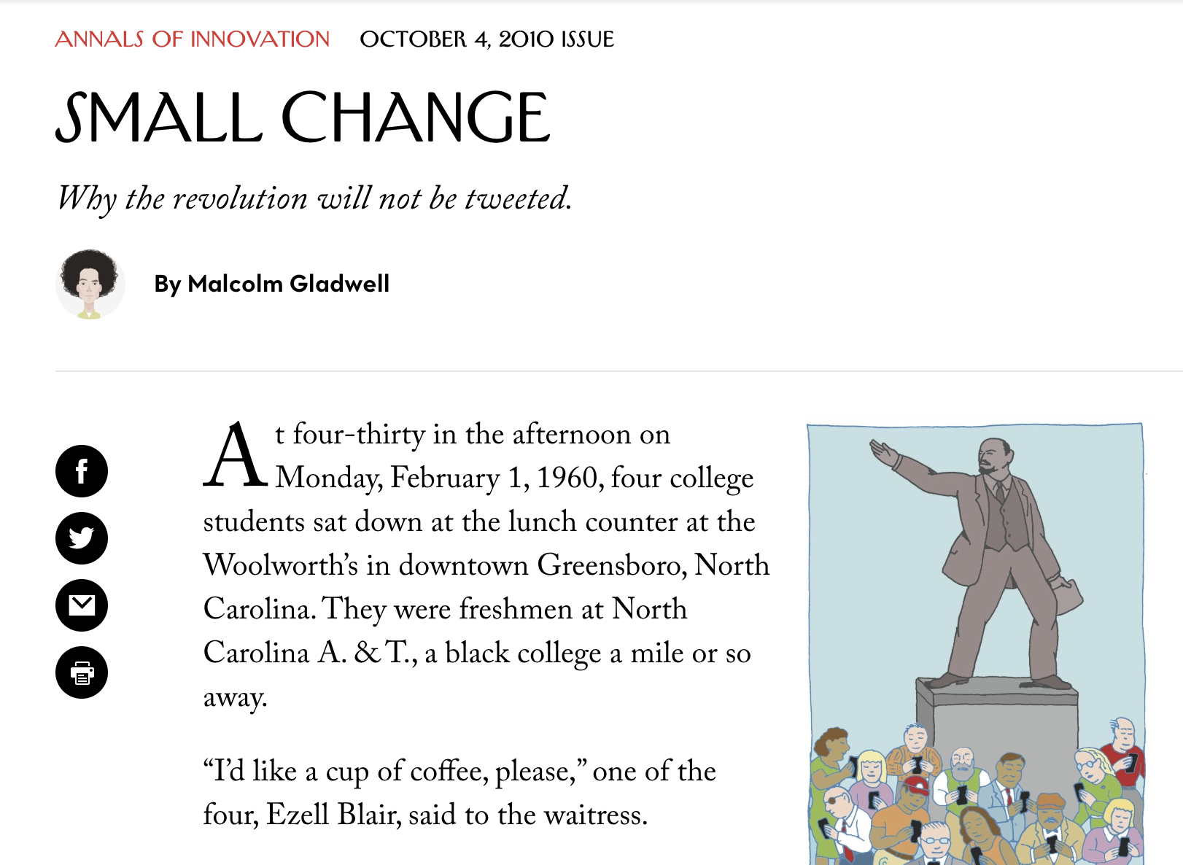
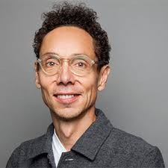
Weak ties networks & Slactivism

Slide 21
Social Capital
Social capital provides resources that people can use to advance their economic or social well being.
We all know it’s who you know, not what you know. SC provides an attempt to theorize about social resources

Slide 22
4. Homophily
SW, SF, SC focuses on macro, but what drives all of these are network choices at the individual (micro) level.
People tend to affiliate with others like themselves.
Ties are often among those of the same sex, ethnicity, social class, and so on
Because people associate with others like themselves, their networks are often closed to outside information

Slide 23
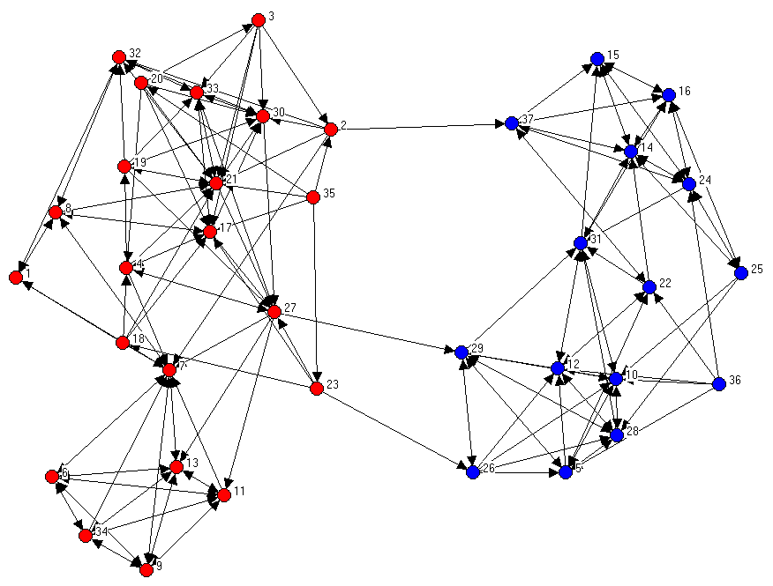
Friendship Network 6th Graders

Slide 24
5. Diffusion/contagion
Ideas and practices spread through networks.
As friends do something, you are more likely to do something
Contagion is the special case of diffusion in which only contact is required for adoption/spread
Diffusion is really the special case of social influence models

Slide 25
6. Centrality/Popularity
One important factor affecting diffusion is the behavior of opinion leaders (OLs)
OLs both reflect and drive the diffusion process
Identify OLs by those who receive many nominations (typically top 10-15%)
Other measures of centrality- who is located at the center of the network

Slide 26
Centrality
This is why central members are so important.
They are seen as the same yet different than everyone else in the network
Little hope to get diffusion going unless central members embrace the idea
Yet, most ideas start on the periphery of the network because they are freed from social norms.
Bridges
Notes:
Watts & Dodds (2007) Under most conditions that we consider, we find that large cascades of influence are driven not by influentials but by a critical mass of easily influenced individuals.

Slide 27
7. Individual v. Network Level
Individual behaviors are not independent of the network within which the behaviors occur.
Individual network position is not independent of the network structure – being central in a centralized network is different than being central in a decentralized network.

Slide 28
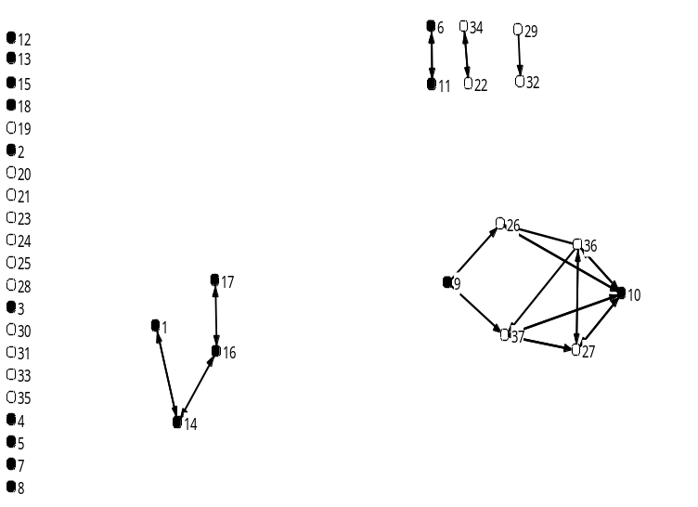
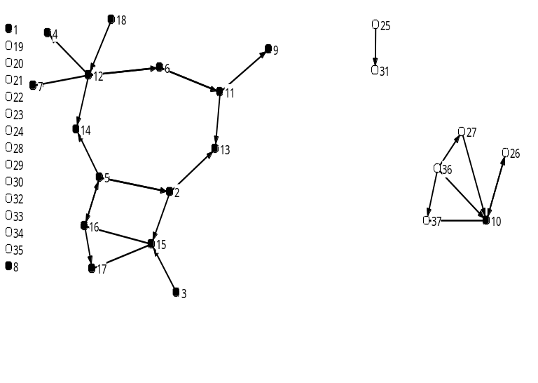
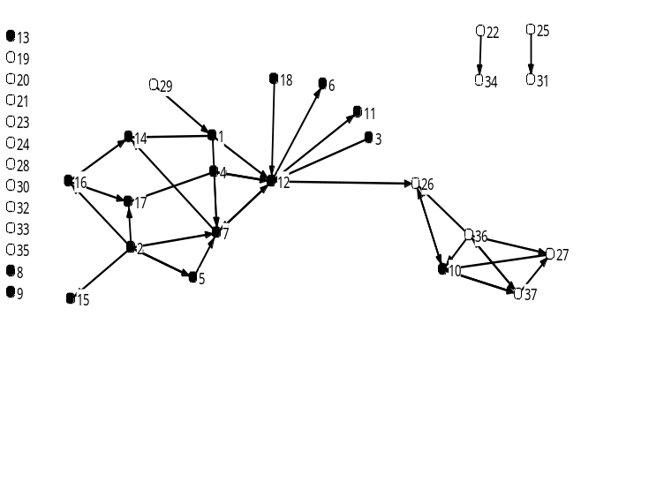
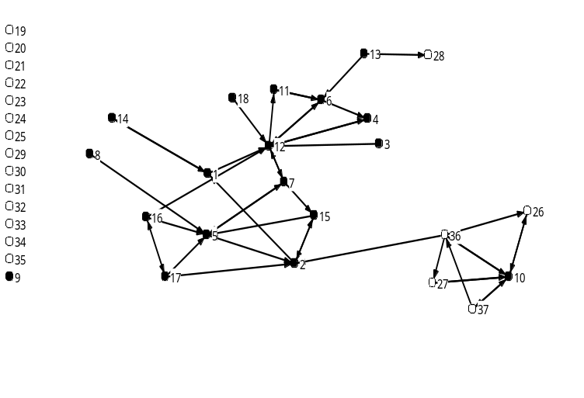
8. Network Dynamics & Stability
T1
T2

Slide 29
9. Efficient network forms
What is the best network?
Inter-organizational collaboration or organizational behavior researchers want to know: Is this structure optimal?
Naïve view is that more density is better than less density, but this is not always so.
How centralized should a network be? Some cases centralization is good, others, not so good.

Slide 30
10. Agent based models/simulations
Often useful to simulate conditions to get a sense of what happens.
One can create hypothetical networks based on some parameters (e.g., ave. # of links per person, centralization, reciprocity)
Can also simulate what happens to this network over time
And what happens to behaviors within this network

Slide 31
11. Interventions
Network data may help improve health promotion programs
Sociometric segmentation
Identify opinion leaders (over 20 studies)
Identify groups and find leaders within
Identify leaders and match them to nominees

Slide 32
12. Algorithms & Measures
New algorithms to measure well known concepts are continuously being created
E.g., Newman & Girvan method for identifying clusters/groups (communities) in networks
Developing new algorithms also leads to new insights on networks, how they are organized and function

