Slide 1
Social Network Analysis Class (Spring 2019)
Jieun Shin
[ Week 2 ]
Introduction
1) Introduction to Major Concepts & Terminology
2) Data Collection, Management & Basic Measures
3) Personal/Ego-centric Methods
Measures & Methods
4) Centrality & Centralization
5) Relational Measures & Models
6) Structural Measures & Models
7) Network Level
Applications
8) Social Capital
9) Contagion & Selection
10) Diffusion of Innovation
11) Visualization
12) Online/Social Media
13) Inferential Statistics
14) Paper Presentations

Slide 2
Week 4:
Centrality
Centrality measure addresses “Who is the most important or central person in this network?”
Centrality has been a central preoccupation in the study of networks
There are many ways to identify central nodes in a network and different methods may have different applications.

Slide 3
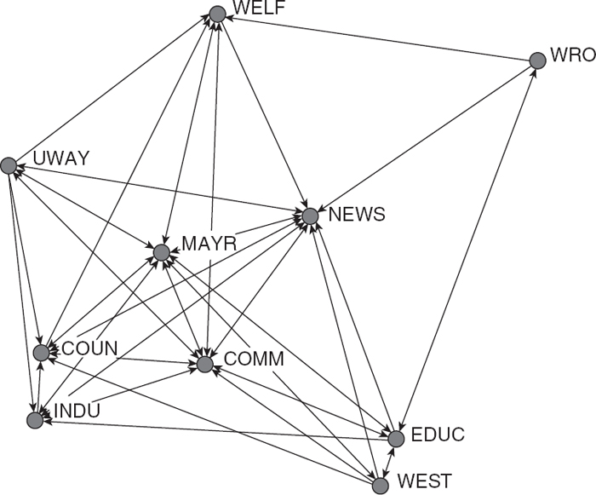
Top down : size, component, density, etc
Bottom-up: centrality, reciprocity, transitivity
Notes:
Information Exchange Network
(Knoke & Wood, 1978)

Slide 4
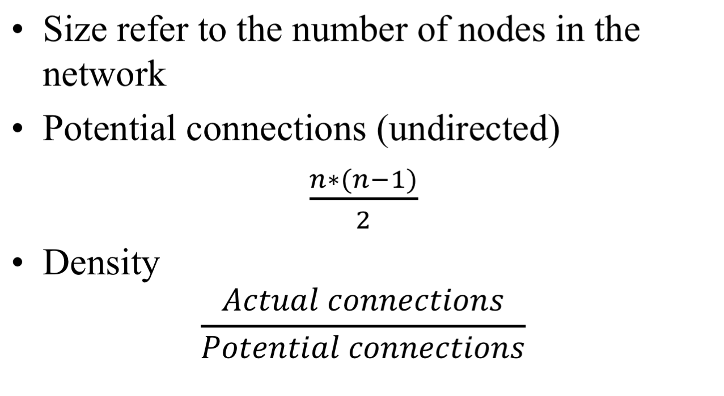
Density
Notes:
Try with 3 nodes network, 4 nodes network

Slide 5
Implications of network density
The degree to which a respondent's ties know one another.
The speed at which information diffuses among the nodes
The extent to which actors have high levels of social capital and/or social constraint

Slide 6
Reciprocity
Measures the extent to which a tie from A to B is reciprocated by a tie from B to A
Reciprocity is meaningful when a network is directed
B
A
C

Slide 7
Calculating Reciprocity
Proportion of dyads with reciprocated ties among all possible dyads
1/3=0.33
Proportion of dyads with reciprocated ties among all connected dyads **
1/2 = 0.5

Slide 8
Transitivity
Triad refer to any structure that involves three nodes
There are 4 types of triads with undirected
transitive
Notes:
The smallest piece of society. When a third person enters a “dyad”, it transforms into a “group” (Zimmel). ….. Heider’s “balance theory” argues that people tend to seek balance in their relations. If a triad has all positive relationship, or two negatives and one positive, it is “balanced”.

Slide 9
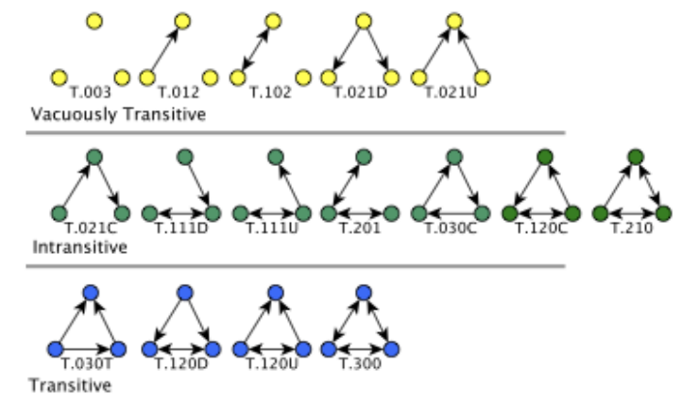
Alhazmi et al., (2015)
Notes:
Actors seek out transitive relations, and avoid intransitive relations (because it involves a middle man, and cause stress for at least one person.
A triple is transitive. If A → B, B → C, and A → C are present

Slide 10
Centrality
Individual Centrality
Local centrality vs. global centrality
Local centrality - when a node has a large number of connections to other points in its immediate environment.
Global centrality - has a strategic position within the network.
Centralization - overall centrality of the network
Whether the ties are directed to or clustered around one or a set of nodes.

Slide 11
Centrality Measures (Freeman, 1979)
Degree centrality
Closeness centrality
Betweenness centrality

Slide 12
1. Centrality measure: Degree
In-degree - # of nominations received
Out-degree - # of nominations sent
Degree measures only comparable for graphs of same size
Relative degree measures correct for the size of the graph by dividing by the maximum # of possible ties (N-1).

Slide 13
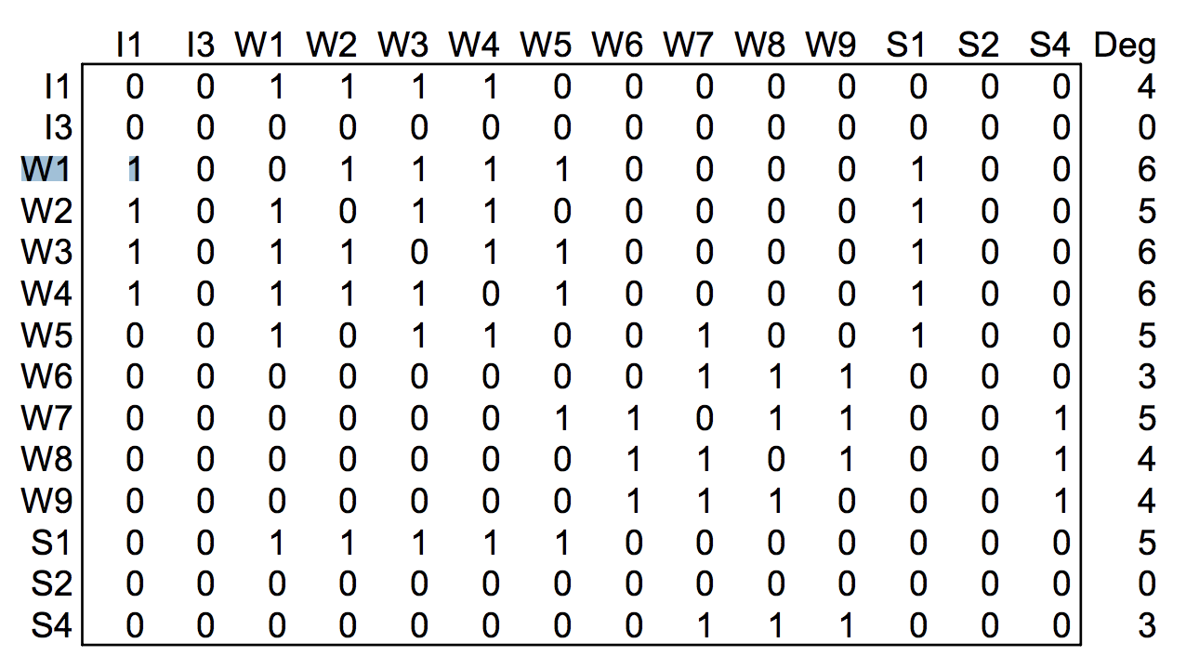
Calculating degree centrality

Slide 14
2. Centrality measure: Closeness
The farness of a node : Defined as the sum of its distances to all other nodes
Centrally close points can reach others in fewer steps
Closeness measures how long it will take to spread information from a node to all other nodes

Slide 15
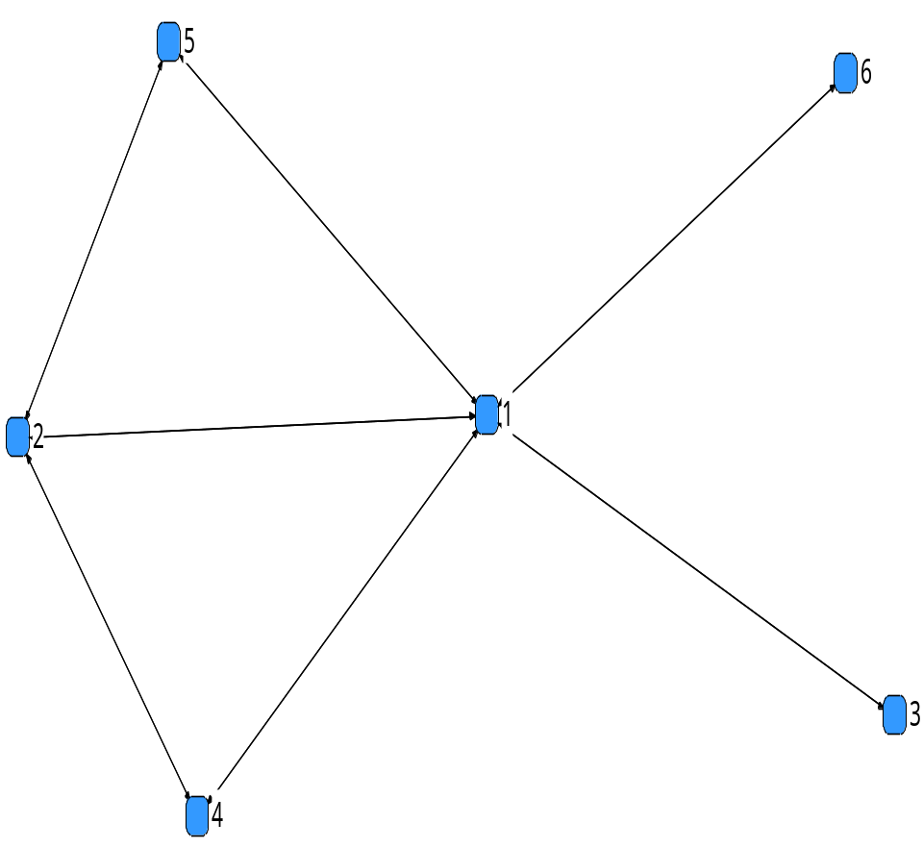
Distances
1 2 3 4 5 6
1 0 1 1 1 1 1
2 1 0 2 1 1 2
3 1 2 0 2 2 2
4 1 1 2 0 2 2
5 1 1 2 2 0 2
6 1 2 2 2 2 0

Slide 16
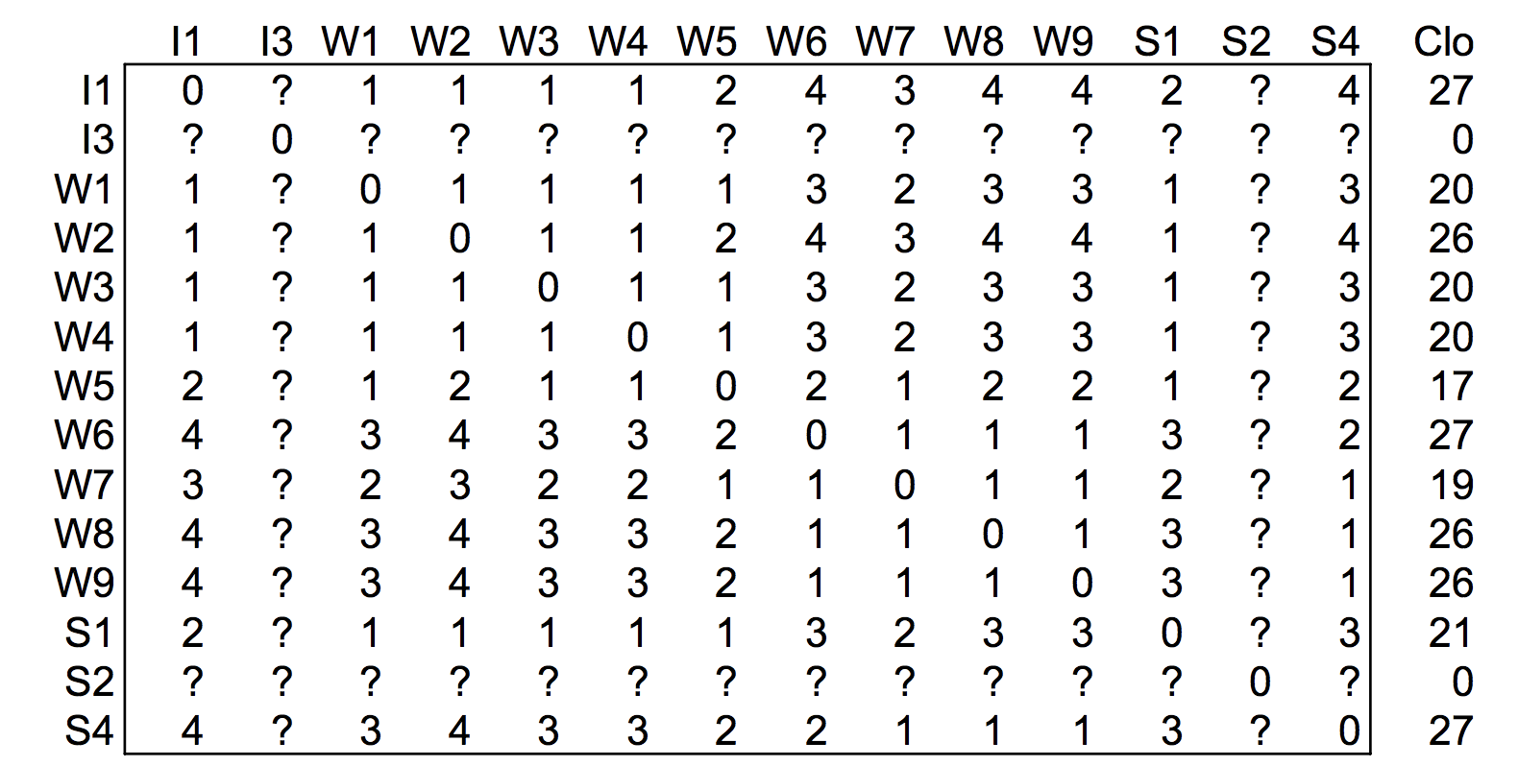
Calculating Closeness

Slide 17
Isolates in Networks
2 nodes that are unreachable technically are infinitely far apart.
Using infinity to represent being unreachable is problematic for several reasons
Dividing or summing with infinity becomes infinity
Unreachable are not necessarily infinitely far apart, rather just very far apart.

Slide 18
Values for Unconnected Pairs:
Using a variant of N the network size:
  N-1 is the maximum distance
  N-1+1 to guarantee that a disconnected pair is further apart than a pair that are maximally distant
D+1 in which D=diameter, the longest distance in the network. Unreachable nodes are one step farther apart than the most distant ones

Slide 19
3. Centrality Measure : Betweenness
The frequency a person lies on the shortest path connecting everyone else in the network
Betweenness individuals play a gatekeeper or broker role
It indicates that the individual is a possible relay between many potential communicants in the network
It can be divided by the maximum betweenness possible to get normalized betweenness.

Slide 20
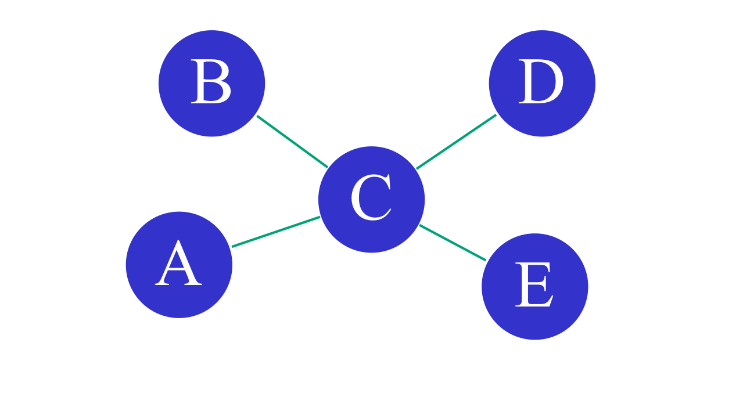
Calculating betweenness
10 path ways possible

Slide 21
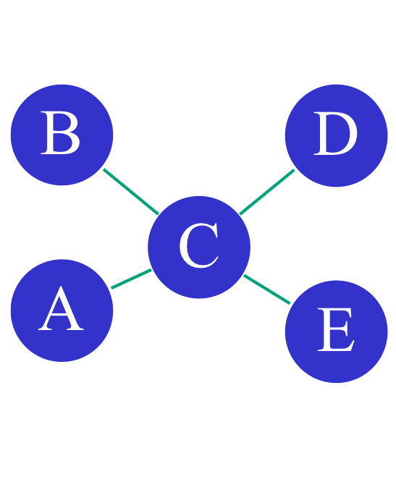
Calculating betweenness
Link | Link
A | B
A | C
A | D
A | E
B | C
B | D
B | E
C | A
C | B
D | E
Geodesic
(A,B)
(A,C)
(A,C,D)
(A,C,E)
(B,C)
(B,C,D)
(B,C,E)
(C,D)
(C,E)
(D,C,E)

Slide 22
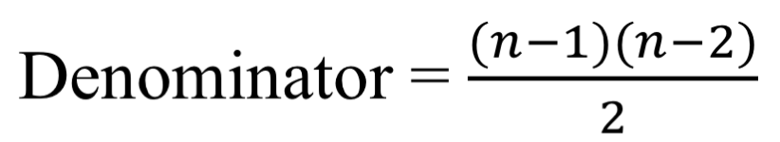
Calculating betweenness
Geodesic
(A,B)
(A,C)
(A,C,D)
(A,C,E)
(B,C)
(B,C,D)
(B,C,E)
(C,D)
(C,E)
(D,C,E)
A | B | C | D | E | F
0 | 0 | 5 | 0 | 0 | Numerator
6 | 6 | 6 | 6 | 6 | Denominator
0 | 0 | 0.83 | 0 | 0 | Betweenness

Slide 23
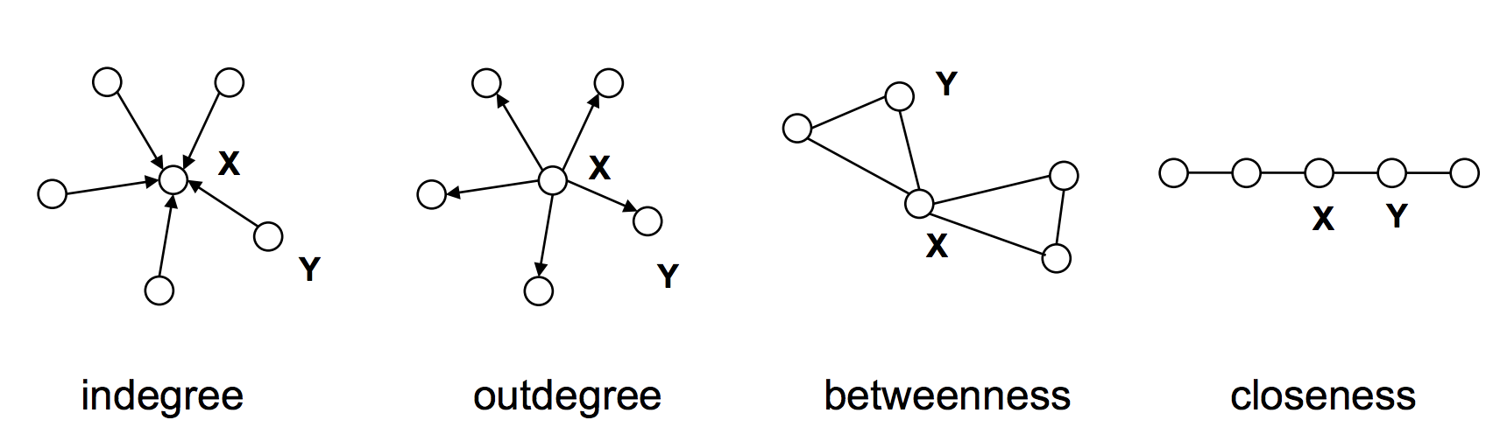
X has higher centrality than Y
Lada Adamic

Slide 24
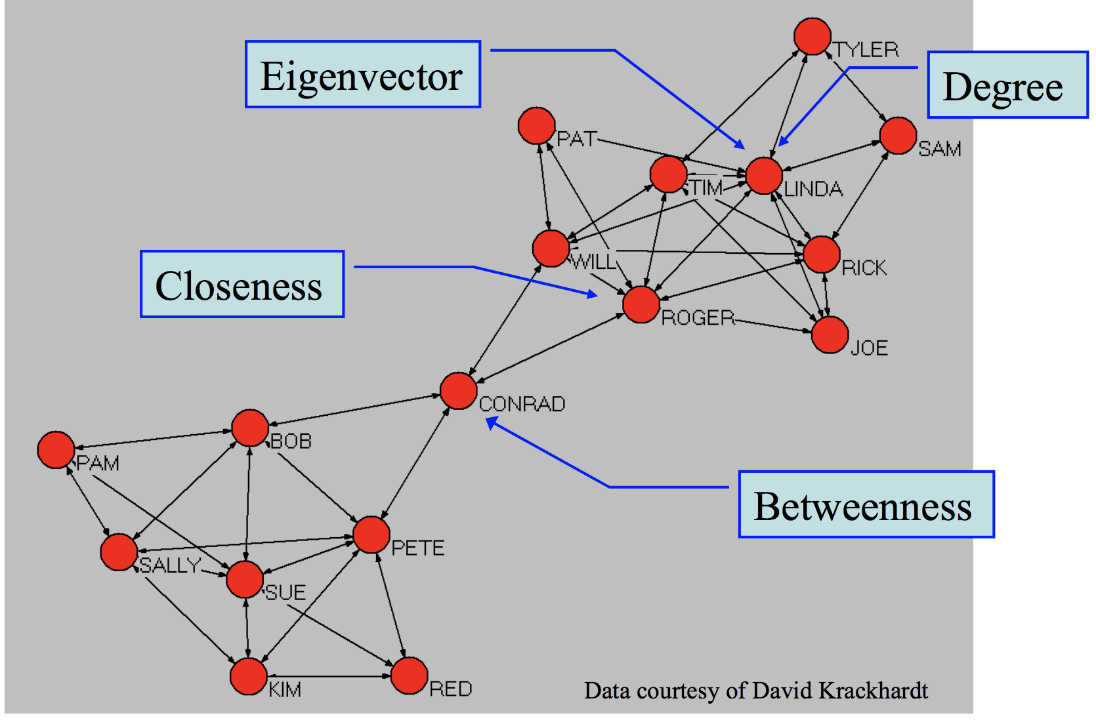

Slide 25
Centralization
The extent to which ties are organized around a set of focal points in the network
The degree of inequality or variance
For example,
1. Degree centralization is calculated by taking the sum of the differences between the node with the highest degree score and all degree scores.
2. The maximum possible sum of differences for degree is n²-3n+2.
3. Dividing the sum in 1. by the value of 2.

Slide 26
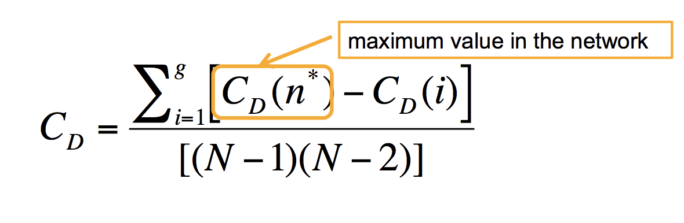
Centralization
(standard deviation)
maximum possible sum of differences for degree
A large SD indicates a centralized network
Notes:
Maximum degree = n-1
Minimum degree = 1
(n-1-1)*(n-1)+0
(n-2)*(n-1)

Slide 27
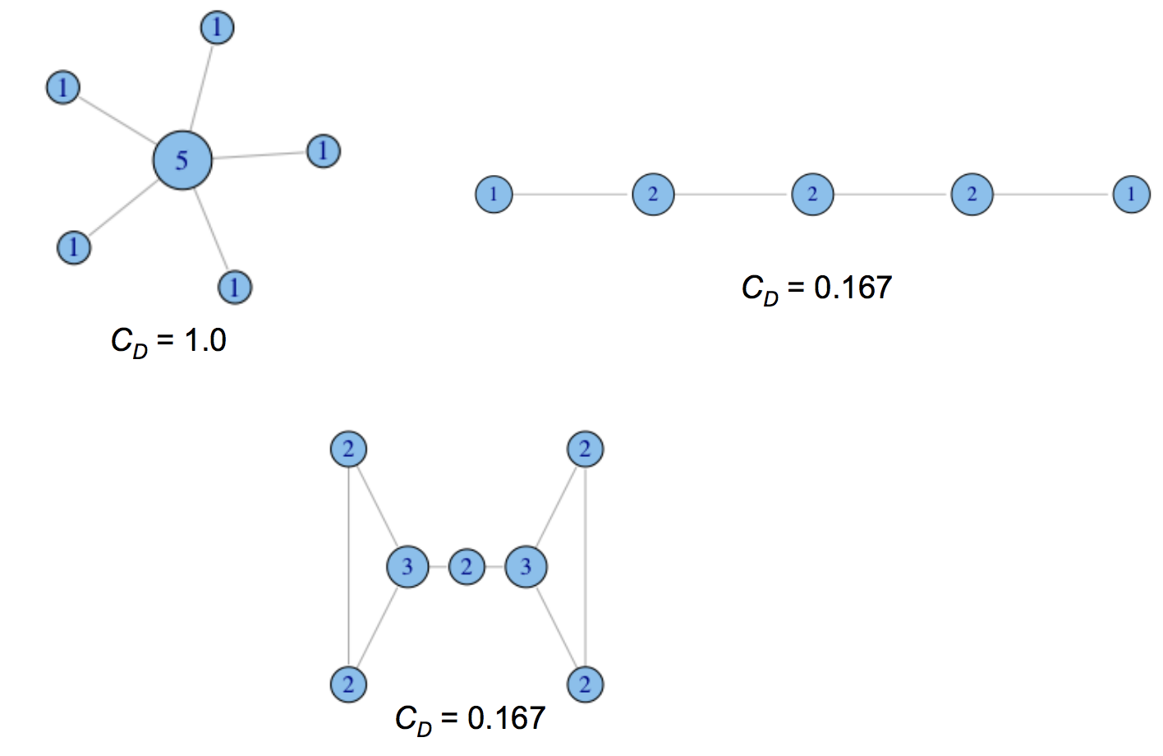
Degree centralization examples

Slide 28
Measure | Meaning
Degree | Activity
In-degree | Influence
Out-degree | Interest
Betweenness | Control
Closeness | Effeciency

Slide 29
When we have time

Slide 30
Costenbader & Valente
Centrality measures are quite stable
For indegree, up to 50% missing and it still correlates at .80 with full sample
Some measures more stable than others

Slide 31
Applications for Centrality Measures
Experimental studies – task efficiency
  Do central people enjoy completing tasks more than peripheral members?
  Are centralized networks more efficient?
  Are people as satisfied working in centralized groups as in decentralized ones?
  Is performance related to centralization or the behavior of central members?

Slide 32
Disease Transmission
Central members of networks are likely to become infected earlier than non-central members
Centralized networks may spread diseases more quickly, particularly once the central nodes become infected

Slide 33
Costenbader & Valente (2003)
People believe that missing data in network studies presents a big problem
If even one non-respondent, you lose N-1pieces of information.
If data are missing at random: How stable are centrality measures?

Slide 34
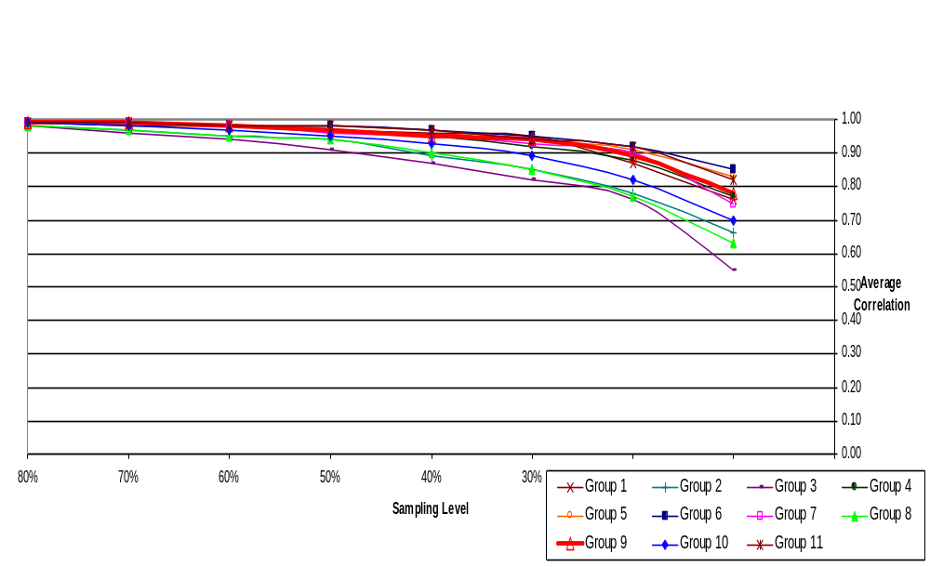
Average Correlation for In-degree Centrality
Brazilian Farmers Data

