Slide 1
Social Network Analysis Class (Spring 2019)
Jieun Shin
[ Week 2 ]
Introduction
1) Introduction to Social Network Analysis
2) Network Data Collection & Basic Measures
3) Personal/Ego-centric Methods
Measures & Methods
4) Fundamental Network Concepts 1 (Centrality)
5) Fundamental Network Concepts 2 (Groups)
6) Fundamental Network Concepts 3 (Positions)
7) Network Level Measures
8) Exponential Random Graph Models (ERGM)
Applications
8) Graphics & Visualization
9) Diffusion & Innovations
10) Digital Media & Network
11) Presentation
12) Presentation
14) Final Project

Slide 2
Week 2: Measures & Methods
There are a variety of ways to collect network data.
The variety of methods can create confusion over what constitutes “network analysis”
Type of method dictates type of analysis possible

Slide 3
Network Analysis Data Types
 | A. General | B. Specific
1. Egocentric | Roles pre-determined | Name generator
2. Sequenced | Random selection of alters | Snowball
3. Census | Nominations w/n bounded community | Roster
4. 2-mode | Nominations of events/orgs. | Membership lists

Slide 4
Egocentric : General - Roles
How often do you turn to _____ for social support:
  Mom
  Dad
  Sister
  Brother
  Friend
  Etc.

Slide 5
Egocentric : Specific – Name Generator
Please provide the names of up to 5 people you talk to about important matters.
 | Name 1 | Name 2 | Name 3 | Name 4 | Name 5
a. How do you know _____________? | 1. Family member a. Mother b. Father c. Sister 2. Friend 3. Neighbor 4. School mate 5. Other ________ _______________ | 1. Family member a. Mother b. Father c. Sister 2. Friend 3. Neighbor 4. School mate 5. Other ________ _______________ | 1. Family member a. Mother b. Father c. Sister 2. Friend 3. Neighbor 4. School mate 5. Other ________ _______________ | 1. Family member a. Mother b. Father c. Sister 2. Friend 3. Neighbor 4. School mate 5. Other ________ _______________ | 1. Family member a. Mother b. Father c. Sister 2. Friend 3. Neighbor 4. School mate 5. Other ________ _______________
b. Does he/she live within ½ mile of your home? | No Yes | No Yes | No Yes | No Yes | No Yes
c. Is _______ male or female)? | Male Female | Male Female | Male Female | Male Female | Male Female
d. How long have you known him/her | ____ yrs. ___ mos. | ____ yrs. ___ mos. | ____ yrs. ___ mos. | ____ yrs. ___ mos. | ____ yrs. ___ mos.
e. How often do you speak with him/her? | 1. once/year 2. 1x/month 3. 1x/week 4. Everyday | 1. once/year 2. 1x/month 3. 1x/week 4. Everyday | 1. once/year 2. 1x/month 3. 1x/week 4. Everyday | 1. once/year 2. 1x/month 3. 1x/week 4. Everyday | 1. once/year 2. 1x/month 3. 1x/week 4. Everyday
f. What do you usually discuss with this person? | 1. Family life 2. Politics 3. The neighborhood 4. Work 5. Other ________ _______________ | 1. Family 2. Politics 3. Neighborhood 4. Work 5. Other ________ _______________ | 1. Family 2. Politics 3. Neighborhood 4. Work 5. Other ________ _______________ | 1. Family 2. Politics 3. Neighborhood 4. Work 5. Other ________ _______________ | 1. Family 2. Politics 3. Neighborhood 4. Work 5. Other ________ _______________

Slide 6
Ego-centric Network Data are Node-based
Same or Higher
Econ. Status
Primary Schooling
Older
Live Outside
of Village
Confidants
& Friends
Kin (sister-
in-law, brother)

Slide 7
Dyadic
One way to analyze ego-centric data is to convert the data to dyadic
In dyadic data, each relationship reported by the respondent is a case in the new dataset.
Dyadic data:
  Increases sample size
  Facilitates some types of analyses
  Reflect theoretical processes of study (e.g., is behavior associated with homophily)

Slide 8
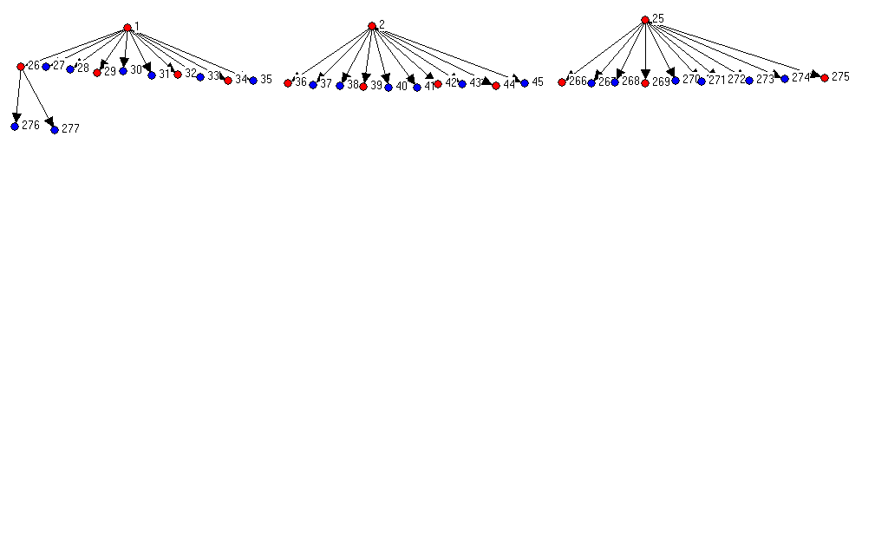
2. Sequenced and Snowball Sampling
Sequenced: random alters interviewed
Snowball: all alters interviewed
……………
……………
25 Indexes
250 1st degree
alters identified;
100 alters are
interviewed
2,000 2nd degree
Alters identified; none interviewed in pilot study
Red nodes are interviewed alters
Blue node are not Interviewed

Slide 9
Respondent Driven Sampling
Indexes are paid for their interview and given coupons to distribute to their contacts
Index gets compensated for every alter who gets interviewed and redeems his/her coupon
Alter is now an index and gets coupons to distribute

Slide 10
3.Census : Nominations within a community
Who are your five BEST FRIENDS in this class?
Think about the five people in this class who are your closest friends. Write up to 5 names on the lines below, starting with your best friend leader on the first line. If you can’t think of five names in this class, then leave the extra lines blank.
FIRST NAME
LAST NAME
1
2
3
4
5

Slide 11
3.Census : Nominations with a roster
 | How Often Do You Talk to
 | Never | 1/Year | 1/Month | 1/Week | Daily
Bob Banks | 1 | 2 | 3 | 4 | 5
Charles Chuckles | 1 | 2 | 3 | 4 | 5
David Derivative | 1 | 2 | 3 | 4 | 5
Edward Eats | 1 | 2 | 3 | 4 | 5

Slide 12
Census
The most typical kind of network methodology
Usually what people think of when we say network analysis.
These data can be graphed and analyzed using matrix methods

Slide 13
2016 Network Class
dl n=35 format = nodelist
row labels:
1 2 3 4 5 6 7 8 9 10 11 12 13 14 15 16 17 18 19 20
21 22 23 24 25 26 27 28 29 30 31 32 33 34 35
Data:
1 16
2 19 20 13 23 11
3 25 35 28
4 8 11
5 8
6 28 22 23 19
….
….
….
31
32 17 30
33 28 22 12
34 10 23 6
35 23 3 16 28 25

Slide 14
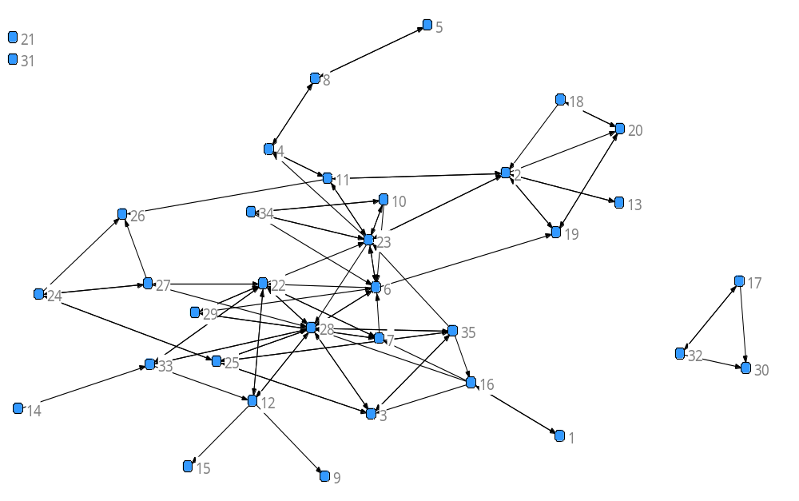
Graph of 2016 class

Slide 15
Nominations vs. Roster
Nominations
  Less demanding for Respondents
  Unaided measure
  Rank order of nominations has meaning, 1st might be closest, 2nd next closest, etc.
  If network is too dense, can restrict to fewer alters (e.g., only take 1st 3 nominations)

Slide 16
Roster
Roster
  Requires respondent to read all names
  May be biased by the way the list is formed, alphabetical for example
  If someone is left off list creates problems
  Cannot rank order choices, though you can put in a rating scale

Slide 17
4. Two-Mode Data
People who attend the same events or belong to the same groups are linked through their joint participation
Matrix manipulation of the affiliation matrix provides two matrices indicating dual nature of persons and groups.

Slide 18
Transposing a Matrix
Matrix A
Matrix A’ (transpose)
 | Event A | Event B | Event C
Person 1 | 1 | 0 | 1
Person 2 | 1 | 1 | 0
Person 3 | 0 | 1 | 0
Person N | 0 | 0 | 1
 | Person 1 | Person 2 | Person 3 |  |  | Person N
Event A | 1 | 1 | 0 |  |  | 0
Event B | 0 | 1 | 1 |  |  | 0
Event C | 1 | 0 | 0 |  |  | 1
AxA’= Person by Person
A’xA= Event by Event

Slide 19
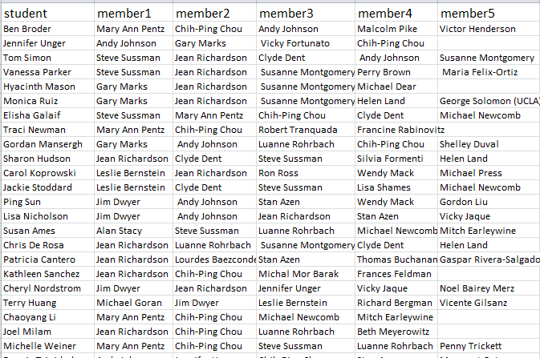
Student Dissertation Committees

Slide 20
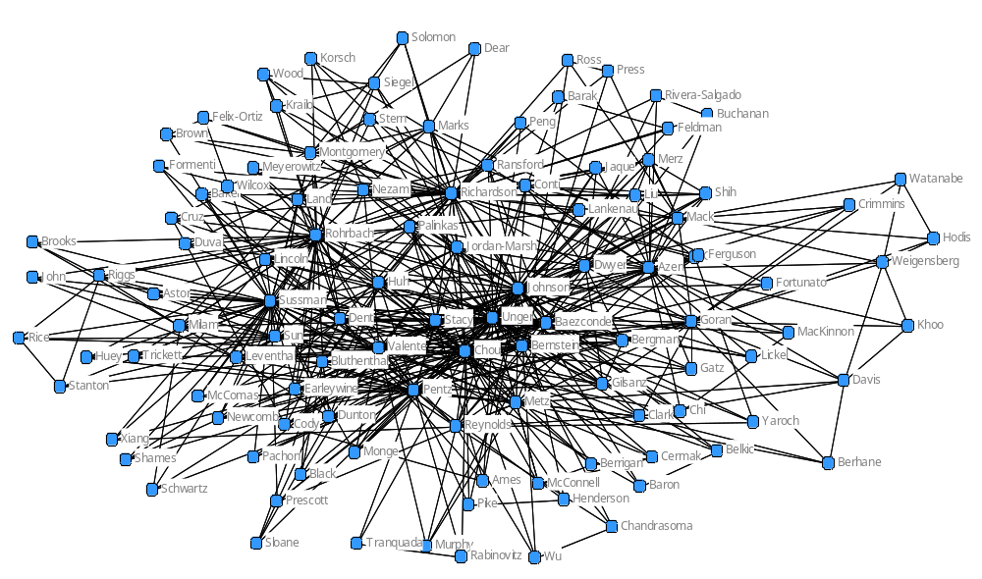
Faculty Served on Same Committee

Slide 21
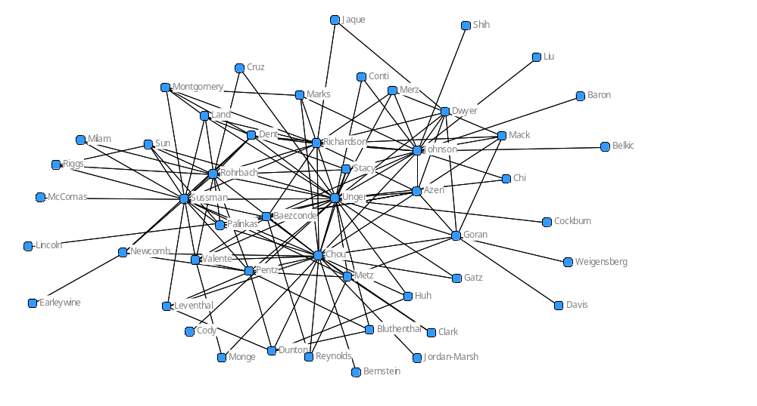
Faculty Co-membership

Slide 22
2 Types of Network Data
Ego-Centric
Sociometric
9
10
1
12
3
4
1
2
11
7
5
2
8
6

Slide 23
Visualization of Graph
Graph Theory
  Nodes connected by ties
  Individuals connected by relations
  Organizations connected by shared attributes (or exchange)
There is no one "correct" way to draw a graph – in fact there are an infinite number.
Types of lines
  non-directed vs. directed
  binary vs. valued
  uni-plex vs. multiplex (# of relations)

Slide 24
Network Terminologies
adjacent - two points connected by a line
neighborhood - set of adjacent points
degree - numerical measure of neighborhood
walk - sequence of lines
path - lines in a unique walk
distance - length of shortest path (geodesic)
in-degree - # of lines directed toward point
out-degree - # of lines directed away from a point

Slide 25
Network Density
maximum # of ties: n(n-1)/2
(e.g.., n=5-->max.=10; n=6-->max.=15)
density = total # of lines divided by the maximum possible
density = lines/(n(n-1)/2
Not clear what the denominator should be for valued ego-centric density calculations.
Density is dependent on the size of a graph and this prohibits comparison of density measures between graphs. Larger graphs, all things equal, will have lower densities than small graphs.

Slide 26
Density
1. symmetric data:
maximum # of ties: n(n-1)/2
density = total # of lines divided by the maximum possible
density = lines/(n(n-1)/2
2. directed data:
maximum # of ties: n(n-1)
density = total # of lines divided by the maximum possible
density = lines/(n(n-1)

Slide 27
Network Ties Have 3 Components
1. Role - How related friend, spouse, co-worker, etc.
2. Meaning and Content - What do ties talk about? That is, love, politics, health, etc.?
3. Strength - How well are ties connected? That is, not so well or very close strong ties? Do they talk often or rarely?

