Slide 1
Social Network Analysis Class (Spring 2019) Jieun Shin [ Week 3 ]
Introduction
1) Introduction to Social Network Analysis
2) Network Data Collection & Basic Measures
3) Personal/Ego-centric Methods
Measures & Methods
4) Fundamental Network Concepts 1 (Centrality)
5) Fundamental Network Concepts 2 (Groups)
6) Fundamental Network Concepts 3 (Positions)
7) Network Level Measures
8) Exponential Random Graph Models (ERGM)
Applications
8) Graphics & Visualization
9) Diffusion & Innovations
10) Digital Media & Network
11) Presentation
12) Presentation
14) Final Project

Slide 2
Week 3: Egocentric Data
Ego-centric network analysis is about relations surrounding individuals or social contexts of an individual
Egocentric network data are collected from independently sampled units (people).
Respondents are asked a “name generator” question and then respondents provide data on these alters
Ego centric data provide some estimate of a person’s immediate close ties
Notes:
2

Slide 3
The shape of an ego-centric network
Ascribed characteristics
Achieved characteristics
Sex
Age
Race
Income
Occupation
Religion
Cutural Taste

Slide 4
Burt, 1984 GSS Egocentric Survey
Proposed and tested a set of egocentric network survey items
Recommended name generator “Name up to 5 people you discuss important matters with”
Discussion networks are stable and salient
Network questions were included in the GSS for the first time (1985), due largely to the efforts of Burt
The GSS is expensive ($600,000)

Slide 5
Egocentric Survey (sample)
Please provide the first names or initials of up to 5 people you
talk to about important matters.
 | Name 1 | Name 2 | Name 3 | Name 4 | Name 5
a. How do you know _____________? | 1. Family 2. Friend 3. Neighbor 4. School mate 5. Other _____________ | 1. Family 2. Friend 3. Neighbor 4. School mate 5. Other ____________ | 1. Family 2. Friend 3. Neighbor 4. School mate 5. Other ____________ | 1. Family 2. Friend 3. Neighbor 4. School mate 5. Other ____________ | 1. Family 2. Friend 3. Neighbor 4. School mate 5. Other ____________
b. Does _________ live within 5 miles of your home? | No Yes | No Yes | No Yes | No Yes | No Yes
b. Is _______ male or female)? | Male Female | Male Female | Male Female | Male Female | Male Female
c. How long have you known _________? | ____ mos ___ yrs. | ___ mos ___ yrs. | ___ mos ___ yrs. | ___ mos ___ yrs | ___ mos ___ yrs.
d. How often do you see _________? | 1. Daily 2. 1x/week 3. 1x/month 4. once | 1. Daily 2. 1x/week 3. 1x/month 4. once | 1. Daily 2. 1x/week 3. 1x/month 4. once | 1. Daily 2. 1x/week 3. 1x/month 4. once | 1. Daily 2. 1x/week 3. 1x/month 4. once
e. Does _________ smoke? | No Yes | No Yes | No Yes | No Yes | No Yes
f. What do you usually discuss with _________ ? | 1. Family 2. Politics 3. Neighborhood 4. Work 5. Other ______________ | 1. Family 2. Politics 3. Neighborhood 4. Work 5. Other ____________ | 1. Family 2. Politics 3. Neighborhood 4. Work 5. Other ____________ | 1. Family 2. Politics 3. Neighborhood 4. Work 5. Other ____________ | 1. Family 2. Politics 3. Neighborhood 4. Work 5. Other ____________

Slide 6
Graphs of Ego-centric
1
2
3
4
5
Notes:
6

Slide 7
Egocentric Survey
Does _____ know _____?
 | Name 1 | Name 2 | Name 3 | Name 4 | Name 5
a. Name 1
b. Name 2 | No Yes
c. Name 3 | No Yes | No Yes
d. Name 4 | No Yes | No Yes | No Yes
e. Name 5 | No Yes | No Yes | No Yes | No Yes

Slide 8
Graphs of Ego-centric
1
2
3
4
5
Notes:
8

Slide 9
Ego-centric Networks
Typically the following characteristics are measured:
1. Type of relation (family, friend, coworker)
2. Strength of relation (close, acquaintance, stranger; how long known)
2. Frequency of interaction (how often talk to)
4. Socio-economic characteristics (education, religion, wealth)
5. Demographic characteristics (age, location)
6. Substantive characteristics (approve of abortion)
7. Content of communication (discuss politics, health, child rearing)
9
Notes:
9

Slide 10
egocentric variables:
Compositional (e.g., mean, percentage)
Heterogeneity (variance)
Size- number of alters
Density – connectedness of alters

Slide 11
Marsden (1987) “Core Discussion Networks”
Data show remarkably high tendency of homogeneity- and may be underestimated because of presence of kin
These are “core” networks, they are small, centered on kin, comparatively dense, and homogenous by comparison to the R population.

Slide 12
McPherson, Smith-Lovin, & Brashears (2006)
They replicated the 1985 network questions in the 2004 GSS
Questions used
From time to time, most people discuss important matters with other people. Looking back over the last six months—who are the people with whom you discussed matters important to you? Just tell me their first names or initials.
If less than 5 names mentioned, probe: Anyone else?
Please think about the relations between the people you just mentioned. Some of them may be total strangers in the sense that they wouldn’t recognize each other if they bumped into each other on the street. Others may be especially close, as close or closer to each other as they are to you.
Are they especially close? PROBE: As close or closer to each other as they are to you?

Slide 13
McPherson, Smith-Lovin, & Brashears (2006)
Discussion networks were smaller in 2004 than in 1985.
# of people saying there is no one with whom they discuss important matters nearly tripled.
Size decreased by about a 1/3 (one confidant), from 2.94 in 1985 to 2.08 in 2004.

Slide 14
The GSS Controversy
Fisher (2006)
Problems with the survey instruments : A block of taxing questions were placed in prior to the network questions. Respondents knew that more names would lead to more questions
A random technical error : some respondents who declined to answer the network question were misclassified in a way that lumped them in with those that said they don’t have any discussion partners
Problem with the question wording : Some people may have not considered online communication

Slide 15
Ego Centric Data Used to Study 5 Behavioral Hypotheses
Degree/Size
Personal Network Exposure
Ties Strength
Concurrency
Density/Constraint
Notes:
15

Slide 16
1. Ego-centric – degree/size
Higher Risk
Or More Privileged Position
Lower Risk
Or Isolated
Notes:
16

Slide 17
Size
Basic and critical variable in analysis
Often restricted to name up to 5 or 7 alters so the variable is censored.
5 names is the cost effective number of alters to record (Merluzzi & Burt, 2013)

Slide 18
2. Personal Network Exposure
= Non-User
= User
Exposure=33%
Exposure=66%
Exposure=100%
18
Notes:
18

Slide 19
Personal Network Thresholds
= Non-FP User
= FP User
PN Exposure=33%
PN Threshold=33%
PN Threshold=66%
Low Threshold Adopter
High Threshold Adopter
19
Notes:
19

Slide 20
3. Ego-centric –Tie Strength
Weak ties are strong for communicating information,
strong ties necessary for behavior change.
The more complex the behavior, the more tie strength matters.
Notes:
20

Slide 21
Ways to Incorporate Tie Strength
Take the average of any tie strength measure you have such as closeness or frequency of communication.
Convert the data to dyadic and test whether stronger ties are more strongly associated with behavioral homophily than weak ones.

Slide 22
Dyadic Data
Ego-centric data are converted to dyadic in which case is the person-alter relationships.
If 100 respondents name an overage of 3.1 alters, the dyadic data has 310 cases.
Makes testing some hypotheses easier (e.g., association between behavior and gender homophily).

Slide 23
Dyadic Format
Normal Data (wide) |  |  |  |  | Dyadic (long)
Bob | Mary | Jim | Sue |  | Bob | Mary
Amy | Sam | Ken |  |  | Bob | Jim
 |  |  |  |  | Bob | Sue
 |  |  |  |  | Amy | Sam
 |  |  |  |  | Amy | Ken
Notes:
23

Slide 24
Testing Relational Hypotheses
Is behavioral correspondence more likely among homogeneous pairs than among heterogeneous ones.
E.g., Smoking similarity greater among same sex pairs than among different sex pairs.

Slide 25
Valente & Vlahov (2001) Baltimore NEP
Time Period: August 12, 1994 - February 12, 1997
Repeated interviews with 1,184 respondents at baseline, 2-week, 6-month, 1-year, 18-month
Included ego-centric questions on survey
“Provide the initials or nicknames of up to 5 your closest friends”
Asked whether the respondent shared syringes with each friend named
Notes:
25

Slide 26
Schematic of Needle Network Study
Get Needles
Return Needles
Registration
N=3,500
Return to van periodically
and continue about their
business
Every
Seventh
Participated in
Evaluation
Study N=448
Interviewed at Baseline
2-weeks (364),
6 mos. (308),
1 year (175), and
18 mos. (88).
26
Notes:
26

Slide 27
Graph of reported syringe sharing by friendship rank and survey wave : sharing decreases
Notes:
27

Slide 28
Valente et al. (2001) Syringe relay
# of Needles a Person Acquired and Returned
1 2 3 4 5 …… 57..
Number of Needles Person 3
Acquired and Person 57 Returned
1
2
3
4
5
.
57
Number of Needles Person 57 Acquired
and Person 3 Returned
Notes:
28

Slide 29
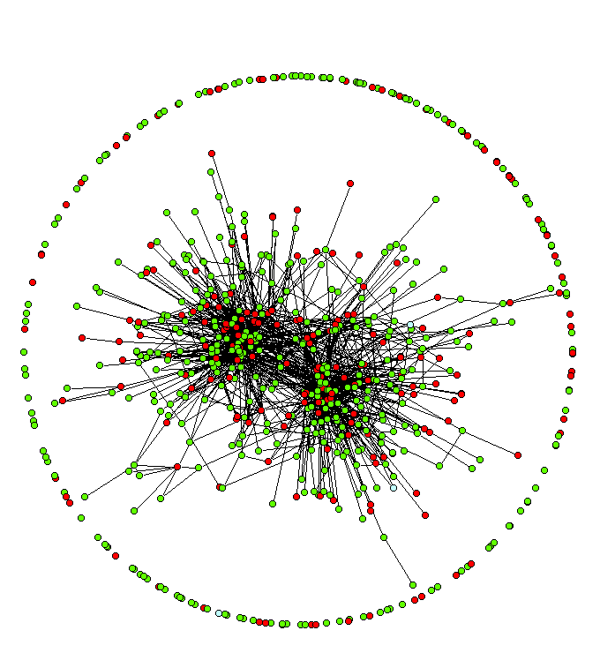
BNEP Evaluation Sample: Links indicate connection via syringes and red indicates HIV+
Notes:
29

Slide 30
4. Ego-centric -Concurrent
Serial
Concurrent
Notes:
30

Slide 31
Concurrency
Changes the sexual contact network
Simulation studies show that HIV spreads more rapidly when concurrency is common.
Data driven simulation show that concurrency may be responsible for the HIV epidemic in South Africa and for racial disparities in HIV in the US

Slide 32
Concurrency (cont.)
Difficult to measure concurrency accurately since it requires enrolling indexes and their partners who might not want to be identified
Also challenging because disease spread depends significantly on the type and duration of the behavior.

Slide 33
5. Dense vs. Radial Personal Networks
Ego
Ego
Integrated/Dense/ Constrained
Personal Network
Radial/Open
Personal Network
Notes:
33

Slide 34
Snowball Sampling (sequenced method)
Often used for recruitment into clinical trials; or
Prevention studies
Index cases nominate or recruit alters

Slide 35
Network linkages among indexes and alters in which at least one alter was enrolled (794 links, 59.2%).
D
A
C
B

Slide 36
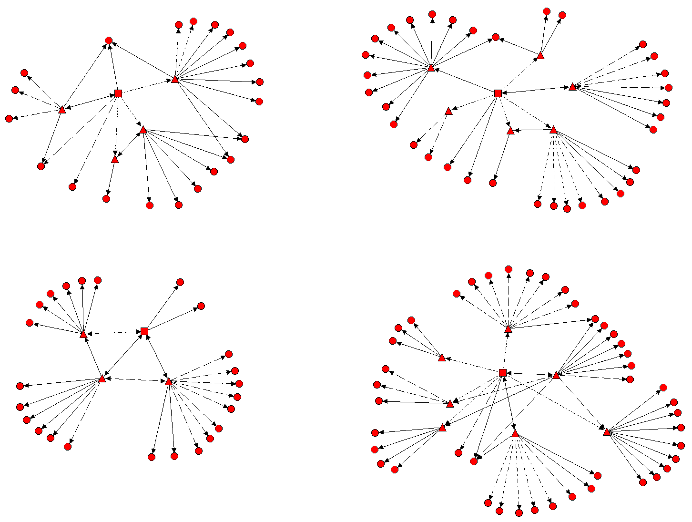
A
B
C
D

Slide 37
Network Data Types
Local – ego-centric
Partial – sequenced methods
Complete - sociometric

Slide 38
Respondent Driven Sampling (special type of snowball sampling)
Indexes are paid for their interview and given coupons to distribute to their contacts
Index gets compensate for every alter who gets interviewed and redeems his/her coupon
Alter is now an index and gets coupons to distribute
A fixed number of coupons per person reduces the dependency between the seeds and the final sample
Relying on Rs to pass coupons to recruit others reduces the confidentiality concerns in a potentially stigmatized population

Slide 39
Personal v. Sociometric Data
Several studies have tested the correspondence between ego-centric and sociometric data;
Generally find poor agreement on what ego thinks alters do, and what alters self-report
Stronger associations with behavior for perceived alter behavior than alter self-report.

