Slide 1
Too Hot To Talk
A Dynamic Study of Weather and Received Signal Strength on Wireless Transmission
Allison Todd

Slide 2


Received Signal Strength is an important measurement used in many different applications and research topics and should be explored further within the POWDER testbed
Improving and automating the process of gathering signal strength data
Understanding the relationship between current weather and signal strength data

Slide 3

Improving and Automating

Slide 4
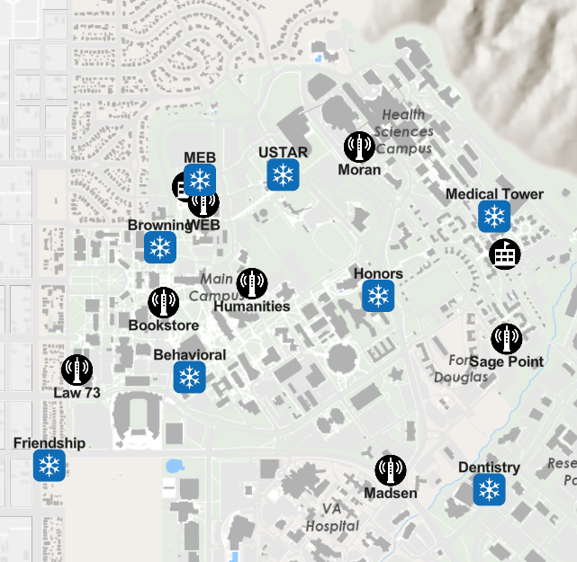
Background
Use of rooftop base stations within the POWDER advanced wireless testbed at the University of Utah
USRP Hardware Driver (UHD) Library
Use of CBRS, specifically transmitting at 3.555 GHz
Relative power measurements in dB
RSS value of - 86 corresponds noise floor
Notes:
Noise floor = reception with no visible transmission

Slide 5
Method
Update UHD commands on rooftop base station SDRs
Improve uhd_siggen timing
Use Python’s Fabric library to remotely access base stations
Use Python Multiprocessing to transmit and receive simultaneously
Python scripts that allow for a variety of different transmission and reception combinations

Slide 6
Automated Collection Tool
Automated process of gathering received signal strength measurements between every combination of transmitter and receiver
 | BES | Browning | Dentistry | FM | Honors | MEB | SMT | USTAR
BES | x | -67.3515 | -86.4586 | -80.2778 | -74.0296 | -61.222 | -85.1051 | -84.6483
Browning | -67.6534 | x | -86.3396 | -59.5711 | -71.0958 | -48.2259 | -85.2628 | -54.4489
Dentistry | -66.4941 | -80.9542 | x | -79.5306 | -71.7399 | -84.9279 | -84.9796 | -84.5642
FM | -75.7799 | -76.9733 | -86.2353 | x | -71.4223 | -82.1362 | -85.4893 | -80.303
Honors | -83.5305 | -79.4032 | -86.3222 | -83.1574 | x | -77.9564 | -85.4169 | -75.1285
MEB | -59.3038 | -52.3777 | -86.3914 | -80.4752 | -68.3281 | x | -84.2641 | -63.9794
SMT | -80.1833 | -70.2205 | -86.3907 | -81.233 | -62.996 | -85.0725 | x | -80.5034
USTAR | -79.1835 | -57.1573 | -86.3122 | -79.1866 | -76.2496 | -65.8648 | -85.0647 | x
* Row corresponds to transmitter and column corresponds to receiver

Slide 7
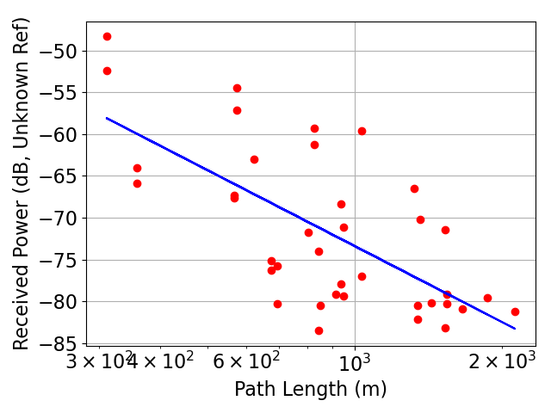
Power and Distance
Using data collected and plot_rxpower_vs_distance.py to determine relationship between power and distance then confirm accuracy of data
My Data:
Path Loss = 3.01863
Rx Power @ Ref = 17.17147
Std of Error = 6.95534
Previous Data:
Path Loss = 3.59104
Rx Power @ Ref = 22.05918
Std of Error = 8.54060

Slide 8

Understanding Weather

Slide 9
Related Work
Increased temperature causes a reduction of current and therefore power
There is a linear relationship between temperature and received signal strength values (Boano et al.)
Water droplets on wireless devices due to rainfall cause a decrease in power measurements (Hillyard et al.)

Slide 10
Background
Weather data is collected using the Open Weather Map API
Environmental temperature, rainfall, wind speed, and humidity are collected
The individual temperatures of the transmission and reception base station are also collected

Slide 11
Method
Using the tools built previously, power data is collected between the specified rooftop base stations
Weather data is then collected using the Open Weather Map API
Both power and weather data is collected every minute for as long as desired
Specific device temperature data is then gathered from the POWDER database for the duration of data collection

Slide 12
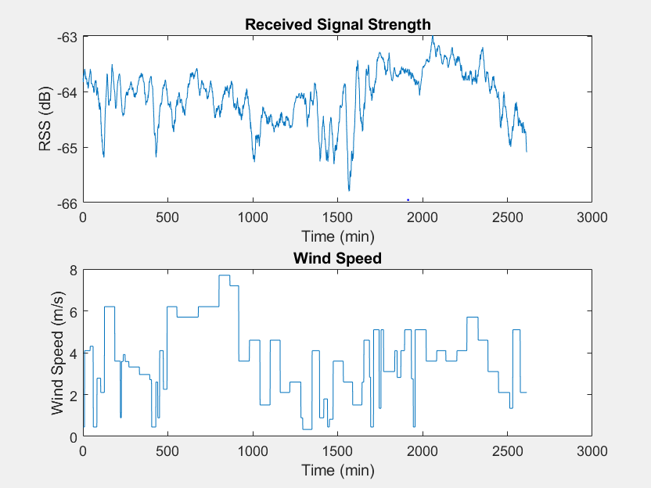

RSS and Wind Speed
8 am
8 pm
8 am
6 pm
8 am
8 pm
8 am
6 pm

Slide 13
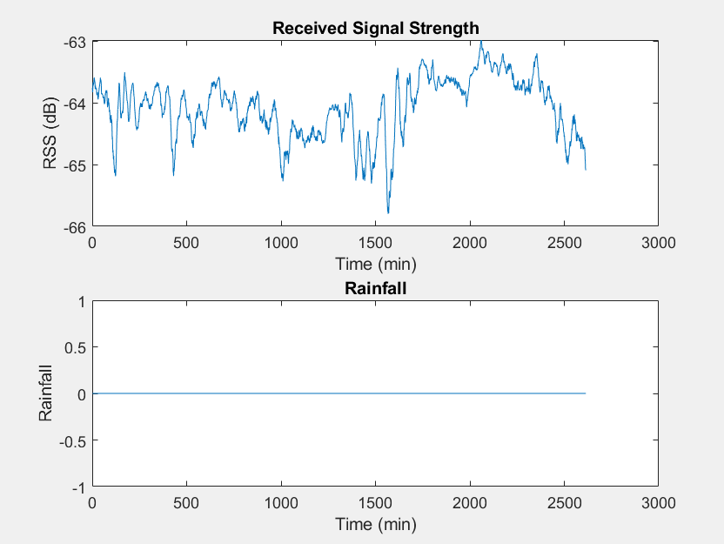
RSS and Rainfall
8 am
8 pm
8 am
6 pm
8 am
8 pm
8 am
6 pm

Slide 14
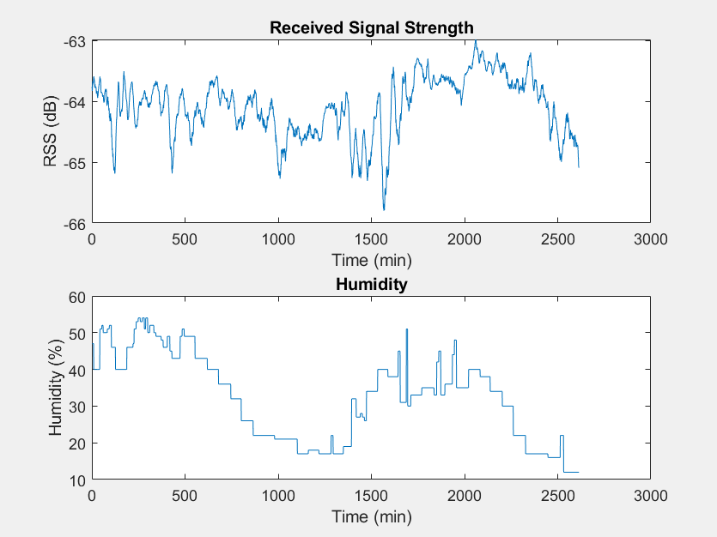
RSS and Humidity
8 am
8 pm
8 am
6 pm
8 am
8 pm
8 am
6 pm

Slide 15
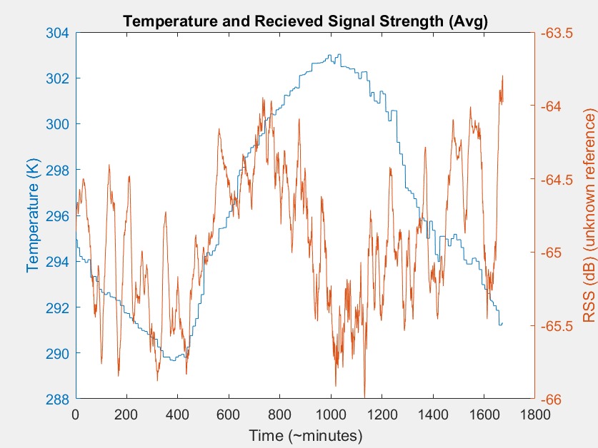
RSS and Environmental Temperature
8 pm
8 am
8 pm
* From previous data collection for 28 hours

Slide 16
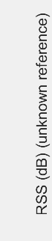
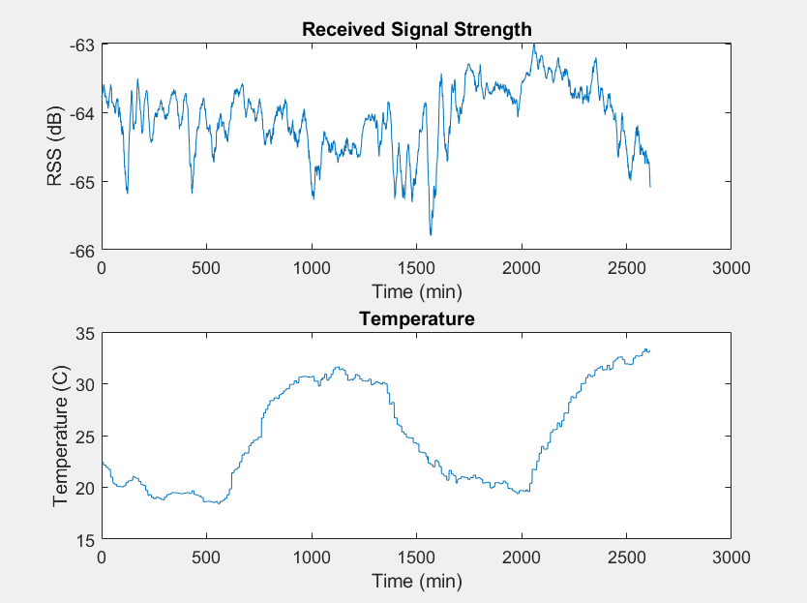
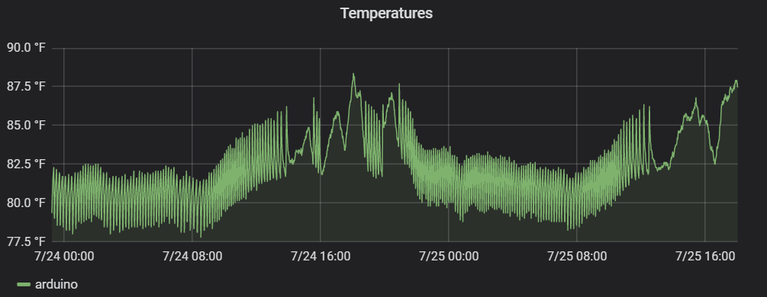
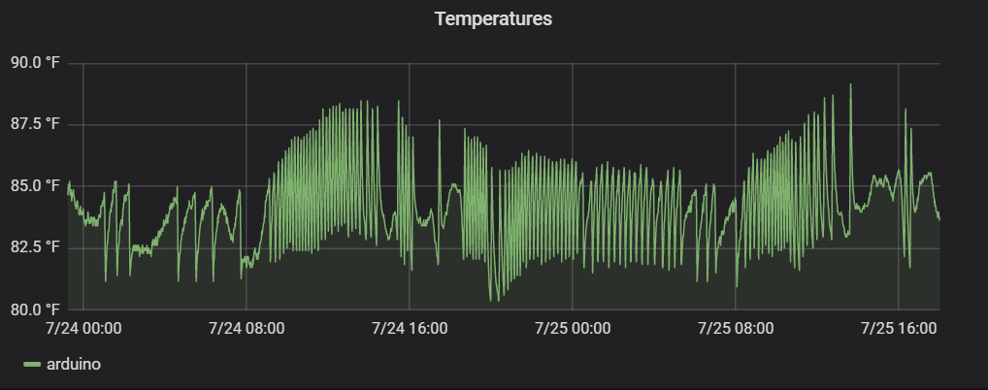
RSS and Temperature
MEB Temperature (Tx)
8 am
8 pm
8 am
6 pm
8 am
8 pm
8 am
6 pm
USTAR Temperature (Rx)
8 am
8 pm
8 am
6 pm
8 pm
8 am
8 am
6 pm

Slide 17
References
C. A. Boano, H. Wennerstrom, M. A. Zuniga, J. Brown, C. Keppitiyagama, F. J. Oppermann, U.Roedig,L. A.Norden,T.Voigt, and K.Romer. HotPackets: A systematic evaluation of the effect of temperature on low power wireless tranceivers. In Proceedings of the 5th Extreme Conference on Communication, 2013.
P. Hillyard, A. Luong, and N. Patwari. Highly Reliable Signal Strength-Based Boundary Crossing Localization in Outdoor Time-varying Environments. In Proceedings of the 15th ACM/IEEE International Conference on Information Processing in Sensor Networks, 2016.

Slide 18

Questions

