Slide 1
Conceptual Design with
ER Model
Lecture #2

Slide 2
What This Course Will Cover
How to create and use a database
How a database management system works

Slide 3
How to Create and Use a DB
A company has
  business people, support people (eg developers), customers
Business people need DBs when the data is large
Customers also need DBs when the data is large
Accessing DBs
  Customers use Web pages
  Business people use Web pages or prompts
  Developers mostly use prompts

Slide 4
How to Create and Use a DB
Business people tell developers what to do
The conversation between these two people is tricky
Developers need to know
  The scope of a DB
  All important constraints
    That exist now, or may occur in the future
  Other stuff
    Such as how much data now, and may have in the future
How to talk with business people about all these?

Slide 5
Steps in Building a DB Application
Step 0: pick an application domain
Step 1: conceptual design
  discuss what to model in the application domain
  need a modeling language to express what you want
  ER model is the most popular such language
  output: an ER diagram of the app. domain

Slide 6
Example ER
name
category
name
price
makes
Company
Product
stockprice
buys
employs
Person
address
name
ssn
Notes:
3 main types of concepts: entity sets, relations, attributes
no operations

Slide 7
Steps in Building a DB Application
Step 2: pick a type of DBMS
  relational DBMS is most popular and is our focus
Step 3: translate ER design to a relational schema
  use a set of rules to translate from ER to rel. schema
  use a set of schema refinement rules to transform the above rel. schema into a good rel. schema
At this point
  you have a good relational schema on paper

Slide 8
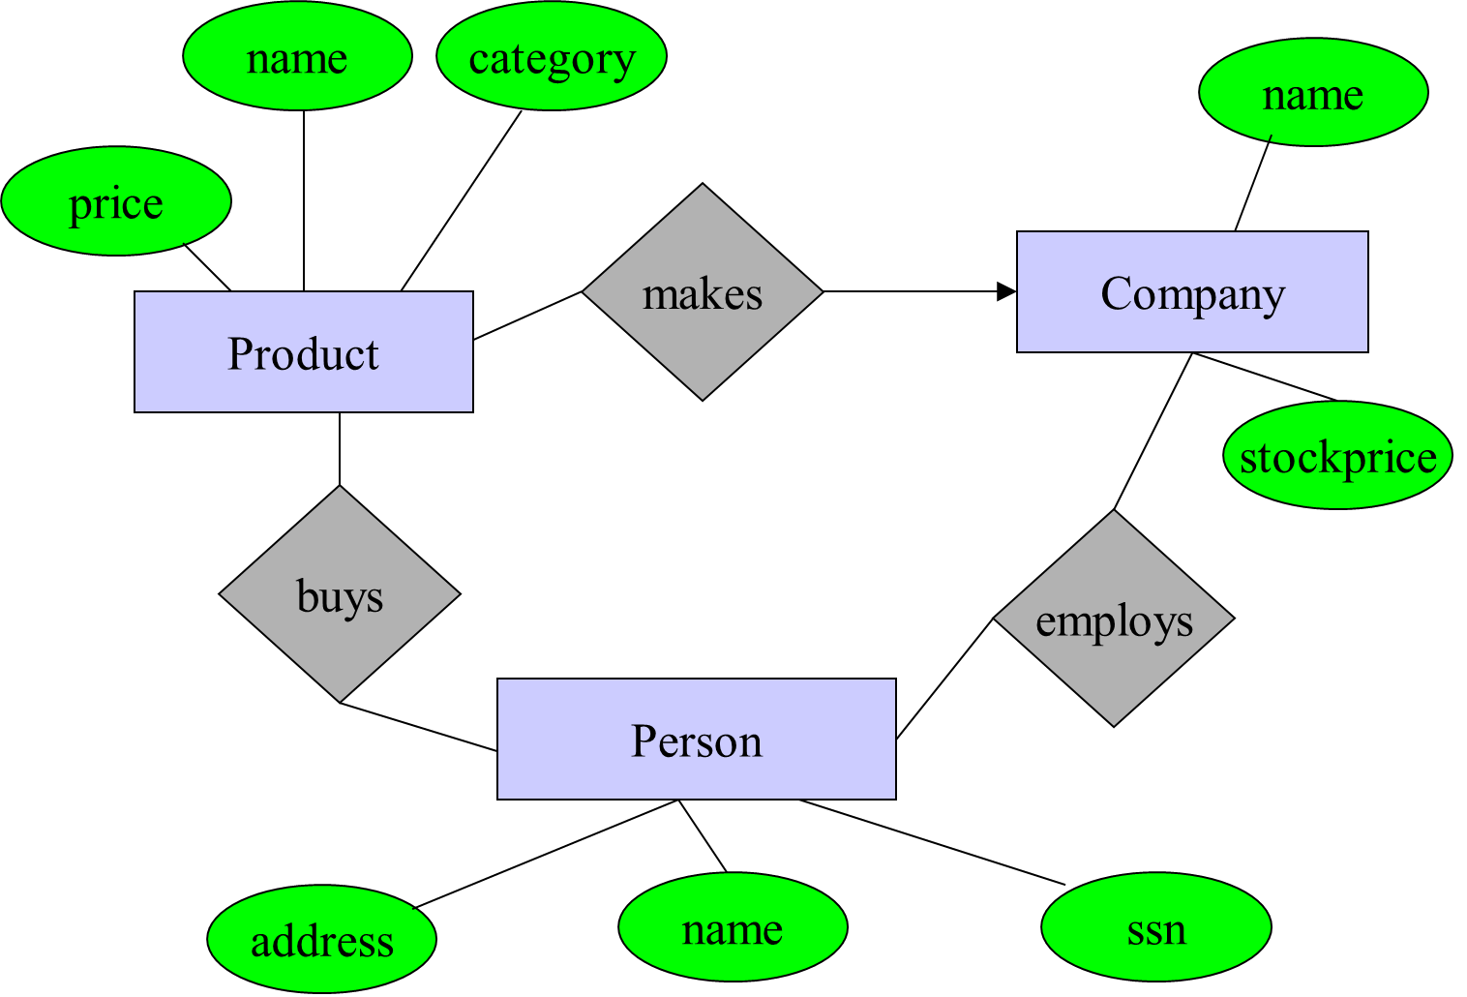
Product(name, category, price)
Person(name, ssn, address)
Company(name, stockprice)
Buys(ssn, name)
…

Slide 9
Steps in Building a DB Application
Subsequent steps include
  implement your relational DBMS using a "database programming language" called SQL
  ordinary users cannot interact with the database directly
  and the database also cannot do everything you want
  hence write your application program in C++, Java, Python, etc to handle the interaction and take care of things that the database cannot do
So, the first thing we should start with is to learn ER model ...

Slide 10
ER Model
Gives us a language to specify
  what information the db must hold
  what are the relationships among components of that information
Proposed by Peter Chen in 1976
What we will cover
  basic stuff
  constraints
  weak entity sets
  design principles

Slide 11
Basic Concepts
name
category
name
price
makes
Company
Product
stockprice
buys
employs
Person
address
name
ssn
Notes:
3 main types of concepts: entity sets, relations, attributes
no operations

Slide 12
Entities and Attributes
Entities
  real-world objects distinguishable from other objects
  described using a set of attributes
Attributes
  each has an atomic domain: string, integers, reals, etc.
Entity set: a collection of similar entities
price
name
category
name
Product
Company
stockprice

Slide 13
Discussion
What does it mean to have “atomic attribute”?
How to translate an entity set into a table?
Why having atomic attributes?

Slide 14
Relations
A mathematical definition:
  if A, B are sets, then a relation R is a subset of A x B
A={1,2,3}, B={a,b,c,d},
  R = {(1,a), (1,c), (3,b)}
1
a
2
b
A=
c
3
B=
d

Slide 15
ER Diagram
name
category
name
price
makes
Company
Product
stockprice
buys
employs
Person
address
name
ssn
Notes:
plus a bunch of other specifications that cannot be pictorially represented
must be specified in English

Slide 16
More about relationships ...

Slide 17
Types of Binary Relations
one-one:
many-one
many-many
1
2
3
a
b
c
d
1
2
3
a
b
c
d
1
2
3
a
b
c
d
makes
Company
Product
Notes:
at most 1
a special case of a constraint on the degree of the relation (e.g., at most 10)

Slide 18
Important: Difference with the Book
We will use
Manages
Employee
Department
Cow book use (see Page 33, 3rd edition)
Manages
Employee
Department
You should use the notations in the lectures

Slide 19
Discussion
one-one relation means
  one entity in A is associated with AT MOST one entity in B, and vice versa
how to translate these relations into tables?

Slide 20
Multiway Relationships
How do we model a purchase relationship between buyers,
products and stores?
Product
Purchase
Store
Person

Slide 21
Arrows in Multiway Relationships
Q: what does the arrow mean ?
A: if I know the store, person, invoice, I know the movie too
will discuss in class what “know” means here
Invoice
VideoStore
Rental
Movie
Person

Slide 22
Arrows in Multiway Relationships
Q: what do these arrow mean ?
A: store, person, invoice determines movie
and store, invoice, movie determines person
will discuss in class what “determines” means
Invoice
VideoStore
Rental
Movie
Person

Slide 23
Arrows in Multiway Relationships
Q: how do I say: “invoice determines store” ?
A: no good way; best approximation:
Q: Why is this incomplete ?
Invoice
VideoStore
Rental
Movie
Person
Notes:
functional dependencies are generalizations of this

Slide 24
Roles in Relationships
What if we need an entity set twice in one relationship?
Product
Purchase
Store
salesperson
buyer
Person
Person

Slide 25
Roles in Relationships
What if we need an entity set twice in one relationship?
Product
Purchase
Store
salesperson
buyer
Another example:
marriage
Discuss how to translate this to tables
Person

Slide 26
Attributes on Relationships
date
Product
Purchase
Store
Person
Notes:
not necessary, but useful

Slide 27
Converting Multiway
Relationships to Binary
date
ProductOf
Product
Purchase
StoreOf
Store
BuyerOf
Person
Notes:
note the many-one nature of the converted relationships

Slide 28
Discussion
Give an example of tables to illustrate this conversion from multiway to binary relations
Emphasize that
  no clear boundary between entity set and relationship
  something can be a relation, e.g., purchase
    but we can revise the ER diagram to make it into an entity set

Slide 29
Relationships: Summary
Modeled as a mathematical set
Binary and multiway relationships
Converting a multiway one into many binary ones
Constraints on the degree of the relationship
  many-one, one-one, many-many
  limitations of arrows
Attributes of relationships
  useful to have

Slide 30
Subclasses in ER Diagrams
name
category
provide an
example of
translating these
into tables
draw three sets
price
Product
isa
isa
Software Product
Educational Product
platforms
Age Group
Notes:
isa is 1-1 relation
the point of the triangle points to the superclass
isa structure must be trees

Slide 31
Subclasses
Subclass = special case = fewer entities = more properties.
Example: Ales are a kind of beer.
  Not every beer is an ale, but some are.
  Let us suppose that in addition to all the properties (attributes and relationships) of beers, ales also have the attribute color.

Slide 32
Example
name
Beers
manf
isa
Ales
color

Slide 33
Subclasses in ER Diagrams
Assume subclasses form a tree.
  I.e., no multiple inheritance.
Isa triangles indicate the subclass relationship.
  Point to the superclass.

Slide 34
Three Different Ways to Translate
Class Hierarchies to Tables
name
Beers
manf
isa
Ales
color

Slide 35
Object-Oriented
name manf
Bud Anheuser-Busch
Beers
name manf color
Summerbrew Pete’s dark
Ales

Slide 36
E/R Style
name manf
Bud Anheuser-Busch
Summerbrew Pete’s
Beers
name color
Summerbrew dark
Ales

Slide 37
Using Nulls
name manf color
Bud Anheuser-Busch NULL
Summerbrew Pete’s dark
Beers

Slide 38
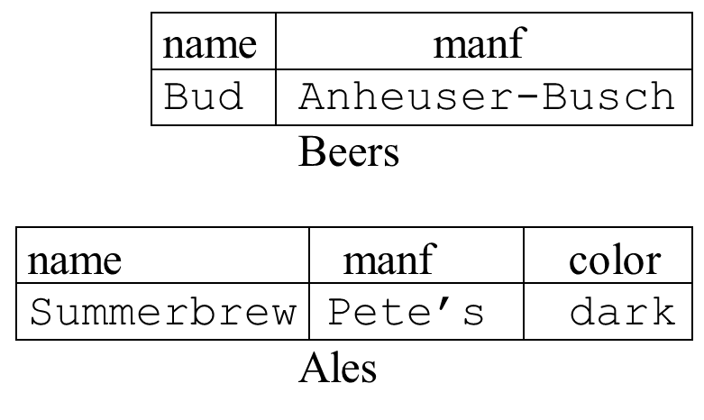
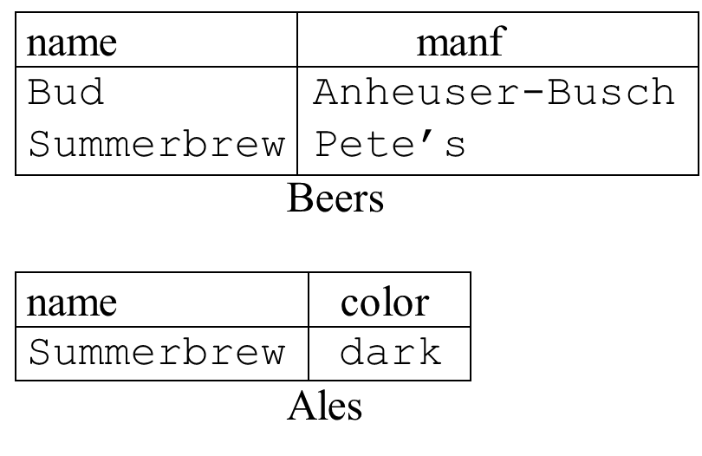
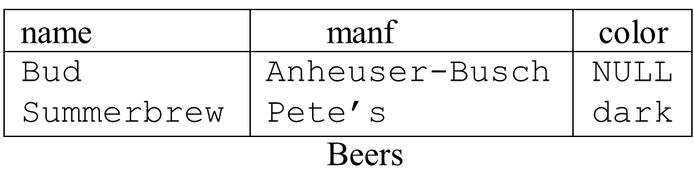
Comparison
It’s all
about trade-offs

Slide 39
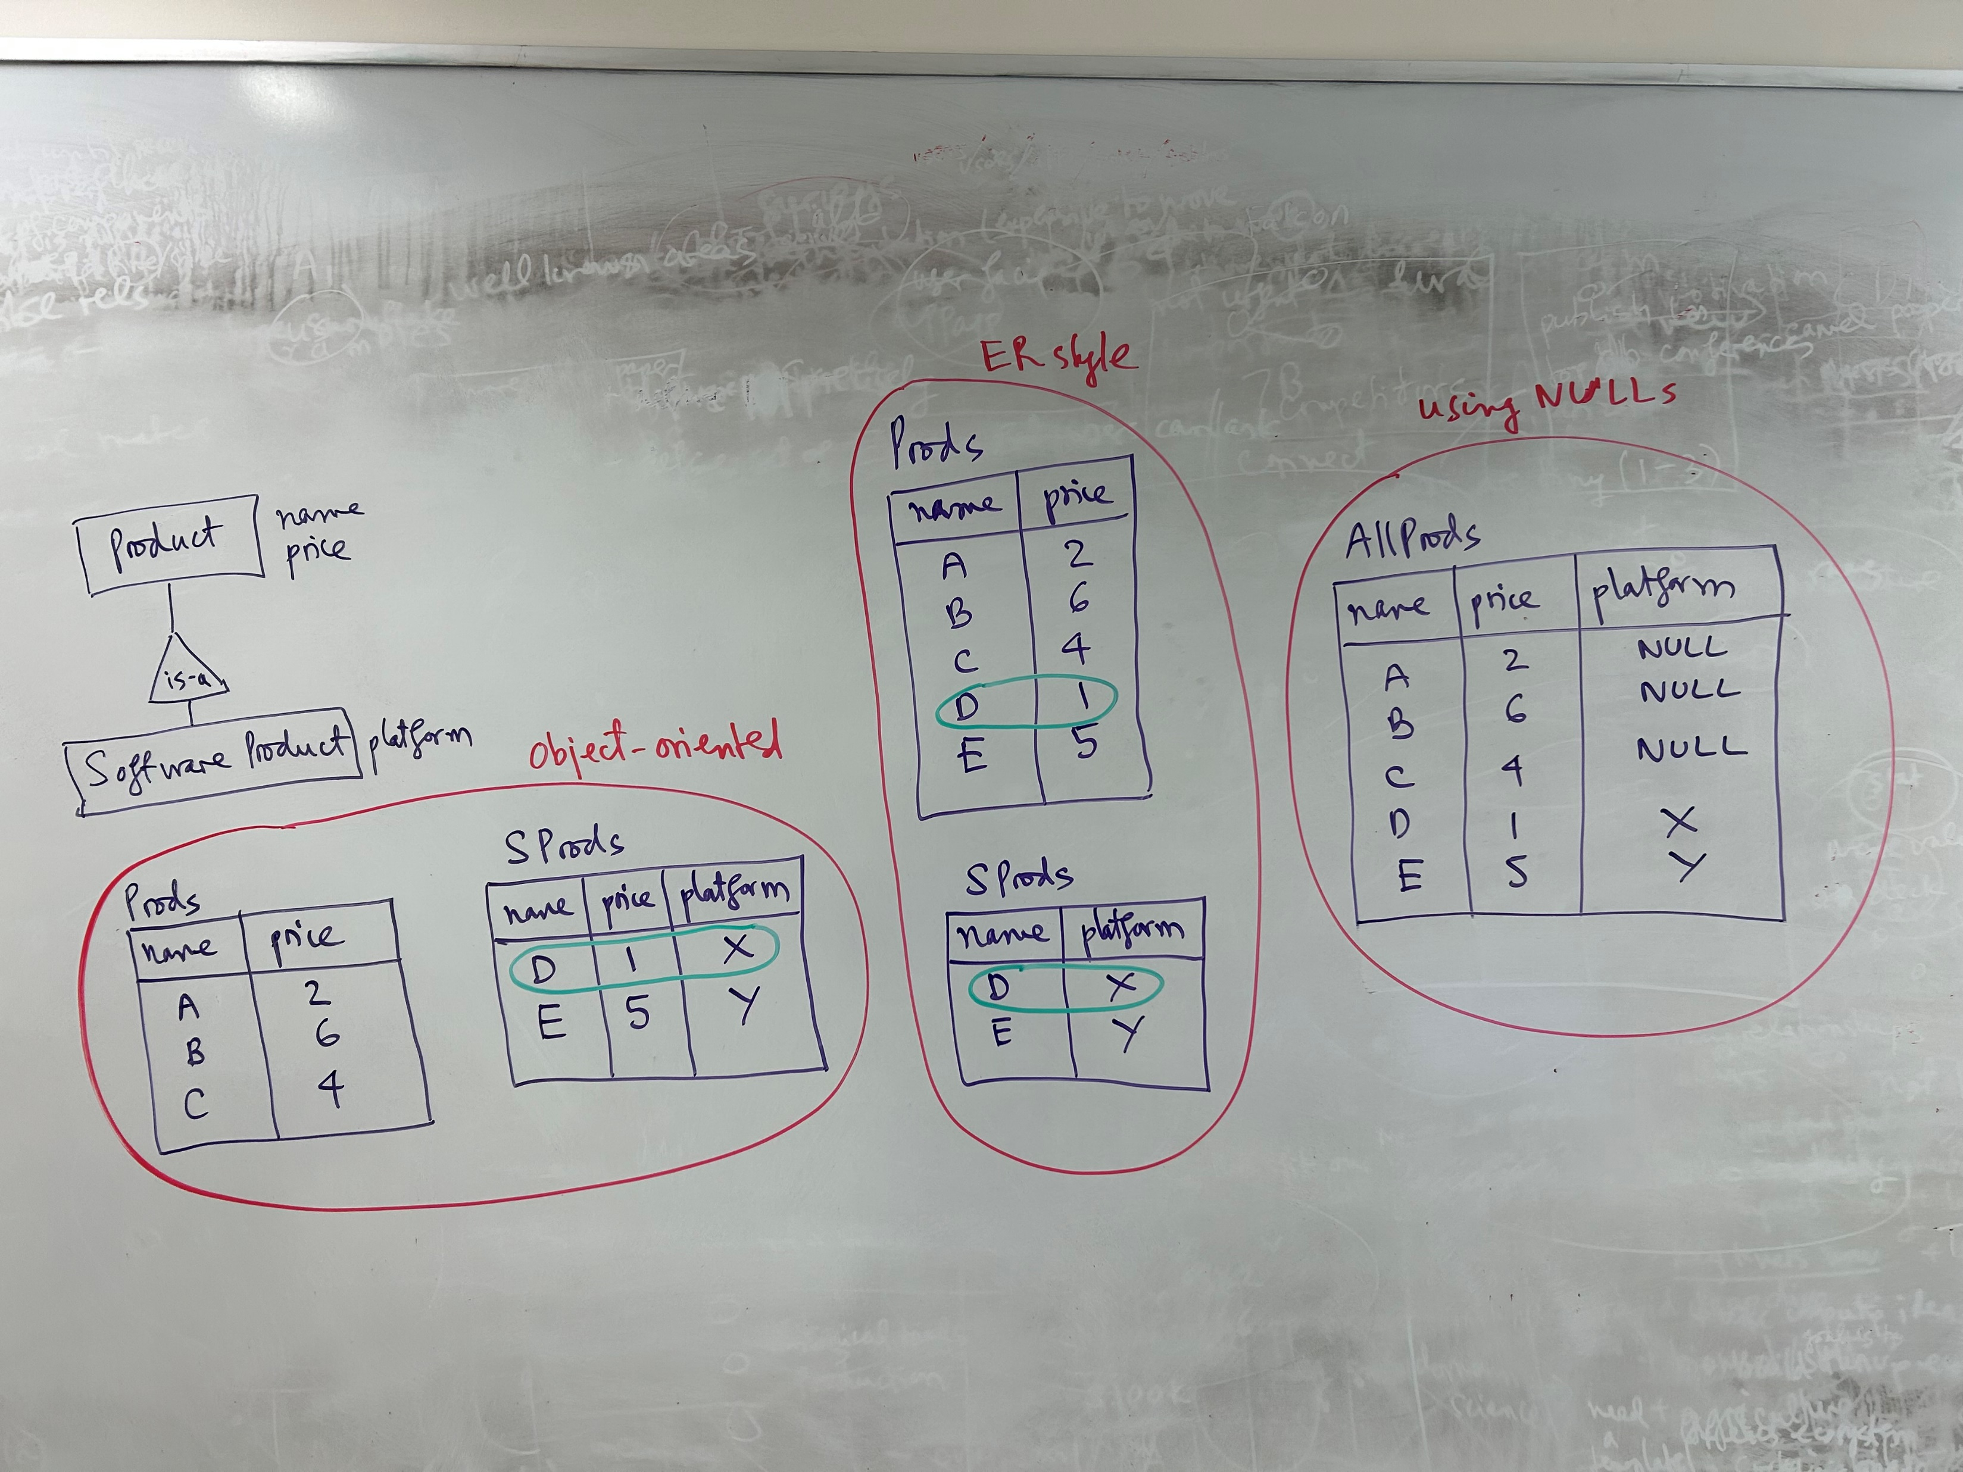

Slide 40
Constraints
When you talk with the business person, you need to find out
  all entities and relationships that person wants to model
But also need to find out as many constraints as possible
  e.g., this relationship is 1-1, or many-1, or 1-many
  more examples of constraints in next slide

Slide 41
Modeling Constraints
Finding constraints is part of the modeling process.
Commonly used constraints:
Keys: social security number uniquely identifies a person.
Single-value constraints: a person can have only one father.
Referential integrity constraints: if you work for a company, it
must exist in the database.
Domain constraints: peoples’ ages are between 0 and 150.
General constraints: all others (at most 50 students enroll in a class)

Slide 42
Why Constraints are Important?
Give more semantics to the data
  help us better understand it
Allow us to refer to entities (e.g, using keys)
Enable efficient storage, data lookup, etc.

Slide 43
Specifying Constraints
For the constraints you find out from the business person
  specify them on the ER diagram
  there may be special notations to represent some constraints
  for other constraints, there are no special notations, you just write them down in English on the ER diagram

Slide 44
Keys in E/R Diagrams
name
category
Underline:
price
Product
No formal way
to specify multiple
keys in E/R diagrams
Person
address
name
ssn
Notes:
are keys like person names?
weak entity sets

Slide 45
More about Keys
Every entity set must have a key
  why?
A key can consist of more than one attribute
There can be more than one key for an entity set
  one key will be designated as primary key
Requirement for key in an isa hierarchy
  not covered in this lecture

Slide 46
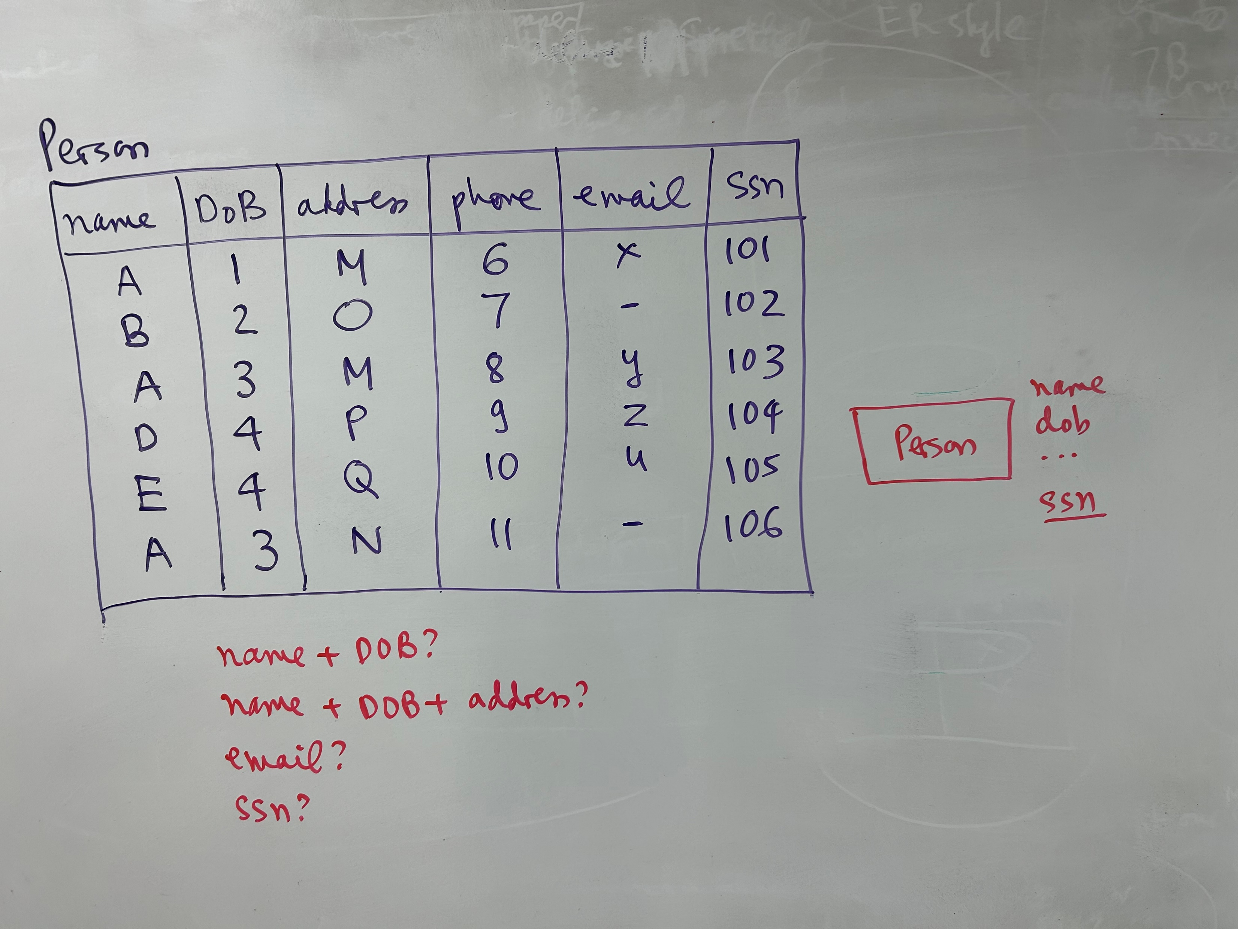

Slide 47
Single Value Constraint
An attribute of an entity set or a relation is “atomic”, that is, has a single value

Slide 48
A Constraint on Many-One Relationship
(A Non-NULL Constraint)
makes
Product
Company
Each product is “made” by at most one company.
makes
Product
Company
Each product is “made” by exactly one company.

Slide 49
Referential Integrity Constraint
(Foreign Key Constraint)
A constraint between two tables A and B
Give an example: Students take Courses

Slide 50
Weak Entity Sets
Entity sets are weak when their key attributes come from other
classes to which they are related.
affiliation
Team
)
University
sport
number
name

Slide 51
Weak Entity Sets
Occasionally, entities of an entity set need “help” to identify them uniquely.
Entity set E is said to be weak if in order to identify entities of E uniquely, we need to follow one or more many-one relationships from E and include the key of the related entities from the connected entity sets.

Slide 52
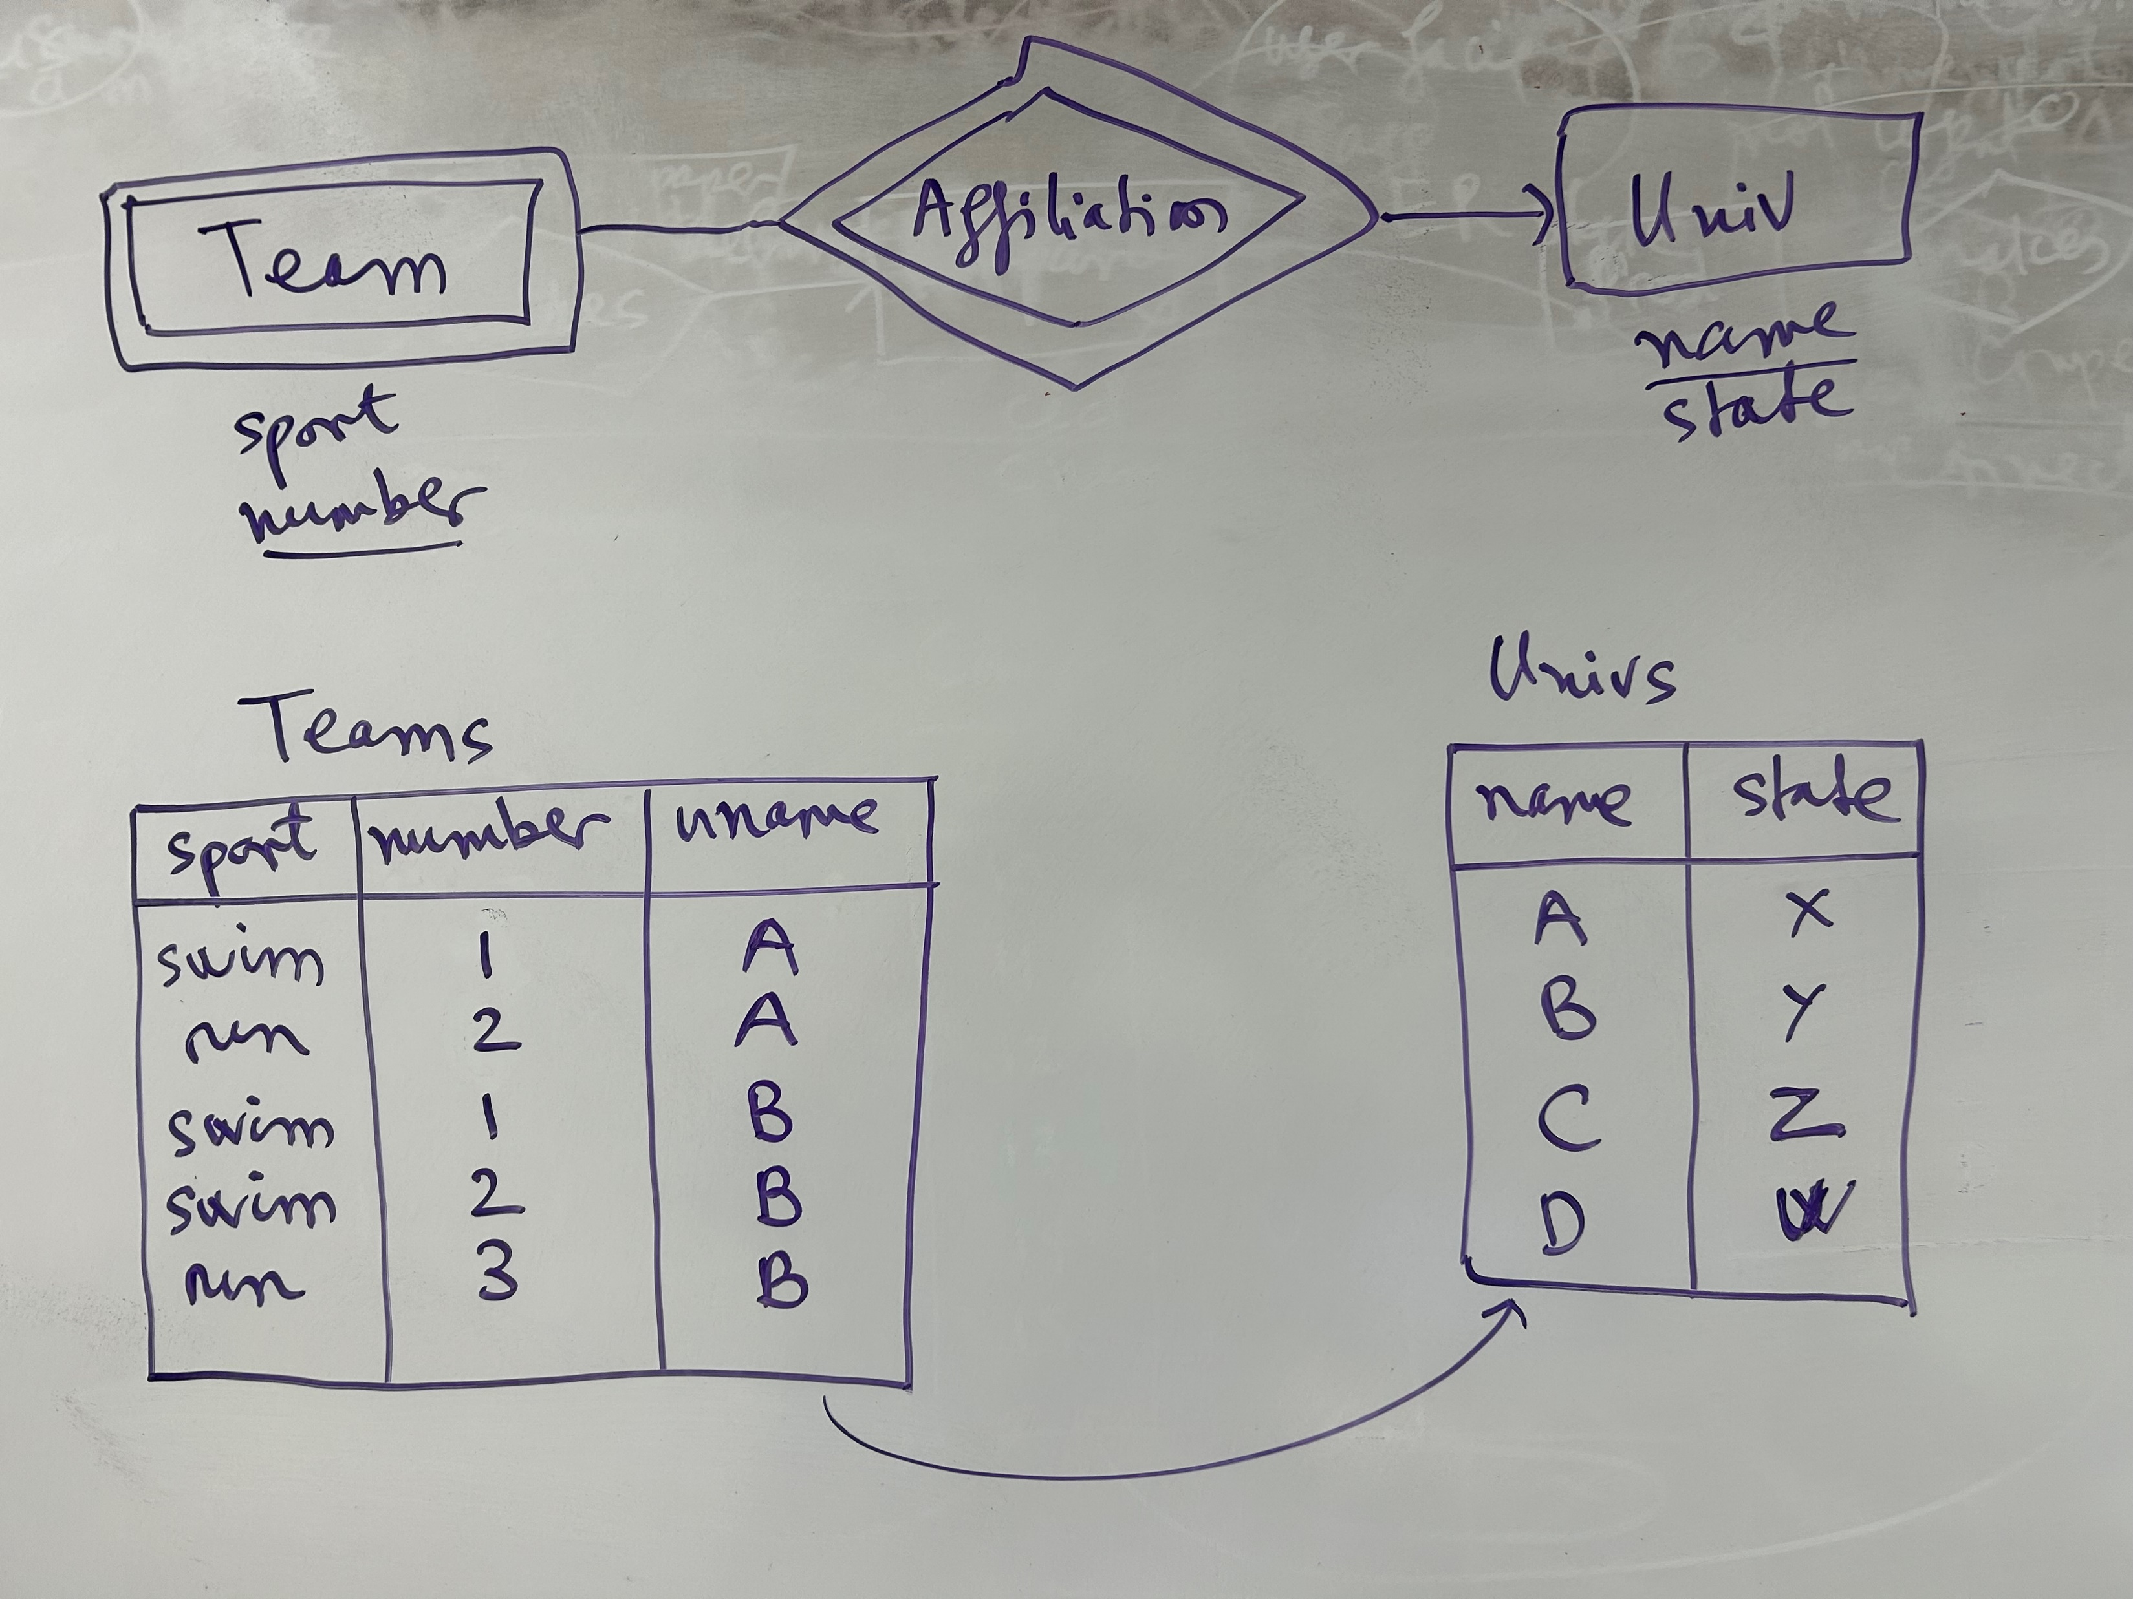

Slide 53
Now, about design techniques ...

Slide 54
Design Principles 1: Be Faithful
Purchase
Product
Person
President
Country
Person
Teaches
Instructor
Course
Notes:
for instructor teaching course: is it many-one or one-one or many-many? depending on which assumptions we have about
the domain

Slide 55
Design Principles 2:
Avoid Redundancy
date
Product
Purchase
Store
personAddr
personName
Notes:
do we need the address? if not, this is fine. if yes, this is not

Slide 56
Design Principles 3: KISS
Dates
date
Product
Purchase
Store
Person
Read the book for more design principles

Slide 57
More on Design Techniques
(from Ullman's slides)
Avoid redundancy.
Limit the use of weak entity sets.
Don’t use an entity set when an attribute will do.

Slide 58
Avoiding Redundancy
Redundancy occurs when we say the same thing in two different ways.
Redundancy wastes space and (more importantly) encourages inconsistency.
  The two instances of the same fact may become inconsistent if we change one and forget to change the other, related version.

Slide 59
Example: Good
name
name
addr
ManfBy
Beers
Manfs
This design gives the address of each manufacturer exactly once.

Slide 60
Example: Bad
name
name
addr
ManfBy
Beers
Manfs
manf
This design states the manufacturer of a beer twice: as an attribute and as a related entity.

Slide 61
Example: Bad
name
manf
manfAddr
Beers
This design repeats the manufacturer’s address once for each beer; loses the address if there are temporarily no beers for a manufacturer.

Slide 62
Entity Sets Versus Attributes
An entity set should satisfy at least one of the following conditions:
  It is more than the name of something; it has at least one nonkey attribute.
  or
  It is the “many” in a many-one or many-many relationship.

Slide 63
Example: Good
name
name
addr
ManfBy
Beers
Manfs
Manfs deserves to be an entity set because of the nonkey attribute addr.
Beers deserves to be an entity set because it is the “many” of the many-one relationship ManfBy.

Slide 64
Example: Good
name
manf
Beers
There is no need to make the manufacturer an entity set, because we record nothing about manufacturers besides their name.

Slide 65
Example: Bad
name
name
ManfBy
Beers
Manfs
Since the manufacturer is nothing but a name, and is not at the “many” end of any relationship, it should not be an entity set.

Slide 66
Don’t Overuse Weak Entity Sets
Beginning database designers often doubt that anything could be a key by itself.
  They make all entity sets weak, supported by all other entity sets to which they are linked.
In reality, we usually create unique ID’s for entity sets.
  Examples include social-security numbers, automobile VIN’s etc.

Slide 67
When Do We Need Weak Entity Sets?
The usual reason is that there is no global authority capable of creating unique ID’s.
Example: it is unlikely that there could be an agreement to assign unique player numbers across all football teams in the world.

Slide 68
ER Review
Basic stuff
  entity, attribute, entity set
  relation: binary, multiway, converting from multiway
  relationship roles, attributes on relationships
  subclasses (is-a)
Constraints
  on relations
    many-one, one-one, many-many
    limitations of arrows
  keys, single-valued, ref integrity, and more

Slide 69
ER Review
Weak entity set
Design principles
  be faithful
  avoid redundancy
  KISS

Slide 70
Higher-Level Takeaways
There are all kinds of languages in CS
  programming languages, data languages
Data languages can be used for multiple purposes
  to talk with others (say business people): ER
  to manipulate data: SQL, XML, JSON, graph data languages, etc.
Data languages can be simple or complex
There are always trade-offs
  regarding understandability, ease of writing, expressive power, fast querying, efficient storage, etc.

