Slide 1
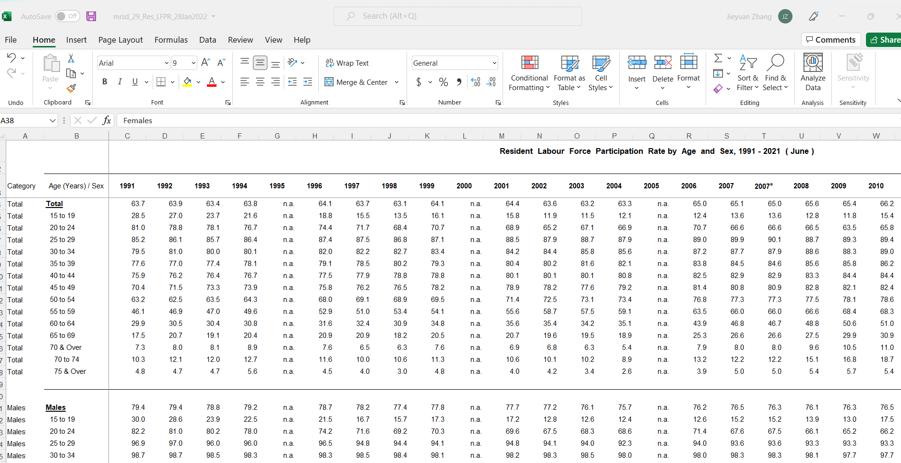

Slide 2
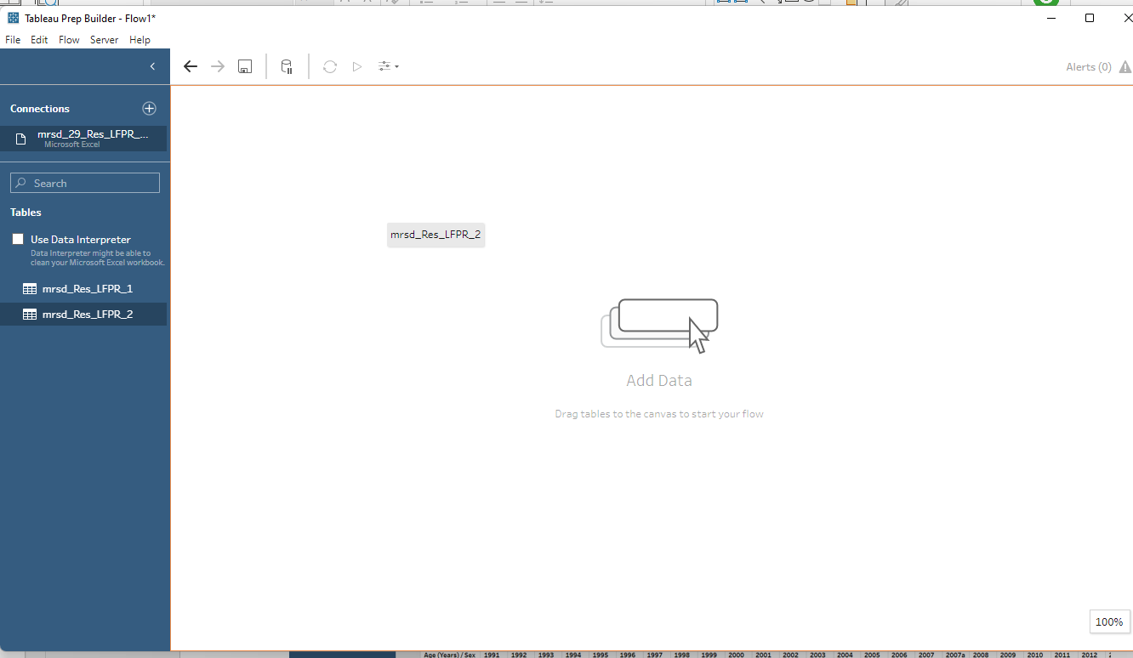
1. Drag the tab into start the data cleaning

Slide 3
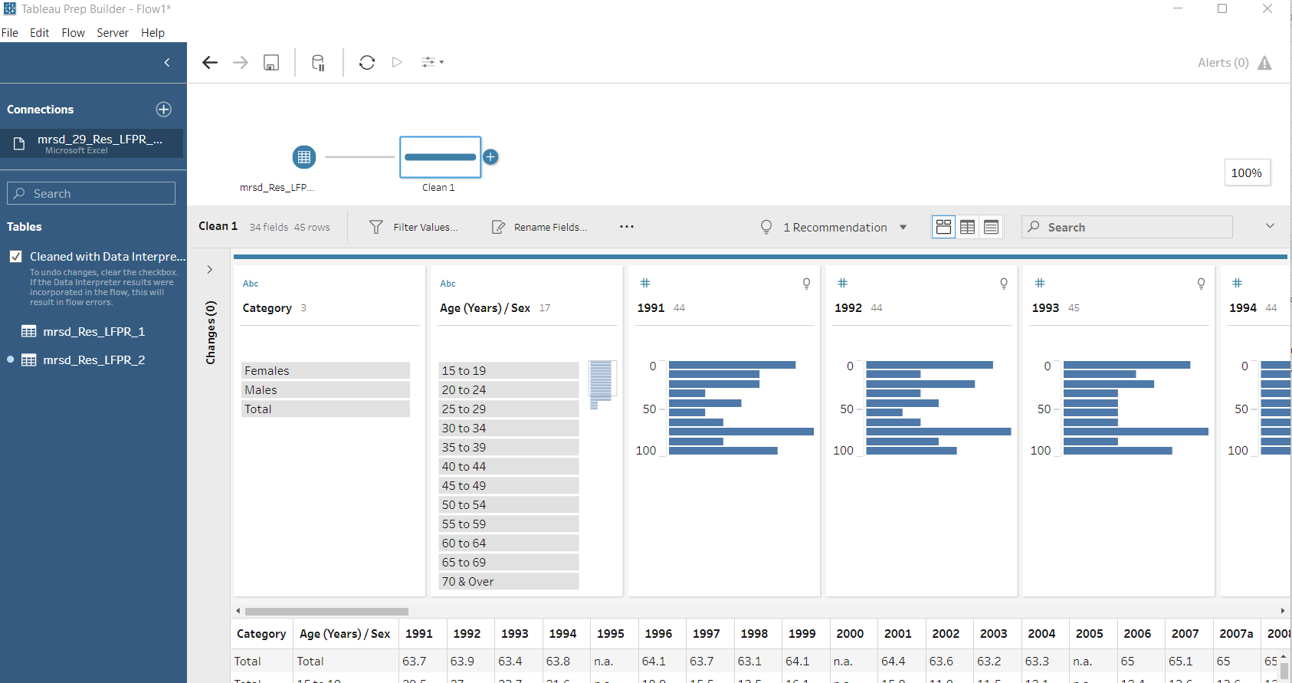
2. Cleaning by adding the cleaning step and tick cleaned with data interpreter. The title of the columns will be automatically identified

Slide 4
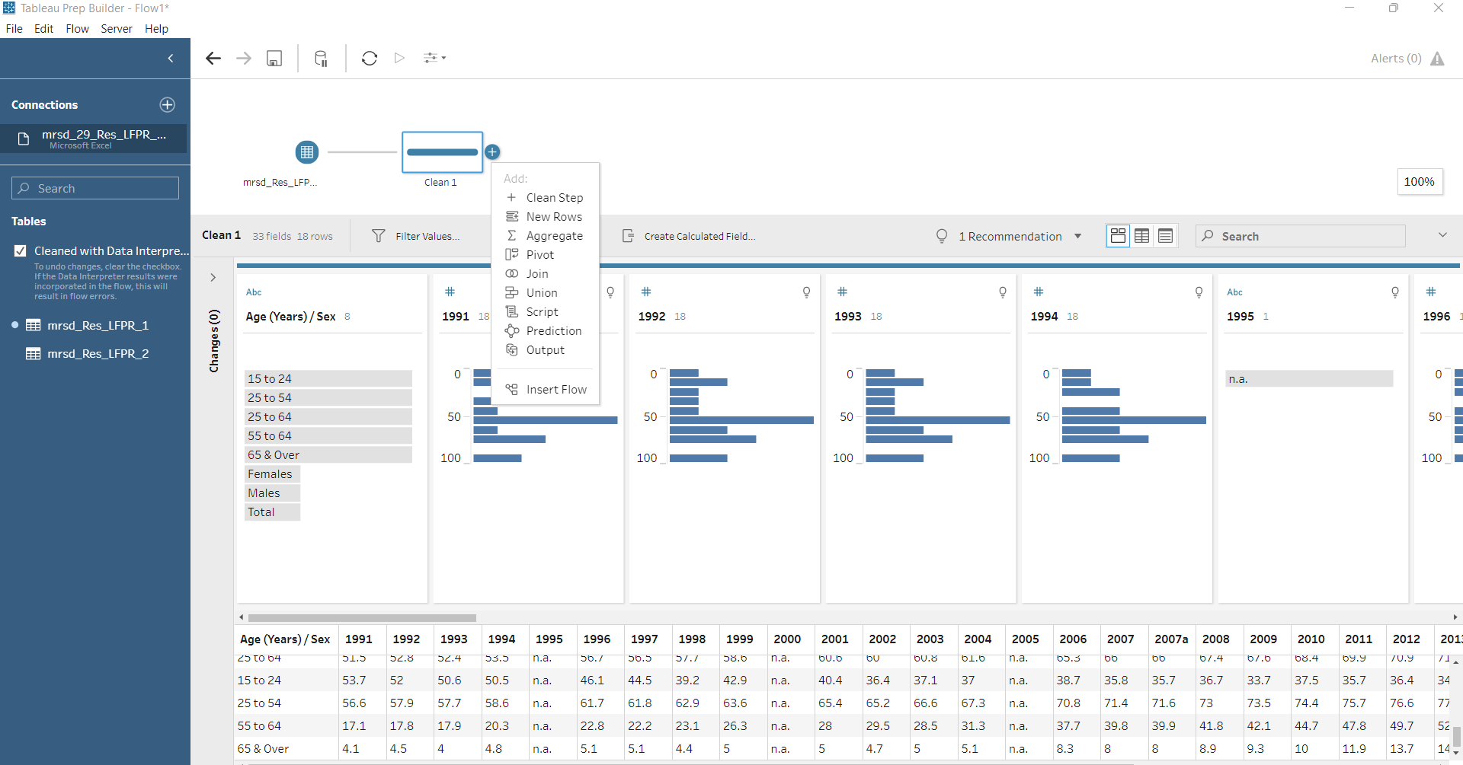
3. Click on the “+” sign and “Pivot” . This will enable us to pivot the years to a column

Slide 5
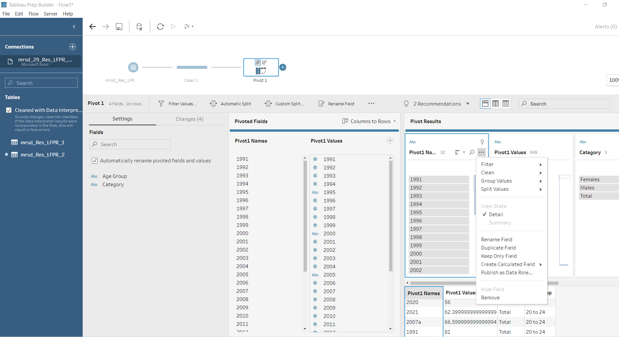
4. Pivot columns to the rows. Rename the column “Pivot1 Values” to LFPR and “Pivot 1 Names” to Year. “Age(Years)/Sex” to Age Group/Overall

Slide 6
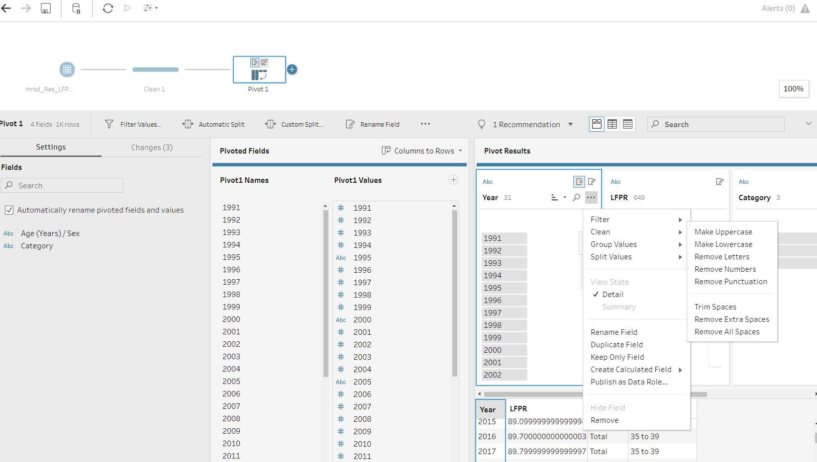

Slide 7
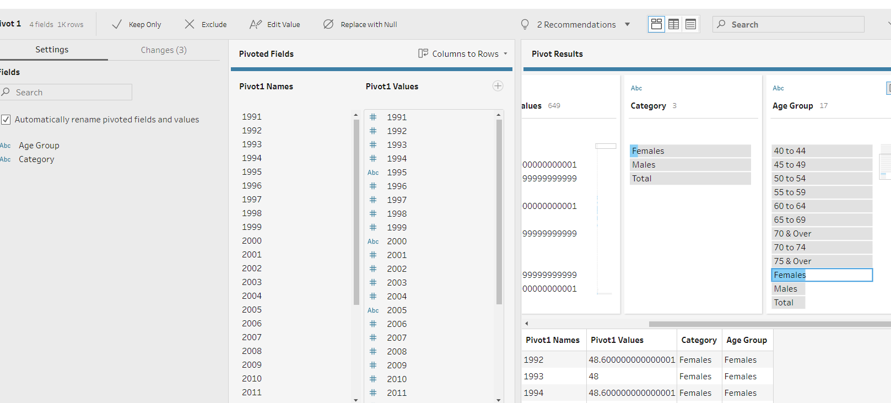
5.Rename “Females”, “Males” and “Total” to “Overall”

Slide 8
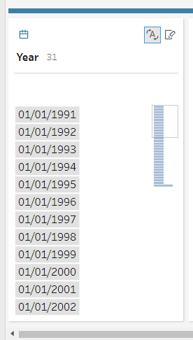
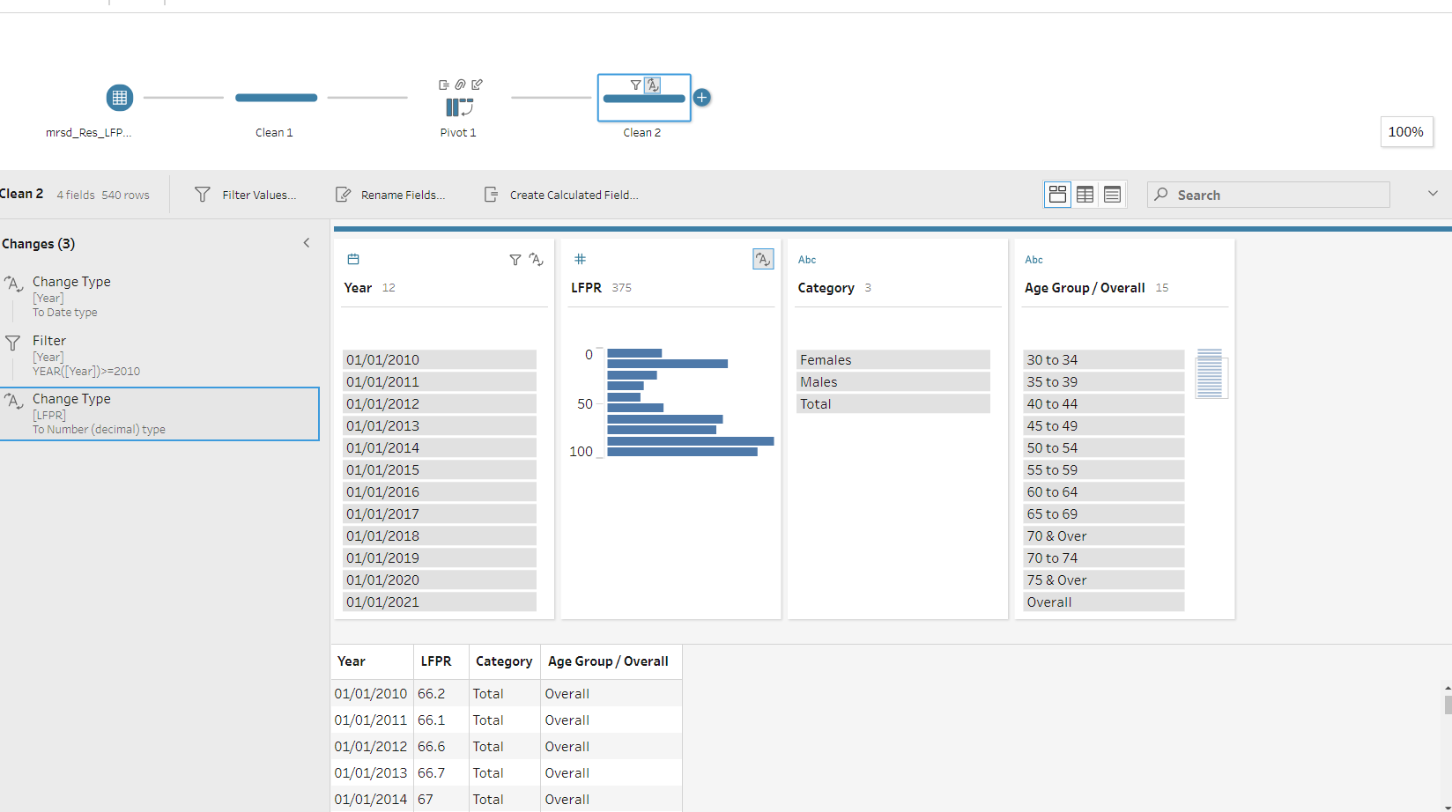
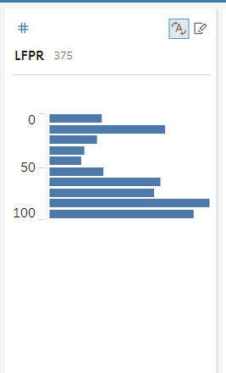
Add a new step. Change the type of data of the year to Date. Add in a filter to filter for data from 2010. Subsequently change the LFPR to decimal format

Slide 9
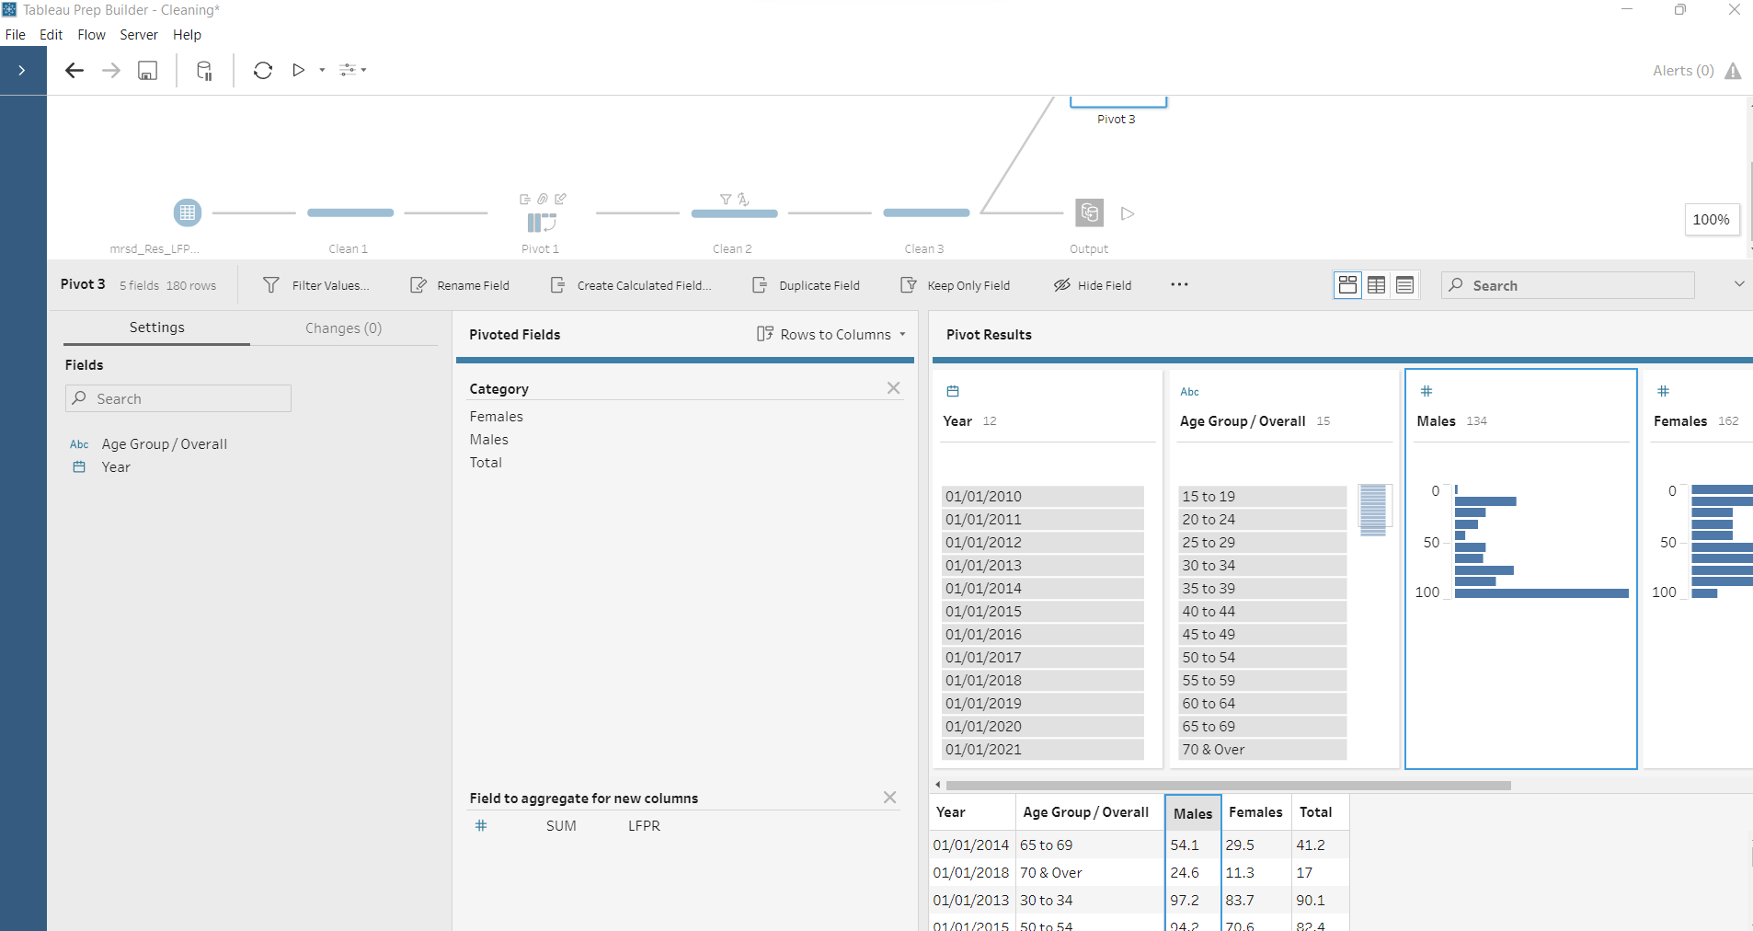
Add a step and click on the “+” sign to add a pivot. Drag the Category to “Pivoted field” and LFPR to “Field to aggregate for new columns”. This will pivot the Male, Female and Total from rows to column title. This step is needed for us to draw LFPR for Total, Males and Female in the same chart in Tableau.
Add a step and click on the “+” sign to add a pivot. Drag the Category to “Pivoted field” and LFPR to “Field to aggregate for new columns”. This will pivot the Male, Female and Total from rows to column title. This step is needed for us to draw LFPR for Total, Males and Female in the same chart in Tableau.

Slide 10
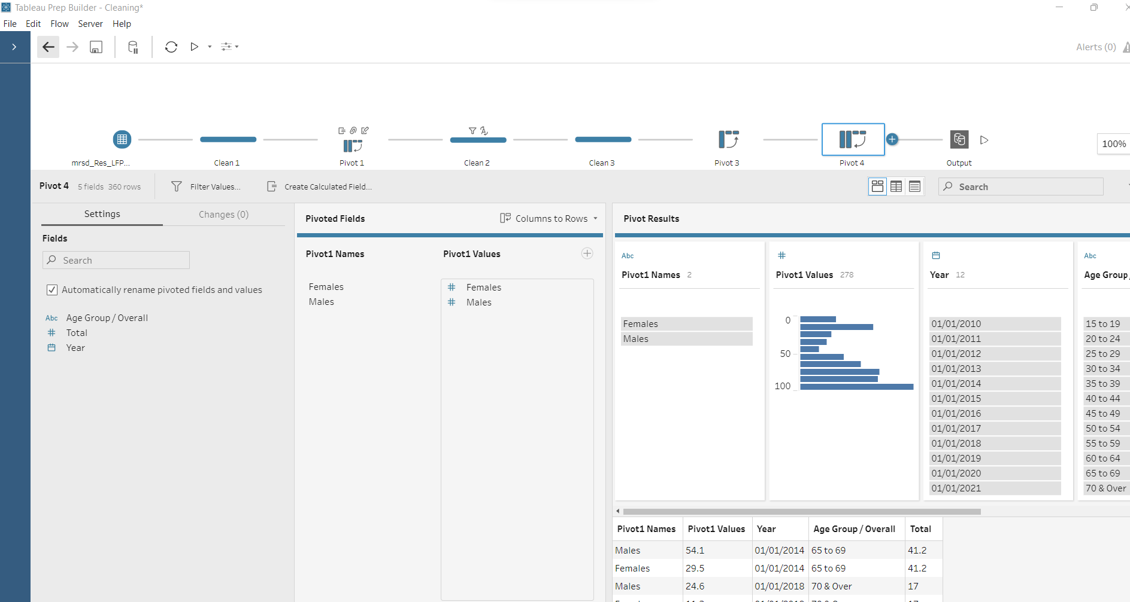
Add a step and click on the “+” sign to add a pivot to pivot the Male and Female and Total a Gender Column. This step is needed for us to draw LFPR for Total, Males and Female in the same chart in Tableau.

