Slide 1

EE5218 Application Acceleration with High-Level Synthesis Lab#A No.6 VitisTM Analyzer
Speaker: Jie-Yun Ma
Date: Mar. 30th, 2022

Slide 2
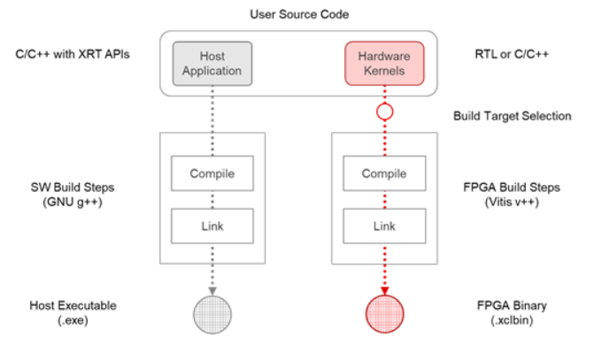
Outline
For individual kernels, Compile Summary.
For device binary, Link Summary.
For application execution, Run Summary.

Slide 3
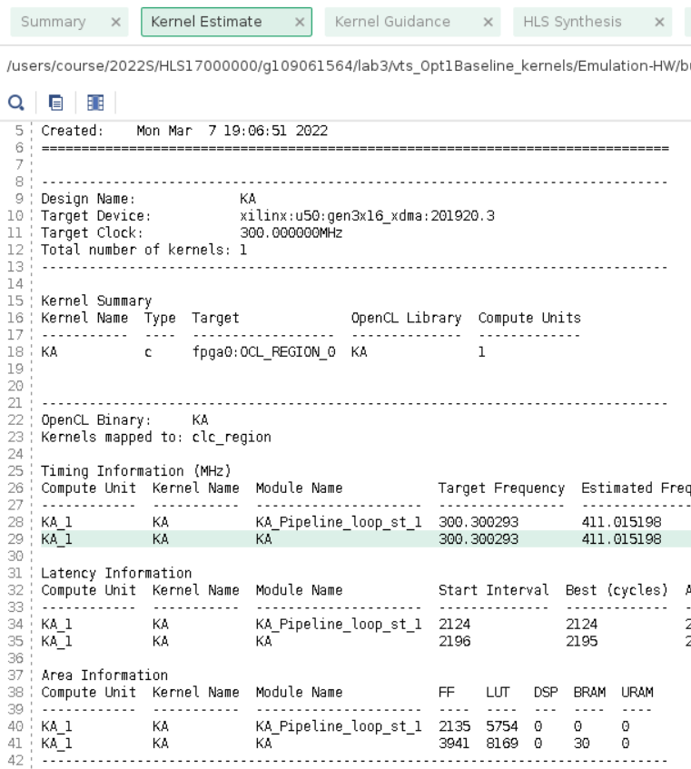
Open summary – Compile summary
$k.xo.compile_summary
Generated by V++
Kernels Estimate
Kernel Guidance
HLS Synthesis
compilation log

Slide 4
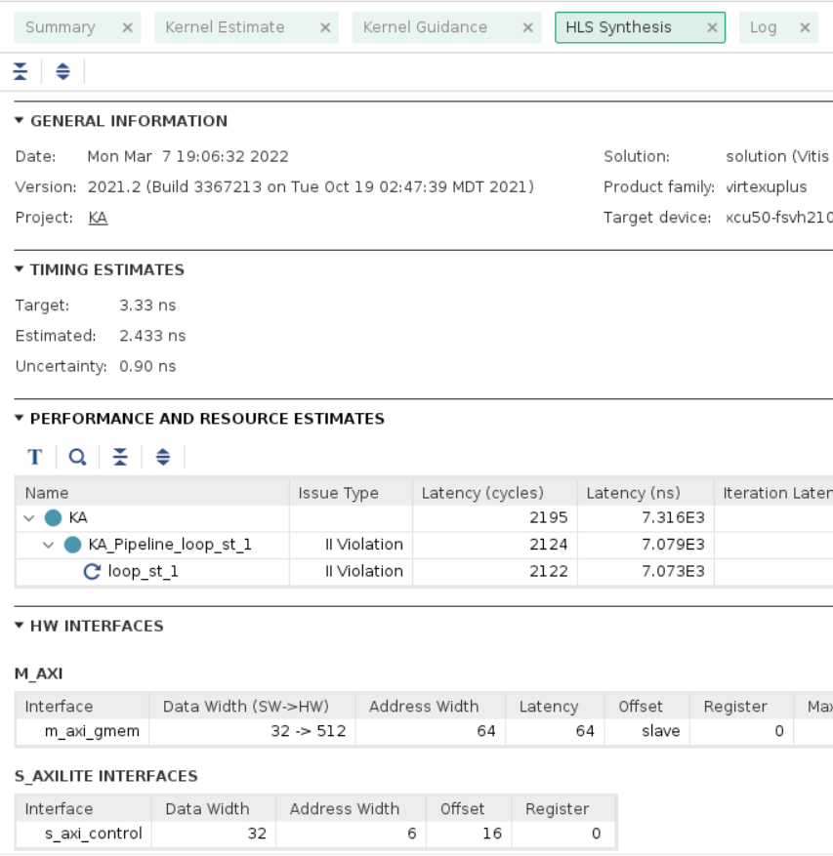
Open summary – Compile summary
$k.xo.compile_summary
Generated by V++
Kernels Estimate
Kernel Guidance
HLS Synthesis
compilation log

Slide 5
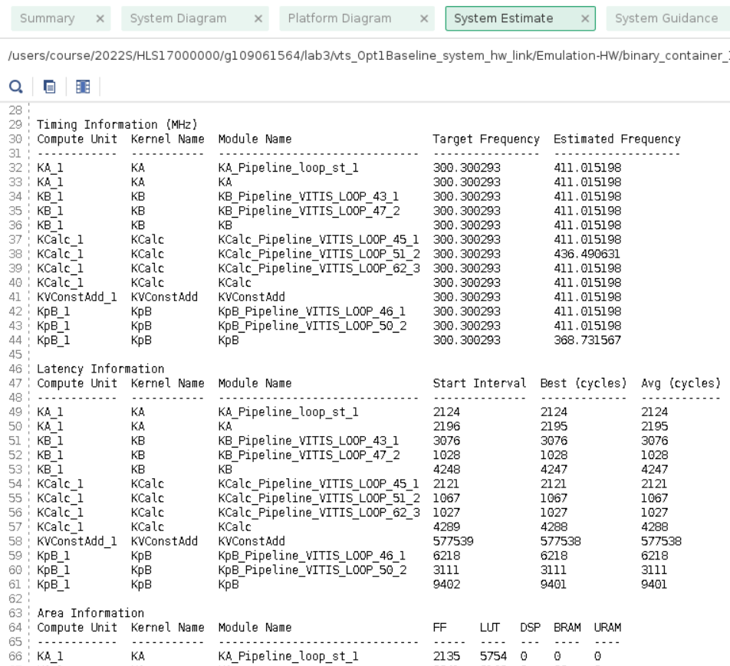
Open summary – Link Summary
$cname.xclbin.link_summary
Generated by V++ during linking and creation of the .xclbin
System Estimation
System Guidance
Timing Summary
Utilization
Platform and System Diagrams
Linking log

Slide 6
Open summary – Link Summary
$cname.xclbin.link_summary
Generated by V++ during linking and creation of the .xclbin
System Estimation
System Guidance
Timing Summary
Utilization
Platform and System Diagrams
Linking log

Slide 7
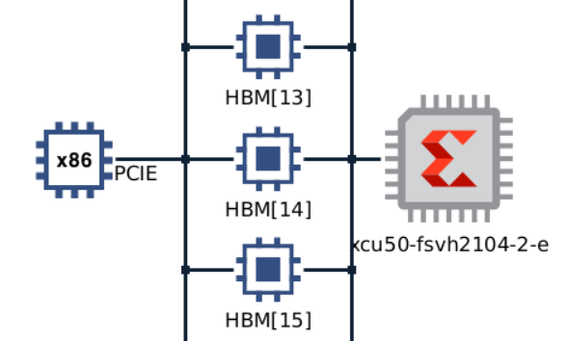

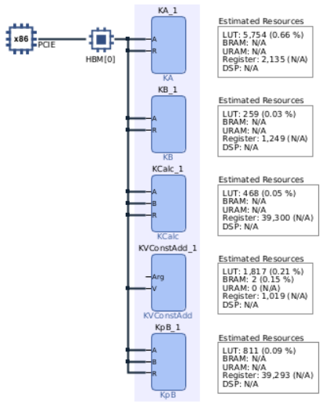
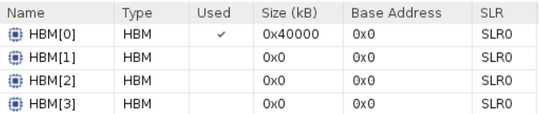
Open summary – Link Summary
$cname.xclbin.link_summary
Generated by V++ during linking and creation of the .xclbin
System Estimation
System Guidance
Timing Summary
Utilization
Platform and System Diagrams
Linking log

Slide 8
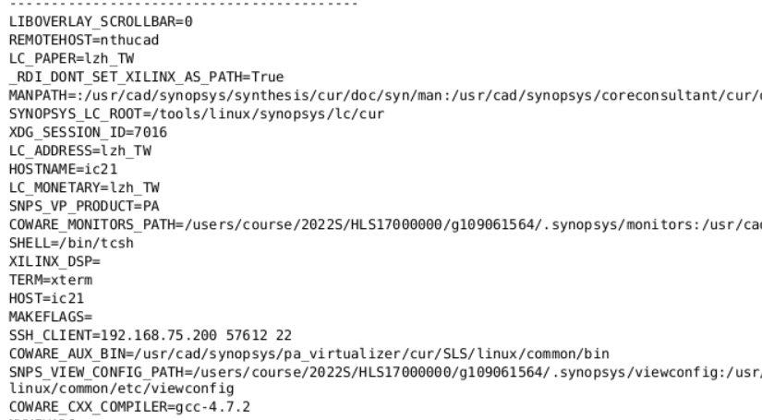
Open summary – Package summary
$cname.xclbin.package_summary
Information about emulation scripts and SD card output

Slide 9
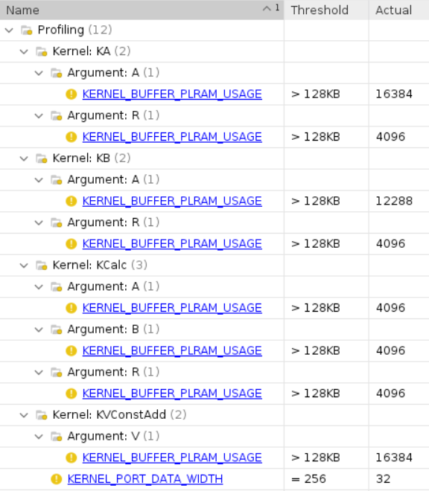
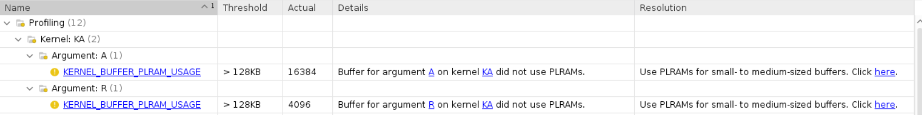
Open summary – Run summary
xrt.run_summary
Created by XRT library
Guidance
Profile Summary
Timeline Trace
Platform and System Diagrams
Simulation Waveforms

Slide 10
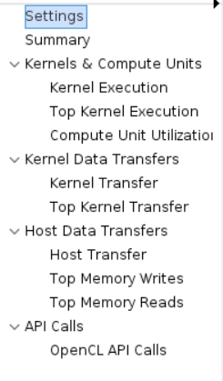
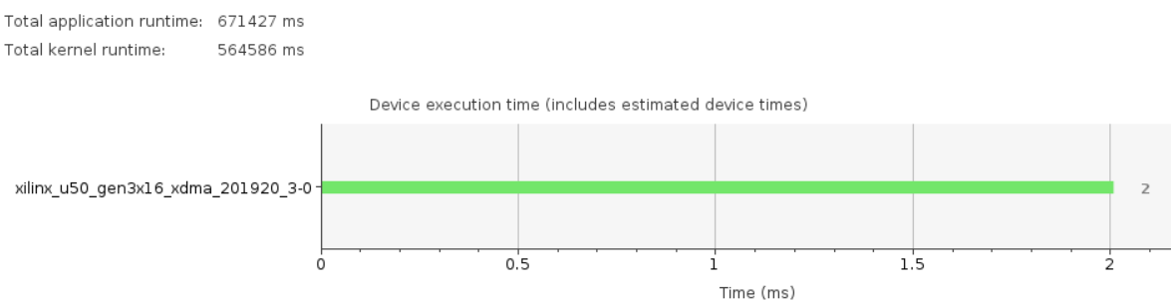
Open summary – Run summary
xrt.run_summary
Created by XRT library
Guidance
Profile Summary
Timeline Trace
Platform and System Diagrams
Simulation Waveforms

Slide 11
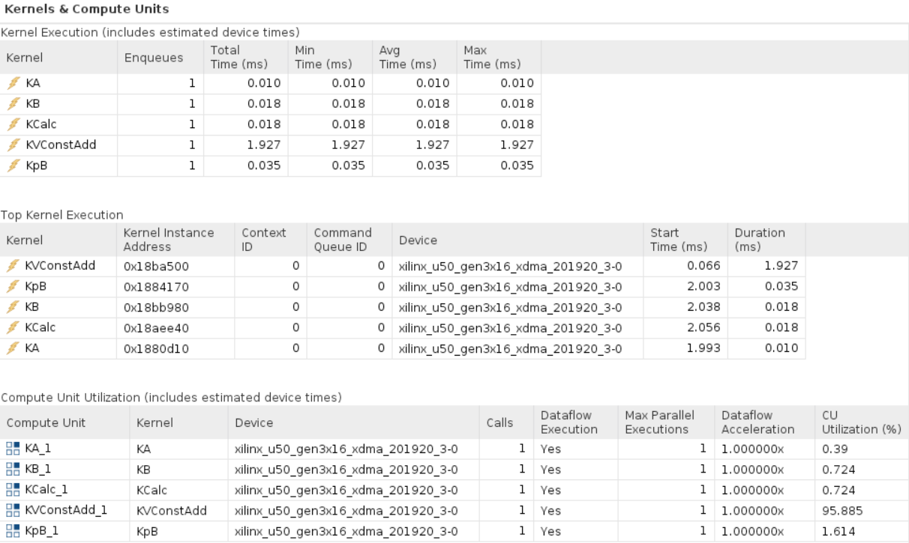
Open summary – Run summary

Slide 12
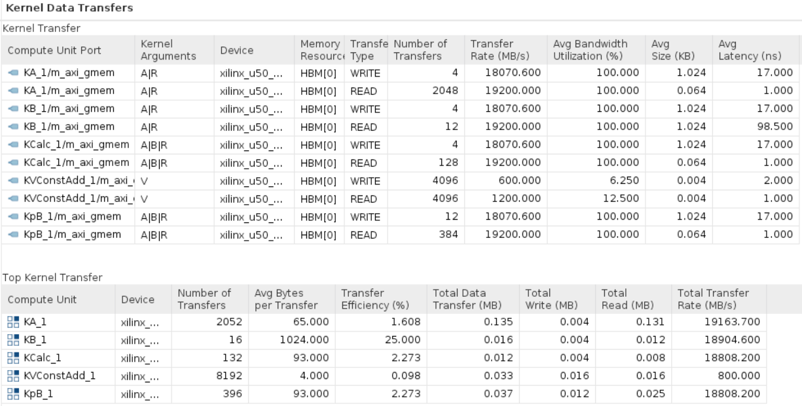
Open summary – Run summary

Slide 13
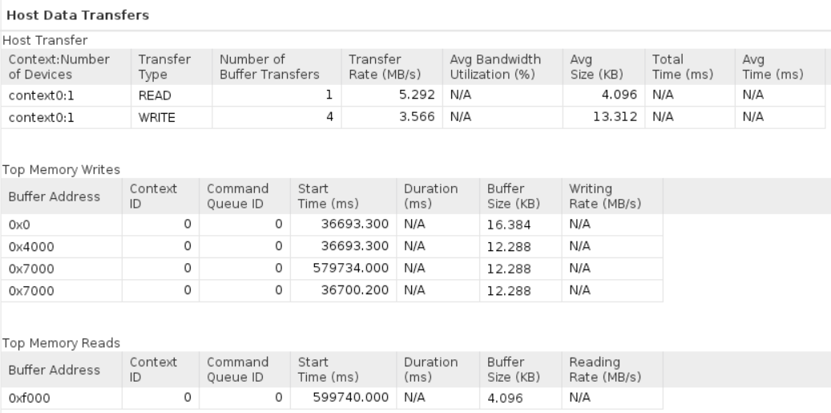
Open summary – Run summary

Slide 14
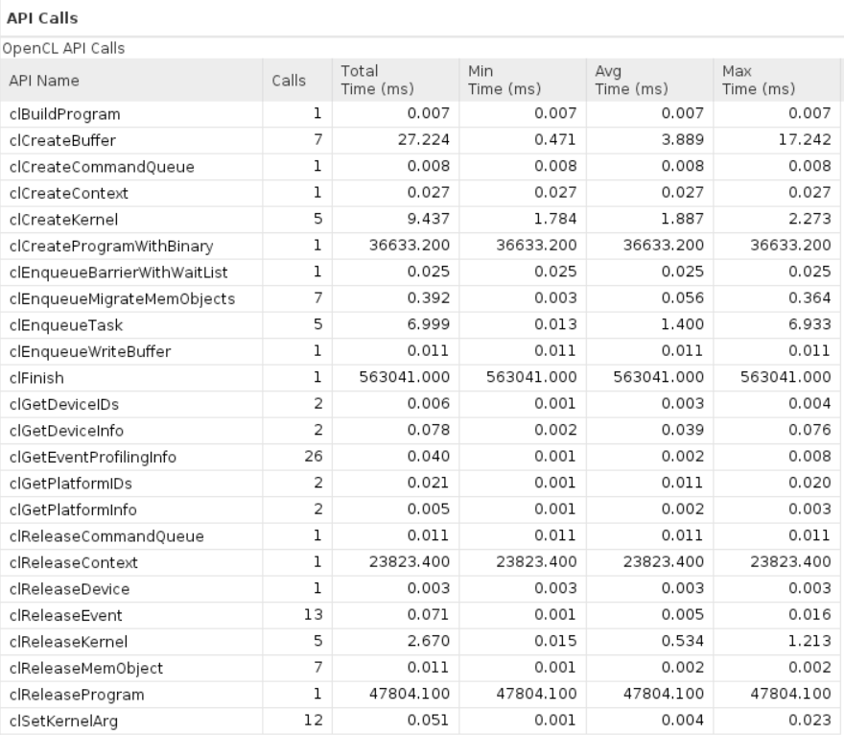
Open summary – Run summary

Slide 15
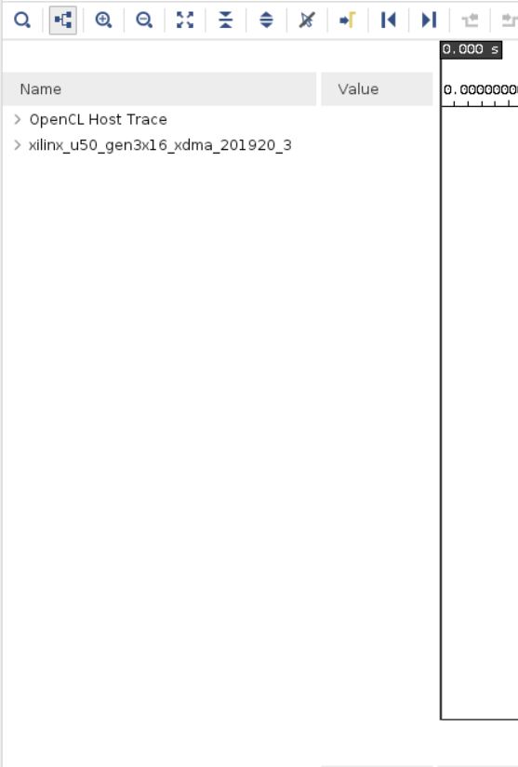
Open summary – Run summary
xrt.run_summary
Created by XRT library
Guidance
Profile Summary
Timeline Trace
Platform and System Diagrams
Simulation Waveforms

Slide 16
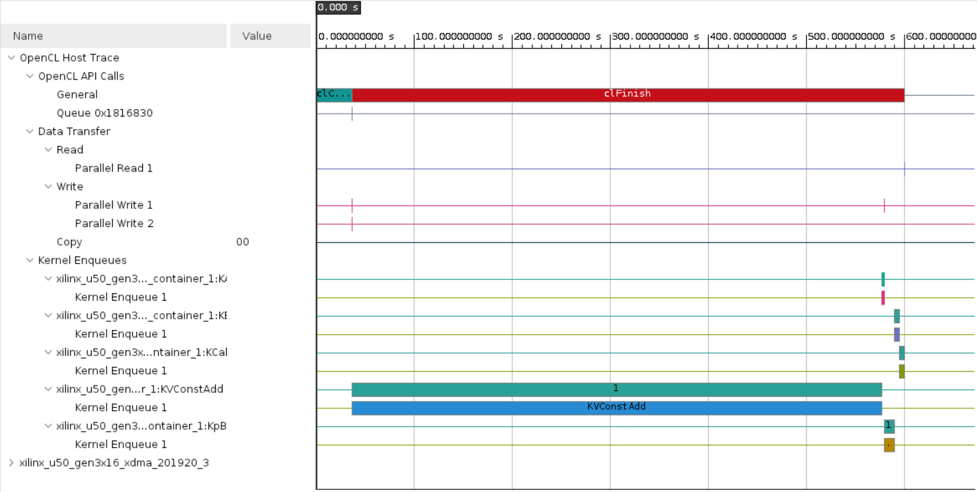
Open summary – Run summary

Slide 17
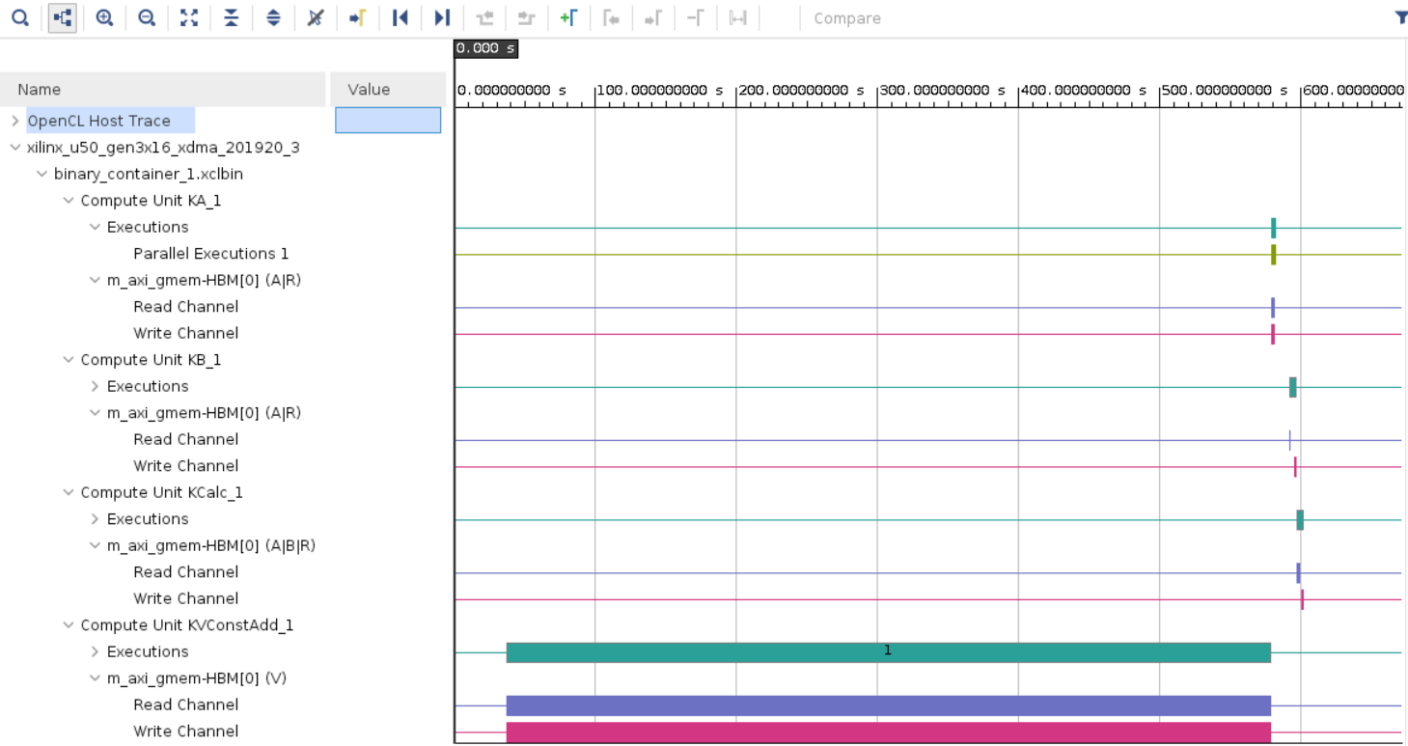
Open summary – Run summary

Slide 18
Quiz

Slide 19
Q & A

