Slide 1
Energy Budgeting for Intermittently-Powered Systems
Presented by: Jie Zhan - 7 March 2022
for the viva of his PhD thesis
Supervisors:
Prof. Geoff V. Merrett
Dr. Alex S. Weddell
Examiners:
Prof. James Brusey
Dr. Basel Halak
Notes:
Good morning Prof. James Brusey and Prof. Basel Halak

Slide 2
Energy Budgeting for Intermittently-Powered Systems - Jie Zhan
Contents (~10 min, 6 slides)
Energy Harvesting and Intermittently-Powered Systems (IPSs)
Motivation of Energy Budgeting in IPSs
Contribution 1: Effect of Energy Storage Sizing
Contribution 2: Energy Storage Sizing Approach
Contribution 3: Runtime Energy Profiling and Adaptation
Publications

Slide 3
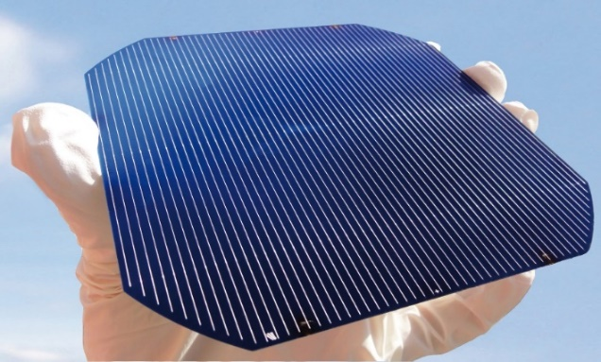
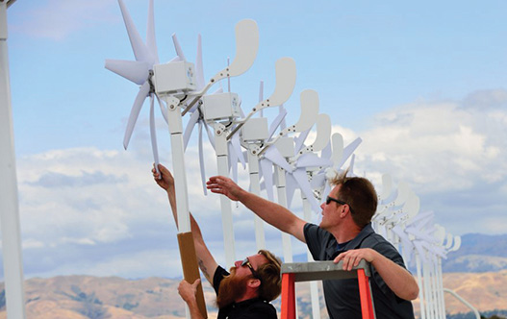
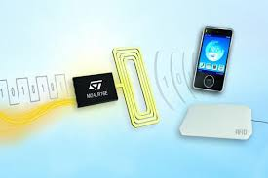
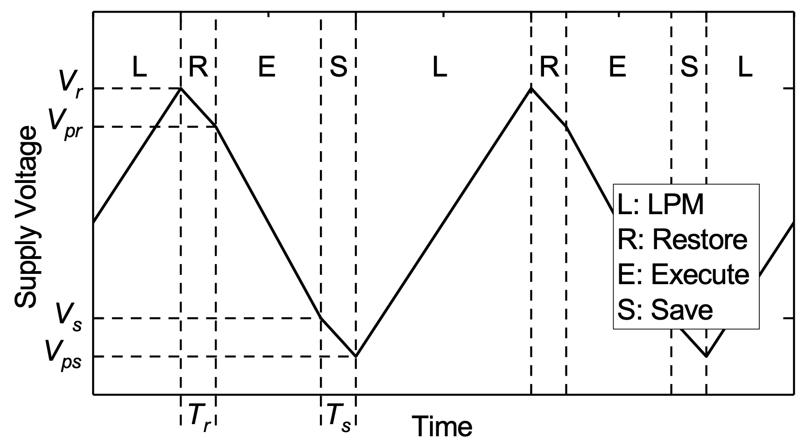
Energy Budgeting for Intermittently-Powered Systems - Jie Zhan
Energy Harvesting and Intermittently-Powered Systems
Energy Harvesters for Powering IoT devices:
Architecture of an IPS:
Intermittent Operation:
Notes:
Energy harvesters have enabled low-powered devices to operate with ambient harvested energy, such as ...
IPSs have emerged in recent research to work with small-scale energy harvesters.
As an general architecture shown in the bottom left figure, an IPS consists of an EH, an EMU, and an MCU with peripherals.
The power regulated is conditioned to charge a uF-level energy buffering capacitor.
When its energy buffering capacitor is charged to a threshold, the MCU wakes up and executes workloads for a short period in milliseconds.
As the input power is weaker than the load, the stored energy will deplete, where the load sleeps or dies, and waits for energy refilling.
Typical work: sensing, processing, communicating
As the charge and discharge cycles are short, state retention is required.
When energy depletes, save the volatile state

Slide 4

Energy Budgeting for Intermittently-Powered Systems - Jie Zhan
Motivation of Energy Budgeting in IPSs
Existing approaches have focussed on efficiently sustaining computing state from the load side.
However, it can also be explored from system-wise energy budgeting.
The energy budget of an IPS is the energy allocated for one power-on cycle, determined by
(1) the system energy storage size C_{stor}
(2) the voltage threshold to wake up the load V_{th}
V_{th}
V_{min}
C_{stor}
Motivations
C_{stor} is minimised or indiscriminately picked
How to size C_{stor} in real IPS deployment
Design-time profiled V_{th} against runtime variations
Contributions
Sizing Effect of C_{stor} on IPS performance
Sizing Approach of C_{stor} in IPS deployment
Runtime Energy Profiling and Adaptation on V_{th}

Slide 5
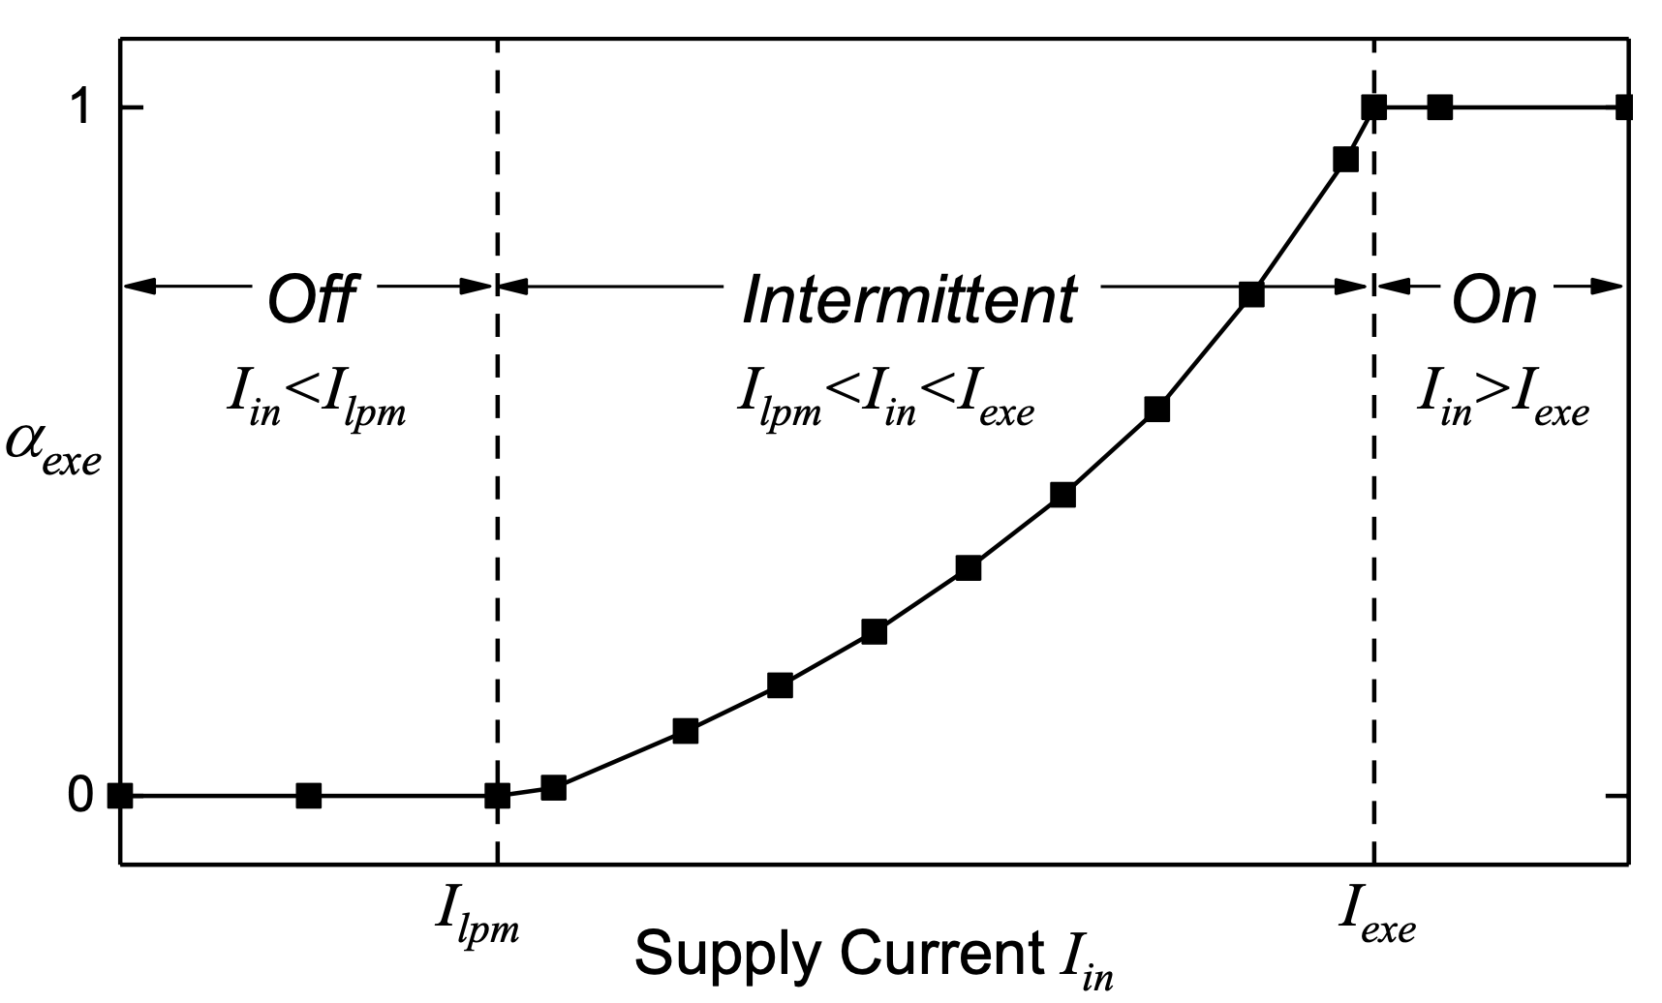
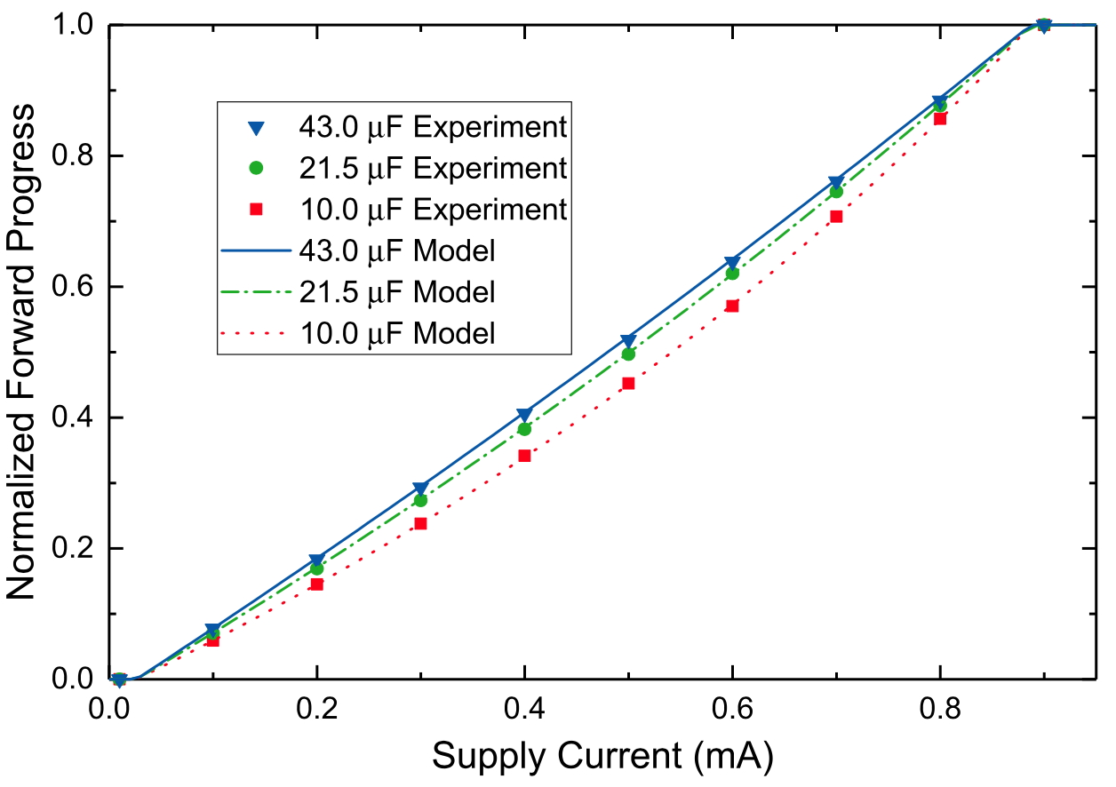
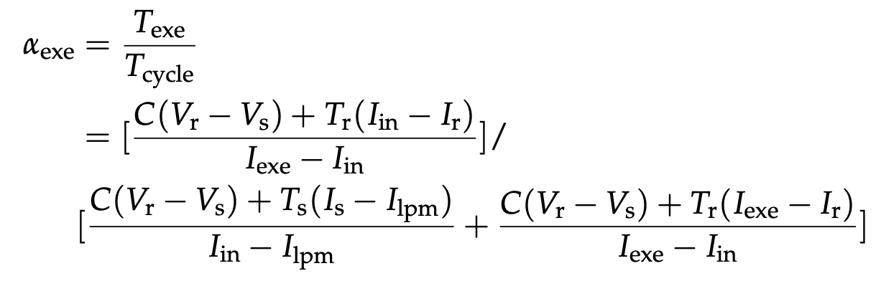
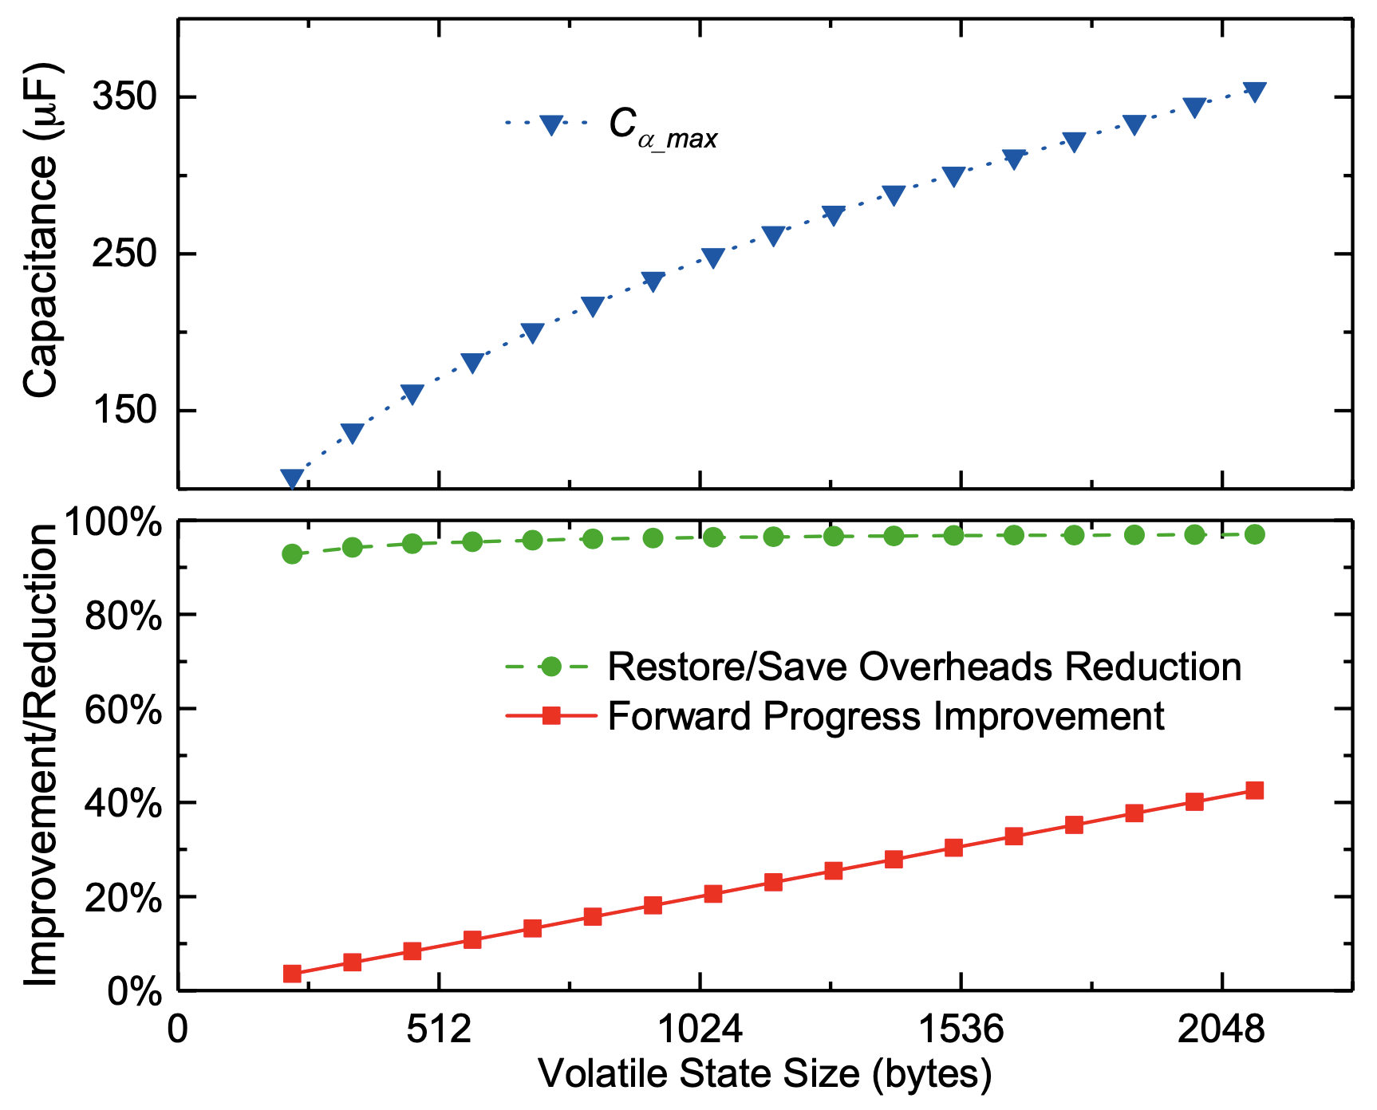
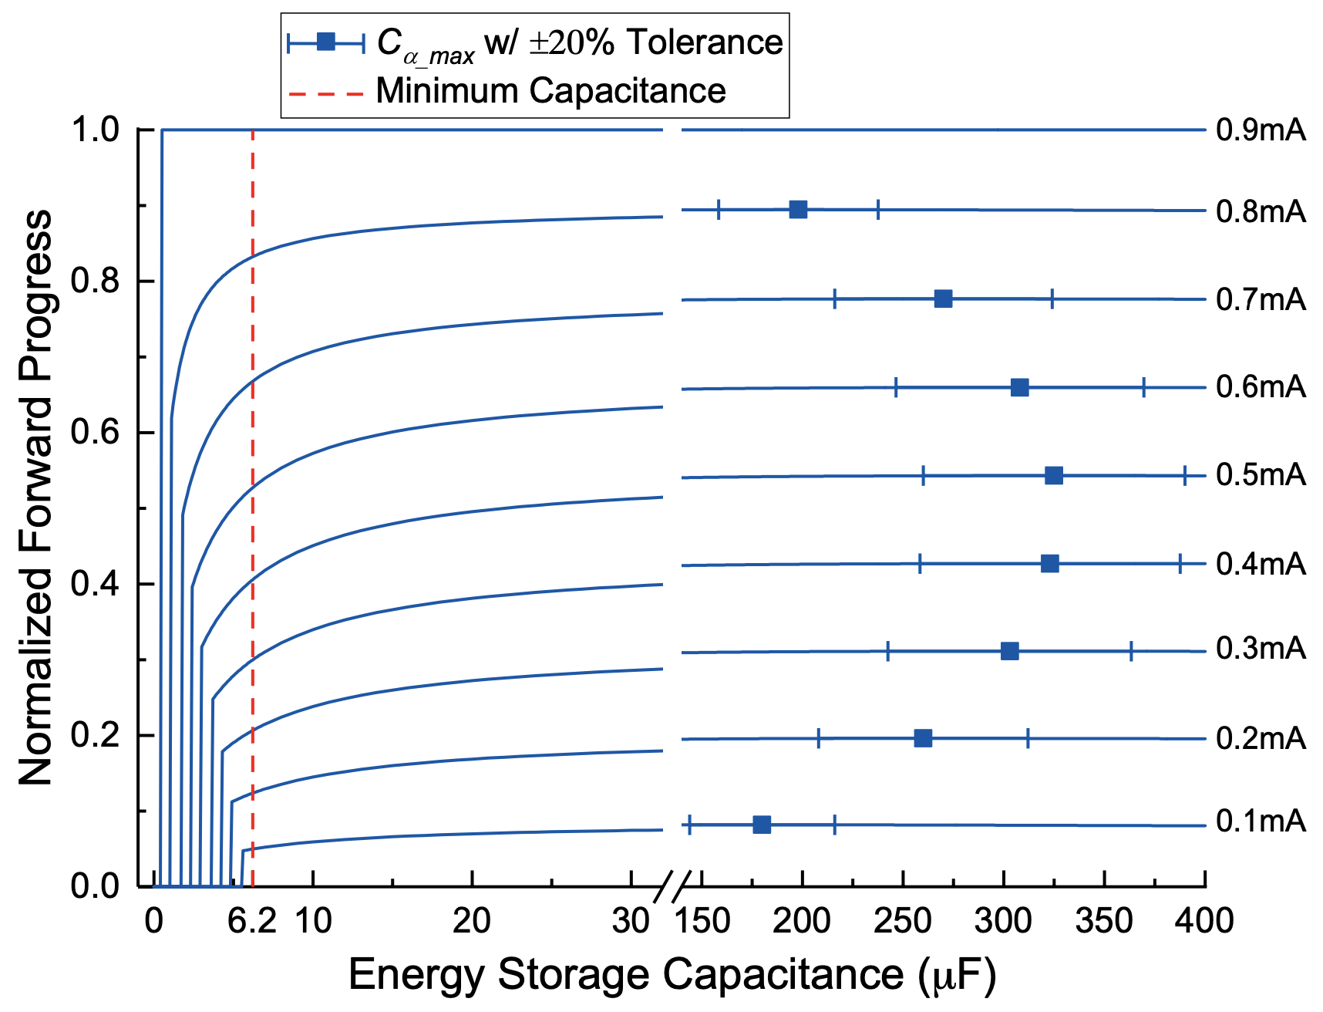
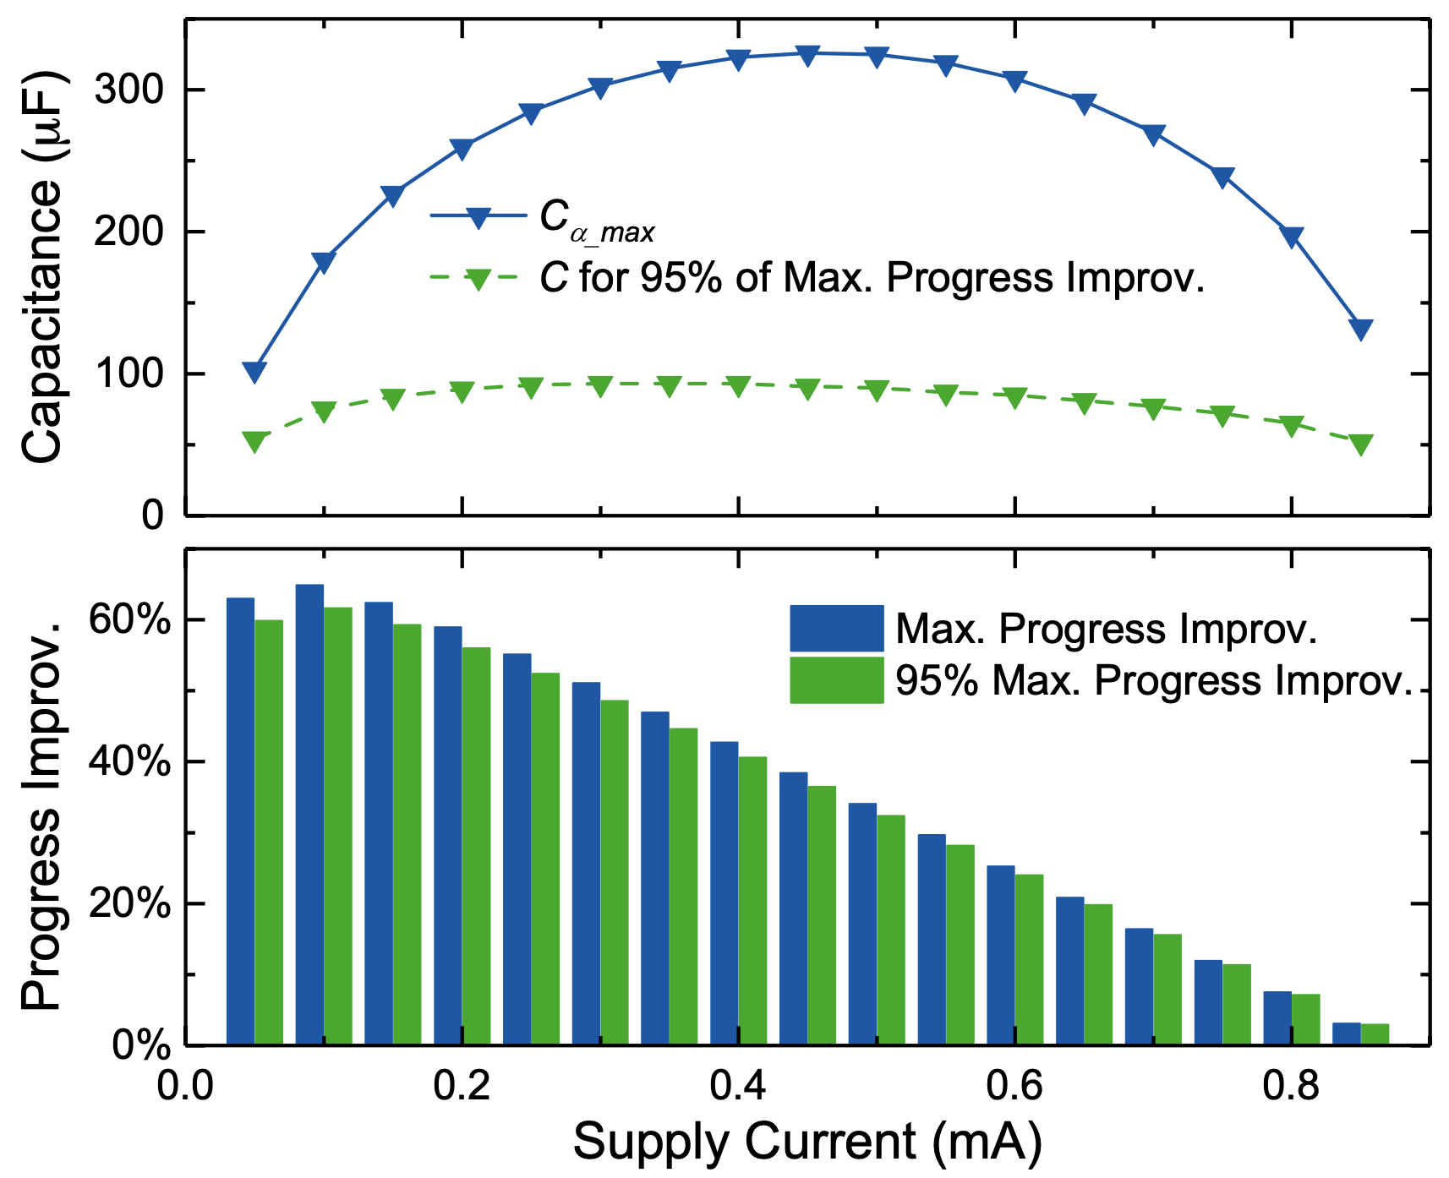
Energy Budgeting for Intermittently-Powered Systems - Jie Zhan
Contribution 1: Effect of Energy Storage Sizing
(1) Reactive IPS model
IPS Operating Modes
Forward progress in the Intermittent mode
Experimentally validated with 0.5% error
(2) Sizing energy storage can improve forward progress
Notes:
Motivation:
The energy storage size in existing IPSs is either minimised or indiscriminately picked.
Provisioning more energy storage can prolong the power-on cycles, reduce the overheads, and hence increase forward progress,
but can also increase system leakage and decrease forward progress.
Fig. bottom left and middle: improve up to 65%
Fig. bottom middle: if we don’t maximize forward progress, adding a small amount of capacitance can also gain a significant improvement
Fig. bottom right: the improvement from sizing energy storage increases with larger state size

Slide 6
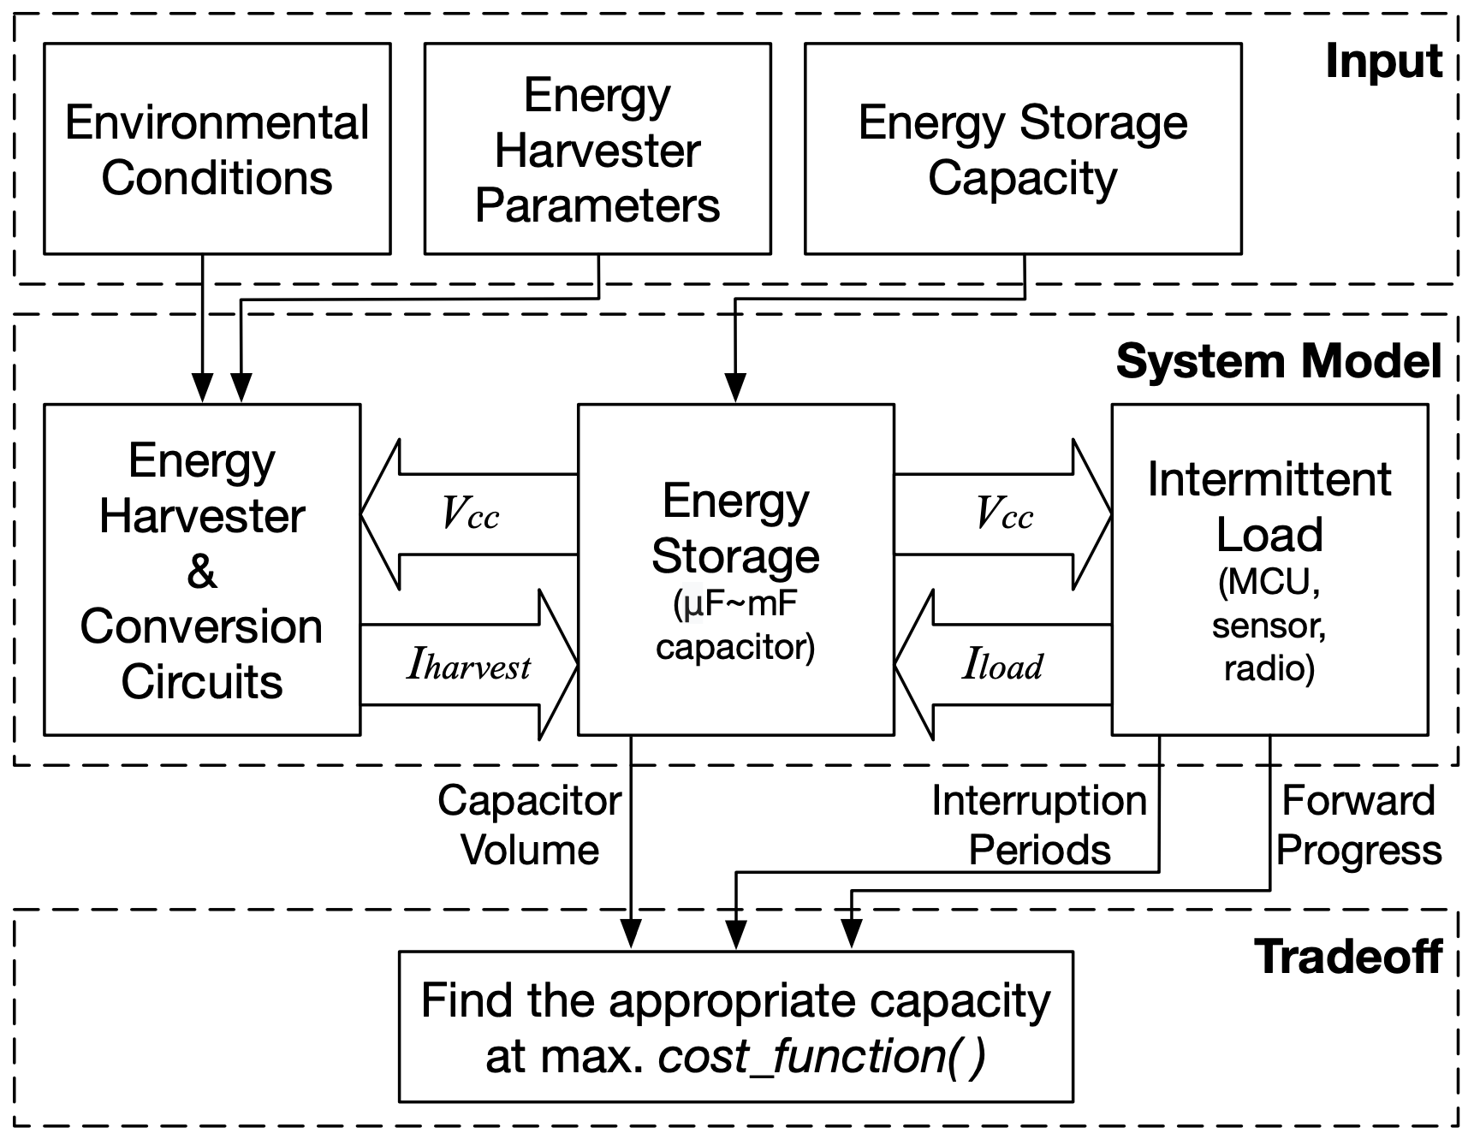
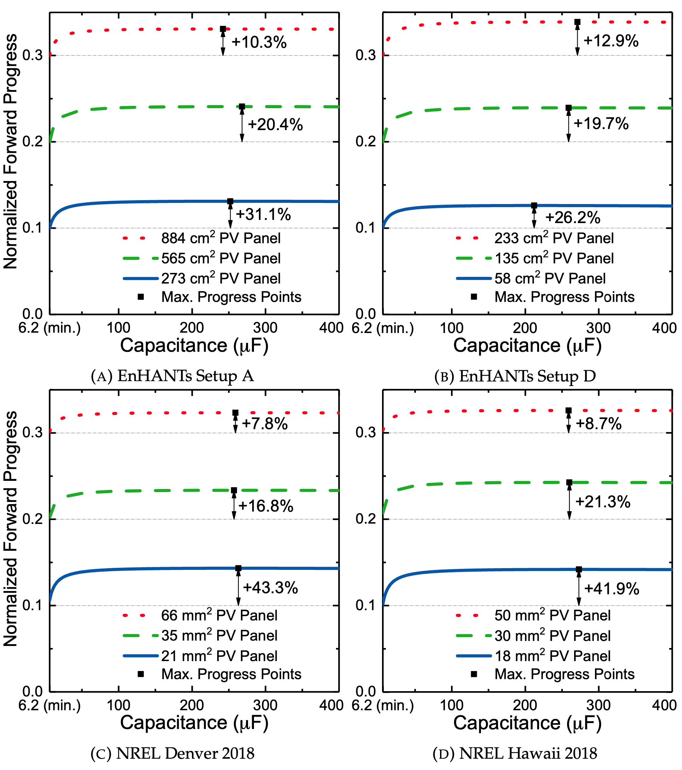
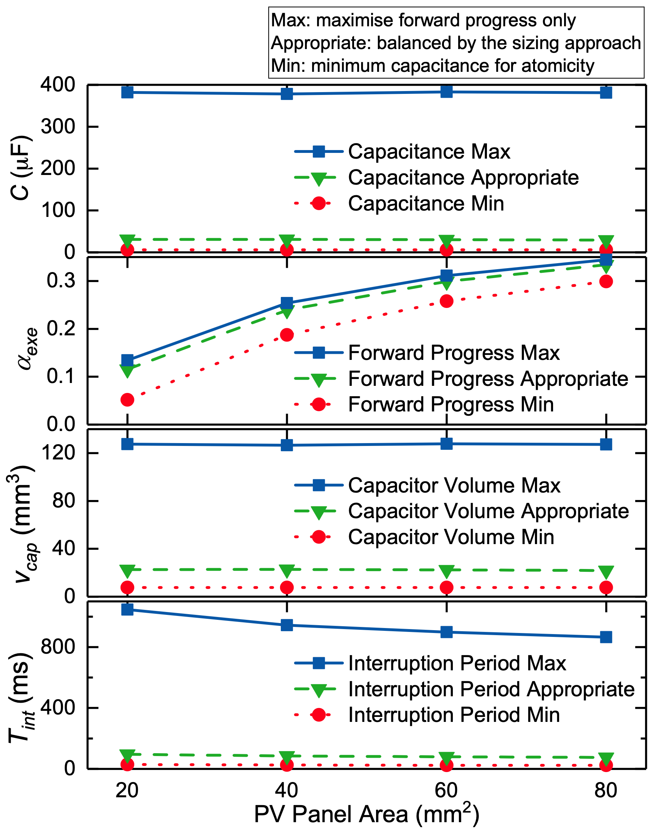
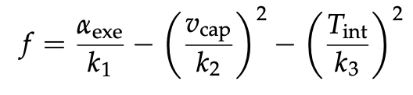
Energy Budgeting for Intermittently-Powered Systems - Jie Zhan
Contribution 2: Energy Storage Sizing Approach
(1) Model-based sizing approach
(2) Evaluation with real energy availability data
Trade off multiple factors
Recommend appropriate C_{stor}
Notes:
Motivation:
How to size energy storage for real IPS deployment?
Trade-off between different design factors besides forward progress.
Example cost function considering capacitor volume and interruption periods
Fig. middle: up to 43% improvement
Fig. right: reduce 83% capacitor volume and 91% interruption periods while achieve 93% of the max forward progress

Slide 7
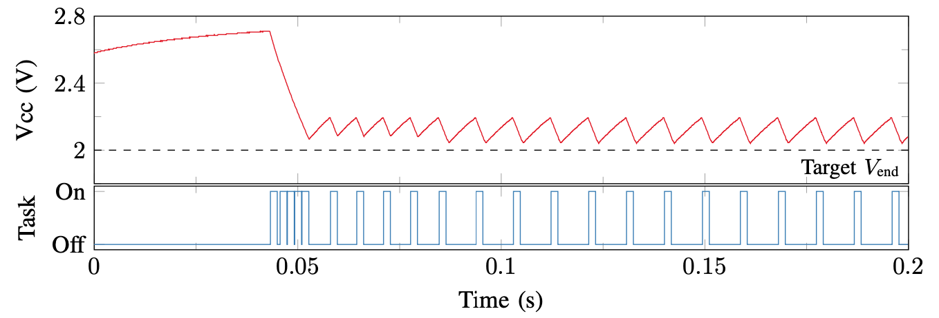
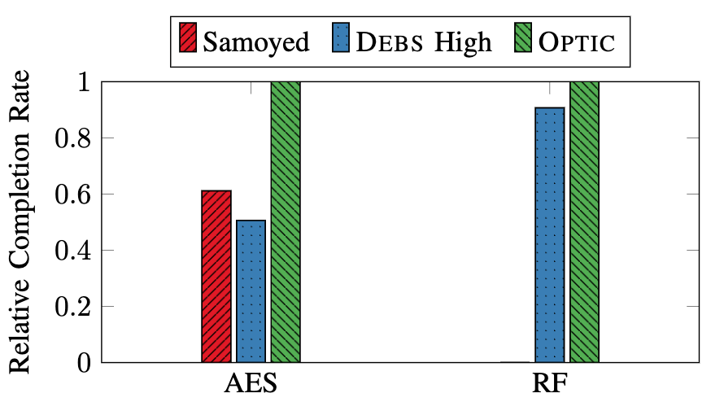
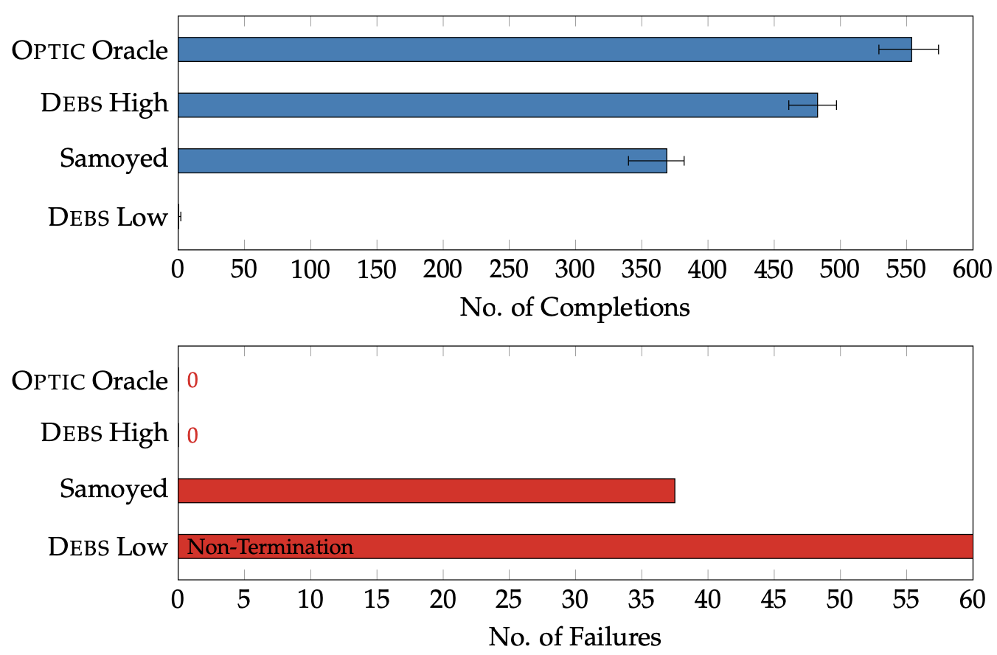
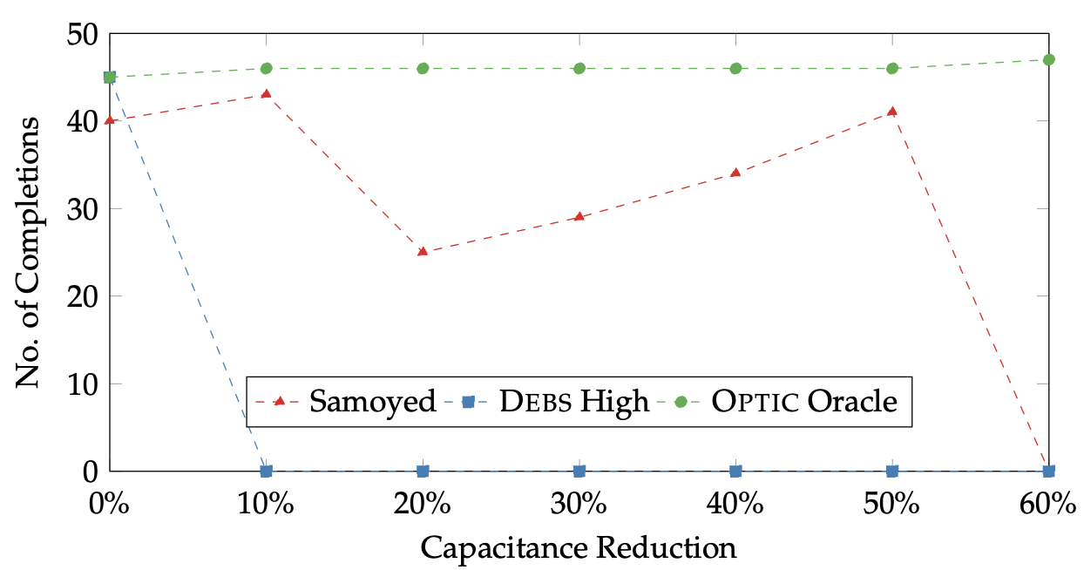
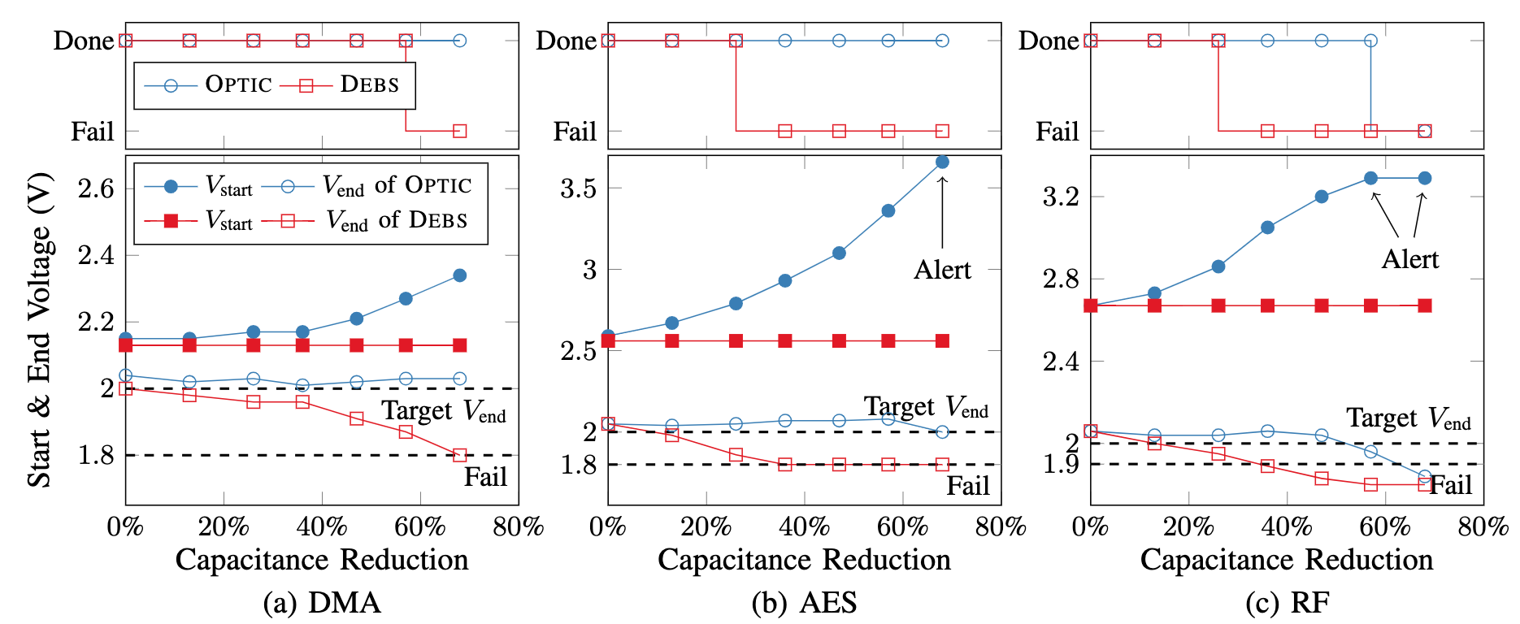
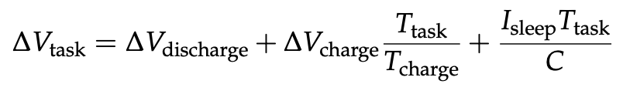
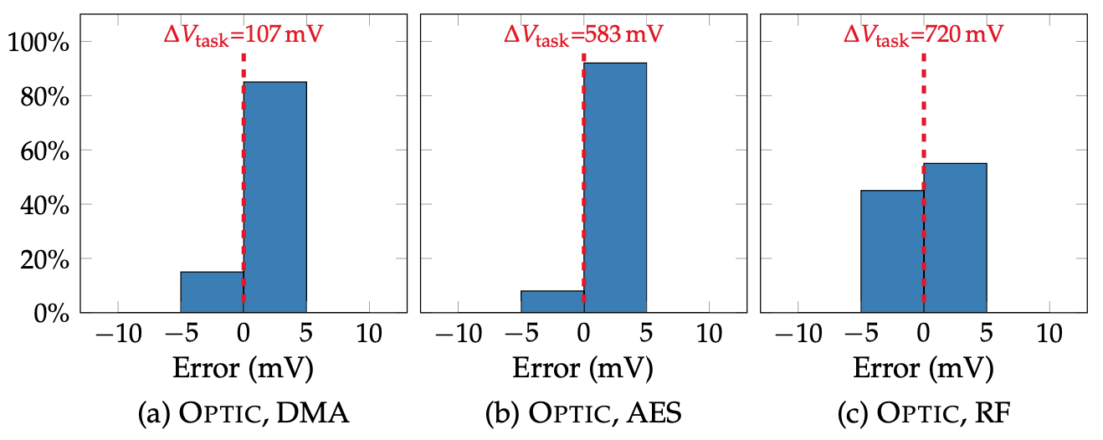
Energy Budgeting for Intermittently-Powered Systems - Jie Zhan
Contribution 3: Runtime Energy Profiling and Adaptation
(1) Exploring runtime energy variations
(3) OPTIC’s runtime energy adaptation
Variable data sizes
Variable peripheral configurations
Device variability
Capacitor ageing and tolerance
Adapting to a new operation
Adapting to variable data sizes
Existing work compared to an adaptive scheme
Adapting to capacitor degradation
(2) OPTIC’s runtime energy profiling
Notes:
Up to 98% improvement on variable workload sizes
Survive with 67% less capacitance, improve device lifetime and reliability.

Slide 8
Energy Budgeting for Intermittently-Powered Systems - Jie Zhan
Publications
Jie Zhan, Alex S. Weddell and Geoff V. Merrett, "Runtime Energy Profiling and Adaptation for Intermittently-Powered Systems" in IEEE Transactions on Computer-Aided Design of Integrated Circuits and Systems. (under editing with supervisors)
Jie Zhan, Geoff V. Merrett and Alex S. Weddell, "Exploring the Effect of Energy Storage Sizing on Intermittent Computing System Performance" in IEEE Transactions on Computer-Aided Design of Integrated Circuits and Systems, vol. 41, no. 3, pp. 492-501, March 2022.
Jie Zhan, Alex S. Weddell and Geoff V. Merrett, "Adaptive Energy Budgeting for Atomic Operations in Intermittently-Powered Systems" in Proceedings of the 8th International Workshop on Energy Harvesting and Energy-Neutral Sensing Systems (ENSsys ‘20), pp. 82–83, November 2020.
Thanks!
Welcome for questions on the thesis

