Slide 1
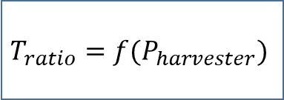
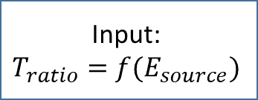
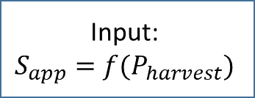

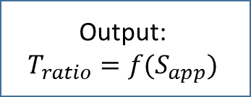
Input:
$$T_{ratio}=f(E_{source})$$
$$T_{ratio}=f(P_{harvester})$$
Output:
$$T_{ratio}=f(S_{app})$$
Input:
$$P_{harvest}=f(E_{source})$$
Input:
$$S_{app}=f(P_{harvest})$$
Energy Harvester Sizing
Energy Harvester Sizing

