Slide 1
Tableau Level Of Detail
Jie Zhang
Nov 17, 2017

Slide 2
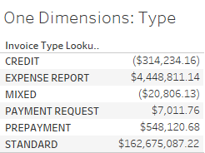
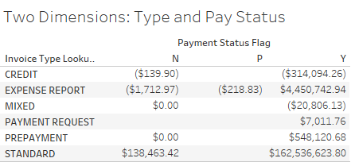
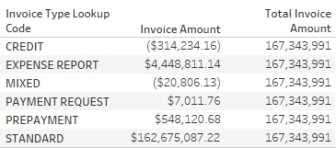
Level of Detail Resolves this Problem
Measures in Tableau always aggregate to the granularity specified in the Tableau visualization (viz LOD)
What if we need to compare the viz LOD value with an aggregation independent to the granularity specified in the viz?
E.g. I want to know the difference between each amount by invoice type and the total amount for the entire data set

Slide 3
LOD Syntax
{[FIXED | INCLUDE | EXCLUDE] <dimension declaration> : <aggregate expression>}
FIXED: lock to the exact granularity specified
INCLUDE: in addition to the viz LOD, include these dimensions
EXCLUDE: remove from the viz LOD these dimensions
Comma separate list of dimension columns
E.g. [Invoice Type], [Payment Status]
Specify the type of aggregation to use
E.g. SUM([Invoice Amount])

Slide 4
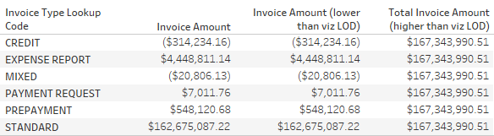
LOD creates a separate table outside of the viz
If the LOD table is at a lower granularity than the viz, then the LOD calculation is aggregated again to the viz level based on the aggregate set in the viz (not in the LOD calculation itself).
If the LOD table is at a higher granularity than the viz, then the LOD calculation repeated for each point in the viz

Slide 5
3 Uses of LOD Demoed

Slide 6
Additional Links
Detail explanation on LOD feature:
https://www.tableau.com/learn/whitepapers/understanding-lod-expressions
More LOD use cases:
https://www.tableau.com/about/blog/LOD-expressions

