Slide 1


Slide 2
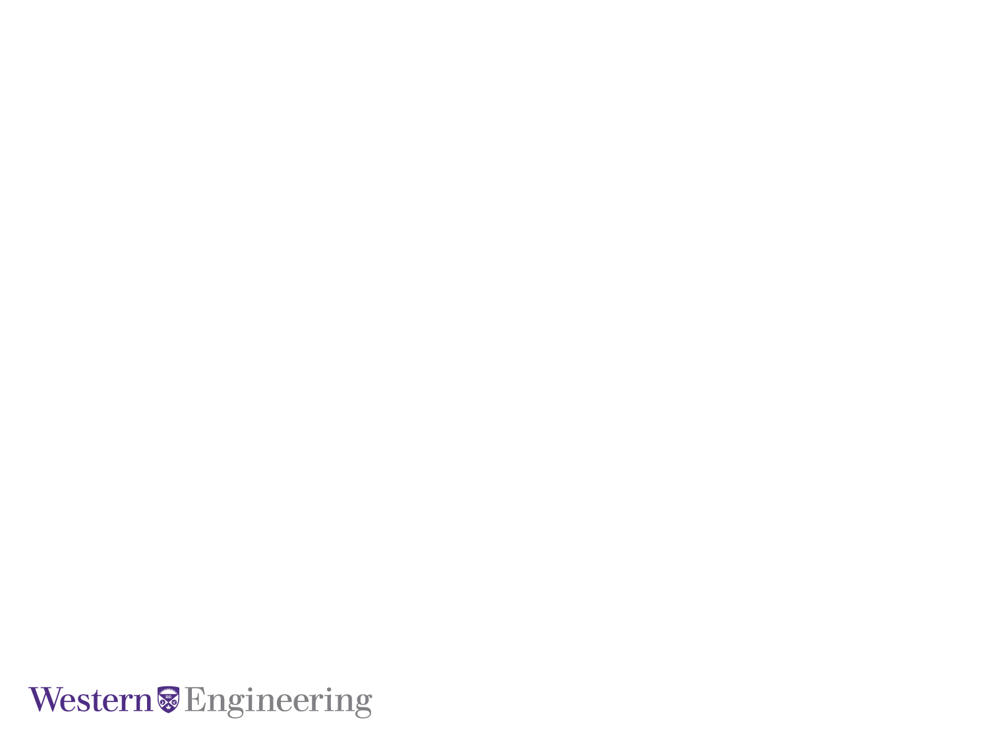
Integrating Explainability into Reinforcement Learning for Autonomous Vehicle Navigation in Simulated Environments
April 1, 2024
By:
Fatemeh Dehrouyeh &
Jifar Mekonnen
ECE

Slide 3
April 1, 2024
Today’s Agenda
Introduction
LR
Methodology
Results
Conclusion
Presentation Title Here

Slide 4
Introduction
XAI
XRL
XRL in Autonomous vehicle
Presentation Title Here

Slide 5
Related Works
Liessner et al.
Explainability: SHapley Additive exPlanations (SHAP) to explain the decision-making process of the RL agent
Environment: OpenAI Gym LongiControl environment
Agent used here: DDPG
L. He et al.
Environment: UAV navigation
Agent: Twin Delayed DDPG (TD3)
Explainability: SHAP (DeepSHAP)
Presentation Title Here

Slide 6
Methodology: Environment
Lunar-lander (from OpenAI gym Box2D)
Action space: 4 discrete actions
0: do nothing
1: fire left orientation engine
2: fire main engine
3: fire right orientation engine
Observation Space: 8-d vector:
the coordinates of the lander in x & y,
linear velocities in x & y,
its angle, its angular velocity, and
two Booleans that represent whether each leg is in contact with the ground or not.
Presentation Title Here

Slide 7
Methodology: Reward
Reward: for each step
is increased/decreased
the closer/further the lander is to the landing pad.
the slower/faster the lander is moving.
is decreased
the more the lander is tilted (angle not horizontal).
by 0.03 points each frame a side engine is firing.
by 0.3 points each frame the main engine is firing.
is increased by 10 points for each leg that is in contact with the ground.
-100 or +100 points for crashing or landing safely respectively.
An episode -> solution if score >= 200 points.
Presentation Title Here

Slide 8
Methodology: Agents
Hyperparameters for the agents:
DQN
gamma = 0.99
learning rate = 6.3e-4
batch size = 128
replay buffer size = 50000
A2C
gamma = 0.995
learning rate = 8.3e-4
PPO
gamma = 0.999
learning rate = 3e-4
Presentation Title Here

Slide 9
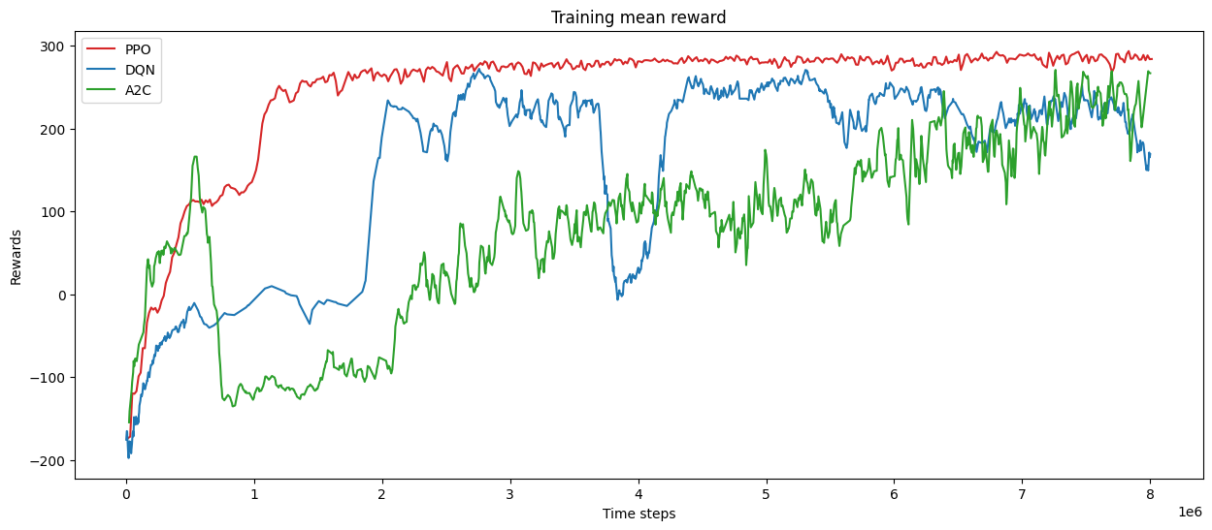
Results: Mean Reward
Presentation Title Here

Slide 10
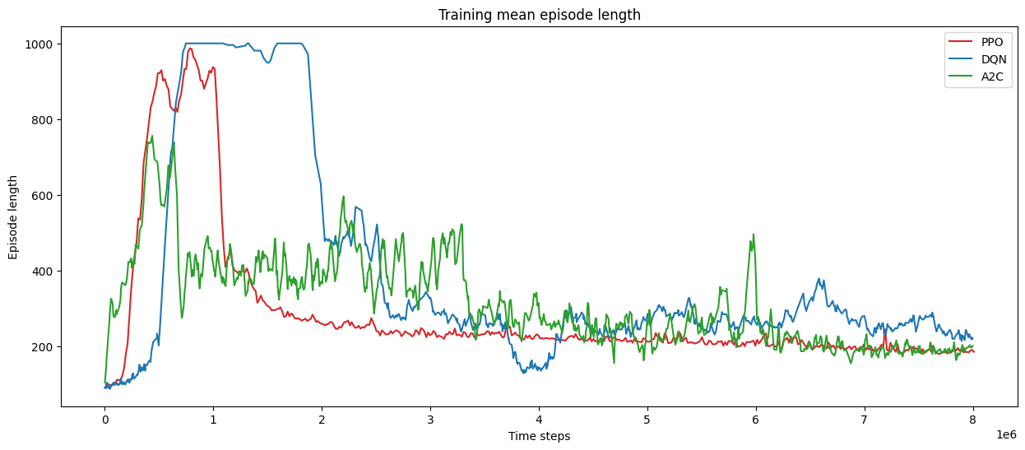
Results: Mean episode length
Presentation Title Here

Slide 11
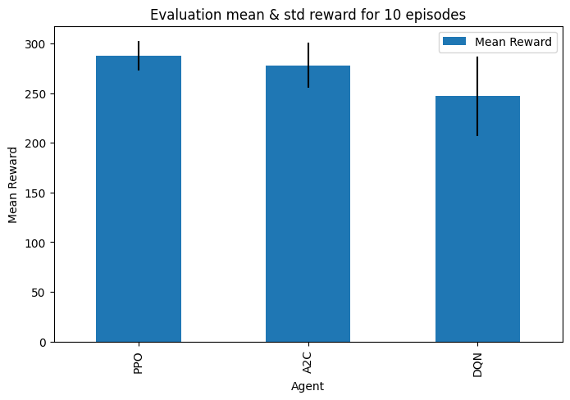
Results: Evaluation
Presentation Title Here

Slide 12
Results: Evaluation rendered
PPO
A2C DQN

Slide 13
Results: SHAP
Presentation Title Here

Slide 14
Conclusion
Qui vel estrum faccaep udiorit atieatio et, veris consect ionesecest.
Qui vel estrum faccaep udiorit atieatio et, veris consect ionesecest.
Qui vel estrum faccaep udiorit atieatio et, veris consect ionesecest.
Presentation Title Here

