Slide 1
Hands-on Automation with STAF/STAX
Part 1

Slide 2
Part 1 Agenda (4 hours)
PART 1A – STAF Introduction
  Introduction
  Basic STAF Concepts
  The STAF Web Page
  Getting Support
  Installing STAF
  Break/LAB 1A (Exercise 1.1)
PART 1B – Using STAF
  Running STAF
  Configuring STAF
  Registering Services
  Interacting with STAF
  Basic STAF Commands
  Break/LAB 1B (Exercises 1.2–1.5)
PART 1C – Leveraging STAF
  STAF Services
  Process Service
  FS Service
  Log Service
  STAF Variables
  Running a simple Testcase
  Running a STAF-enabled Testcase
  STAF Support for Java Testcases
  The STAF Demo
  Break/LAB 1C (Exercises 1.6-1.10)
PART 1D – Debugging STAF
  Tracing
  Debugging STAF
  Break/LAB 1D (Exercise 1.11)

Slide 3
Part 1A - STAF Introduction

Slide 4
Introduction
STAF – Software Testing Automation Framework
Peer-to-peer pluggable framework geared towards test automation
History
  Created at IBM Austin in 1998
  Corporate funded (via QSE) since 1999
  Open-sourced (on SourceForge) in 2001
  Licensed under the Eclipse Public License (EPL) V1.0
User Community
  350+ IBM teams (world-wide)
  275+ external companies
  500k+ downloads of STAF and associated plug-ins since 4Q/2001
  Consistently ranked as one of the Top 50 projects on SourceForge.net

Slide 5
What is STAF?
STAF is an Open Source automation framework designed around the idea of reusable components, called services
It is intended to make it easier to create automated testcases and workloads
STAF can help you increase the efficiency, productivity, and quality of your testing by improving your level of automation and reuse in your individual testcases as well as your overall test environment
Note: This presentation is based on STAF version 3.4.4

Slide 6
STAF as “Middleware for Test”
IBM doesn’t ask or expect its customers to build applications from scratch
IBM customers build their applications on top of our middleware products, such as DB2, MQSeries, and Websphere
By leveraging these products, customers are able to develop individual applications much more quickly and easily, and these applications integrate together more cohesively
STAF provides this type of foundation for the test environment
It provides reusable components that make it easier to create your tests and test environments
It provides an infrastructure that makes it easier to manage your tests and test environments
It provides a common base upon which IBM’s test teams can build and share

Slide 7
STAF as an “Automation Toolbox”
STAF is quick and easy to get started with
  Takes less than 3 minutes to get running on most systems
STAF is very easy to use
  All services have built-in syntax help
  All services are available from the command line
STAF provides many valuable built-in services
  Many more are available for download
  Writing your own services is very straightforward
STAF works well as an integrator or as “glue”
  Provide common services across multiple languages
  Coordinate multiple different tools from a single point of control
  Externalize product specific features to your automation scripts

Slide 8
STAF as “CORBA-Lite”
At its core, STAF acts as a broker, similar to CORBA, DCE, Grid, etc.
STAF simplifies the broker concept by using a basic string request/result format
  Removes the need for IDLs and the like
  Greatly simplifies its use (by non-programmers)
  Eases use in shell-script and batch files
  Command line support for “free”
  Simplifies addition of new language support
In hindsight, this was probably the most important and beneficial decision we made in the design of STAF

Slide 9
STAF for Test Cases
STAF provides a number of facilities that ease the implementation of (complex) test cases
  Standardized and robust logging (Log)
  Remote status monitoring (Monitor)
  Resource management (ResPool)
  Synchronization (Sem)
  Messaging/Notification (Queue, Event)
  Dynamic data/configuration management (Var)

Slide 10
STAF for Test Environments
STAF Provides facilities for automating your test environment (including test harness development)
This is probably the most well-known of STAF’s uses
  Process invocation (Process)
  File Transfer (FS)
  File Packaging/Unpackaging (Zip)
  Synchronization (Sem)
  Resource management (ResPool)
  Dynamic data/configuration management (Var)
  Scheduling (Event, EventManager, Cron)
  Notification (Email)
  Workflow (STAX)

Slide 11
STAF Platform/Language Support
STAF is available for the following platforms
  Windows: 2000, 2003, XP, Vista, Server 2008, Windows 7, Server 2008 R2 (Intel, IA64, AMD64)
  Linux: All platforms (i386, AMD64, PPC64, PPC32, zLinux32, zLinux64)
  AIX 5.3+ (32- and 64-bit)
  Solaris 10+ (Sparc 32/64, x64, x86)
  HP-UX 11.11+ (PA-RISC, IA/64)
  FreeBSD 7.3+
  Mac OS X 10.4+ (i386, PPC)
  Mac OS X 10.6+ (Universal binary with support for i386, x86_64, and ppc)
  IBM i 5.2+ (32- and 64-bit)
  z/OS 1.4+ (32- and 64-bit)
STAF supports the following languages
  Java, C/C++
  Perl, Python, Tcl, Rexx, Shell-script
  Ant
  Command line
STAF “feels” the same across all platforms and languages
Notes:
Note for languages: not all of these are supported as STAF Services
Talk about differences between Major and Minor releases
Mention that we have a back-level version of STAF for OS/2

Slide 12
STAF Customer Usage (Internal – IBM)
Lotus/Workplace
WebSphere
Linux
Printing Systems
Rational
CICS
MQSI
DB2
Tivoli
AIX
LDAP
Java
Global Services
Research
iSeries
zSeries
STAF is the recommended automation infrastructure for all of IBM
It is used in conjunction with other automation tools, such as Rational tools and other vendor tools
STAF is currently being used to automate a wide variety of IBM software/hardware/services testing

Slide 13
STAF Customer Usage (External)
Caldera
Nokia
Symantec
Xerox
HP
SAS
Ammunerve Development Services
Sandia National Laboratories
QUALCOMM
CERN – European Organisation for Nuclear Research
TopSpin
Agilent
NCR
Veritas
ESSsoftware
ClariStore
Sega
Intel
Siemens
Paragon Solutions
Progressive Auto Insurance
Systemware
Kentrox
Alberta Research Council
Sun Microsystems
Logitech
Cisco Systems
VMware

Slide 14
Basic STAF Concepts - STAFProc
STAF runs as a daemon process, called STAFProc, on each system
For example, if you wanted to run STAF on your office machine and 5 test machines in a lab, you would install STAF on all 6 systems. Then, to use STAF in this environment, you would start STAFProc on all 6 machines.
The collection of machines on which you have installed STAF is referred to as the STAF Environment

Slide 15
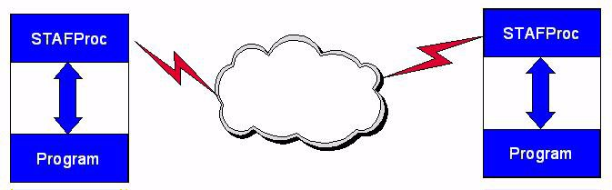
Basic STAF Concepts - STAFProc (cont.)
STAF operates in a peer-to-peer environment; in other words, there is no client-server hierarchy among machines running STAF

Slide 16
Basic STAF Concepts - STAF Services
STAF services are reusable components that provide all the capabilities in STAF. Each STAF service provides a specific set of functionality (such as Logging) and defines a set of requests that it will accept.
STAF Services are used by sending STAF requests to them. A STAF request is simply a string which describes the operation to perform. STAF requests can be sent to services on the local machine or to another, remote, machine in the STAF Environment. In either case, the STAFProc daemon process handles the sending and receiving of requests.

Slide 17
Basic STAF Concepts - STAF Identification
Machine names are used to identify different systems in the STAF Environment. Typically, a STAF machine name is simply the TCP/IP host name of the machine.
Since multiple instances of STAF can be run at the same time on the same system, an Instance name is used to specify a name for each STAF Instance.
A handle is a unique identifier (associated with a process) which is used when submitting requests to STAF. This handle, combined with the STAF Instance name, uniquely identifies a particular process on a STAF machine.
It is this combination of machine name, instance name, and handle that allows STAF Services to track requests from multiple processes on different machines. Every process that accesses STAF does so through a handle.

Slide 18
Basic STAF Concepts - STAF Variables
STAF provides facilities to store and retrieve variables, such as
  Testcase configuration information
  Runtime/state information
  System environment information
STAF variables live within the STAFProc daemon, which allows them to be dynamically updated without having to start and stop applications using them
  After the update, applications referencing the variable will get the new value
STAF maintains a system variable pool that is common to all the handles on a STAF machine
STAF also maintains a shared variable pool which is also system-wide, but which will be sent across the network and used in variable resolution on remote systems
In addition, each handle has its own unique variable pool
By default, the values of variables in a handle's variable pool override the values of variables in the global variable pool
  A handle may override this behavior when asking for the value of a variable

Slide 19
Basic STAF Concepts - STAF Queues
Each handle in STAF has a priority-based message queue associated with it
  Applications receive messages sent from other processes/machines on their queue
STAF Queues serve as the basis for local/network Inter-Process Communication (IPC) in the STAF environment
STAF Queues form the foundation for event-driven programming in the STAF environment

Slide 20
Basic STAF Concepts - STAF Security
Security in STAF can be defined at the machine level and/or user level
In other words, you grant access to machines and/or to users
Access in STAF is granted by specifying a certain trust level for a machine or user, where trust level 0 indicates no access and trust level 5 indicates full access
Users assign a numeric trust level to specific machines and/or users, or to groups of machines/users by specifying match patterns (wild cards)
Other machines receive a default user-configurable trust level
Each service in STAF defines what trust level is required in order to use the various functions the service provides
A simple numerical comparison is used to see if the request is authorized
User authentication overrides machine authentication

Slide 21
Basic STAF Concepts - STAF Authenticators
Authenticators are special external STAF services whose purpose is to authenticate users in order to provide user level trust, which can be used in addition to (or instead of) machine level trust.
An Authenticator is a special service that accepts an authenticate request
  As a user, you cannot directly submit a request to an authenticator service
  Authenticators are accessed indirectly via the Handle service
In order to use user trust security in STAF, you must have at least one authenticator registered
A sample authenticator is provided for STAF V3.3.1. You can write your own authenticators.

Slide 22
Basic STAF Concepts - STAF Network Interfaces
STAF provides two network interfaces, secure TCP/IP and non-secure TCP/IP (except a secure TCP/IP interface is not yet provided for Windows IA64 or z/OS).
The default STAF configuration file configures a secure ssl interface as the
default interface and also configures a non-secure tcp interface (except on Windows IA64 and z/OS where only a non-secure tcp interface is configured).
An interface named local is also provided with STAF. Requests coming from
the local system will appear as though they came from an interface named "local" and a system identifier of "local".

Slide 23
Basic STAF Concepts – Performance Overhead
STAF was designed to consume as little system resources as possible, as we know that people want their test systems as close to clean-room conditions as possible
A typical STAF installation is about 10-50 MB (depending on whether you use the installer with the integrated JVM)
STAF's in-memory size (without any additional external services) is about 2.5-5 MB (depending on the platform)
On an idle STAF system (i.e., one in which there are no requests currently being handled by STAF) STAF consumes 0% CPU on a Windows system and a VERY limited amount on Unix systems. On Unix, we have a thread which wakes up once a second to see if any STAF processes have completed.

Slide 24
Basic STAF Concepts - Types of STAF Services
Internal STAF Services
  The executable code for internal STAF services resides within STAFProc, which means they are always available and have a fixed name
External STAF Services
  The executable code for external STAF services resides outside of STAFProc, for example in a Java jar file or a C++ DLL file
Custom STAF Services
  Note that you can also write your own custom services that can be plugged into STAF.
  All Custom STAF Services are external services
Service Loader Services
  Service loaders are external services whose purpose is to load services on-demand

Slide 25
The STAF web page
The main STAF web page is http://staf.sourceforge.net
From this web page you can:
  Submit bugs and feature requests
  View the STAF source code
  Download the STAF binary files
  Download STAF services
  View STAF documentation
  Access Mailing Lists to view, search, and post messages (Help, Announcements)
  Access Forums to view, search, and post messages

Slide 26
Getting Support
If you need support (problems/questions/etc.) for STAF or any of the STAF services, there are several ways to get help. First, we ask that you:
  Read/search the Frequently Asked Questions (FAQ) document:
  http://staf.sourceforge.net/current/STAFFAQ.htm
  Read/search the STAF User’s Guide and other STAF documentation:
  http://staf.sourceforge.net//docs.php
  Check to see if there is already an open bug or feature:
  http://sourceforge.net/tracker/?group_id=33142&atid=407381 (Bugs)
  http://sourceforge.net/tracker/? group_id=33142&atid=407384 (Features)
There are several ways you can get support:
  Post on our Help forum: http://sourceforge.net/projects/staf/forums/forum/104046
  Subscribe and send a note to our staf-users mailing list:
  staf-users@lists.sourceforge.net
  IBM employees can use the internal newsgroup:
  software.test.automation.staf-stax-ais on ibmforums.ibm.com http://ibmforums.ibm.com/forums/forum.jspa?forumID=2484

Slide 27
STAF Installation
There are two types of installers that are provided for STAF:
  InstallAnywhere (available for Windows and most Unix platforms)
  STAFInst (available for all Unix platforms)
Note that the InstallAnywhere and STAFInst installers install the exact same files on a given platform
You can select which type of installer is most appropriate to use in your environment
You can find detailed information about installing STAF in the “STAF Installation Guide” at http://staf.sourceforge.net/current/STAFInstall.pdf

Slide 28
STAF Installation - InstallAnywhere
InstallAnywhere is a Java-based multi-platform software installation program
InstallAnywhere provides three installation modes:
  Graphical installation mode (requires a UI display)
  Console installation mode (via command-line, useful for systems without
  UI display but requiring an interactive install)
  Silent installation mode (where the install options are specified when
  starting the silent installation, either via command-line options or a
  response file)

Slide 29
STAF Installation – InstallAnywhere (cont.)
There are three types of InstallAnywhere files that are provided for STAF:
  Installer executable with a bundled JVM, named
    STAF<version>-setup-<platform>.exe on Windows
    STAF<version>-setup-<platform>.bin on Unix
  Installer executable without a bundled JVM, named
    STAF<version>-setup-<platform>-NoJVM.exe on Windows
    STAF<version>-setup-<platform>-NoJVM.bin on Unix
    STAF<version>-setup-<platform>.bin on Mac OS X
  Installer zip file without a bundled JVM for Mac OS X, named
    STAF<version>-setup-<platform>.zip

Slide 30
STAF Installation - STAFInst
STAFInst is a script-based installer for Unix platforms
It will install all files required to run STAF, however, it will not perform some installation steps that InstallAnywhere performs, such as updating user profiles for environment variable updates
The STAFInst installer is packaged as a "GNU zipped tar" file, named:
  STAF<version>-<platform>.tar.gz
Except on z/OS where it is packaged as a Unix compressed file, named:
  STAF<version>-<platform>.tar.Z

Slide 31
STAF Installation – Install file examples
For example, the following files are provided for STAF:
  Windows 32-bit:
    STAF344-setup-win32.exe
    STAF344-setup-win32-NoJVM.exe
  Linux 32-bit:
    STAF344-setup-linux.bin
    STAF344-setup-linux-NoJVM.bin
    STAF344-linux.tar.gz
  Mac OS X (universal):
    STAF344-setup-macosx-universal.zip
    STAF344-setup-macosx-universal.bin
    STAF344-macosx-universal.tar.gz

Slide 32
STAF Installation – Target Installation Directory
When installing STAF, you must specify the target installation directory
The default install location varies depending on the operating system:
  On Windows, the default install directory is C:\STAF
  On Mac OS X, the default install directory is /Library/staf
  On other Unix platforms, the default install directory is /usr/local/staf

Slide 33
STAF Installation - Upgrades
STAF allows you to do upgrade installs, instead of first uninstalling the existing version of STAF
When installing STAF via InstallAnywhere, if you have selected a target installation directory where a version of STAF is already installed, you will be asked if you want to upgrade the existing version
  If you choose to do the upgrade installation, all of STAF files will be upgraded to the new version
  Any files created after STAF was installed (e.g. additional services, log files, updated STAF.cfg, etc) will not be removed
When installing STAF via STAFInst, if you have selected a target installation directory where a version of STAF is already installed, the install will display an error message indicating that you must first uninstall the existing version of STAF

Slide 34
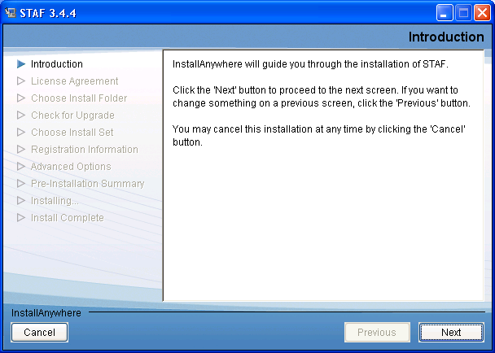
Installing STAF – InstallAnywhere Graphical mode
Execute STAF344-setup-win32.exe

Slide 35
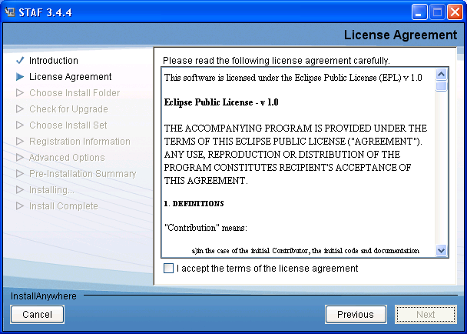
Installing STAF – InstallAnywhere Graphical mode (cont.)

Slide 36
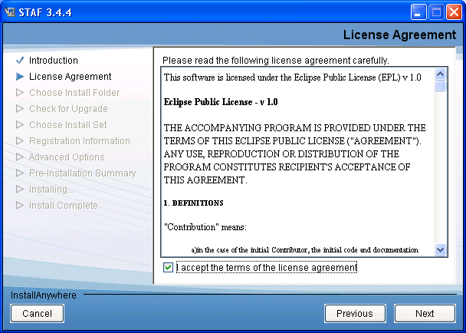
Installing STAF – InstallAnywhere Graphical mode (cont.)

Slide 37
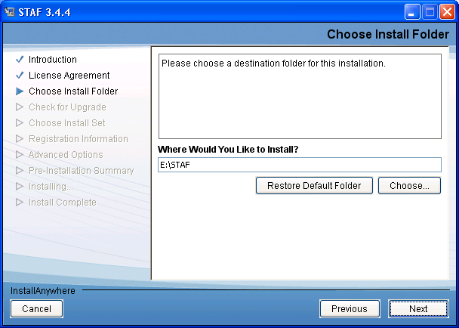
Installing STAF – InstallAnywhere Graphical mode (cont.)

Slide 38
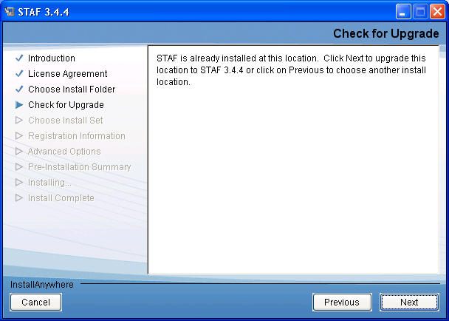
Installing STAF – InstallAnywhere Graphical mode (cont.)

Slide 39
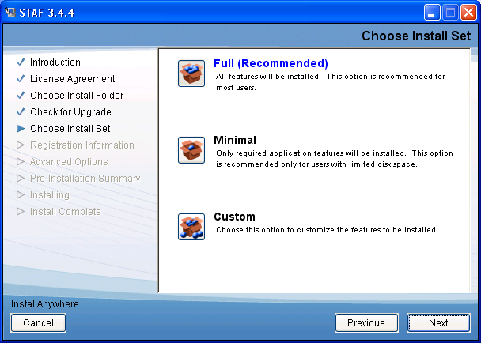
Installing STAF – InstallAnywhere Graphical mode (cont.)

Slide 40
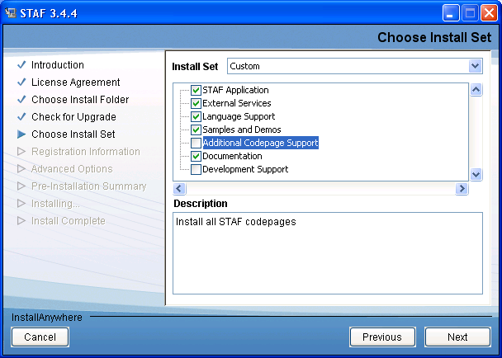
Installing STAF – InstallAnywhere Graphical mode (cont.)

Slide 41
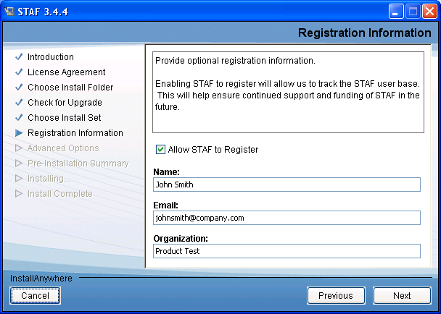
Installing STAF – InstallAnywhere Graphical mode (cont.)

Slide 42
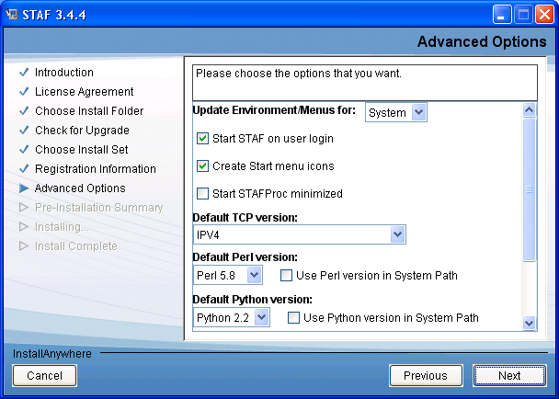
Installing STAF – InstallAnywhere Graphical mode (cont.)

Slide 43
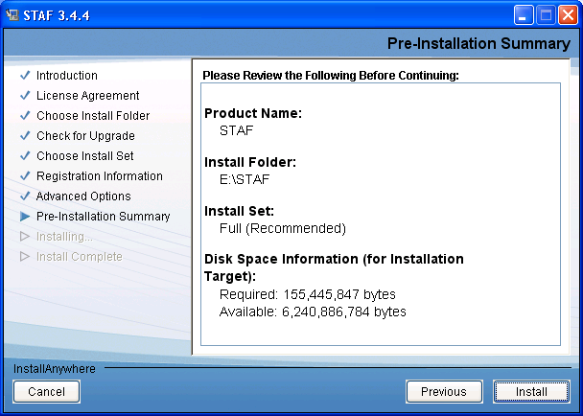
Installing STAF – InstallAnywhere Graphical mode (cont.)

Slide 44
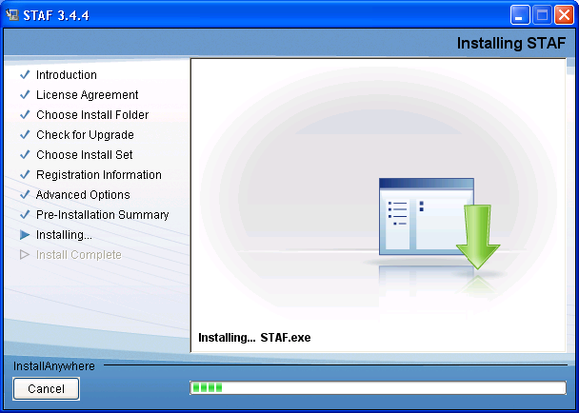
Installing STAF – InstallAnywhere Graphical mode (cont.)

Slide 45
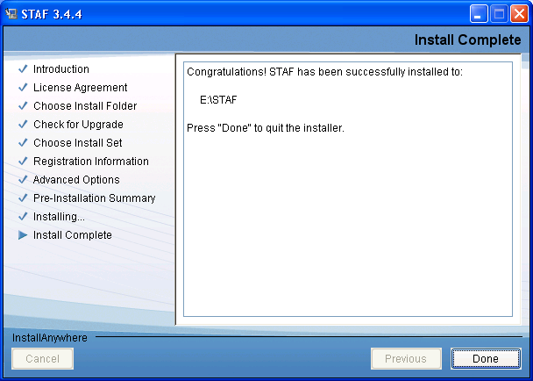
Installing STAF – InstallAnywhere Graphical mode (cont.)

Slide 46
Installing STAF – InstallAnywhere Arguments
Here are the command-line options for an IA installer (or uninstaller):
  STAF344-setup-win32 [-f <path_to_installer_properties_file> | -options]
  (to execute the installer)
  where options include:
  -?
  show this help text
  -i [swing | console | silent]
  specify the user interface mode for the installer
  -D<name>=<value>
  specify installer properties
To perform an install in silent mode, you can specify the "-i silent" option
when starting the installer
To perform an IA install in console mode, you can specify the "-i console"
option when starting the installer

Slide 47
Installing STAF – InstallAnywhere Installer Properties
Here are some of the installer properties than can be specified for a silent install:
ACCEPT_LICENSE | Acceptance of the license agreement. Values are "1" (accept) or "0" (or any value other than "1"). Default is "0“.
USER_INSTALL_DIR | The directory where STAF will be installed.
INSTALLER_UI | The install UI type. Values are "silent", "swing", or "console".
CHOSEN_INSTALL_SET | The install set. Values are "Full", "Minimal", or "Custom".
CHOSEN_INSTALL_FEATURE_LIST | The Custom features to install. Valid features names are: STAF,ExtSvcs,Langs,Samples,Codepage,Docs,Develop.
REGISTER | Whether to perform STAF registration when STAF is first started.
UPDATE_ENVIRONMENT | Scope of environment/menu updates. Values are "System", "User", "None".
START_ON_LOGIN | Whether to start STAF on Login. This is a Windows-only property.
CREATE_START_MENU_ICONS | Whether to create Start menu icons/programs folder for STAF. This is a Windows-only property.

Slide 48
Installing STAF – InstallAnywhere Silent Install Examples
Perform a silent install with all default options:
  STAF344-setup-win32 -i silent -DACCEPT_LICENSE=1
Install STAF in C:\Program Files\STAF:
  STAF344-setup-win32 i silent -DACCEPT_LICENSE=1
  -DUSER_INSTALL_DIR="C:\Program Files\STAF"
Perform a Minimal install of STAF, without updating any menus or environment
variables:
  STAF344-setup-win32 -i silent -DACCEPT_LICENSE=1
  -DCHOSEN_INSTALL_SET=Minimal -DUPDATE_ENVIRONMENT=None
Perform a Custom install of STAF in directory C:\tools\staf, with features STAF,
External Services, Languages, and all codepages:
  STAF344-setup-win32 -i silent -DACCEPT_LICENSE=1
  -DUSER_INSTALL_DIR=C:\tools\staf -DCHOSEN_INSTALL_SET=Custom
  -DCHOSEN_INSTALL_FEATURE_LIST=STAF,ExtSvcs,Langs,Codepage

Slide 49
Installing STAF – InstallAnywhere Silent Install Response File
You can specify a properties (response) file to use when starting the STAF IA
Installer. The properties file should contain the same -D options that you would
specify on a command-line installation. For example:
  STAF344-setup-win32 -i silent -f installer.properties
Here is a sample installer.properties file:
  INSTALLER_UI=silent
  ACCEPT_LICENSE=1
  USER_INSTALL_DIR=C:\\STAF
  CHOSEN_INSTALL_SET=Full
  REGISTER=1
  REGISTRATION_NAME=Joe Smith
  REGISTRATION_EMAIL=address@comany.com
  REGISTRATION_ORG=ABC Test
  UPDATE_ENVIRONMENT=System
  START_ON_LOGIN=1
  CREATE_START_MENU_ICONS=1
  USE_TCP_VERSION=IPV4
  USE_PERL_VERSION=5.8
  STAF_INSTANCE_NAME=STAF
  USER_REQUESTED_RESTART=NO

Slide 50
Installing STAF – STAFInst
To install via STAFInst, you will need to gunzip the gzipped tar file or
uncompress the compressed tar file and then untar it into a temporary directory
from which you will later run the STAFInst command
  Note that when you untar the file, it will expand into a single directory named
  “staf" that will contain the installation files and directories
For example assuming you downloaded the gzipped tar file for Linux into a temporary directory named /tmp/STAF:
  cd /tmp/STAF
  gunzip STAF344-linux.tar.gz
  tar -xvf STAF344-linux.tar
  cd staf

Slide 51
Installing STAF – STAFInst (cont.)
Once the STAF installation image is ready, you should run the STAFInst command. The syntax is:
  STAFInst [-source <source path>] [-target <target path>]
  [-bin <directory>] [-lib <directory>] [-preview]
  [-type < m | r | f >] [-verbose] [-warn]
  [-ro <mode>] [-rx <mode>] [-rw <mode>] [-dp <mode>]
  [-noreg | [-name <name>] [-email <email>] [-org <org>]]
  [-acceptlicense] [-option name=value]...
Here are some options that are commonly specified:
  -target specifies where STAF will be installed
  -acceptlicense indicates that you accept the terms of the license agreement for this
  software. If not specified, the license agreement will be displayed at the beginning of
  the installation.
  -type specifies the type of installation, “m” installs the minimum files, “r” or “f” installs
  recommended (all) files
  -bin specifies the directory where softlinks to executables will be created
  -lib specifies the directory where softlinks to libraries will be created

Slide 52
Installing STAF – STAFInst Examples
Perform a silent install with all default options:
  ./STAFInst –acceptlicense
Perform a recommended install of STAF into the default target directory, and have softlinks placed into /usr/bin and /usr/lib
  ./STAFInst -acceptlicense -bin /usr/bin -lib /usr/lib
Perform a minimum installation of STAF into /opt/staf
  ./STAFInst -acceptlicense -target /opt/staf -type m

Slide 53
Installing STAF – Environment Variables
STAF requires setting some environment variables to run:
  PATH must contain the STAF bin directory in order to start STAFProc or to
  communicate with STAF
  LD_LIBRARY_PATH (LIBPATH on AIX, OS/400, and z/OS systems,
  SHLIB_PATH on HP-UX systems, DYLD_LIBRARY_PATH on Mac OS X)
  must contain the STAF lib directory (e.g. /Library/staf/lib), unless you
  allowed softlinks to be installed in the default system directories
  CLASSPATH must contain the JSTAF.jar file. JSTAF.jar contains the STAF
  Java APIs to communicate with STAF from Java programs and is also
  required to register STAF services written in Java
  STAFCONVDIR must be set to the STAF codepage directory if you did not
  install STAF in the default target directory

Slide 54
Installing STAF – Environment Variables (cont.)
If you performed an InstallAnywhere install and selected an option to have the install update the environment variables, these environment variables should already be updated for STAF
Otherwise, you must set these environment variables yourself. In most cases, you'll probably want to set these environments for the system so that they are always set even after logging out or rebooting.
However, if you are going to be running two or more versions of STAF on the same machine, the install creates STAFEnv script files that you can use to easily switch environment settings for each version of STAF

Slide 55
Installing STAF – STAFEnv Script
After the STAF install is complete, a STAFEnv.bat file (on Windows) or a STAFEnv.sh file (on Unix) will be created in the root STAF install directory
The STAFEnv script files are useful if you are going to be running two versions of STAF on the same machine and need a convenient way to switch settings for each version of STAF. An optional argument specifying the STAF instance name can be passed to a STAFEnv script
Note that to correctly execute the STAFEnv.sh script on Unix, you must execute it in this format:
  . ./STAFEnv.sh
Or, if the STAFEnv.sh script is not in the current directory:
  . ./usr/local/staf/STAFEnv.sh

Slide 56
Installing STAF – STAFEnv Script (cont.)
Here is a sample STAFEnv.bat file from a Windows system:
@echo off
  REM STAF environment variables
  set PATH=C:\STAF\bin;%PATH%
  set CLASSPATH=C:\STAF\bin\JSTAF.jar;C:\STAF\samples\demo\STAFDemo.jar;%CLASSPATH%
  set STAFCONVDIR=C:\STAF\codepage
  if "%1" EQU "" set STAF_INSTANCE_NAME=STAF
  if "%1" NEQ "" set STAF_INSTANCE_NAME=%1
Here is a sample STAFEnv.sh file from a Linux system:
  #!/bin/sh
  # STAF environment variables
  PATH=/usr/local/staf/bin:${PATH:-}
  LD_LIBRARY_PATH=/usr/local/staf/lib:${LD_LIBRARY_PATH:-}
  CLASSPATH=/usr/local/staf/lib/JSTAF.jar:/usr/local/staf/samples/demo/STAFDemo.jar:${CLASSPATH:-}
  STAFCONVDIR=/usr/local/staf/codepage
  if [ $# = 0 ]
  then
  STAF_INSTANCE_NAME=STAF
  else
  STAF_INSTANCE_NAME=$1
  fi
  export PATH LD_LIBRARY_PATH CLASSPATH STAFCONVDIR STAF_INSTANCE_NAME

Slide 57
Installing STAF – startSTAFProc Script
After the STAF install is complete, a startSTAFProc.bat file (on Windows) or a startSTAFProc.sh file (on Unix) will be created in the root STAF install directory
The startSTAFProc script files can be used to set up the STAF environment variables and start STAFProc
Note that to correctly execute the startSTAFProc.sh script on Unix, you must execute it in this format:
  ./startSTAFProc.sh
Or, if the startSTAFProc.sh script is not in the current directory:
  /usr/local/staf/startSTAFProc.sh

Slide 58
Installing STAF – startSTAFProc Script (cont.)
Here is a sample startSTAFProc.bat file from a Windows system:
  REM Sets up the STAF environment variables and starts STAFProc
  call "C:\STAF\STAFEnv.bat"
  start "Start STAF 3.4.1" /min "C:\STAF\bin\STAFProc.exe"
Here is a sample startSTAFProc.sh file from a Linux system:
  #!/bin/sh
  # Sets up the STAF environment variables and starts STAFProc
  # in the background, logging STAFProc output to nohup.out
  . /usr/local/staf/STAFEnv.sh
  nohup /usr/local/staf/bin/STAFProc &

Slide 59
Installing STAF – install.properties
After the STAF install is complete, an install.properties file will be created in the root STAF install directory
The file will contain key/value pairs that provide information about the version of STAF that has been installed:
version | the version of STAF that has been installed
platform | the STAF platform name
architecture | the architecture of the STAF build (32-bit or 64-bit)
installer | the type of installer (InstallAnywhere, STAFInst)
file | the file used to install STAF
osname | the operating system name for the STAF build (equivalent to the "os.name" Java property)
osversion | the operating system version supported by the STAF build ("*" indicates the build is supported on any version of the OS; a version number followed by a "+" indicates the build supports that version or later)
osarch | the operating system architecture supported by the STAF build (equivalent to the "os.arch" Java property)

Slide 60
Installing STAF – install.properties (cont.)
Here is a sample install.properties file from a Windows system (using the IA installer):
  version=3.4.4
  platform=win32
  architecture=32-bit
  installer=IA
  file=STAF344-setup-win32.exe
  osname=Windows
  osversion=*
  osarch=x86
Here is a sample install.properties file from a Mac OS X i386 system (using the STAFInst installer):
  version=3.4.4
  platform=macosx-i386
  architecture=32-bit
  installer=STAFInst
  file=STAF344-macosx-i386.tar
  osname=Mac OS X
  osversion=10.4+
  osarch=i386

Slide 61
Installing STAF – Starting STAF During System Reboot
You can configure your systems to automatically start STAF when the system
starts/reboots
  Note that the STAF installers do not perform this configuration
On Windows, to have STAFProc start automatically when the operating system
is rebooted (without requiring a user to log on to Windows), you can do one of
the following:
  Install STAF as a Windows service
  Start STAF as a scheduled task
On Unix, create a script file that sets up the STAF environment and starts STAF, and configure the system to run the script file during the OS boot sequence
See the STAF Installation Guide for more information
http://staf.sourceforge.net/current/STAFInstall.pdf

Slide 62
Installing STAF – Automatically Upgrading STAF
We provide a STAX library, STAFUpgradeUtil that will upgrade the version of STAF running on a remote target machine
  For example, if you have 100 machines running an older version of STAF,
  and you wanted to upgrade them all to STAF V3.4.1, you could use the
  STAFUpgradeUtil library to automatically upgrade all of these systems to
  STAF V3.4.1, instead of having to manually upgrade each system
The target machines where STAF will be upgraded to a new version must already have STAF running, with a minimum version of:
  STAF 3.0.0 if the target machine is a Windows machine
  STAF 3.1.3 if the target machine is a Unix machine
This library is packaged with the STAX service (stax/libraries/STAFUpgradeUtil.xml)

Slide 63
Part 1A – Break/LAB (10 min.)
Exercise 1.1

Slide 64
Part 1B – Using STAF

Slide 65
Running STAF - STAFProc
STAFProc is what starts STAF running on a machine
Syntax:
  STAFProc [Configuration File]
  If [Configuration File] is not specified, STAFProc will try to use the file STAF.cfg. It will search for this file in the directory in which STAFProc resides.
  On Windows, you can click on "Start STAF 3.4.4" on the Start Menu
To shutdown STAF:
  Run the command staf local shutdown shutdown
  On Windows, you can click on "Shutdown STAF 3.4.4" on the Start Menu

Slide 66
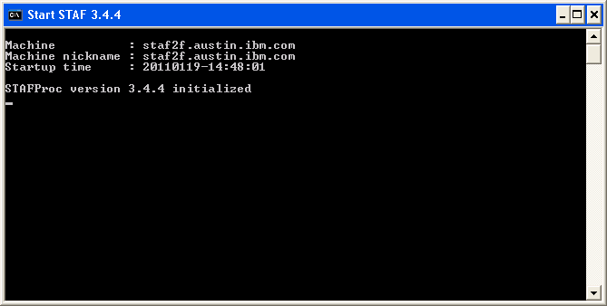
Running STAF - STAFProc (continued)
IMPORTANT!
The first line (Machine:) should ALWAYS have the domain name. If the domain name is not shown, then you need to update your system’s OS network settings.

Slide 67
Configuring STAF
STAF is configured through a text file called the STAF Configuration File
This file may have any name you desire, but the default is STAF.cfg. By default, this file is located in the c:\STAF\bin directory (or /usr/local/staf/bin on UNIX).
When you start the STAF daemon process on each system, that system's STAF.cfg file will be read to determine how STAF should be configured on the machine

Slide 68
Configuring STAF (cont.)
Through the STAF Configuration file, you can alter many aspects of STAF's behavior. For example, you can
  Specify a machine nickname
  Configure communication interfaces
  Configure authenticators
  Define operational parameters for STAF
  Configure Service loader services
  Define system or shared STAF variables (Var service)
  Specify security access to machines and/or users in the STAF environment (Trust service)
  Enable and configure tracing (Trace service)
  Register and configure external STAF services (Service service)
Note that the items shown in blue can also be dynamically added or updated (via the service shown in parenthesis) so you don’t need to restart STAF to pick up changes to your STAF.cfg file.
  Note, however, that these dynamic changes are not persistent. So, usually after making a dynamic change, you will want to also update your STAF.cfg file, so the change will be active the next time STAF is restarted.

Slide 69
Configuring STAF – Machine Nickname
You may specify a machine nickname for your machine using the MACHINENICKNAME configuration statement. The syntax is:
MACHINENICKNAME <Nickname>
This allows you to override the machine nickname which is set, by default, to the value of the STAF/Config/Machine system variable
This primarily effects the data stored by services such as the Log and Monitor services, which store data based on the machine from which it came from, by using the STAF/Config/MachineNickname system variable as part of the directory path when creating log and monitor data. For example:
STAF local LOG QUERY MACHINE <Machine Nickname> LOGNAME <Logname>
STAF local MONITOR QUERY MACHINE <Machine Nickname> HANDLE <Handle>
This allows you to better manage your data
Note that the machine nickname is not used to communicate with other systems and does not have any effect on trust

Slide 70
Configuring STAF – Configuring Communication Interfaces
You indicate that you wish to send and accept requests on a network interface using the INTERFACE configuration statement. The syntax is:
INTERFACE <Name> LIBRARY <Implementation Library>
[OPTION <Name[=value]>]...
  <Name> is the name by which this network interface (aka Connection
  Provider) will be known on this machine
  LIBRARY is the name of the shared library / DLL which implements the network interface (aka Connection Provider). STAF V3.4.4 provides one connection provider that supports both secure and non-secure TCP/IP communication on most platforms.
    The implementation library for this connection provider is called STAFTCP

Slide 71
Configuring STAF – STAFTCP Communication Interface
The STAFTCP connection provider shared library / DLL supports secure and non-secure TCP/IP communication
  STAF supports both IPv4 and IPv6. IPv6 is supported in the IPv6 enabled version of STAF
  The STAFTCP connection provider supports the following OPTIONs
  PORT=<Name> specifies the TCP/IP port on which this connection provider listens for connections. The default is 6500.
  SECURE=<Yes | No> specifies whether to use secure or non-secure TCP/IP. Secure TCP/IP uses OpenSSL. The default is No.
  PROTOCOL=<Name> specifies the communication protocol that this connection provider uses. The possible values are IPv6, IPv4, or IPv4_IPv6.
  CONNECTTIMEOUT=<Number> specifies the maximum time in milliseconds to wait for a connection attempt to a remote system to succeed. The default is 5000 (5 seconds).

Slide 72
Configuring STAF – STAFTCP Communication Interface (cont.)
Examples:
INTERFACE ssl LIBRARY STAFTCP OPTION SECURE=Yes
OPTION PORT=6550
INTERFACE tcp LIBRARY STAFTCP OPTION SECURE=No
OPTION PORT=6500
INTERFACE tcp2 LIBRARY STAFTCP OPTION PORT=6501
INTERFACE tcp3 LIBRARY STAFTCP OPTION PORT=6700
OPTION PROTOCOL=IPv6
INTERFACE tcp4 LIBRARY STAFTCP OPTION
CONNECTTIMEOUT=15000

Slide 73
Configuring STAF – Configuring Authenticators
Authenticator services are registered with the AUTHENTICATOR configuration statement. The first Authenticator registered is the default, unless overridden by using the DEFAULTAUTHENTICATOR operational parameter.
Syntax:
AUTHENTICATOR <Name> LIBRARY <Implementation library>
EXECUTE <Executable>]
[OPTION <Name[=Value]>]...
[PARMS <Parameters>]
  <Name> is the name by which this authenticator service will be known on this machine
  LIBRARY is the name of the shared library / DLL which implements the authenticator service
  EXECUTE is used by service proxy libraries to specify what the proxy library should execute
  OPTION specifies a configuration option that will be passed on to the shared library / DLL
  PARMS specifies optional parameters that will be passed to the authenticator service during initialization

Slide 74
Configuring STAF – Configuring Authenticators (cont.)
Examples:
AUTHENTICATOR MyAuth LIBRARY JSTAF EXECUTE
C:/STAF/services/MyAuth.jar
AUTHENTICATOR AuthSample LIBRARY JSTAF \
EXECUTE {STAF/Config/STAFRoot}\AuthSampleV300.jar \
OPTION JVMName=Auth PARMS "UserPropertiesFile \
{STAF/Config/STAFRoot}/services/authsample.properties"

Slide 75
Configuring STAF - Operational Parameters
Through the SET configuration statement, STAF allows you to set various parameters which affect the general operation of STAF, such as
  Queue size limit
  Default shell to use when starting a process
  Data directory
  Default network interface
  Maximum file size returned for GET FILE or PROCESS START requests
Examples:
  SET MAXQUEUESIZE 10000
  SET DEFAULTSHELL "C:/cygwin/bin/bash.exe -c %c“
  SET DATADIR C:/MyDir
  SET CONNECTATTEMPTS 5 CONNECTRETRYDELAY 2000
  SET DEFAULTSTOPUSING SIGTERM
  SET PROCESSAUTHMODE windows DEFAULTAUTHUSERNAME testuser DEFAULTAUTHPASSWORD tupass
  SET MAXRETURNFILESIZE 25m

Slide 76
Configuring STAF - Variables
You may set system or shared STAF variables at startup by using the SET VAR configuration statement
Examples:
  SET SYSTEM VAR WebServer=testsrv1.austin.ibm.com
  SET SHARED VAR Author="Jane Tester"
  SET SYSTEM VAR tmpDir={STAF/DataDir}/tmp
  SET SYSTEM VAR userDir={STAF/DataDir}/user
  Note that the last 2 examples demonstrate variable resolution

Slide 77
Configuring STAF - Trust Levels
STAF allows you to grant access to machines and/or users by using the TRUST configuration statement
  TRUST LEVEL <Level> MACHINE <Machine> ...
  TRUST LEVEL <Level> USER <User> ...
  TRUST LEVEL <Level> DEFAULT
  DEFAULT indicates that you wish to set the default trust level. This is the trust level that will be used for machines/users which have no explicit trust level set. If no default has been specified in the STAF Configuration file, the default is set to 3.
  MACHINE indicates a machine for which to set a trust level. The format for <Machine> is: [<Interface>://]<System Identifier>
  Logical (e.g. long hostnames) or physical identifiers (e.g. IP addresses) may be specified for the machine.
  USER indicates a user for which to set a trust level. The format for <User> is: [<Authenticator>://]<User Identifier>
You can specify match patterns (e.g. wild cards), ‘*’ and ‘?’, where '*' matches a string of characters (including an empty string) and '?' matches any single character (the empty string does not match).

Slide 78
Configuring STAF - Trust Levels (continued)
Examples:
TRUST LEVEL 5 MACHINE local://local
TRUST LEVEL 4 MACHINE client1.austin.ibm.com \
MACHINE client2.raleigh.ibm.com
  TRUST LEVEL 3 MACHINE *.austin.ibm.com
  TRUST LEVEL 5 MACHINE tcp://9.41.53.147
  TRUST LEVEL 4 MACHINE tcp://9.3.41.*
  TRUST LEVEL 0 MACHINE badguy.xyz.com
  TRUST LEVEL 5 USER Joe@company.com
  TRUST LEVEL 4 USER SampleAuth://*@company.com
  TRUST DEFAULT LEVEL 1

Slide 79
Configuring STAF - Trust Levels (cont.)
TRUST Levels:
  Level 0 - No access
  Level 1 - Restricted access. Only PING and helps available.
  Level 2 - Limited access. Only query/view facilities available.
  Level 3 - Standard access. Non-destructive updates allowed, e.g., logging.
  Level 4 - Advanced access. Update abilities, e.g., copying files, deleting log files.
  Level 5 - All access, e.g., SHUTDOWN, Process invocation, Trust definition manipulation

Slide 80
Configuring STAF – Enable and Configure Tracing
STAF provides various tracing facilities to help in auditing and debugging
STAF externalizes these facilities through trace points
Enabling a particular trace point causes trace messages to be generated whenever
a particular event occurs, such as a service request resulting in an access denied
error code
  Care should be taken when enabling trace points, as certain trace points, such as ServiceResult, can lead to large quantities of trace messages being generated. In these cases, it is best to limit tracing to only specific services
You may enable or disable STAF trace points and STAF services for tracing using
the TRACE configuration statement
We will cover the syntax for enabling and configuring tracing in Part 1D

Slide 81
Registering Services
External services are registered with the SERVICE configuration statement
SERVICE <Name> LIBRARY <Library>
[EXECUTE <Executable>]
[OPTION <Name=Value>]...
[PARMS <Parameters>]
<Name> is the name by which this service will be known on this machine
LIBRARY is the name of the shared library or DLL which implements the service or acts as a proxy for the service
EXECUTE is used by service proxy libraries / DLLs to specify what the proxy library should execute
  For example, this might be the name of the Java jar file which actually implements the service
  This option has no significance for non-proxy service libraries

Slide 82
Registering Services (cont.)
SERVICE <Name> LIBRARY <Library>
[EXECUTE <Executable>]
[OPTION <Name=Value>]...
[PARMS <Parameters>]
OPTION specifes a configuration option that will be passed on to the service library or DLL
  This is typically used by service proxy libraries to further control the interface to the actual service implementation
  You may specify multiple OPTIONs for a given service
PARMS specifies optional parameters that will be passed to the service during initialization
  These parameters are usually used to initialize or alter the behavior of the service

Slide 83
Registering Services (cont.)
Examples for registering C++ services:
SERVICE MONITOR LIBRARY STAFMon
SERVICE NOTIFY LIBRARY Notify PARMS "HOURS 24 DAYS 7"
Examples for registering Java services:
SERVICE SAMPLEJ LIBRARY JSTAF \
EXECUTE C:/STAF/services/Sample.jar \
OPTION "J2=-cp C:/MyJava/Extra.zip" \
PARMS {STAF/Config/STAFRoot}/bin/sample.dft
SERVICE EVENT LIBRARY JSTAF \
EXECUTE C:/STAF/services/STAFEvent.jar

Slide 84
Registering Services (cont.)
Examples for registering Perl services:
SRRVICE Device1 LIBRARY PLSTAF EXECUTE DeviceService
SERVICE Device2 LIBRARY STAFEXECPROXY EXECUTE DeviceService \
OPTION PROXYLIBRARY=PLSTAF
SERVICE testA LIBRARY STAFEXECPROXY EXECUTE myTestService \
OPTION PROXYLIBRARY=PLSTAF \
OPTION USELIB=C:\MyServices

Slide 85
STAFEXECPROXY Service Proxy Library
This library will allow you to execute an external STAF service within a new executable, rather than directly within the STAFProc executable
For example, this library could be used to run the Zip service in a separate executable, or run a Perl service where the Perl interpreter will run in a separate executable
Running an external STAF service in a separate executable will ensure that if the service has a fatal error, the error will not kill STAFProc
In addition, this allows monitoring of the external service's system resource utilization, since you can view the utilization for the new executable
Note that using the STAFEXECPROXY library will introduce a level of IPC communication for all service requests to the service; rather than STAFProc sending the requests directly to the service
  So, for external STAF services where performance is critical, such as the Log and Monitor services, using the STAFEXECPROXY library is not recommended

Slide 86
STAFEXECPROXY Service Proxy Library (cont.)
Examples for using STAFEXECPROXY:
SERVICE Zip LIBRARY STAFEXECPROXY EXECUTE STAFZip
SERVICE Device LIBRARY STAFEXECPROXY EXECUTE DeviceService \
OPTION PROXYLIBRARY=PLSTAF
SERVICE getenvvar LIBRARY STAFEXECPROXY \
EXECUTE GetEnvVar OPTION PROXYLIBRARY=PLSTAF \
OPTION USELIB=/usr/local/staf/services \
OPTION PROXYENV=LD_PRELOAD=/usr/lib/perl5/5.8.8/i386-linux-thread-multi/CORE/libperl.so \
OPTION PROXYENV=TESTVAR=abcdef

Slide 87
Registering Services Dynamically
You may also register and unregister services dynamically, without needing to shutdown and restart STAF
The Service service accepts the following requests:
ADD SERVICE <Service Name> LIBRARY <Library Name>
[EXECUTE <Executable>] [OPTION <Name[=Value]>]...
[PARMS <Parameters>]
REMOVE SERVICE <Service Name>
Examples:
ADD SERVICE Log LIBRARY STAFLog
ADD SERVICE STAX LIBRARY JSTAF EXECUTE \
C:/STAF/services/stax/STAX.jar
REMOVE SERVICE STAX

Slide 88
Service Loaders
Service loader services are external services whose purpose is to load other services on-demand
They allow services to be loaded only when they have been requested, so they don't take up memory until needed
They dynamically register the service when a request is made so that you don't have to change the STAF configuration file to register a service
A default service loader service (STAFDSLS) is shipped with STAF. It knows how to dynamically load the Log, Monitor, ResPool, and Zip services. This service will automatically be configured in your STAF.cfg file:
  serviceloader Library STAFDSLS

Slide 89
Default STAF.cfg file
This is the default configuration file provided with STAF:
  # Turn on tracing of internal errors and deprecated options
  trace enable tracepoints "error deprecated"
  # Enable TCP/IP connections
  interface ssl library STAFTCP option Secure=Yes option Port=6550
  interface tcp library STAFTCP option Secure=No option Port=6500
  # Set default local trust
  trust machine local://local level 5
  # Add default service loader
  serviceloader library STAFDSLS

Slide 90
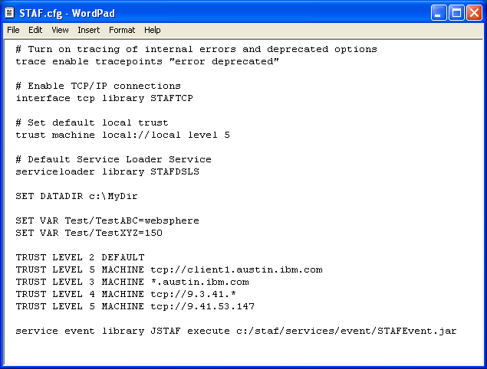
Sample STAF.cfg file

Slide 91
Interacting with STAF
STAF is an executable that is used to submit requests to STAF from the command line
STAF [-verbose] <Endpoint> <Service> <Request>
  -verbose specifies to force the use of the verbose mode for the output.
  <Endpoint> is either LOCAL, if you wish to make a request of the local machine, or the name of the machine of which you wish to make a request. More details on the format for the <Endpoint> are provided later in this section
  <Service> is the name of the service to which you are submitting a request
  <Request> is the actual request string that you wish to submit to the service
Output:
Response
--------
[Result string]
  Where [Result string] is any information that was returned from the STAF service request

Slide 92
Interacting with STAF (cont.)
On an unsuccessful STAF request (i.e., a request with a non-zero return code), the output from the STAF command will be as follows
Error submitting request, RC: <Return code>
[Additional info: <Result string>]
  Where <Return code> is the actual return code from the request, and <Result string> is any information returned from the request. <Result string> usually contains information that explains why the error occurred.

Slide 93
Interacting with STAF (cont.)
When structured data is returned in the result string, the STAF command will automatically unmarshall the data and “pretty” print it in the most appropriate format.
  If the data is a <List> of <String>, then each entry in the list is printed on its own line. For example:
  C:\>STAF local FS LIST DIRECTORY C:\
  Response
  --------
  AUTOEXEC.BAT
  CONFIG.SYS
  If the data is a <Map> (or <Map: <Class>>) which has values that are all of type <String>, each key/value pair is printed on its own line. For example:
  C:\>STAF local MONITOR LIST SETTINGS
  Response
  --------
  Max Record Size : 1024
  Resolve Message : Disabled
  Resolve Message Var: Disabled
  The above two types of formatted output are referred to as “default format”

Slide 94
Interacting with STAF (cont.)
If the data is a <List> of <Map:<Class>> where every item in the list is an instance of the same map class, then the data will be printed out in a tabular format, called "table format". For example:
C:\>STAF local HANDLE LIST HANDLES
Response
--------
Handle Handle Name State Last Used Date-Time
------ ------------------------------- --------- -------------------
1 STAF_Process InProcess 20040929-13:57:40
2 STAF/Service/STAFServiceLoader1 InProcess 20040929-16:06:47
5 STAF/Service/LOG InProcess 20040929-13:57:52
You can disable the output of tables by specifying option –verbose or by setting the environment variable STAF_PRINT_NO_TABLES to any value. If you disable the output of tables, their data will show up in the more verbose mode

Slide 95
Interacting with STAF (cont.)
If the data is more complex or you’ve turned off tables (e.g. by specifying the
–verbose option), the output will be printed in a hierarchical nested format, called "verbose format“. The best way to describe it is with an example:
C:\>STAF -verbose local HANDLE LIST HANDLES
Response
--------
[
{
Handle : 1
Handle Name : STAF_Process
State : InProcess
Last Used Date-Time: 20100329-13:57:40
}
{
Handle : 2
Handle Name : STAF/Service/STAFServiceLoader1
State : InProcess
Last Used Date-Time: 20100329-16:06:47
}
]

Slide 96
Remote System Identification
When making a STAF request to a remote system, in addition to specifying the machine name, you may also specify the network interface over which communication will take place. The format for this is
  [<Interface>://]<System Identifier>[@<Port>]
    <Interface> is the name of the network interface
    <System Identifier> is a valid network identifier
If no <Interface> is specified, the default interface is used.
You may specify logical or physical identifiers
  For example, for a TCP/IP interface, the physical identifier for a system is the IP address, while the logical identifier is the hostname
  You may optionally specify a valid port to use for a TCP/IP interface

Slide 97
Running Multiple Instances of STAFProc
Multiple instances of STAFProc can be run at the same time on the same system
  This makes it possible to use STAF to install/upgrade STAF itself
To run multiple instances of STAF, system-specific resources need to be differentiated
  There is a special environment variable, STAF_INSTANCE_NAME, that can be used to specify a name for each STAFProc instance to differentiate between multiple instances of STAF
  If this environment variable is not set, the default value, "STAF", is used for the instance name
For each instance of STAFProc running on a system, the following settings must be unique
  The ports used by STAF TCP connection providers must be unique
  Each STAFProc instance must use a different data directory

Slide 98
Basic STAF Commands
STAF LOCAL PING PING
STAF LOCAL VAR LIST
STAF LOCAL SERVICE LIST
STAF LOCAL SERVICE LIST REQUESTS
STAF LOCAL HANDLE QUERY ALL
STAF LOCAL PROCESS QUERY ALL
STAF LOCAL SERVICE ADD SERVICE LOG LIBRARY STAFLog
STAF LOCAL LOG HELP
STAF LOCAL HELP ERROR 25
STAF LOCAL MISC WHOAMI
STAF LOCAL MISC LIST SETTINGS
STAF LOCAL MISC LIST INTERFACES
STAF LOCAL MISC LIST PROPERTIES

Slide 99
Part 1B – Break/LAB (20 min.)
Exercises 1.2-1.5

Slide 100
Part 1C - Leveraging STAF

Slide 101
STAF Services
HELP
  Provides Help on STAF error codes (internal)
PING
  Provides a simple is-alive message (internal)
SERVICE
  Allows you to list services available on a machine and to examine the requests that have been submitted on a machine (internal)
SHUTDOWN
  Provides a means to shutdown STAF and register for shutdown notifications (internal)
ECHO
  Echos back a supplied message (internal)
MISC
  Handles miscellaneous commands and tracing (internal)
DELAY
  Provides a means to sleep a specified amount of time (internal)
DIAG
  Allows you to record and list diagnostics data (internal)

Slide 102
STAF Services (cont.)
FS (File System)
  Allows you to get and copy files (text and binary) across the network, list directories, copy directories/subdirectories, and delete files (internal)
FSEXT (File System Extensions)
  Provides some tools to perform extended file system requests (external)
ZIP
  Provides a means to zip/unzip PKZip/WinZip compatible archives (external)
HTTP
  Provides the ability to quickly and easily make HTTP requests (external)
LOG
  Provides a full-featured logging facility (external)
MONITOR
  Allows a testcase to publish its current running execution status for others to read (external)
LIFECYCLE
  Allows STAF service requests to be run when STAFProc starts up or shuts down (internal)
SXE
  Allows the user to sequentially execute any number of STAF commands (external)

Slide 103
STAF Services (cont.)
FTP
  Provides client side FTP (File Transfer Protocol) functions like downloading or uploading a file in binary mode from a remote FTP server (external)
HANDLE
  Provides information about existing STAF handles (internal)
QUEUE
  Provides a network-enabled IPC mechanism for STAF programs (internal)
PROCESS
  Allows you to start, stop, and query processes (internal)
SEM (Semaphore)
  Provides network-enabled named event and mutex semaphores (internal)
VAR (Variable)
  Provides a method for maintaining configuration and runtime data/variables (internal)
TRUST
  Interfaces with STAF's security (internal)
STAX
  Provides an XML-based execution engine. STAX also provides a powerful GUI monitoring application which allows you to interact with and monitor the progress of your jobs (external)

Slide 104
STAF Services (cont.)
EVENT
  Provides a publish/subscribe notification system (external)
EVENTMANAGER
  Allows you to run a STAF command when a specified Event occurs (external)
CRON
  Allows you to run a STAF command at a specified time interval (minute, hour, day, month, weekday) (external)
TIMER
  Allows a process on one machine to periodically receive a notification message from the same or another machine (external)
NAMESPACE
  Provides a namespace hierarchy for storing and retrieving a persistent repository of variables (external)
RESPOOL (Resource Pool)
  Allows you to manage exclusive access to pools of elements, e.g. VM UserIDs or Software Licenses (external)
EMAIL
  Allows information, such as test results, to be emailed to a list of addresses (external)

Slide 105
Process service
The Process service allows you start any process (executable, script, operating
system command, etc.) in your STAF environment
Processes may be started synchronously or asynchronously
You may also specify to which workload they belong, parameters to pass to
them, their working directory, any process specific STAF variables to set for
them, as well as any environment variables they may need
You can also specify where standard output and standard error will be written,
and have the data returned after the process completes. In fact, you can even
have any file (that resides on the machine where the process was executed)
returned after the process completes.

Slide 106
Process service - Syntax
START [SHELL [<Shell>]] COMMAND <Command> [PARMS <Parms>] [WORKDIR <Directory>]
[VAR <Variable>=<Value>] [ENV <Env. Var.>=<Value>] [USEPROCESSVARS]
[WORKLOAD <Name>] [TITLE <Title>] [WAIT [<Number>[s|m|h|d|w]] | ASYNC]
[STOPUSING <Method>] [STATICHANDLENAME <Name>]
[NEWCONSOLE | SAMECONSOLE] [FOCUS <Background | Foreground | Minimized>]
[USERNAME <User Name> [PASSWORD <Password>]]
[DISABLEDAUTHISERROR | IGNOREDISABLEDAUTH]
[STDIN <File>] [STDOUT <File> | STDOUTAPPEND <File>]
[STDERR <File> | STDERRAPPEND <File> | STDERRTOSTDOUT]
[RETURNSTDOUT] [RETURNSTDERR] [RETURNFILE <File>]...
[NOTIFY ONEND [HANDLE <Handle> | NAME <Name>]
[MACHINE <Machine>] [PRIORITY <Priority>] [KEY <Key>]]
STOP <ALL CONFIRM | WORKLOAD <Name> | HANDLE <Handle>> [USING <Method>]
LIST [HANDLES] [RUNNING] [COMPLETED] [WORKLOAD <Name>] [LONG]
QUERY HANDLE <Handle>

Slide 107
Process service – Syntax (cont.)
FREE <ALL | WORKLOAD <Name> | HANDLE <Handle>>
NOTIFY REGISTER ONENDOFHANDLE <Handle> [HANDLE <Handle> | NAME <Name>]
[MACHINE <Machine>] [PRIORITY <Priority>]
NOTIFY UNREGISTER ONENDOFHANDLE <Handle> [HANDLE <Handle> | NAME <Name>]
[MACHINE <Machine>] [PRIORITY <Priority>]
NOTIFY LIST ONENDOFHANDLE <Handle>
SET [DEFAULTSTOPUSING <Method>] [DEFAULTCONSOLE <New | Same>]
[DEFAULTFOCUS <Background | Foreground | Minimized>]
[PROCESSAUTHMODE <Auth Mode>]
[DEFAULTAUTHUSERNAME <User Name>] [DEFAULTAUTHPASSWORD <Password>]
[DEFAULTAUTHDISABLEDACTION <Error | Ignore>] [DEFAULTSHELL <Shell>]
[DEFAULTNEWCONSOLESHELL <Shell>] [DEFAULTSAMECONSOLESHELL <Shell>]

Slide 108
Process service - Examples
PROCESS START SHELL COMMAND "java -version"
Notice that the handle number is returned as the result
Response
--------
35
PROCESS START SHELL COMMAND "java -version"
Response
--------
37
Notice that this process is assigned a new handle number
PROCESS START SHELL COMMAND "java -version" WAIT
Response
--------
{
Return Code: 0
Key : <None>
Files : []
}
Notice that since we specified the WAIT option, the request does not return until the process finishes.
The result shows the process return code, as well as any files that were returned.

Slide 109
Process service – Examples (cont.)
PROCESS START SHELL COMMAND "java -version" WAIT STDERRTOSTDOUT RETURNSTDOUT
Response
--------
{
Return Code: 0
Key : <None>
Files : [
{
Return Code: 0
Data : java version "1.5.0"
Java(TM) 2 Runtime Environment, Standard Edition (build 1.5.0-b64)
Java HotSpot(TM) Client VM (build 1.5.0-b64, mixed mode, sharing)
}
]
}
Notice that since we specified the STDERRTOSTDOUT and RETURNSTDOUT options, we get this output as the first file returned

Slide 110
FS service
The File System service, called FS, allows you to interface with the file system on machines in your STAF environment
When submitting requests to the FS service, three different options are used to refer to objects in the file system:
  FILE is used when the object in question must be a file
  DIRECTORY is used when the object in question must be a directory
  ENTRY is used when the object in question may be any object in the file
  system
Some of the FS requests allow match patterns to be specified. These patterns recognize two special characters:
  * matches any string of characters (including an empty string)
  ? matches any single character (the empty string does not match)

Slide 111
FS service - Syntax
COPY FILE <Name> [TOFILE <Name> | TODIRECTORY <Name>] [TOMACHINE <Machine>]
[TEXT [FORMAT <Format>]] [FAILIFEXISTS | FAILIFNEW]
COPY DIRECTORY <Name> [TODIRECTORY <Name>] [TOMACHINE <Machine>]
[NAME <Pattern>] [EXT <Pattern>] [CASESENSITIVE | CASEINSENSITIVE]
[TEXTEXT <Pattern>... [FORMAT <Format>]]
[RECURSE [KEEPEMPTYDIRECTORIES | ONLYDIRECTORIES]]
[IGNOREERRORS] [FAILIFEXISTS | FAILIFNEW]
MOVE FILE <Name> <TOFILE <Name> | TODIRECTORY <Name>>
MOVE DIRECTORY <Name> TODIRECTORY <Name>
GET FILE <Name> [[TEXT | BINARY] [FORMAT <Format>]]
GET ENTRY <Name> <TYPE | SIZE | MODTIME | LINKTARGET |
CHECKSUM [<Algorithm>]>

Slide 112
FS service – Syntax (cont.)
QUERY ENTRY <Name>
CREATE DIRECTORY <Name> [FULLPATH] [FAILIFEXISTS]
LIST DIRECTORY <Name> [RECURSE] [LONG [DETAILS] | SUMMARY] [TYPE <Types>]
[NAME <Pattern>] [EXT <Pattern>] [CASESENSITIVE | CASEINSENSITIVE]
[SORTBYNAME | SORTBYSIZE | SORTBYMODTIME]
LIST COPYREQUESTS [LONG] [INBOUND] [OUTBOUND]
[FILE [[BINARY] [TEXT]]] [DIRECTORY]
LIST SETTINGS
DELETE ENTRY <Name> [CHILDREN [NAME <Pattern>] [EXT <Pattern>] [TYPE <Types>]
[CASESENSITIVE | CASEINSENSITIVE]] [RECURSE] [IGNOREERRORS] CONFIRM
SET STRICTFSCOPYTRUST <Enabled | Disabled>

Slide 113
FS service - Examples
FS COPY FILE c:\testcase\tc1.cmd TOFILE d:\WebTests\webtc1.cmd TOMACHINE Client1
Response
--------
Notice that if the request is successful there is nothing returned
FS COPY DIRECTORY c:/test TODIRECTORY d:/WebTests TOMACHINE Client1 FAILIFEXISTS
Response
--------
Notice that if the request is successful there is nothing returned
FS GET FILE {STAF/Config/BootDrive}/TestFile.txt
Response
--------
Hello world! This is a test.
In this example the result buffer contains the contents of the TestFile.txt file
FS GET ENTRY /test1/projectX.tar SIZE
Response
--------
Upper 32-bit Size: 0
Lower 32-bit Size: 340488704
This example returns the size of file projectX.tar

Slide 114
FS service – Examples (cont.)
FS MOVE FILE C:\testcase\test1.exe TOFILE C:\testcase\test2.exe
Response
--------
Rename file C:\testcase\test1.exe to file C:\testcase\test2.exe, overwriting the file if it exists
FS MOVE FILE C:\testcase\test1.exe TODIRECTORY C:\testcase\TestDir
Response
--------
Move file test1.exe from directory C:\testcase to directory C:\testcase\TestDir, overwriting the file if it exists
FS MOVE FILE C:\testcase\test*.txt TODIRECTORY D:\Saved_Tests
Response
--------
Move all files that begin with "test" and have extension txt from directory C:\testcase to directory D:\Saved_Tests
FS MOVE DIRECTORY C:\testcase TODIRECTORY C:\MyTestcases
Response
--------
Rename directory C:\testcase to a new directory named C:\MyTestcases

Slide 115
FS service – Examples (cont.)
FS QUERY ENTRY /tests/project.tar.gz
Response
--------
Name : /tests/project.tar.gz
Type : F
Size : 340488704
Upper 32-bit Size : 0
Lower 32-bit Size : 340488704
Modified Date-Time: 20040512-18:07:52
The F type indicates that it is a file
FS LIST DIRECTORY /tmp
Response
--------
en_platformsdk_win2003.exe
2-ltp-logfile
test1
project-docs.tar
ACME_NEW2.xml
project.htm
AutoFVT.bsh
This request lists all of the entries contained in the /tmp directory

Slide 116
FS service – Examples (cont.)
FS LIST DIRECTORY C:\Projects EXT txt CASESENSITIVE
Response
--------
javacore.20030420.041412.7713.txt
windoc.txt
mytest.txt
svt-spa02dynos390.txt
This example demonstrates that you list files with certain extensions
FS CREATE DIRECTORY D:\TestData FAILIFEXISTS
Response
--------
Notice that if the request is successful there is nothing returned
FS DELETE ENTRY /tmp/myfiles RECURSE CONFIRM
Response
--------
This example uses the RECURSE option so that all subdirectories are also deleted

Slide 117
FS service – Examples (cont.)
FS LIST COPYREQUESTS LONG
Response
--------
[
{
Start Date-Time: 20050725-18:31:32
In/Out : Out
Machine : tcp://client2.company.com
Directory Name : c:/temp/TestA
Type : D
Transfer State : {
Name : c:/temp/TestA/TestA.zip
Mode : Binary
File Size : 9873006
Bytes Copied: 1288000
}
}
]
This example shows detailed information on all the copy requests that are currently in progress

Slide 118
Log service
The purpose of the Log service is to allow a test case to easily and flexibly
manage information that needs to be logged
It allows you to specify a log mask which defines which messages actually get
logged to the log file
This log mask can be dynamically changed to alter the set of log messages
written to the log file(s), and can greatly assist in debugging
  For example, while a test case is running, you can dynamically alter the log
  mask to allow debug and trace log messages to start being logged
The log query mechanism allows for record selection based on many selection
criteria matches

Slide 119
Log service - Syntax
LOG <GLOBAL | MACHINE | HANDLE> LOGNAME <Logname> LEVEL <Level>
MESSAGE <Message> [RESOLVEMESSAGE | NORESOLVEMESSAGE]
QUERY <GLOBAL | MACHINE <Machine> [HANDLE <Handle>]> LOGNAME <Logname>
[LEVELMASK <Mask>] [QMACHINE <Machine>]... [QHANDLE <Handle>]...
[NAME <Name>]... [USER <User>]... [ENDPOINT <Endpoint>]...
[CONTAINS <String>]... [CSCONTAINS <String>]...
[STARTSWITH <String>]... [CSSTARTSWITH <String>]...
[FROM <Timestamp> | AFTER <Timestamp>]
[BEFORE <Timestamp> | TO <Timestamp>]
[FROMRECORD <Num>] [TORECORD <Num>]
[FIRST <Num> | LAST <Num> | ALL] [TOTAL | STATS | LONG]
[LEVELBITSTRING]
LIST GLOBAL | MACHINES | MACHINE <Machine> [HANDLES | HANDLE <Handle>] |
SETTINGS
DELETE <GLOBAL | MACHINE <Machine> [HANDLE <Handle>]> LOGNAME <Logname> CONFIRM

Slide 120
Log service – Syntax (cont.)
PURGE <GLOBAL | MACHINE <Machine> [HANDLE <Handle>]> LOGNAME <Logname> CONFIRM
[LEVELMASK <Mask>] [QMACHINE <Machine>]... [QHANDLE <Handle>]...
[NAME <Name>]... [USER <User>]... [ENDPOINT <Endpoint>]...
[CONTAINS <String>]... [CSCONTAINS <String>]...
[STARTSWITH <String>]... [CSSTARTSWITH <String>]...
[FROM <Timestamp> | AFTER <Timestamp>]
[BEFORE <Timestamp> | TO <Timestamp>]
[FROMRECORD <Num>] [TORECORD <Num>]
[FIRST <Num> | LAST <Num>]
SET [MAXRECORDSIZE <Size>] [DEFAULTMAXQUERYRECORDS <Number>]
[ENABLERESOLVEMESSAGEVAR | DISABLERESOLVEMESSAGEVAR]
[RESOLVEMESSAGE | NORESOLVEMESSAGE]

Slide 121
Log service - Examples
LOG LOG GLOBAL LOGNAME stresstst LEVEL error MESSAGE “aborted with error 255“
Response
--------
LOG LOG MACHINE LOGNAME Regression5 LEVEL start MESSAGE "Step1 in Test1 initiated“
Response
--------
LOG QUERY GLOBAL LOGNAME stresstst LEVELMASK "ERROR“
Response
--------
Date-Time Level Message
----------------- ----- -------------------------------
20040811-02:53:20 Error Step 3: Sharing buffer exceeded
20040812-10:17:53 Error aborted with error 255

Slide 122
Log service – Examples (cont.)
LOG QUERY GLOBAL LOGNAME stresstst total
Response
--------
17
This example queries the total records in log stresstst
LOG LIST GLOBAL
Response
--------
Log Name Date-Time Size
--------- ----------------- ------
stresstst 20040810-14:17:00 120823
Suite100 20040811-15:45:00 2622
This examples lists all of the global logs

Slide 123
STAF Variables
Leveraging the power of STAF variables can remove hard-coded dependencies in your testcases and allow you to easily change the behavior of your testcases while they are still executing
  STAF variables are defined in a hierarchy
    Variables beginning with "STAF" or "STAF/" are reserved for use by STAF
  STAF variables allow recursion
  STAF variables are dynamic and can be changed on-the-fly
Resolution and Recursion
  STAF resolves variable references in strings to their values
  A variable reference is denoted by surrounding the variable in curly braces, for example, {WebServer}
  Recursive and compound variable references are allowed

Slide 124
STAF Variables - Examples
Defined variables: Resolved variables:
  12=Fun "{a} and {b}" = You and Me
  a=You {c}{d} = 12
  b=Me {{c}{d}} = Fun
  c=1 {{e}} = You
  d=2
  e=a

Slide 125
STAF Variables - Examples (cont.)
System variables: Local Process A variables:
  a=You a=Dogs
  b=Me b=Cats
    Local Process B variables:
    a=Birds
On Process A:
  SYSTEM RESOLVE {a} = You
  RESOLVE "{a} and {b}" = Dogs and Cats
On Process B:
  RESOLVE "{a} and {b}" = Birds and Me

Slide 126
STAF Variables - Examples (cont.)
Given Variables:
AIXDelay=1000
WIN32Delay=2000
LinuxDelay=1500
OSName=AIX
Then :
{{OSName}Delay} resolves to AIXDelay = 1000

Slide 127
STAF Variables - Examples (cont.)
Given Variables:
DBPARMS1/DataBaseServer = DBS1
DBPARMS1/Timeout = 1500
DBPARMS1/MaxRetries = 3
DBPARMS2/DataBaseServer = DBS2
DBPARMS2/Timeout = 5000
DBPARMS2/MaxRetries = 10
DBParmGroup = DBPARMS1
Then:
{{DBParmGroup}/DataBaseServer} resolves to DBS1

Slide 128
Running a simple Testcase
STAF can run testcases which are completely unaware of STAF
You can start using your existing testcases with STAF without making any changes to the testcases
  You aren't required to use any STAF services
  You aren't required to call any STAF APIs
You can choose when/if you enable STAF in your testcases

Slide 129
Running a simple Testcase (cont.)
staf local process start shell command "java SimpleTestcase 10“ env CLASSPATH={STAF/Env/Classpath};C:/STAF/testcases
  1: public class SimpleTestcase
  2: {
  3: public static void main(String[] args)
  4: {
  5: int counter = 10;
  6: if (args.length > 0) counter = (new Integer(args[0])).intValue();
  7: for (int i=0; i < counter; i++)
  8: {
  9: System.out.println("Loop #" + String.valueOf(i)); 10: try
  11: {
  12: Thread.sleep(1000); // 1 second
  13: }
  14: catch(InterruptedException e)
  15: {
  16: e.printStackTrace();
  17: }
  18: }
  19: }
  20: }

Slide 130
Running a STAF-Enabled Testcase
You can leverage STAF in your testcases by making calls into STAF services
For all of the supported STAF languages, you can do the following
  Register with STAF
  Submit any number of calls into STAF services
  Optionally unregister with STAF
staf local process start shell command
"java STAFTestcase 30"
    env CLASSPATH={STAF/Env/Classpath};C:/STAF/testcases

Slide 131
Running a STAF-Enabled Testcase (cont.)
1: import com.ibm.staf.*;
2: public class STAFTestcase {
3: public static void main(String[] args) {
4: int counter = 10;
5: STAFHandle handle = null;
6: try {
7: handle = new STAFHandle("STAFTestcase");
8: }
9: catch(STAFException e) {
10: e.printStackTrace();
11: System.exit(1);
12: }
13: if (args.length > 0) counter = (new Integer(args[0])).intValue();
14: for (int i=0; i < counter; i++) {
15: System.out.println("Loop #" + i);
16: STAFResult result = handle.submit2("local", "monitor",
17: "log message " +
18: STAFUtil.wrapData("Loop #" + i));
19: // Testcase Logic goes here.
20: }
21: System.exit(0);
22: }
23: }

Slide 132
STAF support for Java Testcases
STAFHandle
  Used to register, unregister, and submit service requests to STAF
  Provides both exception-based and non-exception-based submit() methods
STAFResult
  Returned by the non-exception-based STAFHandle.submit2() method
  Contains both the STAF return code as well as the result string
  This class also contains the constant definitions for all the STAF return codes
STAFException
  This is the exception class thrown by the STAFHandle class
  It contains an rc variable which contains the actual return code from STAF
STAFUtil
  Contains utility functions provided by STAF
  One of the functions provided is the static function wrapData() which is used to generate the colon-length-colon delimited version of a string to be passed to STAF
STAFMapClassDefinition and STAFMarshallingContext
  STAFMapClassDefinition is a class used to define a Map with intrinsic metadata
  STAFMarshallingContext is used for (un)marshalling data structures
Notes:
Mention the CLC format (related to wrapData)

Slide 133
The STAF Demo
The STAF Demo is a sample application, written in Java, that demonstrates STAF's capabilities and how to leverage the primary internal and external services in STAF
In particular, it shows the use of the following STAF services:
  Process
  Variable
  Semaphore
  Queue
  Log
  Monitor
  Resource Pool
The STAF Demo is shipped with STAF
  It is located in the C:/STAF/samples/demo directory (on Windows) or the /usr/local/staf/samples/demo directory (on Unix)
For more detailed information on STAF’s Java APIs, go to the “Java User’s Guide for STAF V3” at: http://staf.sourceforge.net/current/STAFJava.htm

Slide 134
The STAF Demo (cont.)
Run the demo
Note that if you are going through this education material by yourself (not
during an actual class), you can refer to the “Getting Started with STAF V3”
document at: http://staf.sourceforge.net/current/STAFGS.pdf
It provides instructions on how to run the STAF Demo

Slide 135
Part 1C – Break/LAB (20 min.)
Exercises 1.6-1.10

Slide 136
Part 1D – Debugging STAF

Slide 137
Tracing
STAF provides various tracing facilities to help in auditing and debugging via the TRACE service
  ENABLE TRACEPOINTS
  [ServiceRequest] [ServiceResult]
  [ServiceError] [ServiceAccessDenied]
  [ServiceManagement] [Registration]
  [RemoteRequests] [Error]
  [Warning] [Info] [Deprecated] [All]
  ENABLE SERVICE <Service> [SERVICE <Service>]…
  SET DESTINATION TO <STDOUT | STDERR | FILE <Filename> >
  ENABLE ALL [TRACEPOINTS | SERVICES]
Note that trace options can also be set via the STAF Configuration File

Slide 138
Tracing (cont.)
ServiceRequest causes a trace message to be generated for every incoming service request before it is processed by the service
ServiceResult causes a trace message to be generated for every incoming service request after it is processed by the service
ServiceError causes a trace message to be generated for every incoming service request which results in a non-zero error code
ServiceAccessDenied causes a trace message to be generated for every incoming service request which results in an Access Denied error code
ServiceManagement causes a trace message to be generated for service management operations such as service initialization and termination
Registration causes a trace message to be generated for every registration or unregistration done by a process
RemoteRequests causes trace messages to be generated for requests destined for other machines
Error causes a trace message to be generated for error conditions that STAF detects, such as broken communication connections and fatal REXX Service errors
Warning causes a trace message to be generated for warning conditions that STAF detects
Info causes a trace message to be generated for information conditions that STAF detects
Deprecated causes a trace message to be generated for deprecated options that STAF detects
All causes all the aforementioned trace messages are to be generated
Notes:
Show some live tracing here.

Slide 139
Tracing (continued)
Examples
  TRACE SET DESTINATION TO STDOUT
  TRACE SET DESTINATION TO FILE {STAF/Config/STAFRoot}/bin/STAF.trc
  TRACE ENABLE TRACEPOINT ServiceResult
  TRACE ENABLE TRACEPOINT Error TRACEPOINT ServiceAccessDenied
  TRACE ENABLE TRACEPOINTS “Error Warning Info Deprecated”
  TRACE DISABLE TRACEPOINTS “ServiceResult Error”
  TRACE DISABLE ALL TRACEPOINTS
  TRACE ENABLE ALL SERVICES
  TRACE ENABLE SERVICES "PROCESS QUEUE"
  TRACE LIST
Notes:
Show some live tracing here.

Slide 140
Debugging STAF
RC 10 when starting a process
  This indicates that a base operating system error was encountered
  The actual base operating system error code will be returned in the result buffer
  A base OS error of 2 indicates that the executable or script file could not be found
  Solution:
    Make sure the the executable or script file is in the PATH of the machine where it will be executed., or fully qualify the command option on the process request (i.e. /opt/tests/mytest)
  To find out information about OS error codes:
    On Windows systems, you can find more information for OS error codes by typing "net helpmsg <error code>"
    On Unix systems, you can find more information for OS error codes from include files named errno.h found in directory /usr/include and its subdirectories.

Slide 141
Debugging STAF (cont.)
RC 25 when starting a Process on a remote machine
  This error indicates that you have submitted a request from a machine which is not authorized to perform the request
  To start a process on a remote machine, a TRUST level of 5 is required
  Solution:
    On the remote machine, add a TRUST statement to its STAF.cfg file, giving the requesting machine/user a level of 5
    Shutdown and restart STAF on the remote machine

Slide 142
Debugging STAF (cont.)
RC 16 when submitting a STAF request
  This error means that STAFProc was not able to submit the request to the requested endpoint (i.e. machine), and usually indicates:
    STAF is not running on the target system
    The requested endpoint is not valid
    The network interface or port for the requested endpoint is not supported
  Alternatively, you may need to increase your CONNECTTIMEOUT value for the network interface and/or increase your CONNECTATTEMPTS value in your STAF.cfg file.

Slide 143
Debugging STAF (cont.)
Submitting STAF requests from the command line
  When you submit a request to STAF from the command line, a unique handle is generated for that request
  After the request completes, that handle is no longer active in STAFProc
  If you were to submit a subsequent STAF request from the command line which referenced that handle or was dependent upon the continued existence of that handle, your request would fail
  The solution to this problem is to use a static handle. This will be covered in Part 3C.
Notes:
Do a live example of this.

Slide 144
Debugging STAF (cont.)
STAF Installation on Unix
  When installing STAF on Unix platforms, if using the tar.gz installation files, always run the STAFInst script
  It is NOT sufficient to simply untar the compressed STAF image

Slide 145
Debugging STAF (cont.)
Hostname Issues
  If you are having problems communicating between machines, make sure that the hostname and domain for all of the machines are correct
  When STAFProc starts, it lists what it thinks is the identity (hostname) of the machine. Other machines in the STAF Environment need to be able to access the machine by that identity.
  Always use domain names when configuring network settings on your machines
  If you have STAF machines that are unable to communicate with each other (i.e., "staf <hostname> ping ping" does not work), it is a good idea to try a non-STAF ping ("ping <hostname>") to determine if it is a basic network configuration error
  Submitting a WHOAMI request to the MISC service may be helpful in debugging a communication problem as it can show the instance name, interface, logical ID, physical ID, Endpoint, Machine, Trust Level, etc.
    You should always specify the hostname for the endpoint in the WHOAMI request, not ‘local’, in order to get the correct logical and physical IDs, etc.

Slide 146
Debugging STAF (cont.)
Understanding STAF Service option value formats
  If the value contains no spaces or quotes, you may simply specify the value
    MESSAGE Hello
  You may enclose the value in quotes. When doing so, the backslash character is the escape character. Any character after the backslash is treated as a literal character. To specify a backslash, use two backslashes.
    MESSAGE "Hello World"
  You may use a length delimited format that is of the form :<Length>:<String> (affectionately known as Colon-Length-Colon, or CLC, format). Note that the length is specified in characters, not bytes.
    MESSAGE :11:Hello World
    This format is typically used in STAF programs (as opposed to the command line)
    STAF provides wrappers for easily creating CLC format option values, such as the STAF Java method STAFUtil.wrapData()

Slide 147
Debugging STAF (cont.)
Backslash (\) vs.Forwardslash (/)
  When you use a backslash in a STAF command request (especially when specifying a fully-qualified file/path name), the backslash can sometimes be interpreted as an escape character, and may cause problems
    This is particularly true in quoted strings
  We recommend using forward slashes (in general). Another option is to escape the
  backslash by specifying another backslash. The following requests are equivalent:
    staf local process start command c:/winnt/notepad.exe
    staf local process start command c:\\winnt\\notepad.exe

Slide 148
Debugging STAF (cont.)
VAR RESOLVE vs. VAR GET
  In most cases you should not use the VAR GET request. Instead you should use the VAR RESOLVE request.
  The VAR GET command retrieves the literal value of a given variable
  The VAR RESOLVE command resolves the values of any referenced variables before returning the value of the given string
  a=world VAR GET b = Hello {a}
  b=Hello {a} VAR RESOLVE {b} = Hello world
Notes:
Describe in general what the last 2 bullets mean.

Slide 149
Part 1D – Break/LAB (10 min.)
Exercise 1.11

Slide 150
End of Presentation
End of Presentation

Slide 151
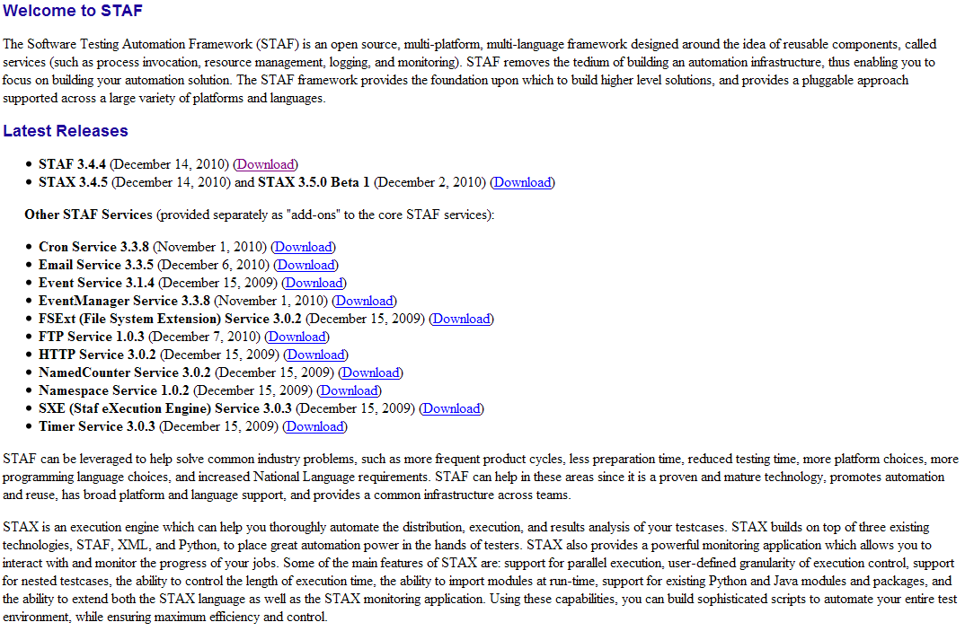
http://staf.sourceforge.net/index.php

Slide 152
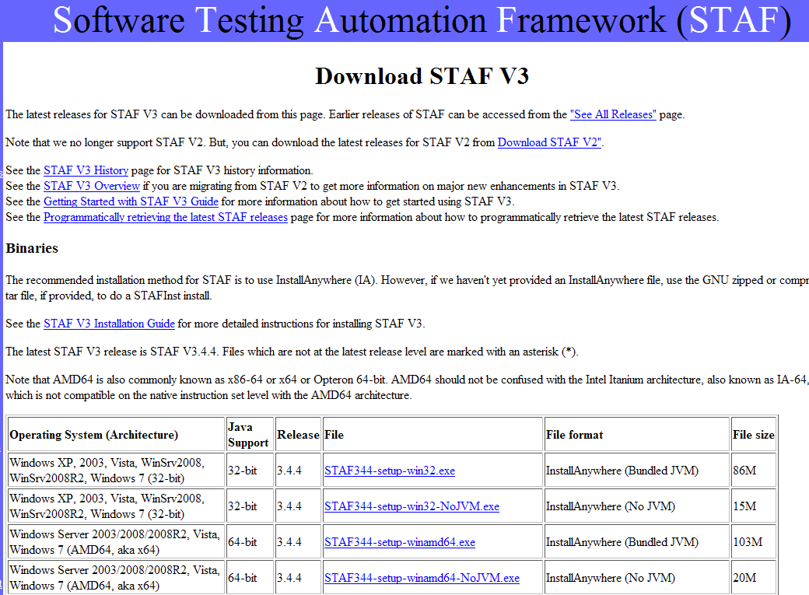
http://staf.sourceforge.net/getcurrent.php

Slide 153
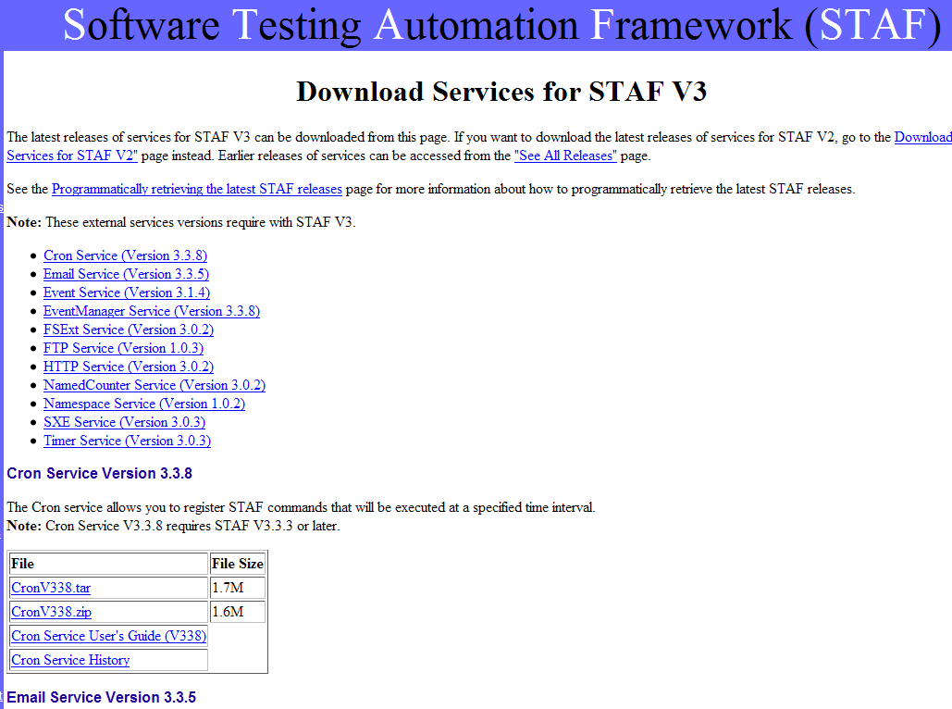
http://staf.sourceforge.net/getservices.php

Slide 154
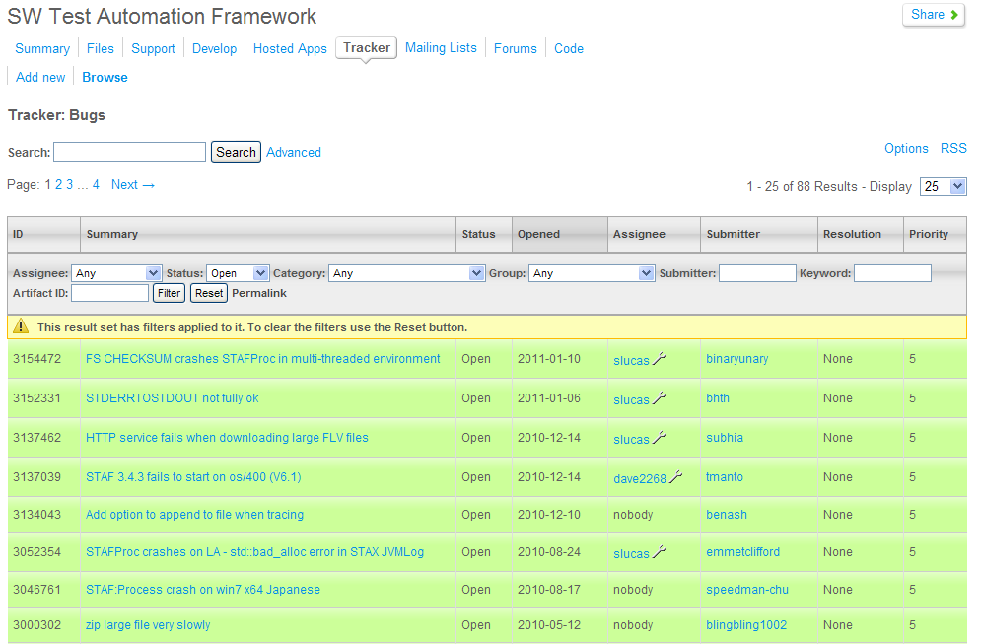
http://staf.sourceforge.net "Browse Bugs"

Slide 155
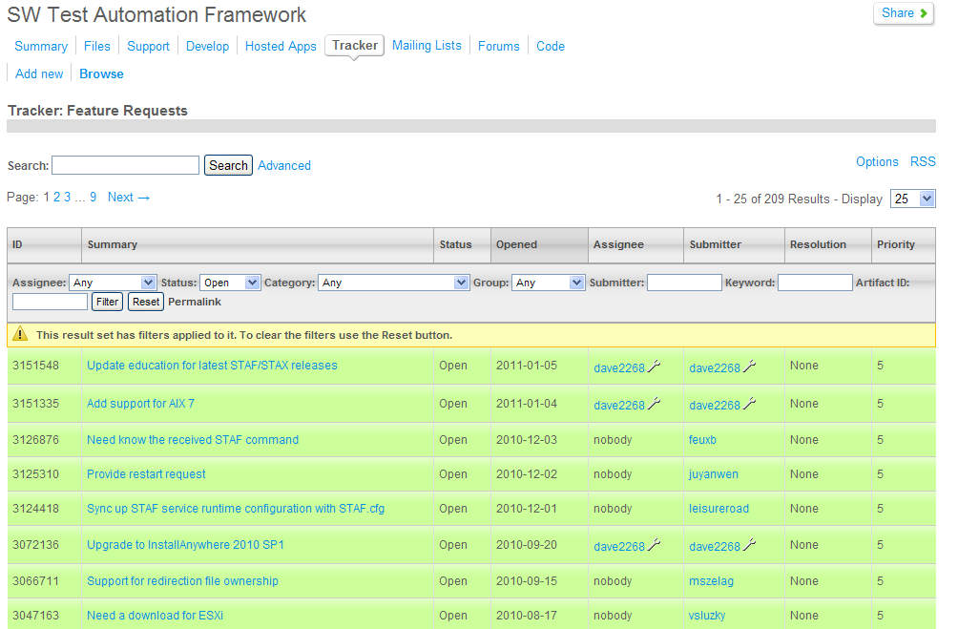
http://staf.sourceforge.net "Browse Features"

Slide 156
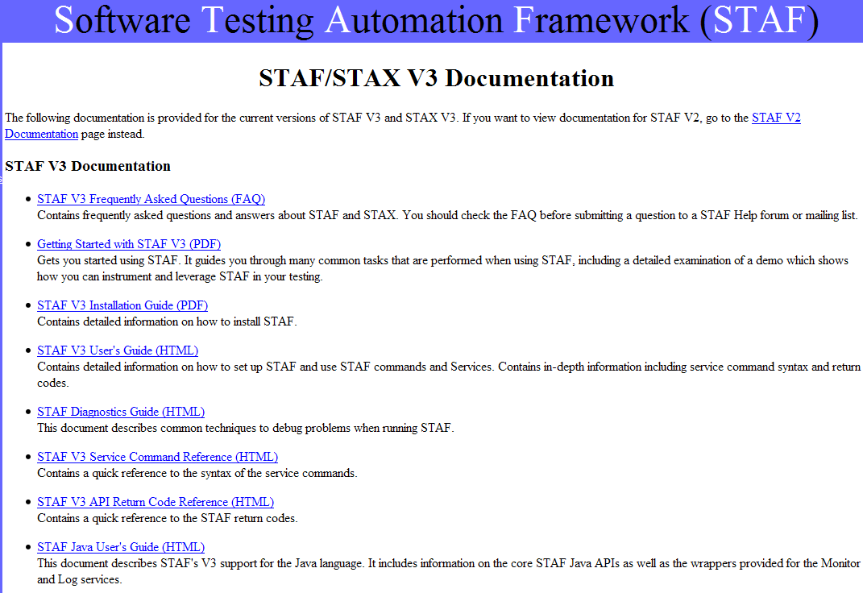
http://staf.sourceforge.net/docs.php

Slide 157
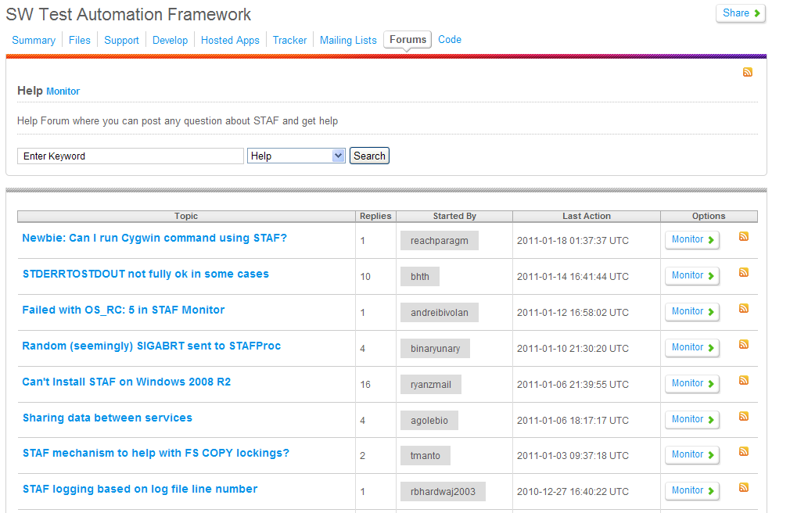
http://staf.sourceforge.net "Discussion Forums"

