Slide 1
Hands-on Automation with STAF/STAX
Part 2

Slide 2
Part 2 Agenda (4 hours)
PART 2A – STAX Introduction
  What is STAX?
  Technologies used in STAX
  Concepts
  Introduction to STAX XML Elements
  The STAX Web Page
  STAX Requirements
  STAX Machine Environment
  Installing STAX
  Configuring STAX
  Using the STAX Monitor
  Controlling Execution of STAX Jobs
  Understanding STAX Logs
  Submitting STAX Requests
  Break/LAB 2A (Exercises 2.1-2.3)
PART 2B – Creating STAX Jobs
  Using Python in STAX XML Documents
  Using XML to Define STAX Jobs
  Understanding STAX XML Elements:
    Fundamental Actions: <script>, <process>, <stafcmd>
    Groupings: <sequence>, <function>
    Looping: <loop>, <iterate>, <break>, <continue>
    Conditionals: <if>, <elseif>, <else>
    Execution Blocks: <block>
    Logging and Messages: <log>, <message>
  Creating a Simple STAX Job
  Break/LAB 2C (Exercises 2.4-2.5)
PART 2C – Creating more complex STAX jobs
  Understanding Additional STAX XML Elements:
    Parallel Execution: <parallel>, <paralleliterate>
    Testcases and Timers: <testcase>, <tcstatus>, <timer>
  Debugging STAX
  Break/LAB 2C (Exercises 2.6-2.7)

Slide 3
Part 2A - STAX Introduction

Slide 4
What is STAX?
STAX is an automation system
With STAX you can automate and monitor your entire test environment
  System/product setup
  Testcase distribution
  Testcase execution
  Testcase results collection and analysis
STAX consists of
  A programming language designed for automation
    Programs written in this language are called jobs
  An execution engine (similar to an interpreter for other programming/scripting languages) which manages the execution and runtime behavior of the job
  A GUI application, called the STAX Monitor, which provides a dynamically updated view of your executing jobs
  A tool (STAXDoc) that is used to generate documentation for your STAX jobs
Note: This presentation is relative to STAX Version 3.4.5

Slide 5
Technologies used in STAX
STAF
  STAF provides the infrastructure on which STAX builds. The full power of STAF and its services is exposed for use within STAX jobs.
XML
  The STAX programming language is based on XML. This provides built-in structure to your jobs, as well as providing a set of existing tools for use in constructing your jobs, such as XML (aware) editors and XSLT.
Python
  The STAX programming language builds on Python to provide a rich and accessible data model
  STAX's Python integration also allows you to access the wealth of existing Python libraries
Java
  The STAX programming language allows you to access existing Java classes/libraries, providing another source for reuse

Slide 6
Concepts – STAX Elements
A STAX Element is a node in a STAX XML document
Some of the items that STAX Elements can represent are:
  data to be used during the job
  commands/processes to be executed
  definitions of the logic and control flow within the job
  exceptions and signals
  and wrappers such as functions and blocks that encompass other STAX Elements

Slide 7
Concepts – Processes and Commands
A STAX job definition describes the execution flow for processes and STAF commands
A process element really defines the execution information for a STAF PROCESS START command
  A process element specifies a command to be executed and the machine where it should run
    For example, the command could specify to run a Java application or a Python file which is one of your testcases
  A process element may contain many optional elements (which corrrespond to optional options that you can specify for a STAF PROCESS START command)
    For example, the parms, workdir, env, stdin, stdout, and stderr elements are some of the optional elements that can be specified within a process element
A stafcmd element defines execution information for other STAF commands
  A stafcmd element specifies the STAF service and request to be executed (e.g. RESPOOL REQUEST POOL, FS COPY FILE) and the machine where it should be run
Processes and stafcmds may be put into sequential and/or parallel wrappers which can be nested

Slide 8
Concepts – Expression Evaluation via Python
STAX allows you to avoid hard-coding information in your job definition by using Python to assign values to variables and then using Python scripting language to evaluate expressions and to execute Python code
STAX also sets some variables in Python that provide runtime information about the job definition's execution
For example, instead of hard-coding the name of the machines where processes and commands are executed during the job, a Python variable can be assigned the name of the machine and specified for the location element
After STAX processes some elements (e.g. process and stafcmd), the return code and result (if applicable) are accessible via STAX variables. These variables can be referenced by other STAX elements (e.g. via the if element's expression attribute) to determine logic flow within the job.

Slide 9
Concepts – Groups
STAX can execute groups of STAX elements sequentially or in parallel
When elements are executed in parallel, STAX will run each of the elements on a separate thread

Slide 10
Concepts – Loops
Loop elements are available which allow a STAX Element to be executed repeatedly
Additionally, there are Iterate elements which allow a STAX Element to be executed repeatedly while stepping through a list of data for each iteration (this could be used, for example, to execute a sequence of commands for each machine in a list)

Slide 11
Concepts – STAX-Threads
When the STAX Service executes elements in parallel, rather than using real system threads (and thereby potentially creating an overabundance of system threads), the STAX Service will simulate the threading capabilities via a thread pool which will utilize a manageable number of real system threads
These simulated threads are called STAX-Threads
Whenever a new STAX-Thread is created, existing variables are cloned from the parent STAX-Thread
STAX elements that can create STAX-Threads include the following: <parallel>, <paralleliterate>, <process-action>, <job-action>, and <function> elements with a local scope
To create a global variable that can be accessed across STAX-Threads, use the STAXGlobal class

Slide 12
Concepts – Wrappers
STAX has several Wrapper elements which simply provide additional functionality to another STAX element
These Wrapper elements can denote:
  Testcases (with testcase status)
  Blocks (for which execution control can be manipulated)
  Timers (for time-based execution control)
  Functions (which provide a unique name that can be called from other STAX elements in the job definition

Slide 13
Concepts – Functions
Functions are a nearly universal program-structuring device
Functions serve two primary development roles:
  code reuse
  procedural decomposition
Functions are the simplest way to package logic you may wish to use in more than one place and more than one time
Functions allow us to group and parameterize chunks of XML to be used arbitrarily many times later
Functions also provide a tool for splitting jobs into pieces that have a well-defined role. STAX allows functions to be imported from other XML files so that you can build up libraries of STAX functions that can be reused by many different STAX jobs.

Slide 14
Concepts – Sub-Jobs
STAX provides a job element so that sub-jobs can be executed within a parent job with synchronized completion as well as providing access to the sub-job result

Slide 15
Concepts – Logic Flow
STAX provides an if element which can evaluate conditions using Python (for example, a return code) to determine logic flow within the STAX Job Definition, thus allowing job flow to branch dynamically

Slide 16
Concepts – Exceptions and Signals
The STAX Service provides exception and signal handling capabilities
STAX exception handlers, as well as finally blocks, alter the execution flow of the job
STAX signal handlers provide asynchronous error handling of raised signals
The STAX execution engine may also raise signals or throw exceptions for errors which occur during job execution

Slide 17
Concepts – Monitoring STAX Jobs
A STAX Monitor application is available for the STAX Service
This application displays a graphical representation of the currently running elements of a given Job
The STAX Monitor makes it easy to see which processes and STAF commands are currently running as well as the blocks which contain them
You may select a process or STAF command to get more detailed information about it
You may also select a block and then control the execution of the job by choosing to hold, release, or terminate the block
The STAX Monitor also displays a list of testcases that have been run and the number of passes and fails for each
Also, a messages panel displays any messages that are sent by the job
This can help make debugging a job definition easy

Slide 18
Concepts – Logging
The STAX Service maintains a service log which records high level information about all jobs that have been submitted
The STAX Service also maintains an individual job log for each submitted job
  These job-specific logs record information such as testcase status and job execution tracing
  If the log element is used within the STAX Job Definition, then a user log is also created for the submitted job

Slide 19
Introduction to STAX XML Elements
Fundamental Action Elements:
  process - defines the execution information for a STAF PROCESS START command. A process element specifies a command to be executed and the machine where it should run.
  stafcmd - defines execution information for other STAF commands. A stafcmd element specifies the STAF service and request to be executed and the machine where it should run.
  script - defines Python code to be executed
Sequential Group Elements:
  sequence - executes any number of STAX elements sequentially. Also, used for nesting multiple child elements within other elements.
  function - provides a structuring device for STAX XML documents.. Functions allow us to group and parametize chunks of XML to be used arbitrarily many times later. Functions also provide a tool for splitting jobs into pieces that have a well-defined role.
Conditional Elements:
  if, elseif, else - provide the standard complement of condition testing capabilities

Slide 20
Introduction to STAX XML Elements (cont.)
Looping Elements:
  loop - allows a STAX element to be executed repeatedly (like "for", "do", "while", and "until" constructs found in other languages)
  iterate - allows a STAX element to be executed repeatedly while stepping through a list of data for each iteration
  break/continue - allows breaking out of the nearest enclosing <loop> or <iterate> element or stopping execution of the current loop/iteration and continues with the next loop/iteration
Execution Block Elements:
  block - allows you to define a set of actions over which you have internal and external control (hold, release, and terminate). Blocks may be nested to produce an execution hierarchy. Each job consists of at least one block, called "main" which encompasses the entire job.
Log and Message Elements:
  log - allows you to place information into a job's user-managed log
  message - allows your job to send informational messages to the STAX Monitor GUI

Slide 21
The STAF/STAX Web Page
The main STAF/STAX web page is http://staf.sourceforge.net
  STAX is available from the main page by clicking on the "Download STAX Service" link on the navigate bar at the left
  The main STAF/STAX web page can be used to open bug reports and feature requests for STAX by clicking on the "Submit New Bug" or "Request New Feature" link on the navigate bar at the left under "Feedback".
  This main STAF/STAX web page can also be used to access Mailing Lists to view, search, and post messages (Help, Announcements) and access Forums to view, search, and post messages
  The STAX User's Guide can also be viewed by clicking on the "Download STAX Service" link on the navigate bar at the left, and then clicking on the "STAX User's Guide" link. This document is essential to understanding and using the STAX Service.
  The “Getting Started with STAX V3” document can be downloaded from:
  http://staf.sourceforge.net/current/staxgs.pdf

Slide 22
STAX Requirements
A STAX Service machine is where the STAX Service is installed. The STAX Service machine has the following software requirements:
  STAF 3.3.4 or higher
  Java 1.4 or higher
  Log Service - Should be configured (highly recommended)
  Event Service 3.0.0 or higher - Doesn't have to be installed the same system
  STAX Service 3.4.5 or higher

Slide 23
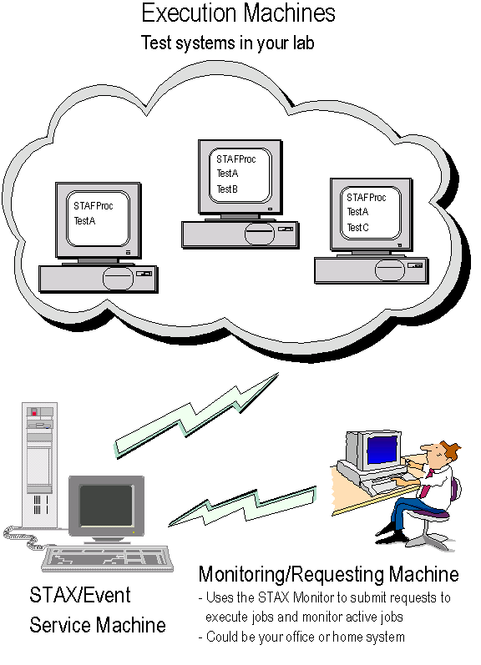
STAX Machine Environment

Slide 24
Installing STAX
Download the STAX tar or zip file from: http://staf.sourceforge.net/getstax.php
The contents of the tar and zip files are the same:
stax/STAX.jar | The STAX service jar file
stax/STAXMon.jar | The STAX Monitor jar file
stax/STAFEvent.jar | The Event service jar file
stax/STAXDoc.jar | A tool to generate documentation for your STAX jobs
stax/readme.1st | The Readme file for this STAX service version
stax/docs/History | A text file containing the complete history of STAX bugs/features
stax/docs/staxug.pdf | The STAX User’s Guide
stax/docs/staxgs.pdf | The Getting Started with STAX document
stax/docs/STAXDoc.pdf | The STAXDoc User’s Guide
stax/libraries/STAXUtil.xml | A library of common functions that you can use in your STAX jobs
stax/libraries/STAXUtil.html | Documentation for the STAXUtil.xml common functions
stax/samples/sample1.xml | A sample STAX job to demonstrate some capabilities of STAX
stax/samples/FunctionList.xsl | An XSL Stylesheet that can be used to generate HTML documents that describe the functions in your STAX jobs

Slide 25
Configuring STAX
After unpackaging the STAX zip/tar file, add the following statements to your STAF.cfg file:
SERVICE STAX LIBRARY JSTAF \
EXECUTE {STAF/Config/STAFRoot}/services/stax/STAX.jar \
OPTION J2=-Xmx512m
SERVICE Event LIBRARY JSTAF \
EXECUTE {STAF/Config/STAFRoot}/services/stax/STAFEvent.jar
SET MAXQUEUESIZE 10000

Slide 26
Configuring STAX (cont.)
Here is the STAX service configuration syntax and parameters:
SERVICE <Name> LIBRARY JSTAF EXECUTE <STAX Jar File Name>
[OPTION <Name[=Value]>]...
[PARMS <"> [EVENTSERVICEMACHINE <EventMachine>]
[EVENTSERVICENAME <EventName>]
[NUMTHREADS <NumThreads>]
[PROCESSTIMEOUT <ProcessTimeout>]
[FILECACHING <Enabled | Disabled>]
[MAXFILECACHESIZE <Max Files>]
[MAXMACHINECACHESIZE <Max Machines>]
[MAXRETURNFILESIZE <Number>[k|m]]
[MAXGETQUEUEMESSAGES <Number>]
[MAXSTAXTHREADS <Number>]
[CLEARLOGS <Enabled | Disabled>]
[LOGTCELAPSEDTIME <Enabled | Disabled>]
[LOGTCNUMSTARTS <Enabled | Disabled>]
[LOGTCSTARTSTOP <Enabled | Disabled>]
[PYTHONOUTPUT <PythonOutput>]
[PYTHONLOGLEVEL <Log Level>]
[EXTENSIONXMLFILE <Extension XML File> |
EXTENSIONFILE <Extension Text File>]
[EXTENSION <Extension Jar File>...
<">]

Slide 27

Using the STAX Monitor
To start the STAX Monitor, change to the directory which contains your STAXMon.jar file and type:
java -jar STAXMon.jar
If you are in another directory, fully qualify the STAXMon.jar file:
java -jar c:/staf/services/stax/STAXMon.jar

Slide 28
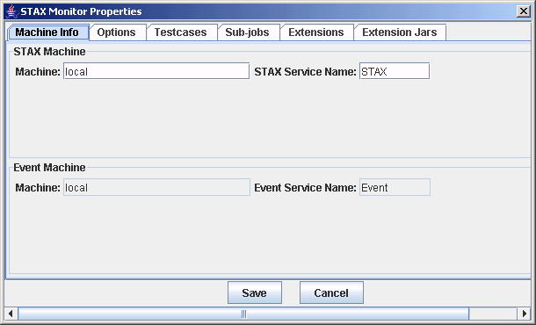
Using the STAX Monitor (cont.)
The first time you start the STAX Monitor, the STAX Monitor Properties window will be displayed
  The STAX Machine defaults to your local system with Service Name STAX. Click on the "Save" button to save any changes or the "Cancel" button to end without saving changes.
  If any changes are made to the STAX machine/name properties, then you will need to close and restart the STAX Monitor for the changes to take affect

Slide 29
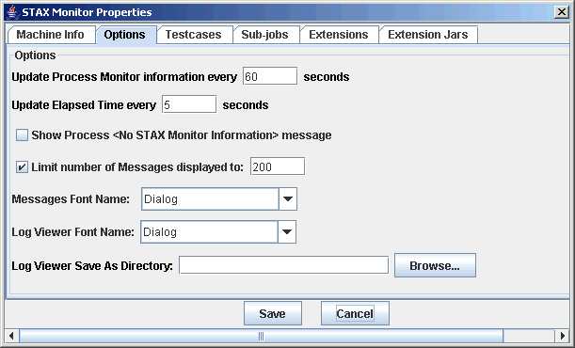
Using the STAX Monitor (cont.)
The Options tab allows you to specify options for the STAX Monitor

Slide 30
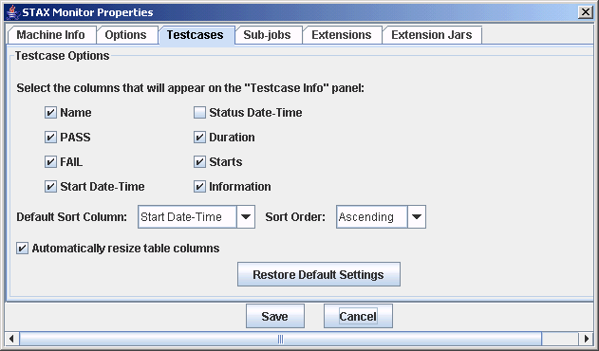
Using the STAX Monitor (cont.)
The Testcases tab allows you to specify testcase options for the STAX
Monitor

Slide 31
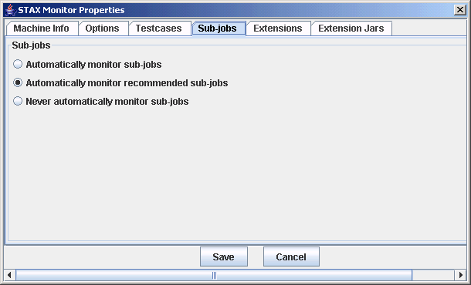
Using the STAX Monitor (cont.)
  The Sub-jobs tab allows you to specify whether to automatically monitor sub-jobs

Slide 32
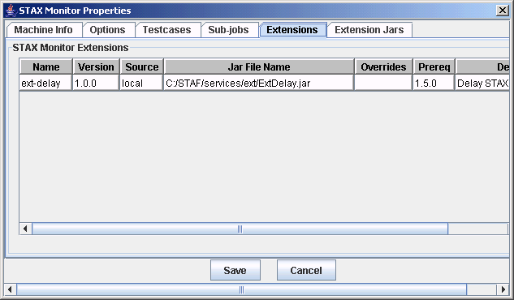
Using the STAX Monitor (cont.)
  The Extensions tab allows you to display the monitor extensions that are registered with the STAX Monitor

Slide 33
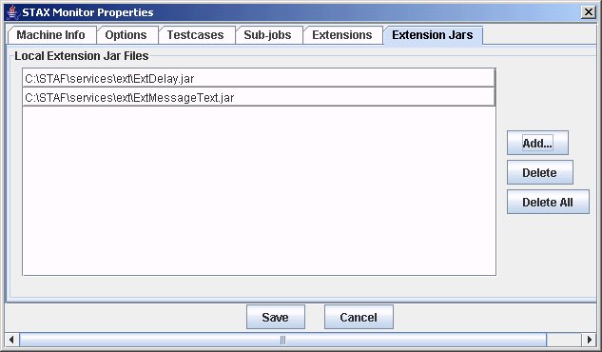
Using the STAX Monitorr (cont.)
  The Extension Jars tab allows you to specify any local extension jar files containing STAX Monitor extensions that you want to register.
  These extensions can override monitor extensions registered when the STAX service was configured.

Slide 34
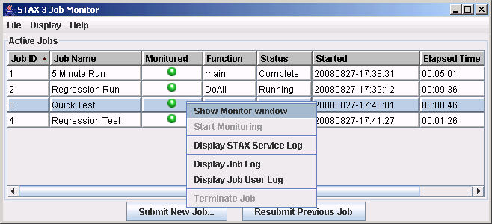
Using the STAX Monitor (cont.)
This is the main display panel you will see when you start the STAX Monitor
  Displays information about all running and/or monitored jobs
  Allows you to launch new jobs, monitor existing jobs, view STAX logs, and terminate jobs
Click on "Start New Job" to start a new STAX job

Slide 35
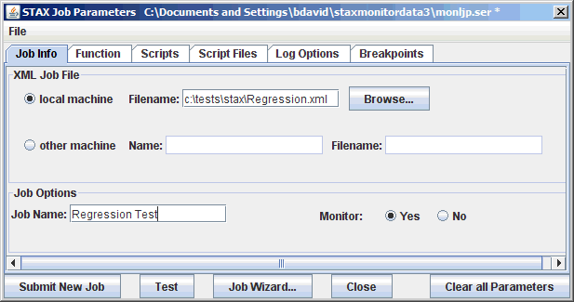
Using the STAX Monitor (cont.)
The Start Job Parameters panel allows you to define characteristics for a job:
  Specify the file name for the STAX job (e.g. C:\STAF\services\stax\samples\sample1.xml) and optionally specify other information
  Click on the Submit New Job button to run the job (or click on the Test button to validate the XML)

Slide 36
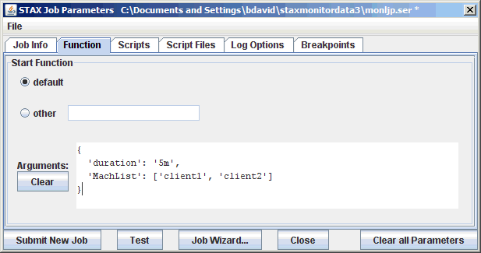
Using the STAX Monitor (cont.)
The Function tab allows you to specify the start function parameters for the job

Slide 37
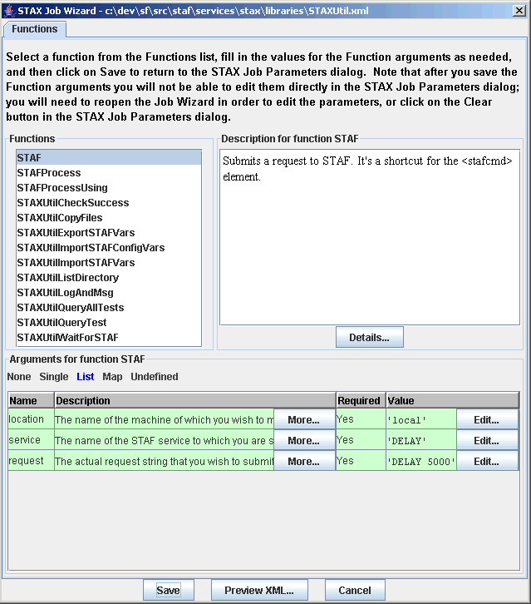
Using the STAX Monitor (cont.)
  The STAX Job Wizard helps you select the starting function for a job you want to execute, and helps you specify function arguments for it, if needed

Slide 38
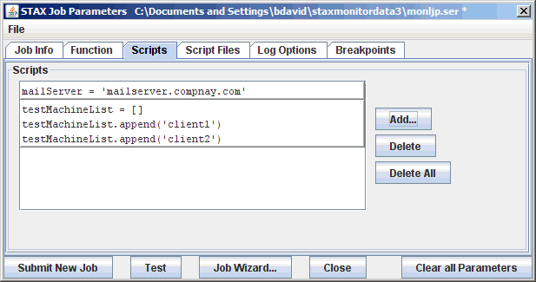
Using the STAX Monitor (cont.)
  The Scripts tab allows you to specify Script parameters

Slide 39
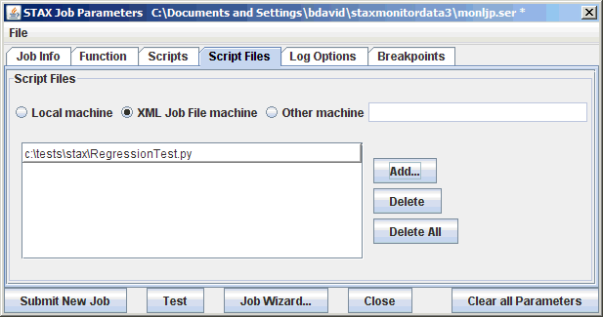
Using the STAX Monitor (cont.)
  The Script Files tab allows you to specify Script File parameters

Slide 40
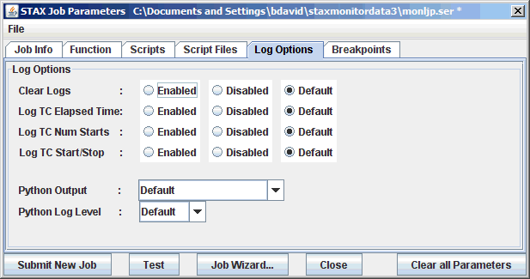
Using the STAX Monitor (cont.)
  The Log Options tab allows you to specify the log parameters

Slide 41
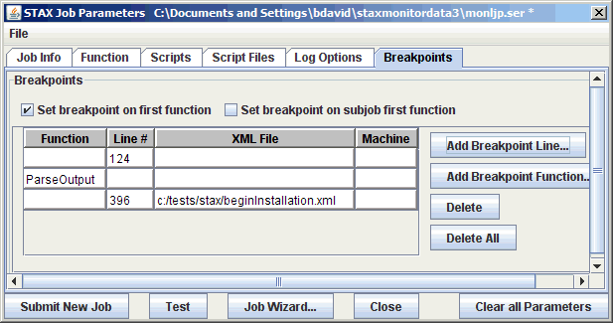
Using the STAX Monitor (cont.)
  The Breakpoints tab allows you to specify breakpoints
  Using breakpoints to debug STAX jobs will be covered in detail in Part 4

Slide 42
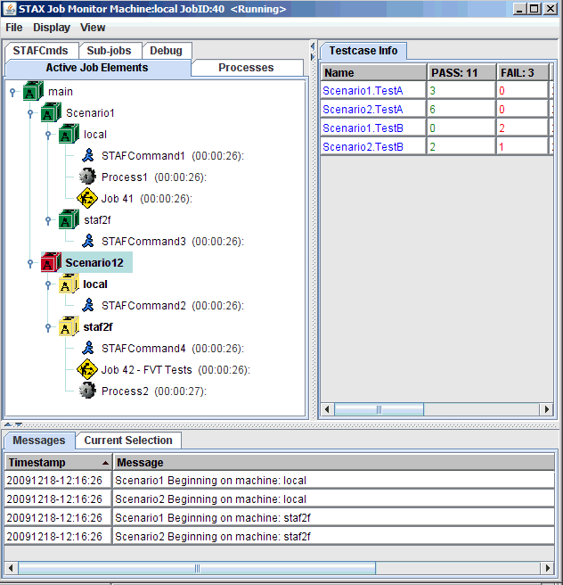
Using the STAX Monitor (cont.)

Slide 43
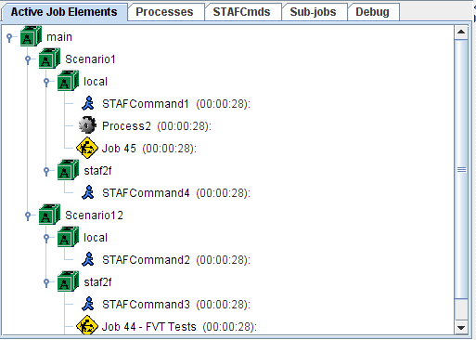
Using the STAX Monitor (cont.)
The Active Job Elements tab displays the currently executing <block>, <job>, <process>, and <stafcmd> elements for a job in a tree format, in order to show the hierarchy of the currently executing elements
  For each <job>, <process>, and <stafcmd> element represented in the tree, the elapsed time (HH:MM:SS) that the process or stafcmd element has been running is displayed to the right of the process or stafcmd name in parenthesis
  For each <process> element represented in the tree, if the process generates STAF Monitor Service messages, the current monitor message is displayed to the right of the process name and elapsed time. The monitor information is periodically refreshed while the process is running.

Slide 44
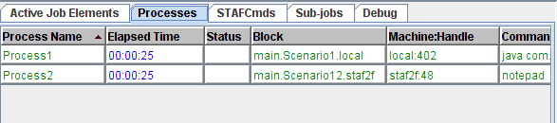
Using the STAX Monitor (cont.)
The Processes tab displays the currently executing <process> elements for a job
  For each <process> element represented in the table, the elapsed time (HH:MM:SS) that the process element has been running is displayed in the table
  For each <process> element represented in the table, if the process generates STAF Monitor Service messages, the current monitor message is displayed in the "Status" column. The monitor information is periodically refreshed while the process is running.

Slide 45
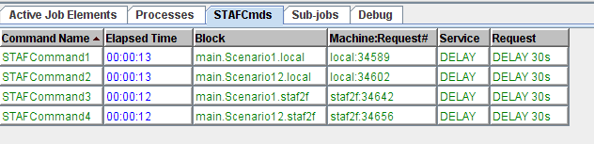
Using the STAX Monitor (cont.)
The STAFCmds tab displays the currently executing <stafcmd> elements for a job
  For each <stafcmd> element represented in the table, the elapsed time (HH:MM:SS) that the stafcmd element has been running is displayed in the table

Slide 46
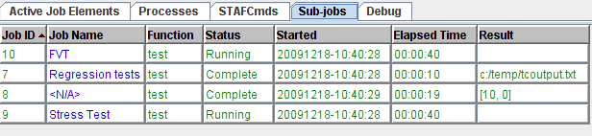
Using the STAX Monitor (cont.)
The Sub-jobs tab displays information about both active and completed sub-jobs
  For each <job> element represented in the table, the elapsed time (HH:MM:SS) that the <job> element has been running is displayed in the table
  For each <job> element represented in the table, the job’s status (“Running” or “Complete”) is displayed in the "Status" column

Slide 47
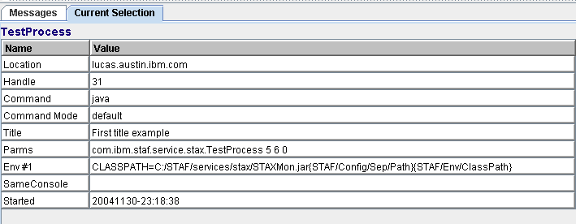
Using the STAX Monitor (cont.)
The Current Selection tab displays more details about an active element when you click on an entry in the "Active Job Elements", "Active Processes", "Active STAFCmds“, and “Sub-jobs” tabs

Slide 48
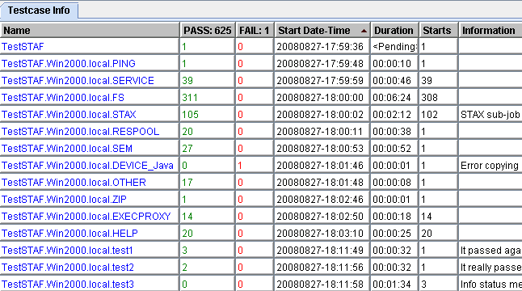
Using the STAX Monitor (cont.)
The Testcase Info tab displays the name of each <testcase> element that has been executed and the cumulative number of its passes, fails, duration, and starts from when the job started executing, along with the last status message it provided via a <tcstatus> element
  Note that at least one testcase status (pass or fail) must be recorded via a <tcstatus> element in order for a testcase to appear here (unless the testcase's mode is set to 'strict')

Slide 49
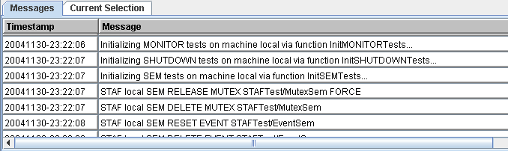
Using the STAX Monitor (cont.)
The Messages tab displays the messages (and their timestamps) from each message sent by a <message> element in the XML document. The STAX service can also generate messages via its default signal handlers.
You can change the font that is displayed in the Messages table
  Open the STAX Monitor Properties, go to the “Options” tab, and update “Messages Font Name”

Slide 50
Using the STAX Monitor (cont.)
All of the tables in the Job Monitor are sortable:
  To sort the table in ascending order by a column, click on the table's column header for that column
  To sort the table in descending order by a column, hold the Shift key while clicking on the table's column header for that column

Slide 51
Controlling Execution of STAX Jobs
If you right-mouse-click on a block in the "Active Job Elements" panel, a popup menu is displayed with the options Hold, Release, and Terminate which allows you to control the execution of the block
The color of the block icon for each block indicates the state of the block:
  Green - indicates the block is currently running
  Red - indicates the block has been held
  Yellow - indicates the block is held by a parent block
The hold, release, and terminate states are propagated to all nested child blocks
Note: Blocks may also be held, released, and terminated via STAF command requests and by STAX elements defined within a STAX XML document

Slide 52
Understanding STAX Logs
STAX uses the STAF Log Service for logging, so the Log Service must be configured in order for STAX logs to be created
There are 3 types of STAX logs:
  STAX Service Log - One log for the STAX Service
  STAX Job Logs - One log for each STAX Job ID
  STAX Job User Logs - One log for each STAX Job ID (if the <log> element is used)
Actions Resulting in a Message Written to the STAX Job Log | Log Level
Job starts execution | Start
Job is held, released, or terminated | Info
Job raises a signal (via the STAX service itself) and its default signal handler is invoked | Error
Job contains a <tcstatus> element which specifies a message | Pass or Fail
A testcase starts (and "Log TC Start/Stop" is enabled) | Start
A testcase stops (and "Log TC Start/Stop" is enabled) | Stop
Job stops. Logs a summary of the # of times each test passed or failed (if it contains any <tcstatus> elements) as the total # of testcases, passes, and fails | Status
Job stops execution | Stop

Slide 53
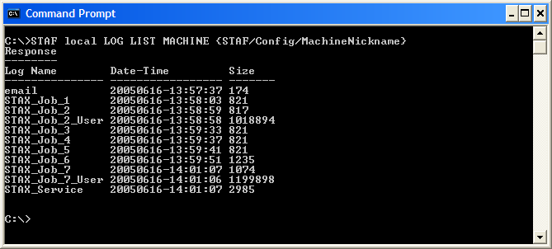
Understanding STAX Logs (cont.)
The STAX logs are machine logs. The names of the STAX logs begin with the STAX service name in uppercase (e.g. STAX).
To get a list of all the logs on a STAX service machine, use the following STAF log list request, replacing <Machine> and <Machine Nickname> with the endpoint and nickname for your STAX service machine. The log files listed whose name begins with the name of the STAX service are the STAX logs.
STAF <Machine> LOG LIST MACHINE <Machine Nickname>
  Note that you can simply use {STAF/Config/Machine/Nickname} for <Machine Nickname>

Slide 54
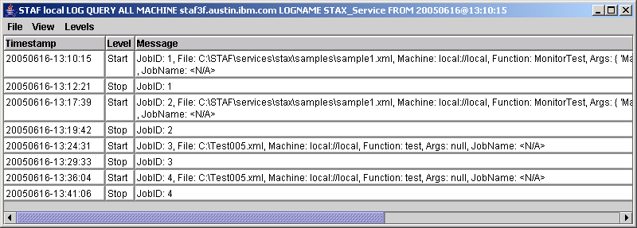
Querying STAX Service Log
To query a STAX service log, use the following STAF log query machine request, replacing <Machine> and <Machine Nickname> with the endpoint and nickname for your STAX service machine:
STAF <Machine> LOG QUERY MACHINE <Machine Nickname> LOGNAME STAX_Service
You can also view the STAX_Service log from the STAX Monitor:

Slide 55
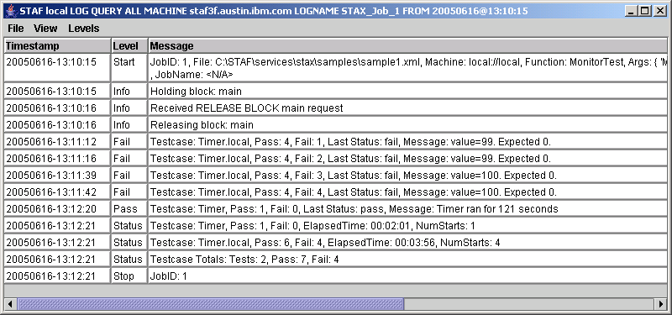
Querying STAX Job Logs
To query a STAX job log for Job ID 1, use the following STAF log query machine request, replacing <Machine> and <Machine Nickname> with the endpoint and nickname for your STAX service machine:
STAF <Machine> LOG QUERY MACHINE <Machine Nickname> LOGNAME STAX_Job_1
You can also view STAX Job logs from the STAX Monitor:

Slide 56
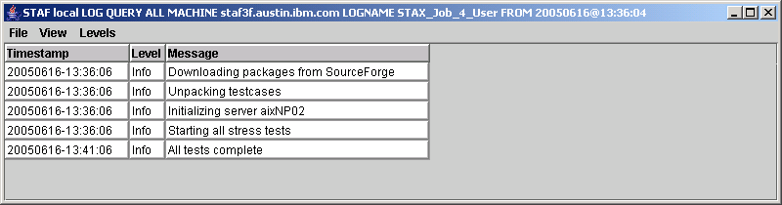
Querying STAX Job User Logs
To query a STAX job user log for Job ID 4, use the following STAF log query machine request, replacing <Machine> and <Machine Nickname> with the endpoint and nickname for your STAX service machine:
STAF <Machine> LOG QUERY MACHINE <Machine Nickname> LOGNAME STAX_Job_4_User
You can also view STAX Job User logs from the STAX Monitor:

Slide 57
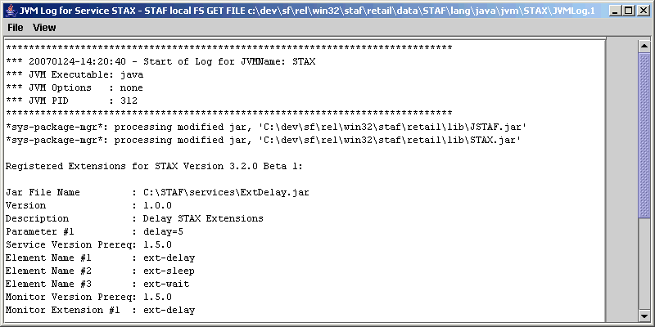
Viewing JVM Logs
To display the JVM Log for the STAX service or for any Java service on any machine, from the main STAX Job Monitor window's Display menu bar, select
“Display STAX JVM Log” or “Display Other JVM Log...”
Here is an example of the dialog that could be shown when you select the Display STAX JVM Log menu item

Slide 58
Submitting STAX Requests via Command Line
The STAX service provides the following requests:
  EXECUTE - Starts a job running based on a XML document which defines its workflow
  LIST - Lists all currently running jobs or specific information about a single job
  QUERY - Queries information about a job that is currently running
  HOLD - Holds a job or a block in a job that is currently running
  RELEASE - Releases a job or a block in a job that is in the hold state
  TERMINATE - Terminates a job or a block in a job
  SET - Lets you change the operational parameters of the STAX service
  GET DTD - Gets the STAX DTD (Document Type Definition)
  UPDATE TESTCASE - Updates the status of a testcase in a job that is currently running
  START TESTCASE - Starts a new testcase in a STAX job that is currently running
  STOP TESTCASE - Stops an active testcase in a STAX job that is currently running
  HELP - Displays a list of requests for the STAX service and how to use them
  VERSION - Displays the version of the STAX service

Slide 59
STAX service - Syntax
EXECUTE < <FILE <XML File Name> [MACHINE <Machine Name>]> | DATA <xml data> >
[JOBNAME <Job Name>] [FUNCTION <Function ID>] [ARGS <Arguments>]
[SCRIPTFILE <File Name>... [SCRIPTFILEMACHINE <machine name>]]
[SCRIPT <Python Code>]... [CLEARLOGS [<Enabled | Disabled>]]
[ HOLD | TEST [RETURNDETAILS] |
WAIT [<Number>[s|m|h|d|w]] [RETURNRESULT [DETAILS]] ]
[ NOTIFY ONEND [BYNAME] [PRIORITY <Priority>] [KEY <Key>] ]
[LOGTCELAPSEDTIME <Enabled | Disabled>]
[LOGTCNUMSTARTS <Enabled | Disabled>]
[LOGTCSTARTSTOP <Enabled | Disabled>]
[PYTHONOUTPUT <Python Output>] [PYTHONLOGLEVEL <Log Level>]
[ BREAKPOINT <Function name> | <Line>[@@<File>[@@<Machine>]] ]...
[BREAKPOINTFIRSTFUNCTION] [BREAKPOINTSUBJOBFIRSTFUNCTION]
GET DTD
GET RESULT JOB <Job ID> [DETAILS]
LIST JOBS | SETTINGS | MACHINECACHE |
FILECACHE [SORTBYLRU | SORTBYLFU | SUMMARY] |
EXTENSIONS | EXTENSIONJARFILES |
JOB <Job ID> <THREADS | < THREAD <Thread ID> VARS [SHORT] > |
PROCESSES | STAFCMDS | SUBJOBS | BLOCKS | TESTCASES |
BREAKPOINTS | FUNCTIONS>

Slide 60
STAX service - Syntax
QUERY EXTENSIONJARFILE <Jar File Name> | EXTENSIONJARFILES |
JOB <Job ID> [THREAD <Thread ID> [ VAR <VarName> [SHORT] ] |
PROCESS <Location:Handle> | STAFCMD <Request#> |
BLOCK <Block Name> | TESTCASE <Test Name>
FUNCTION <Function Name>]
HOLD JOB <Job ID> [BLOCK <Block Name>]
RELEASE JOB <Job ID> [BLOCK <Block Name>]
TERMINATE JOB <Job ID> [BLOCK <Block Name>]
START JOB <Job ID> TESTCASE <Testcase name> [KEY <Key>]
[PARENT <Testcase name>]
STOP JOB <Job ID> TESTCASE <Testcase name> [KEY <Key>]
UPDATE JOB <Job ID> TESTCASE <Testcase name> STATUS <Status>
[MESSAGE <Message text>] [FORCE [PARENT <Testcase name>]]
LOG JOB <Job ID> MESSAGE <Message> [LEVEL <Level>] [SEND]
SEND JOB <Job ID> MESSAGE <Message>

Slide 61
STAX service – Syntax (cont.)
ADD JOB <Job ID> BREAKPOINT
< FUNCTION <Function Name> |
LINE <Line Number> FILE <XML File> [MACHINE <Machine Name>] >
REMOVE JOB <Job ID> BREAKPOINT <Breakpoint ID>
RESUME JOB <Job ID> THREAD <Thread ID>
STEP JOB <Job ID> THREAD <Thread ID> [INTO | OVER]
STOP JOB <Job ID> THREAD <Thread ID>
PYEXEC JOB <Job ID> THREAD <Thread ID> CODE <Python Code>

Slide 62
STAX service – Syntax (cont.)
SET [CLEARLOGS <Enabled | Disabled>]
[LOGTCELAPSEDTIME <Enabled | Disabled>]
[LOGTCNUMSTARTS <Enabled | Disabled>]
[LOGTCSTARTSTOP <Enabled | Disabled>]
[PYTHONOUTPUT <Python Output>]
[PYTHONLOGLEVEL <Log Level>]
[FILECACHING <Enabled | Disabled>]
[MAXFILECACHESIZE <Max Files>]
[MAXMACHINECACHESIZE <Max Machines>]
[MAXRETURNFILESIZE <Number>[k|m]]
[MAXGETQUEUEMESSAGES <Number>]
NOTIFY REGISTER ONENDOFJOB <Job ID> [BYNAME] [PRIORITY <Priority>]
NOTIFY UNREGISTER ONENDOFJOB <Job ID>
NOTIFY LIST [JOB <Job ID>]
PURGE <FILECACHE | MACHINECACHE> CONFIRM
VERSION [JYTHON]

Slide 63
STAX service - Examples
STAX EXECUTE FILE D:\stax\xml\JobA.xml JOBNAME JobA
Response
--------
1
This example starts a job defined by an XML file named d:\stax\xml\JobA.xml and gives it a job name of JobA. Notice that the Job ID, 1, is returned in the result string.
STAX LIST JOBS
Response
--------
Job ID Job Name Start Date-Time Function
------ ---------- ----------------- -----------
4 Sample Job 20040919-20:40:16 MonitorTest
5 TestA 20040919-20:52:31 main
7 WebTest 20040919-21:15:23 InitJob
This example lists all of the jobs that are currently running

Slide 64
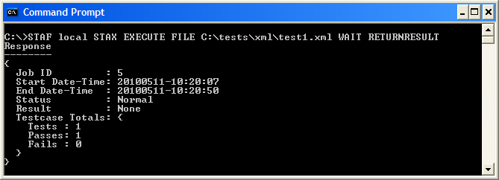
STAX EXECUTE Command Line Request
Results:
Upon successful return, the result buffer contains the Job ID if the TEST or RETURNRESULT options are not specified
Upon successful return, the result buffer contains nothing if the TEST option is specified
If the request times out before the job has completed (due to the WAIT option being specified with a Timeout), a RC 37 (Timeout) is returned and the result buffer contains the Job ID
If the WAIT and RETURNRESULT options are specified, and the request does not timeout, the result buffer contains a marshalled map class representing the job result
Notes:
Note that the file name specified is fully qualified. This is because files are relative to the directory where STAFProc is started, rather than relative to the current directory. So, it's best to just fully qualify file names used in STAF commands.

Slide 65
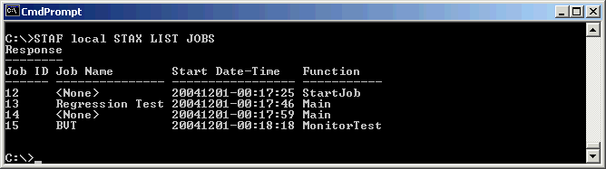
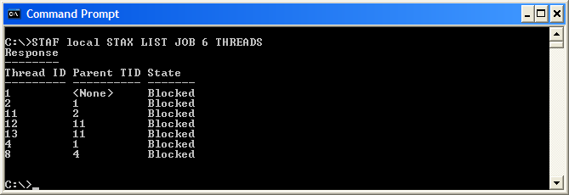
STAX LIST Command Line Request
LIST JOBS | SETTINGS | FILECACHE | MACHINECACHE |
EXTENSIONS | EXTENSIONJARFILES |
JOB <Job ID> <THREADS | < THREAD <Thread ID> VARS [SHORT] > |
PROCESSES | STAFCMDS | SUBJOBS | BLOCKS | TESTCASES |
BREAKPOINTS>
Examples:
  Goal: List all of the jobs
  Goal: List all the threads running for a job with Job ID 6

Slide 66
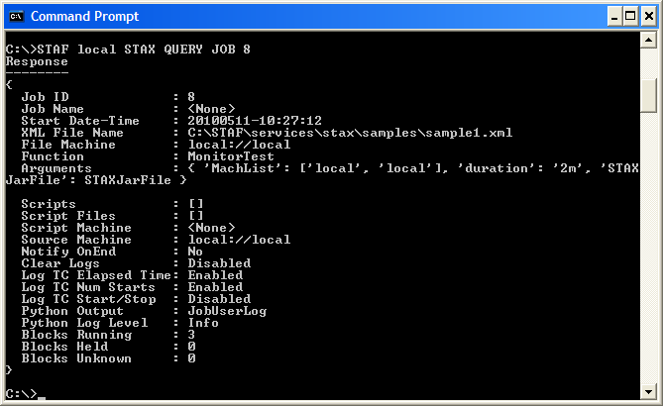
STAX QUERY Command Line Request
QUERY EXTENSIONJARFILE <Jar File Name> | EXTENSIONJARFILES |
JOB <Job ID> [THREAD <Thread ID> [ VAR <VarName> [SHORT] ] |
PROCESS <Location:Handle> | STAFCMD <Request#> |
BLOCK <Block Name> | TESTCASE <Test Name>]
Examples:
  Goal: Query a job with ID 8

Slide 67
Part 2A – Break/LAB (20 min.)
Exercises 2.1-2.3

Slide 68
Part 2B – Creating STAX Jobs

Slide 69
Using Python in STAX XML Documents
STAX uses Python for variable assignments and expression evaluation
Python variable naming conventions:
  Syntax: (underscore or letter) + (any number of letters, digits or underscores)
  Case matters: "MACHNAME" is not the same as "machname"
  STAX and Python reserved words are off limits. Following are reserved words in STAX:
    RC, any word beginning with STAX (e.g. STAXJobName, STAXThreadID), and any word beginning with STAF
Python provides powerful built-in object types such as:
Object Type Example Usage
Numbers 0, 1234, 3.1415
Strings 'spam', "guido's"
Lists [1, [2, 'three'], 4]
Dictionaries {'food': 'spam', 'taste': 'yum'}
Tuples (1, 'spam', 4, 'U')
Python Expression Operators:
Operators Description
x or y Logical or (y is evaluated only if x is false)
x and y Logical and (y is evaluated only if x is true)
not x Logical negation
<, <=, >, >=, ==, != Comparison operators
Note: Must use &lt; instead of < in XML documents
Notes:
Python reserved words are listed in the STAX User's Guide. They are:
and, assert, break, class, continue, def, del, elif, else,
except, exec, finally, for, from global, if, import, in, is,
lambda, not, or, pass, print, raise, return, try, while.

Slide 70
Using Python in STAX XML Documents (cont.)
Python Strings:
  Strings can be enclosed in single or double quotes (usually use single quotes)
  poolName = 'machPool'
  machName = "machineA.ibm.com"
  mixed = "Guido's“
  You can escape a special character inside a string by preceding it with a backslash (e.g. \\, \', \", \n, \t, etc)
  mixed = 'Guido\'s' # Guido's
  Remember this when specifying file names and specify a forward slash (/) instead of a backward slash (\) to avoid escaping characters when you didn't mean to. The following file name does not evaluate as intended.
  fileName = 'C:\newTests\test1.xml‘
  You can concatenate strings, repeat strings, and get the length of a string:
  newString = 'abc' + 'def' # concatenation: a new string
  repeatString = 'Hi!' * 3 # like "Hi!" + "Hi!" + "Hi!"
  length = len(newString) # length: number items = 6

Slide 71
Using Python in STAX XML Documents (cont.)
Python Strings:
  Python overloads the % operator to work on strings. It provides a simple way to format strings. Simply provide a format string on the left (with embedded conversion targets--e.g. %s), along with object(s) on the right that you inserted into the string on the left, at the conversion targets. Note that %s can be used to specify the print format for ANY object.
  request = 'RELEASE POOL %s ENTRY %s' % (poolName, machName)
  Note: The request variable's value evaluates to:
  RELEASE POOL machPool ENTRY machineA.ibm.com'
  Python provides utility modules for processing strings. The string module includes tools for converting case, searching strings for substrings, converting strings to numbers, etc.
  import string
  upper = string.upper("spam") # Converts to uppercase, "SPAM"
  string.find(upper, "PA") # Returns index of substring, 1
Python comments:
  Start with a # character and extend to the end of the current line

Slide 72
Using Python in STAX XML Documents (cont.)
Python Lists:
  A Python list can contain any sort of object: numbers, strings, other lists, etc.
  L1 = [] # An empty list
  L2 = [0, 1, 2, 3] # A list containing 4 iterms: indexes 0-3
  L3 = ['abc', [0, 'xyz']] # Nested sublists
  L2[i], L3[i][j] # Index
  L2[i:j] # Slice
  len(L2) # Length
  L1 + L2 # Concatenate
  L2[3] = 'cat' # Index assignment
  range(4) # Makes a list of integers: [0, 1, 2, 3, 4]
  L2.append(4) # Method: grow the list
There are no braces or begin/end delimiters around blocks of code; instead, Python uses the indentation of statements under a header to group the statements in a nested block
x = 'spam'
if x == 'spam':
y = 2
print 'block1'
print 'block0'
Most STAX elements and attribute values can contain Python expressions

Slide 73
Using Python in STAX XML Documents (cont.)
Jython/Python Documentation
  See the Python and Jython websites for documentation on Python and Jython at:
    http://www.python.org
    http://www.jython.org
  Some Python and Jython books that are available include:
    "Python Pocket Reference", O'Reilly
    "Learning Python", O'Reilly, Mark Lutz & David Ascher
    "Jython Essentials", O'Reilly, Samuele Pedroni & Noel Rappin
    "Jython for Java Programmers", Robert Bill

Slide 74
Using Python in STAX XML Documents (cont.)
STAX uses Jython 2.1 (a Java implementation of Python) which is based on Python 2.1
Jython 2.1 cannot execute Python code that uses functions that were provided in later versions of Python, such as Python 2.2 or later
Although in most cases Jython behavior is identical to the C-language implementation of Python (CPython), there are still cases where the two implementations differ.
Most Python modules that are written in Python work fine in Jython. A few types of modules will not run under Jython such as:
  Modules that contain functionality not included in a JVM
    Some standard CPython modules depend on operating system calls that are not available under Java. The most notable of these is os, which actually does run in Jython, but is missing much of its functionality
  Modules that are implemented in C
    A number of common CPython modules are implemented in C rather than Python, either for a speed boost or because the module is a C wrapper around an external C library. The C modules, or any modules that depend on them, will not run in Jython.

Slide 75
Using XML to Define STAX Jobs
STAX uses XML (Extensible Markup Language) to describe STAX job definitions
Some XML fundamentals:
  In XML, tags always start with < and end with >. The names that can be used for a tag are defined by the DTD (Document Type Definition).
  <function>
  Both markup and text in an XML document are case-sensitive
  <function name="main"> is different from <Function name="Main">
  XML comments start with <!-- and end with -->
  <!-- Assign a list of machines to variable machList -->
  XML documents are made up of XML elements. Like in HTML, you create XML elements with an opening tag, such as <log>, followed by the element content (if any), such as text or other elements, and ending with the matching closing tag that starts with </, such as </log>.
  <log>'This is some text'</log>

Slide 76
Using XML to Define STAX Jobs (cont.)
More XML fundamentals:
  Elements may contain only character data, only elements, a mixture of both, or nothing at all (empty elements)
  <!-- empty element -->
  <nop/> <!-- this is equivalent to <nop></nop> -->
  <!-- Contains two elements, each containing character data -->
  <process>
  <location>'machineA'</location>
  <command>'C:/tests/stress1.exe'</command>
  </process>
  Attributes in XML are name-value pairs that let you specify additional data in start and empty tags. To assign a value to an attribute, you use an equal sign. You must enclose attribute values in quotation marks (usually double quotes). Examples:
  <defaultcall function="Main"/>
  <call function="'Main'"/>
  <block name='“CreateInstallers"'/>

Slide 77
Using XML to Define STAX Jobs (cont.)
STAX XML documents define the workflow of the job; what processes and/or STAF commands are executed and in what order.
A STAX XML document must comply with the STAX DTD
  The first line in an XML document should start with an XML declaration
  The second line in an XML document should be the document type declaration. This is used to indicate the DTD used for the document. It defines the name of the root element, stax, and the DTD to be used.
  All other elements in a STAX XML document must be contained between <stax> and </stax>
Every STAX XML document should look like:
<?xml version="1.0" encoding="UTF-8" standalone="no"?>
<!DOCTYPE stax SYSTEM "stax.dtd">
<stax>
...
</stax>

Slide 78
Editing STAX XML Documents
You can create a STAX XML document using any editor, even notepad
There are many XML editors available:
http://www.xml.com/pub/rg/XML_Editors
Many of these XML editors provide the following features:
  Color-coded XML editing
  Extensible support for external tools, such as XSL processors, XML formatters, and web browsers
  Ability to open files via URL
  Checks well-formedness and validates XML documents
  Line numbering

Slide 79
Retrieving the STAX DTD
A DTD (Document Type Description) is a formal description in XML Declaration Syntax of a particular type of document. It defines what names can be used for different types of elements, where they may occur, and how they all fit together. An XML document is considered valid if it complies with its DTD.
  STAX checks the syntax of XML documents using a validating XML parser to verify that the document complies with the DTD
  The STAX DTD is dynamically generated when you start STAF (with the STAX Service configured)
To retrieve the STAX DTD and stored the result in a file named C:\stax.dtd, use the following STAX command:
STAF local STAX GET DTD > C:\stax.dtd
To use this DTD with a validating XML editor, you must remove the first two lines that are inserted by the STAF command:
Response
--------

Slide 80
Understanding STAX XML Elements
Fundamental Action Elements:
  process - defines the execution information for a STAF PROCESS START command. A process element specifies a command to be executed and the machine where it should run.
  stafcmd - defines execution information for other STAF commands. A stafcmd element specifies the STAF service and request to be executed and the machine where it should run.
  script - defines Python code to be executed
Sequential Group Elements:
  sequence - executes any number of STAX elements sequentially. Also, used for nesting multiple child elements within other elements.
  function - provides a structuring device for STAX XML documents.. Functions allow us to group and parametize chunks of XML to be used arbitrarily many times later. Functions also provide a tool for splitting jobs into pieces that have a well-defined role.
Conditional Elements:
  if, elseif, else - provide the standard complement of condition testing capabilities

Slide 81
Understanding STAX XML Elements (cont.)
Looping Elements:
  loop - allows a STAX element to be executed repeatedly (like "for", "do", "while", and "until" constructs found in other languages)
  iterate - allows a STAX element to be executed repeatedly while stepping through a list of data for each iteration
  break/continue - allows breaking out of the nearest enclosing <loop> or <iterate> element or stopping execution of the current loop/iteration and continues with the next loop/iteration
Execution Block Elements:
  block - allows you to define a set of actions over which you have internal and external control (hold, release, and terminate). Blocks may be nested to produce an execution hierarchy. Each job consists of at least one block, called "main" which encompasses the entire job.
Log and Message Elements:
  log - allows you to place information into a job's user-managed log
  message - allows your job to send informational messages to the STAX Monitor GUI

Slide 82
Fundamental Actions: <script>
The <script> element contains Python code
All <script> elements contained in the root stax element are executed at the beginning of the job, in the order they are defined in the XML document
All other <script> elements are executed as they are encountered
Examples:
  Goal: Create a variable named testName and assign it the value "CoolTest1"
  <script>testName = 'CoolTest1'</script>
  Goal: Create a list called allMachList by combining lists named unallocMachList and allocMachList
  <script>unallocMachList = ['MachA','MachB','MachC','MachD']</script>
  <script>allocMachList = ['AllocMachA','AllocMachB']</script>
  <script>allMachList = unallocMachList + allocMachList</script>
  Goal: Generate a random number (which could be used to randomly select which function to call) using the random module provided by Python. Note that in Python, you can use a semicolon to separate multiple statements on the same line.
  <script>
  from random import random; r=random()*100
  </script>

Slide 83
Fundamental Actions: <script> (cont.)
Examples (continued):
  Goal: Use Java class STAFUtil and its wrapData() method to turn strings containing spaces into the colon-length-colon form needed for submitting a STAF Notify request. Note that the STAFUtil class needs to be imported in order to use its wrapData() method.
  <script>
  from com.ibm.staf import STAFUtil
  name = 'Jane Smith'
  msg = 'STAX Job ID %s failed.' % (STAXJobID)
  request = ('NOTIFY PROFILE %s LEVEL NORMAL MESSAGE %s' %
  (STAFUtil.wrapData(name), STAFUtil.wrapData(msg)))
  </script>
  Given this, the request variable would evaluate to something like the following:
  NOTIFY PROFILE :10:Jane Smith LEVEL NORMAL MESSAGE :21:STAX Job ID 6 failed.
  Note: This example also shows that for statements that are too long to fit on one line, Python lets you continue typing the statement on the next line, if you're coding something enclosed in (), {}, or [] pairs. Continuation lines can start at any indentation level. An alternative is to specify the continuation character, \, at the end of the line to be continued.
  request = 'NOTIFY PROFILE %s LEVEL NORMAL MESSAGE %s' % \
  (STAFUtil.wrapData(name), STAFUtil.wrapData(msg))

Slide 84
Fundamental Actions: <process>
The <process> element allows you to execute arbitrary processes on any system (where STAF is running).
The <process> element has the following required elements:
  location
  command - Has attribute mode. Can be set to 'shell' or 'default' (default).
The <process> element may contain many optional elements, such as:
  parms
  workdir
  title
  vars (or var)
  envs (or env)
  stdout, stderr
  returnstdout, returnstderr
  Note: Each of these optional elements may specify an if attribute. If it does not evaluate to a true value, the element is ignored.
Notes:
Most of the STAX XML elements and attributes that can contain character data (text) are evaluated by Python and thus, can contain Python variables. So, if a string is intended, you must specify quotes around it.
Examples:
machine = 'machineA'
'machineA'
machine
However, some attributes can only contain a literal string (that is, they are not evaluated by Python). These are documented in the STAX User's Guide.
Examples:
The function element's name attribute can only contain a literal. However, to call this function, specify
since the call element's name attribute is evaluated by Python.

Slide 85
Fundamental Actions: <process> (cont.)
After a process has completed (or if it could not be started) the following variables are set and can be referenced by the job:
  RC - the return code from the process. It is an integer.
  STAFResult - the STAF result from starting the process. If the process failed to start successfully, it contains any error messages from starting the process. It is a string.
  STAXResult - contains any files specified by returnstdout, returnstderr, and/or returnfile(s). If no files are returned, STAXResult is set to the special Python object None.
Examples:
  Goal: Run a Java program passing it three parameters
  <process name="'TestProcess'">
  <location>'local'</location>
  <command>'java'</command>
  <parms>'com.ibm.staf.service.stax.TestProcess 5 1 0'</parms>
  <title>'Test Process'</title>
  <env>'CLASSPATH=c:/stax/services/stax.jar;%CLASSPATH%'</env>
  </process>
  Goal: Run a ping command as though you were at a shell prompt. It assumes machName is a Python variable that is set, via a <script> element, to the name of the machine to ping.
  <process name="'Ping'">
  <location>'local'</location>
  <command mode="'shell'">'ping -n 1 -w 1 %s' % machName</command>
  </process>

Slide 86
Fundamental Actions: <stafcmd>
STAF Command
  The <stafcmd> element allows you to call STAF services within your job
  This allows the capabilities of existing STAF services to be leveraged in your jobs
The stafcmd element has the following three required elements:
  location, service, request
Examples:
  Goal: Use the STAF Resource Pool (RESPOOL) service to request a machine from the resource pool called 'MachinePool'. The machine name will be returned in STAFResult.
  <stafcmd>
  <location>'local'</location>
  <service>'RESPOOL'</service>
  <request>'REQUEST POOL MachinePool'</request>
  </stafcmd>
  Goal: Delay for 5 seconds using the STAF Delay Service
  <stafcmd>
  <location>'local'</location>
  <service>'DELAY'</service>
  <request>'DELAY 5s'</request>
  </stafcmd>

Slide 87
Groupings: <sequence>
The <sequence> element:
  Represents a container of STAX elements which will be executed serially, in the order in which the contained elements are listed in the sequence
  May contain any number of task elements
Example:
<sequence>
<script>
fileServer = 'server1'
machName = 'testMachine1'
fileName = 'C:/tests/TestA.exe'
</script>
<stafcmd>
<location>fileServer</location>
<service>'FS'</service>
<request>'COPY FILE %s TOMACHINE %s' % (fileName, machName)</request>
</stafcmd>
<process>
<location>machName</location>
<command>fileName</command>
</process>
</sequence>
Notes:
A task element is defined in the STAX DTD to be:

Slide 88
Groupings: <function>
The <function> element:
  Defines a named task and contains a single task element
  May only be defined within the root stax element
  The first function called when a job is started is determined by the <defaultcall> element or by the FUNCTION parameter of the STAX EXECUTE request
The function element has the following attributes:
  name - Required. Is a literal.
  scope - Optional. Is a literal. Must be global or local. Defaults to global.
  requires - Optional. Specifies any functions it requires.
The <call> element can be used to call a function, and optionally pass arguments
The <return> element:
  Ends the function call and sends a result object back to the caller
  The result is assigned to a variable named STAXResult. If nothing is returned, it's value defaults to special Python object None.

Slide 89
Groupings: <function> (cont.)
Examples:
  Goal: Define a function that pings a machine and returns the RC (0 if successful)
<function name="Ping" scope="local">
<sequence>
<stafcmd>
<location>machName</location>
<service>'PING'</service>
<request>'PING'</request>
<stafcmd>
<return>RC</return>
</sequence>
</function>
  Goal: Call the 'Ping' function and print a message containing its result
<sequence>
<script>machName = 'machine1'</script>
<call function="'Ping'"/>
<message>'Result from ping is %s' % STAXResult</message>
</sequence>

Slide 90
Looping: <loop>
The <loop> element:
  Contains a single task element which may be executed a specified number of times, allowing specification of an upper and lower bound with an increment value and where the index counter is available to the contained task element
  Specification of constraint attributes (e.g. to, while, and/or until) expressions are allowed
  Loops "forever", if no constraint attributes are specified
The loop element has the following optional attributes:
  var - the name of the variable which will contain the loop index variable
  from - the starting value of the loop index variable. It defaults to 1.
  to - the maximum value of the loop index variable
  by - the increment value for the loop index variable. It defaults to 1.
  while - an expression evaluated at the top of each loop. If false, breaks out of the loop.
  until - an expression evaluated at the bottom of each loop. If true, breaks out of loop.
Example:
<loop from="1" to="5" until="RC != 0">
<process>
<location>machName</location>
<command>'notepad.exe'</command>
</process>
</loop>

Slide 91
Looping: <iterate>
The <iterate> element:
  Contains a single task element
  Performs the task for each value in a list. The iterations of the task are executed serially.
The iterate element has the following attributes:
  var -the name of the variable which will contain the current item in the list/tuple being iterated
  in - the list to be iterated. Note that the list may be assigned in many ways:
  in="['machineA', 'machineB', 'machineC']"
  in="machineList"
  indexvar - the name of the variable which will contain the index of the current item in the list being iterated. The index for the first element in the list is 0. It is optional.
Example:
  Goal: Run a test sequentially on three machines
  <iterate var="machName" in="['mach1','mach2','mach3']">
  <process>
  <location>machName</location>
  <command>'C:/tests/test.exe'</command>
  </process>
  </iterate>

Slide 92
Condition Testing: <if>
The <if> element:
  Specifies a task to execute if an expression is evaluated to be true
  Allows optional <elseif> elements and an optional <else> element to be performed if the expression is evaluated to be false
  The <if>, <else>, and <elseif> elements may contain a single task element
The if and elseif elements have the following required attribute:
  expr - expression to be evaluated by Python
Example:
  Goal: Randomly call one of three functions using a Python random number generator
  <script>from random import random; r = random()*100</script>
  <if expr="r > 66.6">
  <call function="'Function1'"/>
  <elseif expr="r &lt; 33.3">
  <call function="'Function2'"/>
  </elseif>
  <else>
  <call function="'Function3'"/>
  </else>
  </if>

Slide 93
Execution Blocks: <block>
The <block> element:
  Is a wrapper containing a single task element for which execution control is provided
  It may be used in conjunction with the <hold>, <release>, and <terminate> elements and the STAX Service HOLD, RELEASE, and TERMINATE requests
  A block named 'main' exists that wraps everything in the job
  For nested blocks, the block name will be recorded in the hierarchical form of ParentBlockName.ChildBlockName in the STAX logs and queries. The childl block's name must be unique within the parent block's scope.
Example:
<block name="'Block1'">
<sequence>
<call function="'GetTest'"/>
<call function="'RunTest'"/>
<call function="'CheckRC'"/>
</sequence>
</block>

Slide 94
Logging and Messages: <log>, <message>
The <log> element:
  Logs a message in the STAX job user log
  The log element has the following optional attributes:
    level - the logging level of the message to be logged ('info' is the default)
    if - specifies an expression. If it evaluates to true, a message is logged.
    message – specifies an expression. If it evaluates to true, the message is also sent to the STAX Monitor and displayed via its GUI in the message panel.
The <message> element:
  Specifies a message which will be sent to the STAX Monitor and displayed via its GUI
  The message element has the following optional attributes:
    if - specifies an expression. If it evaluates to true, a message is sent to the monitor.
    log – specifies an expresssion. If it evaluates to true, the message is also logged in the STAX Job User log.
Examples:
<log if="debug" level="'debug'">'Put debug information here'</log>
<message if="RC != 0” log=“1” >'RC=%s on machine %s' % (RC, machName)</message>
<log message=“1”>’Here is some important data’</log>

Slide 95
Creating a Simple STAX Job: Part 1
Every STAX job begins with the same basic information
  XML document header
  <stax> declaration
  One or more function definitions
  Optionally, a <defaultcall> element that specifies the starting function
<?xml version="1.0" encoding="UTF-8" standalone="no"?>
<!DOCTYPE stax SYSTEM "stax.dtd">
<stax>
<defaultcall function="StartHere"/>
<function name="StartHere"/>
...
</function>
</stax>

Slide 96
Creating a Simple STAX Job: Part 2
Now let's run a stress testcase
<?xml version="1.0" encoding="UTF-8" standalone="no"?>
<!DOCTYPE stax SYSTEM "stax.dtd">
<stax>
<defaultcall function="StartHere"/>
<function name="StartHere">
<process name="'stress1'">
<location>'machine1'</location>
<command>'C:/tests/stress1.exe'</command>
</process>
</function>
</stax>

Slide 97
Creating a Simple STAX Job: Part 3
Let's abstract away
  The machine on which it runs
  The name of the testcase and it's executable
<stax>
<defaultcall function="StartHere"/>
<script>
machine = 'machine1'
test = [ 'Stress1', 'C:/tests/stress1.exe' ]
</script>
<function name="StartHere">
<process name="test[0]">
<location>machine</location>
<command>test[1]</command>
</process>
</function>
</stax>

Slide 98
Creating a Simple STAX Job: Part 4
Let's check if the test ran successfully and send a message indicating whether it was successful to the STAX Monitor.
<script>
machine = 'machine1'
test = [ 'Stress1', 'C:/tests/stress1.exe' ]
</script>
<function name="StartHere">
<sequence>
<process name="test[0]">
<location>machine</location>
<command>test[1]</command>
</process>
<if expr="RC == 0">
<message log=“1”>'Test %s passed' % test[0]</message>
<else>
<message log=“1”>'Test %s failed with RC=%s' % (test[0], RC)</message>
</else>
</if>
</sequence>
</function>

Slide 99
Creating a Simple STAX Job: Part 5
Now let's run more testcases
<script>
machine = 'machine1'
testList = [ [ 'Stress1', 'C:/tests/stress1.exe' ],
[ 'Stress2', 'C:/tests/stress2.exe' ],
[ 'Stress3', 'C:/tests/stress3.exe' ] ]
</script>
<function name="StartHere">
<iterate var="test" in="testList">
<sequence>
<process name="test[0]">
<location>machine</location>
<command>test[1]</command>
</process>
...
</sequence>
</iterate>
</function>

Slide 100
Creating a Simple STAX Job: Complete
<?xml version="1.0" encoding="UTF-8" standalone="no"?>
<!DOCTYPE stax SYSTEM "stax.dtd">
<stax>
<defaultcall function="StartHere"/>
<script>
machine = 'machine1'
testList = [ [ 'stress1', 'C:/tests/stress1.exe' ],
[ 'stress2', 'C:/tests/stress2.exe' ],
[ 'stress3', 'C:/tests/stress3.exe' ] ]
</script>
<function name="StartHere">
<iterate var="test" in="testList">
<sequence>
<process name="test[0]">
<location>machine</location>
<command>test[1]</command>
</process>
<if expr="RC == 0">
<message log=“1”>'Test %s passed' % test[0]</message>
<else>
<message log=“1”>'Test %s failed with RC=%s' % (test[0], RC)</message>
</else>
</if>
</sequence>
</iterate>
</function>
</stax>

Slide 101
Part 2B – Break/LAB (15 min.)
Exercises 2.4-2.5

Slide 102
Part 2C – Creating More Complex STAX jobs

Slide 103
Understanding additional STAX XML Elements
Parallel Execution:
  parallel - defines a set of elements which will be executed in parallel
  paralleliterate - allows a STAX element to be executed repeatedly, in parallel, while stepping through a list of data for each iteration
Testcases and Timers:
  testcase, tcstatus – define a named set of elements for which you can have any number of testcase passes/fails
  timer - allow you to place time constraints on portions of your automation jobs

Slide 104
Parallel Execution: <parallel>, <paralleliterate>
The STAX programming languages provides direct support for spawning multiple flows of execution and synchronizing their completion
The <parallel> element allows you to spawn and synchronize multiple heterogeneous flows of execution. For example:
  Transferring a set of files to one system, while
  Installing some applications on another system, while
  Waiting for another system to reboot
The <paralleliterate> element allows you to spawn and synchronize multiple homogeneous flows of execution. For example:
  Performing the same sequence of tests in parallel across a group of systems
  Transferring a set of files in parallel to a group of systems
  Executing a set of tests in parallel on one or more systems

Slide 105
Parallel Execution: <parallel>
Example:
  Goal: Transfer a file from a server to machine1, install some applications on machine2, and reboot machine3, all at the same time. When all three tasks are complete, the parallel element is complete and processing will continue with the next element defined after the </parallel> element.
  <parallel>
  <stafcmd>
  <location>'server1'</location>
  <service>'FS'</service>
  <request>'COPY FILE C:/tests/test1.zip TOMACHINE machine1'</request>
  </stafcmd>
  <process>
  <location>'machine2'</location>
  <command>'C:/Applications/install.exe'</command>
  </process>
  <call function="'Reboot'">'machine3'</call>
  </parallel>

Slide 106
Parallel Execution:<paralleliterate>
The <paralleliterate> element contains a single task element and has the following attributes:
  var - the name of the variable which will contain the current item in the list being iterated
  in - the list to be iterated. Note that the list may be assigned in many ways:
  in="['machineA', 'machineB', 'machineC']"
  in="machineList"
  indexvar - the name of a variable which will contain the index of the current item in the list
Example:
  Goal: Run TestA simultaneously on a group of machines whose names are contained in a list. The <paralleliterate> element is not complete until "TestA" has completed on all of the machines whose names are contained in the list.
  <paralleliterate var="machine" in="['machineA', 'machineB']">
  <process>
  <location>machine</location>
  <command>'C:/tests/TestA.exe'</command>
  </process>
  </paralleliterate>

Slide 107
Creating a simple STAX job (cont.)
Now let's add more machines
<script>
machines = [ 'machine1', 'machine2', 'machine3' ]
tests = [ [ 'Stress1', 'C:/tests/stress1.exe' ],
[ 'Stress2', 'C:/tests/stress2.exe' ],
[ 'Stress3', 'C:/tests/stress3.exe' ] ]
</script>
<function name="StartHere"/>
<paralleliterate var="machine" in="machines">
<iterate var="test" in="tests">
<testcase name="test[0]">
<sequence>
...
<process>
<location>machine</location>
<command>test[1]</command>
</process>
...
</sequence>
</testcase>
</iterate>
</paralleliterate>
</function>

Slide 108
Testcases: <testcase>, <tcstatus>
Any arbitrary set of STAX logic may be deemed a testcase
You have direct control over:
  The scope of the testcase
  The success/failure criteria of the testcase
Testcases may be nested which:
  Provides greater control over testcase results
  Eases namespace management and incorporation of other testcases and test suites
The <testcase> element is a wrapper which defines a testcase and contains a single task element for which testcase status is recorded
  Attributes:
    name - the name of the testcase
    mode - 'default' or 'strict'
The <tcstatus> element is used to increment testcase pass/fail counters and record any additional diagnostic information
  Attribute:
    result - 'pass' or 'fail'

Slide 109
Testcases: <testcase>, <tcstatus> (cont.)
Example:
  Goal: Create a testcase 'Test1' that includes running a process on a set of machines. Create subtests (e.g. 'Test1.machineA', 'Test1.machineB', 'Test1.machineC') that include running a process on a single machine. If the process is successful (indicated by RC = 0), record a pass status, otherwise record a fail status and a message with the return code.
  <testcase name="'Test1'">
  <paralleliterate var="machine" in="['machineA', 'machineB', 'machineC']">
  <testcase name="machine">
  <sequence>
  <process>
  <location>machine</location>
  <command>'C:/tests/test1.exe'</command>
  </process>
  <if expr="RC == 0">
  <tcstatus result="'pass'"/>
  <else>
  <tcstatus result="'fail'">'Failed with RC=%s' % RC</tcstatus>
  </else>
  </if>
  </sequence>
  </testcase>
  </paralleliterate>
  </testcase>

Slide 110
Timers: <timer>
Many automation tasks require a level of control over the amount of time consumed by the task. Two common examples:
  Bounding the amount of time consumed by a particular task
  Ensuring that a task runs for a specific amount of time
The STAX programming language provides direct support for these types of issues via the <timer> element
The STAX engine handles all cleanup activities and provides you direct control over the outcome of an expired timer
The <timer> element is a wrapper which defines a single task for which time control is provided. It has one attribute:
  duration - specifies the maximum length of time to run the task (e.g. '5m', '2h', '1d')
Upon completion of a <timer> element, the STAX execution engine sets:
  RC - the timer's return code
  1 = task was still running when timer expired
  0 = task ended before timer expired
  -1 = task never began (e.g., invalid duration specified)

Slide 111
Timers: <timer> (cont.)
Example:
  Goal: Run a stress test for two hours. If it is still running after two hours, terminate it and record a testcase pass result. If it is not still running after two hours, record a fail result.
  <testcase name="'Stress1'">
  <sequence>
  <timer duration="'2h'">
  <process>
  <location>'machine1'</location>
  <command>'C:/tests/stress1.exe'</command>
  </process>
  </timer>
  <if expr="RC == 1">
  <tcstatus result="'pass'"/>
  <else>
  <tcstatus result="'fail'">'Timer RC=%s' % RC</tcstatus>
  </else>
  </if>
  </sequence>
  </testcase>

Slide 112
Debugging STAX Jobs
Understanding XML Parser Error Messages:
  When submitting a job for execution), if the XML document specified is not valid (does not conform to the STAX DTD), error 4001 is returned. Additional information about the error is put into the STAF Result (including the line number where the parser error occurred).
  Example: A STAX XML document contains a <sequence> element, with no end-tag element:
  Additional information:
  Caught com.ibm.staf.service.stax.STAXXMLParseException:
  Line 78: The element type "sequence" must be terminated by the matching end-tag
  "</sequence>".
  Example: A STAX XML document contains a <stafcmd> element with no <service> element:
  <stafcmd>
  <location>machine</location>
  <request>'ping'</request>
  </stafcmd>
  Additional information:
  Caught com.ibm.staf.service.stax.STAXXMLParseException:
  Line 27: The content of element type "stafcmd" must match
  "(location,service,request)".

Slide 113
Debugging STAX Jobs (cont.)
Understanding Python Error Messages:
  Whenever you make changes to a STAX xml file that is going to be imported by other STAX jobs, you should always test it to show any XML parsing or Python compile errors
  When Python cannot successfully evaluate a value, expression, or statement(s), a PythonEvaluationError signal is raised. Information about the element which could not be successfully evaluated by Python is provided in a variable named STAXPythonEvalMsg.
  Its default signal handler sends a message that includes the variable named STAXPythonEvalMsg to the STAX Monitor, logs a message in the STAX Job Log with level 'error', and terminates the job
  NameError Example: Variable workdir is used in a <process> element (<workdir>workdir</workdir>), but was never assigned a value and, thus, doesn't exist
  STAXPythonEvaluationError signal raised. Terminating job.
  <process name=Process1> with location=crankin command=test1.exe
  com.ibm.staf.service.stax.STAXPythonEvaluationException: Traceback (innermost last):
  File "<string>", line 1, in ?
  NameError: workdir

Slide 114
Debugging STAX Jobs (cont.)
Understanding Python Error Messages:
  SyntaxError Example:
  <log level="'info'">'This is the start of the STAX job</log>
  The message specified in a <log> element is missing a closing quote ('). Note the SyntaxError message tells you the column #, 35, where the quote is missing.
  STAXPythonEvaluationError signal raised. Terminating job.
  <log level="'info'">'This is the start of the STAX job</log> com.ibm.staf.service.stax.STAXPythonEvaluationException: Traceback (innermost last):
  (no code object) at line 0
  SyntaxError: ('Lexical error at line 1, column 35. Encountered: "\\n" (10), after : ""', ('<string>', 1, 35, "'This is the start of the STAX job"))

Slide 115
Debugging STAX Jobs (cont.)
Understanding Python Error Messages:
  SyntaxError Example:
  <message>'%d file(s) returned in STAXResult' %
  len(STAXResult)</message>
  The text for the message expands over two lines without a continuation character.
  STAXPythonEvaluationError signal raised. Terminating job.
  <message>'%d file(s) returned in STAXResult' %
  len(STAXResult)</message>
  com.ibm.staf.service.stax.STAXPythonEvaluationException: Traceback (innermost last):
  (no code object) at line 0
  SyntaxError: ('invalid syntax', ('<string>', 1, 39, "'%d file(s) returned in
  STAXResult' % "))
  Can be fixed by specifying a continuation character or enclosing in parentheses as follows:
  <message>'%d files(s) returned in STAXResult' % \
  len(STAXResult)</message>
  <message>('%d files(s) returned in STAXResult' %
  len(STAXResult))</message>

Slide 116
Debugging STAX Jobs (cont.)
Understanding Process Start Error Messages:
  Example: When a process fails to start, look at the information provided in the job log (or STAX Monitor message) that shows the evaluated values for location and the PROCESS START request information
  <script>fileName = 'C:\tests\newtest.exe'</script>
  <process name="'Process1'">
  <location>machName</location>
  <command>fileName</command>
  </process>
  This raises a STAXProcessStartError signal and logs the following information:
  STAXProcessStartError signal raised. Continuing job.
  <process name=Process1> with location=lucas request=start command :18:C: ests
  ewtest.exe notify onend
  RC=10 STAFResult=5
  Note that the command specified does not look anything like the fileName variable's value you specified because Python replaces escape code characters like \t (Tab) and \n (Newline) with the special characters they represent. To fix this, specify one of the following for the fileName variable value:
  <script>fileName = 'C:/tests/newtest.exe'</script>
  <script>fileName = 'C:\\tests\\newtest.exe'</script>

Slide 117
Debugging STAX Jobs (cont.)
Use <message> and <log> elements and their "if" attributes:
<script>debug = 1 # Set to 0 (no debug) or 1 (debug)</script>
<message if="debug" log="1">'Whatever text/vars you want to see'</message>
<log if="locals().hasKey('debug') && debug" level="'Debug'“ message=“1”>
'Whatever text/variables you want to see'
</log>
Use Jython print statements (recorded in the staf/data/STAF/lang/java/jvm/<JVMName>/JVMLog.1 file):
<script>
if debug:
print 'Debug info: ', machName, cmd
</script>
Query the STAX Job Log for error messages. Signals raised by the STAX execution engine (using the default signal handlers) log an 'Error' message with additional information about why the signal was raised.

Slide 118
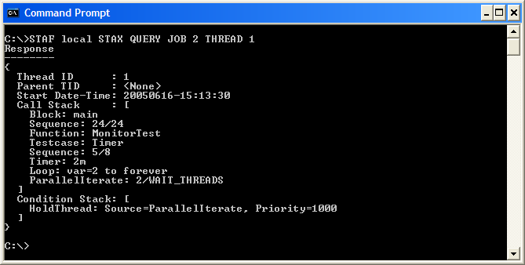
Debugging STAX Jobs (cont.)
Use STAX LIST/QUERY requests. In particular, querying a particular thread in a job shows the call stack.
STAF local STAX QUERY JOB <Job ID> THREAD <Thread ID>

Slide 119
Part 2C – Break/LAB (15 min.)
Exercises 2.6-2.7

Slide 120
Questions and Additional Topics

Slide 121
End of Presentation
End of Presentation

Slide 122
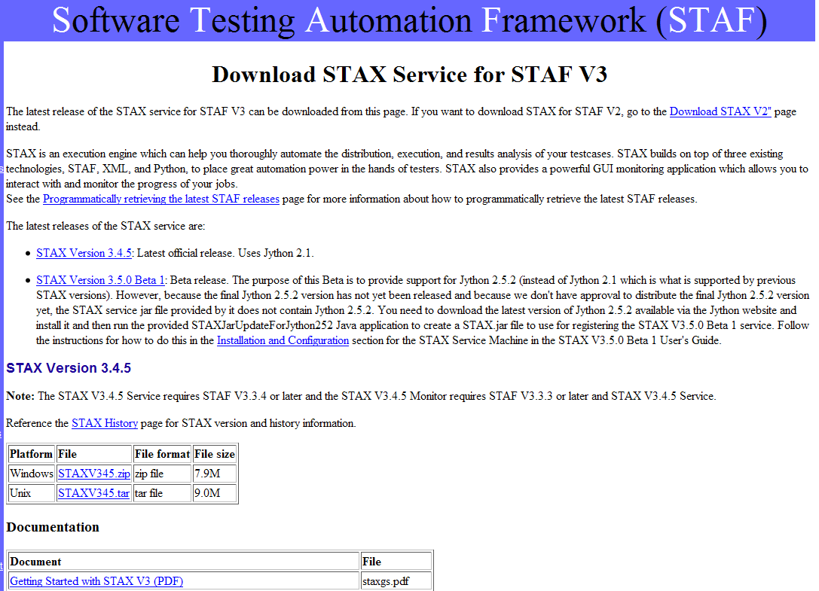
http://staf.sourceforge.net/getstax.php

Slide 123
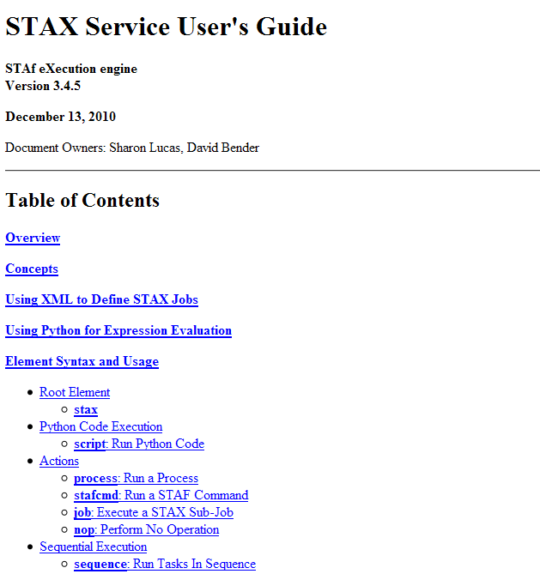
STAX Service User’s Guide

