Slide 1
Hands-on Automation with STAF/STAX
Part 3

Slide 2
Part 3 Agenda (4 hours)
PART 3A – Additional STAF Services 1
  FSExt, Zip
  Monitor, ResPool
  Trust, Service
  Delay, Misc
  LifeCycle
  Break/LAB 3A (Exercise 3.1)
PART 3B – Additional STAF Services 2
  Namespace
  Email, Event
  EventManager
  Cron
  HTTP
  FTP
  Break/LAB 3B (Exercise 3.2)
PART 3C – Advanced Topics 1
  Writing custom STAF services
  STAF Support for C++, Perl, Python, and Tcl Testcases
  STAF Support for Ant
  STAF Support for shell-scripts
  Marshalled Data
  Private Data
  Break/LAB 3C (Exercise 3.3)
PART 3D – Advanced Topics 2
  Automation Tasks
  End-to-end Automation with STAF
  Keys to successful STAF/STAX deployment
  STAF Eclipse Plug-in
  Contributing to STAF
  Break

Slide 3
Part 3A – Additional STAF Services 1

Slide 4
FSExt service
The purpose of the FSExt service is to provide some tools to perform extended
file system requests which may be useful in automation environments
It provides the capabilities to compare files and directories, search for strings within files, and search for strings on particular lines in a file

Slide 5
FSExt service - Syntax
COMPAREDIR DIR <Directory> FILE <File> [FILE <File>]... [EXISTS]
[ATTEMPTS <Num Attempts> [INTERVAL <Polling Interval>]]
FILECONTAINS FILE <File> STRING <String> [STRING <String>]... [NOT]
[IGNORECASE] [SAVEONFAILURE]
LINECONTAINS FILE <File> STRING <String> [STRING <String>]... [IGNORECASE]
[SAVEONFAILURE] [LINENUMBER <Line #>]
PROCESSFILE [MODE <capture | compare>] FILE1 <File1> FILE2 <File2> [SORT]
[SAVEONFAILURE]
SUBSTITUTE FILE <File> [TOFILE <File>] [TOMACHINE <Machine>]
[FAILIFNEW | FAILIFEXISTS]
WAITFORFILE FILE <File> [TIMEOUT <Max Wait Time>]
[INTERVAL <Polling Interval>] [NOT]

Slide 6
FSExt service - Examples
FSExt COMPAREDIR DIR C:/tests/testA FILE testA.exe FILE help.txt
Response
--------
This example checks if directory C:/tests/testA contains only files testA.exe and help.txt
FSExt FILECONTAINS FILE C:/results/testA.out STRING Success
Response
--------
This example checks if file C:/results/testA.out contains string "Success"
FSExt FILECONTAINS FILE C:/results/testC.out NOT STRING Error STRING Failure
STRING "Warning: " IGNORECASE
Response
--------
This example checks if file C:/results/testC.out does not contain strings "Error", "Failure", or "Warning: ", performing a case-insensitive search for these strings

Slide 7
FSExt service – Examples (cont.)
FSExt FILECONTAINS FILE C:/results/testB.out STRING "Success!!!" IGNORECASE LINENUMBER -1
This example checks if file C:/results/testB.out contains string "Success!!!" in the last line of the file (via a case-insensitive search)
Response
--------
Line Number: 54
Line : success!!!
FSExt SUBSTITUTE FILE C:/tests/testA.txt TOFILE D:/testA/testA.bat
TOMACHINE client1 FAILIFEXISTS
Response
--------
This example substitutes any STAF variables in file C:/tests/testA.txt with their respective values, copying this modified file to file D:/testA/testA.bat on machine client1, failing if file D:/testA/testA.bat already exists on machine client1
FSExt WAITFORFILE FILE C:/results/testB.out TIMEOUT 300000 INTERVAL 60000
Response
--------
This example waits for up to 5 minutes for file C:/results/testB.out to exist, checking every minute to see if the file exists

Slide 8
Zip service
The purpose of the Zip service is to allow a test case to easily work with Zip archives
By using of Zlib compression library, the Zip service can create, extract, delete and manage PKZip, WinZip and Jar compatible archives

Slide 9
Zip service - Syntax
UNZIP ZIPFILE <Name> TODIRECTORY <Name>
[FILE <Name>]... [DIRECTORY <Name>]...
[RESTOREPERMISSION] [REPLACE]
ADD ZIPFILE <Name> < FILE <Name> | DIRECTORY <Name> [RECURSE] >
[RELATIVETO <Directory>]
DELETE ZIPFILE <Name> FILE <Name> [FILE <Name>]... CONFIRM
LIST ZIPFILE <Name>

Slide 10
Zip service - Examples
ZIP ADD ZIPFILE D:/myzip.zip FILE C:/file.txt
Response
--------
This example adds file C:/file.txt to Zip archive D:/myzip.zip
ZIP ADD ZIPFILE /myzip.zip DIRECTORY /opt/mydir RECURSE RELATIVETO /opt
Response
--------
This example adds directory /opt/mydir and all its subdirectories and files to Zip archive, relative to directory /opt
ZIP UNZIP ZIPFILE C:/tests/myzip.zip TODIRECTORY D:/mydata/
Response
--------
This example unzips an archive C:/tests/myzip.zip to folder D:/mydata
ZIP UNZIP ZIPFILE /opt/myzip.zip TODIRECTORY /usr/lpp/mydata/ FILE
/myjava/Hello.java RESTOREPERMISSION REPLACE
Response
--------
This example unzips the file myjava/Hello.java from myzip.zip to folder /usr/lpp/mydata, restores permission attributes, and replaces the file if it already exists

Slide 11
Zip service – Examples (cont.)
ZIP LIST ZIPFILE /usr/local/staf/services/STAXV300.zip
Response
--------
Length Method Size Ratio Date Time CRC-32 Name
------- ------ ------- ----- -------- ----- -------- ------------------------
30745 Defl:N 9575 31% 04-02-04 11:16 cfd0aacb History
27227 Defl:N 24653 90% 04-02-04 11:16 c03ffb2c STAFEvent.jar
2566524 Defl:N 2501266 97% 04-02-04 11:16 e1f6f392 STAX.jar
185037 Defl:N 172931 93% 04-02-04 11:16 51b7700d STAXMon.jar
0 Stored 0 0% 04-02-04 11:16 00000000 libraries/
58695 Defl:N 11009 18% 04-02-04 11:16 0142b502 libraries/STAXUtil.html
82953 Defl:N 15887 19% 04-02-04 11:16 349eee04 libraries/STAXUtil.xml
2453 Defl:N 1082 44% 04-02-04 11:16 a98db290 readme.1st
0 Stored 0 0% 04-02-04 11:16 00000000 samples/
5274 Defl:N 826 15% 04-02-04 11:16 277d4fb7 samples/FunctionList.xsl
11140 Defl:N 2959 26% 04-02-04 11:16 8584d238 samples/sample1.xml
764931 Defl:N 512404 66% 04-02-04 11:16 8165dd0c staxug.pdf
ZIP DELETE ZIPFILE /opt/myzip.zip FILE myjava/Hello.java FILE bin/run CONFIRM
Response
--------
This example deletes files myjava/Hello.java and bin/run from Zip archive /opt/myzip.zip

Slide 12
Monitor service
The purpose of the Monitor service is to give a test case the ability to write
status messages
This allows someone to query a process or workload and easily get the current
status
The Monitor service only keeps the last monitor message it receives from a
particular machine and process
A "centralized network clipboard" is a term that could be used to describe the
Monitor service

Slide 13
Monitor service - Syntax
LOG MESSAGE <Message> [NAME <Name>] [RESOLVEMESSAGE | NORESOLVEMESSAGE]
QUERY MACHINE <Machine> < HANDLE <Handle> | NAME <Name> >
LIST <MACHINES | [MACHINE <Machine>] [NAMES] | SETTINGS>
DELETE [BEFORE <Timestamp> | MACHINE <Machine> NAME <Name>] CONFIRM
SET [RESOLVEMESSAGE | NORESOLVEMESSAGE]
[MAXRECORDSIZE <Size>]
[ENABLERESOLVEMESSAGEVAR | DISABLERESOLVEMESSAGEVAR]

Slide 14
Monitor service - Examples
MONITOR LOG MESSAGE "Step1 in Test1 initiated on bootdrive
{STAF/Config/BootDrive}"
Response
--------
This example shows the request a testcase would make to update its monitor message
MONITOR QUERY MACHINE automate.austin.ibm.com HANDLE 32
Response
--------
Date-Time: 20040911-16:00:32
Message : Testcase aborted with error "255"
Show me the monitor message from machine automate.austin.ibm.com and process handle 32
MONITOR QUERY MACHINE testmachine1 HANDLE 85
Response
--------
Date-Time: 20041022-17:58:01
Message : TestC: Step 2 of 5
In this example notice that we are using the machine nickname

Slide 15
Monitor service – Examples (cont.)
MONITOR LIST MACHINES
Response
--------
automate.austin.ibm.com
testmachine1
Show me all the machines that have written monitor data
MONITOR LIST MACHINE automate.austin.ibm.com
Response
--------
Handle Date-Time Size
------ ----------------- ----
34 20040910-16:29:03 30
36 20040910-16:29:13 148
37 20040910-16:29:19 97
68 20040911-16:00:32 43
Show me all the STAF handles for machine automate.austin.ibm.com that have logged monitor information
MONITOR DELETE BEFORE today CONFIRM
Response
--------
This example deletes delete all data prior to the current system date

Slide 16
Monitor service – Examples (cont.)
MONITOR LOG MESSAGE "TestW: Step 32 of 109" NAME ActiveXYZRequests
Response
--------
This example shows the request to update the message for a named monitor
MONITOR QUERY MACHINE automate.austin.ibm.com NAME ActiveXYZRequests
Response
--------
Date-Time: 20070625-08:24:01
Message : TestW: Step 32 of 109
Show me the monitor message from machine automate.austin.ibm.com with monitor name ActiveXYZRequests
MONITOR LIST MACHINE automate.austin.ibm.com NAMES
Response
--------
Name Date-Time Size
----------------- ----------------- ----
ActiveXYZRequests 20061205-13:50:06 39
test1 20061205-13:54:14 25
Show me all the named monitors for machine automate.austin.ibm.com

Slide 17
ResPool service
The purpose of the Resource Pool service is to manage exclusive access to the entries within resource pools
For example, if you had a group of VM UserIDs and passwords for a particular VM system that needed to be shared amongst numerous testcases, you could create a resource pool for them and then testcases that required a logon to that VM system could request a UserID and password from this resource pool, perform the test, and then release the UserID and password back to the resource pool

Slide 18
ResPool service - Syntax
CREATE POOL <PoolName> DESCRIPTION <Pool Description>
DELETE POOL <PoolName> CONFIRM [FORCE]
LIST [POOLS | SETTINGS]
ADD POOL <PoolName> ENTRY <Value> [ENTRY <Value>]...
REMOVE POOL <PoolName> ENTRY <Value> [ENTRY <Value>]... CONFIRM [FORCE]
QUERY POOL <PoolName>
REQUEST POOL <PoolName>
[FIRST | RANDOM | ENTRY <Value>] [PRIORITY <Number>]
[TIMEOUT <Number>[s|m|h|d|w]] [GARBAGECOLLECT <Yes | No>]
RELEASE POOL <PoolName> ENTRY <Value> [FORCE]
CANCEL POOL <PoolName>
[FORCE [MACHINE <Machine>] [HANDLE <Handle #> | NAME <Handle Name>]]
[ENTRY <Value>] [PRIORITY <Priority>] [FIRST | LAST]

Slide 19
ResPool service – Static Handles
Since handles are garbage collected, for the following examples we will need to create a static handle, so that subsequent requests to the ResPool service will all use the same handle. For example:
STAF local HANDLE CREATE HANDLE NAME MyHandle
Response
--------
33
This command created static handle 33.
set STAF_STATIC_HANDLE=33

Slide 20
ResPool service - Examples
RESPOOL CREATE POOL AUSVMR DESCRIPTION "UserIDs/Passwords for VM System AUSVMR“
Response
--------
This example creates a resource pool called AUSVMR
RESPOOL ADD POOL AUSVMR ENTRY "User1 Password1" ENTRY "User2 Password2"
Response
--------
This example adds the entries "User1 Password1" and "User2 Password2" to resource pool AUSVMR
RESPOOL ADD POOL VMware_Licenses ENTRY 1047923
Response
--------
This example adds entry 1047923 to resouce pool VMware_Licenses
RESPOOL REMOVE POOL AUSVMR ENTRY "User1 Password1" CONFIRM
Response
--------
This example removes entry "User1 Password1" from resource pool AUSVMR, but only if the entry is not currently owned

Slide 21
ResPool service – Examples (cont.)
RESPOOL REMOVE POOL VMware_Licenses ENTRY 1137849 ENTRY 107523 CONFIRM FORCE
Response
--------
This example removes entries 1137849 and 1075234 from resource pool VMware_Licenses regardless of whether the are currently owned
RESPOOL REQUEST POOL AUSVMR FIRST
Response
--------
User1 Password1
This example requests, and wait indefinitely for, the first available entry from resource pool AUSVMR
RESPOOL REQUEST POOL VMware_Licenses TIMEOUT 300000
Response
--------
1047923
This example requests a random entry from resource pool VMware_Licenses. If no entry is available within five minutes (300 seconds), timeout

Slide 22
ResPool service – Examples (cont.)
RESPOOL RELEASE POOL AUSVMR ENTRY "User2 Password2"
Response
--------
This example releases exclusive access of entry "User2 Password2" to resource pool AUSVMR
RESPOOL RELEASE POOL VMware_Licenses ENTRY 1137849 FORCE
Response
--------
This example forces the release of entry 1137849 which is a member of resource pool VMware_Licenses
RESPOOL DELETE POOL AUSVMR CONFIRM
Response
--------
This example deletes resource pool AUSVMR, but only if there are no pending requests

Slide 23
ResPool service – Examples (cont.)
RESPOOL QUERY POOL AUSVMR
Response
--------
{
Description : UserIDs/Passwords for VM System AUSVMR
Pending Requests: []
Resources : [
{
Entry: USER1 PASSWORD1
Owner: {
Machine : client3.austin.ibm.com
Handle Name : CM2_Test
Handle : 19
User : none://anonymous
Endpoint : tcp://client3.austin.ibm.com@6500
Date-Time Requested: 20041030-15:58:30
Date-Time Acquired : 20041030-15:58:30
}
}
{
Entry: USER3 PASSWORD3
Owner: <None>
}
]
}

Slide 24
Sem service
The SEM service allows you to manipulate and manage two kinds of semaphores
  A mutex semaphore allows you to synchronize access to a particular resource
  An event semaphore is a signaling mechanism used to synchronize two or more tasks

Slide 25
Sem service - Syntax
REQUEST MUTEX <Name> [TIMEOUT <Number>[s|m|h|d|w]] [GARBAGECOLLECT <Yes | No>]
RELEASE MUTEX <Name> [FORCE]
POST EVENT <Name>
RESET EVENT <Name>
PULSE EVENT <Name>
WAIT EVENT <Name> [TIMEOUT <Number>[s|m|h|d|w]]
DELETE MUTEX <Name> | Event <Name>
QUERY MUTEX <Name | Event <Name>
LIST MUTEX | EVENT

Slide 26
Sem service – Static Handles
Since handles are garbage collected, for the following examples we will need to create a static handle, so that subsequent requests to the Sem service will all use the same handle. For example:
STAF local HANDLE CREATE HANDLE NAME MyHandle
Response
--------
33
This command created static handle 33.
set STAF_STATIC_HANDLE=33

Slide 27
Sem service - Examples
SEM REQUEST MUTEX Printers/Printer1
Response
--------
This example requests exclusive access to mutex semaphore Printers/Printer1
SEM RELEASE MUTEX Printers/Printer1
Response
--------
This example releases exclusive access to mutex semaphore Printers/Printer1
SEM POST EVENT Server1/LAN_Started
Response
--------
This example posts event semaphore Server1/LAN_Started
SEM RESET EVENT Coffee/Ready
Response
--------
This example resets event semaphore Coffee/Ready

Slide 28
Sem service – Examples (cont.)
SEM PULSE EVENT Race/StartLap
Response
--------
This example pulses event semaphore Race/StartLap
SEM WAIT EVENT Coffee/Ready WAIT 20000
Response
--------
This example waits a maximum of 20 seconds for event semaphore Coffee/Ready
SEM DELETE EVENT Shutdown_The_Lab
Response
--------
This example deletes the event semaphore Shutdown_The_Lab
SEM LIST EVENT
Response
--------
Name State Waiters
------------------- ------ -------
Coffee/Ready Posted 0
Server1/LAN_Started Reset 5
Shutdown_The_Lab Reset 0
This example obtains a list of the of event semaphores

Slide 29
Sem service – Examples (cont.)
SEM QUERY EVENT Server1/LAN_Started
Response
--------
{
State : Posted
Last Posted: {
Machine : machine1.austin.ibm.com
Handle Name: STAF/Client
Handle : 20
User : none://anonymous
Endpoint : tcp://machine1.austin.ibm.com@6500
Date-Time : 20041026-23:59:51
}
Last Reset : {
Machine : server2.austin.ibm.com
Handle Name: myHandle
Handle : 17
User : IBM://Tester1@us.ibm.com
Endpoint : tcp://server2.austin.ibm.com@6500
Date-Time : 20041026-23:59:15
}
Waiters : []
}

Slide 30
Trust service
The Trust service allows you to query and set the trust entries for both machines and/or userids

Slide 31
Trust service - Syntax
SET <MACHINE <Machine> | USER <User> | DEFAULT> LEVEL <Level>
GET MACHINE <Machine> [USER <User>]
DELETE MACHINE <Machine> | USER <User>
LIST

Slide 32
Trust service - Examples
TRUST SET MACHINE local://local LEVEL 5
Response
--------
This example sets the trust level for local requests to 5
TRUST SET DEFAULT LEVEL 1
Response
--------
This example sets the default trust level to 1
TRUST SET MACHINE client1.austin.ibm.com LEVEL 5
Response
--------
This example sets the trust level to 5 for machine *://client1.austin.ibm.com (e.g. a machine with host name client1.austin.ibm.com using any network interface)
TRUST SET MACHINE 9.3.224.16 LEVEL 5
Response
--------
This example sets the trust level to 5 for machine *://93.224.16 (e.g. a machine with IP address 9.3.224.16 using any network interface)

Slide 33
Trust service – Examples (cont.)
TRUST SET MACHINE tcp2://9.3.224.* LEVEL 3
Response
--------
This example sets the trust level to 3 for a group of machines using network interface tcp2 and with IP addresses that begin with "9.3.224."
TRUST SET MACHINE *.austin.ibm.com LEVEL 2
Response
--------
This example sets the trust level to 2 for a group of machines with host names that end with ".austin.ibm.com" using any network interface
TRUST SET MACHINE tcp*://*.site.com LEVEL 2
Response
--------
This example sets the trust level to 2 for a group of machines using a network interface that begins with tcp and with host names that end with ".site.com"
TRUST GET MACHINE 9.3.224.16
Response
--------
5
This example gets the trust level for machine 9.3.224.16 (using the default network interface)

Slide 34
Trust service – Examples (cont.)
TRUST LIST
Response
--------
Type Entry Trust Level
------- ----------------------------- -----------
Default <None> 1
Machine *://*.austin.ibm.com 2
Machine *://9.31.73.14* 3
Machine *://9.31.73.147 5
Machine *://client1.austin.ibm.com 5
Machine *://client3.austin.ibm.com 3
Machine local://local 5
Machine tcp://client2.austin.ibm.com 0
TRUST DELETE MACHINE client1.austin.ibm.com
Response
--------
This example deletes the trust entry for machine *://client1.austin.ibm.com

Slide 35
Service service
The Service service allows you to:
  Display information about the services, service loaders, or authenticators
  available on the machine or requests that have been submitted on the
  machine
  Dynamically add or remove external STAF services

Slide 36
Service service - Syntax
LIST [ SERVICES | SERVICELOADERS | AUTHENTICATORS |
REQUESTS <[PENDING] [COMPLETE] [LONG]> | [SUMMARY] ]
QUERY SERVICE <Service Name> | SERVICELOADER <ServiceLoader Name> |
AUTHENTICATOR <Authenticator Name> | REQUEST <Request Number>
ADD SERVICE <Service Name> LIBRARY <Library Name>
[EXECUTE <Executable>] [OPTION <Name[=Value]>]...
[PARMS <Parameters>]
REMOVE SERVICE <Service Name>
FREE REQUEST <Request Number> [FORCE]

Slide 37
Service service – Examples
SERVICE LIST SERVICES
Response
--------
Name Library Executable
-------- ---------- -------------------------------------DELAY <Internal> <None>
DIAG <Internal> <None>
ECHO <Internal> <None>
EVENT JSTAF C:\STAF\services\stax\STAFEvent.jar
FS <Internal> <None>
HANDLE <Internal> <None>
HELP <Internal> <None>
MISC <Internal> <None>
PING <Internal> <None>
PROCESS <Internal> <None>
QUEUE <Internal> <None>
SEM <Internal> <None>
SERVICE <Internal> <None>
SHUTDOWN <Internal> <None>
STAX JSTAF C:\STAF\services\stax\STAX.jar
TRACE <Internal> <None>
TRUST <Internal> <None>
VAR <Internal> <None>

Slide 38
Service service – Examples (cont.)
SERVICE ADD SERVICE STAX LIBRARY JSTAF EXECUTE C:\STAF\services\stax\STAX.jar
Response
--------
This example adds a service named “STAX” using the C:\STAF\services\stax\STAX.jar file
SERVICE REMOVE SERVICE STAX
Response
--------
This example removes the STAX service
SERVICE LIST REQUESTS
Response
--------
Request# Start Date-Time Service Request
-------- ----------------- ------- ------------------------------------------
39 20050321-16:33:03 QUEUE GET WAIT
63 20050321-16:33:03 QUEUE GET WAIT 10000
102 20050321-16:34:42 QUEUE GET WAIT 120000 TYPE ProductA/Test2/Status
165 20050321-16:34:52 DELAY DELAY 60000
106 20050321-16:34:58 SERVICE LIST REQUESTS
This example lists all the pending requests on a machine

Slide 39
Delay service
A DELAY request to the Delay service simply sleeps for a specified amount of time (in milliseconds, seconds, minutes, hours, days, or weeks) before returning to the calling program

Slide 40
Delay service – Syntax and Examples
DELAY <Number>[s|m|h|d|w]
DELAY DELAY 30s
Response
--------
This example delays 30 seconds before returning from STAFProc

Slide 41
Misc service
The Misc service provides a home for miscellaneous commands

Slide 42
Misc service - Syntax
VERSION
WHOAMI
WHOAREYOU
LIST INTERFACES | SETTINGS | ENDPOINTCACHE | PROPERTIES
QUERY INTERFACE <Name>
SET [CONNECTATTEMPTS <Number>] [CONNECTRETRYDELAY <Number>[s|m|h|d|w]]
[MAXQUEUESIZE <Number>] [HANDLEGCINTERVAL <Number>[s|m|h|d]]
[INTERFACECYCLING <Enabled | Disabled>]
[DEFAULTINTERFACE <Name>] [DEFAULTAUTHENTICATOR <Name>]
[RESULTCOMPATIBILITYMODE <Verbose | None>]
PURGE ENDPOINTCACHE <ENDPOINT <Endpoint>... | CONFIRM>

Slide 43
Misc service – Examples
MISC VERSION
Response
--------
3.4.1
This example displays the version of STAF running
MISC WHOAMI
Response
--------
Instance Name : STAF
Instance UUID : 648C8241CC0B00000929359375636173
Request Number : 1812
Interface : tcp
Logical ID : server1.austin.ibm.com
Physical ID : 9.41.53.147
Endpoint : tcp://server1.austin.ibm.com@6500
Machine : server1.austin.ibm.com
Machine Nickname: Server1
Local Request : No
Handle : 33
Handle Name : myHandle
User : authSample://User1
Trust Level : 5
This example displays information about who the remote system thinks you are.
This can be useful in debugging trust issues and other problems.

Slide 44
Misc service – Examples (cont.)
MISC WHOAREYOU
Response
--------
Instance Name : STAF
Instance UUID : 648C8241CC0B00000929359375636173
Machine : server1.austin.ibm.com
Machine Nickname: Server1
Local Request : No
Current Date-Time: 20110124-14:15:17
This example displays information about the machine to which the request is sent

Slide 45
Misc service – Examples (cont.)
MISC LIST INTERFACES
Response
--------
[
{
Interface Name: local
Library : STAFLIPC
Options : {
IPCName: STAF
}
}
{
Interface Name: tcp
Library : STAFTCP
Options : {
ConnectTimeout: 5000
Port : 6500
Protocol : IPv4
}
}
]
This example lists all enabled interfaces (a.k.a. Connection Providers)

Slide 46
Misc service – Examples (cont.)
MISC LIST PROPERTIES
Response
--------
version : 3.4.4
platform : win32
architecture: 32-bit
installer : IA
file : STAF344-setup-win32.exe
osname : Windows
osversion : *
osarch : x86
This example displays the install properties for STAF

Slide 47
LifeCycle service
The LifeCycle service allows STAF service requests to be run when STAFProc
starts up or shuts down
  The registrations for the LifeCycle service are persistent
  This means that if STAF is shutdown and restarted (or if the machine is rebooted), the prior registration information for the LifeCycle service will still exist
When STAFProc starts, it reads in the existing registration data and executes the enabled registered STAF service requests with the "Startup" phase specified
When STAFProc is shutdown, it reads in the existing registration data and executes the enabled registered STAF service requests with the "Shutdown" phase specified

Slide 48
LifeCycle service - Syntax
REGISTER PHASE <Startup | Shutdown>
MACHINE <Machine> SERVICE <Service> REQUEST <Request>
[PRIORITY <Priority>] [DESCRIPTION <Desription>]
UNREGISTER ID <Registration ID>
UPDATE ID <Registration ID> [PRIORITY <Priority>]
[MACHINE <Machine>] [SERVICE <Service>] [REQUEST <Request>]
[PHASE <Startup | Shutdown>] [DESCRIPTION <Description>]
LIST [PHASE <Startup | Shutdown>] [LONG]
QUERY ID <Registration ID>
TRIGGER <ID <Registration ID> | PHASE <Startup | Shutdown>> CONFIRM
ENABLE ID <Registration ID>
DISABLE ID <Registration ID>

Slide 49
LifeCycle service - Examples
LIFECYCLE REGISTER PHASE Startup MACHINE client1.company.com SERVICE Process
REQUEST "START SHELL COMMAND C:/tests/TestA.exe" DESCRIPTION "Start TestA"
Response
--------
1
This example registers to start a process that runs command "C:/tests/TestA.exe" on machine client1.company.com whenever STAFProc starts up
LIFECYCLE REGISTER PHASE Startup MACHINE server1 SERVICE STAX REQUEST
"EXECUTE FILE /tests/TestA.xml ARGS \"{'testMach': 'client1',
'serverMach': 'server1'}\""
Response
--------
2
This example registers to run STAX job /test/TestA.xml on machine server1 whenever STAFProc starts up, passing the STAX job's main function a Python map of arguments
LIFECYCLE UNREGISTER ID 1
Response
--------
This example unregisters the service request with registration ID 1.

Slide 50
LifeCycle service – Examples (cont.)
LIFECYCLE UPDATE ID 2 PRIORITY 25 DESCRIPTION "Run TestA"
Response
--------
This example update the priority of registration ID 2 to have priority 25 and description "Run TestA"
LIFECYCLE LIST
This example lists all the registrations for the LifeCycle service
Response
--------
Phase P ID State Machine Service Request
------- -- -- ------- ------- ------- -----------------------------------------
Startup 25 1 Enabled local PROCESS START SHELL COMMAND C:/tests/TestA.exe
Startup 25 4 Enabled client1 PROCESS START SHELL COMMAND C:/test/TestB.exe WAI
T
Startup 40 3 Disable local PROCESS START SHELL COMMAND C:/test/TestC.exe WAI
d T
Startup 50 5 Enabled server1 STAX EXECUTE FILE C:/stax/jobA.xml
Shutdow 25 2 Enabled local PROCESS START SHELL COMMAND C:/tests/TestTerm.exe
n
Shutdow 50 6 Enabled server1 STAX EXECUTE FILE C:/stax/jobTerm.xml
n

Slide 51
LifeCycle service – Examples (cont.)
LIFECYCLE QUERY ID 5
Response
--------
Phase : Startup
Priority : 50
ID : 5
State : Enabled
Machine : server1
Service : STAX
Request : EXECUTE FILE C:/stax/jobA.xml
Description: Run STAX JobA
This example queries registration ID 5 for the LifeCycle service
LIFECYCLE TRIGGER ID 5 CONFIRM
This example submits the STAF service request specified for registration ID
Response
---------
Machine: server1
Service: STAX
Request: EXECUTE FILE C:/stax/jobA.xml
RC : 0
Result : 4

Slide 52
LifeCycle service – Logging
The LifeCycle service maintains a machine log where it writes an entry when
the following occurs:
  A REGISTER request is received
  When STAFProc is started/shutdown or when a TRIGGER PHASE
  Startup/shutdown request is submitted
  When a TRIGGER ID request for a registration is submitted or a TRIGGER
  PHASE request is submitted
  When an UPDATE, ENABLE, or DISABLE request is received
  An UNREGISTER request is received
The logname for the LifeCycle service is LIFECYCLE

Slide 53
Part 3A – Break/LAB (20 min.)
Exercise 3.1

Slide 54
Part 3B – Additional STAF Services 2

Slide 55
Namespace service
The Namespace service provides a namespace hierarchy for storing and retrieving a persistent repository of variables
It allows the creation of namespaces and allows you to set key/value pairs (e.g. variables) in a namespace
Unlike the VAR service, any variables set in a namespace will persist across stops and restarts of STAF with no additional steps required by the user

Slide 56
Namespace service - Syntax
CREATE NAMESPACE <Name> DESCRIPTION <Description> [PARENT <Name>]
MODIFY NAMESPACE <Name> [DESCRIPTION <Description>] [PARENT <Name>]
DELETE NAMESPACE <Name> < VAR <Key>... | CONFIRM >
LIST [NAMESPACES | <NAMESPACE <Name> [ONLY]>]
QUERY NAMESPACE <Name> [TREE]
SET VAR <Key=Value> [VAR <Key=Value>]... NAMESPACE <Name>
GET VAR <Key> NAMESPACE <Name>

Slide 57
Namespace service - Examples
NAMESPACE CREATE NAMESPACE AIS DESCRIPTION "Global AIS Namespace"
Response
--------
This example creates a new namespace named "AIS" which exists as the top of a namespace hierarchy
NAMESPACE CREATE NAMESPACE WebSphereSVT PARENT AIS
DESCRIPTION "WebSphere SVT Namespace"
Response
--------
This example creates a new namespace named "WAS" which inherits variables from the "AIS" namespace
NAMESPACE SET VAR WASSVTVar1=WASSVTValue1 VAR GlobalVar2=OverrideGlobalValue2
NAMESPACE WebSphereSVT
Response
--------
This example sets multiple variables in the "WebSphereSVT" namespace

Slide 58
Namespace service – Examples (cont.)
NAMESPACE GET VAR GlobalVar2 NAMESPACE WebSphereSVT
Response
--------
OverrideGlobalValue2
This example gets the value for the variable with key "GlobalVar2" starting in the "WebSphereSVT" namespace
NAMESPACE LIST NAMESPACE WebSphereSVT ONLY
Response
--------
GlobalVar2 OverrideGlobalValue2 WebSphereSVT
WASSVTVar1 WASSVTValue1 WebSphereSVT
This example lists only the variables defined in the WebSphereSVT namespace
NAMESPACE QUERY NAMESPACE AIS
Response
--------
{
Name : AIS
Description: Global AIS Namespace
Parent :
Children : [
WebSphereSVT
]
}
This example shows detailed information about namespace AIS

Slide 59
Email service
The Email service will send an email message to a list of recipients
Multiple attachments (both text and binary) are supported, and you may specify whether the message body content type is text/plain or text/html

Slide 60
Email service – Configuration Parameters
SERVICE <EmailName> LIBRARY JSTAF EXECUTE <Service Jar File Name> \
PARMS "MAILSERVER <mailserver> [PORT <mailport>] \
[BACKUPMAILSERVERS \"<Space-separated list of mail servers>\"] \
[CONTENTTYPE <contenttype>] \
[RESOLVEMESSAGE | NORESOLVEMESSAGE]"
MAILSERVER is the mail server through which the email will be sent
PORT is the port through which the mail server will be accessed (default port is 25)
CONTENTTYPE specifies the default content type to be used for the message body. The valid values are "text/plain“ (default) and "text/html“.
RESOLVEMESSAGE | NORESOLVEMESSAGE specifies whether to resolve the
MESSAGE option for STAF variables
BACKUPMAILSERVERS specifies the backup mail servers to use if an error is encountered when using the primary mail server
IBM Users of the Email service must use one of the official SMTP mail servers:
  North America – na.relay.ibm.com
  EMEA – emea.relay.ibm.com
  AP – ap.relay.ibm.com
  Latin America – la.relay.ibm.com

Slide 61
Email service – Syntax
SEND < TO <Address> | CC <Address> | BCC <Address> >...
[FROM <user@company.com>] [CONTENTTYPE <ContentType>]
< MESSAGE <Message> | FILE <File> [MACHINE <Machine>] >
[SUBJECT <Subject>] [NOHEADER] [TEXTATTACHMENT <File>]...
[BINARYATTACHMENT <File>]... [ATTACHMENTMACHINE <Machine>]
[RESOLVEMESSAGE | NORESOLVEMESSAGE]
[AUTHUSER <User> AUTHPASSWORD <Password>]
LIST SETTINGS
SET [MAILSERVER <MailServer>]
[PORT <MailPort>]
[BACKUPMAILSERVERS <Space-separated list of backup mailservers>]
[CONTENTTYPE <ContentType>]
[RESOLVEMESSAGE | NORESOLVEMESSAGE]

Slide 62
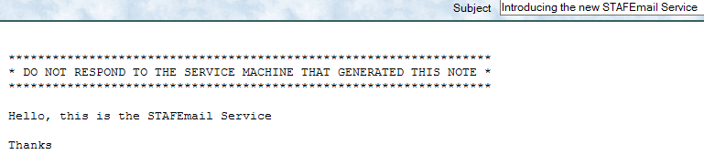
Email service - Examples
SERVICE email LIBRARY JSTAF EXECUTE c:/staf/services/email/STAFEmail.jar \
PARMS "MAILSERVER na.relay.ibm.com"
EMAIL SEND TO user1@us.ibm.com TO user2@us.ibm.com MESSAGE "Hello, this is the STAFEmail Service\n\nThanks" SUBJECT "Introducing the new STAFEmail Service"
Response
--------
This example sends an email message to two email addresses
Here is a screen capture of the email:

Slide 63
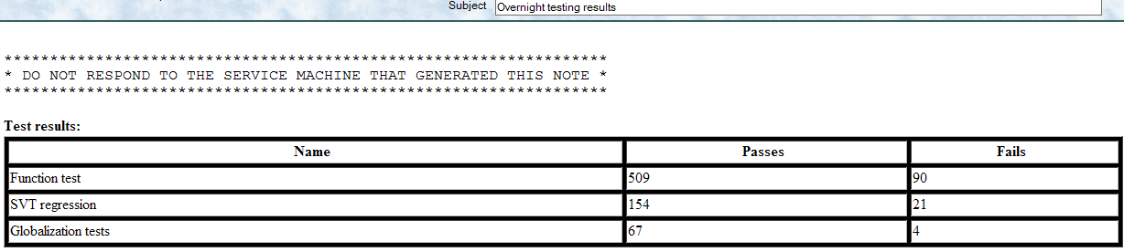
Email service – Examples (cont.)
EMAIL SEND TO user6@us.ibm.com message "Here are the test results" SUBJECT "Test Results" TEXTATTACHMENT G:/projects/test/Results.html BINARYATTACHMENT G:/projects/test/DetailedResults.zip ATTACHMENTMACHINE server1.company.com
Response
--------
This example sends an email message to email address user6@us.ibm.com with two attachments located on a remote machine
EMAIL SEND TO user90@us.ibm.com MESSAGE "<h4>Test results:</h4><table border="1"><tr><th>Name</th><th>Passes</th><th>Fails</th></tr><tr><td>Function test</td><td>509</td><td>90</td></tr><tr><td>SVT regression</td><td>154</td><td>21</td></tr><tr><td>Globalization tests</td><td>67</td><td>4</td></tr></table" CONTENTTYPE text/html SUBJECT "Overnight testing results"
Here is a screen capture of the above email (sent as html content):

Slide 64
Email service – Logging
The Email service maintains a machine log where it writes an entry when
the following occurs:
  The service is registered. The mail server and port number will be included.
  When a SEND request is received. Summary information about the SEND request will be logged. After the SEND request, entries will be logged for each reply from the mail server
The logname for the Email service is the name under which the service is registered

Slide 65
Email service – Logging (cont.)
Here is an example of what an Email service log on machine client1.austin.ibm.com (with the Email service's registered name being email) could look like
LOG QUERY MACHINE client1.austin.ibm.com LOGNAME email
Response
--------
Date-Time Level Message
----------------- ----- --------------------------------------------------------
20050611-16:05:36 Info email service initialized, using mailserver na.relay.ib
m.com port 25
20050611-16:05:51 Info SEND TO [bdavid@us.ibm.com] FROM user@ibm.com SUBJECT T
his is a test TEXTATTACHMENTS [c:/temp/rc0.txt, c:/temp
/perf.txt] BINARYATTACHMENTS [c:/temp/staf1.gif]
20050611-16:05:51 Info 220 d01av01.pok.ibm.com ESMTP Sendmail 8.12.11/8.12.11;
Sat, 11 Jun 2005 17:05:53 -0400
20050611-16:05:51 Info 250 d01av01.pok.ibm.com Hello dave2268.austin.ibm.com [
9.53.53.168], pleased to meet you
20050611-16:05:51 Info 250 2.1.0 user@ibm.com... Sender ok
20050611-16:05:51 Info 250 2.1.5 bdavid@us.ibm.com... Recipient ok
20050611-16:05:51 Info 354 Please start mail input.
20050611-16:05:51 Info 250 Mail queued for delivery.

Slide 66
Event service
The purpose of the EVENT service is to provide an interface to allow process
communication based on events occurring
  For instance, a process registers with the EVENT service that it is
  interested in builds completing
  A different process tell the EVENT service when a build has completed
  The EVENT service then notifies all processes that have registered interest
  in the build completing that the build has completed

Slide 67
Event service - Syntax
REGISTER TYPE <Type> [SUBTYPE <Subtype>]...
[ACKNOWLEDGETIMEOUT <Timeout>] [MAXATTEMPTS <Number>]
PRIORITY <Number>] [PRIORITYDELTA <Number>]
[BYNAME | BYHANDLE]
UNREGISTER TYPE <Type> [SUBTYPE <Subtype>]...
[FORCE [MACHINE <Machine>] [HANDLE <Handle> | NAME <Name>]]
ACKNOWLEDGE EVENTID <Event ID>
[FORCE [MACHINE <Machine>] [HANDLE <Handle> | NAME <Name>]]
GENERATE TYPE <Type> SUBTYPE <Subtype> [PROPERTY <Name>=<Value>]...
LIST TYPES [LONG]
LIST SUBTYPES TYPE <Type>
LIST REGISTRATIONS [TYPE <Type> [SUBTYPE <Subtype>]] [LONG]
LIST EVENTIDS [LONG]
QUERY EVENTID <Event ID> [LONG]
RESET <REG | GEN> FORCE

Slide 68
Event service - Examples
EVENT REGISTER TYPE build
Response
--------
This example registers the requesting process by handle name for events with type build
EVENT REGISTER TYPE build SUBTYPE Linux SUBTYPE AIX SUBTYPE HP-UX
Response
--------
This example registers the requesting process by handle name for events with type build, but only for subtypes Linux, AIX, and HP-UX
EVENT GENERATE TYPE build SUBTYPE Sp
Response
--------
74
This example notifies the Event Service that an event of type "build" and subtype "Sp" has occurred. Note that the Event ID of the generated event is returned.
EVENT GENERATE TYPE build SUBTYPE Sp PROPERTY Version=2.1.0
PROPERTY "Status=Passed BVT"
Response
--------
83
This example notifies the Event Service that an event of type "build" and subtype "Sp" with the following two properties: Version=2.1.0 and Status=Passed BVT

Slide 69
Event service – Examples (cont.)
EVENT UNREGISTER TYPE build
Response
--------
This example unregisters the requesting process by handle name, the default, for all events of TYPE build:
EVENT UNREGISTER TYPE build SUBTYPE sp SUBTYPE fr FORCE MACHINE machA HANDLE 7
Response
--------
This example unregisters the process with handle 7 on machine machA for events of TYPE build, SUBTYPEs sp and fr only
EVENT LIST REGISTRATIONS
Response
--------
Type Subtype Machine Notify By Notifiee
----- ------- ---------------------- --------- ---------------
build Sp client2.austin.ibm.com Name SpanishJavaTest
build <None> client2.austin.ibm.com Name EnglishJavaTest
This example lists all registered processes

Slide 70
EventManager service
The EventManager service allows you to register with the Event service in order
to execute STAF Commands
When an Event is generated, the Event Service (which normally sends
messages to machines registered for specified events) will execute a STAF
Command via the EventManager service
The EventManager service also provides a User Interface to simplify interaction
with the EventManager service
Note that EventManager registration information is persistent data
  This means that if you register with the EventManager service, if you
  shutdown STAF and restart it (even if you reboot the machine), the prior
  registration information will still be active
  When STAF starts, it reads in the previous EventManager registration
  information, and again registers each STAF command with the Event
  service

Slide 71
EventManager service - Syntax
REGISTER [DESCRIPTION <description>]
MACHINE <machine> | PYTHONMACHINE <machine>
SERVICE <service> | PYTHONSERVICE <machine>
REQUEST <request> | PYTHONREQUEST <request>
TYPE <eventType> [SUBTYPE <eventSubType>]
[PREPARE <script>]
[ENABLED | DISABLED]
UNREGISTER ID <registrationID>
LIST <[MACHINE <machine>] [TYPE <eventType>] [LONG | SHORT]> | SETTINGS
TRIGGER ID <registrationID> [SCRIPT <Python code>]...
ENABLE ID <registrationID>
DISABLE ID <registrationID>

Slide 72
EventManager service – Event Generation
When an event is generated with a matching type/subtype, the following Python
variables will be available when the PREPARE, PYTHONMACHINE,
PYTHONSERVICE, and PYTHONREQUEST options are evaluated as python strings:
  eventservice
  eventid
  generatingmachine
  generatingprocess
  generatinghandle
  eventtimestamp
  eventtype
  eventsubtype
In addition, each PROPERTY option name=value pair for the generated event will be set as Python variables
Also, a Python dictionary named "eventinfo" will contain all of the above name/value pairs

Slide 73
EventManager service – Examples
EVENTMANAGER REGISTER MACHINE local SERVICE PROCESS REQUEST
"START COMMAND notepad" TYPE a SUBTYPE b DESCRIPTION “Testing notepad app”
Response
--------
1
This example executes the STAF command "start command notepad" whenever an Event of Type a and Subtype b is generated. Note that the EventManager ID is returned.
EVENTMANAGER REGISTER MACHINE local SERVICE PROCESS PYTHONREQUEST
"'START COMMAND %s' % (mycmd)" TYPE a SUBTYPE b
Response
--------
2
This example executes the command "start command xxx" whenever an Event of Type a and Subtype b is generated (where xxx is a python variable called mycmd, which is set in the Event service GENERATE request).
EVENT GENERATE TYPE a SUBTYPE b PROPERTY mycmd=notepad
Response
--------
14
This example will generate an event (with ID 14) with TYPE a and SUBTYPE b. This will cause the EventManager service to execute the request, and notepad will be started.

Slide 74
EventManager service – Examples (cont.)
EVENTMANAGER UNREGISTER ID 1
Response
--------
This example unregisters the STAF command registered with EventManager ID 1
This example lists information about all the commands registered with the EventManager service
EVENTMANAGER LIST
Response
--------
ID Description Machine Service Request Event Type Event Subtype
-- --------------- ----------- ------- -------------- ----------- -------------
1 Start the Windo client1.aus PROCESS START COMMAND mytype <None>
ws Registry Edi tin.ibm.com regedit
tor
2 <None> client2 PROCESS START COMMAND myType mySubType
/tests/TestA
3 Notify tester t client1.aus EMAIL SEND TO JohnDo manual-test BEGIN:default
hat the manual tin.ibm.com e@us.ibm.com M
test is ready t ESSAGE "Manual
o be executed Test begin"

Slide 75
EventManager service – Examples (cont.)
EVENTMANAGER LIST SHORT
This example lists general information about all the commands registered with the EventManager service
Response
--------
ID Description Machine Service Request
-- ----------------- ---------------------- ------- ---------------------------
1 Start the Windows client1.austin.ibm.com PROCESS START COMMAND regedit
Registry Editor
2 <None> client2 PROCESS START COMMAND /tests/TestA
3 Notify tester tha client1.austin.ibm.com EMAIL SEND TO JohnDoe@us.ibm.com
t the manual test MESSAGE "Manual Test begin"
is ready to be e
xecuted

Slide 76
EventManager service – Examples (cont.)
EVENTMANAGER LIST MACHINE client1.austin.ibm.com TYPE manual-test LONG
This example lists detailed information about all the commands registered with the EventManager service with machine
client1.austin.ibm.com and event type manual-test
Response
--------
[
{
ID : 3
Description : Notify tester that the manual test is ready to be executed
Machine : client1.austin.ibm.com
Machine Type : Literal
Service : EMAIL
Service Type : Literal
Request : SEND TO JohnDoe@us.ibm.com MESSAGE "Manual Test begin"
Request Type : Literal
Event Type : manual-test
Event Subtype : BEGIN:default
Prepare Script: <None>
}]

Slide 77
EventManager service – Logging
The EventManager service maintains a machine log where it writes an entry when
the following occurs:
  A REGISTER request is received
  An event has been generated that matches the type/subtype previously
  specified in a REGISTER request. The log entry will include the STAF
  request number for the submitted STAF command.
  The service receives notification that a submitted STAF command has
  completed. The log entry will include the STAF request number, as well as
  the RC and result from the STAF command.
  An UNREGISTER request is received
The logname for the EventManager service is the name under which the service is registered

Slide 78
EventManager service – Logging (cont.)
Here is an example of what an EventManager service log on machine
client1.austin.ibm.com (with the EventManager service's registered name being
em) could look like
LOG QUERY MACHINE client1.austin.ibm.com LOGNAME em
Response
--------
Date-Time Level Message
----------------- ----- -------------------------------------------------------
20060808-15:33:34 Info [ID=1] [local://local, STAF/Client] Registered a STAF c
ommand. Register request: REGISTER DESCRIPTION :20:Get
the STAF version MACHINE local SERVICE misc REQUEST ver
sion TYPE q SUBTYPE p
20060808-15:33:39 Info [ID=1] [dave2268.austin.ibm.com:2322] Submitted a STAF
command. Event information: type=q subtype=p prepare= e
ventservice=Event eventid=4 generatingmachine=local://l
ocal generatingprocess=STAF/Client generatinghandle=94
eventtimestamp=20060808-15:33:39 properties={} Submitte
d STAF command: STAF local misc version
20060808-15:33:39 Pass [ID=1] [dave2268.austin.ibm.com:2322] Completed a STAF
command. RC=0, Result=3.1.4.1
20060808-15:33:50 Info [ID=1] [local://local, STAF/Client] Unregistered a STAF
command.

Slide 79
EventManager service – EventManagerUI
The EventManager service provides a User Interface to simplify interaction with the
EventManager service
  It is especially useful when registering complex STAF commands with Python code;
  this can have quoting issues when registering at the command line, and the
  EventManager User Interface handles these issues for you
  It also allows you to modify existing registrations (without having to unregister and the re-
  register the updated STAF command), and view the EventManager service's log
To use this UI, after installing and configuring the EventManager service, from a
command prompt enter the following command:
java -jar STAFEventManager.jar
A UI will be displayed which allows you to interact with the EventManager service

Slide 80
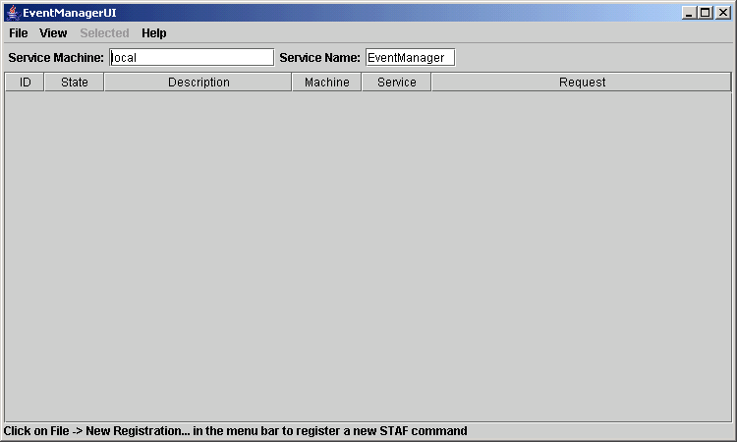
EventManager service – EventManagerUI (cont.)

Slide 81
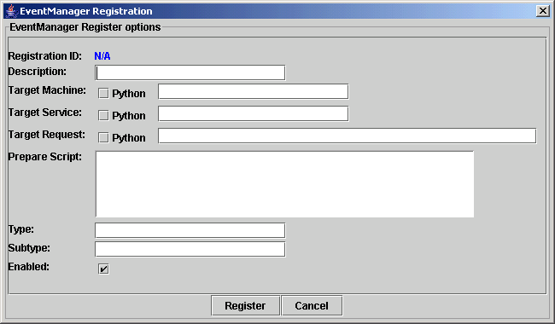
EventManager service – EventManagerUI (cont.)

Slide 82
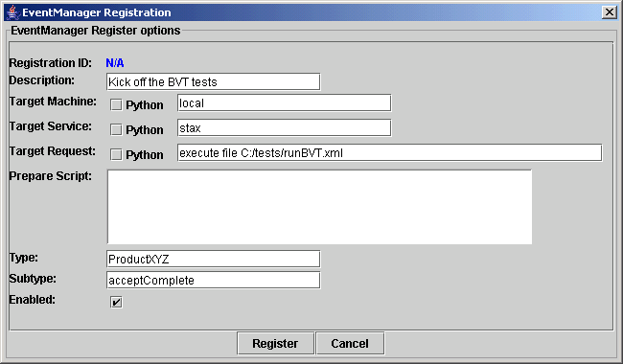
EventManager service – EventManagerUI (cont.)

Slide 83
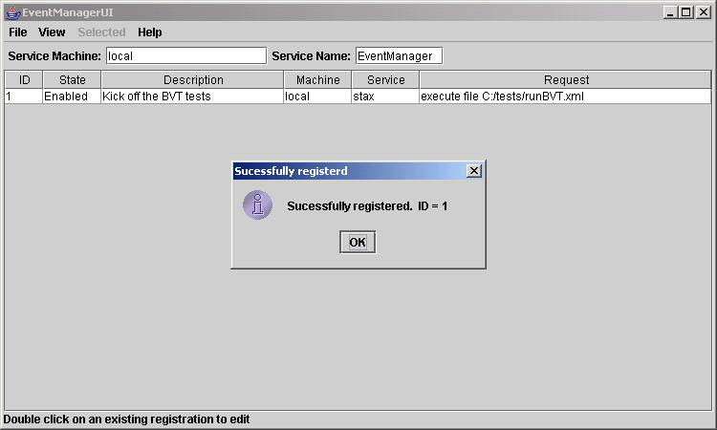
EventManager service – EventManagerUI (cont.)

Slide 84
Cron service
The The Cron service allows you to register STAF commands that will be
executed at a specified time interval(s)
The Cron service also provides a User Interface to simplify interaction with the Cron service
Note that Cron registration information is persistent data
  This means that if you register with the Cron service, if you shutdown
  STAF and restart it (even if you reboot the machine), the prior
  registration information will still be active
  When STAF starts, it reads in the previous Cron registration information, and
  will execute the registered STAF commands at the specified time interval(s)
Note that the Cron service uses its machine's Operating System date/time
information to determine the current date/time in relation to the registered
requests. Users of the Cron service must ensure that the machine on which
the Cron service is running has the correct Operating System date/time (and
that it correctly updates the current date/time relative to Daylight Savings Time).

Slide 85
Cron service - Syntax
REGISTER [DESCRIPTION <description>]
MACHINE <machine> | PYTHONMACHINE <machine>
SERVICE <service> | PYTHONSERVICE <machine>
REQUEST <request> | PYTHONREQUEST <request>
[PREPARE <script>]
[MINUTE <minute>] [HOUR <hour>]
[DAY <day>] [MONTH <month>]
[WEEKDAY <weekday>]
[ONCE]
[ENABLED | DISABLED]
UNREGISTER ID <registrationID>
LIST [MACHINE <machine>] [LONG | SHORT]
TRIGGER ID <registrationID> [SCRIPT <Python code>]...
ENABLE ID <registrationID>
DISABLE ID <registrationID>

Slide 86
Cron service – Examples
CRON REGISTER MACHINE local SERVICE PROCESS REQUEST "START COMMAND notepad"
HOUR 1 DESCRIPTION “Testing notepad app”
Response
--------
1
This example submits request "start command notepad“ to the PROCESS service on the local machine at 1:00AM every day. Note that the Cron ID is returned.
CRON REGISTER MACHINE local SERVICE stax REQUEST "EXECUTE FILE
c:/tests/startall.xml" MONTH 12
Response
--------
2
This example executes a STAX job every December 1st. Note that the registration in this example would only result in the command being executed the next time the month changes to 12. So, if you registered this command on Dec 5, 2004, it would not be executed until 12AM Dec 1 2005.
CRON REGISTER MACHINE local SERVICE PROCESS REQUEST "START COMMAND notepad"
HOUR 1 WEEKDAY Sunday
Response
--------
3
This example submits request “start command notepad" to the PROCESS service on the local machine at 1:00AM every Sunday

Slide 87
Cron service – Examples (cont.)
CRON REGISTER MACHINE local SERVICE stax REQUEST "EXECUTE FILE
c:/tests/startall.xml" MONTH 12 DAY "*"
Response
--------
4
This example executes a STAX job every day in December
CRON REGISTER MACHINE server1 SERVICE stax REQUEST "EXECUTE FILE
c:/automate/updateStatus.xml" WEEKDAY "Monday-Friday" HOUR "8, 12, 15-18, 0"
Response
--------
5
This example executes a STAX job called C:/automate/updateStatus.xml via the STAX service on machine server1 every week day (Monday through Friday) at the following times: 8:00AM, 12:00 noon, 3:00PM, 4:00PM, 5:00PM, 6:00PM, and 12:00 midnight
CRON UNREGISTER ID 1
Response
--------
This example unregisters the STAF command registered with Cron ID 1

Slide 88
Cron service – Examples (cont.)
This example lists information about all the commands registered with the Cron service
CRON LIST
Response
--------
ID Desc Machine Service Request Minute Hour Day Month Weekday Once
-- ------ ------- ------- ----------- ------ ------ ------ ------ ------- -----
1 <None> client1 PROCESS START COMMA <None> 1 <None> <None> <None> false
.austin ND notepad
.ibm.co
m
2 Run th server1 STAX EXECUTE FIL <None> 8,12,1 <None> <None> 1,2,3,4 false
e STAX E c:/automa 5,16,1 ,5
job t te/updateSt 7,18,0
o upda atus.xml
te sta
tus
3 Run al server1 STAX EXECUTE FIL <None> 8 <None> <None> <None> false
l regr E c:/tests/
ession runAll.xml
tests
4 <None> local PROCESS START COMMA <None> 18 <None> <None> 5 true
ND notepad bm.com

Slide 89
Cron service – Examples (cont.)
CRON LIST SHORT
This example lists general information about all the commands registered with the Cron service
Response
--------
ID Description Machine Service Request
-- ------------ ---------------------- ------- --------------------------------
1 <None> client1.austin.ibm.com PROCESS START COMMAND notepad
2 Run the STAX server1 STAX EXECUTE FILE c:/automate/updateS
job to upda tatus.xml
te status
3 Run all regr server1 STAX EXECUTE FILE c:/tests/runAll.xml
ession tests
4 <None> local PROCESS START COMMAND notepad

Slide 90
Cron service – Examples (cont.)
CRON LIST LONG MACHINE server1
Response
--------
[
{
ID : 2
Description : Run the STAX job to update status
Machine : server1
Machine Type : Literal
Service : STAX
Service Type : Literal
Request : EXECUTE FILE c:/automate/updateStatus.xml
Request Type : Literal
Prepare Script: <None>
Minute : <None>
Hour : 8,12,15,16,17,18,0
Day of Month : <None>
Month : <None>
Day of Week : 1,2,3,4,5
Once : false
}
]
This example lists detailed information about all the commands registered with the Cron service with machine server1

Slide 91
Cron service – Logging
The Cron service maintains a machine log where it writes an entry when
the following occurs:
  A REGISTER request is received
  A time trigger matches the options previously specified in a REGISTER request. The log entry will include the STAF request number for the submitted STAF command.
  The service receives notification that a submitted STAF command has
  completed. The log entry will include the STAF request number, as well as
  the RC and result from the STAF command.
  An UNREGISTER request is received
The logname for the Cron service is the name under which the service
is registered

Slide 92
Cron service – Logging (cont.)
Here is an example of what an Cron service log on machine client1.austin.ibm.com
(with the Cron service's registered name being cron) could look like
LOG QUERY MACHINE client1.austin.ibm.com LOGNAME Cron
Response
--------
Date-Time Level Message
----------------- ----- -------------------------------------------------------
20060808-16:08:29 Info [ID=2] [local://local, STAF/Client] Registered a STAF c
ommand. Register request: REGISTER DESCRIPTION :17:Run
java -version MACHINE local SERVICE process REQUEST :61
:start command java parms -version returnstdout stderrt
ostdout MINUTE 10
20060808-16:10:01 Info [ID=2] [dave2268.austin.ibm.com:2681] Submitted a STAF
command. Triggers: minute[10] Submitted STAF command: S
TAF local process start command java parms -version ret
urnstdout stderrtostdout
20060808-16:10:01 Pass [ID=2] [dave2268.austin.ibm.com:2681] Completed a STAF
command. RC=0, Result=134
20060808-16:10:01 Pass [ID=2] [dave2268.austin.ibm.com:2681] Process completed
. Process info: {key=, handle=134, rc=0, endTimestamp=2
0060808-16:10:01, fileList=[{rc=0, data=java version "1
.5.0" Java(TM) 2 Runtime Environment, Standard Edition
(build 1.5.0-b64) Java HotSpot(TM) Client VM (build 1
.5.0-b64, mixed mode) }]}
20060808-16:11:25 Info [ID=2] [local://local, STAF/Client] Unregistered a STAF
command.

Slide 93
Cron service – CronUI
The Cron service provides a User Interface to simplify interaction with the Cron
service
  It is especially useful when registering complex STAF commands with Python
  code; this can have quoting issues when registering at the command line, and
  the Cron User Interface handles these issues for you
  It also allows you to modify existing registrations (without having to unregister and
  the re-register the updated STAF command), and view the Cron service's log
To use this UI, after installing and configuring the Cron service, from a command prompt enter the following command:
java -jar STAFCron.jar
A User Interface will be displayed which allows you to interact with the Cron service

Slide 94
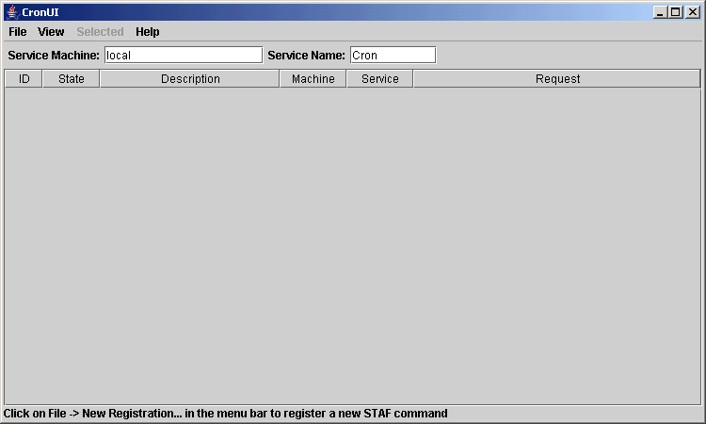
Cron service – CronUI (cont.)

Slide 95
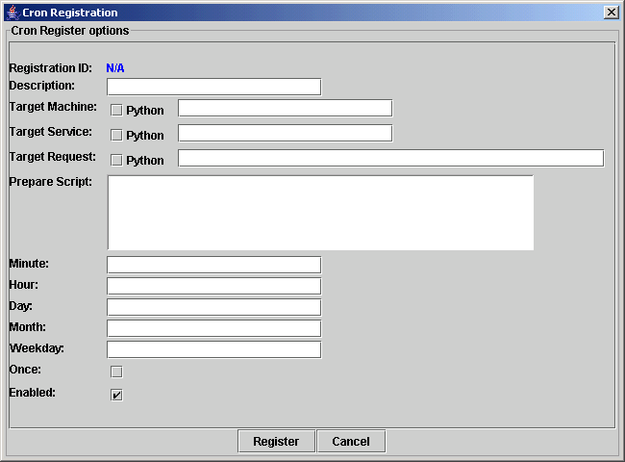
Cron service – CronUI (cont.)

Slide 96
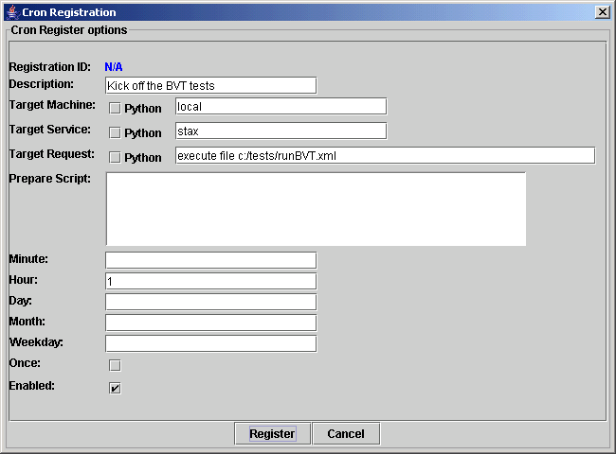
Cron service – CronUI (cont.)

Slide 97
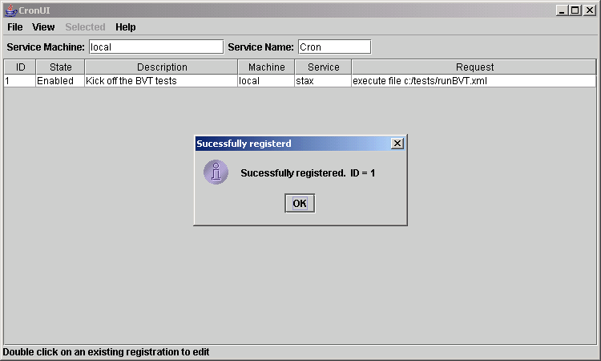
Cron service – CronUI (cont.)

Slide 98
HTTP service
The HTTP service provides the ability to quickly and easily make HTTP requests
These requests can be grouped together in a session which provides the ability to simulate a web browsing experience
With this support it is possible to manipulate cookies, login to secure http sites, and interact with form and link html elements that are returned from requests

Slide 99
HTTP service - Syntax
OPEN SESSION
CLOSE SESSION <Session>
LIST SESSIONS
LIST <FORMS | LINKS | COOKIES | DEFAULTHEADERS | AUTHENTICATIONHOSTS |
CONTROLNAMES FORM [NAME <Form Name> | ID <Id> | INDEX <Index>]>
SESSION <Session>
QUERY SESSION <Session>
GET SESSION <Session> CONTENT [FILE <File Name> [TOMACHINE <Machine>]]

Slide 100
HTTP service – Syntax (cont.)
REQUEST METHOD <Http Method> URL <Target Url> [CONTENT <Content>]
[HEADER <Key>=<Value>]... [PARAMETER <Key>=<Value>]...
[CONTENTFILE <Key>=<File Name>]...
[FOLLOWREDIRECT | DONOTFOLLOWREDIRECT] [SESSION <Session>]
[FILE <Filename> [TOMACHINE <Machine>]]
[IGNOREERRORS] [NOSTATUS] [RETURNHEADERS] [RETURNNOCONTENT]
DOPOST URL <Target Url> [CONTENT <Content>]
[HEADER <Key>=<Value>]... [PARAMETER <Key>=<Value>]...
[CONTENTFILE <Key>=<File Name>]...
[FOLLOWREDIRECT | DONOTFOLLOWREDIRECT] [SESSION <Session>]
[FILE <Filename> [TOMACHINE <Machine>]]
[IGNOREERRORS] [NOSTATUS] [RETURNHEADERS] [RETURNNOCONTENT]
DOGET URL <Target Url> [CONTENT <Content>]
[HEADER <Key>=<Value>]... [PARAMETER <Key>=<Value>]...
[FOLLOWREDIRECT | DONOTFOLLOWREDIRECT] [SESSION <Session>]
[FILE <Filename> [TOMACHINE <Machine>]]
[IGNOREERRORS] [NOSTATUS] [RETURNHEADERS] [RETURNNOCONTENT]
SET <FOLLOWREDIRECT | DONOTFOLLOWREDIRECT> SESSION <Session>

Slide 101
HTTP service – Syntax (cont.)
QUERY AUTHENTICATIONHOST <Host> SESSION <Session>
SET AUTHENTICATIONHOST <Host> AUTHENTICATIONUSER <User>
[AUTHENTICATIONPASSWORD <Password>] [AUTHENTICATIONDOMAIN <Domain>]
SESSION <Session>
DELETE AUTHENTICATIONHOST <Host> SESSION <Session>
QUERY DEFAULTHEADER <Key> SESSION <Session>
SET DEFAULTHEADER <Key> VALUE <Value> SESSION <Session>
DELETE DEFAULTHEADER <Key> SESSION <Session>
QUERY COOKIE NAME <Name> SESSION <Session>
SET COOKIE <NAME <Name> VALUE <Value>> | <POLICY <policy>>
SESSION <Session>
DELETE COOKIE NAME <Name> SESSION <Session>

Slide 102
HTTP service – Syntax (cont.)
QUERY FORM [NAME <Form Name> | ID <Id> | INDEX <Index>] [CONTROLNAME <Name>]
SESSION <Session>
SET FORM [NAME <Form Name> | ID <Id> | INDEX <Index>]
CONTROLNAME <Name> VALUE <Value> SESSION <Session>
SUBMIT FORM [NAME <Form Name> | ID <Id> | INDEX <Index>] SESSION <Session>
[FOLLOWREDIRECT | DONOTFOLLOWREDIRECT]
[FILE <Filename> [TOMACHINE <Machine>]]
[IGNOREERRORS] [NOSTATUS] [RETURNHEADERS] [RETURNNOCONTENT]
RESET FORM [NAME <Form Name> | ID <Id> | INDEX <Index>] SESSION <Session>
QUERY LINK <NAME <Name> | ID <Id> | INDEX <Index>> SESSION <Session>
FOLLOW LINK <NAME <Name> | ID <Id> | INDEX <Index>> SESSION <Session>
[FOLLOWREDIRECT | DONOTFOLLOWREDIRECT]
[FILE <Filename> [TOMACHINE <Machine>]]
[IGNOREERRORS] [NOSTATUS] [RETURNHEADERS] [RETURNNOCONTENT]

Slide 103
HTTP service – Examples
HTTP REQUEST METHOD options URL http://www.ebay.com RETURNHEADERS
Response
--------
{
Status Code : 200
Status Message: OK
Headers : {
Allow : GET, HEAD, POST, TRACE, OPTIONS
Content-Length: 0
Date : Tue, 11 May 2010 21:04:21 GMT
Server : Apache-Coyote/1.1
}
Content :
}
This example gets the HTTP options available in a request to the ebay website

Slide 104
HTTP service – Examples (cont.)
HTTP OPEN SESSION
Response
--------
1
This example opens a new session. Notice that the session ID is returned in the result buffer.
HTTP SET FOLLOWREDIRECT SESSION 1
Response
--------
This example enables automatic redirection
HTTP DOPOST URL https://www.sourceforge.net/account/login.php PARAMETER
form_loginname=user PARAMETER form_pw=password PARAMETER login=Login+With+SSL
SESSION 1 RETURNNOCONTENT
Response
--------
Status Code : 200
Status Message: OK
Headers : <None>
Content : <None>
This example logs in to SourceForge (replace the value for the form_loginname parameter with your userid and replace the value for the form_pw parameter with your password)

Slide 105
HTTP service – Examples (cont.)
HTTP DOGET URL ../tracker/ PARAMETER group_id=33142 PARAMETER atid=407381 RETURNNOCONTENT SESSION 1
This example gets a list of pending bugs. The group_id and atid parameters used in this request can be obtained by going to the bug tracker for the STAF project. These parameters are used by SourceForge to index into the database and pull up the relevant entries to put in the displayed table.
Response
--------
Status Code : 200
Status Message: OK
Headers : <None>
Content : <None>
HTTP GET SESSION 1 CONTENT FILE c:/temp/stafbugs.html
Response
--------
This example stores the current contents of a session (1) in a file (c:/temp/stafbugs.html). The c:/temp/stafbugs.html file should be an html file equivalent to acquiring the page in a browser.

Slide 106
HTTP service – Examples (cont.)
HTTP DOGET URL http://money.cnn.com/quote/quote.html/?symb=IBM RETURNNOCONTENT SESSION 1
Response
--------
Status Code : 200
Status Message: OK
Headers : <None>
Content : <None>
This example gets the current IBM stock quote
HTTP GET SESSION 1 CONTENT FILE c:/temp/ibmquote.html
Response
--------
This example stores the current contents of a session (1) in a file (c:/temp/ibmquote.html). The c:/temp/ibmquote.html file should be an html file equivalent to acquiring the page in a browser.

Slide 107
FTP service
The purpose of the FTP service is to provide client side FTP functionality that can be used to access remote FTP servers
This service only provides a few basic FTP capabilities:
  The ability to perform a binary file download from a FTP host server
  The ability to perform a binary file upload to a FTP host server machine
  The ability to list the contents of a directory on a FTP host server machine

Slide 108
FTP service - Syntax
GET HOST <Host> [PORT <Port>] URLPATH <FTP URL File Path> FILE <Name>
[USER <Name> PASSWORD <Password>]
PUT HOST <Host> [PORT <Port>] URLPATH <FTP URL File Path> FILE <Name>
[USER <Name> PASSWORD <Password>]
DIR HOST <Host> [PORT <Port>] URLPATH <FTP URL Directory Path>
[USER <Name> PASSWORD <Password>]

Slide 109
FTP service – Examples
FTP GET HOST server1.company.com URLPATH /tests/test.zip FILE
C:/myTests/test.zip USER tester PASSWORD !!@secret@!!
This example downloads file "/tests/test.zip" from remote FTP host server "server1.company.com" and stores it on the local FTP service machine in file "C:/myTests/test.zip". Login to the FTP host server machine using user "tester" and password "secret" (specifying STAF privacy delimiters around the password to protect it).
Response
--------
FTP PUT FILE /tests/test1.jar HOST 9.3.99.999 PORT 2121
URLPATH ./myProduct/tests/test1.jar
Response
--------
This example uploads file "/tests/test1.jar" from my local machine to FTP host server "9.3.99.999“ using port 2121 and store it as file "./myProduct/tests/test1.jar" on the FTP host server. Login to the FTP host server anonymously (assuming the FTP server allows anonymous logins).

Slide 110
FTP service – Examples (cont.)
FTP DIR HOST server1.company.com URLPATH . USER tester PASSWORD !!@secret@!!
This example obtains a directory listing for the FTP root folder on remote FTP host server "server1.company.com", specify "." for the remote directory
Response
--------
drwxr-xr-x 2 0 0 4096 Jul 30 2005 automate
drwxr-xr-x 77 0 0 4096 Sep 24 15:21 build
-rw-r--r-- 1 0 0 135669760 Oct 12 2006 hang.tar
-rw-r--r-- 1 0 0 16752 Oct 12 2006 hang.xml
-rw-r--r-- 1 0 0 63614186 Oct 12 2006 hangTest.zip
drwxr-xr-x 3 0 0 4096 Sep 25 20:11 tools
-rw-r--r-- 1 0 0 153115 Apr 23 00:07 test.zip
drwxr-xr-x 5 0 0 4096 Jan 22 2007 vmware

Slide 111
Part 3B – Break/LAB (15 min.)
Exercise 3.2

Slide 112
Part 3C – Advanced Topics

Slide 113
Writing custom STAF Services
You can write your own custom STAF Services in Java, C++, or Perl
The STAF Service Developer's Guide, which describes how to create STAF services and includes implementation of a sample service in Java, C++ and Perl, is available on the STAF website
Life cycle of a STAF Service
  Construction
    The service exists in the STAF memory space; not yet ready to accept requests
  Initialization
    The service has been initialized (with appropriate parameters), and is ready to accept requests
  Accepting requests
    The service is active
  Termination
    The service has terminated
  Deconstruction
    The service is removed from the STAF memory space
Notes:
Mention Java portability issues

Slide 114
Writing custom STAF Services (cont.)
All Java STAF services should implement the STAFServiceInterfaceLevel30 interface
Java services must implement the following methods:
  STAFResult init(STAFServiceInterfaceLevel30.InitInfo initInfo)
    This method is called by STAF to initialize the service
    This method allows the service to perform its initialization
  STAFResult acceptRequest(STAFServiceInterfaceLevel30.RequestInfo reqInfo)
    This is the method called whenever the service needs to perform a request
    This is the primary method by which programs/users interact with the service
    The actual interpretation of command arguments is, typically, done inside handleCommandXXX() methods, for example, handleHelp() and handleList()
  STAFResult term()
    This method is called by STAF to terminate the service
    This method allows the service to perform any cleanup
Notes:
Mention Java portability issues

Slide 115
Writing custom STAF Services (cont.)
The InitInfo object, which is passed as a parameter to the init method, contains the following fields:
  public String name
  public String parms
  public JarFile serviceJar
  public int serviceType
  public String writeLocation
Notes:
Talk to the specific fields

Slide 116
Writing custom STAF Services (cont.)
The RequestInfo object, which is passed as a parameter to the acceptRequest() method, contains the following fields:
  public String stafInstanceUUID
  public String machine
  public String machineNickname
  public String handleName
  public int handle
  public int trustLevel
  public boolean isLocalRequest
  public int diagEnabled
  public String request
  public int requestNumber
  public String user
  public String endpoint
Notes:
Talk to the specific fields

Slide 117
STAF Service Command Parsing
In the init method, you will typically create one or more STAFCommandParser objects (one for each command supported by your STAF Service)
  The STAFCommandParser class is used to parse commands and options submitted to your service
The STAFCommandParser class contains the following methods:
public void addOption(String name, int maxAllowed,
int valueRequirement)
  This method is used to specify the name of an identifier that may appear in a space-separated string passed to the STAFCommandParser
  Example
  fQueryParser = new STAFCommandParser();
  fQueryParser.addOption("QUERY", 1,
  STAFCommandParser.VALUENOTALLOWED);
  fQueryParser.addOption("PRINTER", 1,
  STAFCommandParser.VALUEREQUIRED);

Slide 118
STAF Service Command Parsing (cont.)
public void addOptionGroup(String optionNames,
int min, int max)
This method is used to specify a list of names that are to be treated as a group
This is typically used to specify groups of mutually exclusive options
Example
fQueryParser.addOptionGroup("PRINTER MODEM", 1, 1);
public void addOptionNeed(String needers, String needees)
This method is used to specify dependency relationships between names in space-separated strings passed to the STAFCommandParser
Example
fExecuteParser.addOptionNeed("EXECUTE", "FILE DATA");

Slide 119
STAF Service Command Parsing (cont.)
In the acceptRequest() method, you will typically determine the command that the request starts with, and call a corresponding method, e.g., handleHelp(), handleList(), etc.
The handle<command>() method would call the following method to parse the request:
  public STAFCommandParseResult parse(String data)
You can call the following methods on the STAFCommandParseResult object
  public int optionTimes(String name)
    This returns the number of times a particular option was specified
  public String optionValue(String name)
    This returns the value of the first instance of an option. If no instance exists, an empty string is returned.
  public String optionValue(String name, int instanceNumber)
    This returns the value of a specific instance of an option. If the given instance does not exist, an empty string is returned.

Slide 120
STAF Service Command Parsing (cont.)
public int numInstances()
  This returns the total number of options specified
public String instanceName(int instanceNumber)
  Returns the name of the option for the given instance
public String instanceValue(int instanceNumber)
  Returns the value of option for the given instance

Slide 121
STAF Service Command Parsing (cont.)
Example (this shows a subset of the PROCESS START options)
  PROCESS START COMMAND <command> [ENV <env>]...
  [ASYNC | WAIT [timeout]]
  [USERNAME <User name> [PASSWORD <Password>]]
  STAFCommandParser fStartParser = new STAFCommandParser();
  fStartParser.addOption("COMMAND", 1, STAFCommandParser.VALUEREQUIRED);
  fStartParser.addOption("ENV", 0, STAFCommandParser.VALUEREQUIRED);
  fStartParser.addOption("ASYNC", 1, STAFCommandParser.VALUENOTALLOWED);
  fStartParser.addOption("WAIT", 1, STAFCommandParser.VALUEALLOWED);
  fStartParser.addOption("USERNAME", 1, STAFCommandParser.VALUEREQUIRED);
  fStartParser.addOption("PASSWORD", 1, STAFCommandParser.VALUEREQUIRED);
  fStartParser.addOptionGroup("COMMAND", 1, 1);
  fStartParser.addOptionGroup("WAIT ASYNC", 0, 1);
  fStartParser.addOptionNeed("PASSWORD", "USERNAME");
  STAFCommandParseResult parsedResult = fStartParser.parse(request);

Slide 122
STAF Service Command Parsing (cont.)
String command = parsedResult.optionValue("COMMAND");
int envNum = parsedResult.optionTimes("ENV");
for (int i = 0; i < envNum; i++)
{
String env = parsedResult.optionValue("ENV", i)
}
if (parsedResult.optionTimes("ASYNCH") > 0)
{ do something }
else if (parsedResult.optionTimes("WAIT") > 0)
{
String timeout = parsedResult.optionValue("WAIT");
}
if (parsedResult.optionTimes("USERNAME") > 0)
{
String userName = parsedResult.optionValue("USERNAME");
if (parsedResult.optionTimes("PASSWORD") > 0)
{
String password = parsedResult.optionValue("PASSWORD");
}
}

Slide 123
STAF Service template
import com.ibm.staf.*;
public class SampleService implements STAFServiceInterfaceLevel30
{
public SampleService() { }
public STAFResult init(STAFServiceInterfaceLevel30.InitInfo info)
{
// register with STAF
// create STAFCommandParser objects for your service's commmands
}
public STAFResult acceptRequest(STAFServiceInterfaceLevel30.RequestInfo info)
{
// determine the request's <Command>
// call the appropriate handle<Command> method
}
private STAFResult handle<Command1>(
STAFServiceInterfaceLevel30.RequestInfo info)
{
// check the Trust level for this request
// parse the request to determine all of the options
// add your service logic here
}
private STAFResult handle<Command2> { ... }
public STAFResult term() { }
}

Slide 124
Interacting with STAF from other languages
You can interact with STAF from a variety of languages:
  C++, Java, Perl, Python, TCL, Ant, and shell scripts
We already covered the Java support in Part 1C, so the next charts will
provide an overview of the other language support
The C++ language support is documented in the STAF User’s Guide. Here are links to the documentation for the other languages:
  Java: http://staf.sourceforge.net/current/STAFJava.htm
  Perl: http://staf.sourceforge.net/current/STAFPerl.htm
  Python: http://staf.sourceforge.net/current/STAFPython.htm
  TCL: http://staf.sourceforge.net/current/STAFTcl.htm
  Ant: http://staf.sourceforge.net/current/STAFAnt.htm

Slide 125
STAF support for C++ Testcases
STAFHandle
  Handles registering and unregistering with STAF as well as submitting service requests
  #include "STAF.h"
STAFResult
  Contains the result of a STAFHandle->submit() call and some utility functions
  #include "STAF.h"
STAFString
  Encapsulates UTF-8 strings
  #include "STAFString.h“
STAFMapClassDefinition
  A class used to define a Map with intrinsic metadata
STAFObjectPtr
  Used for defining data structures and (un)marshalling data structures
  Multi-valued results must be unmarshalled to access the root data structure
  #include “STAFDataTypes.h”

Slide 126
STAF support for Perl Testcases
STAF::Register
  Allows you to register with STAF (procedural)
STAF::Submit
  Allows you to submit requests to STAF (procedural)
STAF::UnRegister
  Allows you to unregister with STAF (procedural)
STAF::STAFHandle
  Object to call into STAF (object-oriented)
    new - Creates a handle that registers with STAF
    submit - Same as STAF::Submit but different calling convention
    unRegister - Same as STAF::UnRegister but different calling convention
STAF::WrapData
  This function takes a string and produces the colon-length-colon delimited version of that string. This function is widely used to pass the values of options in STAF requests.
STAF::STAFUnmarshall
  Used for defining data structures and (un)marshalling data structures
  Multi-valued results must be unmarshalled to access the root data structure

Slide 127
STAF support for Python Testcases
STAFHandle
  The primary class for communicating with STAF
STAFResult
  A class representing the result of a STAF request
STAFException
  A class representing an error registering with STAF
STAFWrapData
  A utility function for creating colon-length-colon delimited strings for use in STAF requests
STAFMapClassDefinition
  A class used to define a Map with intrinsic metadata
STAFMarshallingContext
  Represents a set of map class definitions and a data structure defined in terms of them
  Multi-valued results must be unmarshalled to access the root data structure

Slide 128
STAF support for Tcl Testcases
STAF::Register
  Allows you to register with STAF
STAF::Submit
  Allows you to submit requests to STAF
STAF::UnRegister
  Allows you to unregister with STAF
STAF::WrapData
  Generates the colon-length-colon delimited version of a string

Slide 129
STAF support for Ant
The STAF Ant Task allows you call into the STAF framework from within an Ant build script
This allows you to take advantage of some of STAF's capabilities such as distributed synchronization via the SEM (Semaphore) service and resource pooling via the ResPool service
The STAFWrapData Ant Task allows you to create a length delimited representation of a string, which is useful when submitting STAF requests that contain embedded spaces and quotes

Slide 130
STAF Ant Examples
This example shows how to submit a STAX job via the STAF Ant task
  <project name="args5" default="main" basedir=".">
  <description>
  Build file to execute STAX job args5.xml
  </description>
  <taskdef name="staf"
  classname="com.ibm.staf.ant.taskdef.STAF"/>
  <target name="main">
  <staf location="local"
  service="STAX"
  request="EXECUTE FILE C:/staxtest/args5.xml ARGS &quot;{ 'ArchiveIDs': [\'B1\',\'B2\',\'B3\',\'B4\'] }&quot; WAIT RETURNRESULT"
  resultPrefix="staxexecute"/>
  <echo>RC: ${staxexecute.rc}, Result: ${staxexecute.result}</echo>
  </target>
  </project>

Slide 131
STAF Ant Examples (cont.)
This example shows how to use the STAFWrapData Ant Task to create a length delimited representation of a string, which will then be used as part of the "request" attribute for a STAF Ant Task
  <project name="TestSTAFWrapDataAntExtension" default="main" basedir=".">
  <description>
  Build file to test the STAFWrapData Ant Extension
  </description>
  <taskdef name="staf"
  classname="com.ibm.staf.ant.taskdef.STAF"/>
  <taskdef name="stafWrapData"
  classname="com.ibm.staf.ant.taskdef.STAFWrapData"/>
  <target name="main">
  <stafWrapData data="dir &quot;C:\Program Files\Java&quot;"
  result="dirCommand"/>
  <staf location="local"
  service="PROCESS"
  request="START SHELL COMMAND ${dirCommand} RETURNSTDOUT STDERRTOSTDOUT WAIT"
  resultPrefix="process"/>
  <echo>RC: ${process.rc}, Result: ${process.result}</echo>
  </target>
  </project>

Slide 132
STAF support for shell-scripts
You can call the STAF executable from shell-scripts:
  STAFResult=`STAF local ping ping`
There are two special environment variables that can be used to make the STAF command blend in with shell-scripts
  Setting the STAF_QUIET_MODE environment variable to any non-null value will cause the STAF command to only output the <Result string> that the request generated
    For example, the "STAF local ping ping" command would simply return
      PONG
    instead of
      Response
      --------
      PONG
  If the STAF_STATIC_HANDLE environment variable is set, the STAF command will use the handle number indicated by this environment variable. This ensures that the shell-script can use the same handle throughout its execution.
    A static handle is created via the Process service or the Handle service

Slide 133
Marshalled Data
In STAF 3.0 any service result that returns a result that “logically” contains more than one value has been changed to the marshalled form of a data structure (e.g. list of strings, list of maps, a map, etc.)
STAF supports the automatic marshalling and unmarshalling of structured data
  Marshalling takes a data structure and converts it into a string- based representation, while unmarshalling reverses this and converts the string-based representation back into a data structure
STAF supports the following generic data types with its marshalling:
  None - a unique type representing the absence of a value
  String - an arbitrary string value
  List - an ordered collection of other objects
  Map - an unordered collection of key/value pairs
  Map class - a Map with intrinsic metadata
  Marshalling context - represents a set of map class definitions and a data structure defined in terms of them
Most languages support some form of the None, String, List, and Map data types

Slide 134
Marshalled Data – Command Line
The STAF command will automatically unmarshall the data and print it in the most appropriate formal: simple (or default), table, or verbose
  If the data is a <List> of <String>, then each entry in the list will be printed on its own line:
C:\> staf local fs list directory c:\
Response
--------
AUTOEXEC.BAT
CONFIG.SYS
Documents and Settings
If the data is a <Map> (or <Map:<Class>>) which has values which are all of type
<String>, then each key/value pair will be printed on its own line
C:\> staf local monitor list settings
Response
--------
Max Record Size : 1024
Resolve Message : Disabled
Resolve Message Var: Disabled

Slide 135
Marshalled Data – Command Line (cont.)
  If the data is a <List> of <Map:<Class>> where every item in the list is an instance of the same map class, then the data will be printed out in a tabular format, called "table format"
C:\> staf local handle list handles
Response
--------
Handle Handle Name State Last Used Date-Time
------ ------------------------------- ---------- -------------------
1 STAF_Process InProcess 20040929-13:57:40
2 STAF/Service/STAFServiceLoader1 InProcess 20040929-16:06:47
5 STAF/Service/LOG InProcess 20040929-13:57:52
7 STAF/Service/RESPOOL InProcess 20040929-13:58:04
51 STAF/Service/MONITOR InProcess 20040929-16:06:47
57 STAF/Client Registered 20040929-16:09:35
You can disable the output of tables by setting the environment variable
STAF_PRINT_NO_TABLES to any value. If you disable the output of tables,
their data will show up in the more verbose mode
You can force the exclusive use of the verbose mode by setting the
environment variable STAF_PRINT_MODE to “verbose”

Slide 136
Marshalled Data – Command Line (cont.)
  If the data is more complex than the previous examples (or tables have been turned off), the output will be printed in a hierarchical nested format, called "verbose format“
  You can change the amount of indentation used by setting the environment variable STAF_INDENT_DELTA to any non-negative integer
C:\> staf local sem query event Test
Response
--------
{
State : Reset
Last Posted: {
Machine : crankin3
Handle Name: STAF/Client
Handle : 62
User : none://anonymous
Date-Time : 20040929-16:20:56
}
Last Reset : {
Machine : crankin3
Handle Name: STAF/Client
Handle : 65
User : none://anonymous
Date-Time : 20040929-16:21:43
}
Waiters : [
{
Machine : crankin3
Handle Name: TestHandle
Handle : 67
User : none://anonymous
Date-Time : 20040929-16:22:16
}
]
}

Slide 137
Marshalled Data – Command Line (cont.)
  You can use the -verbose option to force the use of the verbose mode on a command basis
C:\> staf -verbose local fs list directory c:\
Response
--------
[
AUTOEXEC.BAT
boot.ini
CONFIG.SYS
Documents and Settings
i387
IO.SYS
MSDOS.SYS
My Music
NTDETECT.COM
ntldr
PAGEFILE.SYS
Program Files
Recycled
RECYCLER
System Volume Information
temp
WINNT
]

Slide 138
Marshalled Data – Command Line (cont.)
  Here is an example that shows the command line output for a RESPOOL LIST request, where the result is a data structure consisting of a list of maps, one for each pool:
C:\>STAF local RESPOOL LIST POOLS
Response
--------
Pool Name Description
--------- -----------------------
pool1 Pool 1
STAFDemo STAF Demo Resource Pool
In the next slides we will see how the same data structure can be handled
within a STAX job and a Java program

Slide 139
Marshalled Data – Handling within a STAX Job
  Iterate through the result and obtain the pool name and description for each entry in the list:
<stafcmd>
<location>'local'</location>
<service>'RESPOOL'</service>
<request>'LIST POOLS'</request>
</stafcmd>
<if expr="RC == 0">
<iterate var="poolMap" in="STAFResult">
<message>
'Name: %s, Description: %s' % \
(poolMap['poolName'], poolMap['description'])
</message>
</iterate>
</if>
This results in a message sent to the STAX Monitor for each entry in the pool:
20041007-18:10:06 Name: pool1, Description: Pool 1
20041007-18:10:06 Name: STAFDemo, Description: STAF Demo Resource Pool

Slide 140
Marshalled Data – Handling within a Java Program
  Here's a snippet of Java code that submits a LIST POOLS request to the RESPOOL service, unmarshalls the result, and accesses the structured data (a List containing a Map for each resource pool):
STAFResult sr = handle.submit2("local", "RESPOOL", "LIST POOLS");
STAFMarshallingContext outputContext =
STAFMarshallingContext.unmarshall(sr.result);
List poolList = (List)outputContext.getRootObject();
Iterator iter = poolList.iterator();
while (iter.hasNext())
{
Map poolMap = (HashMap)iter.next();
System.out.println("Name: " + poolMap.get("poolName") +
", Description: " + poolMap.get("description"));
}
Here's the output from running this sample Java program:
NameName: pool1, Description: Pool 1
Name: STAFDemo, Description: STAF Demo Resource Pool

Slide 141
Private Data
In STAF 3.1.0 or later, some service command options allow their values to
contain private data which will be handled by the service. This will be noted in
the command options that allow it.
Private data is denoted by surrounding the private data, e.g. a password,
between an opening privacy delimiter (!!@) and a closing privacy delimiter (@!!). For example, !!@password@!!
  Because of this special significance of "!!@" and "@!!", if you do not want them to denote private data, use a caret (^), as an escape character for "!!@" and "@!!". Nested private data is allowed.
Using privacy delimiters indicates that the data enclosed between opening and closing privacy delimiters should be protected so that if the private data is displayed (e.g. in a LIST or QUERY request), any private data will be masked (replaced with asterisks).

Slide 142
Private Data - Examples
The Process service's START request handles private data in the COMMAND, PARMS, and/or PASSWORD options. If the command contains a password (e.g. secret) that you want to keep private, enclose the password between privacy delimiters as follows:
START SHELL COMMAND "C:/tests/myTest.exe -password !!@secret@!!"
  The above command would be displayed as "myTest.exe -password ************“
  in a LIST or QUERY request.
If you want to start command "TestA.exe" as another user (e.g. userid testuser and password secret), you can indicate that the password is private as follows:
START COMMAND C:/tests/TestA.exe USER testuser PASSWORD !!@secret@!!

Slide 143
Part 3C – Break/LAB (10 min.)
Exercise 3.3

Slide 144
Part 3D – End-to-End Automation with STAF

Slide 145
Automation Tasks
Automation Startup
System Setup
Execution
Testcase Execution
Monitoring
Synchronization
Testcase Output Analysis
Resource Management
Testcase Cleanup
Results Notification
Automation Completion

Slide 146
Automation Tasks – Automation Startup
Automation startup refers to the stage where your end-to-end automation begins and is usually the result of a prior piece of work, such as a product build successfully completing or by the passage of a designated time interval
  In the first case, the Event and EventManager services can be used to initiate STAF/STAX automation
    STAF-enabled testcases can register for a certain Event, and take appropriate action when the Event (such as a product build completion) occurs
    Instead of using STAF-enabled testcases to listen for these events, you can use the EventManager service to execute an arbitrary STAF command when the Event occurs
    In most scenarios, the STAF command is the submission of a STAX Job which will kick off the target automation
  In the second case, the Cron service can be used to execute an arbitrary STAF command at a designated time interval (for example, every hour, every day at 12 midnight, every 15th day of month, etc.)
    In most cases, the STAF command is the submission of a STAX Job which will kick off the target automation

Slide 147
Automation Tasks – System Setup
During the setup phase, a baseline OS can be established by using Ghost/Drive images and/or VMWare images. STAF's Process Service allows you to boot these images.
Prior to testcase execution, STAF's FileSystem (FS) and Process services can be used to install the product under test and any pre-requisite software
In most cases, testcase files will need to be extracted from a server or a code repository. STAF's Process service allows testcases to be extracted from code repositories, and STAF's FS service allows testcase files to be transferred from a server machine to test machines.

Slide 148
Automation Tasks – Testcase Execution
Testcases are typically files (such as binary executables, Java class files, shell scripts, Perl/Python/Tcl/Rexx scripts etc.) or system commands that will be executed on a test machine
STAF and STAX allow you to start any executable file/script/command, just as if you were executing that file or command while logged into a terminal on the machine
Testcases are executed in the STAF environment by the Process service
  The Process service can execute testcases that are completely unaware that they are being executed by STAF/STAX, or they can leverage STAF services in order to take advantage of additional automation capabilities
  In your STAX job, the <process> element is used to submit a START command to the Process service
To automate GUI testing, you would need to use tools such as SilkTest, Rational FunctionTester, WinRunner, etc.
  Once you have the GUI testing automated, you would then use STAF/STAX to kick off the GUI automation tools to run the tests
  After the tests complete, STAF/STAX can analyze the output to determine if the tests were successful, and take appropriate action

Slide 149
Automation Tasks – Testcase Execution - Monitoring
It is desirable to have the means to easily determine the status of testcases as they are executing
Testcases can leverage the Monitor service in order to publish their current execution status
  As an example, a testcase that loops through a set of tests 1000 times could publish the current loop number as its latest status
  By using the Monitor service, you could then, from a central machine in the STAF environment, query the current status of all of your testcases
  Furthermore, when using the STAX Monitor, all of your testcases' current status will be dynamically updated in the STAX Monitor
  The STAX Monitor allows you to remotely view all of your executing testcases in a single view
Throughout your STAX job, you can define blocks, which represent a portion of your job over which you would like to have runtime control
  The STAX Monitor allows you to hold, release, and terminate any blocks that are defined in your job

Slide 150
Automation Tasks – Testcase Execution - Synchronization
Testcases may need to synchronize at certain points before proceeding with additional execution. STAF and STAX allow testcases, even when on remote machines, to synchronize via the Semaphore (SEM) service.
The STAX service allows you to synchronize the completion of multiple activities via the <parallel> and <paralleliterate> elements
The STAX service also allows you to place time constraints on portions of your automation jobs via the <timer> element
  Allows cleanup of "infinite" tasks after the time limit is reached
  Allows detection and cleanup of "hung" tasks
  The STAX engine handles all cleanup activities and gives you direct control over the outcome of an expired timer

Slide 151
Automation Tasks – Testcase Execution - Resources
Testcases can have pools of resources that can be shared among a number of other testcases. Resources are typically a set of machines, printers, or other hardware devices to which you want to manage access. Resources can also be "logical" resources, such as software licenses or userids.
  One example would be if part of your test effort includes a certain software package for which you only have 5 software licenses, but you have 20 testcases that may, at some point during their execution, need to obtain one of these software licenses. The ResourcePool (ResPool) service could be used to set up a resource pool with 5 software licenses, from which the 20 testcases would request acquisition of one of the resources before continuing with their execution.
  Another example would be if you had 3 userids that your testcases could use to log into a system. You could again use the ResPool service to control access to the 3 userids.
  A third example would be if you had a machine pool of 10 machines on which your testcases can execute. You could leverage the ResPool service to control access to the machines.

Slide 152
Automation Tasks – Testcase Output Analysis
Testcases often write output to log files or to the standard output stream
When using STAF and STAX, you can have any number of files and/or the entire standard error/output stream returned when the testcase completes
Every STAF command and process returns a return code which can be used to determine the automation flow
The files and/or standard error/output stream can then be parsed through, or otherwise analyzed in STAX, and appropriate action can then be taken depending on the content of the files and/or standard error/output
Throughout your STAX job, you can define <testcase> elements and corresponding <tcstatus> elements to record testcase passes and failures
The FileSystem service can be used to check for the presence/absence of files as part of the output analysis
The FSExt service can be used to search files for particular strings as part of the output analysis
Within your STAX job, you can use Python’s Regular Expression search capabilities to analyze testcase output

Slide 153
Automation Tasks – Testcase Cleanup, Results Notification
Testcase Cleanup
  After your testcases have completed execution, STAF's FS and Process services allow you to cleanup any temporary output and/or the testcases themselves
  The FS service can also transfer any output or log files that have been created by the testcases to a central server
Results Notification
  After your automation has completed, you can use STAF's Email service to distribute the automation results
  STAF's HTTP Service allows you to post forms with the automation results on the web

Slide 154
End-to-End Automation with STAF and STAX
Automation Startup
S
T
A
X
J
o
b
Event, EventManager, Cron
<function>
<parallel>
<sequence>
<process>
<stafcmd>
<testcase>
<timer>
<block>
<loop>
<message>
<log>
<import>
<job>
<iterate>
<paralleliterate>
<hold>
<release>
<terminate>
System Setup
FS, Process
Testcase Execution
Process, Monitor, Log, Variable,
Queue, ResPool, SEM
Testcase Output Analysis
Log, Process
Testcase Cleanup
Process, FS
Results Notification
Email, HTTP
Automation Completion

Slide 155
End-to-End Automation with STAF and STAX
Automation Startup
Event
EventManager
Cron
Test systems in your lab
ResPool
Log
Http
Variable
FS
Semaphore
Process
Monitor
Email
Queue
STAX Monitor Machine - this could be your office or home system
STAX Service Machine

Slide 156
End-to-End Automation with STAF and STAX
Extract source code
Transfer code to build machines
Cron service starts build job at 1am every day
Build product on each platform
Linux
Transfer product binary files to ISMP machine
AIX
Build ISMP packages
WIN32
Transfer product installation packages to common network location
OS/400
z/OS
Transfer build results to project web site
Generate "Build Available" event
STAX Service Machine

Slide 157
End-to-End Automation with STAF and STAX
EventManager service receives a notification for the "Build Available" event, and kicks off the SVT job
Acquire SVT test machines from the machine pool
Download product installation packages from common network location to SVT machines
HP-UX
Install product on SVT machines
Solaris
WIN32
Run SVT testcases
OS/400
If SVT fails, send a page to project manager
z/OS
Post SVT results to project website
STAX Service Machine

Slide 158
Keys to successful STAF/STAX deployment
Set aside enough time to get familiar with STAF/STAX and know how to access the available STAF/STAX documentation, and how to ask STAF/STAX questions
Designate one or more people to become STAF/STAX experts in your area/group to help others in your group get started using STAF/STAX
Understand your automation goals. You need to understand what you are trying to accomplish with automation before implementing a STAF/STAX solution.
Stage in automation if possible. Perhaps the first phase is to use STAX to run non-STAF enabled testcases, and later update/create STAF-enabled testcases. Or automate one set of tests first, etc.
Get management buy-in. Automation takes time to implement.
You need to think long-term with regards to the savings achieved by automation

Slide 159
STAF Eclipse Plug-in
A STAF plug-in for Eclipse is available for download on the SourceForge website: http://staf.sourceforge.net/geteclipse.php
It provides an entry point for beginning STAF users to get introduced to STAF via a GUI environment
Advanced users may find it useful as it provides access to a variety of information displayed in a graphical format and provides a persistent history of commands
Following the spirit of Eclipse, the STAF Editor is extensible so that the STAF team and other users may easily add additional pages to the STAF Multi-Page Editor

Slide 160
STAF Eclipse Plug-in - Features
Submit any STAF commands via an eclipse editor
Results of commands are saved for later reference
Results of commands displayed in dynamically generated widget based on format of result data
Open editors for multiple machines
Uses the Eclipse extension architecture to allow additional editor tabs to be quickly developed
Currently Implemented Service-Based plug-ins:
  Service - provides graphical access to the details of currently running services and requests
  Trust - provides ability to quickly view and modify trust settings
  Var - provides ability to quickly view and modify STAF variables
  Handle - provides quick access to STAF handles and allows for easy filtering of which handles are displayed

Slide 161
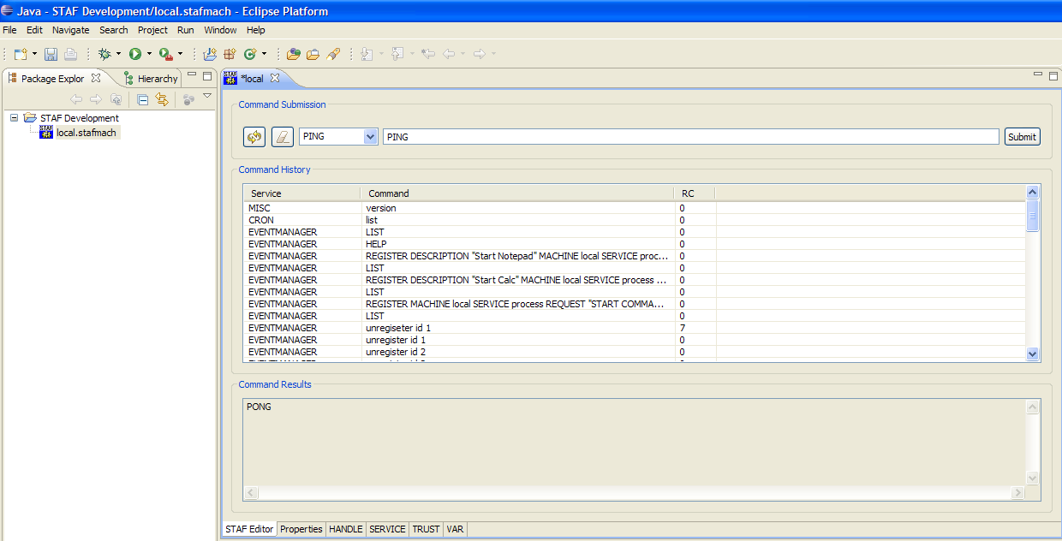
STAF Eclipse Plug-in - Examples

Slide 162
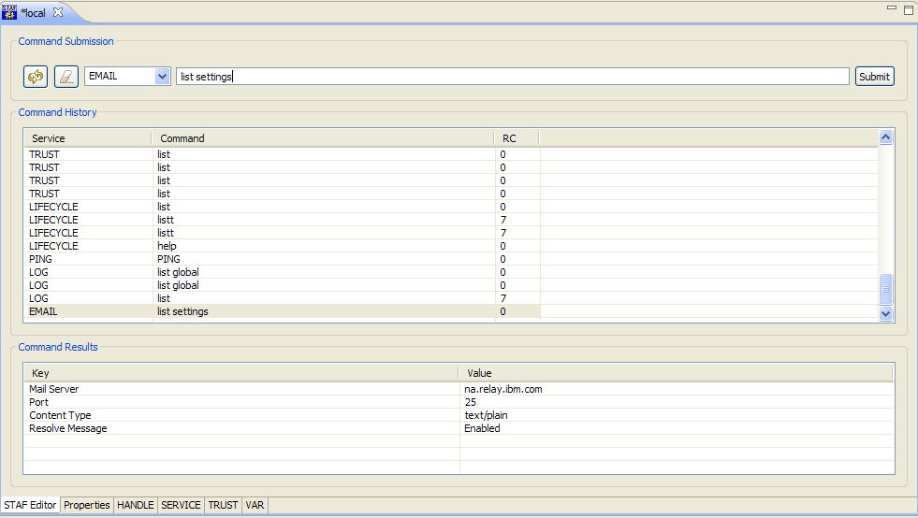
STAF Eclipse Plug-in – Examples (cont.)

Slide 163
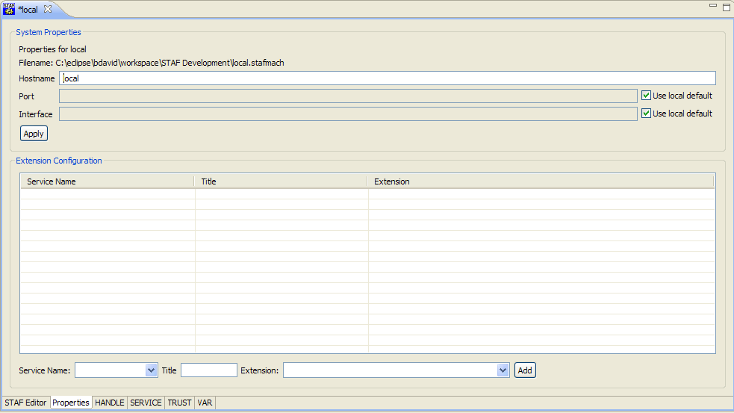
STAF Eclipse Plug-in – Examples (cont.)

Slide 164
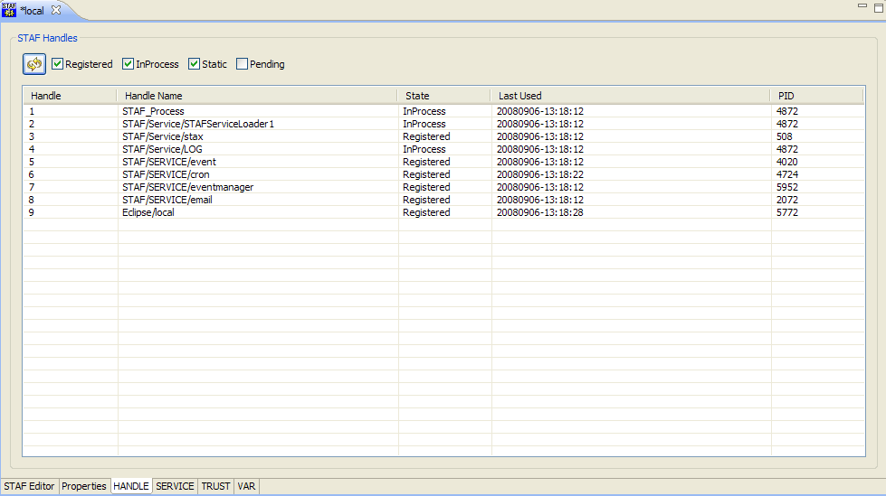
STAF Eclipse Plug-in – Examples (cont.)

Slide 165
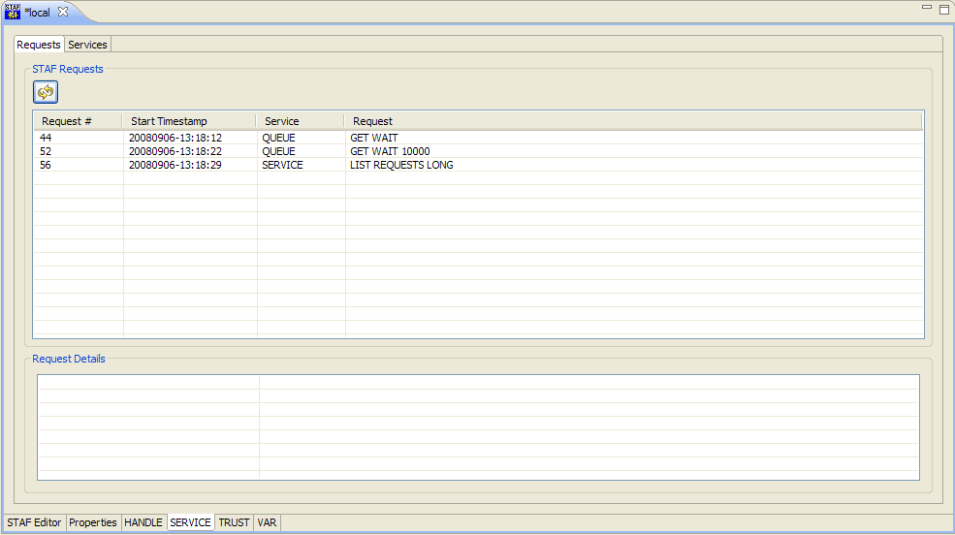
STAF Eclipse Plug-in – Examples (cont.)

Slide 166
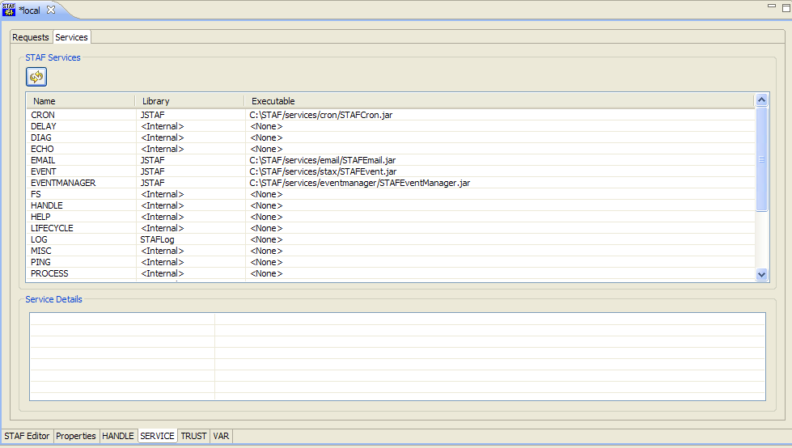
STAF Eclipse Plug-in – Examples (cont.)

Slide 167
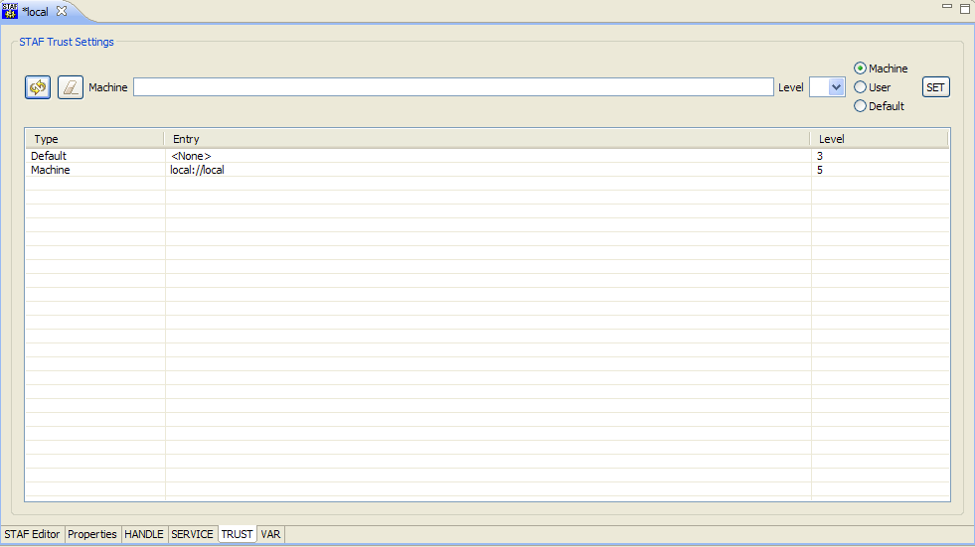
STAF Eclipse Plug-in – Examples (cont.)

Slide 168
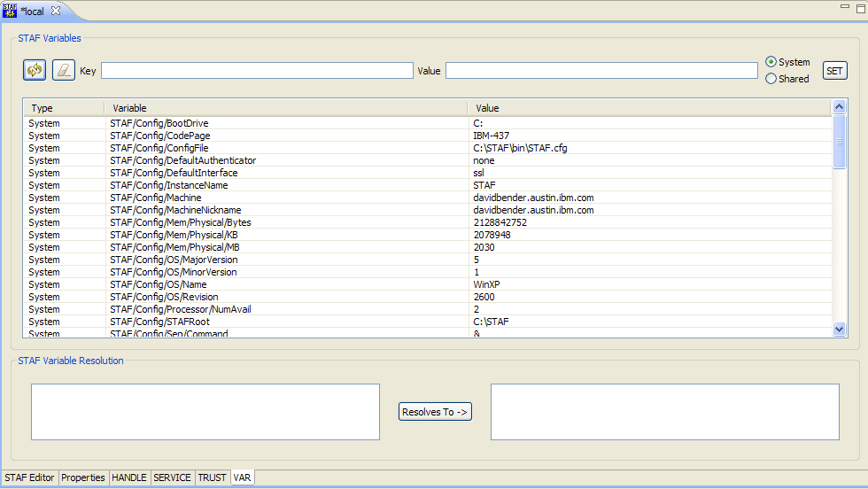
STAF Eclipse Plug-in – Examples (cont.)

Slide 169
Contributing to STAF
The STAF project accepts contributions such as software, documentation, and/or other materials that enhance or extend the STAF project
Feedback and contributions from the community are the indispensable, invaluable resource that will ensure the project's continued success
Please help to improve some aspect of STAF; no improvement is too small or too simple!
See http://staf.sourceforge.net/contributions.php for more details

Slide 170
Contributing to STAF (cont.)
If you would like to contribute back to the STAF community, please use the patch tracker to submit a patch
  http://sourceforge.net/tracker/?func=add&group_id=33142&atid=407383
When submitting a patch, please include the following:
  The patch file(s) containing your contribution
  The appropriate Statement of Origin
  A description of the functionality you are contributing
  The version of STAF used to create your patch. Also, if the patch is relevant to one or more external STAF services, provide the version of the service(s) used to create your patch.
Your contribution will be licensed under the EPL (Eclipse Public License), the license used for the STAF project. The license has been approved by the OSI (Open Source Initiative) as a fully certified open source license.

Slide 171
Part 3D - Break

Slide 172
End of Presentation
End of Presentation

