Slide 1
Hands-on Automation with STAF/STAX
Part 4

Slide 2
Part 4 Agenda (4 hours)
PART 4A – Additional STAX Elements
  Signals and Exceptions: <raise>, <signalhander>, <try>, <catch>
  Defining Function Arguments
  Subjobs
  STAX File and Machine Caching
  Break/LAB 4A (Exercise 4.1)
PART 4B – Sample STAX Jobs 1
  DoesNothing.xml
  RunNotepadProcess.xml
  RunDelayRequest.xml
  CheckSTAFCmdRC.xml
  RunTestProcess.xml
  UsingScripts.xml
  FunctionParameters.xml
  FunctionParametersLogging.xml
  Break 4B
PART 4C – Sample STAX Jobs 2
  ImportFunction.xml
  Block.xml, Parallel.xml
  Loop.xml, Testcase.xml
  Timer.xml, Email.xml
  DateTime.xml
  Break 4C
PART 4D – Advanced Topics
  STAXDoc
  STAX Extensions
  STAX Variables
  STAXUtil Functions
  Rational Quality Manager
  STAXGlobal Class
  Break/LAB 4D (Exercises 4.2-4.3)
  PART 4E – STAX Debugging
  Exception Stacktrace
  Breakpoints
  Break/LAB 4E (Exercise 4.4)

Slide 3
Part 4A – Additional STAX Elements

Slide 4
Understanding additional STAX XML Elements
Signals and Exceptions:
  raise, signalhandler - deal with the raising and handling of STAX signals
  try, catch, finally, throw, rethrow - deal with the processing of STAX exceptions and running finalization tasks
Functions:
  function, call, return – defines portions of a STAX job that can be called repeatedly
  function-prolog, function-epilog – contains a textual description of the function
  function-no-arg, function-single-arg, function-list-arg, function-map-arg – defines formal arguments for the function
Common Libraries:
  import – allows you to import functions from other STAX xml files
Sub-Jobs:
  job – defines a sub-job which will be executed within the parent job

Slide 5
Signals: <raise>, <signalhandler>
Signals
  STAX signals are very similar to C oriented signals. They are a means to inform your job of certain conditions. Incoming signals preempt the normal flow of your job until they are handled.
  STAX uses signals to inform the job about certain error situations (such as data evaluation errors or nonexistant functions)
  STAX provides default signal handlers for all predefined signals
  You may override the default signal handlers, as well as create your own custom signals and signal handlers
  The <raise> element allows you to raise signals
  The <signalhandler> element allows you to define a signal handler for a specified signal
Signals that may be raised by the STAX execution engine include:
  STAXPythonEvaluationError
  STAXProcessStartError
  STAXFunctionDoesNotExist
  STAXInvalidBlockName

Slide 6
Signals: <raise>, <signalhandler> (cont.)
Example:
  Goal: Override the default signalhandler for STAXPythonEvaluationError so that it logs a message and sends a message to the STAX Monitor, but does not terminate the job
  <signalhandler signal="'STAXPythonEvaluationError'">
  <log level="'error'" message="1">
  ('STAXPythonEvaluationError signal raised. ' +
  'Continuing job. %s' % (STAXPythonEvalMsg))
  </log>
  </signalhandler>
  Goal: The following example of the raise element raises a signal named 'NonZeroRCError' when a non-zero return code is encountered
  <function name="Valid-if-RC-0">
  <if expr="RC != 0">
  <raise signal="'NonZeroRCError'"/>
  </if>
  </function>

Slide 7
Exceptions: <try>, <catch>, <throw>, <finally>
Exceptions
  STAX provides exceptions that work analogously to C++ and Java exceptions
  The <try> element defines a section of your job in which you want to catch exceptions
  The <catch> element defines an exception that is to be caught
  The <throw> element allows you to throw exceptions
  The <finally> element allows you to run a finalization task
Example:
  Goal: Demonstrate the use of try, catch, throw elements.
  <try>
  <sequence>
  <call function="'CheckServerAvailability'"/>
  <if expr="RC != 0">
  <throw exception="'ServerNotAvailable'"/>
  </if>
  <call function="'StartServers'"/>
  <if expr="RC != 0">
  <throw exception="'Timeout.ServerStart'">'Server %s' % machine</throw>
  </if>
  </sequence>
  <catch exception="'ServerNotAvailable'">
  <log>'Handler: ServerNotAvailable'</log>
  </catch>
  <catch exception="'Timeout'" typevar="exceptionType" var="eInfo">
  <log>'Handler: Timeout, eType: %s, eInfo: %s' % (exceptionType, eInfo)</log>
  </catch>
  </try>
Notes:
The example shows a try block containing a sequence of tasks to perform. If an exception is thrown, the catch block for the exception thrown is run and then processing will continue by executing the element following the end of the try block. If a 'Timeout.ServerStart' exception is thrown, the catch block for exception 'Timeout' can handle this exception because they are sub-types of exception 'Timeout'.

Slide 8
Exceptions: <try>, <catch>, <throw>, <finally> (cont.)
Example:
  Goal: Demonstrate the use of try, catch, finally elements
  <function name="Main">
  <try>
  <block name="'RunTest'">
  <sequence>
  <call function="'InitJob'"/>
  <call function="'CheckServerAvailability'"/>
  <call function="'StartServers'"/>
  <call function="'StartClients'"/>
  </sequence>
  </block>
  <catch exception="'...'" typevar="eType" var="eInfo">
  <sequence>
  <log message="1">"Handler: ..., eType: %s, eInfo: %s" % (eType, eInfo)</log>
  <call function="'HandleException'"/>
  </sequence>
  </catch>
  <finally>
  <block name="'Cleanup'">
  <sequence>
  <log message="1">'Perform Clean-up'</log>
  <call function="'Cleanup'"/>
  </sequence>
  </block>
  </finally>
  </try>
  </function>
Notes:
The example shows a try block containing a sequence of tasks to perform. If an exception is thrown, the catch block for the exception thrown is run and then processing will continue by executing the element following the end of the try block. If a 'Timeout.ServerStart' exception is thrown, the catch block for exception 'Timeout' can handle this exception because they are sub-types of exception 'Timeout'.

Slide 9
Defining Function Arguments
Arguments for functions can be defined. The <function> element can optionally contain the following elements, in the order listed, before the task element:
  <function-prolog> - a description of the function
  An argument definition element. Can be one of the following elements:
    <function-no-arg/> - specifies that no arguments can be passed to this function
    <function-single-arg> - can contain a single <function-arg-def> element
    <function-list-args> - can contain any number of <function-arg-def> elements
    <function-map-args> - can contain any number of <function-arg-def> elements
A <function-arg-def> element has the following attributes:
  name : the name of the argument
  type : the argument type (“required”, “optional”, “other”)
  default : the default value for the argument
A <function-arg-def> element can also optionally contain the following elements:
  <function-arg-description> - contains a description of the argument
  <function-arg-private> - indicates that the argument contains private data
  <function-arg-property> - allows you to specify properties for the argument
Notes:
A function that does not define its arguments is implicitly defined as:

Slide 10
Defining Function Arguments (cont.)
Example: Define a function that accepts two arguments (one required, one optional) in a list
<function name="RunTest" scope="local">
<function-description>Runs a test on a machine.</function-description>
<function-list-args>
<function-arg-def name="test“ type=“required”>
<function-arg-description>Name of test to run</function-arg-description>
</function-arg-def>
<function-arg-def name="machine“ type=“optional” default="'local'">
</function-arg-description>Name of machine where the test should run</function-arg-description>
</function-arg-def>
</function-list-args>
<process>
<location>machine</location>
<command>test</command>
</process>
</function>
Example: Call function 'RunTest', passing it two arguments (test name and machine name) in a list. The three ways shown are equivalent ways to call the function.
<call function="'RunTest'">'C:/tests/stress1.exe', 'machine1'</call>
<call function="'RunTest'">['C:/tests/stress1.exe', 'machine1']</call>
<call-with-list function="'RunTest'">
<call-list-arg>'C:/tests/stress1.exe'</call-list-arg>
<call-list-arg>'machine1'</call-list-arg>
</call-with-list>

Slide 11
Creating Libraries of Common STAX Functions
The STAX programming language allows you to import functions from other STAX jobs. This allows you to create libraries of reusable modules and also makes it easy to share testcases, and even whole test suites, with other teams
  Makes using other's testcases as easy as 1) import and 2) run
The <import> element specifies a set of functions to be imported from another STAX XML job file or from a directory. The import element has the following attributes:
  file is the name of the STAX XML file from which the function(s) will be imported
  directory is the name of a directory that contains STAX XML files from which functions will be imported
  machine is the name of the machine where the STAX XML file or directory is located
  replace - specifies what to do if a function already exists
  mode - specifies what happens when an error occurs when importing functions
When using the file attribute, the import element can contain the following optional elements:
  <import-include> - specifies a list of the the functions to import from the job file. If not present, then all functions will be imported (bound by any exclude list).
  <import-exclude> - specifies a list of functions which will not be imported from the job file. If not present, then no functions will be excluded.
    The <import-include> and <import-exclude> elements support grep matching
If an error occurs while executing an import element, a STAXImportError signal will be raised if its mode is 'error'

Slide 12
Creating Libraries of Common STAX Functions (cont.)
The <import> element may be specified anywhere except in the root element. This allows it to be executed at runtime, allowing Python expressions to be used in the element and enabling dynamic importing of functions.
After an import element is executed, any other function can then call the imported function. If you have many functions to import, you can create a function which does all of the imports and is the first function called.
Examples:
  Goal: Import all functions from file c:\util\library.xml, which is located on machine Server1A.
  <import machine="'Server1A'" file="'c:/util/library.xml'"/>
  Goal: Only import functions FunctionA and FunctionB.
  <import machine="'Server1A'" file="'c:/util/library.xml'">
  <import-include>'FunctionA', 'FunctionB'</import-include>
  </import>
  Goal: Import all functions that start with "MyFuncs" but do not start with "MyFuncsWin32".
  <import machine="'Server1A'" file="'/usr/local/util/library.xml'">
  <import-include>'MyFuncs.*'</import-include>
  <import-exclude>'MyFuncsWin32.*'</import-exclude>
  </import>

Slide 13
Creating Libraries of Common STAX Functions (cont.)
Examples (cont):
  Goal: Import all functions from file c:\util\library.xml, which is located on machine Server1A and replaces any functions that already exist (e.g. that were already imported or defined in the xml file being executed)
  <import machine="'Server1A'" file="'c:/util/library.xml'" replace="1"/>
  Goal: Import all functions from all .xml files in directory /stax/common which is located on the STAXCurrentXMLMachine
  <import directory="'/stax/common'"/>
  Goal: Import all functions from a directory using a relative path (relative to STAXCurrentXMLFile)
  <import directory="'../libraries'"/>

Slide 14
Executing Sub-jobs
The <job> element represents a sub-job that will be executed within the parent job
A sub-job will appear as a separate job
Terminating a parent job will terminate any sub-jobs as well
Holding/releasing a parent job will not hold/release its sub-jobs
After a sub-job has completed (or it could not be started), the following variables are set and can be referenced by the job:
  RC - the return code from submitting the request to execute the sub-job
  STAFResult - the STAF result from submitting the request to execute the sub-job
  STAXSubJobID - the job ID of the sub-job
  STAXResult - contains the result returned by the starting function of the sub-job
Examples:
  Goal: Execute a sub-job, with a job name “Job 2”, defined by XML file c:/stax/xml/myJob2.xml
  <job name="'Job 2'">
  <job-file>'C:/stax/xml/myJob2.xml'</job-file>
  </job>

Slide 15
Executing Sub-jobs (cont.)
In the following example of a job element, a sub-job defined by an XML file named tests/testB/xml located on machine myMachine is executed and given a job name of 'Test B'. The job is started by calling function 'Main' and passing this function an argument list of [1, 'server']. In addition, two scriptfiles are specified as well as a couple of script elements. This sub-job is similar to the following STAX EXECUTE request:
  EXECUTE FILE /tests/testB.xml MACHINE myMachine JOBNAME "Test B" CLEARLOGS
  FUNCTION Main ARGS "[1, 'server1']" SCRIPTFILEMACHINE myMachine
  SCRIPTFILE /tests/testB1.py SCRIPTFILE /tests/testB2.py
  SCRIPT "MachineList = ['machA', 'machB'] SCRIPT "maxTime = '1h'"
  <job name="'Test B'" clearlogs="1">
  <job-file machine="'myMachine'">'/tests/testB.xml'</job-file>
  <job-function>'Main'</job-function>
  <job-function-args>[1, 'server1']</job-function-args>
  <job-scriptfiles machine="'myMachine'">
  ['/tests/testB1.py', '/tests/testB2.py']
  </job-scriptfiles>
  <job-script>MachineList = ['machA', 'machB']<job-script>
  <job-script>maxTime = '1h'</job-script>
  <job-action>
  <log>'Started sub-job %s' % (STAXSubJobID)</log>
  </job-action>
  </job>

Slide 16
STAX File and Machine Caching
STAX file and machine caching can improve performance when you re-run a STAX job using the same STAX xml file and/or when you import the same STAX xml file that has already been imported by another job
  No re-parsing of the STAX xml file is required and no additional information about the machine where the STAX xml file resides is required
The file cache stores parsed STAX XML files that have been loaded from a machine. When file caching is enabled, the cache will be checked during the following operations:
  When submitting an EXECUTE request using the FILE option
  When a STAX job file uses the import element
The machine cache stores information (e.g. file separator) about the machines where the STAX XML files that have been loaded reside if the machine where the STAX XML file resides is remote (e.g. not the STAX service machine). The machine cache is checked during the same operations as above if the STAX XML file resides on a remote machine.
The STAX file cache first attempts to retrieve the modification time of the file from the target machine. If the modification time is different than that of the copy in the cache, the file will be reloaded and the cached copy will be updated. If the modification time cannot be retrieved, the cache will be bypassed.

Slide 17
STAX File and Machine Caching (cont.)
You can set a maximum number of entries in the file cache
  The default is 20, but you can change this by specifying the MAXFILECACHESIZE parameter when registering the STAX service, or you can change it dynamically by submitting a SET MAXFILECACHESIZE request to the STAX service
You can set a maximum number of entries in the machine cache
  The default is 20, but you can change this by specifying the MAXMACHINECACHESIZE parameter when registering the STAX service, or you can change it dynamically by submitting a SET MAXMACHINECACHESIZE request to the STAX service
STAX file/machine caching uses a least recently used (LRU) algorithm for clearing the cache when it becomes full. The items with the oldest "Last Hit Date-Time" will be removed when the cache extends beyond its bounds, or when the size of the cache is changed to a smaller value.
You can also clear the file/machine cache by submitting a PURGE FILECACHE request or a PURGE MACHINECACHE request to the STAX service.

Slide 18
Part 4A – Break/LAB (10 min.)
Exercise 4.1

Slide 19
Part 4B – Sample STAX Jobs 1

Slide 20
Sample STAX Jobs 1
Note that if you are going through this education material by yourself (not during an actual class), you can refer to the “Getting Started with STAX V3” document at:
http://staf.sourceforge.net/current/staxgs.pdf
which describes the STAX jobs in this section and has instructions on how to execute them

Slide 21
DoesNothing.xml
<?xml version="1.0" encoding="UTF-8" standalone="no"?>
<!DOCTYPE stax SYSTEM "stax.dtd">
<stax>
<defaultcall function="main"/>
<function name="main">
<nop/>
</function>
</stax>

Slide 22
RunNotepadProcess.xml
<?xml version="1.0" encoding="UTF-8" standalone="no"?>
<!DOCTYPE stax SYSTEM "stax.dtd">
<stax>
<defaultcall function="main"/>
<function name="main">
<process>
<location>'local'</location>
<command>'notepad'</command>
</process>
</function>
</stax>

Slide 23
RunDelayRequest.xml
<?xml version="1.0" encoding="UTF-8" standalone="no"?>
<!DOCTYPE stax SYSTEM "stax.dtd">
<stax>
<defaultcall function="main"/>
<function name="main">
<stafcmd>
<location>'local'</location>
<service>'delay'</service>
<request>'delay 30000'</request>
</stafcmd>
</function>
</stax>

Slide 24
CheckSTAFCmdRC.xml
<stax>
<defaultcall function="main"/>
<function name="main">
<sequence>
<stafcmd>
<location>'local'</location>
<service>'var'</service>
<request>'resolve string {STAF/Config/OS/Name}'</request>
</stafcmd>
<if expr="RC != 0">
<message>'Oops, RC = %s, Result = %s' % (RC, STAFResult)</message>
<else>
<message>'Great! STAF/Config/OS/Name = %s' % (STAFResult)</message>
</else>
</if>
</sequence>
</function>
</stax>

Slide 25
RunTestProcess.xml
<stax>
<defaultcall function="main"/>
<function name="main">
<sequence>
<process name="'My Test Process'">
<location>'local'</location>
<command>'java'</command>
<parms>'com.ibm.staf.service.stax.TestProcess 10 3 99'</parms>
<env>
'CLASSPATH=C:/STAF/bin/JSTAF.jar;C:/STAF/services/stax/STAXMon.jar'
</env>
<stderr mode="'stdout'"/>
<returnstdout/>
</process>
<if expr="RC != 0">
<message>'Error: RC=%s, STAXResult=%s' % (RC, STAXResult)</message>
<else>
<message>'Process RC was 0. STAXResult=%s' % STAXResult</message>
</else>
</if>
</sequence>
</function>
</stax>

Slide 26
UsingScripts.xml (1 of 2)
<?xml version="1.0" encoding="UTF-8" standalone="no"?>
<!DOCTYPE stax SYSTEM "stax.dtd">
<stax>
<script>
jstafJar = '{STAF/Config/STAFRoot}/bin/JSTAF.jar'
staxmonJar = '{STAF/Config/STAFRoot}/services/stax/STAXMon.jar'
machine = 'local'
java_command = 'java'
java_class = 'com.ibm.staf.service.stax.TestProcess'
loopCount = 10
incSeconds = 3
returnCode = 50
parms = '%s %s %s' % (loopCount, incSeconds, returnCode)
cp = 'CLASSPATH=%s;%s' % (jstafJar, staxmonJar)
</script>
<defaultcall function="main"/>

Slide 27
UsingScripts.xml (2 of 2)
<function name="main">
<sequence>
<process name="'My Test Process'">
<location>machine</location>
<command>java_command</command>
<parms>'%s %s' % (java_class, parms)</parms>
<env>cp</env>
<stderr mode="'stdout'"/>
<returnstdout/>
</process>
<if expr="RC != 0">
<message>'Error: RC=%s, STAXResult=%s' % (RC, STAXResult)</message>
<else>
<message>'Process RC was 0. STAXResult=%s' % STAXResult</message>
</else>
</if>
</sequence>
</function>
</stax>

Slide 28
FunctionParameters.xml (1 of 4)
<?xml version="1.0" encoding="UTF-8" standalone="no"?>
<!DOCTYPE stax SYSTEM "stax.dtd">
<stax>
<defaultcall function="main"/>
<function name="main">
<function-prolog>
This function is used as an example in the "Getting Started with STAX"
document. It starts the TestProcess, and allows the parms, machine,
java_command, java_class, processName, and classpath to be passed as
arguments to the function.
</function-prolog>

Slide 29
FunctionParameters.xml (2 of 4)
<function-map-args>
<function-arg-def name="parms" type="required">
<function-arg-description>
The three parameters to pass to the process.
</function-arg-description>
</function-arg-def>
<function-arg-def name="machine" type="optional" default="'local'">
<function-arg-description>
The name of machine where the test process should run.
</function-arg-description>
</function-arg-def>
<function-arg-def name="java_command" type="optional" default="'java'">
<function-arg-description>
The name of java executable that should be used to execute the test
process.
</function-arg-description>
</function-arg-def>

Slide 30
FunctionParameters.xml (3 of 4)
<function-arg-def name="java_class" type="optional"
default="'com.ibm.staf.service.stax.TestProcess'">
<function-arg-description>
The name of java class for the test process.
</function-arg-description>
</function-arg-def>
<function-arg-def name="processName" type="optional" default="'My Test Process'">
<function-arg-description>
The name of the process.
</function-arg-description>
</function-arg-def>
<function-arg-def name="classpath" type="optional"
default="'{STAF/Config/STAFRoot}/bin/JSTAF.jar;{STAF/Config/STAFRoot}/services/stax/STAXMon.jar'">
<function-arg-description>
The CLASSPATH that should be used when the test process is started..
</function-arg-description>
</function-arg-def>
</function-map-args>

Slide 31
FunctionParameters.xml (4 of 4)
<sequence>
<process name="processName">
<location>machine</location>
<command>java_command</command>
<parms>'%s %s' % (java_class, parms)</parms>
<env>'CLASSPATH=%s' % classpath</env>
<stderr mode="'stdout'"/>
<returnstdout/>
</process>
<if expr="RC != 0">
<message>'Error: RC=%s, STAXResult=%s' % (RC, STAXResult)</message>
<else>
<message>'Process RC was 0. STAXResult=%s' % STAXResult</message>
</else>
</if>
</sequence>
</function>
</stax>

Slide 32
FunctionParametersLogging.xml (1 of 4)
<?xml version="1.0" encoding="UTF-8" standalone="no"?>
<!DOCTYPE stax SYSTEM "stax.dtd">
<stax>
<defaultcall function="main"/>
<function name="main">
<function-prolog>
This function is used as an example in the "Getting Started with STAX"
document. It starts the TestProcess, and allows the parms, machine,
java_command, java_class, processName, and classpath to be passed as
arguments to the function.
</function-prolog>

Slide 33
FunctionParametersLogging.xml (2 of 4)
<function-map-args>
<function-arg-def name="parms" type="required">
<function-arg-description>
The three parameters to pass to the process.
</function-arg-description>
</function-arg-def>
<function-arg-def name="machine" type="optional" default="'local'">
<function-arg-description>
The name of machine where the test process should run.
</function-arg-description>
</function-arg-def>
<function-arg-def name="java_command" type="optional" default="'java'">
<function-arg-description>
The name of java executable that should be used to execute the test
process.
</function-arg-description>
</function-arg-def>

Slide 34
FunctionParametersLogging.xml (3 of 4)
<function-arg-def name="java_class" type="optional"
default="'com.ibm.staf.service.stax.TestProcess'">
<function-arg-description>
The name of java class for the test process.
</function-arg-description>
</function-arg-def>
<function-arg-def name="processName" type="optional" default="'My Test Process'">
<function-arg-description>
The name of the process.
</function-arg-description>
</function-arg-def>
<function-arg-def name="classpath" type="optional"
default="'{STAF/Config/STAFRoot}/bin/JSTAF.jar;{STAF/Config/STAFRoot}/services/stax/STAXMon.jar'">
<function-arg-description>
The CLASSPATH that should be used when the test process is started..
</function-arg-description>
</function-arg-def>
</function-map-args>

Slide 35
FunctionParametersLogging.xml (4 of 4)
<sequence>
<process name="'%s with parms %s' % (processName, parms)">
<location>machine</location>
command>java_command</command>
<parms>'%s %s' % (java_class, parms)</parms>
<env>'CLASSPATH=%s' % classpath</env>
<stderr mode="'stdout'"/>
<returnstdout/>
</process>
<if expr="RC != 0">
<message log="1" level="'Error'">
'%s with parms %s Error: RC=%s, STAXResult=%s' % \
(processName, parms, RC, STAXResult)
</message>
<else>
<message log="1">
‘SUCCESS: %s with parms %s\nSTAXResult=%s' % \
(processName, parms, STAXResult)
</message>
</else>
</if>
<return>RC</return>
</sequence>
</function>
</stax>

Slide 36
Part 4B – Break (10 min.)

Slide 37
Part 4C – Sample STAX Jobs 2

Slide 38
Sample STAX Jobs 2
Note that if you are going through this education material by yourself (not during an actual class), you can refer to the “Getting Started with STAX V3” document at:
http://staf.sourceforge.net/current/staxgs.pdf
which describes the STAX jobs in this section and has instructions on how to execute them

Slide 39
ImportFunction.xml
<stax>
<defaultcall function="begin_tests"/>
<script>
ImportMachine = 'local'
ImportDirectory = '{STAF/Config/STAFRoot}/services/stax'
</script>
<function name="begin_tests">
<sequence>
<import machine="ImportMachine"
file="'%s/FunctionParametersLogging.xml' % ImportDirectory"/>
<call function="'main'">{ 'parms' : '9 2 7' }</call>
<call function="'main'">{ 'parms' : '2 9 15' }</call>
</sequence>
</function>
</stax>

Slide 40
Block.xml
<stax>
<defaultcall function="begin_tests"/>
<script>
ImportMachine = 'local'
ImportDirectory = '{STAF/Config/STAFRoot}/services/stax'
</script>
<function name="begin_tests">
<block name="'SVT_Regression'">
<sequence>
<import machine="ImportMachine"
file="'%s/FunctionParametersLogging.xml' % ImportDirectory"/>
<call function="'main'">{ 'parms' : '30 1 0' }</call>
<call function="'main'">{ 'parms' : '15 2 0' }</call>
</sequence>
</block>
</function>
</stax>

Slide 41
Parallel.xml
<stax>
<defaultcall function="begin_tests"/>
<script>
ImportMachine = 'local'
ImportDirectory = '{STAF/Config/STAFRoot}/services/stax'
</script>
<function name="begin_tests">
<sequence>
<import machine="ImportMachine"
file="'%s/FunctionParametersLogging.xml' % ImportDirectory"/>
<block name="'Run Processes in Parallel'">
<parallel>
<call function="'main'">{ 'parms' : '40 1 0' }</call>
<call function="'main'">{ 'parms' : '15 2 0' }</call>
<call function="'main'">{ 'parms' : '10 2 0' }</call>
</parallel>
</block>
<call function="'main'">{ 'parms' : '5 3 0' }</call>
</sequence>
</function>
</stax>

Slide 42
Loop.xml
<stax>
<defaultcall function="begin_tests"/>
<script>
ImportMachine = 'local'
ImportDirectory = '{STAF/Config/STAFRoot}/services/stax'
</script>
<function name="begin_tests">
<sequence>
<import machine="ImportMachine"
file="'%s/FunctionParametersLogging.xml' % ImportDirectory"/>
<loop from="1" to="3" var="index">
<block name="'Block #%s' % index">
<call function="'main'">{ 'parms' : '10 %s 0' % index }</call>
</block>
</loop>
</sequence>
</function>
</stax>

Slide 43
Testcase.xml (1 of 2)
<?xml version="1.0" encoding="UTF-8" standalone="no"?>
<!DOCTYPE stax SYSTEM "stax.dtd">
<stax>
<defaultcall function="begin_tests"/>
<script>
ImportMachine = 'local'
ImportDirectory = '{STAF/Config/STAFRoot}/services/stax'
from random import randint
</script>
<function name="begin_tests">
<sequence>
<import machine="ImportMachine"
file="'%s/FunctionParametersLogging.xml' % ImportDirectory"/>

Slide 44
Testcase.xml (2 of 2)
<loop from="1" to="10">
<testcase name="'Test Process'">
<sequence>
<script>r = randint(1, 100)</script>
<call function="'main'">{ 'parms' : '1 1 %s' % r }</call>
<if expr="STAXResult &lt;= 50">
<tcstatus result="'pass'"/>
<else>
<tcstatus result="'fail'"/>
</else>
</if>
</sequence>
</testcase>
</loop>
</sequence>
</function>
</stax>

Slide 45
Timer.xml (1 of 2)
<?xml version="1.0" encoding="UTF-8" standalone="no"?>
<!DOCTYPE stax SYSTEM "stax.dtd">
<stax>
<defaultcall function="begin_tests"/>
<script>
ImportMachine = 'local'
ImportDirectory = '{STAF/Config/STAFRoot}/services/stax'
test_process_times = ['30', '10', '25']
</script>
<function name="begin_tests">
<sequence>
<import machine="ImportMachine"
file="'%s/FunctionParametersLogging.xml' % ImportDirectory"/>
<iterate var="parm1" in="test_process_times" indexvar="index">

Slide 46
Timer.xml (2 of 2)
<sequence>
<timer duration="'20s'">
<call function="'main'">{ 'parms' : '%s 1 0' % parm1 }</call>
</timer>
<if expr="RC == 1">
<message log="1">
'Test # %s still running after the timer expired' % index
</message>
<elseif expr="RC == 0">
<message log="1">
'Test # %s ended before the timer expired' % index
</message>
</elseif>
</if>
</sequence>
</iterate>
</sequence>
</function>
</stax>

Slide 47
Email.xml
<stax>
<script>
from com.ibm.staf import STAFUtil
emailTo = 'user@company.com'
emailSubject = 'This is a test of STAX and the email service'
emailMessage = ('Hello\n\nSTAX Job ID %s Email test ' % STAXJobID +
'successful!\n\nCheers!')
</script>
<defaultcall function="email_example"/>
<function name="email_example">
<sequence>
<stafcmd name="'Sending email'">
<location>'local'</location>
<service>'email'</service>
<request>
'send to %s subject %s message %s' % (emailTo, \
STAFUtil.wrapData(emailSubject), STAFUtil.wrapData(emailMessage))
</request>
</stafcmd>
<message log="1">'Email RC=%s, Result=%s' % (RC, STAFResult)</message>
</sequence>
</function>
</stax>

Slide 48
DateTime.xml (1 of 3)
<stax>
<defaultcall function="test"/>
<function name="test">
<sequence>
<!-- get the python date -->
<script>
from time import localtime, strftime
currenttime = strftime("%a, %d %b %Y %H:%M:%S", localtime())
</script>
<message>'Python time: %s' % currenttime</message>

Slide 49
DateTime.xml (2 of 3)
<!-- get the java date -->
<script>
from java.util import Calendar, Date
from java.text import SimpleDateFormat
formatter = SimpleDateFormat("yyyy.MM.dd G 'at' hh:mm:ss a zzz")
currentTimestamp = Date()
dateString = formatter.format(currentTimestamp)
</script>
<message>'Java time: %s' % dateString</message>
Note that this is equivalent to the following Java program:
import java.util.Date; import java.util.Calendar; import java.text.SimpleDateFormat;
public class DateTime
{
public static void main(String[] args)
{
SimpleDateFormat formatter = new SimpleDateFormat("yyyy.MM.dd G 'at' hh:mm:ss a zzz");
Date currentTimestamp = new Date();
String dateString = formatter.format(currentTimestamp);
System.out.println(dateString);
}
}

Slide 50
DateTime.xml (3 of 3)
<!-- get the STAF date -->
<stafcmd>
<location>'local'</location>
<service>'MISC'</service>
<request>'WHOAREYOU'</request>
</stafcmd>
<message>'STAF time: %s' % STAFResult['currentTimestamp']</message>
</sequence>
</function>
</stax>
STAF local MISC WHOAREYOU
Response
--------
Instance Name : STAF
Instance UUID : D6123F4DEC140000094139CE6E646572
Machine : testmachine1.austin.ibm.com
Machine Nickname : testmachine1
Local Request : Yes
Current Date-Time: 20110125-15:08:34

Slide 51
Part 4C – Break (10 min.)

Slide 52
Part 4D – Advanced Topics

Slide 53
STAXDoc
STAXDoc is used to generate documentation for your STAX xml files
  As you grow your library of STAX functions, you will probably find it useful
  to document the STAX functions to make it easier to reuse them and share
  them with other test groups
STAXDoc is a Java application that parses the documentation elements in a set
of STAX xml files and generates an HTML document describing all of the
functions defined in the STAX xml files
  STAXDoc uses an XSLT stylesheet processor to transform function
  information provided in STAX xml files into HTML files which are nicely formatted
You can run STAXDoc on a set of directories that contains STAX xml files
  Each sub-directory is considered a source "package" and can be passed to the STAXDoc command line
  When you pass in package names to STAXDoc, all .xml files in the specified package directories are processed

Slide 54
STAXDoc - Requirements
Java Runtime Environment (JRE) 1.4 or later
STAXDoc.jar provided with the STAX service
The STAXDoc User’s Guide is available at:
http://staf.sourceforge.net/current/STAXDoc.pdf

Slide 55
STAXDoc - Syntax
java -jar STAXDoc.jar [-options] packagenames...
The following command-line options can be specified:
-d <directory> Destination directory for output files. The current directory is
the default.
-doctitle <html-code> Include title for the package index(first) page
-help Display command line options
-overview <file> Read overview documentation from HTML file
-sourcepath <directory> Root directory of the package(s). The current directory is the
default
-verbose Output messages about what STAXDoc is doing
-windowtitle <title> The title to be placed in the HTML <title> tag

Slide 56
STAXDoc – Syntax (cont.)
java -jar STAXDoc.jar [-options] packagenames...
For packagenames specify the names of one or more subdirectories
in the -sourcepath containing STAX xml files that you want to document
  The subdirectory names must be separated by one or more spaces
  You must separately specify each package (subdirectory) that you
  want to document as subdirectories are not recursively traversed
  Package names can be overridden using the = keyword. For
  example, if you specify src1=P1 src2 in the command line, the first
  package will appear named P1 in the generated documentation
Example:
java -jar STAXDoc.jar -d C:\stax\mydocs
-sourcepath C:\stax\xml src1 src2

Slide 57
STAXDoc – Source Files
STAXDoc will generate output originating from four different types of "source" files
  STAX xml files (.xml)
  Package comment files (package.html)
  Overview comment files (typically overview.html)
  Miscellaneous unprocessed files (optional)

Slide 58
STAXDoc – STAX XML Files
Each STAX xml file contains at least one function. Each function can documented using the standard documentation elements defined for a STAX xml file. These include:
  <function-prolog> (or the deprecated <function-description> element)
  <function-epilog>
  Description text for function arguments: <function-required-arg>,
  <function-optional-arg>, and <function-other-arg>
<function-prolog>
Checks if a STAFCmd was successful and updates testcase status
</function-prolog>
<function-map-args>
<function-required-arg name="returnCode">
Return Code from a STAF Command
</function-required-arg>
<function-required-arg name="result">
Result from a STAF Command
</function-required-arg>
<function-optional-arg name="msg" default="''">
Message to display if an error occurs
</function-optional-arg>
</function-map-args>

Slide 59
STAXDoc – STAX Package comment files
Each package can have its own documentation comment, contained in its own HTML file, that STAXDoc will merge into the package summary page that it generates
  You typically include any documentation that applies to the entire package in this HTML file
To create a package comment file, you must name it package.html and place it in
the package directory in the source tree along with the .xml files
  STAXDoc will automatically look for this filename in this location
  Notice that the filename is identical for all packages
The content of the package comment file is one big documentation comment, written
in HTML, like all other comments
  When writing the comment, you should make the first sentence a summary about the package, and not put a title or any other text between <body> and the first sentence
When STAXDoc runs, it will automatically look for this file; if found, STAXDoc inserts
all content between <body> and </body> tags of the file at the bottom of the
package summary page it generates

Slide 60
STAXDoc – STAX Overview comment files
Each application or set of packages that you are documenting can have its own overview documentation comment, kept in its own HTML file, that STAXDoc will merge into the overview page that it generates
  You typically include any documentation that applies to the entire
  application or set of packages in this HTML file
To create an overview comment file, you can name the file anything you want,
typically overview.html and place it anywhere, typically at the top level of the source
tree
The content of the overview comment file is one big documentation comment, written in HTML, like the package comment file described previously
When you run STAXDoc, you specify the overview comment file name with the
-overview option. The file is then processed similar to that of a package comment
file.

Slide 61
STAXDoc – STAX Miscellaneous unprocessed files
You can also include in your source any miscellaneous files that you want
STAXDoc to copy to the destination directory
  These typically include graphic files, example STAX xml files, and
  self-standing HTML files
To include unprocessed files, put them in a directory called doc-files which can
be a subdirectory of any package directory. You can have one such subdirectory
for each package. You might include images, example code, source files,
applets and HTML files.
Typically these unprocessed files are referenced from STAX documentation tags or package and overview comment files. For example, a function-prolog tag in a STAX xml file may look like:
<function-prolog>
<![CDATA[
This is a custom image <img src="doc-files/MyImage.gif">
]]>
</function-prolog>

Slide 62
STAXDoc – Examples
Suppose you generated HTML documentation for the .xml files in the "samples"
and "libraries" directories in source path C:\STAF\services\stax as follows:
cd C:\STAF\services\stax
java -jar STAXDoc.jar -d c:\STAXDoc\samples samples libraries
  Note that this example requires that STAXDoc.jar be in the CLASSPATH (or you can provide the fully-qualified location of the STAXDoc.jar file, e.g. C:\STAF\services\stax\STAXDoc.jar)

Slide 63
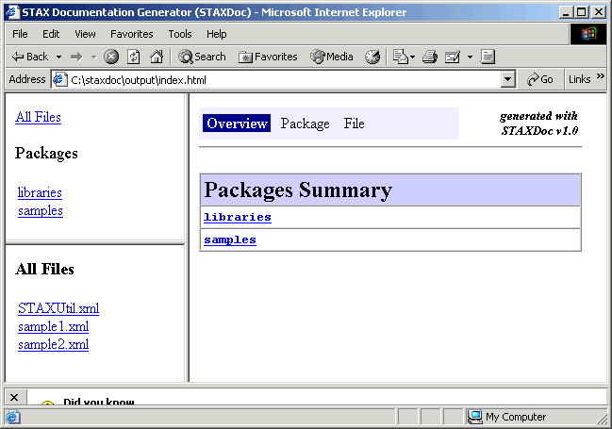
STAXDoc – Examples (cont.)
Here's a view of the HTML documentation generated by STAXDoc for the overall documentation obtained by specifying the index.html file in the destination directory:

Slide 64
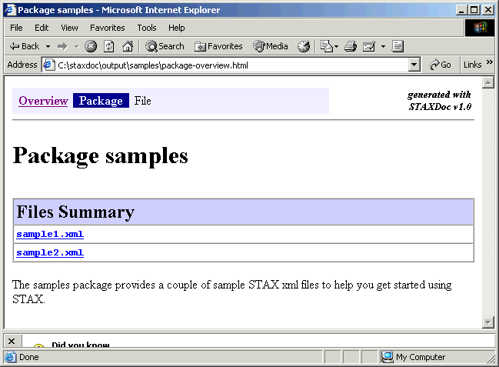
STAXDoc – Examples (cont.)
Here's a view of the HTML documentation generated by STAXDoc for the samples package obtained by clicking on samples in the upper left panel under "Packages" and then clicking on samples in the lower-left panel:

Slide 65
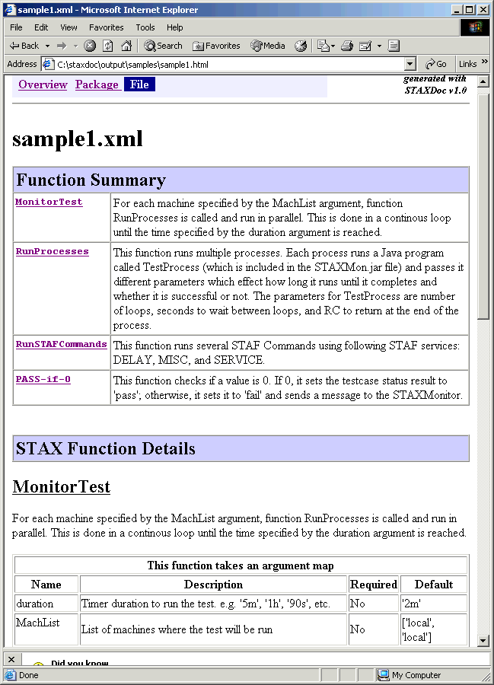
STAXDoc – Examples
Here's a view of part of the HTML documentation generated by STAXDoc for file sample1.xml obtained by clicking on sample1.xml
Note that a summary of all of the functions defined in the xml file are shown first, followed by a detailed description of each function

Slide 66
STAX Extensions
STAX service extensions allow you to extend the STAX DTD and define
additional XML elements that can be used in STAX jobs
STAX Monitor extensions define new plug-in views that can be displayed via
the STAX Monitor
  For example, you may want to register a STAX monitor extension that
  displays a new extension element in the "Active Job Elements" panel
  Or you may want to register a STAX monitor extension that displays a
  new tab in the "Active Job Elements" or "Info" panel
For more information on how to write a STAX extension, you can access the STAX Extensions Developer's Guide at:
http://staf.sourceforge.net/current/staxdg.html

Slide 67
STAX Extensions - Registering
STAX service and monitor extensions are registered via the PARMS option when configuring the STAX service (either in the STAF.cfg file or dynamically using a SERVICE ADD request)
STAX extensions are provided in a jar file. A single jar file can contain one or more service and/or monitor extensions.
You can specify the STAX extension jar files that you want to register using an EXTENSIONXMLFILE parameter or using EXTENSION parameters

Slide 68
STAX Extensions – Registering (cont.)
Syntax:
SERVICE <Name> LIBRARY JSTAF EXECUTE <STAX Jar File Name>
[OPTION <Name[=Value]>]...
[PARMS <"> [EVENTSERVICEMACHINE <EventMachine>]
[EVENTSERVICENAME <EventName>]
[NUMTHREADS <NumThreads>]
[PROCESSTIMEOUT <ProcessTimeout>]
[CLEARLOGS <Enabled | Disabled>]
[LOGTCELAPSEDTIME <Enabled | Disabled>]
[LOGTCNUMSTARTS <Enabled | Disabled>]
[LOGTCSTARTSTOP <Enabled | Disabled>]
[EXTENSIONXMLFILE <Extension XML File> |
EXTENSIONFILE <Extension Text File>]
[EXTENSION <Extension Jar File>]...
<">]
    Note: Parameters shown in red have been deprecated.

Slide 69
STAX Extensions – Registering (cont.)
EXTENSIONXMLFILE
  Specifies the fully-qualified name of an extension XML file that defines all
  of the STAX extensions to be registered in an XML format
  We recommend using the EXTENSIONXMLFILE parameter to register
  STAX extensions as it provides the ability to specify parameters for
  extensions (if the extension supports parameters) and to include or
  exclude specific elements provided in the extension jar file
EXTENSION
  Specifies the fully-qualified name of an extension jar file that defines a
  STAX extension to be registered. The format is:
  <Jar File Name> [ # elementName1 elementName2 ...]
  If no elements are specified when registering the extension, all of the
  elements with staf/stax/extension/<element> entries in the extension jar
  file's manifest file will be registered

Slide 70
STAX Extensions – Registering (cont.)
Example: Configure the STAX service and register all the STAX extensions specified in an extension xml file named extensions.xml in the services/stax directory off the STAF root directory
SERVICE STAX LIBRARY JSTAF EXECUTE C:/STAF/services/stax/STAX.jar
OPTION J2=-Xmx512 \
PARMS "EXTENSIONXMLFILE C:/STAF/services/stax/extensions.xml"
Example: Configure the STAX service using the EXTENSION option to specify extension jar files C:/STAXExt/ExtDelay.jar and C:/STAXExt/MyExt.jar
SERVICE STAX LIBRARY JSTAF EXECUTE C:/STAF/services/stax/STAX.jar \
OPTION J2=-Xm512 \
PARMS "EXTENSION C:/STAXExt/ExtDelay.jar EXTENSION C:/STAXExt/MyExt.jar"
Example: Configure the STAX service using the EXTENSION option to specify extension jar file C:/STAXExt/ExtDelay.jar and to only register the ext-delay and ext-wait elements)
SERVICE STAX LIBRARY JSTAF EXECUTE C:/STAF/services/stax/STAX.jar \
PARMS "EXTENSION \"C:/STAXExt/ExtDelay.jar # ext-delay ext-wait\""

Slide 71
Creating a STAX Extension XML File
A STAX extensions xml file defines the STAX extensions to be registered when configuring the STAX service
This xml file must comply with the STAX Extension File DTD
An example of a STAX extension xml file that registers the sample message and delay extensions is:
<?xml version="1.0" encoding="UTF-8" standalone="no"?>
<!DOCTYPE stax-extensions SYSTEM "stax-extensions.dtd">
<stax-extensions>
<extension jarfile="{STAF/Config/STAFRoot}/services/stax/ExtMessageText.jar"/>
<extension jarfile="{STAF/Config/STAFRoot}/services/stax/ExtDelay.jar">
<parameter name="delay" value="5"/>
<exclude-element name="ext-wait"/>
<exclude-element name="ext-sleep"/>
</extension>
</stax-extensions>

Slide 72
STAX Monitor Extensions - Registering
Any STAX monitor extensions that are registered with the STAX service will be automatically made available to any STAX Monitors configured to use this STAX service machine
To view monitor extensions that are registered with the STAX Monitor, from the main "STAX Job Monitor" panel, click on the File->Properties->Extensions tab
You can override or add extension jar files for your STAX Monitor via the
File->Properties->Extension Jars tab
You can also display the monitor extensions that are registered by specifying the
-extensions option when starting the STAX Monitor

Slide 73
STAX Variables
The following variables are set in Python during Job Execution by the STAX service and can be referenced by your job definition. However, do not change their values.
RC - the return code from a <stafcmd>, <process> element, or <timer> element
STAFResult - the result from a <stafcmd>, <process>, or <job> element
STAFResultContext - the marshalling context object for the result from a <stafcmd> element. Its string representation is equivalent to the "verbose format" (the hierarchical nested format) provided by the STAF executable
STAFRC - the alias for the imported com.ibm.staf.STAFResult Java class. It contains constant definitions for STAF return codes (e.g. STAFRC.Ok, STAFRC.DoesNotExist)
STAXResult - the result from a function <call>, <call-with-list>, <call-with-map>, <process>, <job>, or <import> element

Slide 74
STAX Variables (cont.)
STAXJobID - the Job ID of the STAX job
STAXSubJobID - the Job ID of the STAX sub-job (executed via a <job> element)
STAXJobName - the name of the job specified on the EXECUTE request
STAXJobWriteLocation - the name of a directory on the STAX service machine that the job can use to store data in
STAXJobXMLFile - the fully qualified name of the file containing the XML document
STAXJobXMLMachine - the machine where the file containing the XML document is located
STAXJobSourceMachine - the endpoint of the machine submitting the EXECUTE request

Slide 75
STAX Variables (cont.)
STAXJobSourceHandle - the handle of the process submitting the EXECUTE request
STAXJobSourceHandleName - the name of the handle of the process submitting the EXECUTE request
STAXJobScriptFileMachine - the endpoint for the machine where the script files are located
STAXJobScriptFiles - a list of names of script files
STAXJobStartDate - the date the job started in format yyyymmdd
STAXJobStartTime - the time the job started in format hh:mm:ss
STAXJobStartFunctionName - the name of the starting function for the STAX job

Slide 76
STAX Variables (cont.)
STAXJobStartFunctionArgs - the arguments passed to the starting function for the STAX job (in string format)
STAXJobUserLog - a STAFLog wrapper object for the STAX Job User Log
STAXThreadID - the Thread ID currently running
STAXCurrentBlock - the name of the current block running in a thread
STAXCurrentTestcase - the name of the current testcase running in a thread
STAXProcessHandle - the process handle
STAXServiceName - the registered name of the STAX service executing the job

Slide 77
STAX Variables (cont.)
STAXServiceMachine - the machine name (logical machine identifier) of the STAX service machine (the local machine)
STAXServiceMachineNickname - the machine nickname of the STAX service machine (the local machine)
STAXEventServiceName - the registered name of the Event service (to which the STAX service submits requests)
STAXEventServiceMachine - the machine name of the Event service machine
STAXJobLogName - the name of the STAX job log for the current job (e.g. STAX_Job_1)
STAXJobUserLogName - the name of the STAX job user log for the current job (e.g. STAX_Job_1_User)

Slide 78
STAX Variables (cont.)
STAXMessageLog - a flag indicating if the message being logged via a <log> element should also be sent to the STAX Monitor's message panel
STAXLogMessage - a flag indicating if the message being sent to the STAX Monitor's message panel via a <message> element should also be logged to the STAX Job User log
STAXLogTCElapsedTime - a flag indicating if "Log TC Elapsed Time" is enabled or disabled for the STAX job
STAXLogTCNumStarts - a flag indicating if "Log TC Num Starts" is enabled or disabled for the STAX job
STAXLogTCStartStop - a flag indicating if "Log TC Start/Stop" is enabled or disabled for the STAX job
STAXArg - the arguments passed when calling a function that did not define its arguments

Slide 79
STAXUtil Functions
STAF
  Submits a request to STAF. It is a shortcut for the <stafcmd> element.
STAFProcess
  Submits a STAF request to start a process in a separate shell (using the
  default shell command). It is a shortcut for the <process> element when
  you only need to specify the command to be started in a separate shell.
STAFProcessUsing
  Submits a STAF request to start a process using a map to define values for
  the process element's sub-elements. It is a shortcut for the <process>
  element when additional options need to be specified.

Slide 80
STAXUtil Functions
STAXUtilLogAndMsg
  Logs a message and sends the message to the STAX Monitor. It is a
  shortcut for specifying the <message> and <log> elements for the same
  message.
STAXUtilWaitForSTAF
  Waits for STAF to become available (i.e., for the STAFProc daemon to
  be running) on one or more machines
STAXUtilCopyFiles
  Copies files from a directory on a machine to a directory on the same or different machine

Slide 81
STAXUtil Functions
STAXUtilListDirectory
  Lists files in a directory on a machine. You can specify which files to list
  using the name pattern, extension pattern, case sensitivity, and/or regular
  expression arguments.
STAXUtilCheckSuccess
  Checks if a result indicates success or failure
STAXUtilImportSTAFVars
  Imports STAF variables on the specified machines, creating STAX variables from them
STAXUtilImportSTAFConfigVars
  Imports STAF Configuration variables on the specified machine, creating a STAX variable map containing their values

Slide 82
STAXUtil Functions
STAXUtilExportSTAFVars
  Exports STAX variables, creating STAF variables from them on the
  specified machines
STAXUtilQueryAllTests
  Query the results for all testcases in the currently running job, accumulating
  the total number of testcases, passes, and fails recorded so far as well as a
  map of all the testcases and their passes, fails, elapsed time, and number
  of start
STAXUtilQueryTest
  Query the results for a single testcase in the currently running job

Slide 83
IBM Rational Quality Manager integration with STAF/STAX
You can integrate IBM Rational Quality Manager (RQM) with software automation tools such as and STAF/STAX
When you integrate RQM with STAF/STAX, you can:
  Run scripts on remote lab resources
  View all the available scripts to run
  View the current status of any scripts that have been run
There are two deployment models for running STAF/STAX:
  An integrated STAX server
  An external STAX server
  In both cases, the RQM server and test machines must have the STAF service installed and running
More information can be found at
http://publib.boulder.ibm.com/infocenter/rqmhelp/v1r0m0/index.jsp?topic=/com.ibm.rational.test.lm.doc/topics/c_int_stafstax.html

Slide 84
RQM integration with STAF/STAX - Overview
RQM provides a complete test management and requirements management solution
RQM V1.0.1 includes a STAF/STAX integration adapter, which allows STAX automation to be run natively from RQM
Lab resource characteristics based off of STAF variables (CPU, memory, OS, etc) automatically retrieved and populated in Lab Manager
Ability to run a STAX job on any lab machine that is running STAFProc
STAX job status updated in real time; view results and logs in Lab Manager

Slide 85
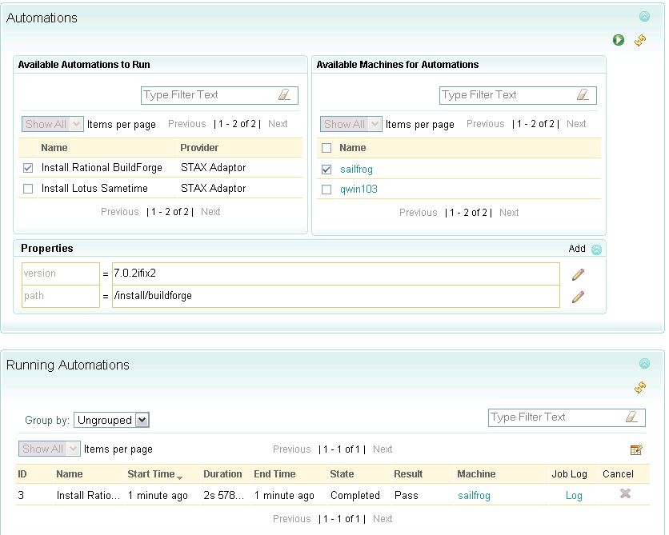
Using RQM to Run STAX Jobs

Slide 86
STAX Global Class
The STAXGlobal class is a Python class which STAX provides as a wrapper to provide for the creation of truly global variables, even across STAX-Threads and when used in functions declared with a local scope
Whenever a new STAX-Thread is created, existing variables are cloned from the parent STAX-Thread
STAX elements that can create STAX-Threads include the following:
  function elements with a local scope
  parallel
  paralleliterate
  process-action
  job-action

Slide 87
STAX Global Class (cont.)
To create a global variable that can be accessed across STAX-Threads, create a variables that is an instance of the STAXGlobal class
A STAXGlobal variable allows you to modify its value if it is passed into a local-scoped function or if it is shared across multiple threads
However, creating a STAXGlobal inside a local-scoped function will not cause it to appear once that function has returned
  Any variable created within a local-scoped function will disappear when that function ends
  Normally, any updates to variables disappear as well, but STAXGlobals allow updates to persist, so long as the STAXGlobal variable was created before the local-scoped function was called

Slide 88
STAX Global Class (cont.)
The STAXGlobal class provides the following constructor and methods:
  STAXGlobal(value = None) - Constructs a new instance of a STAXGlobal variable. If no value is specified, it's value defaults to None.
  set(value) - Sets a value for the STAXGlobal variable
  get() - Returns the value for the STAXGlobal variable
Note that you will generally want to use a list to define a STAXGlobal variable even if its value is just an integer or a string

Slide 89
STAX Global Class (cont.)
For example, when function Main (see below) is called, the message it displays is (2, 3, 3, 3), not (3, 3, 3, 3) as you may have thought would be displayed
<function name="Main" scope="local">
<sequence>
<script>
ctr = STAXGlobal(2) # Be careful if you don't use a list
gCtr = STAXGlobal([2]) # Instead, use a list to define
gCtr2 = STAXGlobal(2) # No list, but set method is used.
gCtr3 = STAXGlobal(2) # Be careful if you don't use a list
</script>
<call function="'TestSTAXGlobal'"/>
<message>ctr, gCtr[0], gCtr2, gCtr3</message>
</sequence>
</function>
<function name="TestSTAXGlobal" scope="local">
<script>
ctr = ctr + 1 # Now ctr is bound to an integer
# object, not a STAXGlobal
gCtr[0] = gCtr[0] + 1 # Still a STAXGlobal
gCtr2.set(gCtr2 + 1) # Still a STAXGlobal
gCtr2.set(gCtr2.get() + 1) # Still a STAXGlobal
gCtr3 += 1 # Still a STAXGlobal
</script>
</function>

Slide 90
STAX Global Class (cont.)
Note that STAXGlobal variables are not atomic across STAX-Threads. That is, if you created the following STAX variable:
<script>gTestIndex = STAXGlobal([0])</script>
And then in a paralleliterate or in a parallel element you incremented this variable as follows:
<script>gTestIndex[0] += 1</script>
If two STAX-Threads updated the counter at exactly the same time, you could end up with the wrong value
You can resolve this issue by using the STAF SEM service to create a mutex semaphore and use it to synchronize access to a STAXGlobal variable

Slide 91
Part 4D – Break/LAB (15 min.)
Exercises 4.2-4.3

Slide 92
Part 4E – STAX Debugging

Slide 93
Exception Stacktrace when catching STAX exceptions
The <catch> element has the following attributes:
  exception - the name of the exception that the catch element handles
  var - the name of a variable containing any additional information provided when the exception was thrown
  typevar - he name of a variable containing the specific type of exception thrown
  sourcevar - the name of a variable containing the source information for the exception. This variable will be a Python class containing the following functions:
    getSource - a Python string containing the source information in the format: throw: <exception-name> (Line: <number>, File: <xml-file>, Machine: <machine>)
    getStackTrace - a Python list containing the stack trace. Each item in the Python list represents a single stack frame (as a string). The frame at the bottom of the stack represents the execution point at which the stack trace was generated (i.e. the execution point where the exception was thown)
    Accessing the sourcevar class directly will return a formatted representation
It is recommended that you always log the stack trace information when catching STAX exceptions

Slide 94
Exception Stacktrace - Examples
Here is a <catch> element that logs the stack trace information:
<catch exception="'...'" var="eInfo" sourcevar="eSource">
<sequence>
<log level="'fail'">
'[Error %s@%s]: %s\n\n%s' % (STAXCurrentTestcase, STAXCurrentFunction, eInfo, eSource)
</log>
<tcstatus result="'fail'">eInfo</tcstatus>
<return>1</return>
</sequence>
</catch>

Slide 95
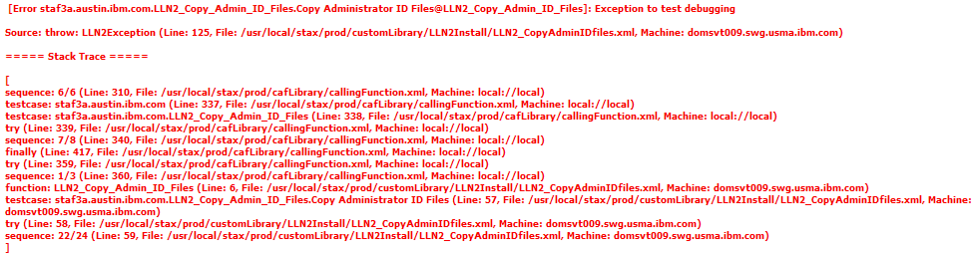
Exception Stacktrace – Examples (cont.)
With this <catch> element, here is an example of what the Job User log could contain if the exception is thrown:

Slide 96
STAX Debugging Capabilities - Overview
STAX V3.4.0 (or later) provides breakpoint capabilities when executing STAX jobs and allows you to step through elements in a STAX job
When executing a STAX job, you can specify any number of breakpoints when submitting the job for execution, or after the job has started
You can set breakpoints for:
  A function name, which means the STAX job will break whenever that function is called
  A line # in a specified STAX xml file, which means the STAX job will break immediately prior to executing the STAX task at that line number in the specified xml file
  The beginning of the first function in the STAX job (or subjob)
You can also include <breakpoint> elements within your STAX job to denote a breakpoint
You can also stop a running thread in a STAX job. After the thread completes the task it is currently executing, the thread will be at a breakpoint.

Slide 97
STAX Debugging Capabilities – Overview (cont.)
There can be one active breakpoint for each STAX thread running within a STAX job
When a breakpoint is reached within a STAX job, the current STAX thread’s execution will pause, and the user will be able to retrieve all the Python variables that are currently set in the thread
When a breakpoint is reached, you can:
  Execute Python code in the current thread (to update variable values and set new variables)
  Resume the breakpoint
  Step Into the breakpoint, meaning that the next task in the STAX job will execute, after which another breakpoint will be reached
  Step Over the breakpoint, meaning that the next task, including any sub-tasks, in the STAX job will execute, after which another breakpoint will be reached

Slide 98
STAX Debugging Capabilities – Overview (cont.)
The STAX Monitor provides a Debug tab that allows you to:
  Set, resume, and step breakpoints
  View active breakpoints in each thread
  View the following information for each active breakpoint:
    The Python variables set in the thread
    The STAX xml file with the breakpoint line highlighted and scrolled to
    Thread information (i.e. Date-Time Started, Call stack, Condition stack)

Slide 99
STAX Debugging – Setting Breakpoints
You can set breakpoints when submitting a STAX job for execution, or dynamically after the job has started
EXECUTE < <FILE <XML File Name> [MACHINE <Machine Name>]> | DATA <XML Data> >
[JOBNAME <Job Name>] [FUNCTION <Function ID>] [ARGS <Arguments>]
[SCRIPTFILE <File Name>... [SCRIPTFILEMACHINE <Machine Name>]]
[SCRIPT <Python Code>]... [CLEARLOGS [<Enabled | Disabled>]]
[ HOLD | TEST [RETURNDETAILS] |
WAIT [<Number>[s|m|h|d|w]] [RETURNRESULT [DETAILS]] ]
[ NOTIFY ONEND [BYNAME] [PRIORITY <Priority>] [KEY <Key>] ]
[LOGTCELAPSEDTIME <Enabled | Disabled>]
[LOGTCNUMSTARTS <Enabled | Disabled>]
[LOGTCSTARTSTOP <Enabled | Disabled>]
[PYTHONOUTPUT <Python Output>] [PYTHONLOGLEVEL <Log Level>]
[ BREAKPOINT <Function name> | <Line>[@@<File>[@@<Machine>]] ]...
[BREAKPOINTFIRSTFUNCTION] [BREAKPOINTSUBJOBFIRSTFUNCTION]
ADD JOB <Job ID> BREAKPOINT
< FUNCTION <Function Name> |
LINE <Line Number> FILE <XML File> [MACHINE <Machine Name>] >
REMOVE JOB <Job ID> BREAKPOINT <Breakpoint ID>

Slide 100
STAX Debugging – Setting Function Breakpoints
To set a function breakpoint, you specify the name of the function (which is case-sensitive)
The job will reach a breakpoint every time a function with that name is called
Examples:
STAX EXECUTE FILE c:/automation/runall.xml BREAKPOINT BeginRegressionTests
STAX ADD JOB 5 BREAKPOINT FUNCTION updateDatabase

Slide 101
STAX Debugging – Setting Line Breakpoints
To set a line breakpoint, you specify the beginning line number of the STAX element. You can also optionally specify:
  The fully-qualified XML file path for the STAX XML containing the line for which you want to set the breakpoint. If you do not specify the XML file, then the STAXJobXmlFile will be used.
  The XML file machine. If the XML file machine is not specified, the STAX job will break immediately prior to executing the STAX task whose line number and XML file match (regardless of the task's XML file machine)
Examples:
STAX EXECUTE FILE c:/automation/runall.xml BREAKPOINT 124
BREAKPOINT 38@@c:/util/TestUtilityFunctions.xml
STAX ADD JOB 5 BREAKPOINT LINE 890

Slide 102
STAX Debugging – Setting Line Breakpoints (cont.)
You must specify the beginning line number of the STAX element
Examples:
23: <stafcmd>
24: <location>'local'</location>
25: <service>'PING'</service>
26: <request>'PING'</request>
27: </stafcmd>
Use line number 23 to set a breakpoint for this <stafcmd>
492: <log if="RC != STAFRC.Ok" level="'warning'">
493: 'RC=%s on %s' % (RC, machName)
494: </log>
Use line number 492 to set a breakpoint for this <log>
1065: <script>
1066: from random import random
1067: r1 = random()*100
1068: r2 = random()*100
1069: </script>
Use line number 1065 to set a breakpoint for this <script>

Slide 103
STAX Debugging – Setting First Function Breakpoints
Use the BREAKPOINTFIRSTFUNCTION option to break at the first function that is called in the STAX job
Use the BREAKPOINTSUBJOBFIRSTFUNCTION option to break at the first function that is called in any subjobs started by the STAX job. This option propagates to any subjobs that the subjob starts.
Examples:
STAX EXECUTE FILE c:/automation/runall.xml
BREAKPOINTFIRSTFUNCTION
STAX EXECUTE FILE c:/automation/runall.xml
BREAKPOINTSUBJOBFIRSTFUNCTION

Slide 104
STAX Debugging – Using the <breakpoint> Element
You can also include <breakpoint> elements within your STAX job to denote a breakpoint
Example:
<sequence>
<call function="'Setup'"/>
<testcase name="Java2D">
<sequence>
<script>variationList = Java2DAPI[:]</script>
<script>jarName = '%s/%s' % (TestCaseDir, TestCaseFiles[0])</script>
<call function="'RunVariations'"/>
</sequence>
</testcase>
<breakpoint/>
<testcase name="Print">
<sequence>
<script>variationList = PrintAPI[:]</script>
<script>jarName = '%s/%s' % (TestCaseDir, TestCaseFiles[1])</script>
<call function="'RunVariations'"/>
</sequence>
</testcase>
</sequence>

Slide 105
STAX Debugging – Breakpoint/Thread Actions
For a currently running STAX thread, you can submit the following requests:
RESUME JOB <Job ID> THREAD <Thread ID>
STEP JOB <Job ID> THREAD <Thread ID> [INTO | OVER]
STOP JOB <Job ID> THREAD <Thread ID>
PYEXEC JOB <Job ID> THREAD <Thread ID> CODE <Python Code>
LIST JOBS | SETTINGS | FILECACHE | MACHINECACHE |
EXTENSIONS | EXTENSIONJARFILES |
JOB <Job ID> <THREADS | < THREAD <Thread ID> VARS [SHORT] > |
PROCESSES | STAFCMDS | SUBJOBS | BLOCKS | TESTCASES |
BREAKPOINTS>
QUERY EXTENSIONJARFILE <Jar File Name> | EXTENSIONJARFILES |
JOB <Job ID> [THREAD <Thread ID> [ VAR <VarName> [SHORT] ] |
PROCESS <Location:Handle> | STAFCMD <Request#> |
BLOCK <Block Name> | TESTCASE <Test Name>]

Slide 106
STAX Debugging – Resuming a Thread
RESUME will resume the thread's execution
Example:
STAX RESUME JOB 18 THREAD 7

Slide 107
STAX Debugging – Stepping a Thread
STEP will step the thread's execution
  If the INTO option is specified, the next task in the STAX job will execute, after which another breakpoint will be reached
  If the OVER option is specified, the next task, including any sub-tasks, in the STAX job will execute, after which another breakpoint will be reached
  The default step option is INTO
Examples:
STAX STEP INTO JOB 18 THREAD 7
STAX STEP JOB 24 THREAD 1 OVER
STAX STEP JOB 5 THREAD 6

Slide 108
STAX Debugging – Stopping a Thread
STOP will stop the thread's execution
  After the task currently being executed in the thread completes, the thread will reach a breakpoint
Example:
STAX STOP JOB 1 THREAD 3

Slide 109
STAX Debugging – Listing/Querying Thread Variables
LIST VARS returns all variables that are set in the specified thread
QUERY VAR allows you query the value for a specific variable
There are 2 formats that can be returned:
  The default format expands all of the variables
  Specifying the SHORT option shows the variables in the original Python format (and displays in a table format on the command line)

Slide 110
STAX Debugging – Listing Thread Variables
Examples
$ STAF local STAX LIST JOB 3 VARS THREAD 5 SHORT
Response
--------
Name Value Type
-------------- --------------------------------------- ------------------------
serverList ['myServer.austin.ibm.com', 'C:/install org.python.core.PyList
', 'serverA.portland.ibm.com', 'D:/inst
all', 'linuxServer.austin.ibm.com', '/u
sr/local/install']
testInfo {'platform': 'win32', 'osarch': 'amd64' org.python.core.PyDictio
, 'parms': {'ZIP': '78703', 'state': 'T nary
X', 'city': 'austin', 'purchases': {'it
ems': ['printerABC', 'routerXYZ', 'usbM
NO'], 'tax': 4.2, 'price': 59.23, 'tota
l': 63.43}}, 'language': ['english', 'f
rench']}

Slide 111
STAX Debugging – Querying Thread Variables
Examples
$ STAF local STAX QUERY JOB 3 VAR testInfo THREAD 5
Response
--------
[
{
Name : testInfo
Value: [
{
Name : platform
Value: 'win32'
Type : org.python.core.PyString
}
{
Name : osarch
Value: 'amd64'
Type : org.python.core.PyString
}

Slide 112
STAX Debugging – Querying Thread Variables (cont.)
Examples
{
Name : parms
Value: [
{
Name : ZIP
Value: '78703'
Type : org.python.core.PyString
}
{
Name : state
Value: 'TX'
Type : org.python.core.PyString
}
{
Name : city
Value: 'austin'
Type : org.python.core.PyString
}

Slide 113
STAX Debugging – Querying Thread Variables (cont.)
Examples
{
Name : purchases
Value: [
{
Name : items
Value: [
{
Name :
Value: 'printerABC'
Type : org.python.core.PyString
}
{
Name :
Value: 'routerXYZ'
Type : org.python.core.PyString
}
{
Name :
Value: 'usbMNO'
Type : org.python.core.PyString
}
]
Type : org.python.core.PyList
}

Slide 114
STAX Debugging – Querying Thread Variables (cont.)
Examples
{
Name : tax
Value: 4.2
Type : org.python.core.PyFloat
}
{
Name : price
Value: 59.23
Type : org.python.core.PyFloat
}
{
Name : total
Value: 63.43
Type : org.python.core.PyFloat
}
]
Type : org.python.core.PyDictionary
}
]
Type : org.python.core.PyDictionary
}

Slide 115
STAX Debugging – Querying Thread Variables (cont.)
Examples
{
Name : language
Value: [
{
Name :
Value: 'english'
Type : org.python.core.PyString
}
{
Name :
Value: 'french'
Type : org.python.core.PyString
}
]
Type : org.python.core.PyList
}
]
Type : org.python.core.PyDictionary
}
]

Slide 116
STAX Debugging – Executing Python Code in a Thread
PYEXEC will execute Python code in the current thread's python interpreter
Examples:
STAX PYEXEC JOB 1 THREAD 3 CODE "server='systemABC.company.com'"
STAX PYEXEC JOB 9 THREAD 12 CODE
"testInfo['language'].append('spanish');
testInfo['parms']['purchases']['tax'] = 8.25"

Slide 117
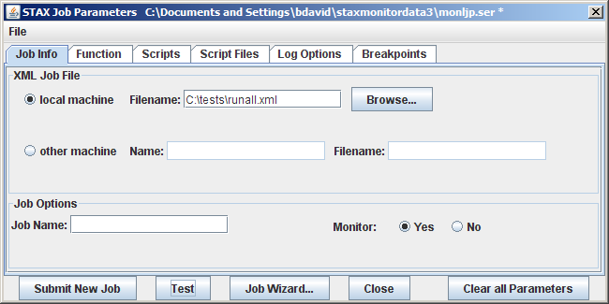
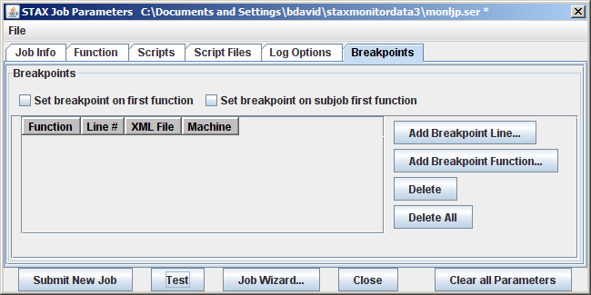
STAX Debugging – Setting Breakpoints in the STAX Monitor
In the STAX Job Parameters dialog, there is a new tab Breakpoints

Slide 118
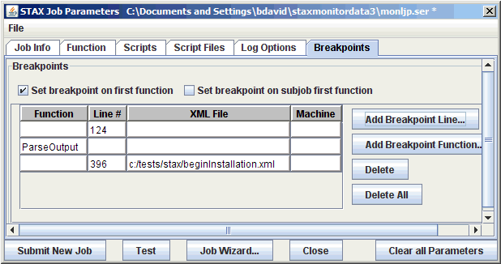
STAX Debugging – Setting Breakpoints in the STAX Monitor (cont.)
Enter one or more function/line breakpoints:

Slide 119
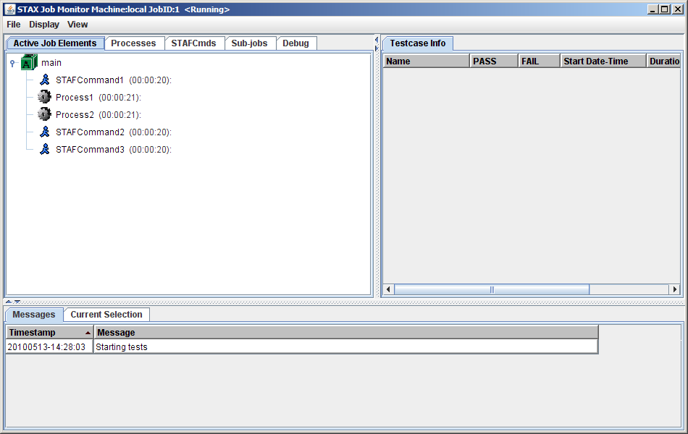
STAX Debugging – Using the STAX Monitor
Next, submit the job:

Slide 120
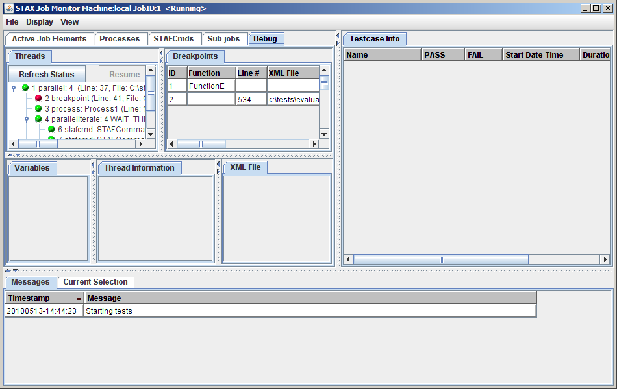
STAX Debugging – Using the STAX Monitor (cont)
There is a new tab Debug which displays the thread/breakpoint information:

Slide 121
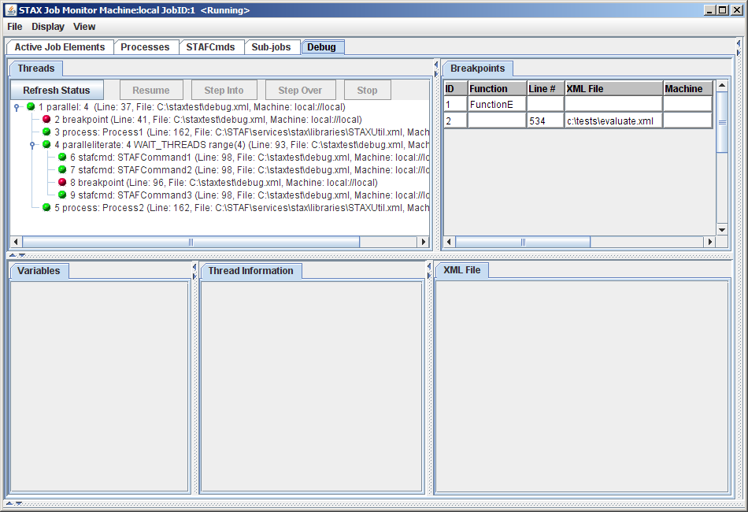
STAX Debugging – Using the STAX Monitor (cont)
Increase the size of the Debug tab panel:

Slide 122
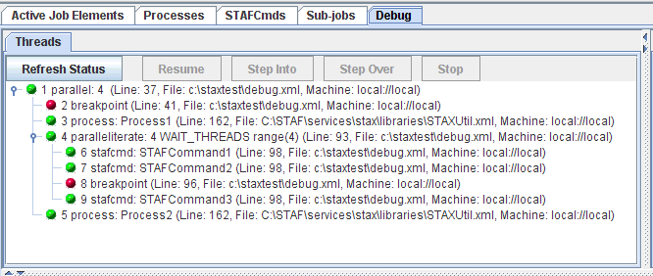
STAX Debugging – Using the STAX Monitor (cont)
The Threads tab shows a tree view of all of the currently running threads
  A green icon next to the thread number indicates the thread is running
  A red icon next to the thread number indicates the thread is at a breakpoint
  The text to the right of the thread number is the current action on the thread's stack

Slide 123
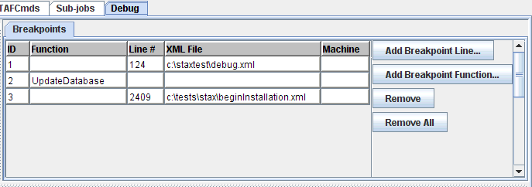
STAX Debugging – Using the STAX Monitor (cont)
The Breakpoints tab shows the breakpoints (line and function) that are currently set for the STAX job
  You can remove a specific breakpoint, or remove all breakpoints (both present a confirmation dialog)
  You can also add a line/function breakpoint

Slide 124
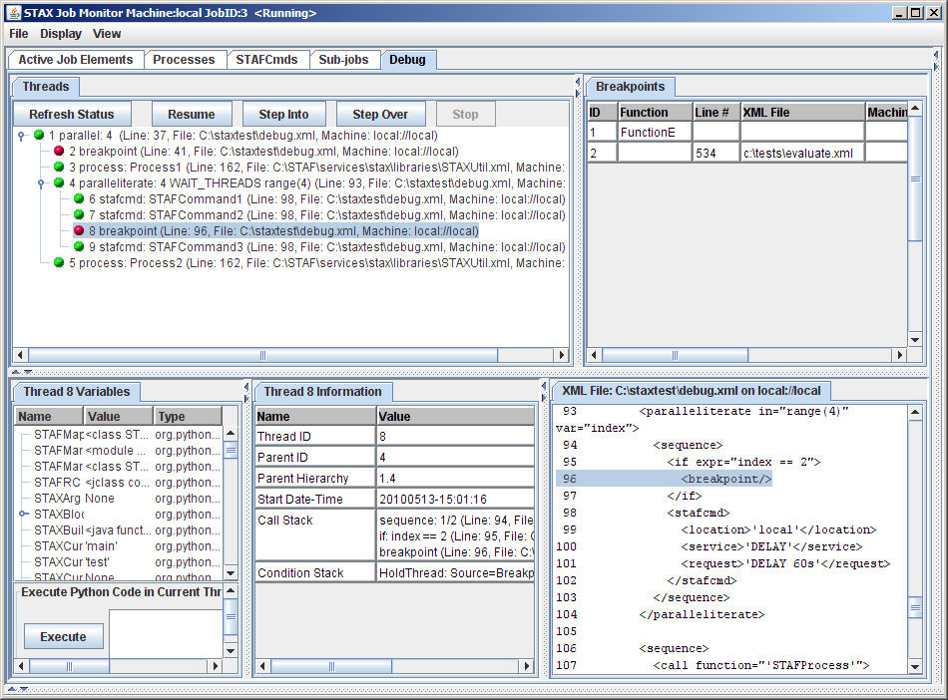
STAX Debugging – Using the STAX Monitor (cont)
The tabs in the bottom panel, "Variables", "Thread Information", and "XML File" are related to the currently selected thread in the "Threads" tab
  If a thread is not selected, then these 3 tabs will be empty

Slide 125
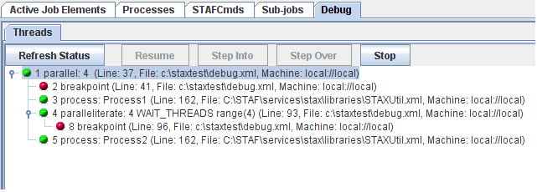
STAX Debugging – Using the STAX Monitor (cont)
If we select thread 1:

Slide 126
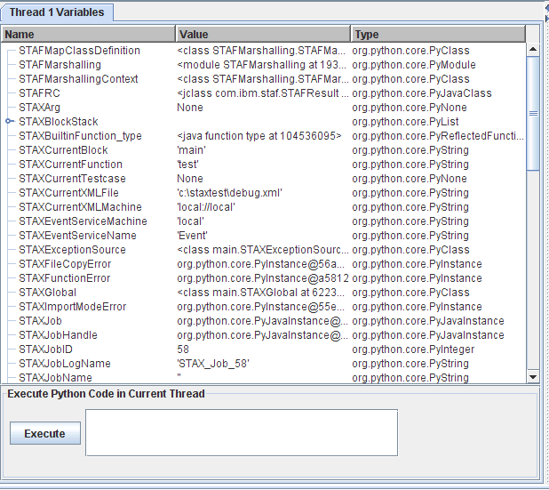
STAX Debugging – Using the STAX Monitor (cont)
The Thread 1 Variables tab shows all of the Python variables that are defined in the thread's Python interpreter

Slide 127
STAX Debugging – Using the STAX Monitor (cont)
The variables are shown in a tree table format, which shows a hierarchical view of any list/dictionary objects
If the variable is a list/tuple/dictionary, you can expand its node to see the items the variable contains
If you right-click in the tree table, a popup-menu will be displayed with "Expand All" and "Collapse All" which allow you to expand/collapse all of the nodes in the tree table

Slide 128
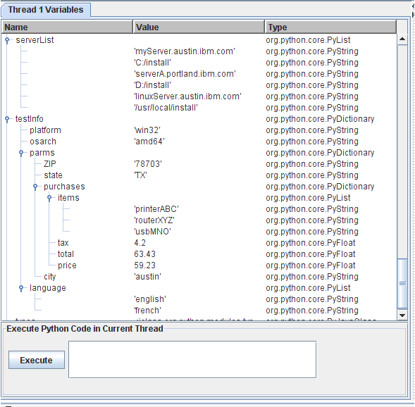
STAX Debugging – Using the STAX Monitor (cont)
In the Thread 1 Variables tab, if you expanded the nodes for testInfo, it would display as:

Slide 129
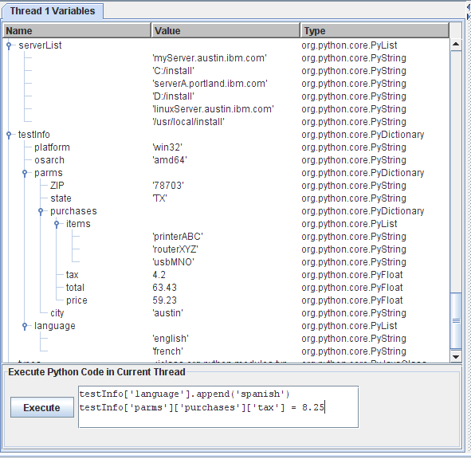
STAX Debugging – Using the STAX Monitor (cont)
You can enter any Python code in the Execute Python Code in Current Thread field. Clicking on Execute will submit a PYEXEC request for the selected thread.

Slide 130
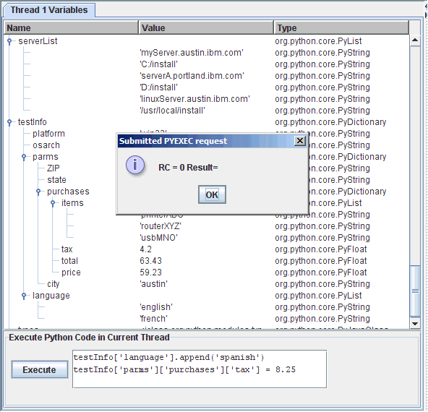
STAX Debugging – Using the STAX Monitor (cont)
When you click on Execute you will get a popup indicating the request was successful:

Slide 131
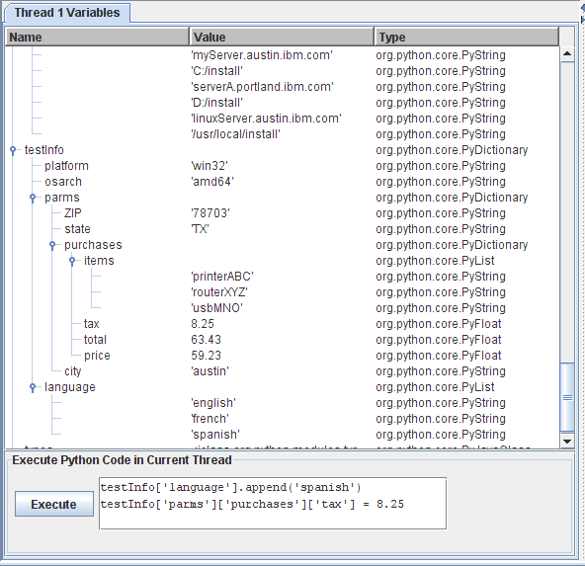
STAX Debugging – Using the STAX Monitor (cont)
The Thread 1 Variables tab will automatically be refreshed. If you expand the variables again, you will see the expected updates for "language" and "tax":

Slide 132
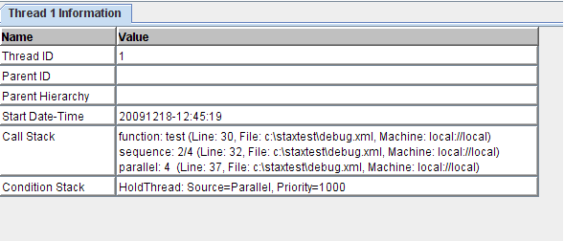
STAX Debugging – Using the STAX Monitor (cont)
The Thread 1 Information tab will show the "QUERY THREAD" output in a table format

Slide 133
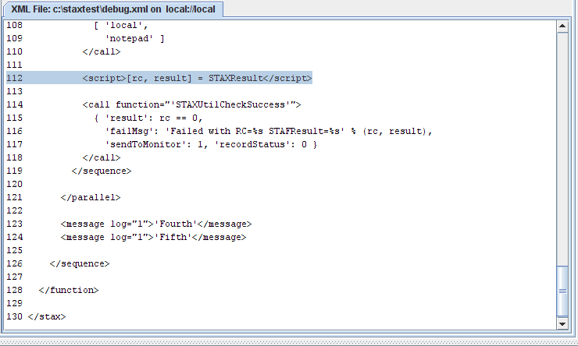
STAX Debugging – Using the STAX Monitor (cont)
The XML File tab will display the XML file for the action the thread is currently executing
  The tab name will include the XML file path/name and the XML file machine
  The tab will show a text panel with the XML file contents, including the line numbers
  The text panel will automatically be scrolled to the line corresponding to the action that the thread is currently executing; the line will also be highlighted

Slide 134
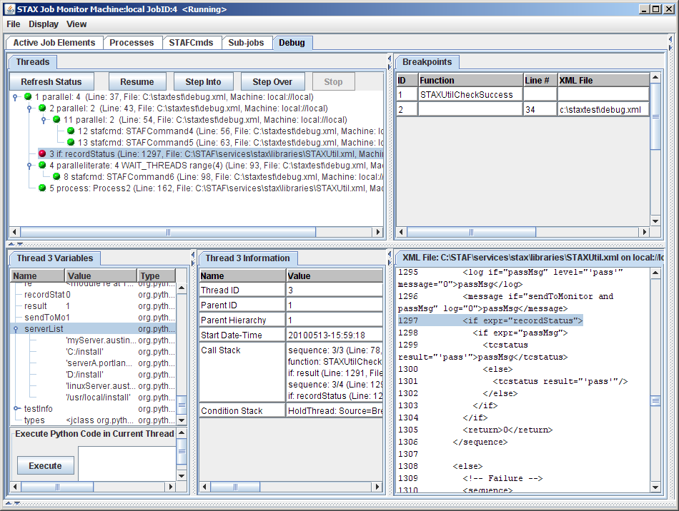
STAX Debugging – Using the STAX Monitor (cont)
Overall View:

Slide 135
Part 4E – Break/LAB (15 min.)
Exercise 4.4

Slide 136
End of Presentation
End of Presentation

