Slide 1
Hands-on Automation with STAF 3

Slide 2
Agenda - STAF
9:00AM - 9:40AM Part 1 - STAF Introduction
  What is STAF?
  Supported Platforms and Languages
  STAF Customer Usage
  Basic STAF Concepts
  The STAF Web Page
  Installing STAF
  Running STAF
  Configuring STAF
  Registering Services
  Interacting with STAF
  Basic STAF Commands
9:40AM - 10:00AM Break / Lab (Exercises 1 - 5)

Slide 3
Agenda – STAF (continued)
10:00AM - 10:30AM Part 2 - Leveraging STAF
  STAF Services
  STAF Variables
  Running a simple Testcase
  Running a STAF-enabled Testcase
  STAF Support for Java Testcases
  STAF Support for C++ Testcases
  STAF Support for Perl Testcases
  STAF Support for Python Testcases
  STAF Support for Tcl Testcases
  STAF Support for shell-scripts
10:30AM - 11:00AM Break / Lab (Exercises 6 - 8)

Slide 4
Agenda – STAF (continued)
11:00AM - 12:00PM Part 3 - Advanced Topics
  The STAF Demo
  Tracing
  Debugging STAF
  Writing custom STAF Services
12:00PM - 1:30PM Lunch / Lab (Exercises 9 - 11)

Slide 5
Part 1 - STAF Introduction

Slide 6
About STAF
STAF
STAF (Software Testing Automation Framework)
  Peer-to-peer pluggable framework geared towards test automation
  History
    Created in 1998
    Corporate funded (via ITCL) since 1999
    Open-sourced (LGPL) in 2001
  Community
    130+ IBM teams (world-wide)
    80+ external companies
    50k+ downloads of STAF and associated plug-ins since 4Q/2001

Slide 7
What is STAF?
STAF is an Open Source automation framework designed around the idea of reusable components, called services
It is intended to make it easier to create automated testcases and workloads
STAF can help you increase the efficiency, productivity, and quality of your testing by improving your level of automation and reuse in your individual testcases as well as your overall test environment
Note: This presentation is relative to STAF 3.0.0

Slide 8
STAF as “Middleware for Test”
IBM doesn’t ask or expect its customers to build applications from scratch
IBM customers build their applications on top of our middleware products, such as DB2, MQSeries, and Websphere
By leveraging these products, customers are able to develop individual applications much more quickly and easily, and these applications integrate together more cohesively
STAF provides this type of foundation for the test environment
It provides reusable components that make it easier to create your tests and test environments
It provides an infrastructure that makes it easier to manage your tests and test environments
It provides a common base upon which IBM’s test teams can build and share

Slide 9
STAF as “CORBA-Lite”
At its core, STAF acts as a broker, similar to CORBA, DCE, Grid, etc.
STAF simplifies the broker concept by using a basic string request/result format
  Removes the need for IDLs and the like
  Greatly simplifies its use (by non-programmers)
  Eases use in shell-script and batch files
  Command line support for “free”
  Simplifies addition of new language support
In hindsight, this was probably the most important and beneficial decision we made in the design of STAF

Slide 10
STAF for Test Cases
STAF provides a number of facilities that ease the implementation of (complex) test cases
Standardized and robust logging (Log)
Remote status monitoring (Monitor)
Resource management (ResPool)
Synchronization (Sem)
Messaging/Notification (Queue, Event)
Dynamic data/configuration management (Var)

Slide 11
STAF for Test Environments
STAF Provides facilities for automating your test environment (including test harness development)
This is probably the most well-known of STAF’s uses
Process invocation (Process)
File Transfer (FS)
File Packaging/Unpackaging (Zip)
Synchronization (Sem)
Resource management (ResPool)
Dynamic data/configuration management (Var)
Scheduling (Event, EventManager, Cron)
Notification (Email)
Workflow (STAX)

Slide 12
Supported STAF Platforms/Languages
Win32
  Win95/98/98SE/Me
  WinNT/2000/XP/2003/IA64
Linux
  IA-32/64, PPC-64, z/Linux
AIX 4.3.3+
Solaris 2.6+
HP-UX 11.00+
  PA-RISC, IA-64-32, IA-64-64
OS/400 V5R2+
z/OS V1.4+
C/C++
Java
Perl
Python
Tcl
Rexx
shell-script
command-line
Notes:
Note for languages: not all of these are supported as STAF Services
Talk about differences between Major and Minor releases
Mention that we have a back-level version of STAF for OS/2

Slide 13
STAF Customer Usage (Internal – IBM)
Netfinity Server Test (Raleigh)
Linux Test Project (Austin)
WebSphere Edge Server Trigger Monitor Test (Pittsburgh)
Printing Systems (Boulder)
WebSphere (Austin, Raleigh, Hursley, Rochester)
Solutions Technologies Build (Austin)
CICS (Hursley)
MQSI (Hursley)
NAS (Portland)
WebSphere Everyplace Wireless Gateway (Raleigh)
DB2 (Toronto, Santa Teresa)
Tivoli Workload Scheduler (Rome)
Informix FVT (Beaverton)
AIX Product Test (Austin)
LDAP FVT (Austin, India)
SYNC Client and Performance (Silicon Valley)
Lotus (Westford)
eCommerce product FVT/SVT (China)
Tivoli Risk Manager FVT (Austin)
Global Print Test (Boulder)
WebSphere Build (Austin)
DASD Subsystem Test (Tucson)
Java SVT (Hursley)
Interactive Financial Systems (Austin)

Slide 14
STAF Customer Usage (External)
Caldera
Nokia
Symantec
Xerox
HP
SAS
Ammunerve Development Services
Sandia National Laboratories
QUALCOMM
CERN – European Organisation for Nuclear Research
TopSpin
Agilent
Veritas
ESSsoftware
ClariStore
Sega
Intel
Siemens
Paragon Solutions
Progressive Auto Insurance
Systemware
Kentrox
Alberta Research Council
Sun Microsystems

Slide 15
Basic STAF Concepts - STAFProc
STAF runs as a daemon process, called STAFProc, on each system
For example, if you wanted to run STAF on your office machine and 5 test machines in a lab, you would install STAF on all 6 systems. Then, to use STAF in this environment, you would start STAFProc on all 6 machines.
The collection of machines on which you have installed STAF is referred to as the STAF Environment

Slide 16
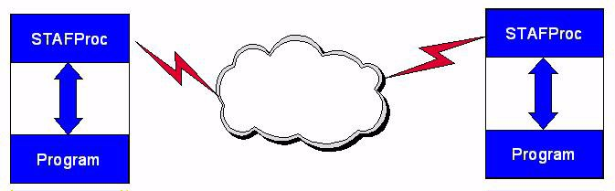
Basic STAF Concepts - STAFProc (continued)
STAF operates in a peer-to-peer environment; in other words, there is no client-server hierarchy among machines running STAF

Slide 17
Basic STAF Concepts - STAF Services
STAF services are reusable components that provide all the capabilities in STAF. Each STAF service provides a specific set of functionality (such as Logging) and defines a set of requests that it will accept.
STAF Services are used by sending STAF requests to them. A STAF request is simply a string which describes the operation to perform. STAF requests can be sent to services on the local machine or to another, remote, machine in the STAF Environment. In either case, the STAFProc daemon process handles the sending and receiving of requests.

Slide 18
Basic STAF Concepts - STAF Identification
Machine names are used to identify different systems in the STAF Environment. Typically, a STAF machine name is simply the TCP/IP host name of the machine.
Since multiple instances of STAF can be run at the same time on the same system, an Instance name is used to specify a name for each STAF Instance.
A handle is a unique identifier (associated with a process) which is used when submitting requests to STAF. This handle, combined with the STAF Instance name, uniquely identifies a particular process on a STAF machine.
It is this combination of machine name, instance name, and handle that allows STAF Services to track requests from multiple processes on different machines. Every process that accesses STAF does so through a handle.

Slide 19
Basic STAF Concepts - STAF Variables
STAF provides facilities to store and retrieve variables, such as
  Testcase configuration information
  Runtime/state information
  System environment information
STAF variables live within the STAFProc daemon, which allows them to be dynamically updated without having to start and stop applications using them
  After the update, applications referencing the variable will get the new value
STAF maintains a system variable pool that is common to all the handles on a STAF machine
STAF also maintains a shared variable pool which is also system-wide, but which will be sent across the network and used in variable resolution on remote systems
In addition, each handle has its own unique variable pool
By default, the values of variables in a handle's variable pool override the values of variables in the global variable pool
  A handle may override this behavior when asking for the value of a variable

Slide 20
Basic STAF Concepts - STAF Queues
Each handle in STAF has a priority-based message queue associated with it
  Applications receive messages sent from other processes/machines on their queue
STAF Queues serve as the basis for local/network Inter-Process Communication (IPC) in the STAF environment
STAF Queues form the foundation for event-driven programming in the STAF environment

Slide 21
Basic STAF Concepts - STAF Security
Security in STAF can be defined at the machine level and/or user level
In other words, you grant access to machines and/or to users
Access in STAF is granted by specifying a certain trust level for a machine or user, where trust level 0 indicates no access and trust level 5 indicates full access
Users assign a numeric trust level to specific machines and/or users
Other machines receive a default user-configurable trust level
Each service in STAF defines what trust level is required in order to use the various functions the service provides
A simple numerical comparison is used to see if the request is authorized

Slide 22
Basic STAF Concepts - Types of STAF Services
Internal STAF Services
  The executable code for internal STAF services resides within STAFProc, which means they are always available and have a fixed name
External STAF Services
  The executable code for external STAF services resides outside of STAFProc, for example in a Java jar file, a C++ DLL file, or a Rexx script file
Custom STAF Services
  Note that you can also write your own custom services that can be plugged into STAF.
  All Custom STAF Services are external services

Slide 23
Basic STAF Concepts - STAF Authenticators
Authenticators are special external STAF services whose purpose is to authenticate users in order to provide user level trust, which can be used in addition to (or instead of) machine level trust.
An Authenticator is a special service that accepts an authenticate request
  As a user, you cannot directly submit a request to an authenticator service
  Authenticators are accessed indirectly via the Handle service
In order to use user trust security in STAF, you must have at least one authenticator registered
A sample authenticator is provided for STAF V3.0.0. You can write your own authenticators. In the next release of STAF, we will provide an IBM Intranet authenticator and a secure TCP/IP connection provider.

Slide 24
Basic STAF Concepts - STAF Connection Providers
Currently, the only network interface which comes with STAF is TCP/IP
However, STAF allows you to plug in network interfaces, called Connection Providers, so that you can create your own connection provider which can communicate via any mechanism you choose (e.g. SSL, a Serial Line, NetBIOS, or SNA)
Connection provider interfaces are C/C++ based so they are platform specific

Slide 25
The STAF web page
The main STAF web page is http://staf.sourceforge.net
From this web page you can:
  Submit bugs and feature requests
  View the STAF source code
  Download the STAF binary files
  Download STAF services
  View STAF documentation
  Access Mailing Lists to view and post messages (Help, Announcements)
  Access Forums to view and post messages

Slide 26
STAF Installation
STAF Installation uses InstallShield 10.5, and provides an executable file (with a bundled JVM) and a Jar file (requires Java 1.2 or later)
  If InstallShield 10.5 does not support the installation platform, then we provide a script-based installer in a tar.gz file
STAF 3.0 allows you to do upgrade installs, instead of first uninstalling the existing version of STAF
  If installing at a location where STAF 2.x is installed, the installer will silently uninstall STAF 2.x, and then proceed with the 3.0 installation
  If installing at a location where STAF 3.x is installed, the installer will perform an upgrade installation
Non-GUI installations can be performed by using the “-silent” option
You can now install multiple different versions of STAF on a system
  STAF 2.6.6 in C:/STAF
  STAF 3.0.0 in C:/STAF300
  STAF 3.1.0 in D:/tools/STAF3.1.0

Slide 27
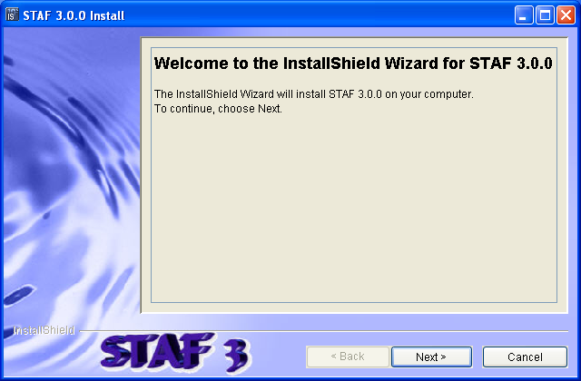
Installing STAF
Execute STAF300-setup-win32.exe

Slide 28
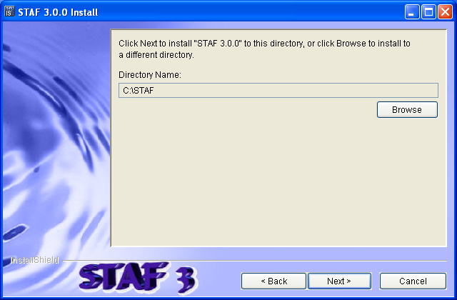
Installing STAF (continued)

Slide 29
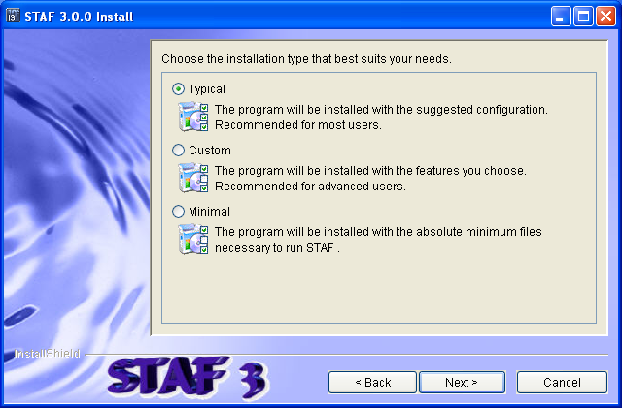
Installing STAF (continued)

Slide 30
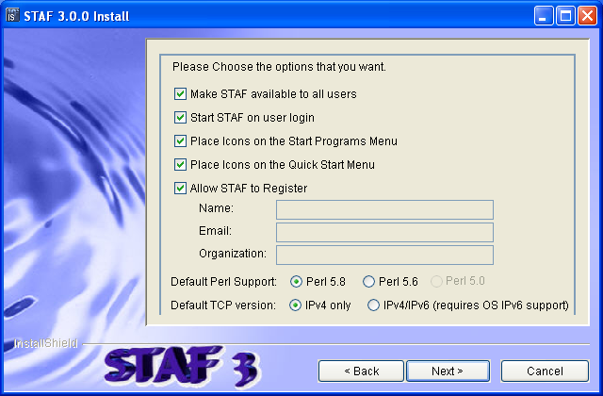
Installing STAF (continued)

Slide 31
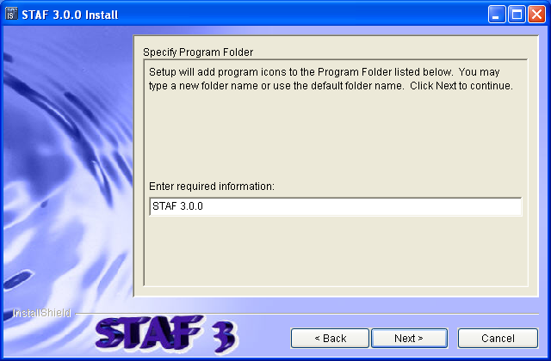
Installing STAF (continued)

Slide 32
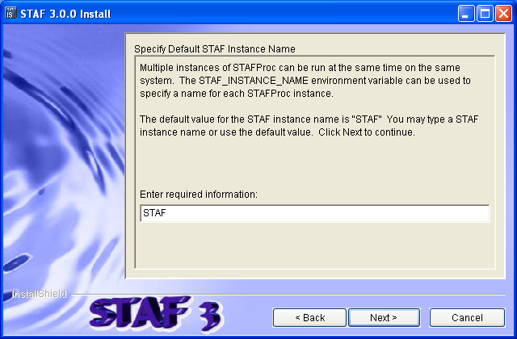
Installing STAF (continued)

Slide 33
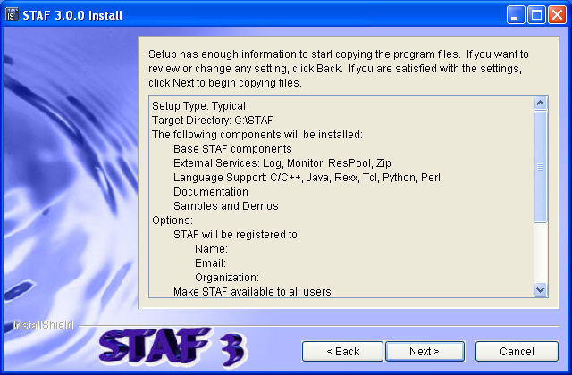
Installing STAF (continued)

Slide 34
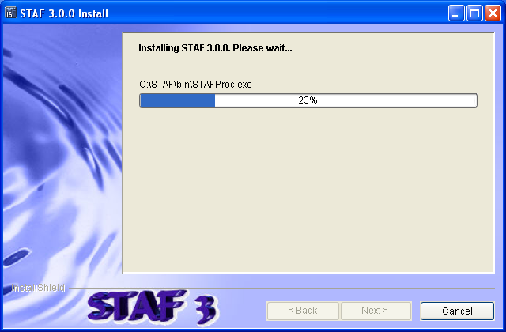
Installing STAF (continued)

Slide 35
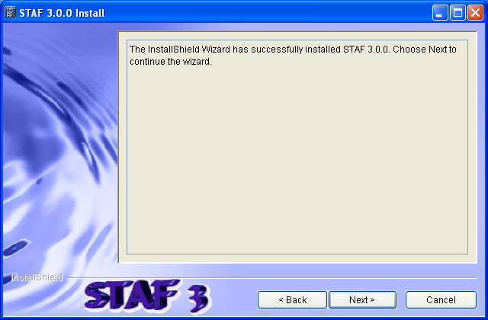
Installing STAF (continued)

Slide 36
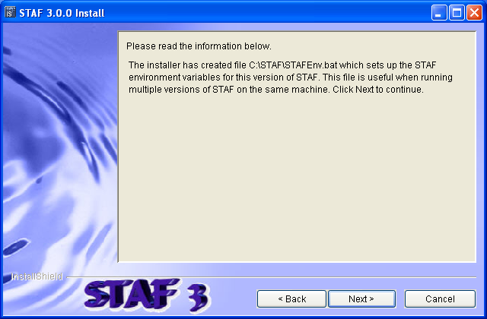
Installing STAF (continued)

Slide 37
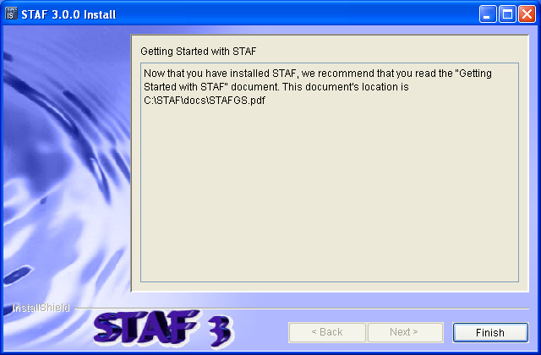
Installing STAF (continued)

Slide 38
Running STAF - STAFProc
STAFProc is what starts STAF running on a machine
Syntax:
  STAFProc [Configuration File]
  If [Configuration File] is not specified, STAFProc will try to use the file STAF.cfg. It will search for this file in the directory in which STAFProc resides.
  On Windows, you can click on "Start STAF 3.0.0" on the Start Menu
To shutdown STAF:
  Run the command staf local shutdown shutdown
  On Windows, you can click on "Shutdown STAF 3.0.0" on the Start Menu

Slide 39
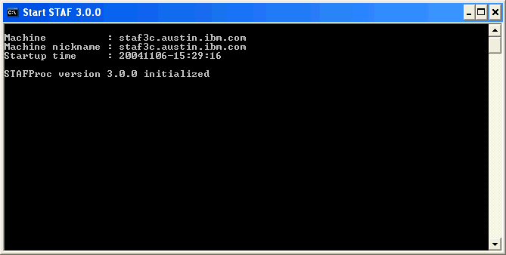
Running STAF - STAFProc (continued)

Slide 40
Configuring STAF
STAF is configured through a text file called the STAF Configuration File
This file may have any name you desire, but the default is STAF.cfg. By default, this file is located in the c:\STAF\bin directory (or /usr/local/staf/bin on UNIX).
When you start the STAF daemon process on each system, that system's STAF.cfg file will be read to determine how STAF should be configured on the machine

Slide 41
Configuring STAF (continued)
Through the STAF Configuration file, you can alter many aspects of STAF's behavior. For example, you can
  Specify a machine nickname
  Configure communication interfaces
  Configure authenticators
  Define operational parameters for STAF
  Define system or shared STAF variables
  Specify security access to machines and/or users in the STAF environment
  Define startup/shutdown notifications
  Enable and configure tracing
  Register and configure external STAF services

Slide 42
Configuring STAF – Machine Nickname
You may specify a machine nickname for your machine using the MACHINENICKNAME configuration statement
This allows you to override the machine nickname which is set, by default, to the value of the STAF/Config/Machine system variable
This primarily effects the data stored by services such as the Log and Monitor services, which store data based on the machine from which it came from, by using the STAF/Config/MachineNickname system variable as part of the directory path when creating log and monitor data. For example:
STAF local LOG QUERY MACHINE <Machine Nickname> LOGNAME <Logname>
STAF local MONITOR QUERY MACHINE <Machine Nickname> HANDLE <Handle>
This allows you to better manage your data
Note that the machine nickname is not used to communicate with other systems and does not have any effect on trust

Slide 43
Configuring STAF - Operational Parameters
Through the SET configuration statement, STAF allows you to set various parameters which affect the general operation of STAF, such as
  Queue size limit
  Default shell to use when starting a process
  Data directory
  Default network interface
Examples:
  SET MAXQUEUESIZE 10000
  SET DEFAULTSHELL "C:/cygwin/bin/bash.exe -c %c“
  SET DATADIR C:/MyDir

Slide 44
Configuring STAF - Variables
You may set system or shared STAF variables at startup by using the SET VAR configuration statement
Examples:
  SET SYSTEM VAR WebServer=testsrv1.austin.ibm.com
  SET SHARED VAR Author="Jane Tester"
  SET SYSTEM VAR tmpDir={STAF/DataDir}/tmp
  SET SYSTEM VAR userDir={STAF/DataDir}/user
  Note that the last 2 examples demonstrate variable resolution

Slide 45
Configuring STAF - Trust Levels
STAF allows you to grant access to machines and/or users by using the TRUST configuration statement
  TRUST LEVEL <Level> MACHINE <Machine> ...
  TRUST LEVEL <Level> USER <User> ...
  TRUST LEVEL <Level> DEFAULT
  DEFAULT indicates that you wish to set the default trust level. This is the trust level that will be used for machines/users which have no explicit trust level set. If no default has been specified in the STAF Configuration file, the default is set to 3.
  MACHINE indicates a machine for which to set a trust level. The format for <Machine> is: [<Interface>://]<System Identifier>
  Logical (e.g. long hostnames) or physical identifiers (e.g. IP addresses) may be specified for the machine.
  USER indicates a user for which to set a trust level. The format for <User> is: [<Authenticator>://]<User Identifier>
You can specify match patterns (e.g. wild cards), ‘*’ and ‘?’, where '*' matches a string of characters (including an empty string) and '?' matches any single character (the empty string does not match).

Slide 46
Configuring STAF - Trust Levels (continued)
Examples:
TRUST LEVEL 5 MACHINE local://local
TRUST LEVEL 4 MACHINE client1.austin.ibm.com \ MACHINE client2.raleigh.ibm.com
  TRUST LEVEL 3 MACHINE *.austin.ibm.com
  TRUST LEVEL 5 MACHINE tcp://9.41.53.147
  TRUST LEVEL 4 MACHINE tcp://9.3.41.*
  TRUST LEVEL 0 MACHINE badguy.xyz.com
  TRUST LEVEL 5 USER Joe@company.com
  TRUST LEVEL 4 USER SampleAuth://*@company.com
  TRUST DEFAULT LEVEL 1

Slide 47
Configuring STAF - Trust Levels (continued)
TRUST Levels:
  Level 0 - No access
  Level 1 - Restricted access. Only PING and helps available.
  Level 2 - Limited access. Only query/view facilities available.
  Level 3 - Standard access. Non-destructive updates allowed, e.g., logging.
  Level 4 - Advanced access. Update abilities, e.g., copying files, deleting log files.
  Level 5 - All access, e.g., SHUTDOWN, Process invocation, Trust definition manipulation

Slide 48
Registering Services
External services are registered with the SERVICE configuration statement
SERVICE <Name> LIBRARY <Library>
[EXECUTE <Executable>]
[OPTION <Name=Value>]...
[PARMS <Parameters>]
<Name> is the name by which this service will be known on this machine
LIBRARY is the name of the shared library or DLL which implements the service or acts as a proxy for the service
EXECUTE is used by service proxy libraries / DLLs to specify what the proxy library should execute
  For example, this might be the name of the REXX script or Java jar file which actually implements the service
  This option has no significance for non-proxy service libraries

Slide 49
Registering Services (continued)
SERVICE <Name> LIBRARY <Library>
[EXECUTE <Executable>]
[OPTION <Name=Value>]...
[PARMS <Parameters>]
OPTION specifes a configuration option that will be passed on to the service library or DLL
  This is typically used by service proxy libraries to further control the interface to the actual service implementation
  You may specify multiple OPTIONs for a given service
PARMS specifies optional parameters that will be passed to the service during initialization
  These parameters are usually used to initialize or alter the behavior of the service

Slide 50
Registering Services (continued)
Examples:
SERVICE MONITOR LIBRARY STAFMon
SERVICE SAMPLEJ LIBRARY JSTAF \
EXECUTE C:/STAF/services/Sample.jar \
OPTION "J2=-cp C:/MyJava/Extra.zip" \
PARMS {STAF/Config/STAFRoot}/bin/sample.dft
SERVICE EVENT LIBRARY JSTAF \
EXECUTE C:/STAF/services/STAFEvent.jar
SERVICE NOTIFY LIBRARY Notify PARMS "HOURS 24 DAYS 7"

Slide 51
Registering Services Dynamically
You may also register and unregister services dynamically, without needing to shutdown and restart STAF
The Service service accepts the following requests:
ADD SERVICE <Service Name> LIBRARY <Library Name>
[EXECUTE <Executable>] [OPTION <Name[=Value]>]...
[PARMS <Parameters>]
REMOVE SERVICE <Service Name>
Examples:
ADD SERVICE Log LIBRARY STAFLog
ADD SERVICE STAX LIBRARY JSTAF EXECUTE \
C:/STAF/services/stax/STAX.jar
REMOVE SERVICE STAX

Slide 52
Service Loaders
Service loader services are external services whose purpose is to load other services on-demand
They allow services to be loaded only when they have been requested, so they don't take up memory until needed
They dynamically register the service when a request is made so that you don't have to change the STAF configuration file to register a service
A default service loader service (STAFDSLS) is shipped with STAF. It knows how to dynamically load the Log, Monitor, ResPool, and Zip services. This service will automatically be configured in your STAF.cfg file:
  serviceloader Library STAFDSLS

Slide 53
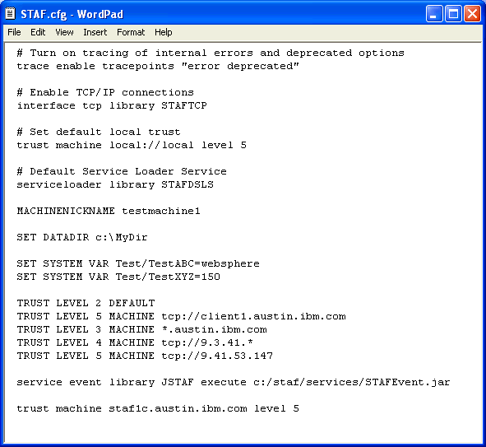
Sample STAF.cfg file

Slide 54
Interacting with STAF
STAF is an executable that is used to submit requests to STAF from the command line
STAF <Endpoint> <Service> <Request>
  <Endpoint> is either LOCAL, if you wish to make a request of the local machine, or the name of the machine of which you wish to make a request
  <Service> is the name of the service to which you are submitting a request
  <Request> is the actual request string that you wish to submit to the service
Output:
Response
--------
[Result string]
  Where [Result string] is any information that was returned from the STAF service request

Slide 55
Interacting with STAF (continued)
On an unsuccessful STAF request (i.e., a request with a non-zero return code), the output from the STAF command will be as follows
Error submitting request, RC: <Return code>
[Additional info: <Result string>]
  Where <Return code> is the actual return code from the request, and <Result string> is any information returned from the request. <Result string> usually contains information that explains why the error occurred.

Slide 56
Interacting with STAF (continued)
When structured data is returned in the result string, the STAF command will automatically unmarshall the data and “pretty” print it in the most appropriate format.
  If the data is a <List> of <String>, then each entry in the list is printed on its own line. For example:
  C:\>STAF local FS LIST DIRECTORY C:\
  Response
  --------
  AUTOEXEC.BAT
  CONFIG.SYS
  If the data is a <Map> (or <Map: <Class>>) which has values that are all of type <String>, each key/value pair is printed on its own line. For example:
  C:\>STAF local MONITOR LIST SETTINGS
  Response
  --------
  Max Record Size : 1024
  Resolve Message : Disabled
  Resolve Message Var: Disabled
  The above two types of formatted output are referred to as “default format”.

Slide 57
Interacting with STAF (continued)
If the data is a <List> of <Map:<Class>> where every item in the list is an instance of the same map class, then the data will be printed out in a tabular format, called "table format". For example:
C:\>STAF local HANDLE LIST HANDLES
Response
--------
Handle Handle Name State Last Used Date-Time
------ ------------------------------- --------- -------------------
1 STAF_Process InProcess 20040929-13:57:40
2 STAF/Service/STAFServiceLoader1 InProcess 20040929-16:06:47
5 STAF/Service/LOG InProcess 20040929-13:57:52
You can disable the output of tables by specifying option –verbose or by setting the environment variable STAF_PRINT_NO_TABLES to any value. If you disable the output of tables, their data will show up in the more verbose mode

Slide 58
Interacting with STAF (continued)
If the data is more complex or you’ve turned off tables (e.g. by specifying the
–verbose option), the output will be printed in a hierarchical nested format, called "verbose format“. The best way to describe it is with an example:
C:\>STAF -verbose local HANDLE LIST HANDLES
Response
--------
[
{
Handle : 1
Handle Name : STAF_Process
State : InProcess
Last Used Date-Time: 20040929-13:57:40
}
{
Handle : 2
Handle Name : STAF/Service/STAFServiceLoader1
State : InProcess
Last Used Date-Time: 20040929-16:06:47
}
{
Handle : 5
Handle Name : STAF/Service/LOG
State : InProcess
Last Used Date-Time: 20040929-13:57:52
}
]

Slide 59
Remote System Identification
When making a STAF request to a remote system, in addition to specifying the machine name, you may also specify the network interface over which communication will take place. The format for this is
  [<Interface>://]<System Identifier>[@<Port>]
  <Interface> is the name of the network interface
  <System Identifier> is a valid network identifier
If no <Interface> is specified, the default interface is used.
You may specify logical or physical identifiers
  For example, for a TCP/IP interface, the physical identifier for a system is the IP address, while the logical identifier is the hostname
  You may optionally specify a valid port to use for a TCP/IP interface

Slide 60
Running Multiple Instances of STAFProc
Multiple instances of STAFProc can be run at the same time on the same system
  This makes it possible to use STAF to install/upgrade STAF itself
To run multiple instances of STAF, system-specific resources need to be differentiated
  There is a special environment variable, STAF_INSTANCE_NAME, that can be used to specify a name for each STAFProc instance to differentiate between multiple instances of STAF
  If this environment variable is not set, the default value, "STAF", is used for the instance name
For each instance of STAFProc running on a system, the following settings must be unique
  The ports used by STAF TCP connection providers must be unique
  Each STAFProc instance must use a different data directory

Slide 61
Basic STAF Commands
STAF LOCAL PING PING
STAF LOCAL VAR LIST
STAF LOCAL SERVICE LIST
STAF LOCAL SERVICE LIST REQUESTS
STAF LOCAL HANDLE QUERY ALL
STAF LOCAL PROCESS QUERY ALL
STAF LOCAL SERVICE ADD SERVICE LOG LIBRARY STAFLog
STAF LOCAL LOG HELP
STAF LOCAL HELP ERROR [Error Number]

Slide 62
Part 2 - Leveraging STAF

Slide 63
STAF Services
HELP
  This internal service provides Help on STAF error codes
PING
  This internal service provides a simple is-alive message
SERVICE
  This internal service allows you to list services available on a machine and to examine the requests that have been submitted on a machine
SHUTDOWN
  This internal service provides a means to shutdown STAF and register for shutdown notifications
ECHO
  This internal service echos back a supplied message
MISC
  This internal service handles miscellaneous commands and tracing
DELAY
  This internal service provides a means to sleep a specified amount of time
DIAG
  This internal service lets you record and list diagnostics data

Slide 64
STAF Services (continued)
FS (File System)
  This internal service allows you to get and copy files (text and binary) across the network, list directories, copy directories/subdirectories, and delete files
FSEXT (File System Extensions)
  This user-written external service provides some tools to perform extended file system requests
ZIP
  This internal service provides a means to zip/unzip/list/delete PKZip/WinZip compatible archives
HTTP
  This user-written external service provides the ability to quickly and easily make HTTP requests
LOG
  This external service provides a full-featured logging facility
MONITOR
  This external service allows a testcase to publish its current running execution status for others to read
SXE
  This user-written external service allows the user to sequentially execute any number of STAF commands

Slide 65
STAF Services (continued)
HANDLE
  This internal service provides information about existing STAF handles
QUEUE
  This internal service provides a network-enabled IPC mechanism for STAF programs
PROCESS
  This internal service allows you to start, stop, and query processes
SEM (Semaphore)
  This internal service provides network-enabled named event and mutex semaphores
VAR (Variable)
  This internal service provides a method for maintaining configuration and runtime data (variables)
TRUST
  This internal service interfaces with STAF's security
STAX
  This external service is an XML-based execution engine which can help you thoroughly automate the distribution, execution, and results analysis of your testcases. STAX also provides a powerful GUI monitoring application which allows you to interact with and monitor the progress of your jobs.

Slide 66
STAF Services (continued)
EVENT
  This external service provides a publish/subscribe notification system
EVENTMANAGER
  This external service allows you to run a STAF command when a specified Event occurs
CRON
  This external service allows you to run a STAF command at a specified time interval (minute, hour, day, month, weekday)
TIMER
  This user-written external service allows a process on one machine to periodically receive a notification message from the same or another machine
RESPOOL (Resource Pool)
  This external service allows you to manage exclusive access to pools of elements, e.g. VM UserIDs or Software Licenses
EMAIL
  This external service allows information, such as test results, to be emailed to a list of addresses

Slide 67
STAF Variables
Leveraging the power of STAF variables can remove hard-coded dependencies in your testcases and allow you to easily change the behavior of your testcases while they are still executing
  STAF variables are defined in a hierarchy
    Variables beginning with "STAF" or "STAF/" are reserved for use by STAF
  STAF variables allow recursion
  STAF variables are dynamic and can be changed on-the-fly
Resolution and Recursion
  STAF resolves variable references in strings to their values
  A variable reference is denoted by surrounding the variable in curly braces, for example, {WebServer}
  Recursive and compound variable references are allowed

Slide 68
STAF Variables - Examples
Defined variables: Resolved variables:
  12=Fun "{a} and {b}" = You and Me
  a=You {c}{d} = 12
  b=Me {{c}{d}} = Fun
  c=1 {{e}} = You
  d=2
  e=a

Slide 69
STAF Variables - Examples (continued)
System variables: Local Process A variables:
  a=You a=Dogs
  b=Me b=Cats
    Local Process B variables:
    a=Birds
On Process A:
  SYSTEM RESOLVE {a} = You
  RESOLVE "{a} and {b}" = Dogs and Cats
On Process B:
  RESOLVE "{a} and {b}" = Birds and Me

Slide 70
STAF Variables - Examples (continued)
Given Variables:
AIXDelay=1000
WIN32Delay=2000
LinuxDelay=1500
OSName=AIX
Then :
{{OSName}Delay} resolves to AIXDelay = 1000

Slide 71
STAF Variables - Examples (continued)
Given Variables:
DBPARMS1/DataBaseServer = DBS1
DBPARMS1/Timeout = 1500
DBPARMS1/MaxRetries = 3
DBPARMS2/DataBaseServer = DBS2
DBPARMS2/Timeout = 5000
DBPARMS2/MaxRetries = 10
DBParmGroup = DBPARMS1
Then:
{{DBParmGroup}/DataBaseServer} resolves to DBS1

Slide 72
Running a simple Testcase
STAF can run testcases which are completely unaware of STAF
You can start using your existing testcases with STAF without making any changes to the testcases
  You aren't required to use any STAF services
  You aren't required to call any STAF APIs
You can choose when/if you enable STAF in your testcases

Slide 73
Running a simple Testcase (continued)
staf local process start shell command "java SimpleTestcase 10“ env CLASSPATH={STAF/Env/Classpath};C:/STAF/testcases
  1: public class SimpleTestcase
  2: {
  3: public static void main(String[] args)
  4: {
  5: int counter = 10;
  6: if (args.length > 0) counter = (new Integer(args[0])).intValue();
  7: for (int i=0; i < counter; i++)
  8: {
  9: System.out.println("Loop #" + String.valueOf(i)); 10: try
  11: {
  12: Thread.sleep(1000); // 1 second
  13: }
  14: catch(InterruptedException e)
  15: {
  16: e.printStackTrace();
  17: }
  18: }
  19: }
  20: }

Slide 74
Running a STAF-Enabled Testcase
You can leverage STAF in your testcases by making calls into STAF services
For all of the supported STAF languages, you can do the following
  Register with STAF
  Submit any number of calls into STAF services
  Optionally unregister with STAF
staf local process start shell command "java
    STAFTestcase 30"
    env CLASSPATH={STAF/Env/Classpath};C:/STAF/testcases

Slide 75
Running a STAF-Enabled Testcase (continued)
1: import com.ibm.staf.*;
2: public class STAFTestcase {
3: public static void main(String[] args) {
4: int counter = 10;
5: STAFHandle handle = null;
6: try {
7: handle = new STAFHandle("STAFTestcase");
8: }
9: catch(STAFException e) {
10: e.printStackTrace();
11: System.exit(1);
12: }
13: if (args.length > 0) counter = (new Integer(args[0])).intValue();
14: for (int i=0; i < counter; i++) {
15: System.out.println("Loop #" + i);
16: STAFResult result = handle.submit2("local", "monitor",
17: "log message " +
18: STAFUtil.wrapData("Loop #" + i));
19: // Testcase Logic goes here.
20: }
21: System.exit(0);
22: }
23: }

Slide 76
STAF support for Java Testcases
STAFHandle
  Used to register, unregister, and submit service requests to STAF
  Provides both exception-based and non-exception-based submit() methods
STAFResult
  Returned by the non-exception-based STAFHandle.submit2() method
  Contains both the STAF return code as well as the result string
  This class also contains the constant definitions for all the STAF return codes
STAFException
  This is the exception class thrown by the STAFHandle class
  It contains an rc variable which contains the actual return code from STAF
STAFUtil
  Contains utility functions provided by STAF
  Currently, the only function provided is the static function wrapData() which is used to generate the colon-length-colon delimited version of a string to be passed to STAF
STAFMapClassDefinition and STAFMarshallingContext
  STAFMapClassDefinition is a class used to define a Map with intrinsic metadata
  STAFMarshallingContext is used for (un)marshalling data structures
Notes:
Mention the CLC format (related to wrapData)

Slide 77
STAF support for C++ Testcases
STAFHandle
  Handles registering and unregistering with STAF as well as submitting service requests
  #include "STAF.h"
STAFResult
  Contains the result of a STAFHandle->submit() call and some utility functions
  #include "STAF.h"
STAFString
  Encapsulates UTF-8 strings
  #include "STAFString.h“
STAFMapClassDefinition
  A class used to define a Map with intrinsic metadata
STAFObjectPtr
  Used for defining data structures and (un)marshalling data structures
  Multi-valued results must be unmarshalled to access the root data structure
  #include “STAFDataTypes.h”

Slide 78
STAF support for Perl Testcases
STAF::Register
  Allows you to register with STAF (procedural)
STAF::Submit
  Allows you to submit requests to STAF (procedural)
STAF::UnRegister
  Allows you to unregister with STAF (procedural)
STAF::STAFHandle
  Object to call into STAF (object-oriented)
    new - Creates a handle that registers with STAF
    submit - Same as STAF::Submit but different calling convention
    unRegister - Same as STAF::UnRegister but different calling convention
STAF::WrapData
  This function takes a string and produces the colon-length-colon delimited version of that string. This function is widely used to pass the values of options in STAF requests.
STAF::STAFUnmarshall
  Used for defining data structures and (un)marshalling data structures
  Multi-valued results must be unmarshalled to access the root data structure

Slide 79
STAF support for Python Testcases
STAFHandle
  The primary class for communicating with STAF
STAFResult
  A class representing the result of a STAF request
STAFException
  A class representing an error registering with STAF
STAFWrapData
  A utility function for creating colon-length-colon delimited strings for use in STAF requests
STAFMapClassDefinition
  A class used to define a Map with intrinsic metadata
STAFMarshallingContext
  Represents a set of map class definitions and a data structure defined in terms of them
  Multi-valued results must be unmarshalled to access the root data structure

Slide 80
STAF support for Tcl Testcases
STAF::Register
  Allows you to register with STAF
STAF::Submit
  Allows you to submit requests to STAF
STAF::UnRegister
  Allows you to unregister with STAF
STAF::WrapData
  Generates the colon-length-colon delimited version of a string

Slide 81
STAF support for shell-scripts
You can call the STAF executable from shell-scripts:
  STAFResult=`STAF local ping ping`
There are two special environment variables that can be used to make the STAF command blend in with shell-scripts.
  Setting the STAF_QUIET_MODE environment variable to any non-null value will cause the STAF command to only output the <Result string> that the request generated
    For example, the "STAF local ping ping" command would simply return
      PONG
    instead of
      Response
      --------
      PONG
  If the STAF_STATIC_HANDLE environment variable is set, the STAF command will use the handle number indicated by this environment variable. This ensures that the shell-script can use the same handle throughout its execution.
    A Static Handle is created via the Process service or the Handle service

Slide 82
Part 3 - Advanced Topics

Slide 83
The STAF Demo
The STAF Demo is a sample application, written in Java, that demonstrates STAF's capabilities and how to leverage the primary internal and external services in STAF
In particular, it shows the use of the following STAF services:
  Process
  Variable
  Semaphore
  Queue
  Log
  Monitor
  Resource Pool
The STAF Demo is shipped with STAF
  It is located in the C:/STAF/samples/demo directory (on Windows) or the /usr/local/staf/samples/demo directory (on Unix)

Slide 84
The STAF Demo (continued)
Run the demo

Slide 85
Tracing
STAF provides various tracing facilities to help in auditing and debugging via the TRACE service
  ENABLE TRACEPOINTS
  [ServiceRequest] [ServiceResult]
  [ServiceError] [ServiceAccessDenied]
  [ServiceManagement] [Registration]
  [RemoteRequests] [Error]
  [Warning] [Info] [Deprecated] [All]
  ENABLE SERVICE <Service> [SERVICE <Service>]...
  SET DESTINATION TO <STDOUT | STDERR | FILE <Filename> >
  ENABLE ALL [TRACEPOINTS | SERVICES]

Slide 86
Tracing (continued)
ServiceRequest causes a trace message to be generated for every incoming service request before it is processed by the service
ServiceResult causes a trace message to be generated for every incoming service request after it is processed by the service
ServiceError causes a trace message to be generated for every incoming service request which results in a non-zero error code
ServiceAccessDenied causes a trace message to be generated for every incoming service request which results in an Access Denied error code
ServiceManagement causes a trace message to be generated for service management operations such as service initialization and termination
Registration causes a trace message to be generated for every registration or unregistration done by a process
RemoteRequests causes trace messages to be generated for requests destined for other machines
Error causes a trace message to be generated for error conditions that STAF detects, such as broken communication connections and fatal REXX Service errors
Warning causes a trace message to be generated for warning conditions that STAF detects
Info causes a trace message to be generated for information conditions that STAF detects
Deprecated causes a trace message to be generated for deprecated options that STAF detects
All causes all the aforementioned trace messages are to be generated
Notes:
Show some live tracing here.

Slide 87
Tracing (continued)
Examples
  TRACE SET DESTINATION TO STDOUT
  TRACE SET DESTINATION TO FILE {STAF/Config/STAFRoot}/bin/STAF.trc
  TRACE ENABLE TRACEPOINT ServiceResult
  TRACE ENABLE TRACEPOINT Error TRACEPOINT ServiceAccessDenied
  TRACE ENABLE TRACEPOINTS “Error Warning Info Deprecated”
  TRACE DISABLE TRACEPOINTS “ServiceResult Error”
  TRACE DISABLE ALL TRACEPOINTS
  TRACE ENABLE ALL SERVICES
  TRACE ENABLE SERVICES "PROCESS QUEUE"
  TRACE LIST
Notes:
Show some live tracing here.

Slide 88
Debugging STAF
RC 10 when starting a process
  This indicates that a base operating system error was encountered
  The actual base operating system error code will be returned in the result buffer
  A base OS error of 2 indicates that the executable or script file could not be found
  Solution:
    Make sure the the executable or script file is in the PATH of the machine where it will be executed., or fully qualify the command option on the process request (i.e. /opt/tests/mytest)
  To find out information about OS error codes:
    On Windows systems, you can find more information for OS error codes by typing "net helpmsg <error code>" (or by typing net help <error code>" on Windows 95/98/ME)
    On Unix systems, you can find more information for OS error codes from include files named errno.h found in directory /usr/include and its subdirectories.

Slide 89
Debugging STAF (continued)
Error binding server socket, rc = 67
  This error can occur on Unix if STAFProc has not been shutdown correctly. The error will be displayed when you attempt to restart STAFProc.
  In main():
  Caught STAFException
  Name : STAFException
  Location : /build2/src/staf/stafif/unix/STAFLocalConnectionFactory.cpp(52)
  Text : Error binding server socket, rc = 67
  Error code: 0
  Solution:
    Go to the /tmp directory, and delete STAFIPC_STAFProc and STAFProc.tmp
    Type "ps" and determine if there are any processes that STAF started which are still running. If there are any, type "kill xxx" where xxx is the PID for the process.
    Restart STAFProc

Slide 90
Debugging STAF (continued)
Error binding server socket, rc = 10048
  This indicates that the socket address is already in use
    HostName: fa2a.test.austin.ibm.com
    Machine name: fa2a
    Caught STAFException
    Name : STAFException
    Location : D:\staf\src\staf\common\STAFSocketConnectionFactory.cpp
    Text : Error binding server socket, rc = 10048
  This error occurs if STAF attempts to bind a socket to an IP address/port that has already been used for an existing socket, or a socket that wasn't closed properly, or one that is still in the process of closing
  Solution:
    You should wait approximately 2-3 minutes for TCP/IP to complete the socket close and retry starting STAF

Slide 91
Debugging STAF (continued)
RC 25 when starting a Process on a remote machine
  This error indicates that you have submitted a request from a machine which is not authorized to perform the request
  To start a process on a remote machine, a TRUST level of 5 is required
  Solution:
    On the remote machine, add a TRUST statement to its STAF.cfg file, giving the requesting machine a level of 5
    Shutdown and restart STAF on the remote machine

Slide 92
Debugging STAF (continued)
RC 16 when submitting a STAF request
  This error means that STAF could not talk to the target system, with likely causes being:
    An invalid or unreachable machine name was specified
    STAF is not running on the target system
    No network interfaces are configured. Make sure that in your STAF.cfg you have an "interface tcpip" statement, which enables network communication.

Slide 93
Debugging STAF (continued)
When I run the STAF InstallShield Multiplatform installer, all I see are a bunch of dots, and the installer never completes
  This error can occur on Unix machines when you are telnet'ing into the machine remotely
  The STAF InstallShield Multiplatform installer is a GUI application, therefore, you must export your DISPLAY from the Unix machine to the machine from which you are telnet'ing
  Most applications will give you an error message if the DISPLAY is not correctly exported, but, there is a bug in Installshield Multiplatform where it does not give you an error message and will just sit there
  Solution:
    Export your DISPLAY:
      export DISPLAY=myHostname.austin.ibm.com:0.0

Slide 94
Debugging STAF (continued)
Submitting STAF requests from the command line
  When you submit a request to STAF from the command line, a unique handle is generated for that request
  After the request completes, that handle is no longer active in STAFProc
  If you were to submit a subsequent STAF request from the command line which referenced that handle or was dependent upon the continued existence of that handle, your request would fail
Notes:
Do a live example of this.

Slide 95
Debugging STAF (continued)
STAF Installation on Unix
  When installing STAF on Unix platforms, if using the tar.gz installation files, always run the STAFInst script
  It is NOT sufficient to simply untar the compressed STAF image

Slide 96
Debugging STAF (continued)
Library search path platform differences
  The library search path environment variable, which must point to the STAF libraries, varies depending on the platform:
    Windows: PATH
    AIX: LIBPATH
    HP-UX: SHLIB_PATH
    Other Unix Platforms: LD_LIBRARY_PATH

Slide 97
Debugging STAF (continued)
Hostname Issues
  If you are having problems communicating between machines, make sure that the hostname and domain for all of the machines are correct
  When STAFProc starts, it lists what it thinks is the identity (hostname) of the machine. Other machines in the STAF Environment need to be able to access the machine by that identity.
  Always use domain names when configuring network settings on your machines
  If you have STAF machines that are unable to communicate with each other (i.e., "staf <hostname> ping ping" does not work), it is a good idea to try a non-STAF ping ("ping <hostname>") to determine if it is a basic network configuration error
  Submitting a WHOAMI request to the MISC service may be helpful in debugging a communication problem as it can show the instance name, interface, logical ID, physical ID, Endpoint, Machine, Trust Level, etc.

Slide 98
Debugging STAF (continued)
Understanding STAF Service option value formats
  If the value contains no spaces or quotes, you may simply specify the value
    MESSAGE Hello
  You may enclose the value in quotes. When doing so, the backslash character is the escape character. Any character after the backslash is treated as a literal character. To specify a backslash, use two backslashes.
    MESSAGE "Hello World"
  You may use a length delimited format that is of the form :<Length>:<String> (affectionately known as Colon-Length-Colon, or CLC, format). Note that the length is specified in characters, not bytes.
    MESSAGE :11:Hello World
    This format is typically used in STAF programs (as opposed to the command line)
    STAF provides wrappers for easily creating CLC format option values

Slide 99
Debugging STAF (continued)
Backslash (\) vs.Forwardslash (/)
  When you use a backslash in a STAF command request (especially when specifying a fully-qualified file/path name), the backslash can sometimes be interpreted as an escape character, and may cause problems
    This is particularly true in quoted strings
  We recommend always using forward slashes:
    staf local process start command c:/winnt/notepad.exe

Slide 100
Debugging STAF (continued)
VAR RESOLVE vs. VAR GET
  In most cases you should not use the VAR GET request. Instead you should use the VAR RESOLVE request.
  The VAR GET command retrieves the literal value of a given variable
  The VAR RESOLVE command resolves the values of any referenced variables before returning the value of the given string
  a=world VAR GET b = Hello {a}
  b=Hello {a} VAR RESOLVE {b} = Hello world
Notes:
Describe in general what the last 2 bullets mean.

Slide 101
Writing custom STAF Services
You can write your own custom STAF Services in Java, C++, or REXX
The STAF Service Developer's Guide, which describes how to create STAF services and includes implementation of a sample service in both Java and C++, is available on the STAF website
Life cycle of a STAF Service
  Construction
    The service exists in the STAF memory space; not yet ready to accept requests
  Initialization
    The service has been initialized (with appropriate parameters), and is ready to accept requests
  Accepting requests
    The service is active
  Termination
    The service has terminated
  Deconstruction
    The service is removed from the STAF memory space
Notes:
Mention Java portability issues

Slide 102
Writing custom STAF Services (continued)
All Java STAF services should implement the STAFServiceInterfaceLevel30 interface
Java services must implement the following methods:
  STAFResult init(STAFServiceInterfaceLevel30.InitInfo initInfo)
    This method is called by STAF to initialize the service
    This method allows the service to perform its initialization
  STAFResult acceptRequest(
  STAFServiceInterfaceLevel30.RequestInfo reqInfo)
    This is the method called whenever the service needs to perform a request
    This is the primary method by which programs/users interact with the service
    The actual interpretation of command arguments is, typically, done inside handleCommandXXX() methods, for example, handleHelp() and handleList()
  STAFResult term()
    This method is called by STAF to terminate the service
    This method allows the service to perform any cleanup
Notes:
Mention Java portability issues

Slide 103
Writing custom STAF Services (continued)
The InitInfo object, which is passed as a parameter to the init method, contains the following fields:
  public String name
  public String parms
  public JarFile serviceJar
  public int serviceType
  public String writeLocation
Notes:
Talk to the specific fields

Slide 104
Writing custom STAF Services (continued)
The RequestInfo object, which is passed as a parameter to the acceptRequest() method, contains the following fields:
  public String stafInstanceUUID
  public String machine
  public String machineNickname
  public String handleName
  public int handle
  public int trustLevel
  public boolean isLocalRequest
  public int diagEnabled
  public String request
  public int requestNumber
  public String user
  public String endpoint
Notes:
Talk to the specific fields

Slide 105
STAF Service Command Parsing
In the init method, you will typically create one or more STAFCommandParser objects (one for each command supported by your STAF Service)
  The STAFCommandParser class is used to parse commands and options submitted to your service
The STAFCommandParser class contains the following methods:
public void addOption(String name, int maxAllowed,
int valueRequirement)
  This method is used to specify the name of an identifier that may appear in a space-separated string passed to the STAFCommandParser
  Example
  fQueryParser = new STAFCommandParser();
  fQueryParser.addOption("QUERY", 1,
  STAFCommandParser.VALUENOTALLOWED);
  fQueryParser.addOption("PRINTER", 1,
  STAFCommandParser.VALUEREQUIRED);

Slide 106
STAF Service Command Parsing (continued)
public void addOptionGroup(String optionNames,
int min, int max)
This method is used to specify a list of names that are to be treated as a group
This is typically used to specify groups of mutually exclusive options
Example
fQueryParser.addOptionGroup("PRINTER MODEM", 1, 1);
public void addOptionNeed(String needers, String needees)
This method is used to specify dependency relationships between names in space-separated strings passed to the STAFCommandParser
Example
fExecuteParser.addOptionNeed("EXECUTE", "FILE DATA");

Slide 107
STAF Service Command Parsing (continued)
In the acceptRequest() method, you will typically determine the command that the request starts with, and call a corresponding method, e.g., handleHelp(), handleList(), etc.
The handle<command>() method would call the following method to parse the request:
  public STAFCommandParseResult parse(String data)
You can call the following methods on the STAFCommandParseResult object
  public int optionTimes(String name)
    This returns the number of times a particular option was specified
  public String optionValue(String name)
    This returns the value of the first instance of an option. If no instance exists, an empty string is returned.
  public String optionValue(String name, int instanceNumber)
    This returns the value of a specific instance of an option. If the given instance does not exist, an empty string is returned.

Slide 108
STAF Service Command Parsing (continued)
public int numInstances()
  This returns the total number of options specified
public String instanceName(int instanceNumber)
  Returns the name of the option for the given instance
public String instanceValue(int instanceNumber)
  Returns the value of option for the given instance

Slide 109
STAF Service Command Parsing (continued)
Example (this shows a subset of the PROCESS START options)
  PROCESS START COMMAND <command> [ENV <env>]...
  [ASYNC | WAIT [timeout]]
  [USERNAME <User name> [PASSWORD <Password>]]
  STAFCommandParser fStartParser = new STAFCommandParser();
  fStartParser.addOption("COMMAND", 1, STAFCommandParser.VALUEREQUIRED);
  fStartParser.addOption("ENV", 0, STAFCommandParser.VALUEREQUIRED);
  fStartParser.addOption("ASYNC", 1, STAFCommandParser.VALUENOTALLOWED);
  fStartParser.addOption("WAIT", 1, STAFCommandParser.VALUEALLOWED);
  fStartParser.addOption("USERNAME", 1, STAFCommandParser.VALUEREQUIRED);
  fStartParser.addOption("PASSWORD", 1, STAFCommandParser.VALUEREQUIRED);
  fStartParser.addOptionGroup("COMMAND", 1, 1);
  fStartParser.addOptionGroup("WAIT ASYNC", 0, 1);
  fStartParser.addOptionNeed("PASSWORD", "USERNAME");
  STAFCommandParseResult parsedResult = fStartParser.parse(request);

Slide 110
STAF Service Command Parsing (continued)
String command = parsedResult.optionValue("COMMAND");
int envNum = parsedResult.optionTimes("ENV");
for (int i = 0; i < envNum; i++)
{
String env = parsedResult.optionValue("ENV", i)
}
if (parsedResult.optionTimes("ASYNCH") > 0)
{ do something }
else if (parsedResult.optionTimes("WAIT") > 0)
{
String timeout = parsedResult.optionValue("WAIT");
}
if (parsedResult.optionTimes("USERNAME") > 0)
{
String userName = parsedResult.optionValue("USERNAME");
if (parsedResult.optionTimes("PASSWORD") > 0)
{
String password = parsedResult.optionValue("PASSWORD");
}
}

Slide 111
STAF Service template
import com.ibm.staf.*;
public class SampleService implements STAFServiceInterfaceLevel30
{
public SampleService() { }
public STAFResult init(STAFServiceInterfaceLevel30.InitInfo info)
{
// register with STAF
// create STAFCommandParser objects for your service's commmands
}
public STAFResult acceptRequest(STAFServiceInterfaceLevel30.RequestInfo info)
{
// determine the request's <Command>
// call the appropriate handle<Command> method
}
private STAFResult handle<Command1>(
STAFServiceInterfaceLevel30.RequestInfo info)
{
// check the Trust level for this request
// parse the request to determine all of the options
// add your service logic here
}
private STAFResult handle<Command2> { ... }
public STAFResult term() { }
}

Slide 112
End of Presentation
End of Presentation

Slide 113
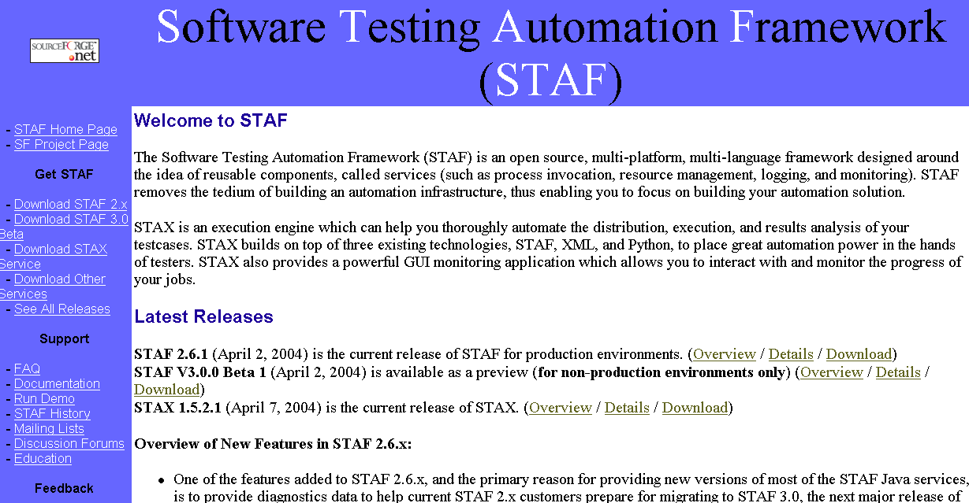
http://staf.sourceforge.net/index.php

Slide 114
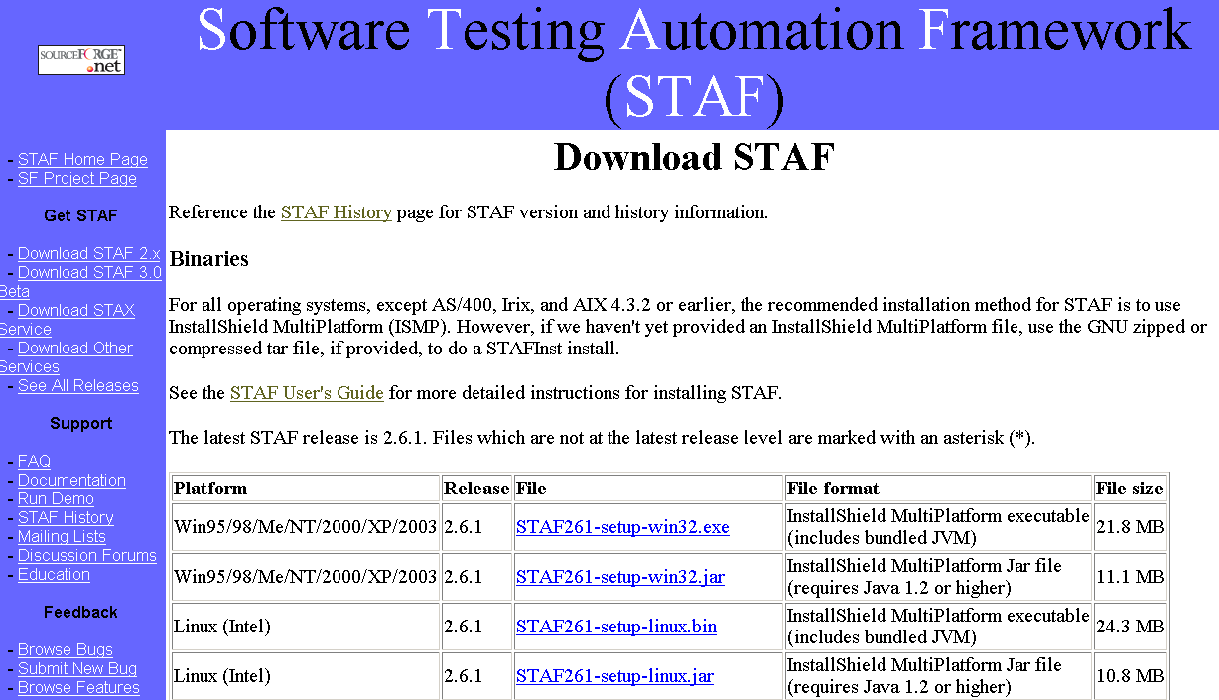
http://staf.sourceforge.net/getcurrent.php

Slide 115
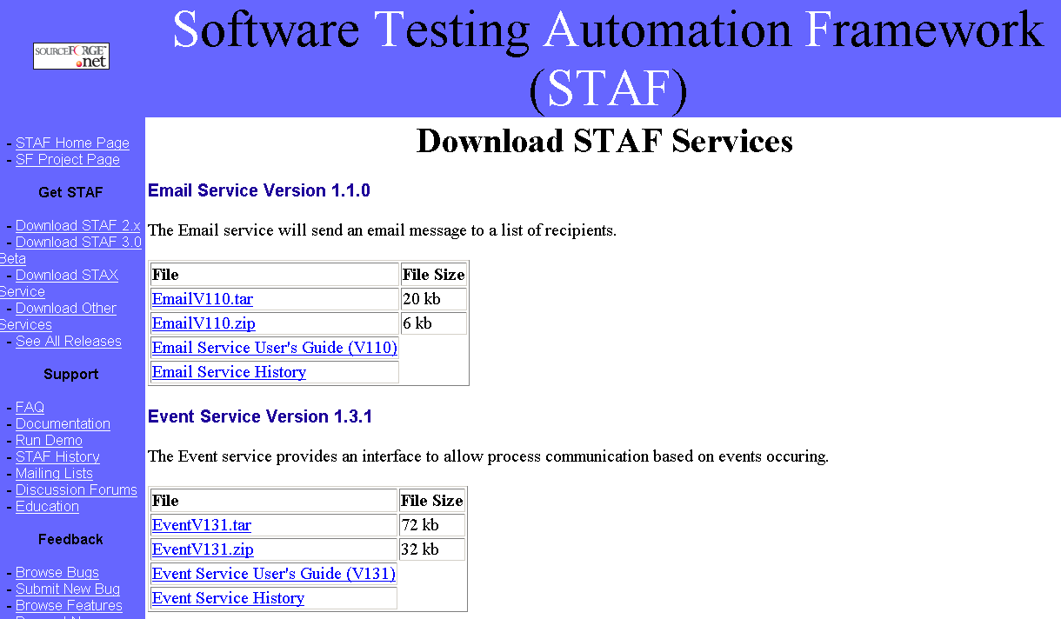
http://staf.sourceforge.net/getservices.php

Slide 116
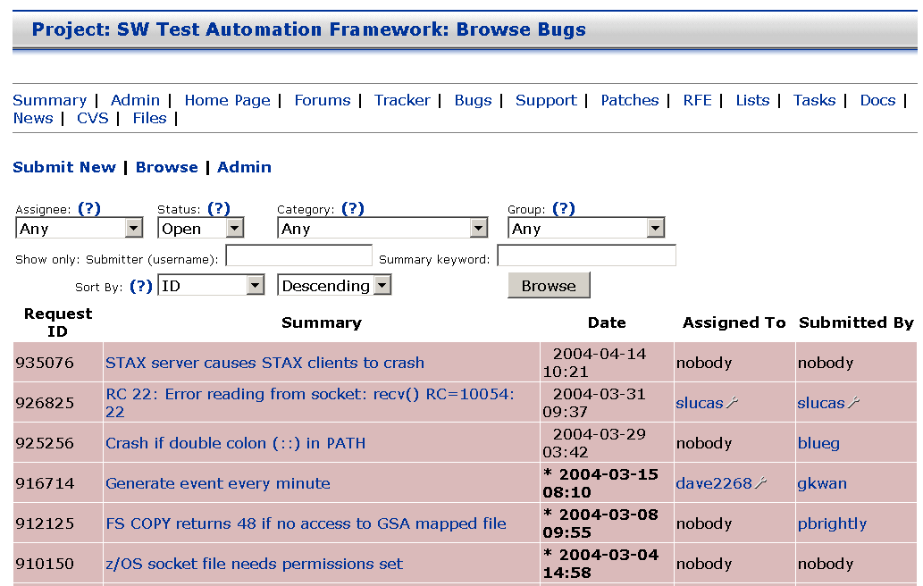
http://staf.sourceforge.net "Browse Bugs"

Slide 117
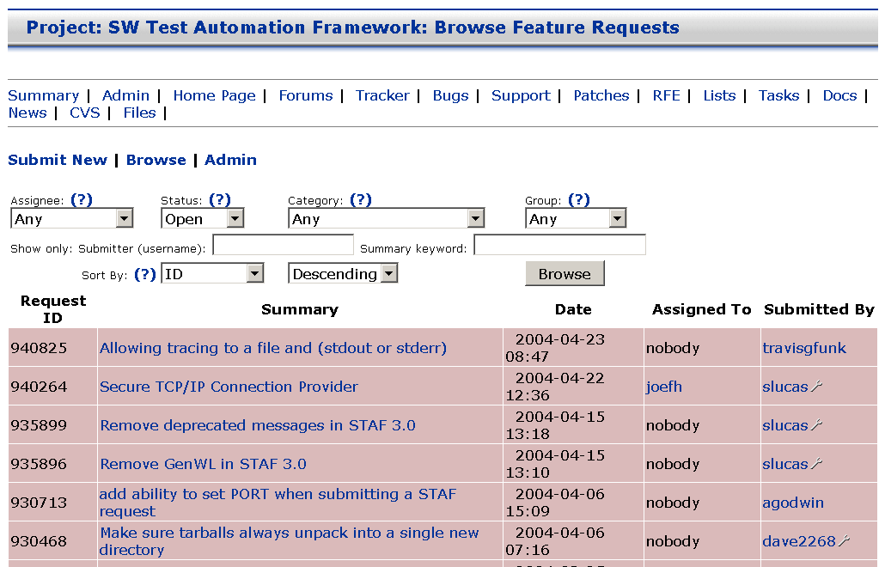
http://staf.sourceforge.net "Browse Features"

Slide 118
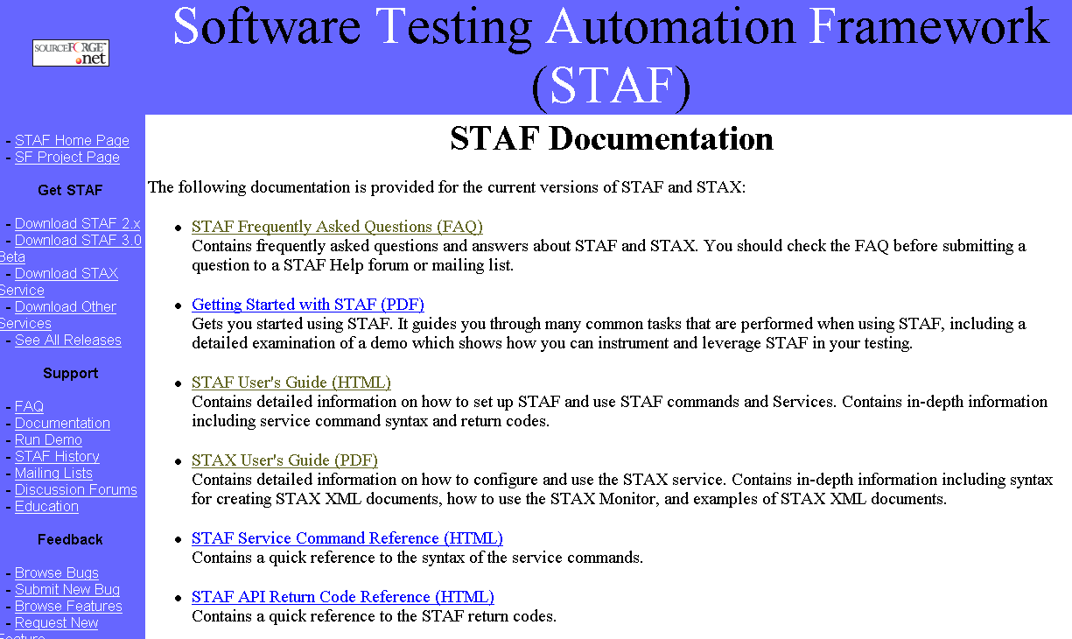
http://staf.sourceforge.net/docs.php

Slide 119
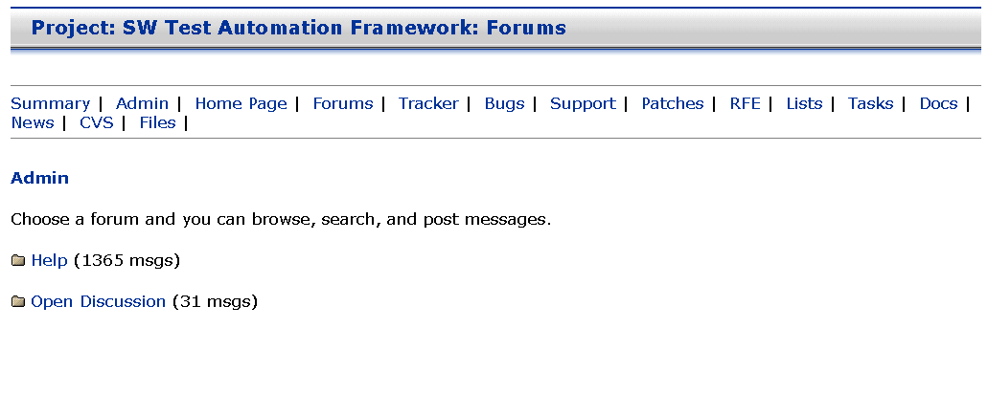
http://staf.sourceforge.net "Discussion Forums"

