Slide 1
Hands-on Automation with STAX 3

Slide 2
Agenda - Hands-on Automation with STAX
1:30 - 2:15pm - Part 1: Introduction to STAX
  What is STAX?
  Technologies used in STAX
  Introduction to STAX XML Elements
  The STAX Web Page
  STAX Requirements
  Perform Exercise 12: Installing STAX
  Using the STAX Monitor (to run and monitor jobs)
  Controlling Execution of STAX Jobs
  Understanding STAX Logs
  Querying STAX Logs
  Submitting STAX Requests via Command Line
2:15 - 2:35pm - Exercises 13 and 14; Break

Slide 3
Agenda - Hands-on Automation with STAX (continued)
2:35 - 3:20pm - Part 2: Creating STAX Jobs
  Using Python in STAX XML Documents
  Using XML to Define STAX Jobs
  Retrieving the STAX DTD
  Editing STAX XML Documents
  Understanding STAX XML Elements:
    Fundamental Actions: <script>, <process>, <stafcmd>
    Groupings: <sequence>, <function>
    Looping: <loop>, <iterate>, <break>, <continue>
    Conditionals: <if>, <elseif>, <else>
    Execution Blocks: <block>
    Logging and Messages: <log>, <message>
  Creating a Simple STAX Job
3:20 - 3:40pm - Exercises 15 and 16; Break

Slide 4
Agenda - Hands-on Automation with STAX (continued)
3:40 - 4:20pm - Part 3: Creating More Complex STAX Jobs
  Understanding Additional STAX XML Elements:
    Parallel Execution: <parallel>, <paralleliterate>
    Testcases and Timers: <testcase>, <tcstatus>, <timer>
    Signals and Exceptions: <raise>, <signalhander>, <try>, <catch>
    Defining Function Arguments
  Debugging STAX Jobs
  Creating Libraries of Common STAX Functions
  Using XSLT to Create STAX Function Description Documents
4:20 - 4:40pm - Exercises 17, 18, and 19; Break
4:40 - 5:00pm - Questions and Additional Topics
  End-to-End Automation

Slide 5
Part 1 - STAX Introduction

Slide 6
What is STAX?
STAX is an automation system
With STAX you can automate and monitor your entire test environment
  System/product setup
  Testcase distribution
  Testcase execution
  Testcase results collection and analysis
STAX consists of
  A programming language designed for automation
    Programs written in this language are called jobs
  An execution engine (similar to an interpreter for other programming/scripting languages) which manages the execution and runtime behavior of the job
  A GUI application, called the STAX Monitor, which provides a dynamically updated view of your executing jobs
Note: This presentation is relative to STAX Version 3.0.0

Slide 7
Technologies used in STAX
STAF
  STAF provides the infrastructure on which STAX builds. The full power of STAF and its services is exposed for use within STAX jobs.
XML
  The STAX programming language is based on XML. This provides built-in structure to your jobs, as well as providing a set of existing tools for use in constructing your jobs, such as XML (aware) editors and XSLT.
Python
  The STAX programming language builds on Python to provide a rich and accessible data model
  STAX's Python integration also allows you to access the wealth of existing Python libraries
Java
  The STAX programming language allows you to access existing Java classes/libraries, providing another source for reuse

Slide 8
Introduction to STAX XML Elements
Fundamental Action Elements:
  process - defines the execution information for a STAF PROCESS START command. A process element specifies a command to be executed and the machine where it should run.
  stafcmd - defines execution information for other STAF commands. A stafcmd element specifies the STAF service and request to be executed and the machine where it should run.
  script - defines Python code to be executed
Sequential Group Elements:
  sequence - executes any number of STAX elements sequentially. Also, used for nesting multiple child elements within other elements.
  function - provides a structuring device for STAX XML documents.. Functions allow us to group and parametize chunks of XML to be used arbitrarily many times later. Functions also provide a tool for splitting jobs into pieces that have a well-defined role.
Conditional Elements:
  if, elseif, else - provide the standard complement of condition testing capabilities

Slide 9
Introduction to STAX XML Elements (continued)
Looping Elements:
  loop - allows a STAX element to be executed repeatedly (like "for", "do", "while", and "until" constructs found in other languages)
  iterate - allows a STAX element to be executed repeatedly while stepping through a list of data for each iteration
  break/continue - allows breaking out of the nearest enclosing <loop> or <iterate> element or stopping execution of the current loop/iteration and continues with the next loop/iteration
Execution Block Elements:
  block - allows you to define a set of actions over which you have internal and external control (hold, release, and terminate). Blocks may be nested to produce an execution hierarchy. Each job consists of at least one block, called "main" which encompasses the entire job.
Log and Message Elements:
  log - allows you to place information into a job's user-managed log
  message - allows your job to send informational messages to the STAX Monitor GUI

Slide 10
The STAX Web Page
The main STAX web page is http://staf.sourceforge.net
  STAX is available from the main page by clicking on the "Download STAX Service" link on the navigate bar at the left
  This page can be used to open bug reports and feature requests for STAX by clicking on the "Submit New Bug" or "Request New Feature" link on the navigate bar at the left under "Feedback".
  This page can also be used to access Mailing Lists to view and post messages (Help, Announcements) and access Forums to view and post messages
  The STAX User's Guide can also be viewed by clicking on the "Download STAX Service" link on the navigate bar at the left, and then clicking on the "STAX User's Guide" link. This document is essential to understanding and using the STAX Service.

Slide 11
STAX Requirements
A STAX Service machine is where the STAX Service is installed. The STAX Service machine has the following software requirements:
  STAF 3.0.0 or higher
  Java 1.2 or higher - The STAX Monitor requires Java 1.3.0 or higher
  Log Service - Should be configured (highly recommended)
  Event Service 3.0.0 or higher - Doesn't have to be installed the same system
  STAX Service 3.0.0 or higher

Slide 12
Perform Exercise 12: Installing STAX
Exercise12 shows you how to:
  Install the STAX Service
  Configure the STAX Service
  Verify the STAX Service is working properly
  Start the STAX Monitor

Slide 13

Using the STAX Monitor
To start the STAX Monitor, change to the directory which contains your STAXMon.jar file and type:
java -jar STAXMon.jar
If you are in another directory, fully qualify the STAXMon.jar file:
java -jar c:/staf/services/stax/STAXMon.jar

Slide 14
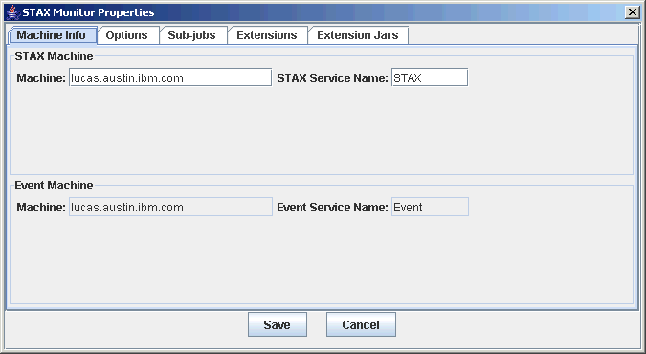
Using the STAX Monitor (continued)
The first time you start the STAX Monitor, the "STAX Monitor Properties" window will be displayed
  The STAX Machine defaults to your local system with Service Name STAX. Click on the "Save" button to save any changes or the "Cancel" button to end without saving changes.
  If any changes are made to the STAX machine/name properties, then you will need to close and restart the STAX Monitor for the changes to take affect

Slide 15
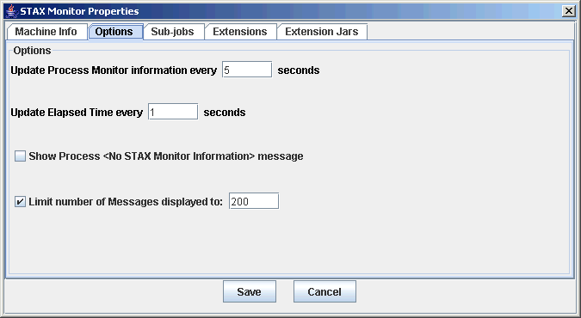
Using the STAX Monitor (continued)
The ”Options” tab allows you to specify options for the STAX Monitor

Slide 16
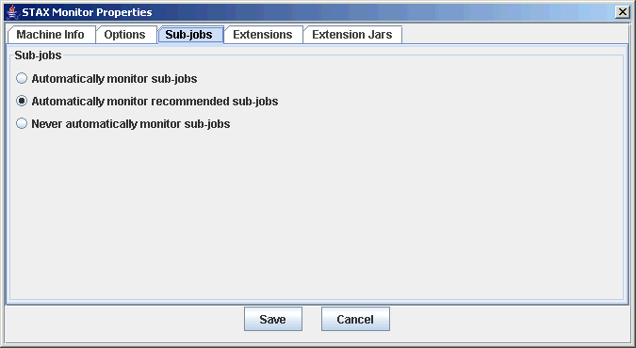
Using the STAX Monitor (continued)
  The ”Sub-jobs” tab allows you to specify whether to automatically monitor sub-jobs

Slide 17
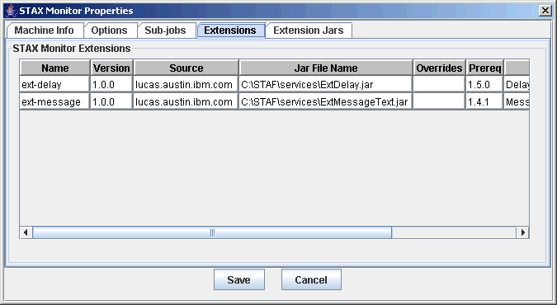
Using the STAX Monitor (continued)
  The ”Extensions” tab allows you to display the monitor extensions that are registered with the STAX Monitor

Slide 18
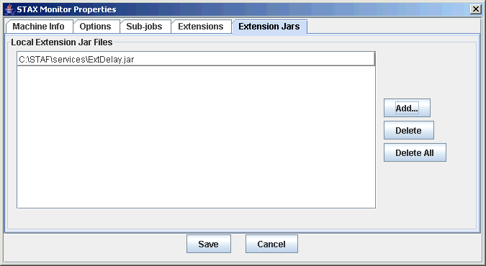
Using the STAX Monitor (continued)
  The ”Extension Jars” tab allows you to specify any local extension jar files containing STAX Monitor extensions that you want to register.
  These extensions can override monitor extensions registered when the STAX service was configured.

Slide 19
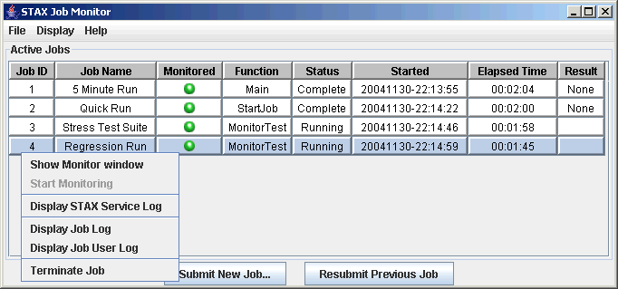
Using the STAX Monitor (continued)
This is the main display panel you will see when you start the STAX Monitor
  Displays information about all running and/or monitored jobs
  Allows you to launch new jobs, monitor existing jobs, view STAX logs, and terminate jobs
Click on "Start New Job" to start a new STAX job

Slide 20
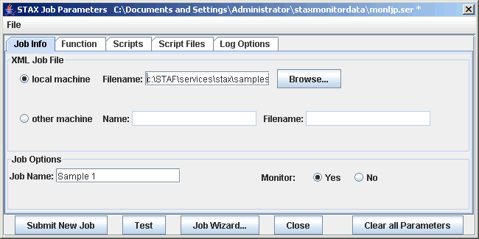
Using the STAX Monitor (continued)
The "Start Job Parameters" panel allows you to define characteristics for a job:
  Specify the file name for the STAX job (e.g. C:\STAF\services\stax\samples\sample1.xml) and optionally specify other information
  Click on the "Submit New Job" button to run the job (or click on the "Test" button to validate the XML)

Slide 21
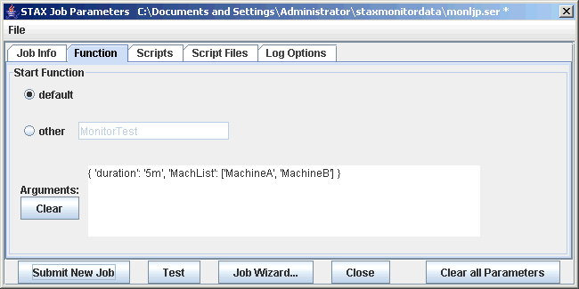
Using the STAX Monitor (continued)
The ”Function” tab allows you to specify the start function parameters for the job

Slide 22
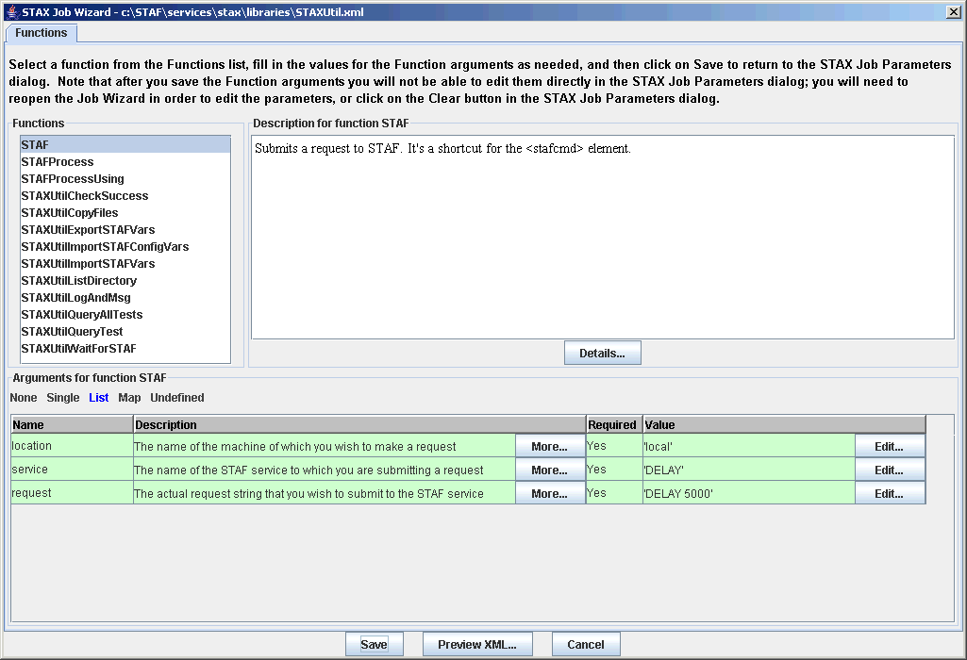
Using the STAX Monitor (continued)
  The STAX Job Wizard helps you select the starting function for a job you want to execute, and helps you specify function arguments for it, if needed

Slide 23
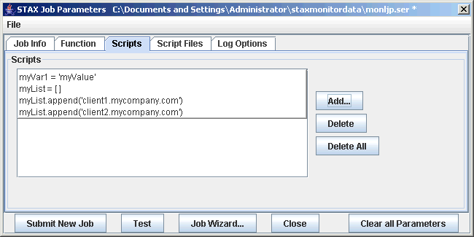
Using the STAX Monitor (continued)
  The ”Scripts” tab allows you to specify Script parameters

Slide 24
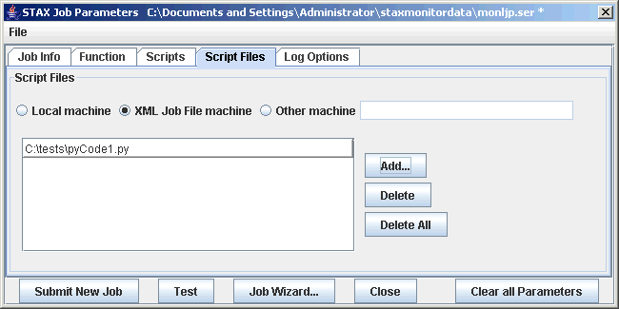
Using the STAX Monitor (continued)
  The ”Script Files” tab allows you to specify Script File parameters

Slide 25
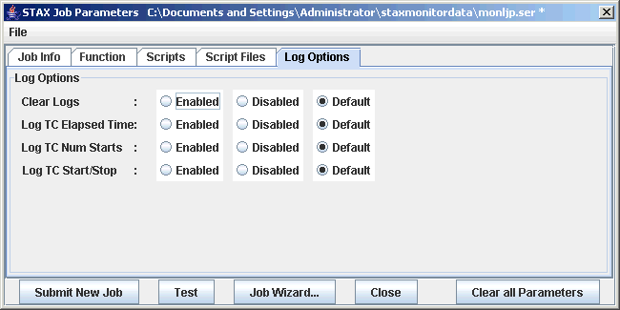
Using the STAX Monitor (continued)
  The ”Log Options” tab allows you to specify the log parameters

Slide 26
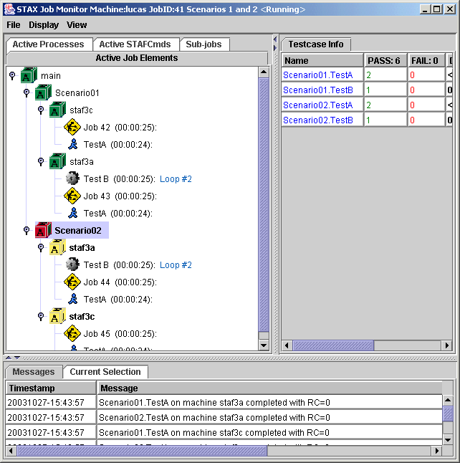
Using the STAX Monitor (continued)

Slide 27
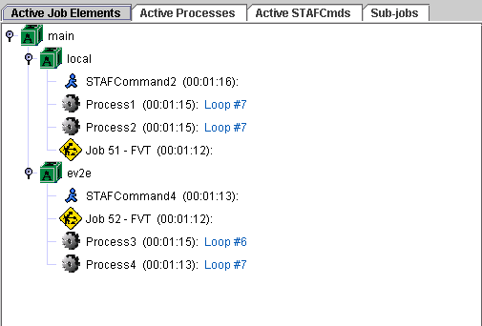
Using the STAX Monitor (continued)
The "Active Job Elements" tab displays the currently executing <block>, <job>, <process>, and <stafcmd> elements for a job in a tree format, in order to show the hierarchy of the currently executing elements
  For each <job>, <process>, and <stafcmd> element represented in the tree, the elapsed time (HH:MM:SS) that the process or stafcmd element has been running is displayed to the right of the process or stafcmd name in parenthesis
  For each <process> element represented in the tree, if the process generates STAF Monitor Service messages, the current monitor message is displayed to the right of the process name and elapsed time. The monitor information is periodically refreshed while the process is running.

Slide 28
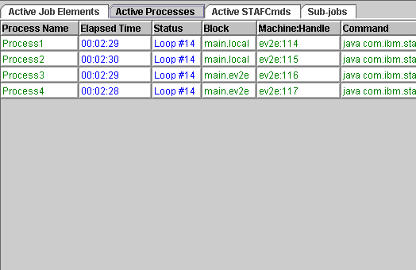
Using the STAX Monitor (continued)
The "Active Processes" tab displays the currently executing <process> elements for a job
  For each <process> element represented in the table, the elapsed time (HH:MM:SS) that the process element has been running is displayed in the table
  For each <process> element represented in the table, if the process generates STAF Monitor Service messages, the current monitor message is displayed in the "Status" column. The monitor information is periodically refreshed while the process is running.

Slide 29
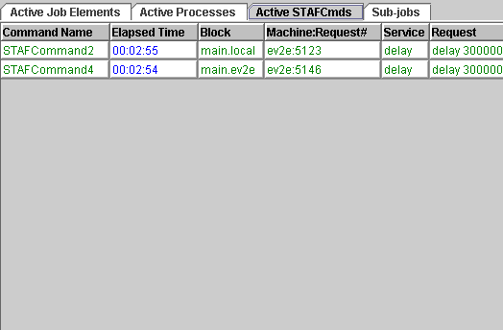
Using the STAX Monitor (continued)
The "Active STAFCmds" tab displays the currently executing <stafcmd> elements for a job
  For each <stafcmd> element represented in the table, the elapsed time (HH:MM:SS) that the stafcmd element has been running is displayed in the table

Slide 30
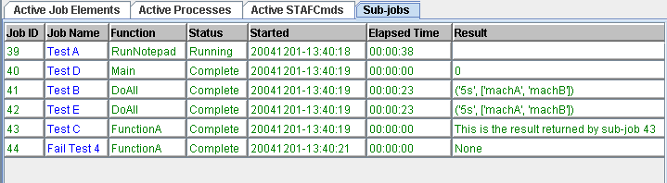
Using the STAX Monitor (continued)
The “Sub-jobs" tab displays information about both active and completed sub-jobs
  For each <job> element represented in the table, the elapsed time (HH:MM:SS) that the <job> element has been running is displayed in the table
  For each <job> element represented in the table, the job’s status (“Running” or “Complete”) is displayed in the "Status" column

Slide 31
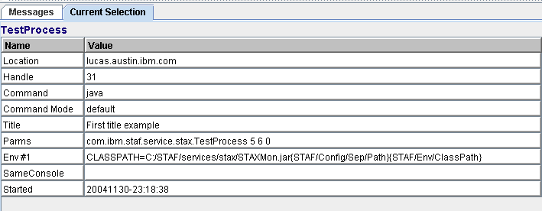
Using the STAX Monitor (continued)
The "Current Selection" tab displays more details about an active element when you click on an entry in the "Active Job Elements", "Active Processes", "Active STAFCmds“, and “Sub-jobs” tabs

Slide 32
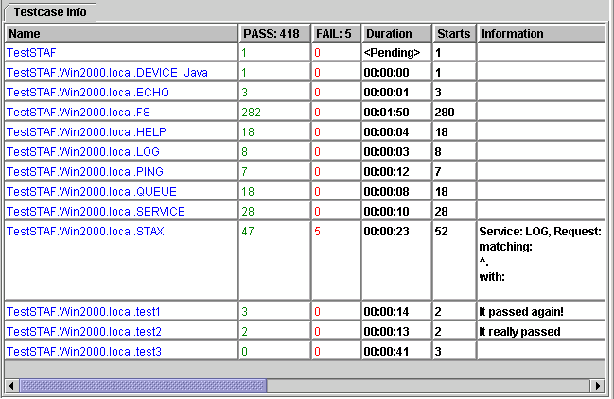
Using the STAX Monitor (continued)
The "Testcase Info" tab displays the name of each <testcase> element that has been executed and the cumulative number of its passes, fails, duration, and starts from when the job started executing, along with the last status message it provided via a <tcstatus> element
  Note that at least one testcase status (pass or fail) must be recorded via a <tcstatus> element in order for a testcase to appear here (unless the testcase's mode is set to 'strict')

Slide 33
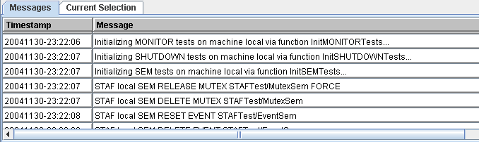
Using the STAX Monitor (continued)
The "Messages" tab displays the messages (and their timestamps) from each message sent by a <message> element in the XML document. The STAX service can also generate messages via its default signal handlers.
All of the tables in the Job Monitor are sortable:
  To sort the table in ascending order by a column, click on the table's column header for that column
  To sort the table in descending order by a column, hold the Shift key while clicking on the table's column header for that column

Slide 34
Controlling Execution of STAX Jobs
If you right-mouse-click on a block in the "Active Job Elements" panel, a popup menu is displayed with the options "Hold", "Release", and "Terminate" which allows you to control the execution of the block
The color of the block icon for each block indicates the state of the block:
  Green - indicates the block is currently running
  Red - indicates the block has been held
  Yellow - indicates the block is held by a parent block
The hold, release, and terminate states are propagated to all nested child blocks
Note: Blocks may also be held, released, and terminated via STAF command requests and by STAX elements defined within a STAX XML document

Slide 35
Understanding STAX Logs
STAX uses the STAF Log Service for logging, so the Log Service must be configured in order for STAX logs to be created
There are 3 types of STAX logs:
  STAX Service Log - One log for the STAX Service
  STAX Job Logs - One log for each STAX Job ID
  STAX Job User Logs - One log for each STAX Job ID (if the <log> element is used)
Actions Resulting in a Message Written to the STAX Job Log | Log Level
Job starts execution | Start
Job is held, released, or terminated | Info
Job raises a signal (via the STAX service itself) and its default signal handler is invoked | Error
Job contains a <tcstatus> element which specifies a message | Pass or Fail
A testcase starts (and "Log TC Start/Stop" is enabled) | Start
A testcase stops (and "Log TC Start/Stop" is enabled) | Stop
Job stops. Logs a summary of the # of times each test passed or failed (if it contains any <tcstatus> elements) as the total # of testcases, passes, and fails | Status
Job stops execution | Stop

Slide 36
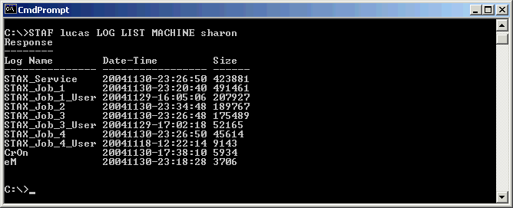
Understanding STAX Logs (continued)
The STAX logs are machine logs. The names of the STAX logs begin with the STAX service name in uppercase (e.g. STAX).
To get a list of all the logs on a STAX service machine, use the following STAF log list request, replacing <Machine> and <Machine Nickname> with the endpoint and nickname for your STAX service machine. The log files listed whose name begins with the name of the STAX service are the STAX logs.
STAF <Machine> LOG LIST MACHINE <Machine Nickname>
Example of output from listing STAX logs on machine lucas

Slide 37
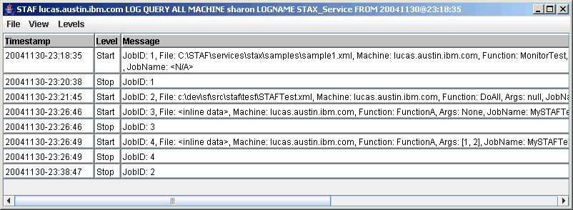
Querying STAX Service Log
To query a STAX service log, use the following STAF log query machine request, replacing <Machine> and <Machine Nickname> with the endpoint and nickname for your STAX service machine:
STAF <Machine> LOG QUERY MACHINE <Machine Nickname> LOGNAME STAX_Service
You can also view the STAX_Service log from the STAX Monitor:

Slide 38
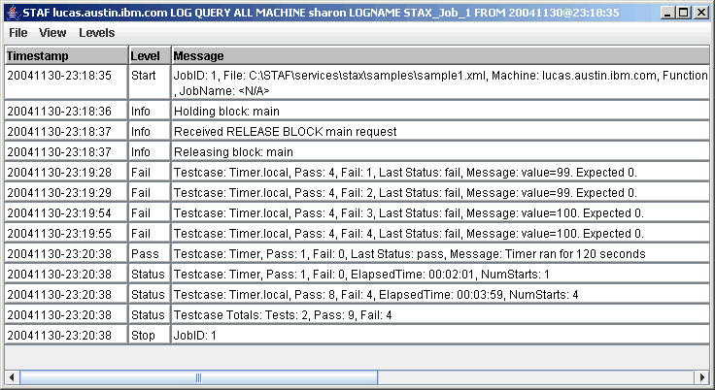
Querying STAX Job Logs
To query a STAX job log for Job ID 1, use the following STAF log query machine request, replacing <Machine> and <Machine Nickname> with the endpoint and nickname for your STAX service machine:
STAF <Machine> LOG QUERY MACHINE <Machine Nickname> LOGNAME STAX_Job_1
You can also view STAX Job logs from the STAX Monitor:

Slide 39
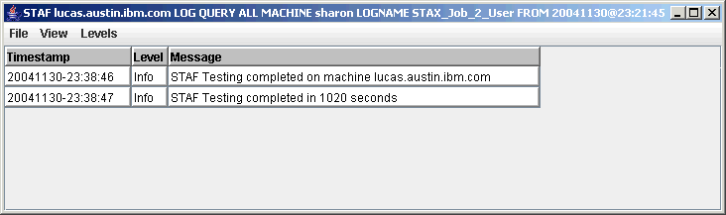
Querying STAX Job User Logs
To query a STAX job user log for Job ID 2, use the following STAF log query machine request, replacing <Machine> and <Machine Nickname> with the endpoint and nickname for your STAX service machine:
STAF <Machine> LOG QUERY MACHINE <Machine Nickname> LOGNAME STAX_Job_2_User
You can also view STAX Job User logs from the STAX Monitor:

Slide 40
Submitting STAX Requests via Command Line
The STAX service provides the following requests:
  EXECUTE - Starts a job running based on a XML document which defines its workflow
  LIST - Lists all currently running jobs or specific information about a single job
  QUERY - Queries information about a job that is currently running
  HOLD - Holds a job or a block in a job that is currently running
  RELEASE - Releases a job or a block in a job that is in the hold state
  TERMINATE - Terminates a job or a block in a job
  SET - Lets you change the operational parameters of the STAX service
  GET DTD - Gets the STAX DTD (Document Type Definition)
  UPDATE TESTCASE - Updates the status of a testcase in a job that is currently running
  START TESTCASE - Starts a new testcase in a STAX job that is currently running
  STOP TESTCASE - Stops an active testcase (which was started via a START request) in a STAX job that is currently running
  HELP - Displays a list of requests for the STAX service and how to use them
  VERSION - Displays the version of the STAX service

Slide 41
STAX EXECUTE Command Line Request
Syntax:
EXECUTE < <FILE <XML File Name> [MACHINE <Machine Name>]> | DATA <xml data> >
[JOBNAME <Job Name>] [FUNCTION <Function ID>] [ARGS <Arguments>]
[SCRIPTFILE <File Name>... [SCRIPTFILEMACHINE <machine name>]]
[SCRIPT <Python Code>]... [CLEARLOGS [<Enabled | Disabled>]]
[ HOLD | TEST | WAIT [Timeout] [RETURNRESULT] ]
[LOGTCELAPSEDTIME <Enabled | Disabled>]
[LOGTCNUMSTARTS <Enabled | Disabled>]
[LOGTCSTARTSTOP <Enabled | Disabled>]
Security: This request requires at least trust level 4.
Examples:
STAF local STAX EXECUTE FILE C:/stax/xml/example1.xml
STAF local STAX EXECUTE FILE C:/stax/test.xml JOBNAME "STAX Example"
STAF local STAX EXECUTE FILE C:/data/sample.xml MACHINE machA CLEARLOGS
STAF local STAX EXECUTE FILE C:/stax/test2.xml FUNCTION Main ARGS "'2h'"
STAF local STAX EXECUTE FILE C:/stax/test.xml SCRIPT "Server = 'machA'"
STAF local STAX EXECUTE FILE C:/stax/test2.xml WAIT RETURNRESULT
Notes:
Note that the file name specified is fully qualified. This is because files are relative to the directory where STAFProc is started, rather than relative to the current directory. So, it's best to just fully qualify file names used in STAF commands.

Slide 42
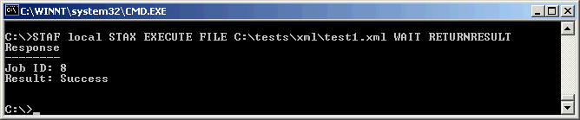
STAX EXECUTE Command Line Request (Continued)
Results:
Upon successful return, the result buffer contains the Job ID if the TEST or RETURNRESULT options are not specified
Upon successful return, the result buffer contains nothing if the TEST option is specified
If the request times out before the job has completed (due to the WAIT option being specified with a Timeout), a RC 37 (Timeout) is returned and the result buffer contains the Job ID
If the WAIT and RETURNRESULT options are specified, and the request does not timeout, the result buffer contains a marshalled map class representing the job result. The map class is defined with two fields: jobID and result
Notes:
Note that the file name specified is fully qualified. This is because files are relative to the directory where STAFProc is started, rather than relative to the current directory. So, it's best to just fully qualify file names used in STAF commands.

Slide 43
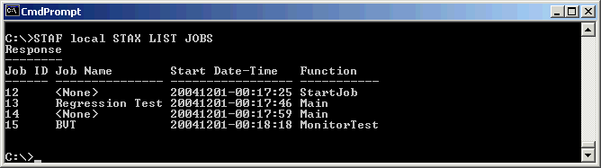
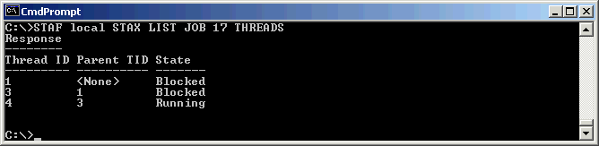
STAX LIST Command Line Request
Syntax:
LIST JOBS | JOB <Job ID> < THREADS | BLOCKS | TESTCASES |
PROCESSES | STAFCMDS | SUBJOBS >
Examples:
  Goal: List all of the jobs
  Goal: List all the threads running for a job with Job ID 17

Slide 44
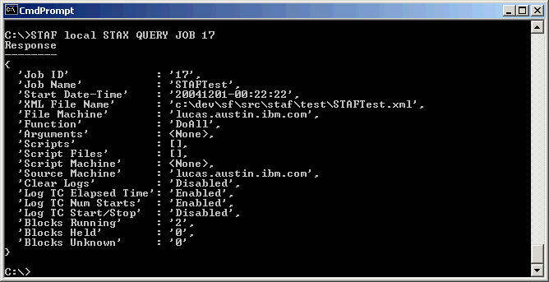
STAX QUERY Command Line Request
Syntax:
QUERY JOB <Job ID>
[BLOCK <Block Name> | THREAD <ThreadID> | TESTCASE <Test Name> |
PROCESS <Location:Handle> | STAFCMD <Request#>]
Examples:
  Goal: Query a job with ID 17

Slide 45
Part 2 – Creating STAX Jobs

Slide 46
Using Python in STAX XML Documents
STAX uses Python for variable assignments and expression evaluation
Python variable naming conventions:
  Syntax: (underscore or letter) + (any number of letters, digits or underscores)
  Case matters: "MACHNAME" is not the same as "machname"
  STAX and Python reserved words are off limits. Following are reserved words in STAX:
    RC, any word beginning with STAX (e.g. STAXJobName, STAXThreadID), and any word beginning with STAF
Python provides powerful built-in object types such as:
Object Type Example Usage
Numbers 0, 1234, 3.1415
Strings 'spam', "guido's"
Lists [1, [2, 'three'], 4]
Dictionaries {'food': 'spam', 'taste': 'yum'}
Tuples (1, 'spam', 4, 'U')
Python Expression Operators:
Operators Description
x or y Logical or (y is evaluated only if x is false)
x and y Logical and (y is evaluated only if x is true)
not x Logical negation
<, <=, >, >=, ==, != Comparison operators
Note: Must use &lt; instead of < in XML documents
Notes:
Python reserved words are listed in the STAX User's Guide. They are:
and, assert, break, class, continue, def, del, elif, else,
except, exec, finally, for, from global, if, import, in, is,
lambda, not, or, pass, print, raise, return, try, while.

Slide 47
Using Python in STAX XML Documents (continued)
Python Strings:
  Strings can be enclosed in single or double quotes (usually use single quotes)
  poolName = 'machPool'
  machName = "machineA.ibm.com"
  mixed = "Guido's“
  You can escape a special character inside a string by preceding it with a backslash (e.g. \\, \', \", \n, \t, etc)
  mixed = 'Guido\'s' # Guido's
  Remember this when specifying file names and specify a forward slash (/) instead of a backward slash (\) to avoid escaping characters when you didn't mean to. The following file name does not evaluate as intended.
  fileName = 'C:\newTests\test1.xml‘
  You can concatenate strings, repeat strings, and get the length of a string:
  newString = 'abc' + 'def' # concatenation: a new string
  repeatString = 'Hi!' * 3 # like "Hi!" + "Hi!" + "Hi!"
  length = len(newString) # length: number items = 6

Slide 48
Using Python in STAX XML Documents (continued)
Python Strings:
  Python overloads the % operator to work on strings. It provides a simple way to format strings. Simply provide a format string on the left (with embedded conversion targets--e.g. %s), along with object(s) on the right that you inserted into the string on the left, at the conversion targets. Note that %s can be used to specify the print format for ANY object.
  request = 'RELEASE POOL %s ENTRY %s' % (poolName, machName)
  Note: The request variable's value evaluates to:
  RELEASE POOL machPool ENTRY machineA.ibm.com'
  Python provides utility modules for processing strings. The string module includes tools for converting case, searching strings for substrings, converting strings to numbers, etc.
  import string
  upper = string.upper("spam") # Converts to uppercase, "SPAM"
  string.find(upper, "PA") # Returns index of substring, 1
Python comments:
  Start with a # character and extend to the end of the current line.

Slide 49
Using Python in STAX XML Documents (continued)
Python Lists:
  A Python list can contain any sort of object: numbers, strings, other lists, etc. Examples:
  L1 = [] # An empty list
  L2 = [0, 1, 2, 3] # A list containing 4 iterms: indexes 0-3
  L3 = ['abc', [0, 'xyz']] # Nested sublists
  L2[i], L3[i][j] # Index
  L2[i:j] # Slice
  len(L2) # Length
  L1 + L2 # Concatenate
  L2[3] = 'cat' # Index assignment
  range(4) # Makes a list of integers: [0, 1, 2, 3, 4]
  L2.append(4) # Method: grow the list
There are no braces or begin/end delimiters around blocks of code; instead, Python uses the indentation of statements under a header to group the statements in a nested block. For example:
x = 'spam'
if x == 'spam':
y = 2
print 'block1'
print 'block0'
Most STAX elements and attribute values can contain Python expressions

Slide 50
Using Python in STAX XML Documents (continued)
Jython/Python Documentation
  See the Python and Jython websites for documentation on Python and Jython at:
    http://www.python.org
    http://www.jython.org
  Some Python and Jython books that are available include:
    "Python Pocket Reference", O'Reilly
    "Learning Python", O'Reilly, Mark Lutz & David Ascher
    "Jython Essentials", O'Reilly, Samuele Pedroni & Noel Rappin
    "Jython for Java Programmers", Robert Bill

Slide 51
Using XML to Define STAX Jobs
STAX uses XML (Extensible Markup Language) to describe STAX job definitions
Some XML fundamentals:
  In XML, tags always start with < and end with >. The names that can be used for a tag are defined by the DTD (Document Type Definition).
  <function>
  Both markup and text in an XML document are case-sensitive
  <function name="main"> is different from <Function name="Main">
  XML comments start with <!-- and end with -->
  <!-- Assign a list of machines to variable machList -->
  XML documents are made up of XML elements. Like in HTML, you create XML elements with an opening tag, such as <log>, followed by the element content (if any), such as text or other elements, and ending with the matching closing tag that starts with </, such as </log>.
  <log>'This is some text'</log>

Slide 52
Using XML to Define STAX Jobs (continued)
More XML fundamentals:
  Elements may contain only character data, only elements, a mixture of both, or nothing at all (empty elements)
  <!-- empty element -->
  <nop/> <!-- this is equivalent to <nop></nop> -->
  <!-- Contains two elements, each containing character data -->
  <process>
  <location>'machineA'</location>
  <command>'C:/tests/stress1.exe'</command>
  </process>
  Attributes in XML are name-value pairs that let you specify additional data in start and empty tags. To assign a value to an attribute, you use an equal sign. You must enclose attribute values in quotation marks (usually double quotes). Examples:
  <defaultcall function="Main"/>
  <call function="'Main'"/>
  <call function='"Main"'/>
  <function name="Main">
  ...
  </function>

Slide 53
Using XML to Define STAX Jobs (continued)
STAX XML documents define the workflow of the job; what processes and/or STAF commands are executed and in what order.
A STAX XML document must comply with the STAX DTD
  The first line in an XML document should start with an XML declaration
  The second line in an XML document should be the document type declaration. This is used to indicate the DTD used for the document. It defines the name of the root element, stax, and the DTD to be used.
  All other elements in a STAX XML document must be contained between <stax> and </stax>
Every STAX XML document should look like:
<?xml version="1.0" encoding="UTF-8" standalone="no"?>
<!DOCTYPE stax SYSTEM "stax.dtd">
<stax>
...
</stax>

Slide 54
Editing STAX XML Documents
You can create a STAX XML document using any editor, even notepad
There are many XML editors available
WebSphere Application Developer (WSAD) provides an XML editor
XML Cooktop is a a free development environment for DTD, XML, and XSLT documents on Windows (http://www.xmlcooktop.com/). We also provided it on the STAF/STAX CD. It can be installed by running cooktop_2.5.0.1192.msi from the <CD-drive>/stax/XMLEditors/Cooktop directory.
It's features include:
  Color-coded XML editing
  Extensible support for external tools, such as XSL processors, XML formatters, and web browsers
  Ability to open files via URL
  Checks well-formedness and validates XML documents
  Line numbering

Slide 55
Retrieving the STAX DTD
A DTD (Document Type Description) is a formal description in XML Declaration Syntax of a particular type of document. It defines what names can be used for different types of elements, where they may occur, and how they all fit together. An XML document is considered valid if it complies with its DTD.
  STAX checks the syntax of XML documents using a validating XML parser to verify that the document complies with the DTD
  The STAX DTD is dynamically generated when you start STAF (with the STAX Service configured)
To retrieve the STAX DTD and stored the result in a file named C:\stax.dtd, use the following STAX command:
STAF local STAX GET DTD > C:\stax.dtd
To use this DTD with a validating XML editor, you must remove the first two lines that are inserted by the STAF command:
Response
--------

Slide 56
Understanding STAX XML Elements
Fundamental Action Elements:
  process - defines the execution information for a STAF PROCESS START command. A process element specifies a command to be executed and the machine where it should run.
  stafcmd - defines execution information for other STAF commands. A stafcmd element specifies the STAF service and request to be executed and the machine where it should run.
  script - defines Python code to be executed
Sequential Group Elements:
  sequence - executes any number of STAX elements sequentially. Also, used for nesting multiple child elements within other elements.
  function - provides a structuring device for STAX XML documents.. Functions allow us to group and parametize chunks of XML to be used arbitrarily many times later. Functions also provide a tool for splitting jobs into pieces that have a well-defined role.
Conditional Elements:
  if, elseif, else - provide the standard complement of condition testing capabilities

Slide 57
Understanding STAX XML Elements (continued)
Looping Elements:
  loop - allows a STAX element to be executed repeatedly (like "for", "do", "while", and "until" constructs found in other languages)
  iterate - allows a STAX element to be executed repeatedly while stepping through a list of data for each iteration
  break/continue - allows breaking out of the nearest enclosing <loop> or <iterate> element or stopping execution of the current loop/iteration and continues with the next loop/iteration
Execution Block Elements:
  block - allows you to define a set of actions over which you have internal and external control (hold, release, and terminate). Blocks may be nested to produce an execution hierarchy. Each job consists of at least one block, called "main" which encompasses the entire job.
Log and Message Elements:
  log - allows you to place information into a job's user-managed log
  message - allows your job to send informational messages to the STAX Monitor GUI

Slide 58
Fundamental Actions: <script>
The <script> element contains Python code
All <script> elements contained in the root stax element are executed at the beginning of the job, in the order they are defined in the XML document
All other <script> elements are executed as they are encountered
Examples:
  Goal: Create a variable named testName and assign it the value "CoolTest1"
  <script>testName = 'CoolTest1'</script>
  Goal: Create a list called allMachList by combining lists named unallocMachList and allocMachList
  <script>unallocMachList = ['MachA','MachB','MachC','MachD']</script>
  <script>allocMachList = ['AllocMachA','AllocMachB']</script>
  <script>allMachList = unallocMachList + allocMachList</script>
  Goal: Generate a random number (which could be used to randomly select which function to call) using the random module provided by Python. Note that in Python, you can use a semicolon to separate multiple statements on the same line.
  <script>
  from random import random; r=random()*100
  </script>

Slide 59
Fundamental Actions: <script> (continued)
Examples (continued):
  Goal: Use Java class STAFUtil and its wrapData() method to turn strings containing spaces into the colon-length-colon form needed for submitting a STAF Notify request. Note that the STAFUtil class needs to be imported in order to use its wrapData() method.
  <script>
  from com.ibm.staf import STAFUtil
  name = 'Jane Smith'
  msg = 'STAX Job ID %s failed.' % (STAXJobID)
  request = ('NOTIFY PROFILE %s LEVEL NORMAL MESSAGE %s' %
  (STAFUtil.wrapData(name), STAFUtil.wrapData(msg)))
  </script>
  Given this, the request variable would evaluate to something like the following:
  NOTIFY PROFILE :10:Jane Smith LEVEL NORMAL MESSAGE :21:STAX Job ID 6 failed.
  Note: This example also shows that for statements that are too long to fit on one line, Python lets you continue typing the statement on the next line, if you're coding something enclosed in (), {}, or [] pairs. Continuation lines can start at any indentation level. As another alternative, you can specify the continuation character, \, at the end of the line to be continued.
  request = 'NOTIFY PROFILE %s LEVEL NORMAL MESSAGE %s' % \
  (STAFUtil.wrapData(name), STAFUtil.wrapData(msg))

Slide 60
Fundamental Actions: <process>
The <process> element allows you to execute arbitrary processes on any system (where STAF is running).
The <process> element has the following required elements:
  location
  command - Has attribute mode. Can be set to 'shell' or 'default' (default).
The <process> element may contain many optional elements, such as:
  parms
  workdir
  title
  vars (or var)
  envs (or env)
  stdout, stderr
  returnstdout, returnstderr
  Note: Each of these optional elements may specify an if attribute. If it does not evaluate to a true value, the element is ignored.
Notes:
Most of the STAX XML elements and attributes that can contain character data (text) are evaluated by Python and thus, can contain Python variables. So, if a string is intended, you must specify quotes around it.
Examples:
machine = 'machineA'
'machineA'
machine
However, some attributes can only contain a literal string (that is, they are not evaluated by Python). These are documented in the STAX User's Guide.
Examples:
The function element's name attribute can only contain a literal. However, to call this function, specify
since the call element's name attribute is evaluated by Python.

Slide 61
Fundamental Actions: <process> (continued)
After a process has completed (or if it could not be started) the following variables are set and can be referenced by the job:
  RC - the return code from the process. It is an integer.
  STAFResult - the STAF result from starting the process. If the process failed to start successfully, it contains any error messages from starting the process. It is a string.
  STAXResult - contains any files specified by returnstdout, returnstderr, and/or returnfile(s). If no files are returned, STAXResult is set to the special Python object None.
Examples:
  Goal: Run a Java program passing it three parameters
  <process name="'TestProcess'">
  <location>'local'</location>
  <command>'java'</command>
  <parms>'com.ibm.staf.service.stax.TestProcess 5 1 0'</parms>
  <title>'Test Process'</title>
  <env>'CLASSPATH=c:/stax/services/stax.jar;%CLASSPATH%'</env>
  </process>
  Goal: Run a ping command as though you were at a shell prompt. It assumes machName is a Python variable that is set (via a <script> element) to the name of the machine to ping.
  <process name="'Ping'">
  <location>'local'</location>
  <command mode="'shell'">'ping -n 1 -w 1 %s' % machName</command>
  </process>

Slide 62
Fundamental Actions: <stafcmd>
STAF Command
  The <stafcmd> element allows you to call STAF services within your job
  This allows the capabilities of existing STAF services to be leveraged in your jobs
The stafcmd element has the following three required elements:
  location, service, request
Examples:
  Goal: Use the STAF Resource Pool (RESPOOL) service to request a machine from the resource pool called 'MachinePool'. The machine name will be returned in STAFResult.
  <stafcmd>
  <location>'local'</location>
  <service>'RESPOOL'</service>
  <request>'REQUEST POOL MachinePool'</request>
  </stafcmd>
  Goal: Delay for 5 seconds using the STAF Delay Service
  <stafcmd>
  <location>'local'</location>
  <service>'DELAY'</service>
  <request>'DELAY 5000'</request>
  </stafcmd>

Slide 63
Groupings: <sequence>
The <sequence> element:
  Represents a container of STAX elements which will be executed serially, in the order in which the contained elements are listed in the sequence
  May contain any number of task elements
Example:
<sequence>
<script>
fileServer = 'server1'
machName = 'testMachine1'
fileName = 'C:/tests/TestA.exe'
</script>
<stafcmd>
<location>fileServer</location>
<service>'FS'</service>
<request>'COPY FILE %s TOMACHINE %s' % (fileName, machName)</request>
</stafcmd>
<process>
<location>machName</location>
<command>fileName</command>
</process>
</sequence>
Notes:
A task element is defined in the STAX DTD to be:

Slide 64
Groupings: <function>
The <function> element:
  Defines a named task and contains a single task element
  May only be defined within the root stax element
  The first function called when a job is started is determined by the <defaultcall> element or by the FUNCTION parameter of the STAX EXECUTE request
The function element has the following attributes:
  name - Required. Is a literal.
  scope - Optional. Is a literal. Must be global or local. Defaults to global.
  requires - Optional. Specifies any functions it requires.
The <call> element can be used to call a function, and optionally pass arguments
The <return> element:
  Ends the function call and sends a result object back to the caller
  The result is assigned to a variable named STAXResult. If nothing is returned, it's value defaults to special Python object None.

Slide 65
Groupings: <function> (continued)
Example:
Goal: Define a function that pings a machine and returns the RC (0 if successful)
<function name="Ping" scope="local">
<sequence>
<stafcmd>
<location>machName</location>
<service>'PING'</service>
<request>'PING'</request>
<stafcmd>
<return>RC</return>
</sequence>
</function>
Goal: Call the 'Ping' function and print a message containing its result
<sequence>
<script>machName = 'machine1'</script>
<call function="'Ping'"/>
<message>'Result from ping is %s' % STAXResult</message>
</sequence>

Slide 66
Looping: <loop>
The <loop> element:
  Contains a single task element which may be executed a specified number of times, allowing specification of an upper and lower bound with an increment value and where the index counter is available to the contained task element
  Specification of constraint attributes (e.g. to, while, and/or until) expressions are allowed
  Loops "forever", if no constraint attributes are specified
The loop element has the following optional attributes:
  var - the name of the variable which will contain the loop index variable
  from - the starting value of the loop index variable. It defaults to 1.
  to - the maximum value of the loop index variable
  by - the increment value for the loop index variable. It defaults to 1.
  while - an expression evaluated at the top of each loop. If false, breaks out of the loop.
  until - an expression evaluated at the bottom of each loop. If true, breaks out of loop.
Example:
<loop from="1" to="5" until="RC != 0">
<process>
<location>machName</location>
<command>'notepad.exe'</command>
</process>
</loop>

Slide 67
Looping: <iterate>
The <iterate> element:
  Contains a single task element
  Performs the task for each value in a list. The iterations of the task are executed serially.
The iterate element has the following attributes:
  var -the name of the variable which will contain the current item in the list/tuple being iterated
  in - the list to be iterated. Note that the list may be assigned in many ways:
  in="['machineA', 'machineB', 'machineC']"
  in="machineList"
  indexvar - the name of the variable which will contain the index of the current item in the list being iterated. The index for the first element in the list is 0. It is optional.
Example:
  Goal: Run a test sequentially on three machines
  <iterate var="machName" in="['mach1','mach2','mach3']">
  <process>
  <location>machName</location>
  <command>'C:/tests/test.exe'</command>
  </process>
  </iterate>

Slide 68
Condition Testing: <if>
The <if> element:
  Specifies a task to execute if an expression is evaluated to be true
  Allows optional <elseif> elements and an optional <else> element to be performed if the expression is evaluated to be false
  The <if>, <else>, and <elseif> elements may contain a single task element
The if and elseif elements have the following required attribute:
  expr - expression to be evaluated by Python
Example:
  Goal: Randomly call one of three functions using a Python random number generator
  <script>from random import random; r = random()*100</script>
  <if expr="r > 66.6">
  <call function="'Function1'"/>
  <elseif expr="r &lt; 33.3">
  <call function="'Function2'"/>
  </elseif>
  <else>
  <call function="'Function3'"/>
  </else>
  </if>

Slide 69
Execution Blocks: <block>
The <block> element:
  Is a wrapper containing a single task element for which execution control is provided
  It may be used in conjunction with the <hold>, <release>, and <terminate> elements and the STAX Service HOLD, RELEASE, and TERMINATE requests
  A block named 'main' exists that wraps everything in the job
  For nested blocks, the block name will be recorded in the hierarchical form of ParentBlockName.ChildBlockName in the STAX logs and queries. The childl block's name must be unique within the parent block's scope.
Example:
<block name="'Block1'">
<sequence>
<call function="'GetTest'"/>
<call function="'RunTest'"/>
<call function="'CheckRC'"/>
</sequence>
</block>

Slide 70
Logging and Messages: <log>, <message>
The <log> element:
  Logs a message in the STAX job user log
  The log element has the following optional attributes:
    level - the logging level of the message to be logged ('info' is the default)
    if - specifies an expression. If it evaluates to true, a message is logged.
The <message> element:
  Specifies a message which will be sent to the STAX Monitor and displayed via its GUI
  The message element has the following optional attribute:
    if - specifies an expression. If it evaluates to true, a message is sent to the monitor.
Examples:
<log if="debug" level="'debug'">'Put debug information here'</log>
<message if="RC ! 0">'RC=%s on machine %s' % (RC, machName)</message>

Slide 71
Creating a Simple STAX Job: Part 1
Every STAX job begins with the same basic information
  XML document header
  <stax> declaration
  One or more function definitions
  Optionally, a <defaultcall> element that specifies the starting function
<?xml version="1.0" encoding="UTF-8" standalone="no"?>
<!DOCTYPE stax SYSTEM "stax.dtd">
<stax>
<defaultcall function="StartHere"/>
<function name="StartHere"/>
...
</function>
</stax>

Slide 72
Creating a Simple STAX Job: Part 2
Now let's run a stress testcase
<?xml version="1.0" encoding="UTF-8" standalone="no"?>
<!DOCTYPE stax SYSTEM "stax.dtd">
<stax>
<defaultcall function="StartHere"/>
<function name="StartHere">
<process name="'stress1'">
<location>'machine1'</location>
<command>'C:/tests/stress1.exe'</command>
</process>
</function>
</stax>

Slide 73
Creating a Simple STAX Job: Part 3
Let's abstract away
  The machine on which it runs
  The name of the testcase and it's executable
<stax>
<defaultcall function="StartHere"/>
<script>
machine = 'machine1'
test = [ 'Stress1', 'C:/tests/stress1.exe' ]
</script>
<function name="StartHere">
<process name="test[0]">
<location>machine</location>
<command>test[1]</command>
</process>
</function>
</stax>

Slide 74
Creating a Simple STAX Job: Part 4
Let's check if the test ran successfully and send a message indicating whether it was successful to the STAX Monitor.
<script>
machine = 'machine1'
test = [ 'Stress1', 'C:/tests/stress1.exe' ]
</script>
<function name="StartHere">
<sequence>
<process name="test[0]">
<location>machine</location>
<command>test[1]</command>
</process>
<if expr="RC == 0">
<message>'Test %s passed' % test[0]</message>
<else>
<message>'Test %s failed with RC=%s' % (test[0], RC)</message>
</else>
</if>
</sequence>
</function>

Slide 75
Creating a Simple STAX Job: Part 5
Now let's run more testcases
<script>
machine = 'machine1'
testList = [ [ 'Stress1', 'C:/tests/stress1.exe' ],
[ 'Stress2', 'C:/tests/stress2.exe' ],
[ 'Stress3', 'C:/tests/stress3.exe' ] ]
</script>
<function name="StartHere">
<iterate var="test" in="testList">
<sequence>
<process name="test[0]">
<location>machine</location>
<command>test[1]</command>
</process>
...
</sequence>
</iterate>
</function>

Slide 76
Creating a Simple STAX Job: Complete
<?xml version="1.0" encoding="UTF-8" standalone="no"?>
<!DOCTYPE stax SYSTEM "stax.dtd">
<stax>
<defaultcall function="StartHere"/>
<script>
machine = 'machine1'
testList = [ [ 'stress1', 'C:/tests/stress1.exe' ],
[ 'stress2', 'C:/tests/stress2.exe' ],
[ 'stress3', 'C:/tests/stress3.exe' ] ]
</script>
<function name="StartHere">
<iterate var="test" in="testList">
<sequence>
<process name="test[0]">
<location>machine</location>
<command>test[1]</command>
</process>
<if expr="RC == 0">
<message>'Test %s passed' % test[0]</message>
<else>
<message>'Test %s failed with RC=%s' % (test[0], RC)</message>
</else>
</if>
</sequence>
</iterate>
</function>
</stax>

Slide 77
Part 3 – Creating More Complex STAX jobs

Slide 78
Understanding additional STAX XML Elements
Parallel Execution:
  parallel - defines a set of elements which will be executed in parallel
  paralleliterate - allows a STAX element to be executed repeatedly, in parallel, while stepping through a list of data for each iteration
Testcases and Timers:
  testcase, tcstatus – define a named set of elements for which you can have any number of testcase passes/fails
  timer - allow you to place time constraints on portions of your automation jobs
Signals and Exceptions:
  raise, signalhandler - deal with the raising and handling of STAX signals
  try, catch, throw, rethrow - deal with the processing of STAX exceptions

Slide 79
Understanding additional STAX XML Elements (continued)
Functions:
  function, call, return – defines portions of a STAX job that can be called repeatedly
  function-prolog, function-epilog – contains a textual description of the function
  function-no-arg, function-single-arg, function-list-arg, function-map-arg – defines formal arguments for the function
Common Libraries:
  import – allows you to import functions from other STAX xml files
Sub-Jobs:
  job – defines a sub-job which will be executed within the parent job

Slide 80
Parallel Execution: <parallel>, <paralleliterate>
The STAX programming languages provides direct support for spawning multiple flows of execution and synchronizing their completion
The <parallel> element allows you to spawn and synchronize multiple heterogeneous flows of execution. For example:
  Transferring a set of files to one system, while
  Installing some applications on another system, while
  Waiting for another system to reboot
The <paralleliterate> element allows you to spawn and synchronize multiple homogeneous flows of execution. For example:
  Performing the same sequence of tests in parallel across a group of systems
  Transferring a set of files in parallel to a group of systems
  Executing a set of tests in parallel on one or more systems

Slide 81
Parallel Execution: <parallel> (continued)
Example:
  Goal: Transfer a file from a server to machine1, install some applications on machine2, and reboot machine3, all at the same time. When all three tasks are complete, the parallel element is complete and processing will continue with the next element defined after the </parallel> element.
  <parallel>
  <stafcmd>
  <location>'server1'</location>
  <service>'FS'</service>
  <request>'COPY FILE C:/tests/test1.zip TOMACHINE machine1'</request>
  </stafcmd>
  <process>
  <location>'machine2'</location>
  <command>'C:/Applications/install.exe'</command>
  </process>
  <call function="'Reboot'">'machine3'</call>
  </parallel>

Slide 82
Parallel Execution:<paralleliterate> (continued)
The <paralleliterate> element contains a single task element and has the following attributes:
  var - the name of the variable which will contain the current item in the list being iterated
  in - the list to be iterated. Note that the list may be assigned in many ways:
  in="['machineA', 'machineB', 'machineC']"
  in="machineList"
  indexvar - the name of a variable which will contain the index of the current item in the list
Example:
  Goal: Run TestA simultaneously on a group of machines whose names are contained in a list. The <paralleliterate> element is not complete until "TestA" has completed on all of the machines whose names are contained in the list.
  <paralleliterate var="machine" in="['machineA', 'machineB']">
  <process>
  <location>machine</location>
  <command>'C:/tests/TestA.exe'</command>
  </process>
  </paralleliterate>

Slide 83
Creating a simple STAX job: Continued
Now let's add more machines
<script>
machines = [ 'machine1', 'machine2', 'machine3' ]
tests = [ [ 'Stress1', 'C:/tests/stress1.exe' ],
[ 'Stress2', 'C:/tests/stress2.exe' ],
[ 'Stress3', 'C:/tests/stress3.exe' ] ]
</script>
<function name="StartHere"/>
<paralleliterate var="machine" in="machines">
<iterate var="test" in="tests">
<testcase name="test[0]">
<sequence>
...
<process>
<location>machine</location>
<command>test[1]</command>
</process>
...
</sequence>
</testcase>
</iterate>
</paralleliterate>
</function>

Slide 84
Testcases: <testcase>, <tcstatus>
Any arbitrary set of STAX logic may be deemed a testcase
You have direct control over:
  The scope of the testcase
  The success/failure criteria of the testcase
Testcases may be nested which:
  Provides greater control over testcase results
  Eases namespace management and incorporation of other testcases and test suites
The <testcase> element is a wrapper which defines a testcase and contains a single task element for which testcase status is recorded
  Attributes:
    name - the name of the testcase
    mode - 'default' or 'strict'
The <tcstatus> element is used to increment testcase pass/fail counters and record any additional diagnostic information
  Attribute:
    result - 'pass' or 'fail'

Slide 85
Testcases: <testcase>, <tcstatus> (continued)
Example:
  Goal: Create a testcase 'Test1' that includes running a process on a set of machines. Create subtests (e.g. 'Test1.machineA', 'Test1.machineB', 'Test1.machineC') that include running a process on a single machine. If the process is successful (indicated by RC = 0), record a pass status, otherwise record a fail status and a message with the return code.
  <testcase name="'Test1'">
  <paralleliterate var="machine" in="['machineA', 'machineB', 'machineC']">
  <testcase name="machine">
  <sequence>
  <process>
  <location>machine</location>
  <command>'C:/tests/test1.exe'</command>
  </process>
  <if expr="RC == 0">
  <tcstatus result="'pass'"/>
  <else>
  <tcstatus result="'fail'">'Failed with RC=%s' % RC</tcstatus>
  </else>
  </if>
  </sequence>
  </testcase>
  </paralleliterate>
  </testcase>

Slide 86
Timers: <timer>
Many automation tasks require a level of control over the amount of time consumed by the task. Two common examples:
  Bounding the amount of time consumed by a particular task
  Ensuring that a task runs for a specific amount of time
The STAX programming language provides direct support for these types of issues via the <timer> element
The STAX engine handles all cleanup activities and provides you direct control over the outcome of an expired timer
The <timer> element is a wrapper which defines a single task for which time control is provided. It has one attribute:
  duration - specifies the maximum length of time to run the task (e.g. '5m', '2h', '1d')
Upon completion of a <timer> element, the STAX execution engine sets:
  RC - the timer's return code
  1 = task was still running when timer expired
  0 = task ended before timer expired
  -1 = task never began (e.g., invalid duration specified)

Slide 87
Timers: <timer> (continued)
Example:
  Goal: Run a stress test for two hours. If it is still running after two hours, terminate it and record a testcase pass result. If it is not still running after two hours, record a fail result.
  <testcase name="'Stress1'">
  <sequence>
  <timer duration="'2h'">
  <process>
  <location>'machine1'</location>
  <command>'C:/tests/stress1.exe'</command>
  </process>
  </timer>
  <if expr="RC == 1">
  <tcstatus result="'pass'"/>
  <else>
  <tcstatus result="'fail'">'Timer RC=%s' % RC</tcstatus>
  </else>
  </if>
  <sequence>
  </testcase>

Slide 88
Signals: <raise>, <signalhandler>
Signals
  STAX signals are very similar to C oriented signals. They are a means to inform your job of certain conditions. Incoming signals preempt the normal flow of your job until they are handled.
  STAX uses signals to inform the job about certain error situations (such as data evaluation errors or non-existant functions)
  STAX provides default signal handlers for all predefined signals
  You may override the default signal handlers, as well as create your own custom signals and signal handlers
  The <raise> element allows you to raise signals
  The <signalhandler> element allows you to define a signal handler for a specified signal
Signals that may be raised by the STAX execution engine include:
  STAXPythonEvaluationError
  STAXProcessStartError
  STAXFunctionDoesNotExist
  STAXInvalidBlockName

Slide 89
Signals: <raise>, <signalhandler> (continued)
Example:
  Goal: Override the default signalhandler for STAXPythonEvaluationError so that it sends a message to the STAX Monitor and logs a message but does not terminate the job
  <signalhandler signal="'STAXPythonEvaluationError'">
  <sequence>
  <script>
  msg1 = 'STAXPythonEvaluationError signal raised. Continuing job.'
  msg = '%s %s' % (msg1, STAXPythonEvalMsg)
  </script>
  <message>msg</message>
  <log level="'error'">msg</log>
  </sequence>
  </signalhander>
  Goal: The following example of the raise element raises a signal named 'NonZeroRCError' when a non-zero return code is encountered
  <function name="Valid-if-RC-0">
  <if expr="RC != 0">
  <raise signal="'NonZeroRCError'"/>
  </if>
  </function>

Slide 90
Exceptions: <try>, <catch>, <throw>, <rethrow>
Exceptions
  STAX provides exceptions that work analogously to C++ and Java exceptions
  The <try> element defines a section of your job in which you want to catch exceptions
  The <catch> element defines an exception that is to be caught
  The <throw> element allows you to throw exceptions
  The <rethrow> element allows you to throw a previously caught exception
Example:
  Goal: Demonstrate the use of try, catch, throw elements.
  <try>
  <sequence>
  <call function="'CheckServerAvailability'"/>
  <if expr="RC != 0">
  <throw exception="'ServerNotAvailable'"/>
  </if>
  <call function="'StartServers'"/>
  <if expr="RC != 0">
  <throw exception="'Timeout.ServerStart'">'Server %s' % machine</throw>
  </if>
  </sequence>
  <catch exception="'ServerNotAvailable'">
  <log>'Handler: ServerNotAvailable'</log>
  </catch>
  <catch exception="'Timeout'" typevar="exceptionType" var="eInfo">
  <log>'Handler: Timeout, eType: %s, eInfo: %s' % (exceptionType, eInfo)</log>
  </catch>
  </try>
Notes:
The example shows a try block containing a sequence of tasks to perform. If an exception is thrown, the catch block for the exception thrown is run and then processing will continue by executing the element following the end of the try block. If a 'Timeout.ServerStart' exception is thrown, the catch block for exception 'Timeout' can handle this exception because they are sub-types of exception 'Timeout'.

Slide 91
Defining Function Arguments
Arguments for functions can be defined. The <function> element can optionally contain the following elements, in the order listed, before the task element:
  <function-description> - a description of the function
  An argument definition element. Can be one of the following elements:
    <function-no-arg/> - specifies that no arguments can be passed to this function
    <function-single-arg> - can contain a <function-required-arg> element or a <function-optional-arg> element
    <function-list-args> - can contain any number of <function-required-arg> elements, followed by any number of <function-optional-arg> elements, optionally followed by a <function-other-args> element
    <function-map-args> - can contain any number of <function-required-arg> elements, followed by any number of <function-optional-arg> elements, optionally followed by a <function-other-args> element
A function argument can be defined to be required, optional, or other:
  <function-required-arg> - Attribute: name
  <function-optional-arg> - Attributes: name, default
  <function-other-args> - is a list or map which will contain any additional arguments passed when calling a function. Attribute: name
Notes:
A function that does not define its arguments is implicitly defined as:

Slide 92
Defining Function Arguments (continued)
Example: Define a function that accepts two arguments (one required, one optional) in a list
<function name="RunTest" scope="local">
<function-description>Runs a test on a machine.</function-description>
<function-list-args>
<function-required-arg name="test">Name of test to run</function-required-arg>
<function-optional-arg name="machine" default="'local'">
Name of machine where the test should run
</function-optional-arg>
</function-list-args>
<process>
<location>machine</location>
<command>test</command>
</process>
</function>
Example: Call function 'RunTest', passing it two arguments (test name and machine name) in a list. The three ways shown are equivalent ways to call the function.
<call function="'RunTest'">'C:/tests/stress1.exe', 'machine1'</call>
<call function="'RunTest'">['C:/tests/stress1.exe', 'machine1']</call>
<call-with-list function="'RunTest'">
<call-list-arg>'C:/tests/stress1.exe'</call-list-arg>
<call-list-arg>'machine1'</call-list-arg>
</call-with-list>

Slide 93
Creating Libraries of Common STAX Functions
The STAX programming language allows you to import functions from other STAX jobs. This allows you to create libraries of reusable modules and also makes it easy to share testcases, and even whole test suites, with other teams
  Makes using other's testcases as easy as 1) import and 2) run
  ITCL preferred mechanism for sharing across test teams
The <import> element specifies a set of functions to be imported from another STAX XML job file. The import element has the following required attributes:
  machine and file
The import element can contain the following optional elements:
  <import-include> - specifies a list of the the functions to import from the job file. If not present, then all functions will be imported (bound by any exclude list).
  <import-exclude> - specifies a list of functions which will not be imported from the job file. If not present, then no functions will be excluded.
The <import-include> and <import-exclude> elements support grep matching
If an error occurs while executing an import element, a STAXImportError signal will be raised if its mode is 'error'

Slide 94
Creating Libraries of Common STAX Functions (continued)
The <import> element may be specified anywhere except in the root element. This allows it to be executed at runtime, allowing Python expressions to be used in the element and enabling dynamic importing of functions.
After an import element is executed, any other function can then call the imported function. If you have many functions to import, you can create a function which does all of the imports and is the first function called.
Examples:
  Goal: Import all functions from file c:\util\library.xml, which is located on machine Server1A.
  <import machine="'Server1A'" file="'c:/util/library.xml'"/>
  Goal: Only import functions FunctionA and FunctionB.
  <import machine="'Server1A'" file="'c:/util/library.xml'">
  <import-include>'FunctionA', 'FunctionB'</import-include>
  </import>
  Goal: Import all functions that start with "MyFuncs" but do not start with "MyFuncsWin32".
  <import machine="'Server1A'" file="'/usr/local/util/library.xml'">
  <import-include>'MyFuncs.*'</import-include>
  <import-exclude>'MyFuncsWin32.*'</import-exclude>
  </import>

Slide 95
Executing Sub-jobs
The <job> element represents a sub-job that will be executed within the parent job
A sub-job will appear as a separate job
Terminating a parent job will terminate any sub-jobs as well
Holding/releasing a parent job will not hold/release its sub-jobs
After a sub-job has completed (or it could not be started), the following variables are set and can be referenced by the job:
  RC - the return code from submitting the request to execute the sub-job
  STAFResult - the STAF result from submitting the request to execute the sub-job
  STAXSubJobID - the job ID of the sub-job
  STAXResult - contains the result returned by the starting function of the sub-job
Examples:
  Goal: Execute a sub-job, with a job name “Job 2”, defined by XML file c:/stax/xml/myJob2.xml
  <job name="'Job 2'">
  <job-file>'C:/stax/xml/myJob2.xml'</job-file>
  </job>

Slide 96
Executing Sub-jobs (continued)
In the following example of a job element, a sub-job defined by an XML file named tests/testB/xml located on machine myMachine is executed and given a job name of 'Test B'. The job is started by calling function 'Main' and passing this function an argument list of [1, 'server']. In addition, two scriptfiles are specified as well as a couple of script elements. This sub-job is similar to the following STAX EXECUTE request:
  EXECUTE FILE /tests/testB.xml MACHINE myMachine JOBNAME "Test B" CLEARLOGS
  FUNCTION Main ARGS "[1, 'server1']" SCRIPTFILEMACHINE myMachine
  SCRIPTFILE /tests/testB1.py SCRIPTFILE /tests/testB2.py
  SCRIPT "MachineList = ['machA', 'machB'] SCRIPT "maxTime = '1h'"
  <job name="'Test B'" clearlogs="1">
  <job-file machine="'myMachine'">'/tests/testB.xml'</job-file>
  <job-function>'Main'</job-function>
  <job-function-args>[1, 'server1']</job-function-args>
  <job-scriptfiles machine="'myMachine'">
  ['/tests/testB1.py', '/tests/testB2.py']
  </job-scriptfiles>
  <job-script>MachineList = ['machA', 'machB']<job-script>
  <job-script>maxTime = '1h'</job-script>
  <job-action>
  <log>'Started sub-job %s' % (STAXSubJobID)</log>
  </job-action>
  </job>

Slide 97
Debugging STAX Jobs
Understanding XML Parser Error Messages:
  When submitting a job for execution), if the XML document specified is not valid (does not conform to the STAX DTD), error 4001 is returned. Additional information about the error is put into the STAF Result (including the line number where the parser error occurred).
  Example: A STAX XML document contains a <sequence> element, with no end-tag element:
  Additional information:
  Caught com.ibm.staf.service.stax.STAXXMLParseException:
  Line 78: The element type "sequence" must be terminated by the matching end-tag
  "</sequence>".
  Example: A STAX XML document contains a <stafcmd> element with no <service> element:
  <stafcmd>
  <location>machine</location>
  <request>'ping'</request>
  </stafcmd>
  Additional information:
  Caught com.ibm.staf.service.stax.STAXXMLParseException:
  Line 27: The content of element type "stafcmd" must match
  "(location,service,request)".

Slide 98
Debugging STAX Jobs (continued)
Understanding Python Error Messages:
  Whenever you make changes to a STAX xml file that is going to be imported by other STAX jobs, you should always test it to show any XML parsing or Python compile errors
  When Python cannot successfully evaluate a value, expression, or statement(s), a PythonEvaluationError signal is raised. Information about the element which could not be successfully evaluated by Python is provided in a variable named STAXPythonEvalMsg.
  Its default signal handler sends a message that includes the variable named STAXPythonEvalMsg to the STAX Monitor, logs a message in the STAX Job Log with level 'error', and terminates the job.
  NameError Example: Variable workdir is used in a <process> element (<workdir>workdir</workdir>), but was never assigned a value and, thus, doesn't exist.
  STAXPythonEvaluationError signal raised. Terminating job.
  <process name=Process1> with location=crankin command=test1.exe
  com.ibm.staf.service.stax.STAXPythonEvaluationException: Traceback (innermost last):
  File "<string>", line 1, in ?
  NameError: workdir

Slide 99
Debugging STAX Jobs (continued)
Understanding Python Error Messages:
  SyntaxError Example:
  <log level="'info'">'This is the start of the STAX job</log>
  The message specified in a <log> element is missing a closing quote ('). Note the SyntaxError message tells you the column #, 35, where the quote is missing.
  STAXPythonEvaluationError signal raised. Terminating job.
  <log level="'info'">'This is the start of the STAX job</log> com.ibm.staf.service.stax.STAXPythonEvaluationException: Traceback (innermost last):
  (no code object) at line 0
  SyntaxError: ('Lexical error at line 1, column 35. Encountered: "\\n" (10), after : ""', ('<string>', 1, 35, "'This is the start of the STAX job"))

Slide 100
Debugging STAX Jobs (continued)
Understanding Python Error Messages:
  SyntaxError Example:
  <message>'%d file(s) returned in STAXResult' %
  len(STAXResult)</message>
  The text for the message expands over two lines without a continuation character.
  STAXPythonEvaluationError signal raised. Terminating job.
  <message>'%d file(s) returned in STAXResult' %
  len(STAXResult)</message>
  com.ibm.staf.service.stax.STAXPythonEvaluationException: Traceback (innermost last):
  (no code object) at line 0
  SyntaxError: ('invalid syntax', ('<string>', 1, 39, "'%d file(s) returned in
  STAXResult' % "))
  Can be fixed by specifying a continuation character or enclosing in parentheses as follows:
  <message>'%d files(s) returned in STAXResult' % \
  len(STAXResult)</message>
  <message>('%d files(s) returned in STAXResult' %
  len(STAXResult))</message>

Slide 101
Debugging STAX Jobs (continued)
Understanding Process Start Error Messages:
  Example: When a process fails to start, look at the information provided in the job log (or STAX Monitor message) that shows the evaluated values for location and the PROCESS START request information
  <script>fileName = 'C:\tests\newtest.exe'</script>
  <process name="'Process1'">
  <location>machName</location>
  <command>fileName</command>
  </process>
  This raises a STAXProcessStartError signal and logs the following information:
  STAXProcessStartError signal raised. Continuing job.
  <process name=Process1> with location=lucas request=start command :18:C: ests
  ewtest.exe notify onend
  RC=10 STAFResult=5
  Note that the command specified does not look anything like the fileName variable's value you specified because Python replaces escape code characters like \t (Tab) and \n (Newline) with the special characters they represent. To fix this, specify one of the following for the fileName variable value:
  <script>fileName = 'C:/tests/newtest.exe'</script>
  <script>fileName = 'C:\\tests\\newtest.exe'</script>

Slide 102
Debugging STAX Jobs (continued)
Use <message> and <log> elements and their "if" attributes:
<script>debug = 1 # Set to 0 (no debug) or 1 (debug)</script>
<message if="debug">'Whatever text/variables you want to see'</message>
<log if="locals().hasKey('debug') && debug" level="'Debug'">
'Whatever text/variables you want to see'
</log>
Use Jython print statements (recorded in the staf/data/STAF/lang/java/jvm/<JVMName>/JVMLog.1 file):
<script>
if debug:
print 'Debug info: ', machName, cmd
</script>
Query the STAX Job Log for error messages. Signals raised by the STAX execution engine (using the default signal handlers) log an 'Error' message with additional information about why the signal was raised.

Slide 103
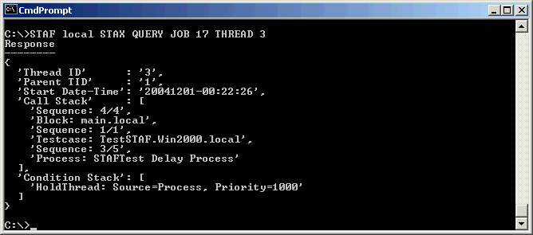
Debugging STAX Jobs (continued)
Use STAX LIST/QUERY requests. In particular, querying a particular thread in a job shows the call stack.
STAF local STAX QUERY JOB <Job ID> THREAD <Thread ID>

Slide 104
Using XSLT to Create STAX Function Documentation
Definitions:
  XSL (Extensible Stylesheet Language) is a language for expressing stylesheets. An XSL stylesheet defines how to present information in a XML document.
  XSLT (XSL Transformer) is a language for transforming XML documents.
Using a sample XSL stylesheet, samples/FunctionList.xsl (provided with STAX), you can transform function information (e.g. function-description and function argument elements) provided in a STAX XML document to an HTML document.
  Note: You will either need to comment out the DOCTYPE line in the STAX XML Document when creating function documentation for it, or make it refer to a valid STAX.DTD file.
There are many XSLT processors available:
  The Xalan-Java XSLT stylesheet processor is available for download from http://xml.apache.org/xalan-j/index.html
An example of an HTML document generated from the sample1.xml document is provided with STAX is on the CD in \stax\samples\sample1.html

Slide 105
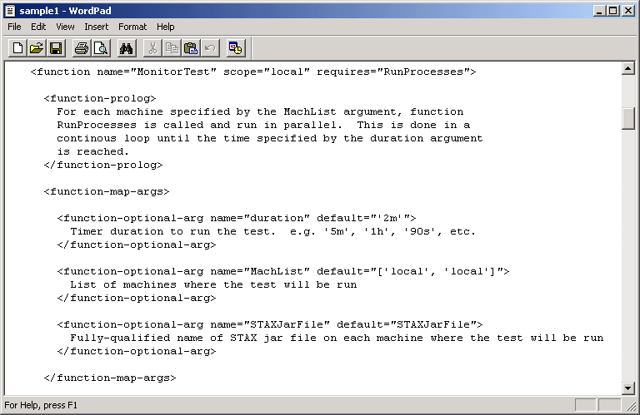
Using XSLT to Create STAX Function Documentation (continued)
Here are the argument definitions for function MonitorTest in stax/samples/sample1.xml

Slide 106
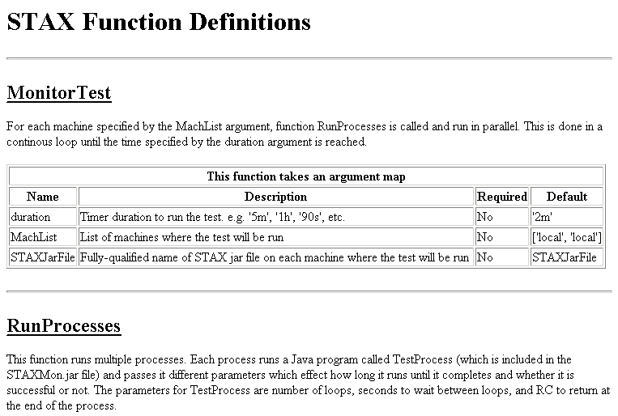
Using XSLT to Create STAX Function Documentation (continued)

Slide 107
End-to-End Automation with STAF and STAX
Automation Startup
S
T
A
X
J
o
b
Event, EventManager, Cron
<function>
<parallel>
<sequence>
<process>
<stafcmd>
<testcase>
<timer>
<block>
<loop>
<message>
<log>
<import>
<job>
<iterate>
<paralleliterate>
<hold>
<release>
<terminate>
System Setup
FileSystem, Process, Zip
Testcase Execution
Process, Monitor, Log, Variable,
Queue, ResourcePool, Semaphore
Testcase Output Analysis
Log, Process
Testcase Cleanup
Process, FileSystem
Results Notification
Email, HTTP
Automation Completion

Slide 108
End-to-End Automation with STAF and STAX
Automation Startup
Event
EventManager
Cron
Test systems in your lab
ResPool
Log
Http
Zip
Variable
FileSystem
Semaphore
Process
Monitor
Email
Queue
STAX Monitor Machine - this could be your office or home system
STAX Service Machine

Slide 109
End-to-End Automation with STAF and STAX
Extract source code
Transfer code to build machines
Cron service starts build job at 1am every day
Build product on each platform
Linux
Transfer product binary files to ISMP machine
AIX
Build ISMP packages
WIN32
Transfer product installation packages to common network location
OS/400
z/OS
Transfer build results to project web site
Generate "Build Available" event
STAX Service Machine

Slide 110
End-to-End Automation with STAF and STAX
EventManager service receives a notification for the "Build Available" event, and kicks off the SVT job
Acquire SVT test machines from the machine pool
Download product installation packages from common network location to SVT machines
HP-UX
Install product on SVT machines
Solaris
WIN32
Run SVT testcases
OS/400
If SVT fails, email the project manager
z/OS
Post SVT results to project website
STAX Service Machine

Slide 111
Questions and Additional Topics

Slide 112
End of Presentation
End of Presentation

Slide 113
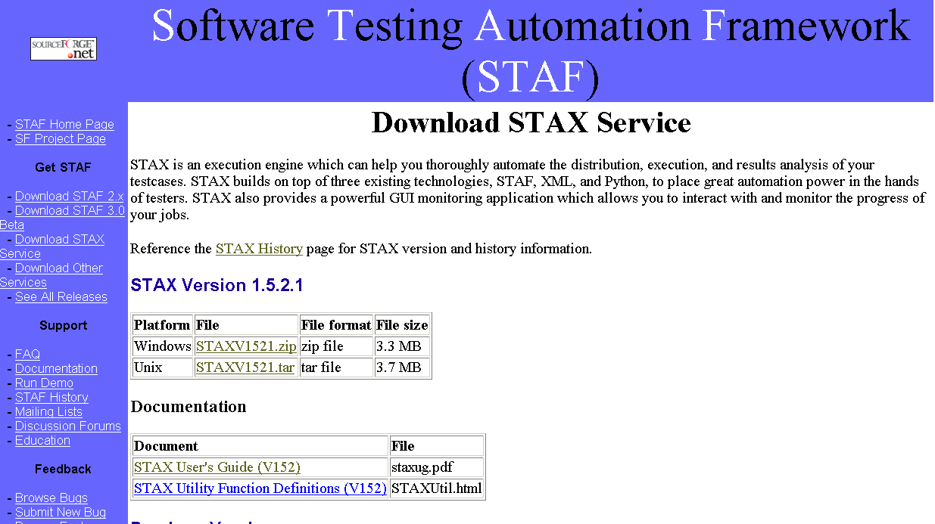
http://staf.sourceforge.net/getstax.php

Slide 114
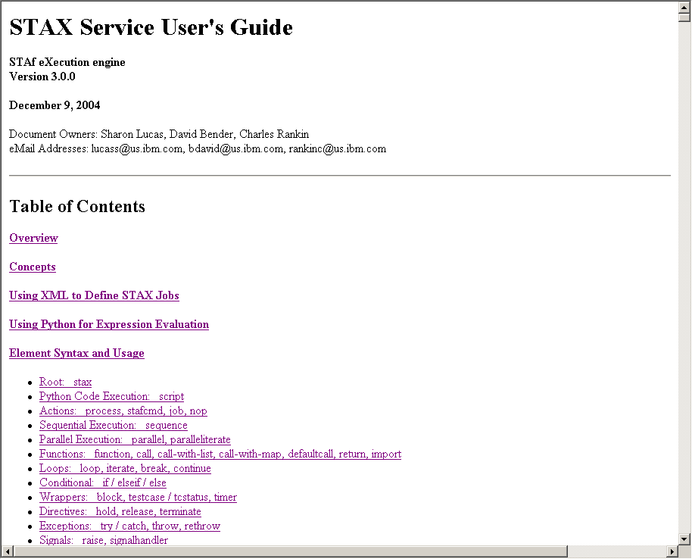
STAX Service User’s Guide

