Slide 1
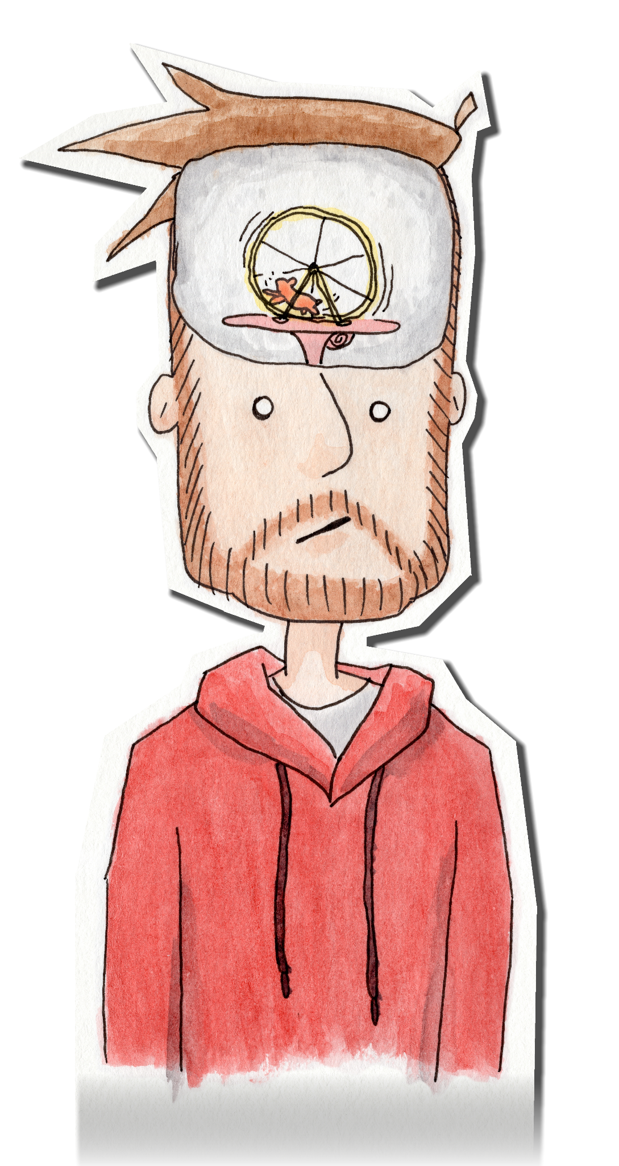
JWalterScribbles
Justin Walter’s art website

Slide 2
Description, Audience, Purpose
This website would be a hub for all of my art related content, and hold all the information someone would need to view or buy art, and contact me about my projects.
The audience is anyone who is curious about me, my work, or wants to commission or buy projects
I want to present myself in a way that is calm but reliable, similar to the feeling of many of my drawings

Slide 3
Archetype, Color, Fonts
My archetype would likely be the creator, because my website will be mostly focused on art of course.
The colors I plan to use will be lighter cream and beige colors, to give the impression of paper.
The fonts I use will be sans serif, specifically Arial for the body of texts. For headers, I want to use “Oswald” from Google Fonts. Arial will be used as the fallback.
https://fonts.google.com/specimen/Oswald?preview.text=JWalterScribbles&preview.text_type=custom&category=Sans+Serif,Handwriting&sidebar.open=true&selection.family=Oswald

Slide 4
Similar Websites
Mattias Adolfson’s website: https://mattiasadolfsson.com/
Felicia Chiao’s Tumblr: https://feliciachiao.tumblr.com/
Inktober website: https://inktober.com/

Slide 5
Hierarchy
Home
Shop
About Me
Commissions

Slide 6
