Slide 1
GROUP 6

Slide 2

PASTRY SHOP
BREAD
TEMPTATION

Slide 3
Who is the site for ?
gluten-free diet
high-fiber breads
Keto Bread
Sugar Free

Slide 4
What do they expect to find or do there?
Flavored Bread/Pandesal
Custom Bread/Cake
Order Without Registration

Slide 5
Is this website's primary aim to inform, to sell, or to amuse?

Slide 6
What competitor sites, if any, exist, and how should this site be inspired by/different than those competitors
breadtalk.com.ph
juliesbakeshop.com.ph
Time Range of Delivery
Subscription

Slide 7
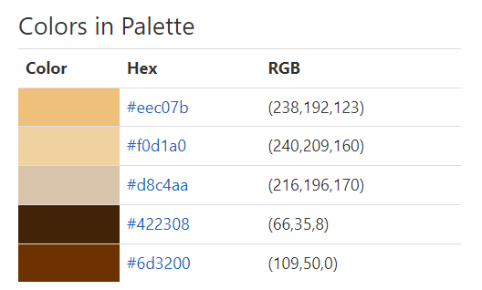

BREAD COLOR PALLETE

Slide 8
E N D
Thank You

