Slide 2
Digit and Analog pin and sensor
GPIO interfacing
Python library for GPIO
Button interfacing
Relay with 250 Volt Connectin
Fastapi Web page based
Mqtt Demo

Slide 3
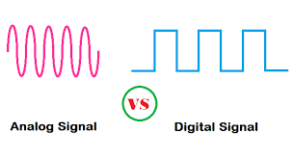
Image Source : https://www.etechnog.com/2019/11/difference-between-analog-vs-digital-signal.html

Slide 4
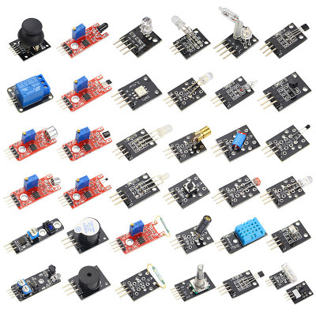
Sensor
Sensors are devices that detect external information, replacing it with a signal that machines can Understand.

Slide 5
Install GPIO Library for Python
URL: https://pypi.org/project/RPi.GPIO/
pip install RPi.GPIO

Slide 6
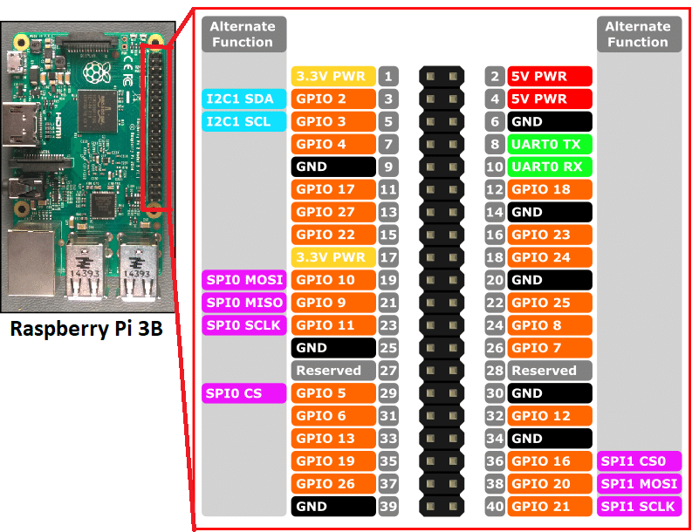
GPIO

Slide 7
Type pinout
SPI pins – The Serial Peripheral Interface (SPI) is a communication protocol used to transfer data between micro-computers like the Raspberry Pi and peripheral devices. The MISO pin receives data, and the MOSI pin sends data from the Raspberry Pi. Furthermore, the serial clock pin sends pulses at a regular frequency between the Raspberry Pi and the SPI device at the same speed in which the devices to transfer data to each other.
UART pins – UART stands for universal asynchronous receiver-transmitter, which is a physical circuit designed to send and recieve data.
PWM pins – PWM means “pulse width modulation,” which is a communication protocol best used with stuff that moves and lights up: motors, LEDs, and so on.
I2C pins – I2C is short for inter-integrated circuit (two “inters” or I"squared"C). It works similarly to SPI, but it doesn’t force you to use nearly so many pins

Slide 8
Pin Numbering Declaration
GPIO.BOARD -- Board numbering scheme. The pin numbers follow the pin numbers on header P1.
GPIO.BCM -- Broadcom chip-specific pin numbers. These pin numbers follow the lower-level numbering system defined by the Raspberry Pi's Broadcom-chip brain.

Slide 9
import RPi.GPIO as GPIO
import time
GPIO.setmode(GPIO.BCM)
sensorPin = 7
GPIO.setup(sensorPin, GPIO.IN)
while True:
if GPIO.input(sensorPIN) == GPIO.LOW:
print "Motion detected"
else:
print "No motion"
time.sleep(0.5)

