Slide 1
AGENT OUTCOME MONITORING FOR WORDPRESS
Agent
SNR
See what agents did.
Hear what they experienced.
Discover what your site is missing.
SNR = SIGNAL-TO-NOISE RATIO
GUIDE → AGENT → HUMAN → VERIFIED OUTCOME
01
Notes:
Agent SNR—signal-to-noise ratio—shows what agents did, invites structured testimony about what worked or was missing, and proves what happened after the human checkpoint.
[Sources]
- README.md
- PRODUCT.md
- submission/devpost-description.md

Slide 2
THE MISSING OPERATIONAL TRUTH
A successful tool call can still hide missed demand.
01
02
03
Search succeeded
Zero matches
Then what?
RELAXED CONSTRAINTS
AGENT FEEDBACK
Operators need the missing signal—not another success log.
HUMAN ORDER
SHOPPER LEFT
AGENT SNR · HACKATHON DEMO
02
Notes:
A search tool can succeed while returning no usable product. Agent SNR records that missed demand at the source, then keeps the agent’s explanation separate from the catalog and WooCommerce facts that the site can verify.
[Sources]
- PRODUCT.md
- demo/HACKATHON_RUNBOOK.md
- submission/testing-instructions.md

Slide 3
A FAMILIAR OPERATIONS PATTERN
The operations layer website agents are missing.
INVESTIGATE
RELIABILITY
OUTCOMES
Journey replay
Tool observability
Product analytics
Reconstruct a journey
Find failures and latency
Connect behavior to results
Agent SNR adds
WebMCP inventory · observed demand · direct agent feedback · verified outcomes
OBSERVED, REPORTED, AND VERIFIED EVIDENCE STAY DISTINCT—NO SCREEN RECORDING.
AGENT SNR · HACKATHON DEMO
03
Notes:
The investigation pattern is familiar, but the observed object is new. Agent SNR combines journey replay, operational health, direct agent feedback, and business outcomes around the website’s own WebMCP tools. The comparison is conceptual; no third-party integration is claimed.
[Sources]
- PRODUCT.md
- submission/devpost-description.md

Slide 4
ARCHITECTURE
The website guides every action—and keeps testimony separate from proof.
UNTRUSTED BROWSER
TRUSTED WORDPRESS
VERIFIED COMMERCE
Browser agent
WebMCP runtime
Execution gateway
WP Abilities
WooCommerce
Reads the Agent Guide
12 storefront tools
Origin · session · CSRF
Schema · policy · rate
Catalog · cart · order
HUMAN CHECKPOINT
Review · accept · place order
Agent SNR monitor
Signals ledger
8 MONITOR TOOLS · REPLAY · NET
OBSERVED · REPORTED · VERIFIED
SNR STORES
Outcomes · canonical demand · feedback enums · evidence IDs · one-way hashes
SNR EXCLUDES
Raw search/prompt · free text · identity · address · payment · DOM/video
AGENT SNR · HACKATHON DEMO
04
Notes:
Two independent top-level WebMCP surfaces expose 12 storefront tools and 8 Agent SNR tools from one first-party catalog. Two older gap abilities remain registered only for compatibility and are absent from public discovery. Guide 1.1 is shared by people and agents. WordPress keeps opportunity evidence, agent testimony, catalog facts, and WooCommerce outcomes separate. The black scope bar describes only Agent SNR's monitoring ledger; ordinary WooCommerce order and billing data remains in WooCommerce.
[Sources]
- plugin/wmcp-agentsnr/src/Contract/ToolName.php
- plugin/wmcp-agentsnr/src/Abilities/ToolCatalog.php
- plugin/wmcp-agentsnr/src/Guidance/AgentGuide.php
- plugin/wmcp-agentsnr/src/Analytics/SignalService.php
- plugin/wmcp-agentsnr/src/WebMCP/ExecutionController.php
[/Sources]

Slide 5
TRUST BOUNDARY · 0 SENSITIVE TOOLS
The agent prepares. The human commits.
AGENT
H
U
M
A
N
HUMAN
Read guide
Find · compare · cite policy
Edit reversible cart
Report structured friction
Prepare checkout handoff
Review details
Accept terms
Place order
VERIFIED OUTCOME
Paid · cancelled · refunded
AGENT SNR LEDGER EXCLUDES: RAW PROMPTS · FREE-TEXT FEEDBACK · IDENTITY · ADDRESS · PAYMENT
AGENT SNR · HACKATHON DEMO
05
Notes:
The agent can reduce work and report friction without crossing the consequential boundary. It never places an order, accepts terms, submits customer details, charges, cancels, or refunds. Feedback is bounded testimony; the human decision and WooCommerce outcome remain separate facts. The privacy line applies only to Agent SNR's monitoring ledger: ordinary WooCommerce order and billing data remains in WooCommerce and is not copied into that ledger.
[Sources]
- README.md
- plugin/wmcp-agentsnr/src/Guidance/AgentGuide.php
- plugin/wmcp-agentsnr/src/Analytics/FeedbackMetricResolver.php
- submission/devpost-description.md
[/Sources]

Slide 6
USE CASES
One evidence loop answers five operator questions.
What happened?
01
WORKFLOW REPLAY
PROVEN NOW
What broke?
Commerce
02
FAILURE · DENIAL · LATENCY
Did it matter?
03
THE SAME PATTERN EXTENDS TO
PAID · REFUNDED · NET
What is missing?
Bookings
Support
Learning
Memberships
04
OBSERVED DEMAND · AGENT FEEDBACK
What changes next?
05
SESSION OR SITE POLICY
EXTENSIONS OF THE PATTERN—NOT V0.1 CLAIMS.
AGENT SNR · HACKATHON DEMO
06
Notes:
The current implementation proves the pattern with commerce: what happened, what broke, whether it mattered, what demand the site missed, what the agent experienced, and what the operator can change. The same evidence loop can extend to other WordPress workflows; those extensions are direction, not v0.1 claims.
[Sources]
- PRODUCT.md
- submission/devpost-description.md

Slide 7

THE LIVE DEMO
One clean session tests discovery, missed demand, feedback, proof, and control.
START HERE
01
Read the Agent Guide
OBSERVE
02
IPX5 search → zero; relax
REPORT + HAND OFF
03
Feedback first; human places order
VERIFY + CONTROL
04
Signals · replay · restrict
GUIDE → ZERO RESULT → IPX4 RECOVERY → FEEDBACK → HUMAN ORDER → PROOF
AGENT SNR · HACKATHON DEMO
07
Notes:
The submitted run begins with the guide, records a real zero-result IPX5 opportunity under $100, recovers with two IPX4 alternatives, records linked agent feedback at handoff, then lets the human place the no-charge WooCommerce order. Agent SNR proves the outcome and restricts the next run.
[Sources]
- demo/HACKATHON_RUNBOOK.md
- submission/testing-instructions.md
- submission/video-script.md
- submission/demo-screenshots/01-agent-snr-overview.png

Slide 8
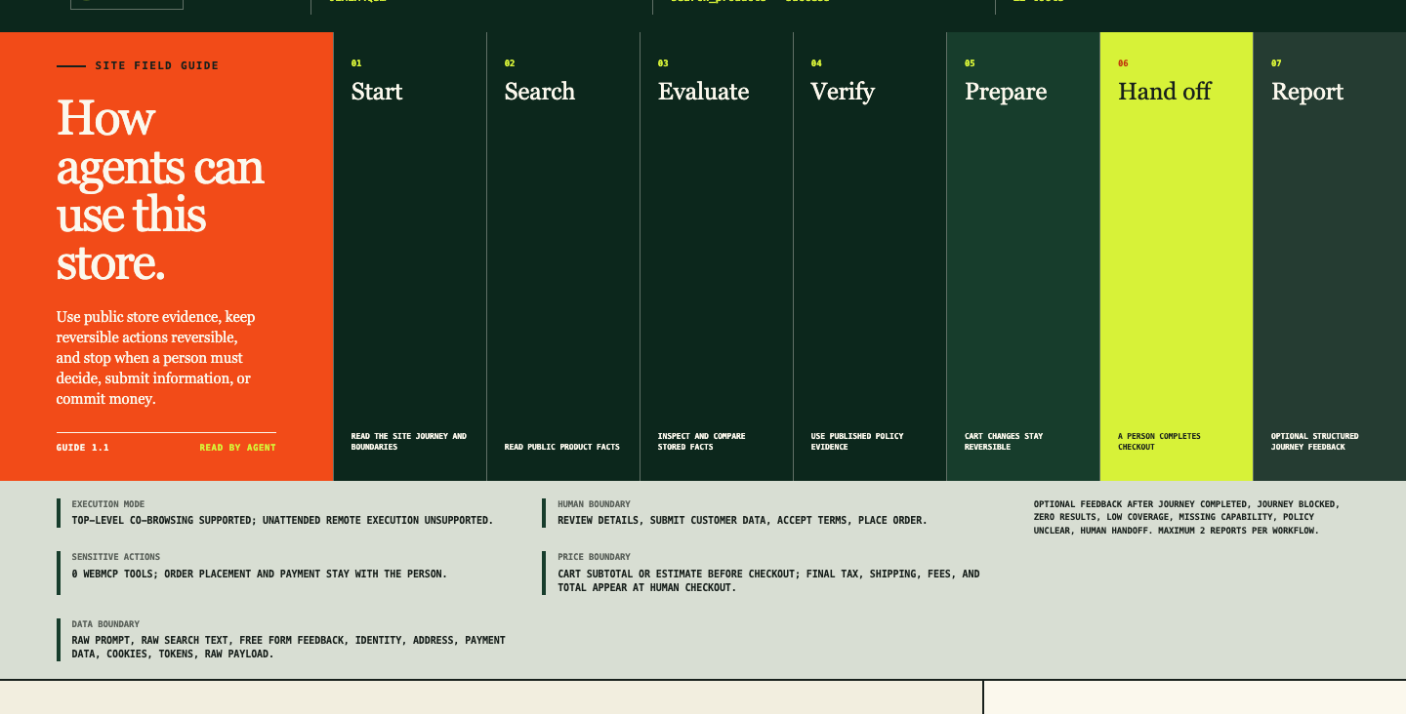
DEMO EVIDENCE
The guide makes co-browsing and human authority explicit.
LIVE SESSION
Guide 1.1
Co-browsing only
0 sensitive tools
Zero-result signal
Linked feedback
Human checkout
OBSERVED + REPORTED BEFORE THE HUMAN CHECKPOINT
AGENT SNR · HACKATHON DEMO
08
Notes:
Guide 1.1 declares top-level co-browsing, unattended execution as unsupported, two outcome journeys, zero Sensitive Action tools, the subtotal/final-total boundary, privacy exclusions, and optional structured feedback. The same canonical object is rendered for the shopper and returned to the agent.
[Sources]
- submission/demo-screenshots/02-agent-guide.png
- submission/demo-screenshots/03-zero-result-opportunity.png
- submission/demo-screenshots/04-agent-feedback-handoff.png
- plugin/wmcp-agentsnr/src/Guidance/AgentGuide.php
[/Sources]

Slide 9
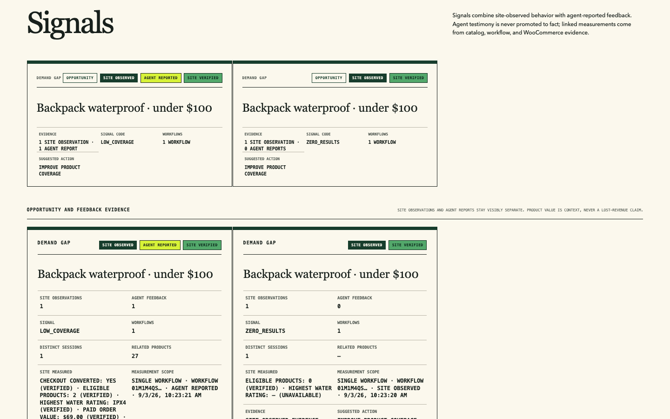
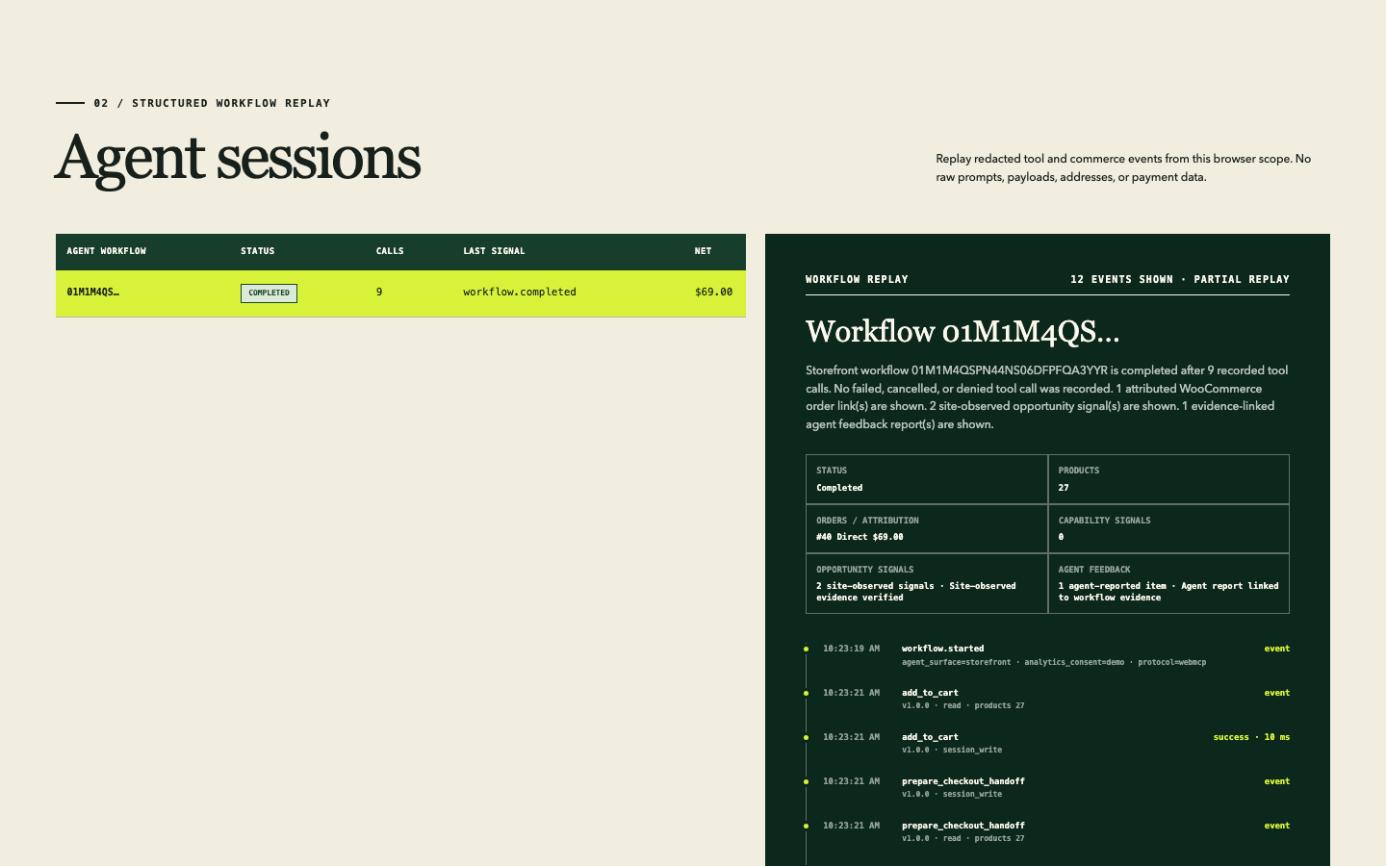
OUTCOME TRUTH
Agent testimony stays separate from verified evidence.
SITE OBSERVED
AGENT REPORTED
SITE VERIFIED
NEVER CLAIMED
Zero result + low coverage
Constraint + ratings + action
2 eligible · IPX4 · paid order
Lost revenue or verified opinion
FEEDBACK NEVER CHANGES ATTRIBUTION · REFUNDS STILL REDUCE NET
AGENT SNR · HACKATHON DEMO
09
Notes:
The Signals view shows the same demand group twice: zero results exist without feedback, while low coverage is corroborated by one agent report. Site measurements later verify the two products, IPX4 ceiling, paid order, and value. The opinion itself is never promoted to fact or allowed to change attribution.
[Sources]
- submission/demo-screenshots/07-opportunity-signals.png
- submission/demo-screenshots/08-workflow-replay.png
- plugin/wmcp-agentsnr/src/Analytics/SignalService.php
- plugin/wmcp-agentsnr/src/WooCommerce/AttributionRules.php

Slide 10
WEBMCP QUALITY LOOP
The journey is evaluated before it is published.
Contract parity
01
20 PUBLIC TOOLS · STRICT SCHEMAS
PROVEN LOCALLY
Native smoke
Native + model evals
02
11/11 KEYLESS CHROME CALLS
Model behavior
03
RELEASE OWNER CHECKS
SELECTION · RECOVERY · NO-CALL
Workbench
Required · real client
Optional · Workbench
Optional · scanner
Optional · directory
04
AUDIT · REPLAY · USER MODE
Public listing
05
SCANNER · DIRECTORY API
EXTERNAL EVIDENCE RUNS ONLY AGAINST THE FROZEN RELEASE.
AGENT SNR · HACKATHON DEMO
10
Notes:
[Sources]
- https://github.com/GoogleChromeLabs/webmcp-tools/tree/v0.0.4/webmcp-evals
- https://developer.chrome.com/docs/ai/webmcp/evals
- https://chromewebstore.google.com/detail/nekuda-webmcp-workbench/amochnnbmnkjjlblolhpddkokhnalkjp
- https://webmcp.com/methodology
- submission/webmcp-eval-report-2026-09-01.md
- submission/verification-report.md
[/Sources]
Contract parity, native smoke, and protected model-backed evaluation are verified repository evidence. Real-client validation is required before submission. Workbench, hosted scanner, and directory listing are optional additional checks against the frozen public release.

Slide 11
PROOF
The critical boundaries are tested, not staged.
125
111
16/16
JavaScript tests
PHP tests / 1,964 assertions
Chromium scenarios
11/11
3
0
Native WebMCP smoke steps
Exact-ZIP WordPress / Woo environments
Plugin Check errors
AGENT SNR · HACKATHON DEMO
11
Notes:
[Sources]
- submission/verification-report.md
- evals/README.md
[/Sources]
Counts reflect the exact final artifact and repository verification run.

Slide 12
BUILD FEEDBACK INTO THE AGENT LOOP
Give every website-agent
journey a voice—and a provable outcome.
PRIMARY
LOCAL
PORTABLE
Top-level WebMCP demo
Docker showcase
WordPress Playground
12 storefront + 8 Agent SNR tools
./bin/start-showcase.sh start
Plugin and human behavior
Guide the agent. Observe missed demand. Hear feedback. Verify outcomes. Improve the next run.
AGENT SNR · OPEN-SOURCE WORDPRESS PLUGIN
12
Notes:
The memorable idea is a website that can teach agents how to use it, record missed demand even when the agent stays silent, receive honest structured feedback, and prove the business outcome without collecting the conversation or weakening human authority.
[Sources]
- README.md
- demo/HACKATHON_RUNBOOK.md
- submission/testing-instructions.md
- submission/devpost-description.md

