Slide 1


Doctor Fee Prediction

Slide 2


PROBLEM STATEMENT
Scrape data from the online medical consultancy booking site PRACTO and create a machine learning model that can predict the consultation fee.

Slide 3


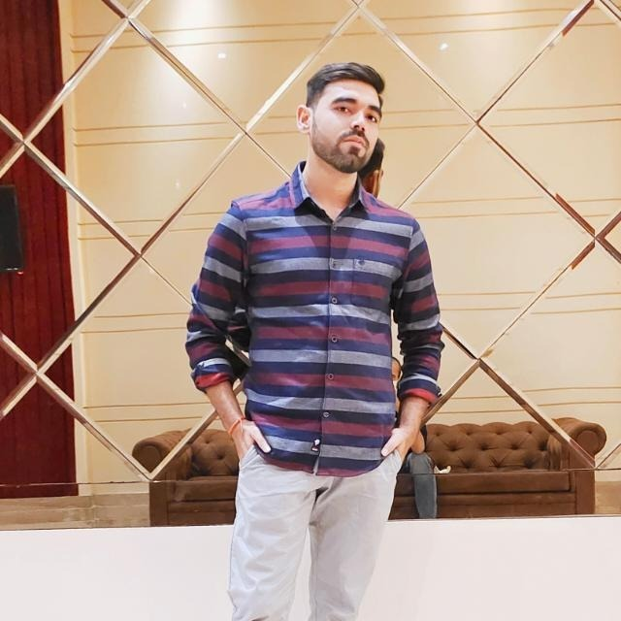
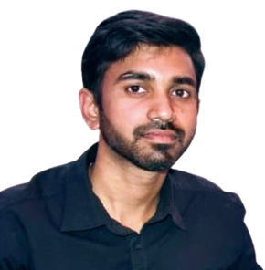
OUR TEAM
Ayush
Verma
Jigar
Sanandiya
Shashank
Shukla
Shreyash Anand

Slide 4
01
ABOUT PRACTO
“Not all angels have wings, some have stethoscopes.”

Slide 5

INTRODUCTION
Practo Online Doctor is a telemedicine platform that provides online doctor consultations and appointment booking.
Patients can connect with a doctor online through their computer or mobile device and receive medical advice, diagnoses, and prescriptions from a qualified healthcare provider.
Practo Online Doctor is designed to make healthcare more accessible, convenient, and affordable.

Slide 6







Technical Aspects
Beautiful soup
Pandas and NumPy
Sci-kit learn
Streamlit

Slide 7
02
ABOUT PROJECT
“The more that you read, the more things you will know, the more that you learn, the more places you’ll go.”

Slide 8
Walk Through The Project
Data Scraping
1
BUILDING MODEL
2
3
4
CREATING WEB PAGE
Data Cleaning and Analysis

Slide 9
DATASET CREATED AFTER WEB SCRAPING
Name | Name Of The Doctor
Speciality_of_doctor | Their Specialty Like Dentists, Gynecologists, Pediatricians, Etc.
Degree | Degree Types Like MBBS, MS, MD, BDS, Etc.
Year_of_experience | Total Year Of Experience
Location | Location Of Clinic
City | City Of The Clinic
Dp_score | This Will Be Doctor Patient Experience Score
Npv | Number Of People Who Votes
Consultation Fees | Consultation Fee At Clinic
B
E
A
U
T
I
F
U
L
S
O
U
P

Slide 10
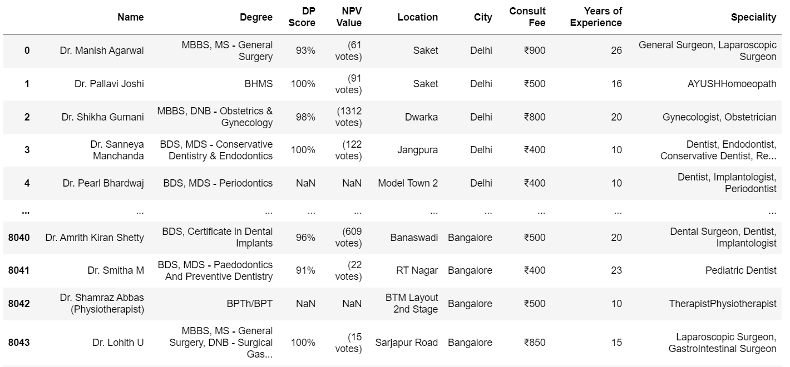

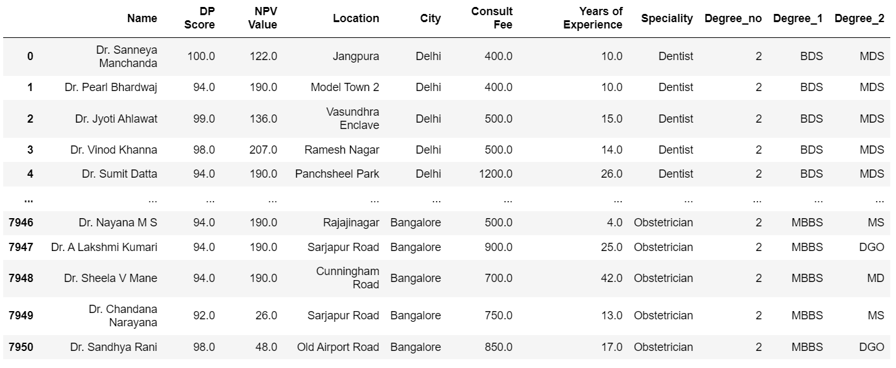
DATAFRAME BEFORE & AFTER CLEANING

Slide 11

MODEL CREATION
MODEL | RMSE
Linear - 1 | 402
DT - 1 | 374
DT - 2 | 482
RF - 1 | 371
RF - 2 | 350
RF - 5 | 349
RF - 6 | 350
RF - 7 | 345
S
C
I
K
I
T
L
E
A
R
N
Trained the Linear regression, Decision Tree, and Random Forest models. We found the best accuracy in Random Forest as compared to other models.

Slide 12
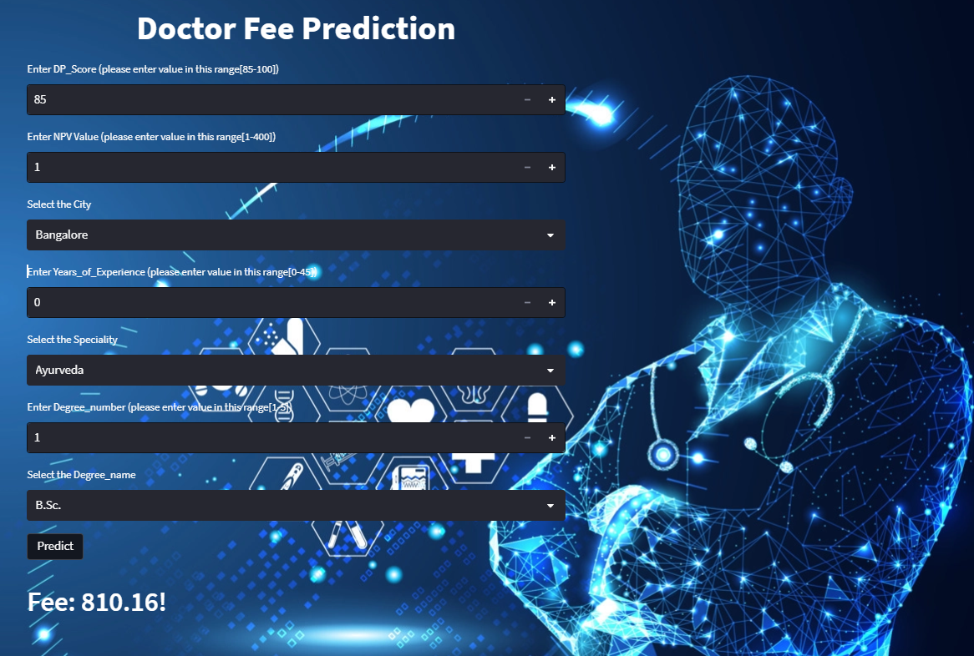
WEB PAGE
S
T
R
E
A
M
L
I
T

Slide 13
KEY NUMBERS
8200+ Doctors
30+ specialties
Delhi, Mumbai, and Bangalore number of specialties, and doctors

Slide 14
Learning
Web scraping with tools like Selenium and Beautiful Soup using Python
Data Cleaning, encoding, scaling, training
Deploying a machine learning model on real-world data
Creating a web page that links with user input and predicted value

Slide 15
Thank you
we are open to answering your questions

