Slide 1

SMS Spam Detection
Pd16_243
Sanandiya Jigar Rajubhai

Slide 2
Data Pre-processing flow diagram
Drop Duplicates
Lemmatization
Removing Stop Words
Converting into Lower Cases
Removing Punctuations
Dropping the Duplicates from the data
Converting the text into lower cases
Removing stop words because stop words are common in all SMS and cannot help us in detecting spam texts
Removing punctuation from all SMS will help to treat each text equally
Lemmatization is a process in Natural Language Processing that converts a word to its base form or root word

Slide 3
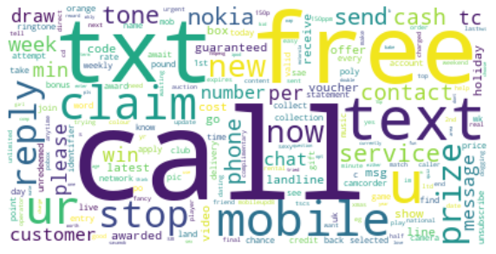
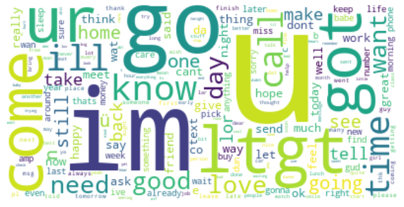
Word Clouds
Word cloud for spam SMS
Word cloud for not spam SMS
As per the word cloud of spam and not spam we can see different words repeating in both images.
In the word cloud of spam we can see the words like call, free, claim, txt, and reply these are repeated words.
In the word cloud of not spam we can see the words like im, go, come, know, got, and u these are the most repeated words.

Slide 4
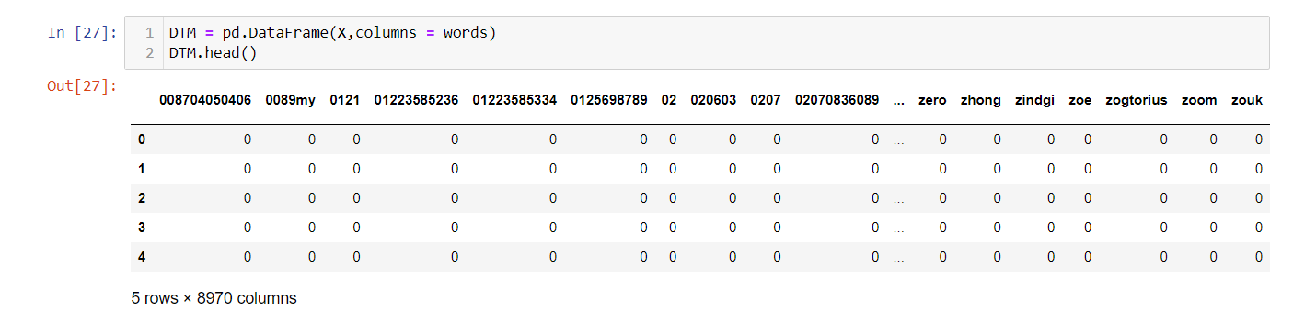
Vectorization Approaches
a) Vectorization using TF:
Vectorization using term frequency (TF) is a method of converting text data into numerical vectors for use in machine learning models. In this method, each document or text sample is represented as a vector of word frequencies, where each element in the vector corresponds to the number of occurrences of a specific word in the document. This representation is called a "term frequency" vector.
This is the DataFrame that we got after using TF for vectorization.

Slide 5
b) Vectorization using TF-IDF:
TF-IDF (term frequency-inverse document frequency) is a variation of this method that takes into account not only the frequency of a word in a document but also its rarity across the entire corpus of documents. This can help to down-weight common words (e.g. "the", "and", etc.) that appear frequently in many documents, and give more weight to words that are more specific to the document and less common across the entire corpus.

Slide 6
Dimension Reduction & Visualization
Principal Component Analysis (PCA) is a statistical technique that is used for dimensionality reduction and data visualization. It is a popular method for transforming high-dimensional data into a lower-dimensional space while preserving as much of the original information as possible.
As we have around 9000 columns so, we are using PCA to reduce the number of columns with 95% of the variance.

Slide 7
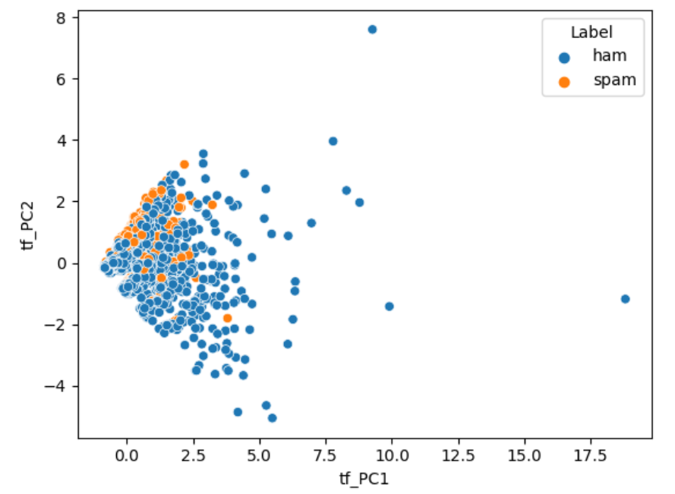
a) PCA on TF Dataframe:
We applied PCA on TF Dataframe with 95% of the variance and we got 1709 components.
Before PCA there were 9002 columns and after doing PCA it was reduced to 1709 columns.

Slide 8
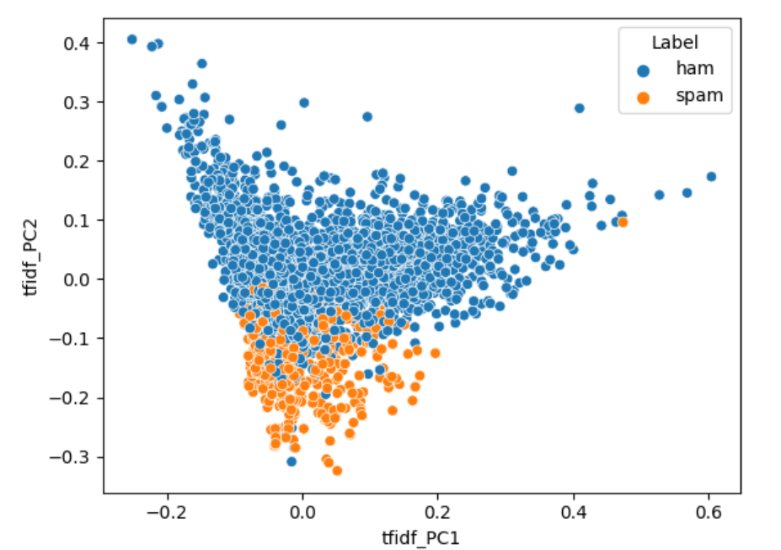
b) PCA on TF-IDF Dataframe:
We applied PCA on TF Dataframe with 95% of the variance and we got 1709 components.
Before PCA there were 9002 columns and after doing PCA it was reduced to 1709 columns.

Slide 9
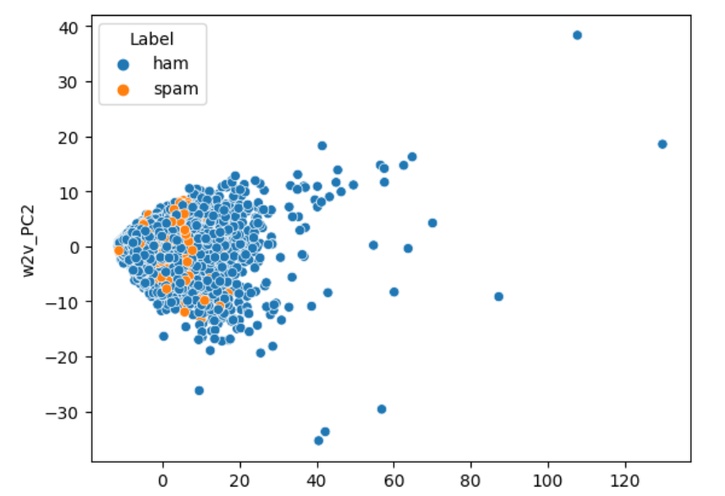
PCA for Word to vec:
We applied PCA for Word to vec data frame with 95% of the variance and we got 160 components.
Before PCA there were 301 columns and after doing PCA it was reduced to 160 columns.

Slide 10
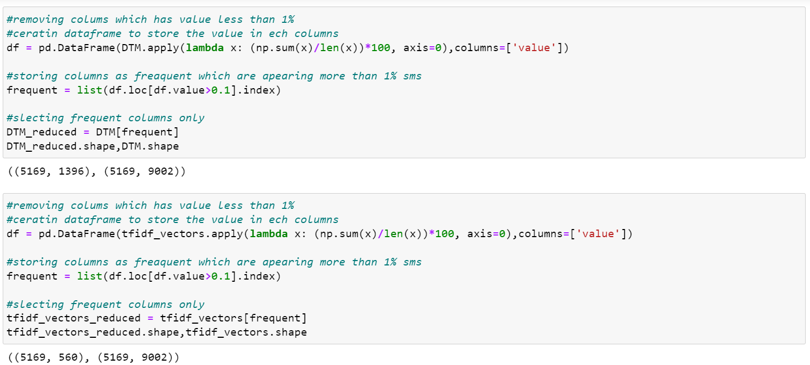
Heuristic Approach for Dimension Reduction:
In this, we have removed columns of a word that are appearing in less than 1% of a document
For TF Dataframe we are getting 1396 columns out of 9002 columns.
For TF-IDF Dataframe we are getting 560 columns out of 9002 columns.

Slide 11
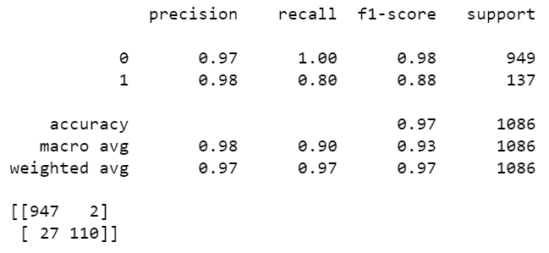
Competing Models
Models on TF Dataframe
1. Logistic Regression:
Aim: To predict the SMS is whether spam or not
Experiment: Applying Logistic Regression
Observations:
Conclusion:
f1-Score for zero is 98
f1-Score for one is 88

Slide 12
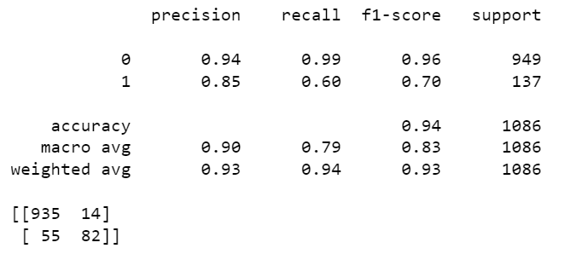
2. Decision Tree Classifier:
Aim: To predict the SMS is whether spam or not
Experiment: Applying Decision Tree Classifier
Observations:
Conclusion:
Here f1-score is decreasing compare to Logistic regression.

Slide 13
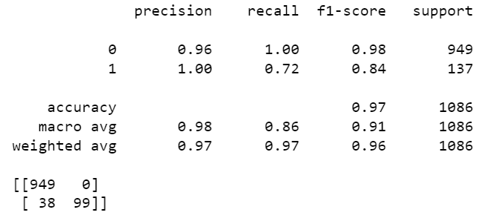
3.Random Forest Classifier:
Aim: To predict the SMS is whether spam or not
Experiment: Applying Random Forest Classifier
Observations:
Conclusion:
Here f1-score is less than logistic regression but greater than Decision Tree Classifier.

Slide 14
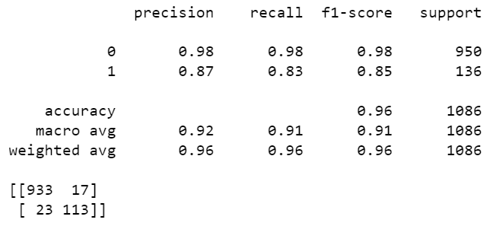
Models on TF-IDF Dataframe
4. Logistic Regression:
Aim: To predict the SMS is whether spam or not
Experiment: Applying Logistic Regression
Observations:
Conclusion:
f1-Score for zero is 98
f1-Score for one is 85

Slide 15
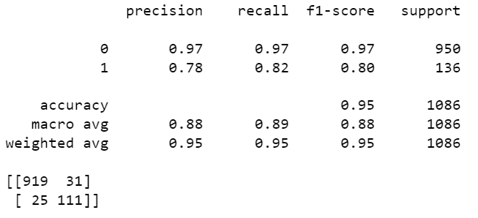
5. Decision Tree Classifier:
Aim: To predict the SMS is whether spam or not
Experiment: Applying Decision Tree Classifier
Observations:
Conclusion:
f1-Score for zero is 97
f1-Score for one is 80

Slide 16
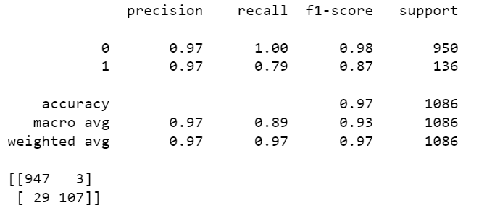
6.Random Forest Classifier:
Aim: To predict the SMS is whether spam or not
Experiment: Applying Random Forest Classifier
Observations:
Conclusion:
f1-Score for zero is 98
f1-Score for one is 87

Slide 17
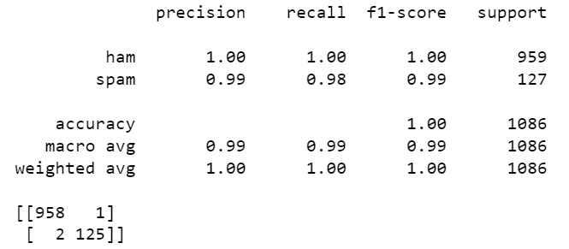
Models on Word 2 vec Dataframe
7. Logistic Regression:
Aim: To predict the SMS is whether spam or not
Experiment: Applying Logistic Regression
Observations:
Conclusion:
f1-Score for zero is 100
f1-Score for one is 99

Slide 18
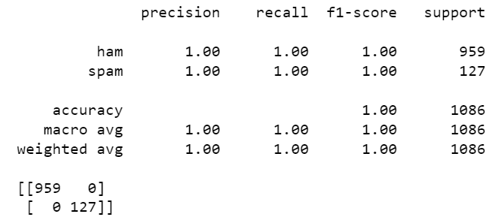
8. Decision Tree Classifier:
Aim: To predict the SMS is whether spam or not
Experiment: Applying Decision Tree Classifier
Observations:
Conclusion:
f1-Score for zero is 100
f1-Score for one is 100

Slide 19
Conclusion:
No. | DataFream | Highest | F1 Score | Accuracy
1 | TF Dataframe | Logistic Regression | 0 - 98 1 - 88 | 0.97
2 | TF-IDF Dataframe | Random Forest Classifier | 0 - 98 1 - 87 | 0.97
3 | Word 2 vec Dataframe | Decision Tree Classifier | 0 - 100 1 - 100 | 1.00

Slide 20
Thank
You
Open to answering your questions ???

