Slide 1




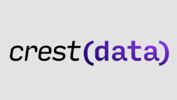

MINeD 2025
Team: not_so_smart
Track: track-4-crest-security-ai-ml
Presented by: Ayush, Aryan, Anmol, Jigar
Hosted by: Institute of Technology, Nirma University

Slide 2


Problem Statement
Cybersecurity threats are evolving rapidly, making traditional malware detection methods less effective against sophisticated attacks. This project aims to develop a machine learning-based malware classification system that accurately detects and classifies malware based on behavioral and structural attributes.
Participants must design, train, and evaluate a robust ML model for malware classification.
Objectives
🔹 Develop an efficient ML model that generalizes well to unseen malware samples. 🔹 Enhance real-world malware detection and prevention mechanisms using AI-driven techniques. 🔹 Optimize feature engineering for improved model performance and scalability.

Slide 3
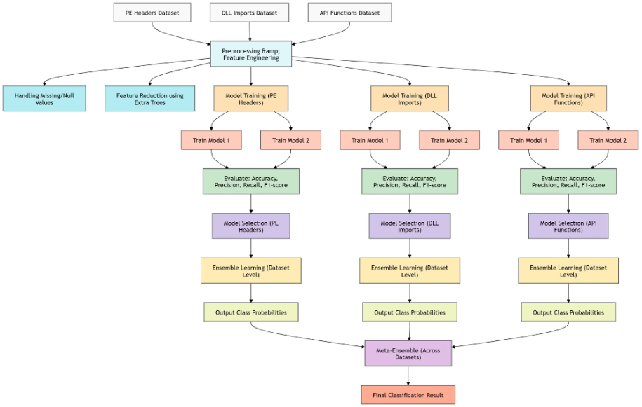
Proposed Approach for Malware Detection
Understanding the Datasets: We have three different datasets, each capturing distinct characteristics of malware:
Portable Executable (PE) Headers: Contains 52 fields related to PE headers and 9 field values for each of 10 PE sections.
DLL Imports: Lists the DLLs imported by different malware families.
API Functions: Contains API function calls made by the malware. This dataset is particularly large (28,017 rows × 21,920 columns), requiring dimensionality reduction.
Modeling Each Dataset Separately: Since each dataset contains unique types of features, we decided to process them individually before combining results:
Preprocessing: We handle missing values, null values, and other inconsistencies in each dataset.
Feature Reduction:
The API functions dataset is too high-dimensional for direct modeling, so we apply feature selection techniques (e.g., Extra Trees) to reduce the number of features while retaining important information.

Slide 4
Resampling:
To address class imbalance, we apply SMOTE and compare model performance on both SMOTE-applied and original datasets.
Model Training & Evaluation:
We trained two models on each dataset.
We evaluate models using key performance metrics such as accuracy, precision, recall, and F1-score.
Model Selection:
We select models that exceed a predefined performance threshold for further ensemble learning.
Ensemble Learning within Each Dataset:
Once we have trained multiple models on each dataset, we take their prediction probabilities and ensemble them using techniques such as stacking to improve robustness and generalization.
This step ensures that for each dataset (API, DLL, and PE Headers), we obtain the most reliable class probabilities.

Slide 5
Meta-Ensemble Across Datasets:
After obtaining the final probability scores from API, DLL, and PE datasets (e.g., 7 probability values from each dataset), we merge them into a 21-column feature set.
We then train a meta-model (such as Logistic Regression) on this combined dataset to generate the final classification result.
How This Approach Aligns with Industry Standards:
Modular Processing: Instead of merging raw features from different datasets into a single model, we process each dataset independently, ensuring that distinct patterns are captured effectively.
Robust Feature Engineering: By applying targeted feature selection methods, we avoid overfitting and improve interpretability.
Adaptive Ensembling: The use of stacked ensemble learning at both individual dataset and meta-level ensures improved classification accuracy and resilience against noisy data.
Continuous Improvement: This approach allows for periodic retraining and fine-tuning as new malware variants emerge.

Slide 6
Why Should One Choose Our Solution?
Our malware detection approach is designed to be robust, scalable, and practical for real-world cybersecurity applications. Here’s why our solution stands out:
✅ 1. Multi-Perspective Analysis for Higher Accuracy
Instead of relying on a single dataset, we leverage three distinct datasets (API calls, DLL imports, PE headers) to gain a comprehensive understanding of malware behavior.
This approach ensures that even if a malware variant evades detection in one dataset, it can still be identified through patterns in the others.
✅ 2. Advanced Feature Selection for Better Performance
The API dataset is extremely high-dimensional (21,920+ features), which can slow down training and introduce noise.
We apply Extra Trees-based feature selection to retain only the most relevant attributes, leading to faster, more efficient, and more interpretable models.
✅ 3. Adaptive Handling of Imbalanced Data
Cybersecurity datasets are often heavily imbalanced (i.e., some malware families are underrepresented).
We use SMOTE (Synthetic Minority Over-sampling Technique) to balance the dataset, ensuring our models do not favor majority classes.
We also compare results on both SMOTEd and original data to avoid unnecessary overfitting.
✅ 4. Ensemble Learning for Improved Generalization
Instead of relying on a single model, we employ stacking ensemble techniques at two levels:
Within each dataset: Multiple models are trained and ensembled for more reliable predictions.
Across datasets: Predictions from the three datasets are merged into a meta-classifier, improving overall detection accuracy.
This layered ensembling increases robustness and reduces false positives/false negatives.
✅ 5. Scalable and Modular Design
Our approach allows for independent improvements in each dataset’s processing.
It can easily adapt to new malware families, additional datasets, or alternative ML techniques.
Security teams can fine-tune individual components without overhauling the entire pipeline.
✅ 6. Practical Real-World Implementation
Our methodology aligns with industry best practices:
Segmented analysis rather than blindly merging features.
Stacked ensemble learning for strong generalization.
Feature selection for computational efficiency.
The final meta-model is lightweight and can be deployed in real-world cybersecurity systems without excessive computational cost.
🚀 The Bottom Line: 🔹 Better generalization using ensemble techniques. 🔹 Scalability & adaptability for real-world applications. 🔹 Efficient and interpretable through feature selection.

Slide 7
Limitations of Our Solution
🚧 High Dimensionality Challenge – Feature sets (21,920+ API features) remain computationally expensive.
🚧 Zero-Day Malware Detection – Struggles with attacks from unknown malware families.
🚧 Feature Engineering Assumptions – Extra Trees' effectiveness depends on assumptions that may not apply to all malware types.
🚧 Synthetic Data Bias – SMOTE may miss real-world variations in malware.
🚧 Ensemble Complexity – Increases accuracy but adds computational overhead and requires careful model selection.
🚧 Limited Inter-Dataset Correlation – Separate datasets (API, DLL, PE) limit the ability to capture comprehensive patterns.

Slide 8
Additional Information & References
Key References:
Ensemble Machine Learning and Feature Selection for Effective Malware Detection: This study explores the combination of ensemble learning and feature selection to improve malware detection capabilities. (https://ieeexplore.ieee.org/abstract/document/10546128
Enhancing Malware Detection using Deep Learning with SMOTE and Noise Filtering: This research investigates the use of deep learning models combined with SMOTE and noise filtering techniques to enhance malware detection accuracy. (https://ieeexplore.ieee.org/abstract/document/10851004
Enhancing Malware Detection with TabNetClassifier: A SMOTE-based Approach: This work presents a method for improving malware detection using TabNetClassifier in conjunction with SMOTE. (https://www.manuscriptlink.com/society/kips/conference/ask2024/file/downloadSoConfManuscript/abs/KIPS_C2024A0197

