Slide 1

CORONA VIRUS ANALYSIS
PROJECT ~ 1
By Jigar Pankajbhai Patel

Slide 2
TABLE OF CONTENTS
01
02
03
04
INTRODUCTION
DATASET & DESCRIPTION
Q&A
LEARNING OUTCOMES

Slide 3
01
INTRODUCTION

Slide 4

Overview:
This project focuses on the analysis of COVID-19 epidemic has had significant impact on public health and has created a global need for data-driven insights to understand the spread of the virus.
Purpose of Analysis:
The major purpose of this research is to use SQL queries to analyze the dataset, with a particular emphasis on the counts of confirmed COVID-19 cases, fatalities, and recoveries, broken down by province and nation.
Understand how the virus spreads throughout the different provinces and countries.
Identify different metrics of COVID-19 affected patients such as: Confirmed, Deaths and Recovered.
Importance of Understanding:
The public to make informed decisions regarding COVID-19 control measures and resource allocation.
Understanding COVID-19 transmission patterns as well as vulnerable groups assists in identifying areas of greatest risk and executing focused actions to slow the spread.

Slide 5
02
DATASET & DESCRIPTION

Slide 6
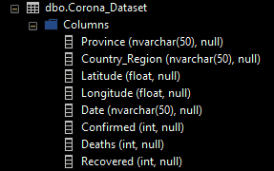
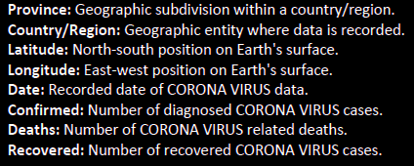

Slide 7
03
Q&A

Slide 8
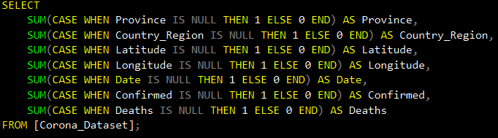

Q1. Write a code to check NULL values

Slide 9
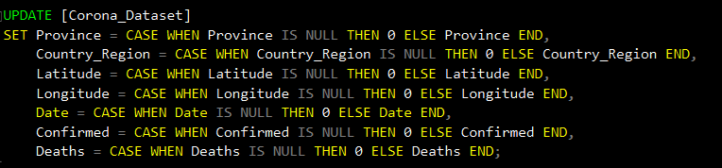
Q2. If NULL values are present, update them with zeros for all columns.
There is no null values in any of columns as we checked in the first question. However, if we get null values from any of columns then we can update them with the zeros by writing following query:

Slide 10


Q3. Check total number of rows
Here we can see that there is total 78,386 rows in the table.

Slide 11


Q4. Check what is start_date and end_date

Slide 12
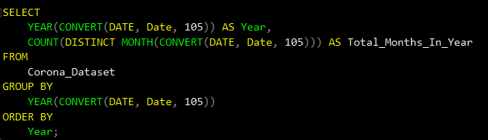

Q5. Number of month present in dataset

Slide 13
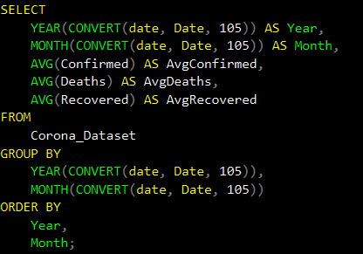
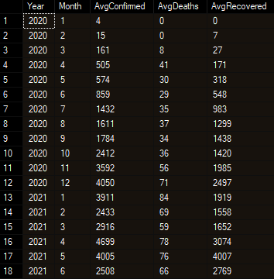
Q6. Find monthly average for confirmed, deaths, recovered

Slide 14
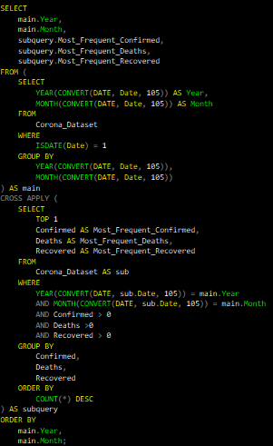
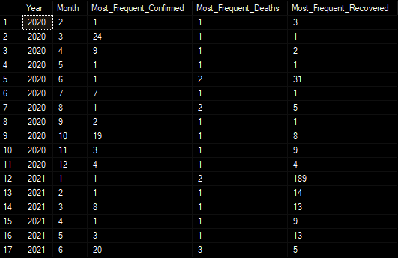
Q7. Find most frequent value for confirmed, deaths, recovered each month

Slide 15
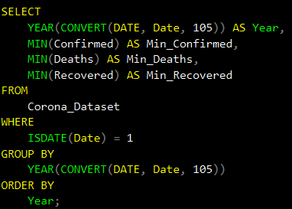

Q8. Find minimum values for confirmed, deaths, recovered per year

Slide 16
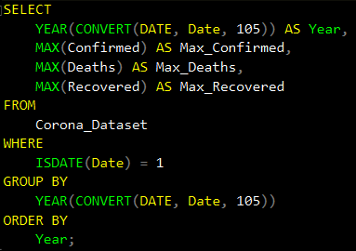

Q9. Find maximum values of confirmed, deaths, recovered per year

Slide 17
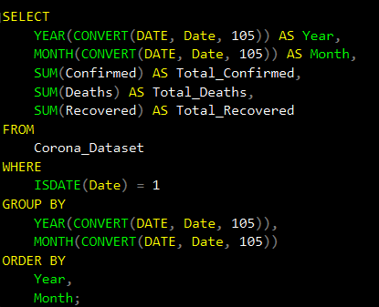
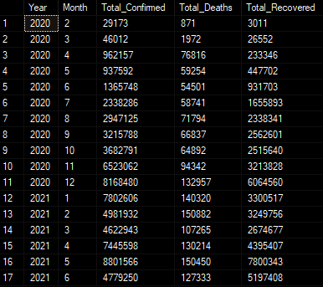
Q10. The total number of case of confirmed, deaths, recovered each month

Slide 18
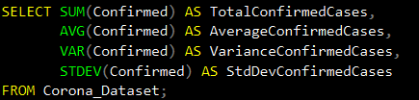
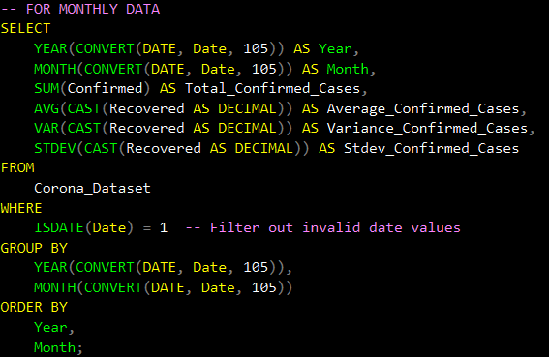
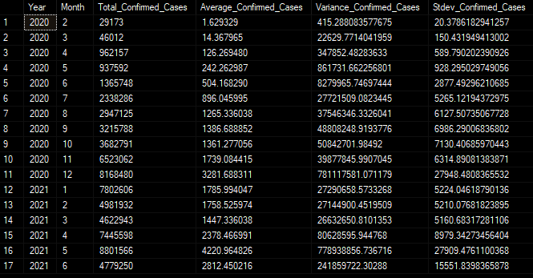
Q11. Check how corona virus spread out with respect to confirmed case (E.g.: total confirmed cases, their average, variance & STDEV )

Slide 19
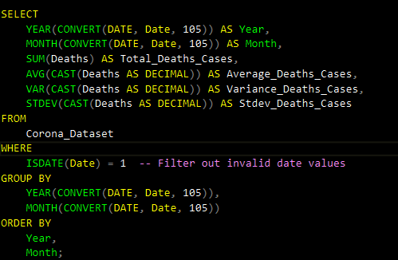
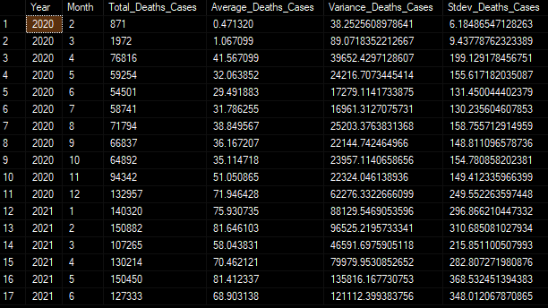
Q12. Check how corona virus spread out with respect to death case per month (E.g.: total death cases, their average, variance & STDEV )

Slide 20
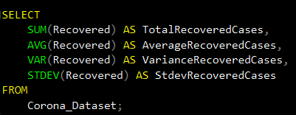
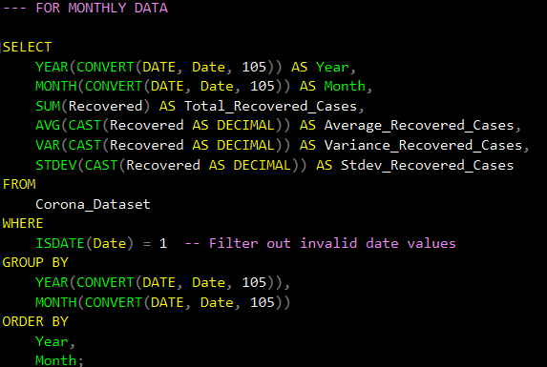
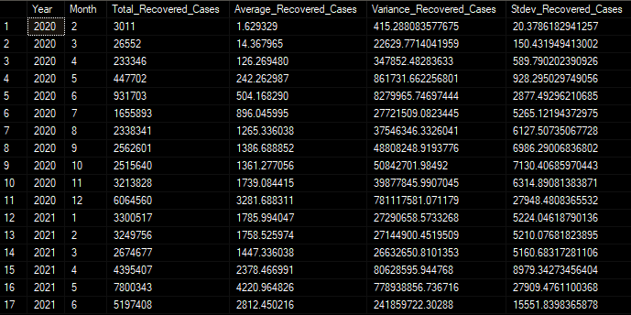
Q13. Check how corona virus spread out with respect to recovered case (E.g.: total recovered cases, their average, variance & STDEV )

Slide 21
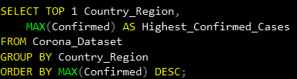

Q14. Find Country having highest number of the Confirmed case

Slide 22
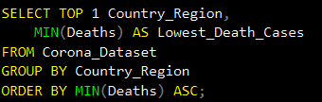

Q15. Find Country having lowest number of the death case

Slide 23

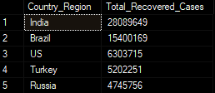
Q16. Find top 5 countries having highest recovered case

Slide 24
04
LEARNING OUTCOMES

Slide 25
Data Quality Assurance
Checking NULL values and replace them with zeros, we can learn the importance of data quality assurance techniques and how to handle missing or incomplete data in dataset.
Temporal Analysis
Examining start and end dates, along with the month count, reveals temporal trends, crucial for understanding patterns.
Statistical Proficiency
Calculating average, minimum and maximum values, variance, and standard deviation for confirmed cases, deaths and recoveries provides a statistical perspective on spread and impact of Covid-19.

Slide 26
Geospatial Understanding
Identifying countries with highest confirmed cases, lowest deaths, and top recoveries reveals pandemic’s geographical impact.
Trend Identification
Analyzing monthly averages and frequent values for cases, deaths, and recoveries aids in understanding pandemic trends monthly.
SQL Proficiency
Practicing SQL functions and constructs such as conditional statements, aggregation functions, date manipulation functions and query optimization techniques, boosts our SQL and data analysis skills.

Slide 27

THANKS
DO YOU HAVE ANY QUESTIONS?
jigar191099patel@gmail.com

