Slide 1
Emp Information Application
Emp Directory
  Emp Name
  Email
  Cell Number
  Location
  Company
  ProfilePic
WebJob/image optimization process
To be loaded faster
API Layer
Welcome email – Automated process
Authentication
  Single Sign on
  Auth. Active Directory
  Enable MFA
Deployment of Application
  IaaS
  PaaS
  DevOps integration
Application High Avail.

Slide 2
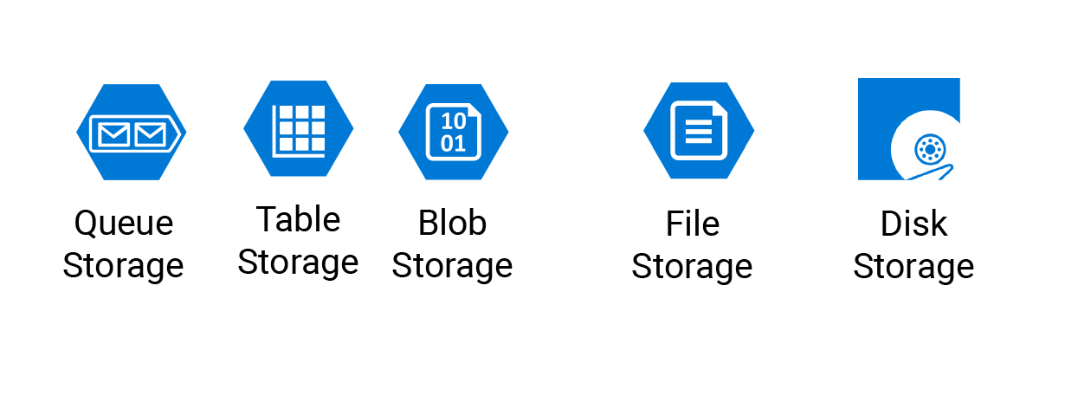
Model
BlobStorageOperation
TableStorageOperation
View
UI to create and view the emp directory
Controller
EmployeeController
Data Model class
EmpDetails.cs
Storage Account – empdetails
Empimages – Profile pic employee
Empdata
  ProfilePic
  Emp Name
  Email
  Cell Number
  Location
  Company
  Profile Pic blob URL will be mapped with EMP record
Emp Information Application
  ProfilePic
  Stores Image URL
  Pass that URL to background process
    Azure Web Jobs – App service plan
    BitMap Resize code
    Azure Cognitive Services – Compute Vision
Azure Service Bus
Azure Function
SQL DB
Code SendGrid services
Welcome email to end user

Slide 3



Emp Information Application
Azure Storage: Access Key in Application to store data
1
2
Can be running on local host
3
Register User in AD for Single Sign on
Application Level Configuration
Convert simple application to SSL driven and make it https enabled
Manage nuget packages related OWIN – OpenIdConnect
Write code to perform single sign related activities
Embed Azure AD configuration to application
Azure AD
Create Active directory as a service
App Registration – register your App and provide client/application id
Use client ID/App ID and register your application for using Microsoft as identity provider
<add key="ida:ClientId" value="b82bd13a-64ea-4d27-ad2a-605fae4bb4e0" />
<add key="ida:Tenant" value="empdirectoryapp.onmicrosoft.com" />
<add key="ida:AADInstance" value="https://login.microsoftonline.com/{0}/v2.0" />
<add key="ida:PostLogoutRedirectUri" value="https://localhost:44384/" />

Slide 4


iPaaS – Azure Logic Apps
Workflow Driven solution
Design B2B Scenario – Automate User creation in AD
Logic App
Designer View
Code View
username@tenant/onmicrosoft.com
TempPassword
Pre-defined Triggers – Poll/push
Varity protocols to connect with it
Action
F Name
AAD Tenant
L Name
AAD
Depart.
Email
Create User

Slide 5
Scenario –
I want to create Traffic update for my upcoming journey. You need to enter start point and end point journey details, you need to use Map services. Once the traffic update is there you need send notification with time frame, create auto check with traffic on time to time basis.
Map services – Bing Map API to capture the Lat Long of start point and end point of journey
Email Service – Outlook to send email notification
Logic Apps to define this work flow and provide some conditional activities to send the updates

Slide 6







Emp. Information Web App
5
6
7
Azure API Management
Azure API Apps
Azure Storage: Access Key in Application to store data
1
2
3
Azure Traffic Manager
Standard App Plan
Azure CDN
8
11
9
Azure Function
12
Azure Service Bus
10
Blob URL
Email ID for Welcome email
Azure Cognitive Service
Compute
4
Register User in AD for Single Sign on

Slide 7
1
User will connect to application using TM profile with the configuration of TM method – Priority, Performance, Geography & Weighted
11
Use Send Grid email service to send automated email to the employee email ID passed via Function app.
2
TM will route the user request to the specific available endpoint based on the method configured
12
Use Azure cognitive service along with Compute Vision service to perform resize operation for images uploaded by employees.
3
Application to be hosted on Azure Web Apps with App service plan to make sure the HA scenario to be taken care, autoscaling rules cloud burst kind of event
4
User will be authenticated with the help Azure AD, to do so you need to register application with AD and all your registered user will have single sign on & MFA to be enabled
5
Azure API Management will helps in terms of managing access to the API at the backend, kind of admin portal and dev portal provided to manage API access
6
Azure API apps to be deployed in App Service Plan and allowing you to connect with your storage services/database service etc..
7
Azure Storage services to capture emp details in table storage and emp images into blob storage
8
Map Blob images to CDN endpoint for caching emp images for faster access into web app
9
Configure Azure Service Bus Queue to send your emp details like Blob URL for image processing and resize it, sending email id to send automated welcome email
10
Use Azure Functions to perform activities based on event triggered and get the message from Service Bus queue and process the further activities. Create function app using predefine templates

Slide 8

CDN – Content Delivery Network
2
1
4
5
6
3
POP location
Origin

