Slide 1
Outline
Scan conversion of circles
<number>
Notes:
<number>

Slide 2
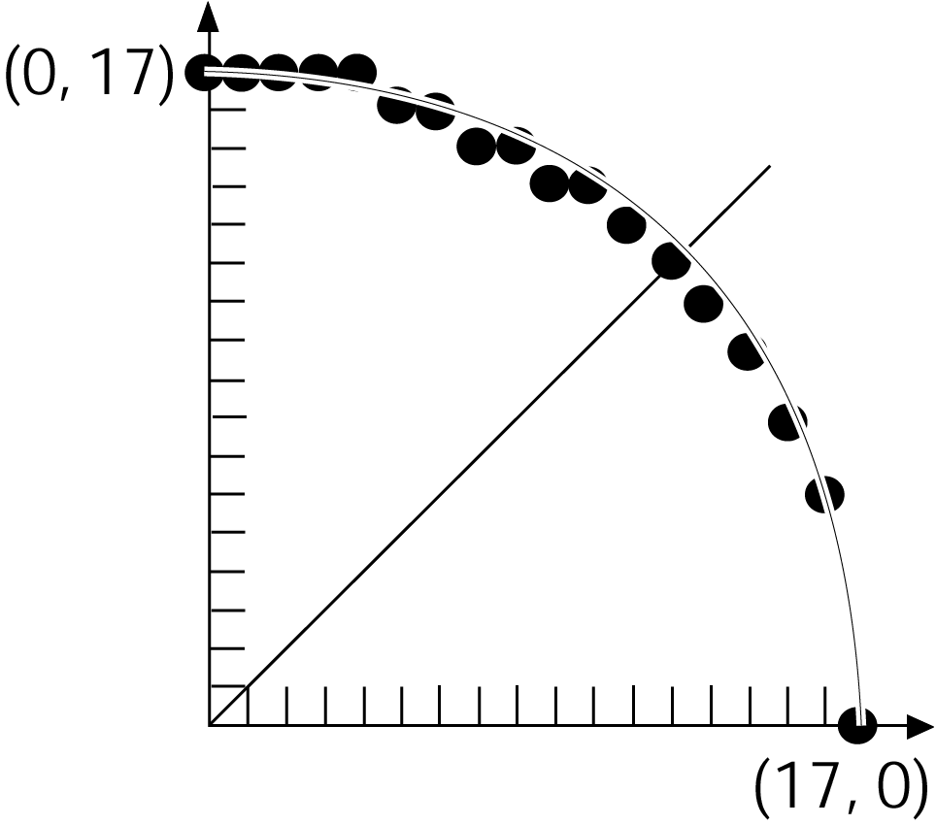
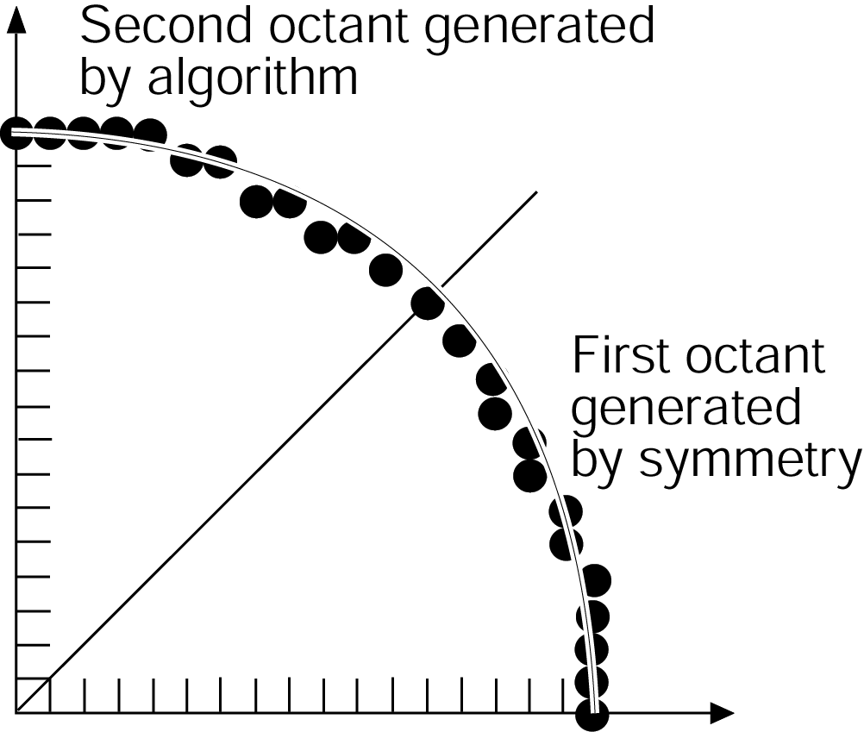
Scan Conversion of Circles
Generalization of the line algorithm
Assumptions:
circle at (0,0)
Fill 1/8 of the circle, then use symmetry
Not using the 8-way symmetry of a circle
Using the 8-way symmetry of a circle:
<number>
1994 Foley/VanDam/Finer/Huges/Phillips ICG
Notes:
<number>

Slide 3


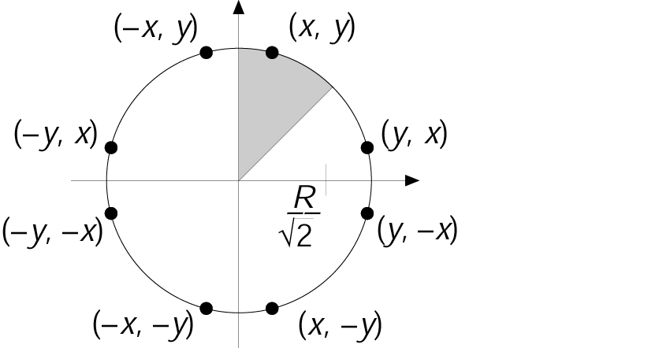
Scan Conversion of Circles
Implicit representation of the circle function:
Note: < 0 for points inside the circle, and > 0 for points outside the circle
<number>
Notes:
<number>

Slide 4

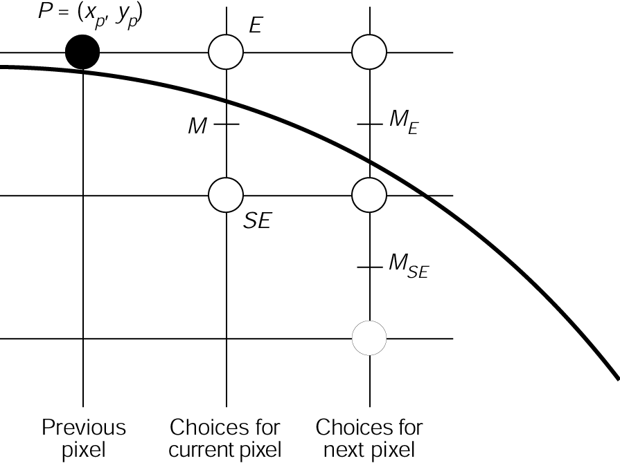
Scan Conversion of Circles
Assume we finished pixel
What pixel to draw next? (going clockwise)
Note: the slope of the circular arc is between 0 and –1
Hence, choice is between: E and SE
Idea: If the circle passes above the midpoint M, then we go to E next, otherwise we go to SE
<number>
1994 Foley/VanDam/Finer/Huges/Phillips ICG
Notes:
<number>

Slide 5
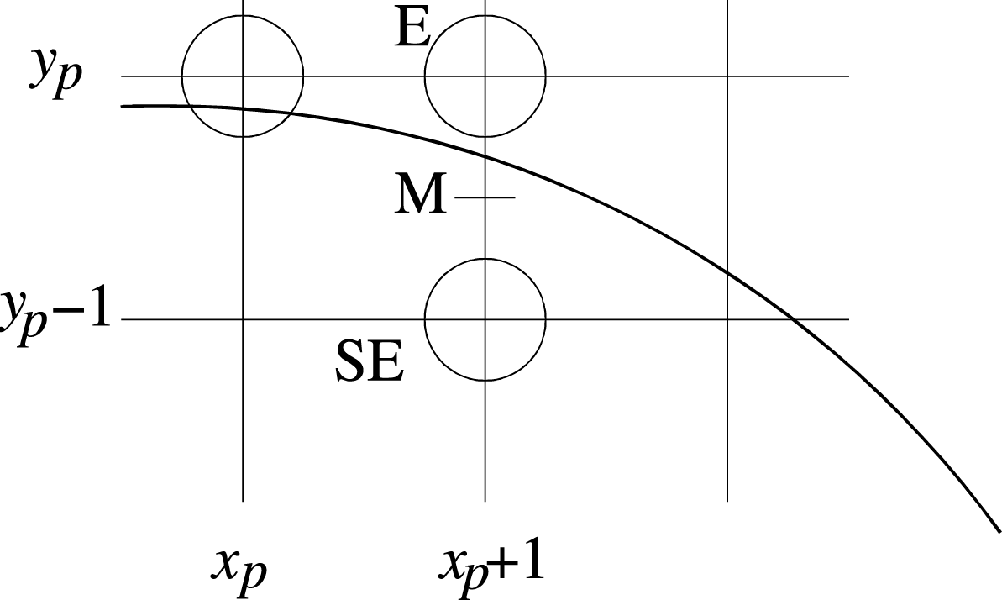
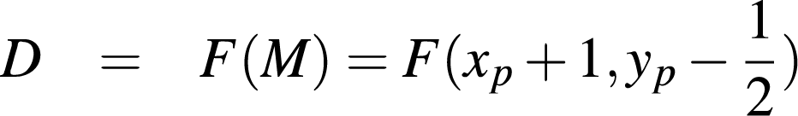
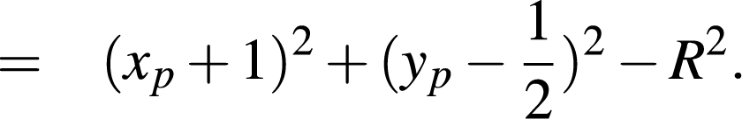


Scan Conversion of Circles
We need a decision variable D:
If then M is below the arc, hence the E pixel is closer to the line.
If then M is above the arc, hence the SE pixel is closer to the line.
<number>
1994 Foley/VanDam/Finer/Huges/Phillips ICG
Notes:
<number>

Slide 6

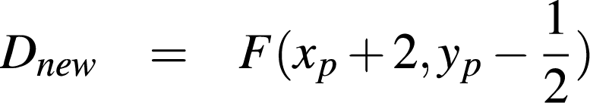
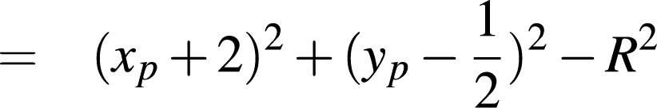
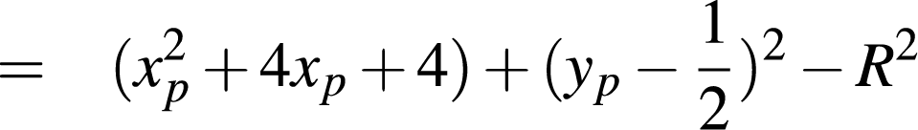
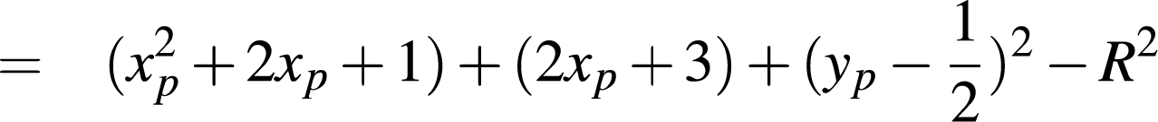
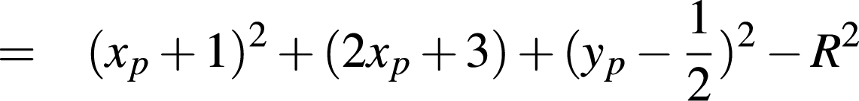


Case I: When E is next
What increment for computing a new D?
Next midpoint is:
Hence, increment by:
<number>
Pics/Math courtesy of Dave Mount @ UMD-CP
Notes:
<number>

Slide 7

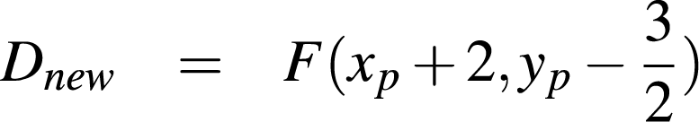
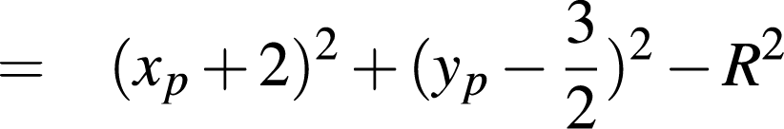
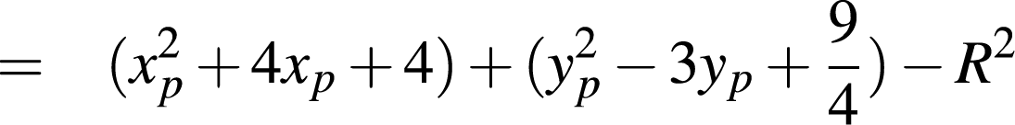


Case II: When SE is next
What increment for computing a new D?
Next midpoint is:
Hence, increment by:
<number>
Pics/Math courtesy of Dave Mount @ UMD-CP
Notes:
<number>

Slide 8
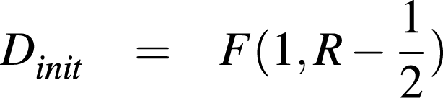
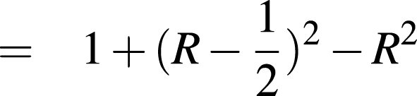
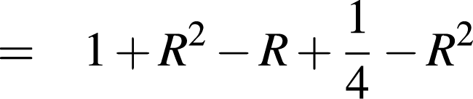
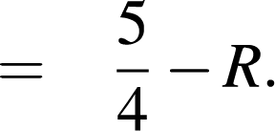
Scan Conversion of Circles
How to compute the initial value of D:
We start with x = 0 and y = R, so the first midpoint is at x = 1, y = R-1/2:
<number>
Notes:
<number>

Slide 9
Scan Conversion of Circles
Converting this to an integer algorithm:
Need only know if D is positive or negative
D & R are integers
Note D is incremented by an integer value
Therefore D + 1/4 is positive only when D is positive; it is safe to drop the 1/4
Hence: set the initial D to 1 – R (subtracting 1/4)
<number>
Notes:
<number>

Slide 10
Circle Scan Conversion Algorithm
Given radius R and center (0, 0)
First point  (0, R)
Initial decision parameter D = 1- R
While x ≤ y
If (D < 0)
x++; D += 2x + 3;
else
x++; y--; D += 2(x - y) + 5
WritePoints(x,y)
<number>
Notes:
<number>

Slide 11
WritePoints(x,y)
Writes pixels to the seven other octants
<number>
Notes:
<number>

